Slide 1
final bootcamp project
food recipes recommender
food.com
misho gavasheli

Slide 2
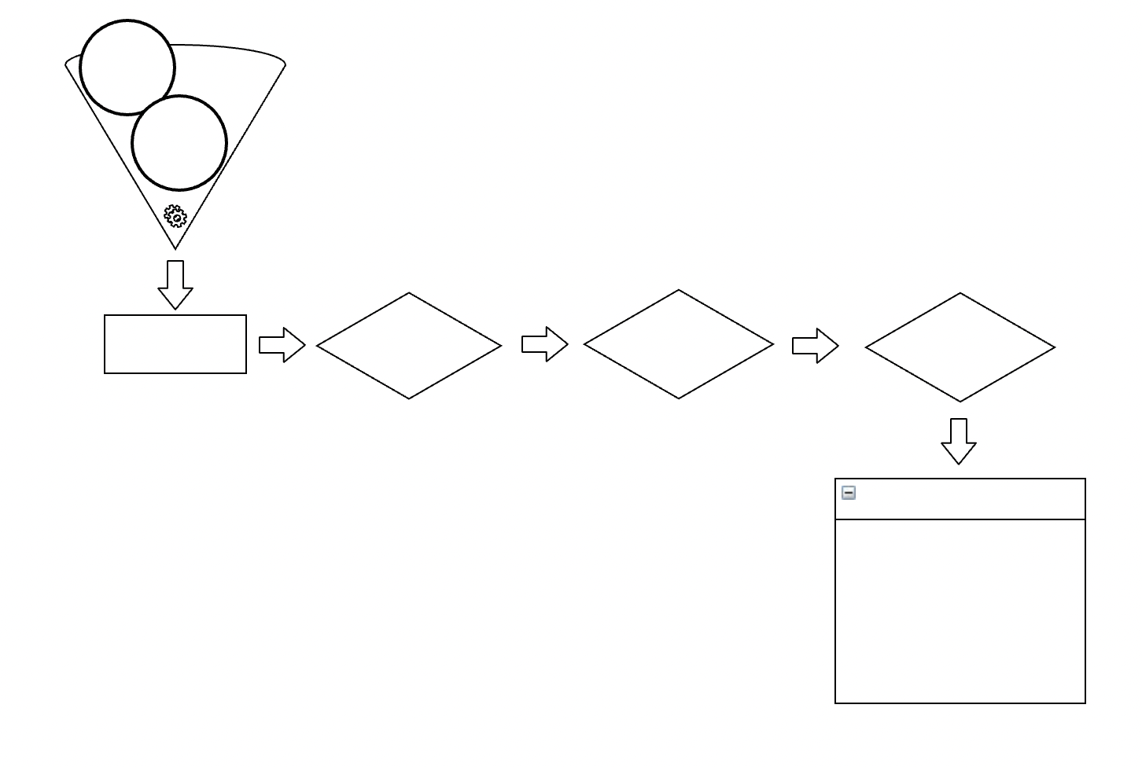
recipes 🍳🍕🍰
review 📝
data preparation
exploring 👀
python 🛠
cleaning 🛁🧽🪣
categorizing 📈
final data 🎉
low calorie 🦴 difficulty 💪 vegan 🥑 time ⏰ type 🍩🥘🥗 cuisine 🇮🇹 🇫🇷🇯🇵 rating 📊 review sentiment 💌
info:
226657 recipes
1132198 review
1132367 rating

Slide 3
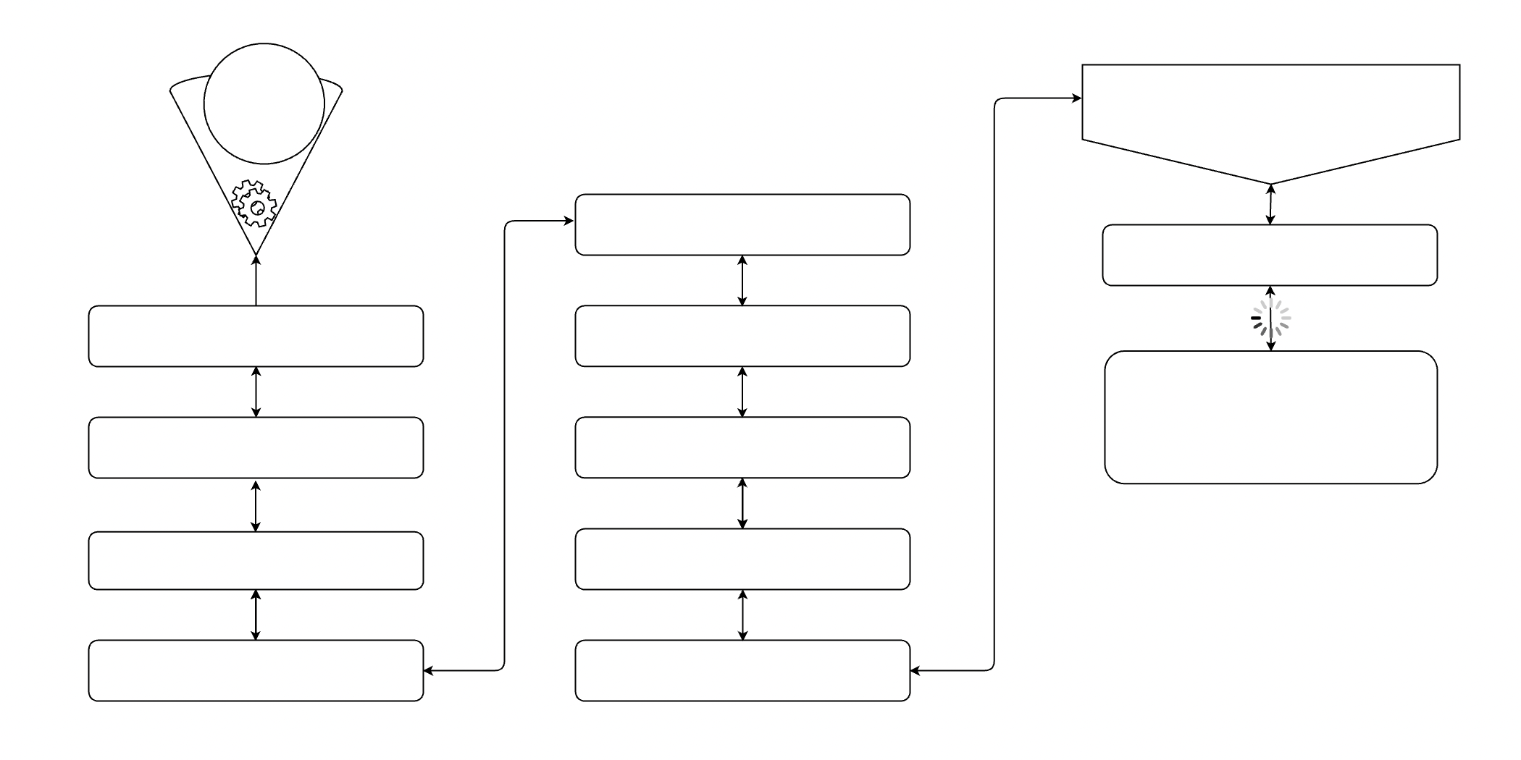
food recipe recommender
new data 📊
top 5 recipes by rating and reviews ⬆️
difficulty 💪
recipe 🧾
name of the dish 🍟🍕🎂
quick or no ⏰
recipe name ingredients steps time
ingredient 🥩🥦🍎
low calorie 🥬
ingredient which you
don't like 🧄
type 🍩🥘🥗
🎉🎉🎉
vegetarian? 🥬🥒🌽
cuisine 🇮🇹 🇫🇷🇯🇵

Slide 4
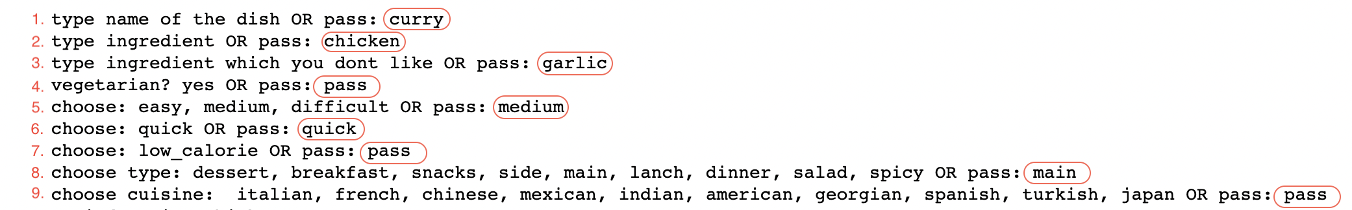
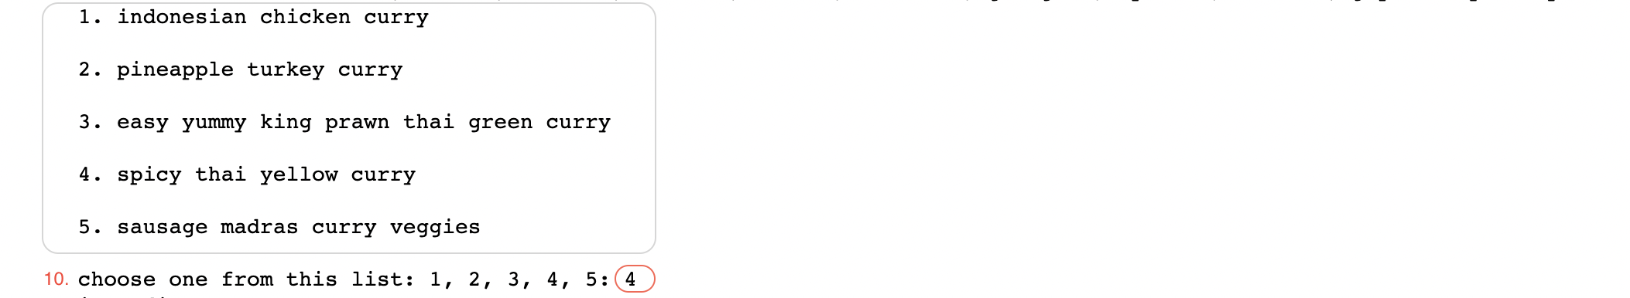
how recommender works:
it shows the top 5 recipes:

Slide 5
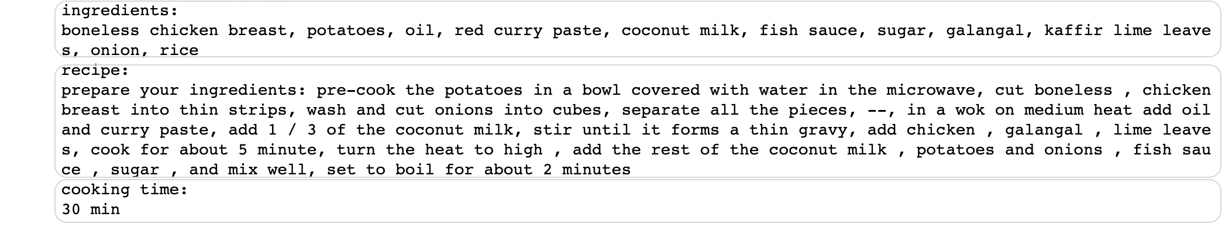
final result:

Slide 6
thank you !
🙌

