Slide 1
IoT @ FMI Lection 5
22.03.2017

Slide 2
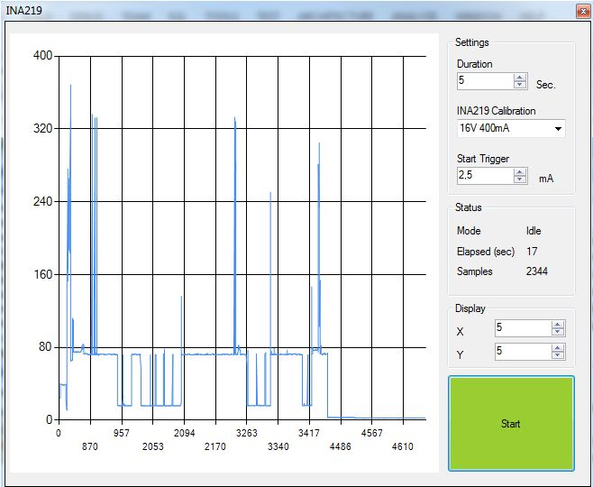
Power Consumption
ESP8266 (2.9-4.2v)
Active: 30-300 ma
Sleep: 0.1 – 10 ma
Arduino (Atmega328p)
Active: 4-20 ma
Sleep: 0.001 – 0.01 ma
Raspberry PI
Active: 80-240 ma
BLE/Zigbee modules
0.02ma (BLE), 0.05ma (Zigbee)

Slide 3
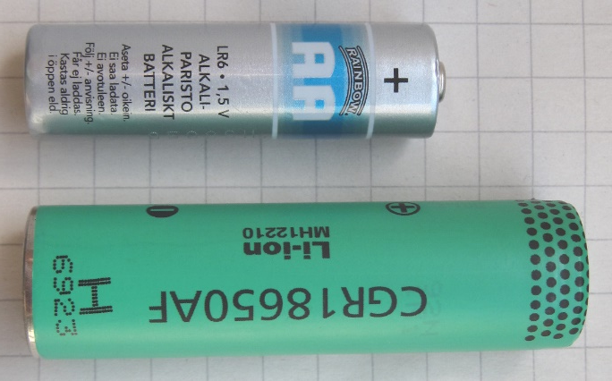
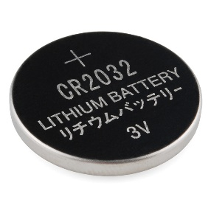
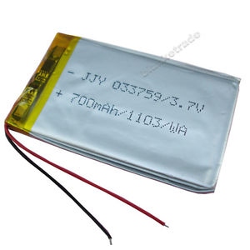
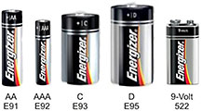
Types of Batteries
Type | Voltage (V) | Capacity (mAh) | Resistance | Self Discharge
Coin Cell 2032 | 3.00 | 200 | High | Low
AAA/AA/C/D (Alkaline) | 1.2 – 1.5 | 1000/2000/5000/10000 | Medium | Low
AAA/AA/C/D (NiMh) | 0.2 – 1.3 | same | Medium | Med/Low
AAA/AA/C/D (Ni-Zn) | 1.3 – 1.6 | Same | > | ?
LiPo (Generic) | 3.3 – 4.2 (3.7) | 10 – 5000 | Low | Low
LiPo - 16850 | Same | 1000 – 5000
LiPo – 14500 | Same | 500 – 1000 | Low | Low

Slide 4
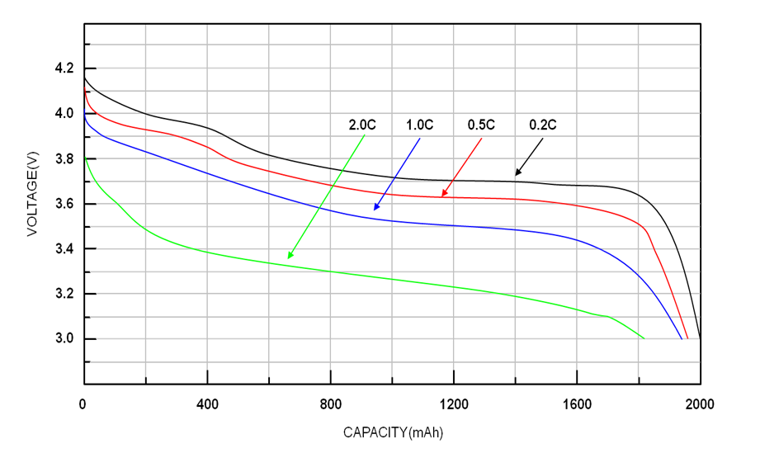
Battery Discharge Curve
Internal Resistance increases with decreased capacity
1 om @ 300 ma = 0.3v voltage Drop

Slide 5
ESP8266 – DeepSleep
Sleep current in DeepSleep is 0.08 ma
Connect D0 and RST with a jumper wire
Call ESP.deepSleep(time); delay(1000);
ESP will go to deep sleep and reset after “time”
Time is in us (1,000,000 us = 1,000 ms = 1 sec)
RTC Memory can be used to store data between iterations
After wake up it takes ~300 ms to boot and ~3-10 sec to connect to WiFi
All GPIOs are set to INPUT during sleep
http://www.espressif.com/sites/default/files/9b-esp8266-low_power_solutions_en_0.pdf

Slide 6
ESP8266 – LIGHT and MODEM sleep
Modem Sleep: ~15 ma. Just use delay(xxx)
Light Sleep: ~0.5 ma
Details: https://github.com/esp8266/Arduino/issues/1381#issuecomment-279117473

Slide 7
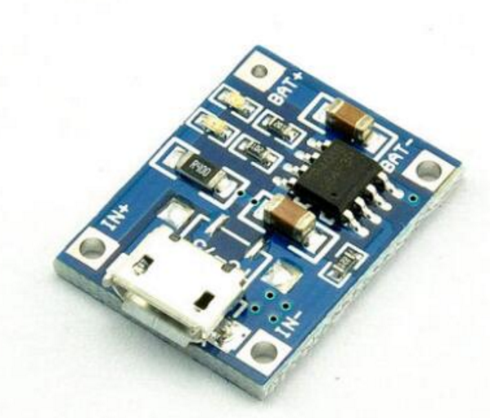
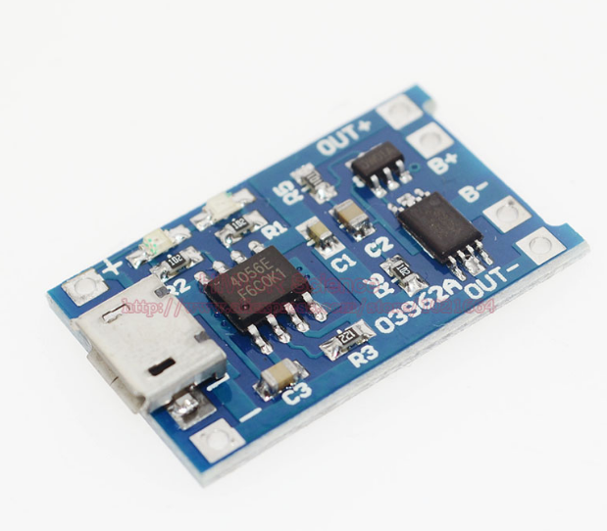
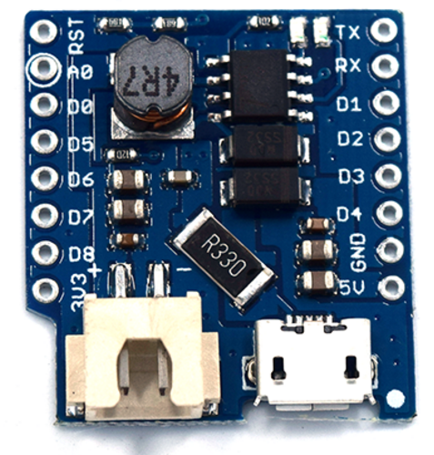
LiPo Chargers
Only Charge
+ battery protection
Wemos Battery Shield
+ battery protection
+ 5v Boost

Slide 8
Popular Software

Slide 9
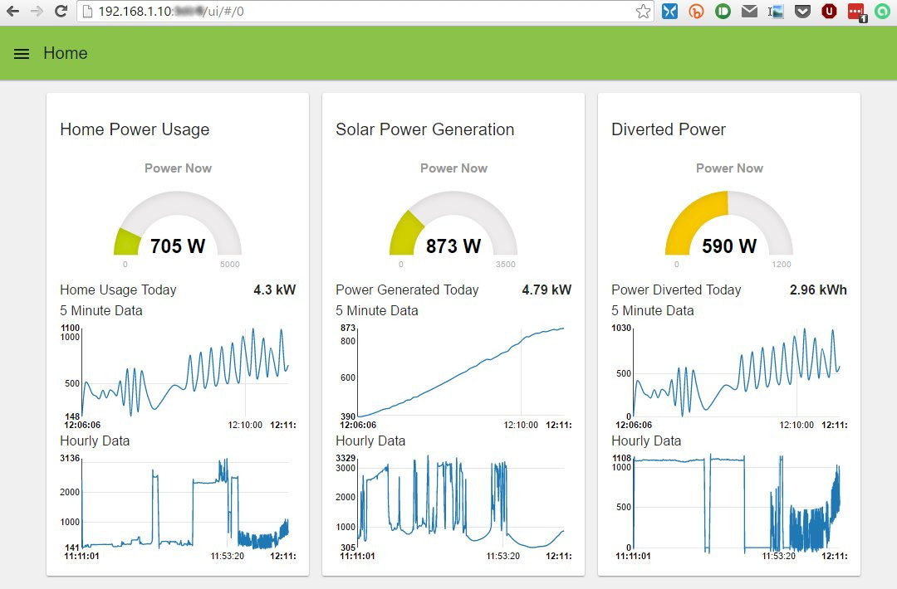
NodeRED
Design flows
Java Script
Dashboards

Slide 10
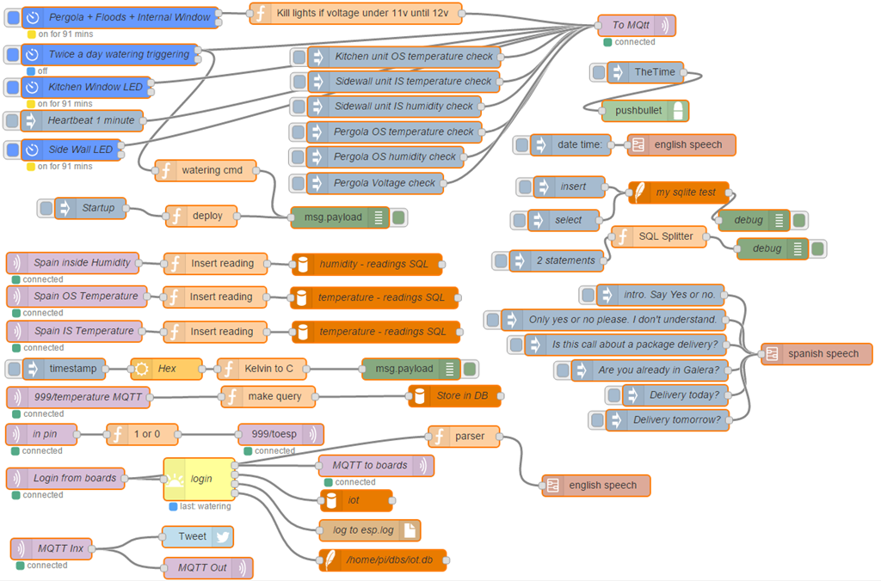

Slide 11
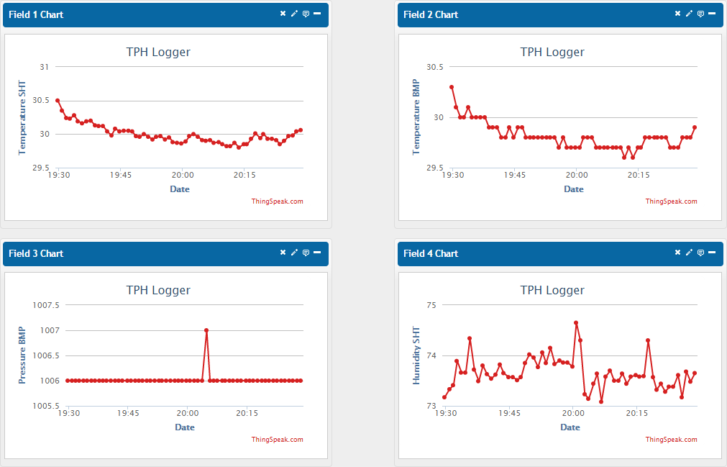
Thingspeak
Easy integration
Lots of display options

Slide 12
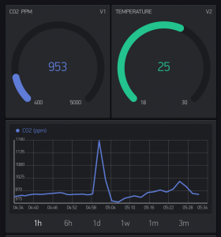
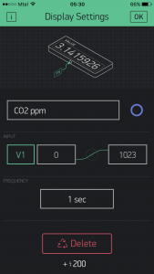
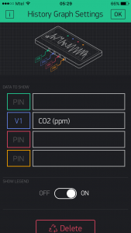
Blynk – Arduino to Mobile

Slide 13
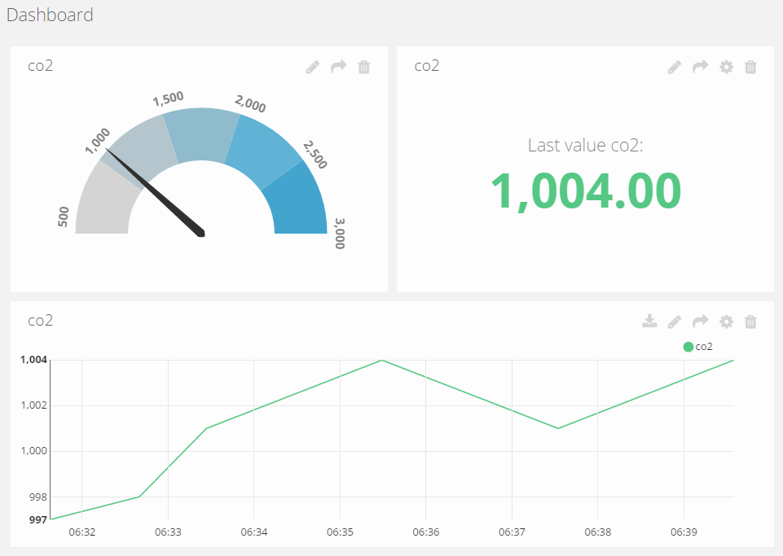
Ubidots – IoT Dashboards

Slide 14
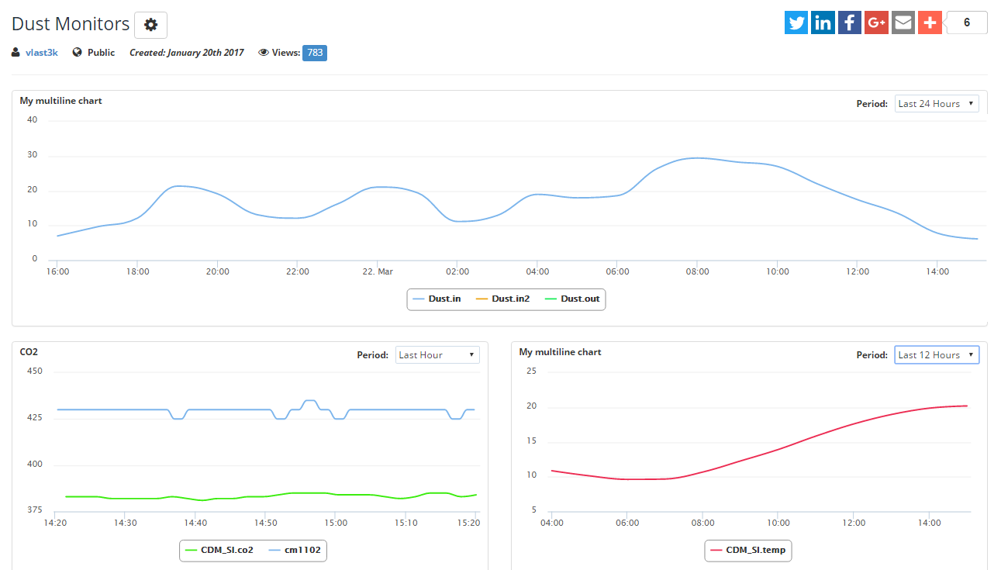
BeeBotte

Slide 15
Popular Hardware

Slide 16
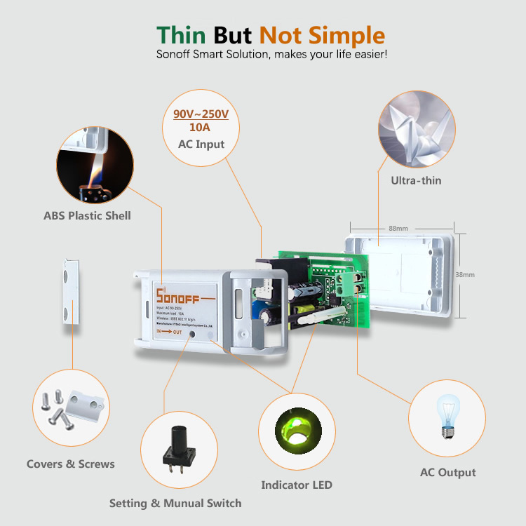
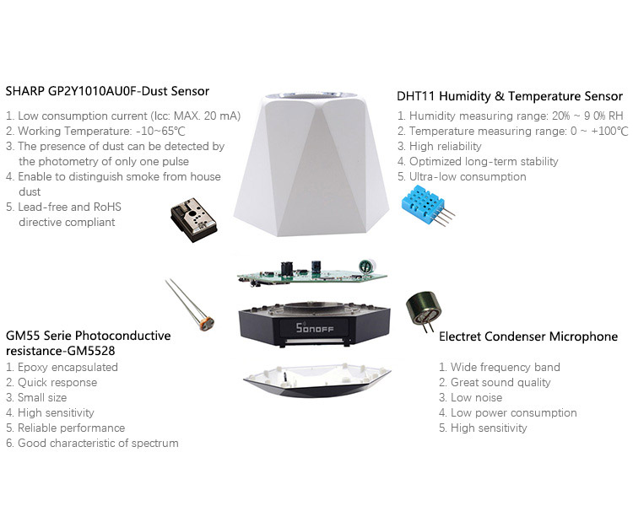
Sonoff
https://www.itead.cc/search/result/?cat=&q=sonoff

Slide 17
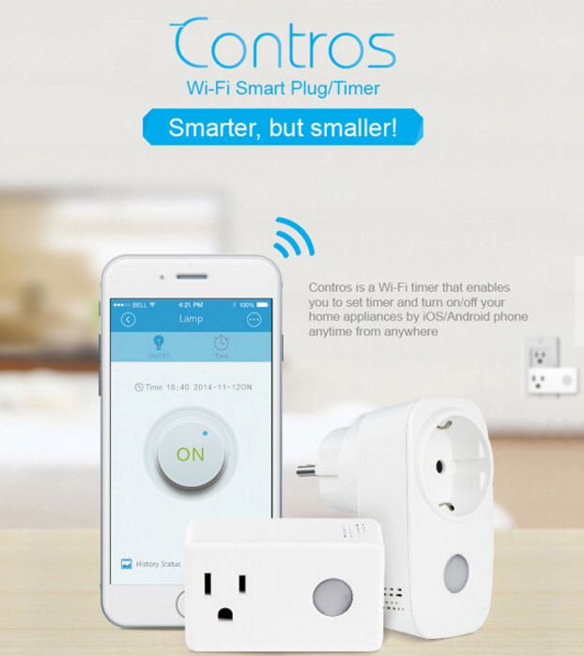
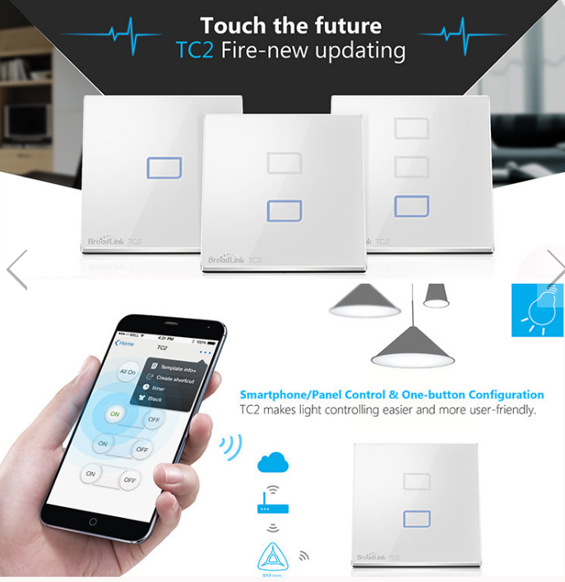
Broadlink

Slide 18
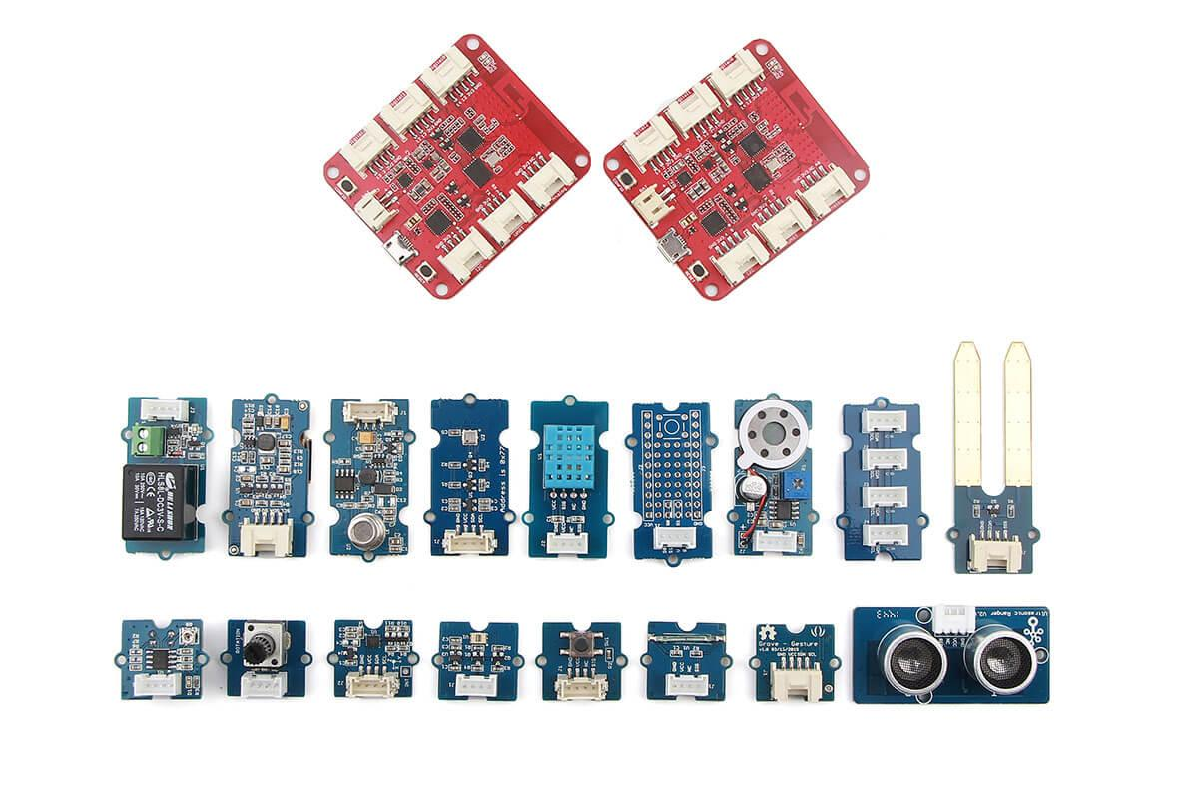
Grove / Wio Link

Slide 19

Xiaomi

