Slide 1
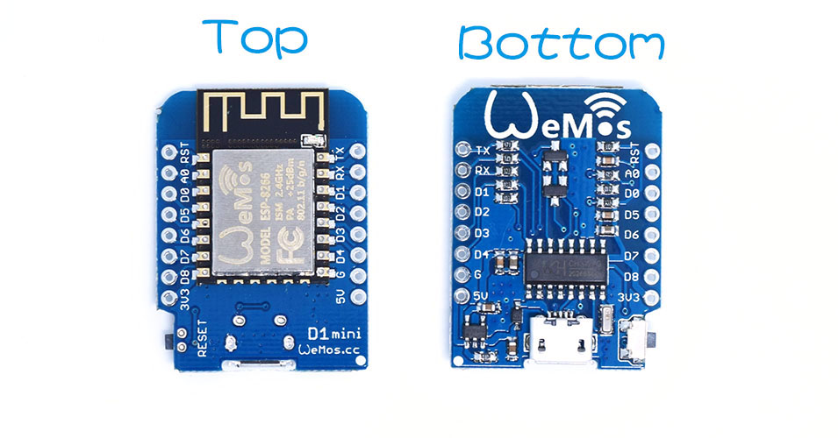
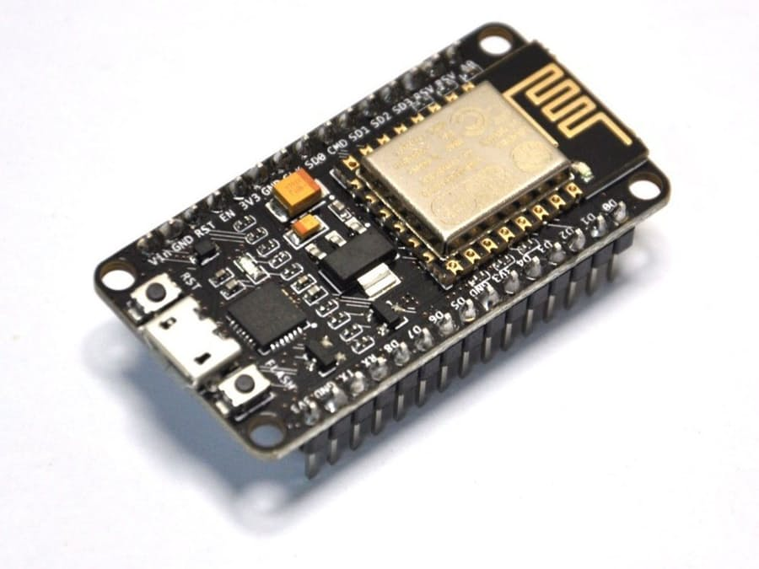
Programing in C
Via Arduino IDE, following Arduino syntax
Scale with Platform IO (native C++ development)
4 MB Flash
40k free memory (RAM)
~ 8 GPIOs
1 ADC
5/3.3 v
90 – 0.1 ma, power consumption
WiFi, Serial, I2C, SPI, PWM – protocols support
Flash via Serial, Over-The-Air, HTTP Update

Slide 2
Github
Now: https://github.com/vlast3k/FMI_IoT_2017
Future: https://github.com/slbedu/iot-2017

Slide 3
Blink Built In Led – Same as Arduino
<Arduino>/Examples/ESP8266/Blink
void setup() {
// initialize digital pin LED_BUILTIN as an output.
pinMode(LED_BUILTIN, OUTPUT);
}
// the loop function runs over and over again forever
void loop() {
digitalWrite(LED_BUILTIN, HIGH); // turn the LED on (HIGH is the voltage level)
delay(1000); // wait for a second
digitalWrite(LED_BUILTIN, LOW); // turn the LED off by making the voltage LOW
delay(1000); // wait for a second
}

Slide 4
Simple Node JS Web Server
Download from: https://raw.githubusercontent.com/vlast3k/FMI_IoT_2017/master/httpsrv.js
Node httpsrv.js
C:\develop\fmi-iot-2017>node httpsrv1.js
Server listening on: http://10.51.71.91:8080

Slide 5
Send HTTP Request
<Arduino>/Examples/ESP8266HTTPClient/BasicHTTPClient
Configure Wifi
Configure Target

Slide 6
Button - Simple
<Github>/Lection2/ButtonSimple

Slide 7
Send HTTP Request with Button
<Github>/Lection2/HTTPClientButton
Combination of previous two examples

Slide 8
Web Server - Simple
<Arduino>/ESP8266WebServer/HelloServer
Setup Wifi network and upload

Slide 9
Blynk
Download library https://github.com/blynkkk/blynk-library/releases/tag/v0.4.4
Install by copying relevant directories to libraries and tools (see page above)
Sketch: <Arduino>/Examples/Blynk/Boards_Wifi/ES8266_Standalone
Install Blynk App
Create Project
Email auth token
Build and upload sketch

