Slide 1

Assessing the Influence of Kindle Unlimited and Best Seller Tags on Reader Engagement (2019-2023)
Michelle Paguada

Slide 2
Data Background
The data used: was sourced from Kaggle:
Data source: Kaggle (130,000 Kindle ebooks)
The data provides information on: Authors, Titles, Unique Identifiers, star ratings, review count, publication dates, and marketing tags (Kindle Unlimited, Best Seller, and Other).
Focus Period: the last 5 years (2019 to 2023)
Why 2019-2023? Significant events reflects shifts in reader behavior influenced by the COVID-19 pandemic starting in 2020.
https://www.kaggle.com/datasets/asaniczka/amazon-kindle-books-dataset-2023-130k-books?select=kindle_data-v2.csv

Slide 3
Amazon Kindle Background
Defined Tags:
Kindle Unlimited: A subscription service allowing readers to borrow eBooks and audiobooks.
Best Seller Tag: Indicates popularity based on sales volume on platforms like Amazon.
Other: Includes books with tags such as Editor’s Picks and Goodreads, and may include high-profile books not available in the Kindle subscription.
Reader Engagement: Reflects interaction through reviews and ratings. Higher engagement can lead to increased visibility and sales.
Consumer Sentiment: Kindle Unlimited often lacks major bestsellers (aka high-profile books), impacting its appeal to some consumers. The “Other” category may include titles marketed as Editor’s Picks and Goodreads Choice, influencing reader engagement.

Slide 4
Project Goal and Objectives
Primary Goal: To assess how Kindle Unlimited and Best Seller tags influence reader engagement.
Objectives:
Analyze the distribution of reviews and ratings.
Examine trends over time for Kindle Unlimited and Best Seller books (2019 to 2023).
Problem Statement: "How do Kindle Unlimited and Best Seller tags impact reader engagement, as measured by star ratings and the number of reviews?"

Slide 5

Hypothesis
Alternate Hypothesis:
Books with Kindle Unlimited and Best Seller tags will show greater reader engagement.
Null Hypothesis:
Kindle Unlimited and Best Seller tags will show no impact on reader engagement.

Slide 6
Process
Data Cleaning: Ensured the dataset was accurate by removing duplicates, correcting formatting issues, and filling in missing values for attributes such as star ratings, reviews, and tags (Kindle Unlimited, Best Seller).
Exploratory Analysis: Conducted an initial analysis to understand the distribution of star ratings and reviews across different categories, identifying trends in reader engagement.
Category Segmentation: Created new “tag” categories to facilitate comparisons, specifically separating "Kindle Unlimited," "Best Seller," "Both (Kindle Unlimited & Best Seller)," and "Other" for deeper insights.
Trend Analysis: Focused on the years 2019 to 2023 to identify current trends in reader engagement, ensuring the analysis reflected recent shifts in consumer behavior.
Insights Synthesis: Summarized key insights to inform recommendations for authors and publishers based on the analysis of reader engagement metrics.

Slide 7
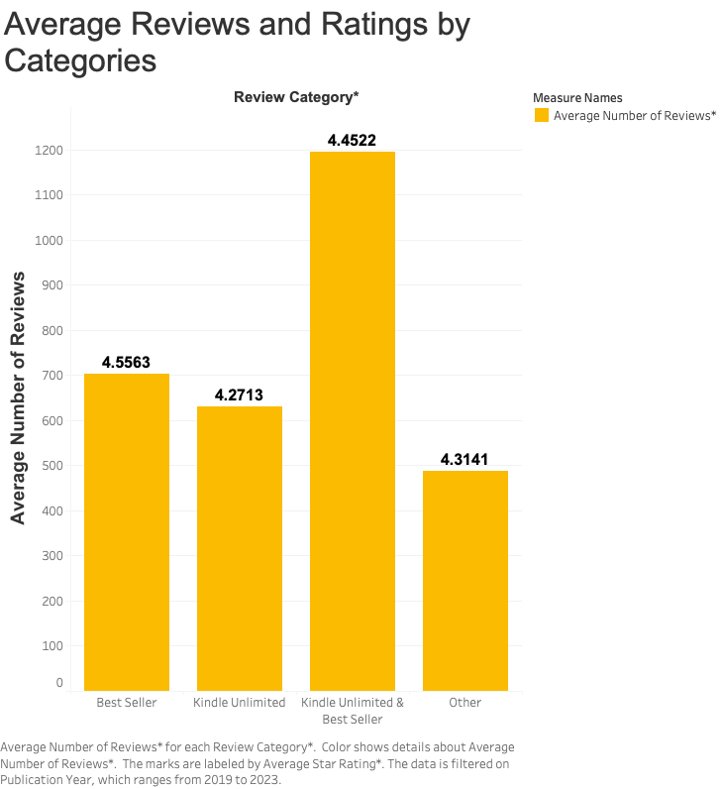
Key Insights:
Kindle Unlimited & Best Seller tags: Highest average reviews (1,194.7), indicating strong engagement from select standout titles.
Best Seller tags: Maintain a strong average rating (4.5), suggesting high quality. However, they exhibit lower overall engagement as shown by total review counts.
Outliers with Averages:
High averages can be misleading; they may be driven by a few highly rated titles rather than widespread popularity across the entire category.
Takeaway:
Deeper Insights Needed: The Kindle Unlimited & Best Seller category may not represent a comprehensive performance metric. High averages may not translate to broader reader engagement or satisfaction.

Slide 8
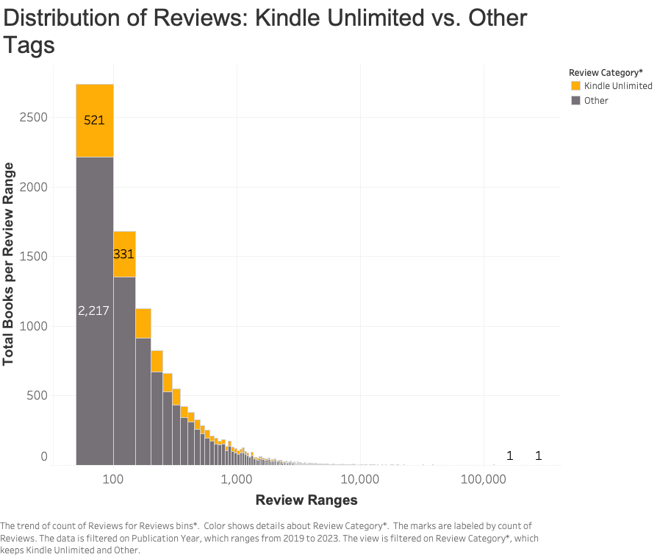
Key Insight: Books in the “Other” category consistently outperform those in Kindle Unlimited in review counts.
50-review range: 2,217 books in "Other" vs. 521 in Kindle Unlimited.
Takeaway: Lower engagement with Kindle Unlimited suggests a need for enhanced quality and marketing strategies.
Implication: Explore the characteristics of titles in the “Other” category to leverage successful marketing strategies.

Slide 9
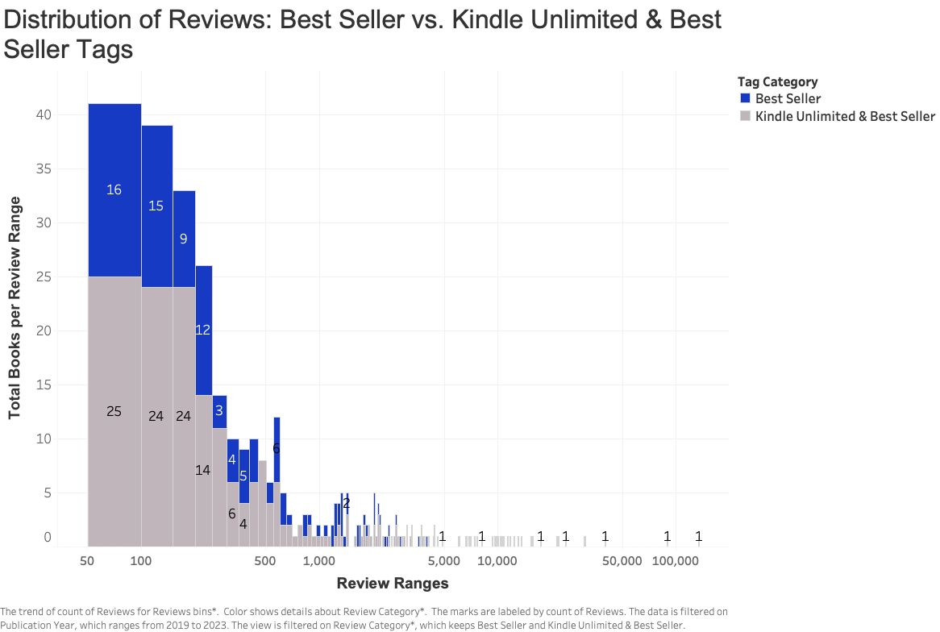
Key Insight: "Kindle Unlimited & Best Seller" books have slightly higher review counts than standalone Best Sellers.
Takeaway: Combining tags enhances visibility and engagement.
Implication: Combining these tags could increase visibility and engagement. However, both a severely underperforming compared to “Kindle Unlimited” and “Other” tag category.

Slide 10
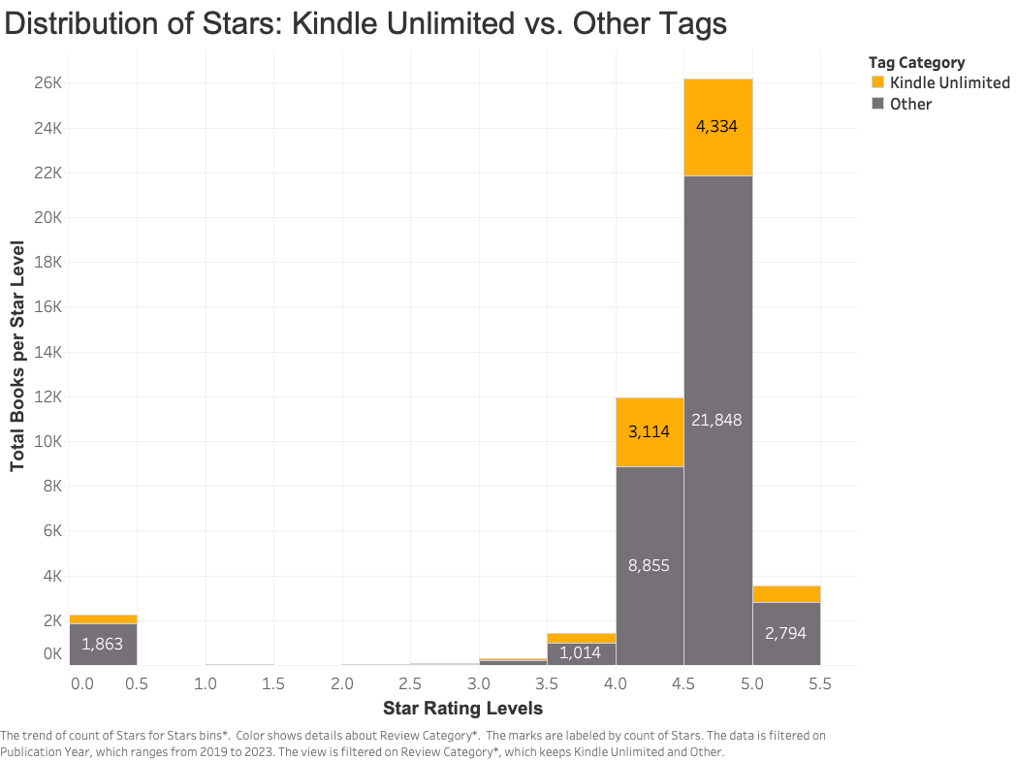
Key Insight: "Other" has a significantly higher number of books in the 4.0 and 4.5 star bins.
Takeaway: Higher star ratings correlate with higher reader engagement in the “Other” category. Quality perceptions vary significantly, with Kindle Unlimited titles lagging behind.
Implication: Curating high-quality titles could enhance Kindle Unlimited appeal.

Slide 11
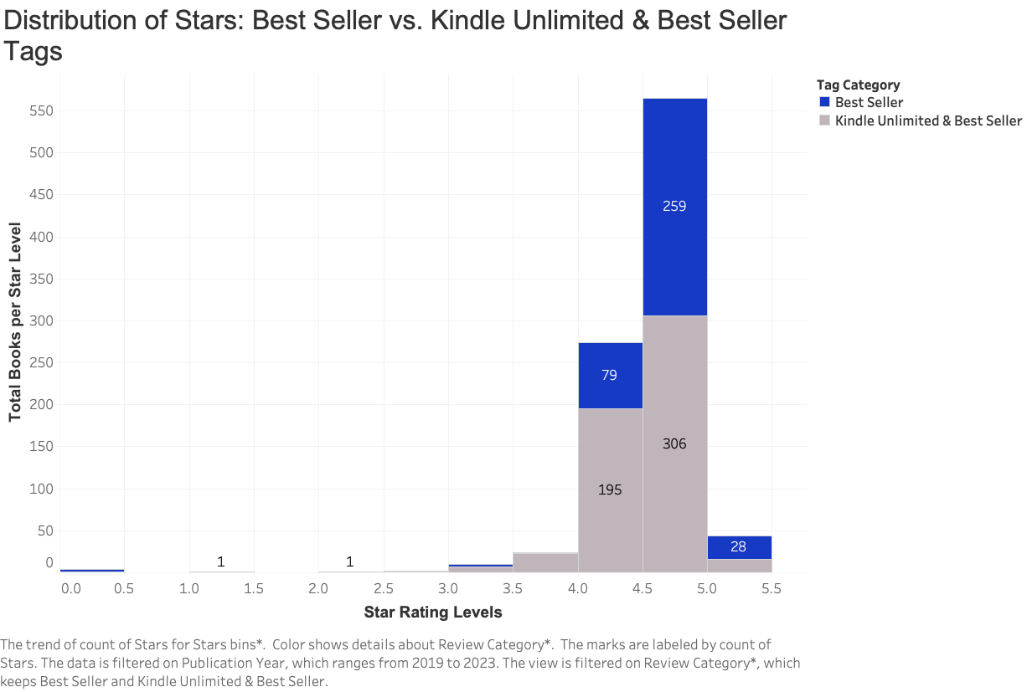
Key Insight: "Kindle Unlimited & Best Seller" tags have better average ratings compared to standalone Best Sellers.
Takeaway: Dual tagging are perceived as more favorable by readers.
Implication: Promote titles with both tags for better engagement outcomes. However, again, it pales in comparison with Kindle Unlimited and Other tags.

Slide 12
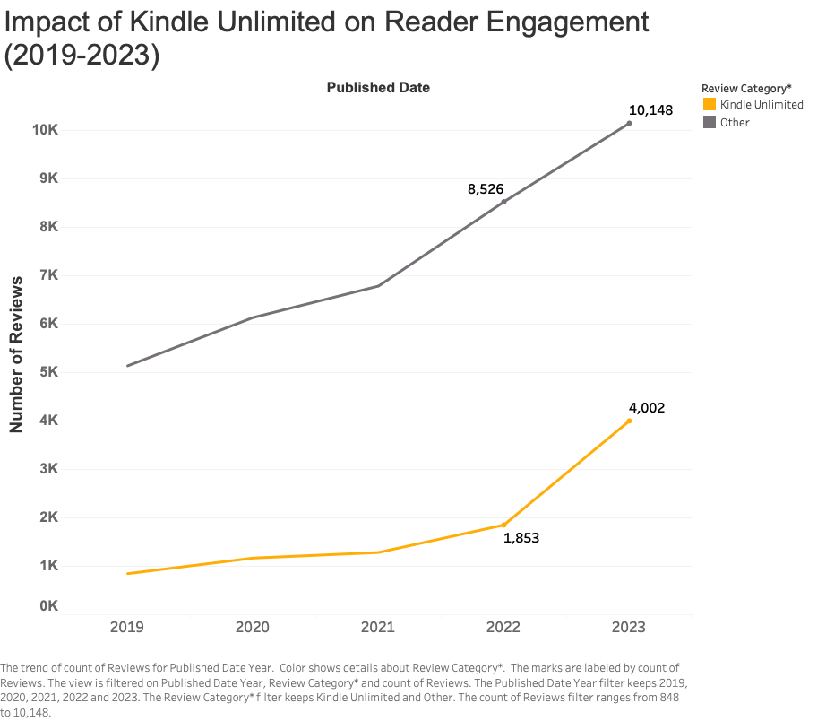
Key Insight: Reviews for Kindle Unlimited shows gradual growth but remains lower than "Other" category..
Takeaway: While engagement is growing, it still lags behind competing categories.
Implication: Kindle Unlimited growth potential exists but needs strategic focus.

Slide 13
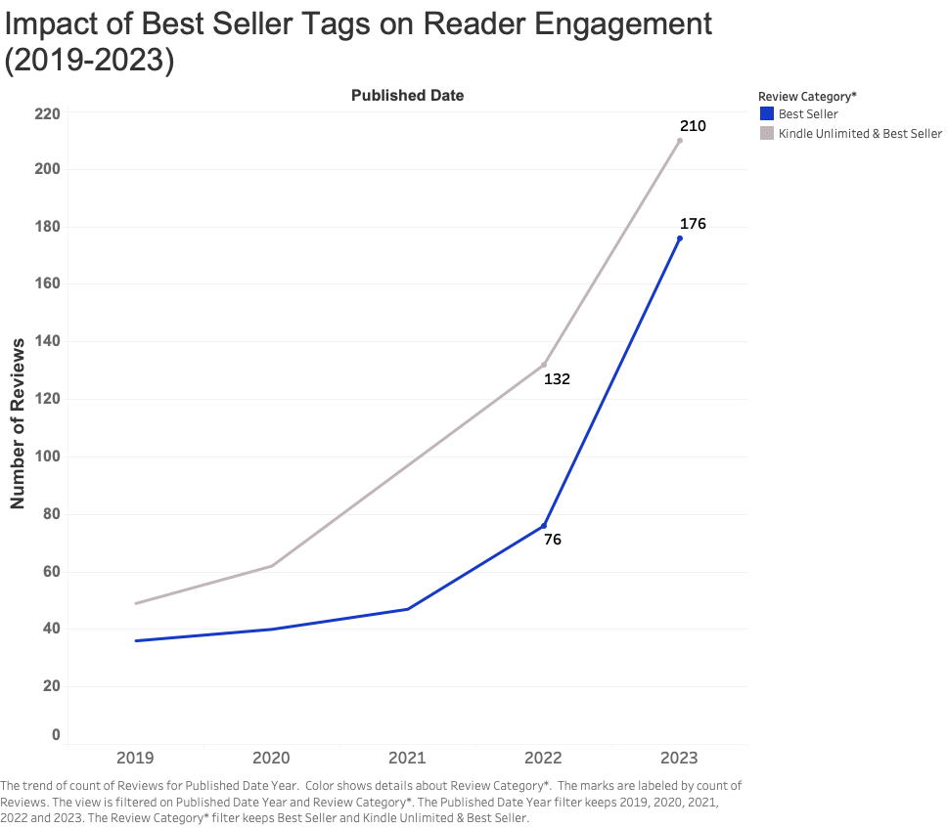
Key Insight: "Kindle Unlimited & Best Seller" combined tags show significant review growth over the years. Where as “Best Seller books” show slower growth.
Takeaway: The combined tags effectively drive engagement but “Best Seller” tags alone may not drive sufficient engagement.
Implication: Prioritize blend marketing strategies to enhance visibility and reader interaction.

Slide 14
Reflection
Gaps Identified:
Lack of high-profile titles in Kindle Unlimited: Explore how the absence of popular, high-profile titles affects reader expectations and engagement.
Limited Data on Reader Preferences: Need for deeper exploration of how different genres impact reader engagement. This analysis focuses on reviews and ratings but it lacks qualitative data on reader motivations and preferences. Why readers choose certain books?
Diversity of Titles in the "Other" Category: Need to analyze the specific types of books within the "Other" category. Understanding what genres or themes are resonating with readers can help shape future recommendations.
Comparative Analysis with Competing Platforms: Comparative data with other platforms (like Audible or traditional publishing) could provide a fuller picture of the market dynamics and how Kindle Unlimited stacks up against competitors.
Future Data Needs: Consumer Surveys, Market Analysis, Competitive Analysis, Engagement Metrics, Content Quality, and Assessment.

Slide 15

Consumer Sentiment
Reader Expectations and Perceptions:
The absence of high-profile titles in Kindle Unlimited shapes reader expectations, potentially leading to reduced engagement.
Higher engagement in the “Other” tag category suggests the importance of balancing popular and diverse selections to enhance user value.
Books in the “Other” category may include these high-profile titles, such as books marked as Goodreads Choice, Editor's Picks, and current popular genres, which were not analyzed in this study.
Implication: A diverse selection of books in the “Other” category can attract a wider audience on Kindle Unlimited and increase reader engagement.

Slide 16
Conclusion and Recommendations
Conclusion: Reject the Alternative Hypothesis. The data indicates that while combined tags can enhance visibility, they do not guarantee higher engagement compared to other titles, particularly those in the “Other” category that significantly outperforms them.
Implications:
Market Shift: Consumer preferences may favor diverse titles over traditional tags.
Engagement Strategy: Tags alone aren’t enough; quality content matters.
Broaden Offerings: Expanding the range of titles could enhance reader engagement.
Recommendations:
Enhance Title Selection: Seek publishing deals for well-rated titles in the "Other" category.
Combine Strategies: Leverage and maintain both Kindle Unlimited and Best Seller tags for improved engagement, focusing on quality.
Explore Partnerships: Explore partnerships with popular titles in the “Other” category while promoting combined tags for greater visibility.

Slide 17
Questions?

