Slide 1

Paris 2024 Olympics: Hypothesis Testing on Event Participation and Medals
Michelle Paguada
October 2024

Slide 2
Data Background
The data used was from Kaggle sourced from the 2024 Paris Olympics Medals Board and Athlete’s site.
The data provides detailed information on: Athletes, Countries, Discipline (aka sport), Events Types, Ages, Birthdate, Weight, and Gender
As well as the Medals Totals and Medal Types by Country
https://www.kaggle.com/datasets/piterfm/paris-2024-olympic-summer-games/data?select=medallists.csv

Slide 3

Top 10 Performing Countries From Paris 2024
Golden
Medals
Silver
Medals
Bronze Medals
TOTAL
USA
40
44
42
126
CHN
40
27
24
91
JPN
20
12
13
45
AUS
18
19
16
53
FRA
16
26
22
64
NED
15
7
2
34
GBR
14
22
29
65
KOR
13
9
10
32
ITA
12
13
15
40
GER
12
13
8
33
Notes:
Mariana

Slide 4
Project Goal
Overview - Out of the 206 countries that competed in the Paris Olympics, only 82 countries received medals.
Of those countries on the Medals board, 23% participated in a range between 252 and 374 events. The countries within that range are: United States, China, Australia, France, and Italy. These countries are within the Top 10.
Of the 82 countries on the Medals Board, what impact does high event participation have on medal success?

Slide 5

Hypothesis
Null Hypothesis:
No impact on medal success with higher participation.
Alternate Hypothesis:
Higher events participated per country means more medals earned.

Slide 6
Process
Data Cleaning: Identified and categorized team events; removed duplicates specifically for team events to avoid skewed results.
Exploratory Analysis: Analyzed the overall distribution of events by countries to identify trends to understand participation levels.
Data Pivoting: Reorganized data for clarity and improved accessibility.
Data Consolidation: Grouped countries on the medals board into ranges based on events participated.

Slide 7
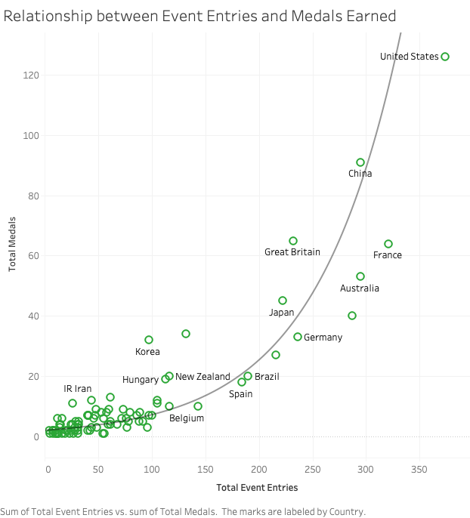
Correlation Analysis: What are the Impacts of Event Entries?
Key Point: Conducted a correlation analysis to assess the relationship between event participation and medal counts.
Takeaway:
P-Value: <0.0001
Very strong statistical significance
Suggests that the relationship between events and medals are unlikely due to random chance.
Correlation Coefficient: 0.83
Positive relationship observed; more event entries likely lead to more medals, possibly at an accelerating rate.
Exponential Growth Pattern: The relationship is not only strong but increasingly beneficial to medal earnings as participation grows.

Slide 8
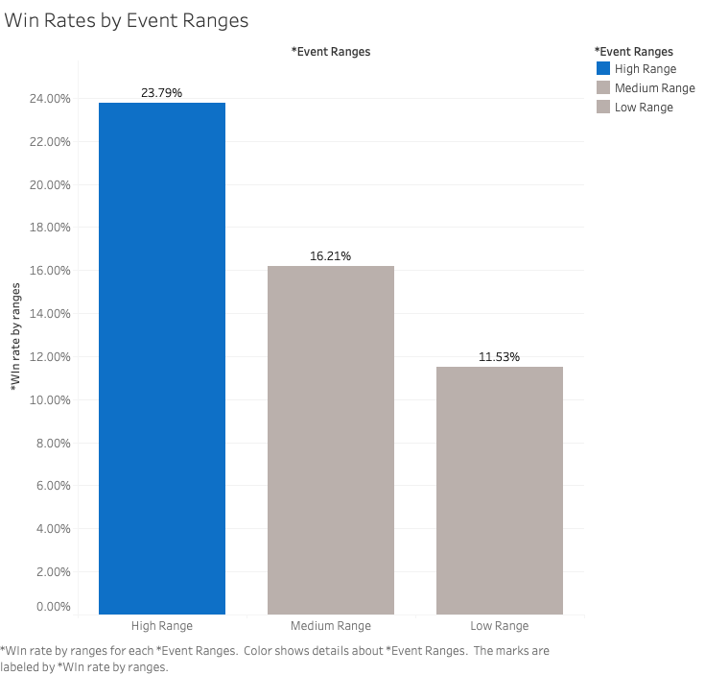
Win Rate Analysis: Effectiveness of Participation
Key Point: Countries in higher participation ranges (252 to 374 events) tend to convert entries into medals effectively (taller bars indicate higher win rates).
Takeaway: Focusing on increasing participation in events can significantly enhance a country’s chances of winning medals, particularly when aiming for higher ranges of participation.
Range breakdown:
High Range: 252 to 374 events
Medium: 128 to 250 events
Low: 4 to 126 events

Slide 9
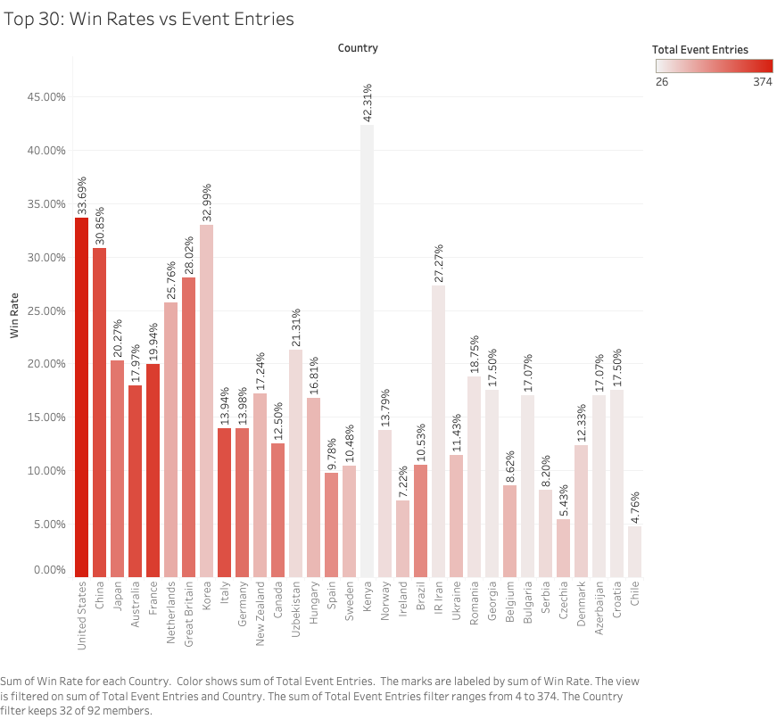
Detailed Breakdown: Top 30 Countries
Key Point: Most countries support the hypothesis, but outliers exist where countries with lower entries outperform those with more.
Takeaway: While higher participation generally correlates with increased success, countries should investigate the strategies of outliers that excel with fewer entries, as they may offer valuable insights for improving overall performance.

Slide 10
Outlier Analysis
Key Point: Outliers challenge the hypothesis—countries with fewer event entries achieving better win rates.
Some of these outliers are in the top 10 like:
South Korea
32.99% win rate with 97 entries
Netherlands
25.76% win rate with 132 entries
Impressive outlier: Kenya!
Ranked 17
42.31% win rate with 26 entries
Discussion: This raises some questions about potential reasons for this phenomenon.

Slide 11
Reflection: Suggested Factors for Outliers
Key Points: We need to consider how outlier countries succeed despite lower participation levels.
Understanding Outliers: The existence of countries with fewer entries performing better prompts us to rethink traditional strategies in Olympic participation.
Investigate the unique practices of these outlier nations.
Analyze the sports where they excel despite lower participation.
Importance of Strategy: Highlight the need for countries to analyze their event entries critically and consider a more strategic approach to maximize win rates.
Focus on quality of training and support.
Develop targeted plans for sports with the highest medal potential.

Slide 12
Conclusion and Recommendations
Conclusion: Reject the null hypothesis; our hypothesis that "higher event participation leads to greater success in earning medals" is valid.
Broader Implications:
Participation alone does not guarantee success; factors like event diversity and talent development are crucial.
Budget considerations are essential for effective talent development, talent support, and resource allocation.
Recommendations:
Explore less popular sports for potential medal opportunities.
Invest in targeted talent development programs.
Need for Research:
Conduct further investigation into outlier strategies.
Evaluate the impact of budget allocations on performance outcomes.

Slide 13
Questions?

