Slide 1

PREDICTING PLANT STOCKOUTS

Slide 2
Content
The Problem
Assumptions
Data Discovery
Predictive Analysis
Action Points and Future Roadmap

Slide 3
1.
THE PROBLEM

Slide 4
$1.1T
$129.5B
4.1%
Is the average retailers lost revenue due to out-of-stocks
Is the overstocking and out-of-stock cost to retailers globally
Is the lost revenue in North America alone. Although this number has reduced in recent years

Slide 5
Problem Statement
1. Background
4. Constraints
A CPG manufacturer wants to reduce the problems and associated cost with stockouts:
Increased transportation/procurement costs to expedite shipments
Delaying fulfillment of a customer order, resulting in loss of revenue and/or goodwill
CPG companies do not have quick reaction time thus predictions on a per day level will not be as useful. Predictions should be done for a longer time frame
Do not use conventional inventory prediction techniques like time series, simulation
2. Desired outcome
5. Stakeholders
Reduction in future stockouts. Leverage analytics to predict stockouts so that the plant managers can plan inventory accordingly
Plant Managers, Plant Employees
Company Shareholders
3. Scope
6. Resources
Plant A data
Only three types of product movements – Stock Transfer, Ship to Customer and Goods Receipt
Product movement data
Product detail data
Inventory data
Softwares such as R, Python, Tableau for analysis

Slide 6
Process Improvement through analytical sophistication
Automating prediction of future stockouts and reduction of manual identification will result in:
Lower error in identification
Better and quicker Inventory planning
Efficient time management
Capture of stockout root causes
Optimization of bandwidth and allocation
The solution will also be scalable to all manufacturing plants

Slide 7
2.
ASSUMPTIONS

Slide 8
Assumptions for descriptive and predictive analytics
Within a sub-segment, the various product groups are representative of the others
There hasn’t been a drastic change (major technology shift etc.) over the period of 3 years
More the number of Inventory changes for a product means more is its demand and thus “Popularity”

Slide 9
2.
DATA DISCOVERY

Slide 10
Creating a Unified Dataset
Product Detail dataset was joined to both the Inventory and movement datasets
Time variables like day of week, seasons etc. were created using date variable
The final dataset was created by a joining the movement set with the Inventory set:
Inventory set contains the dependent variable
Also has more dates in common between the two datasets

Slide 11
Aid in Scope and Variable Reduction
For Scope reduction, we looked at the stockouts and popularity in terms of the groups. We also look at the yearly stockout trend to check for a stark difference between years
To consider if the time variables created will be useful in prediction, we look at stockouts at various time levels
Finally, it is useful in uncovering trends

Slide 12
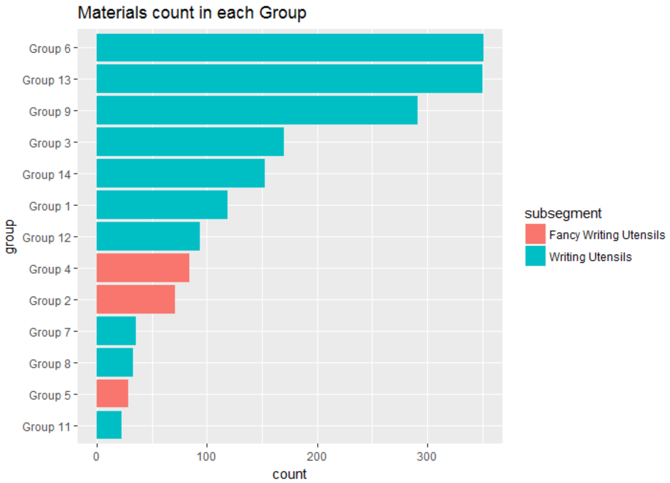
Which Groups should we consider?

Slide 13
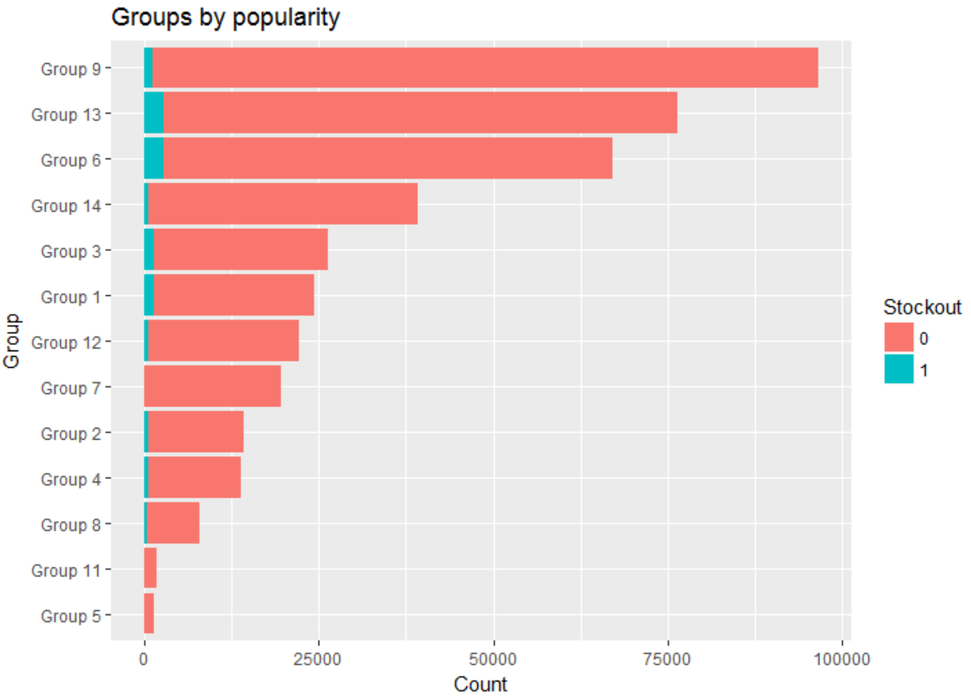
Which Groups should we consider?

Slide 14
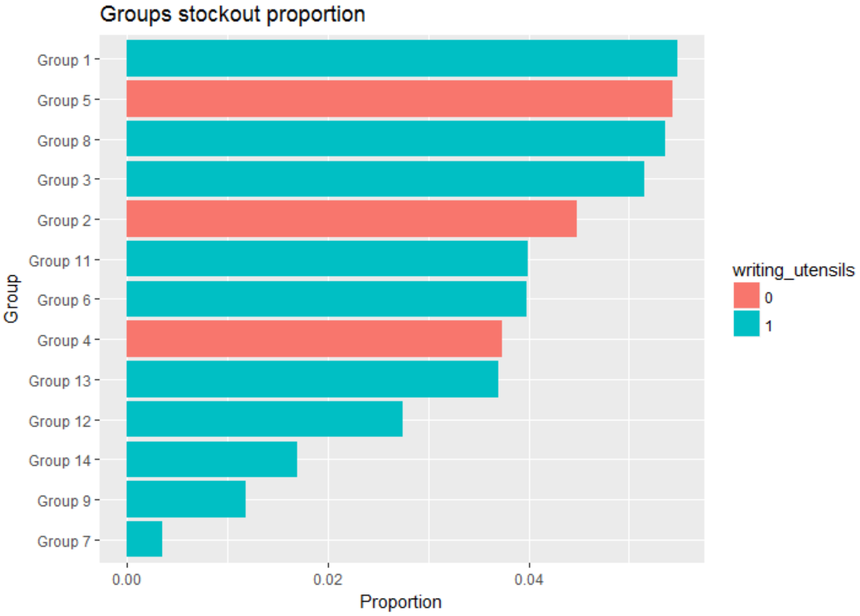
Which Groups should we consider?

Slide 15
Which Groups should we consider?
Groups 6, 13 and 9 have the most number of materials and are also the most popular for Writing Utensils
Group 3 strikes a good balance in terms of high stockout proportion and number of materials/popularity
For Fancy Writing Utensils, Groups 2 and 4 are the only consideration as Group 5 has very low popularity and thus not enough data points
We need high stockout proportion as that is what we need to predict and it will reduce the small sample bias

Slide 16
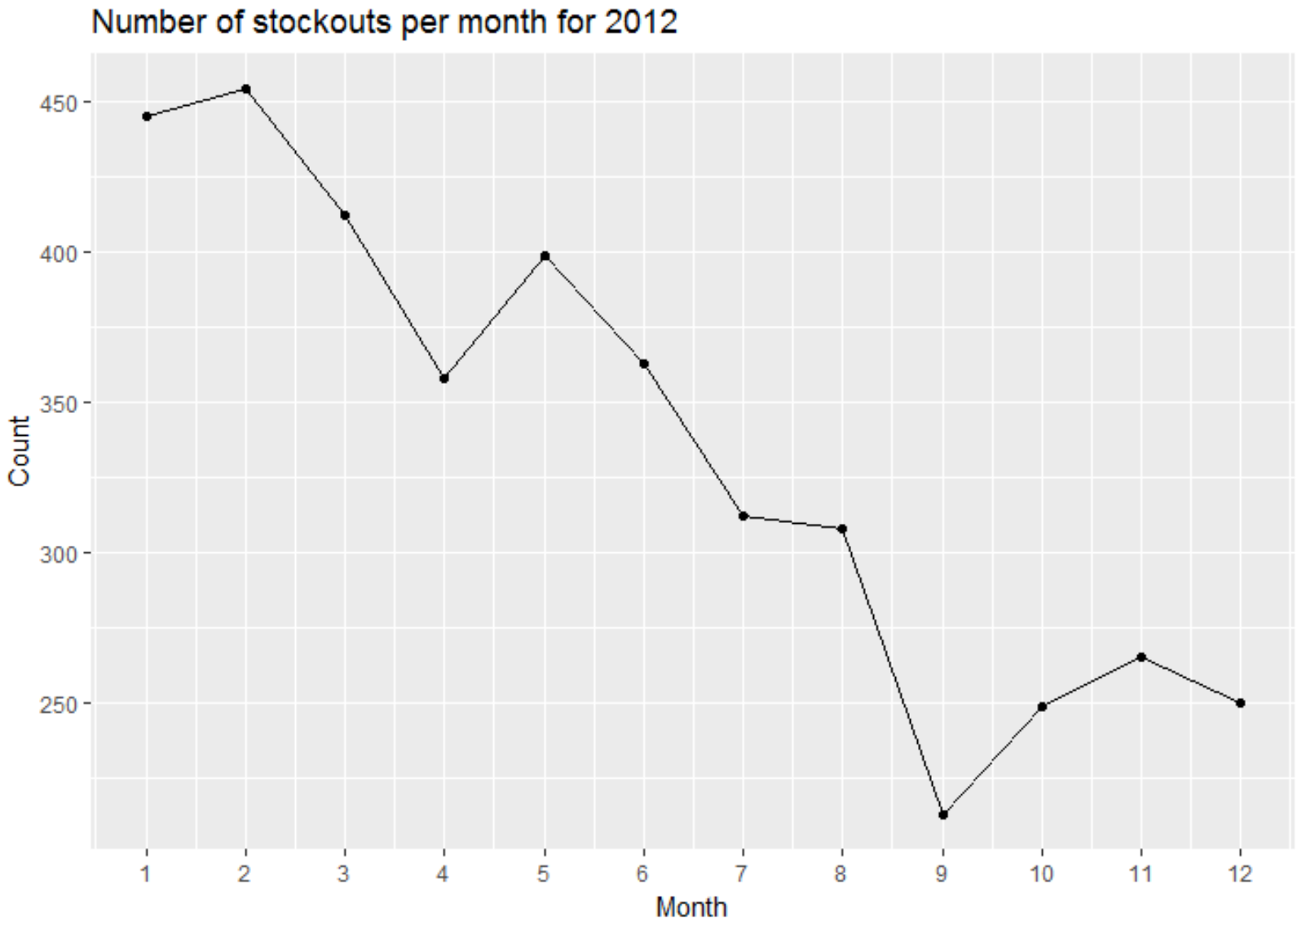
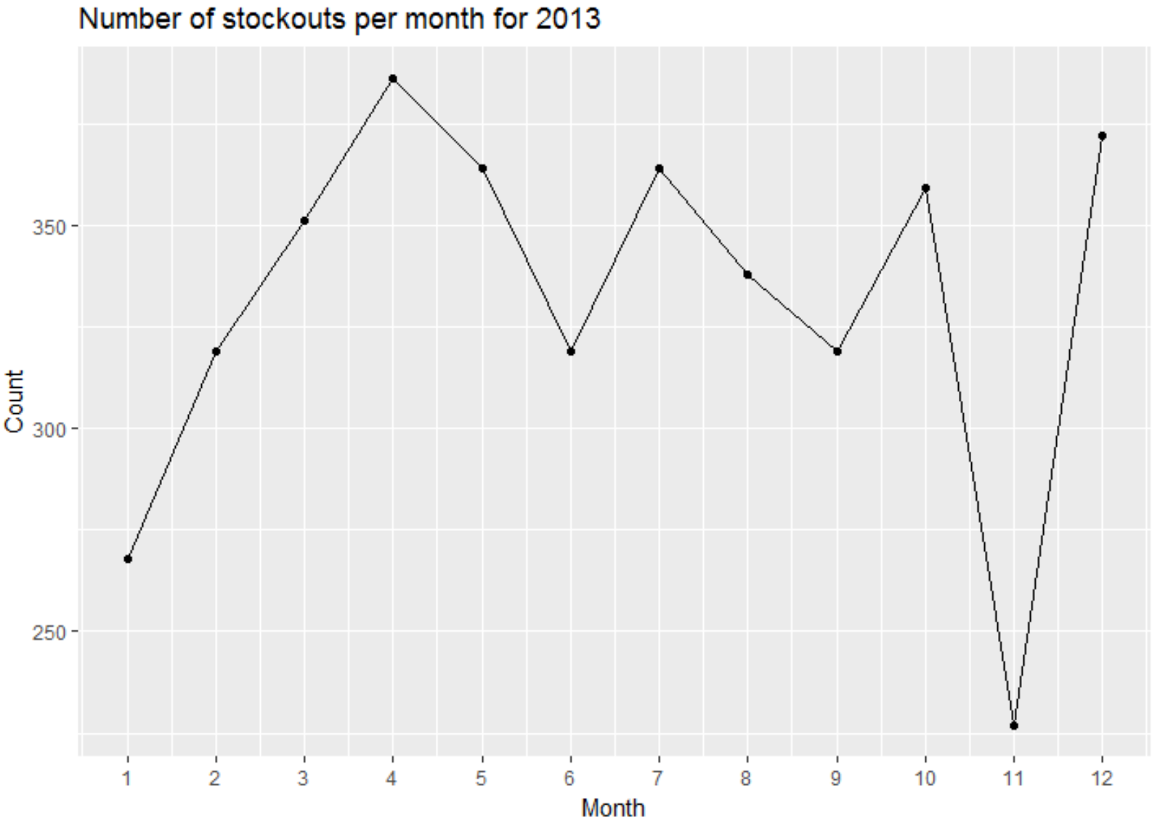
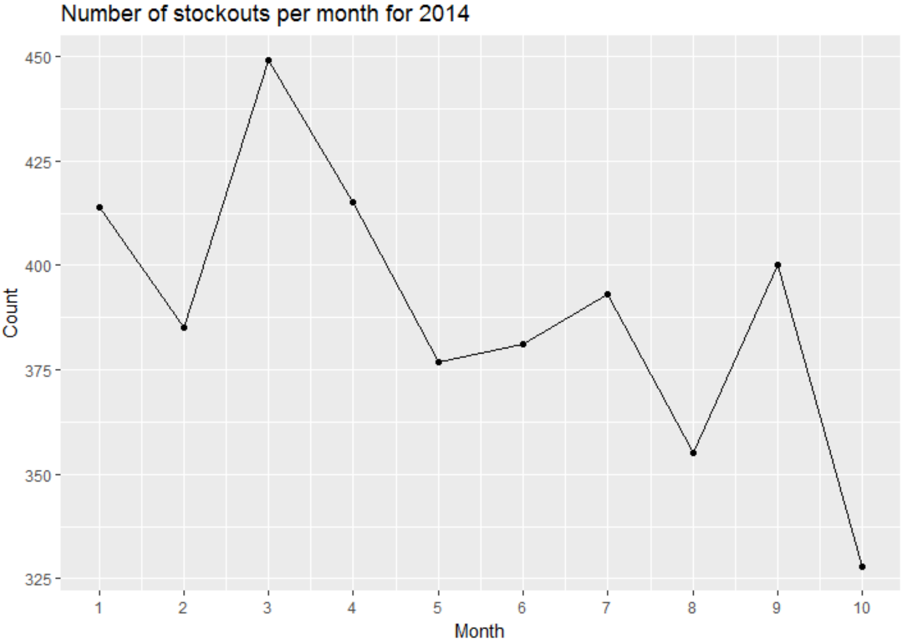
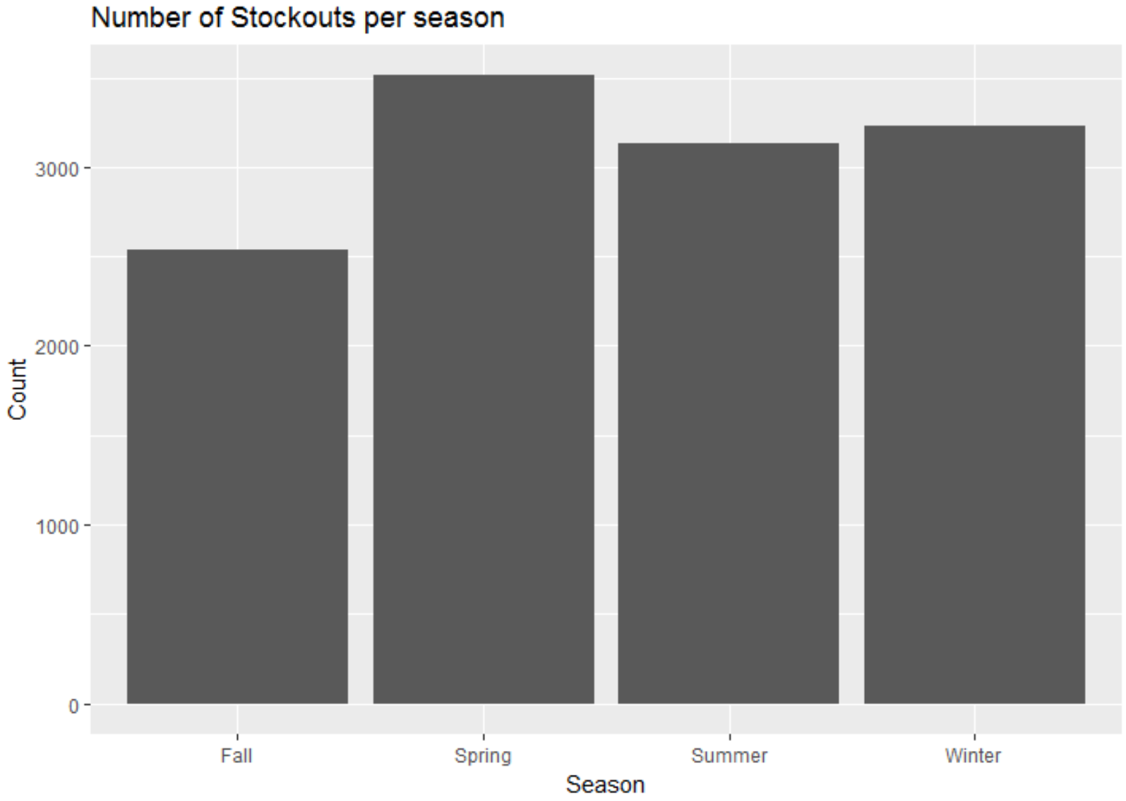
Is there a trend over the years?

Slide 17
Is there a trend over the years?
Although, there is steady decrease in stockouts throughout 2012 which suggests a major change in inventory system management, the stockouts climb back to the range of 400’s in both 2013 and 2014. Hence it can’t be said if there was a major change in 2012
Stockouts see a marked increase in Spring season

Slide 18
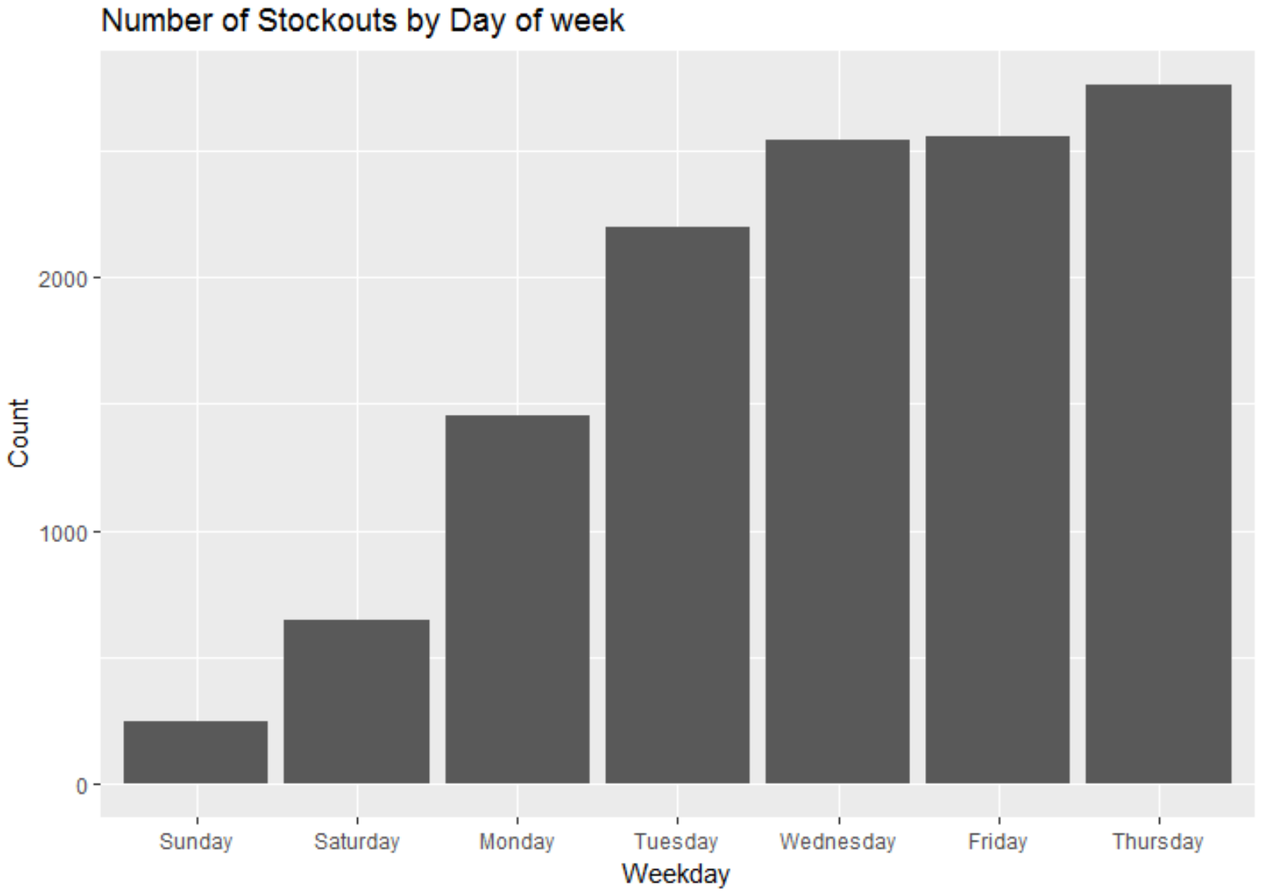
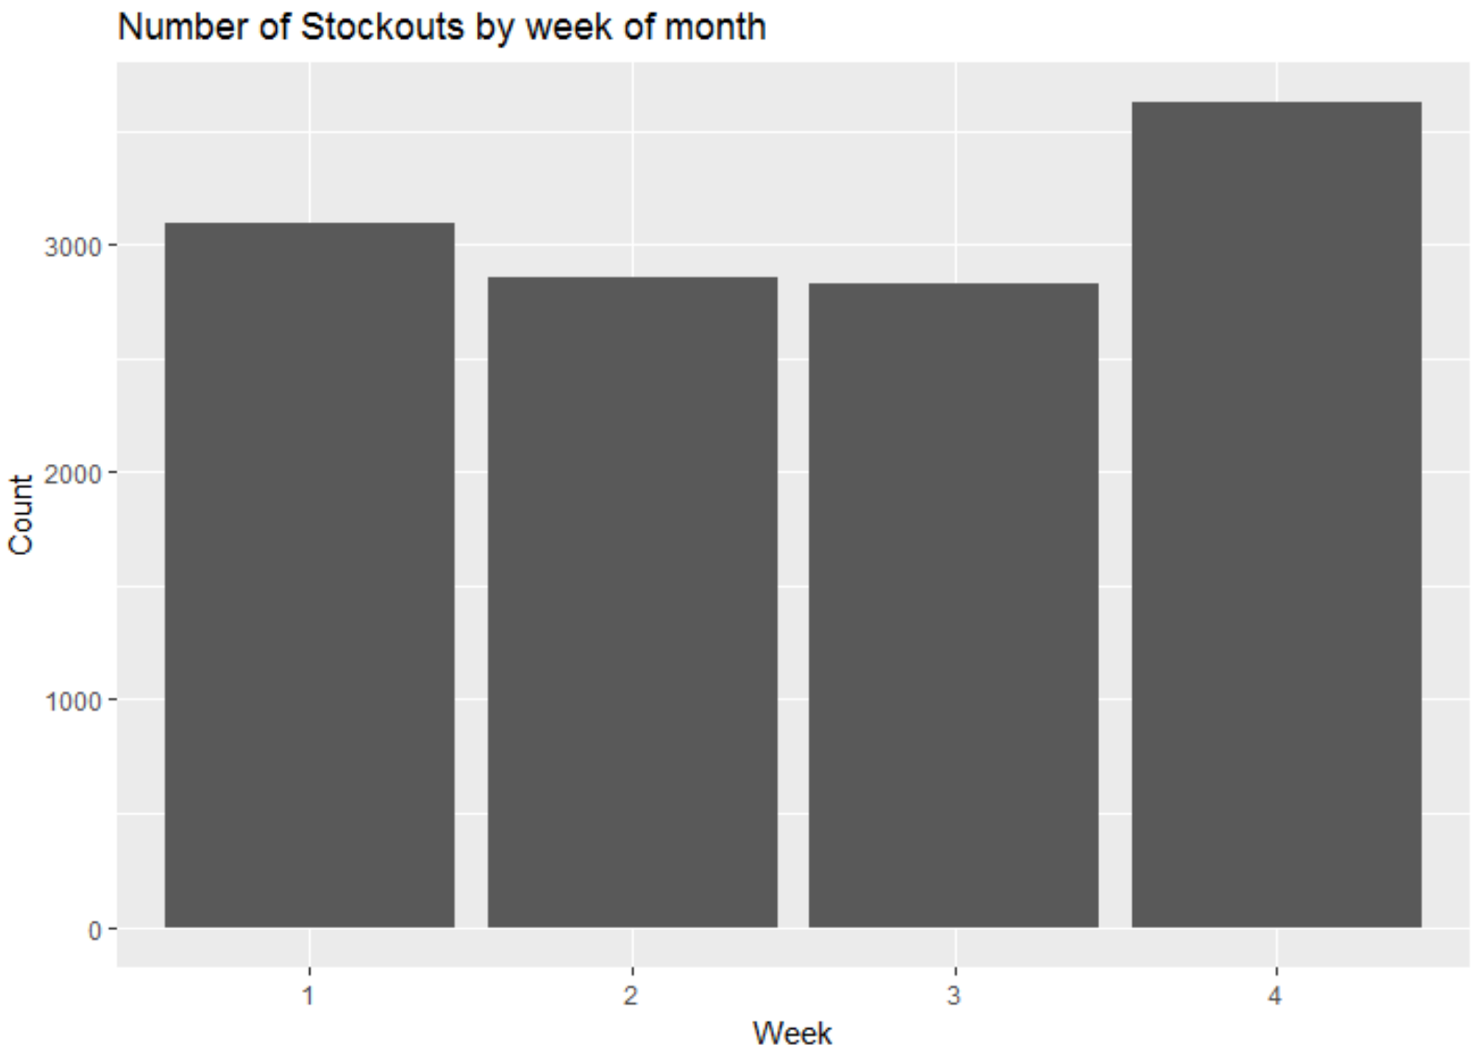
Stockouts over other time frames
It is clear from the graphs that stockouts increase towards the end of the week and the end of the month. We will get more perspective on these insights by looking at the product movement and a test

Slide 19
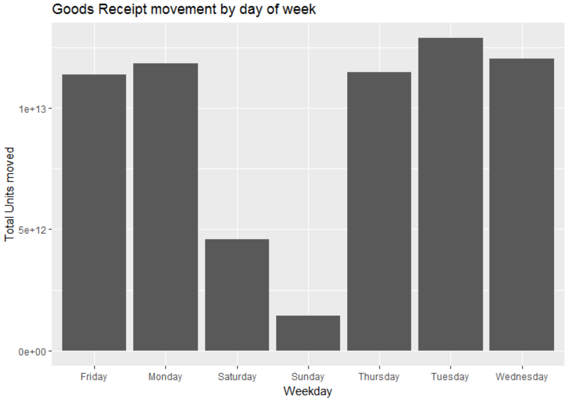
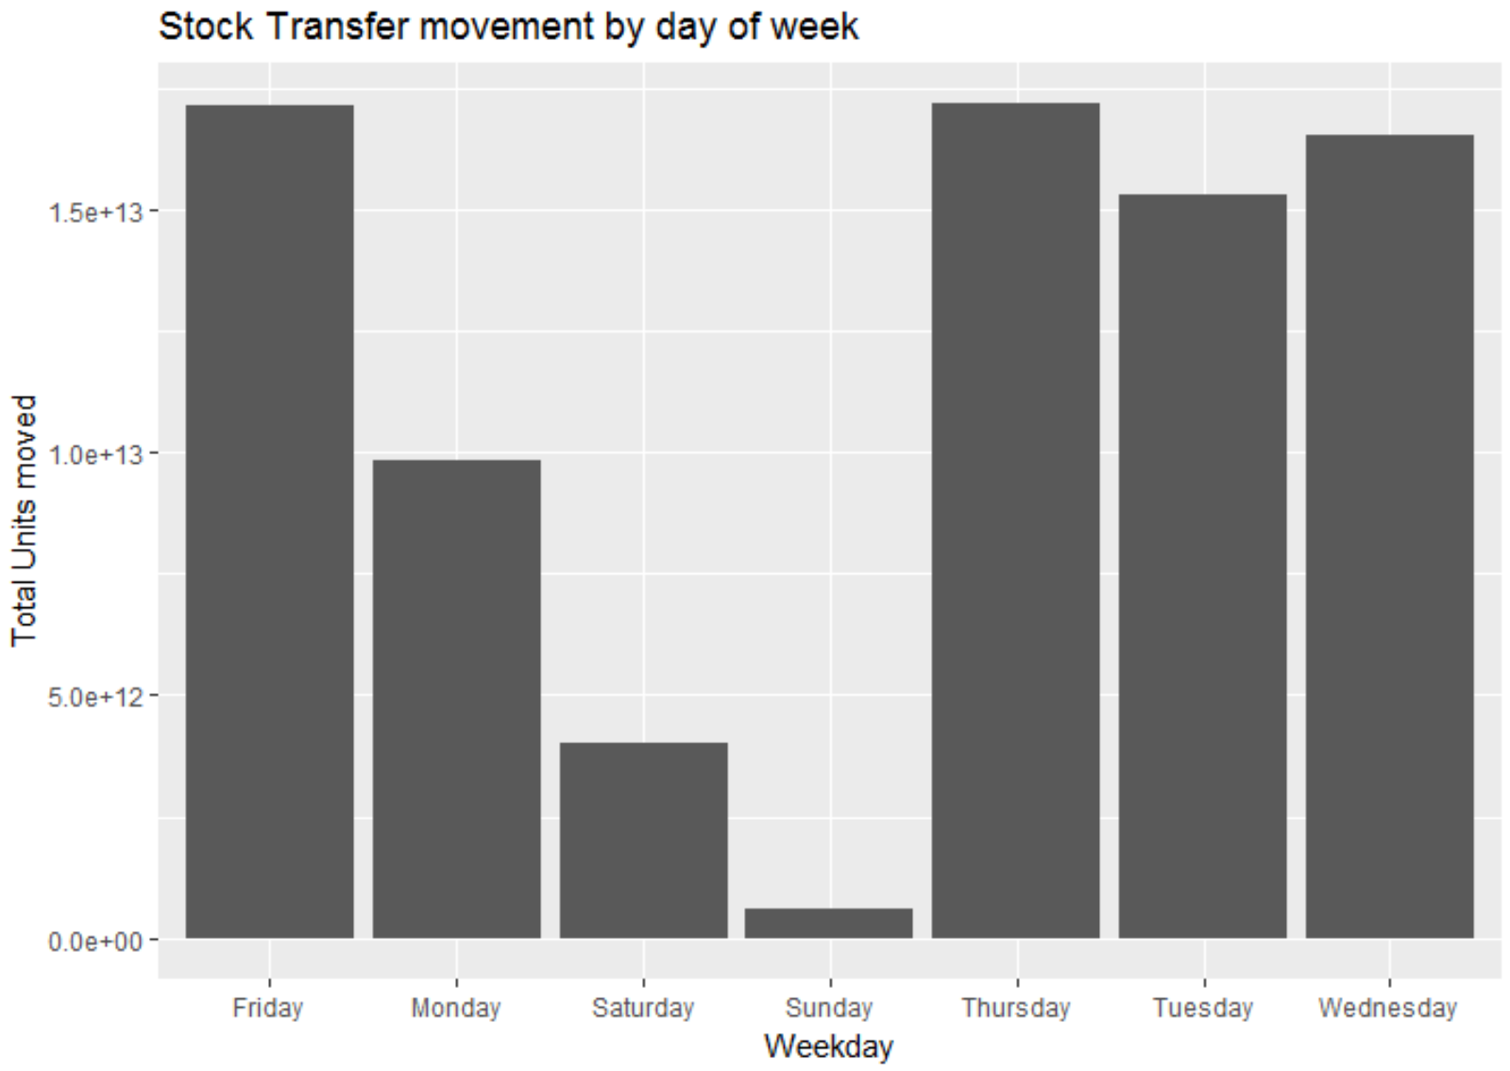
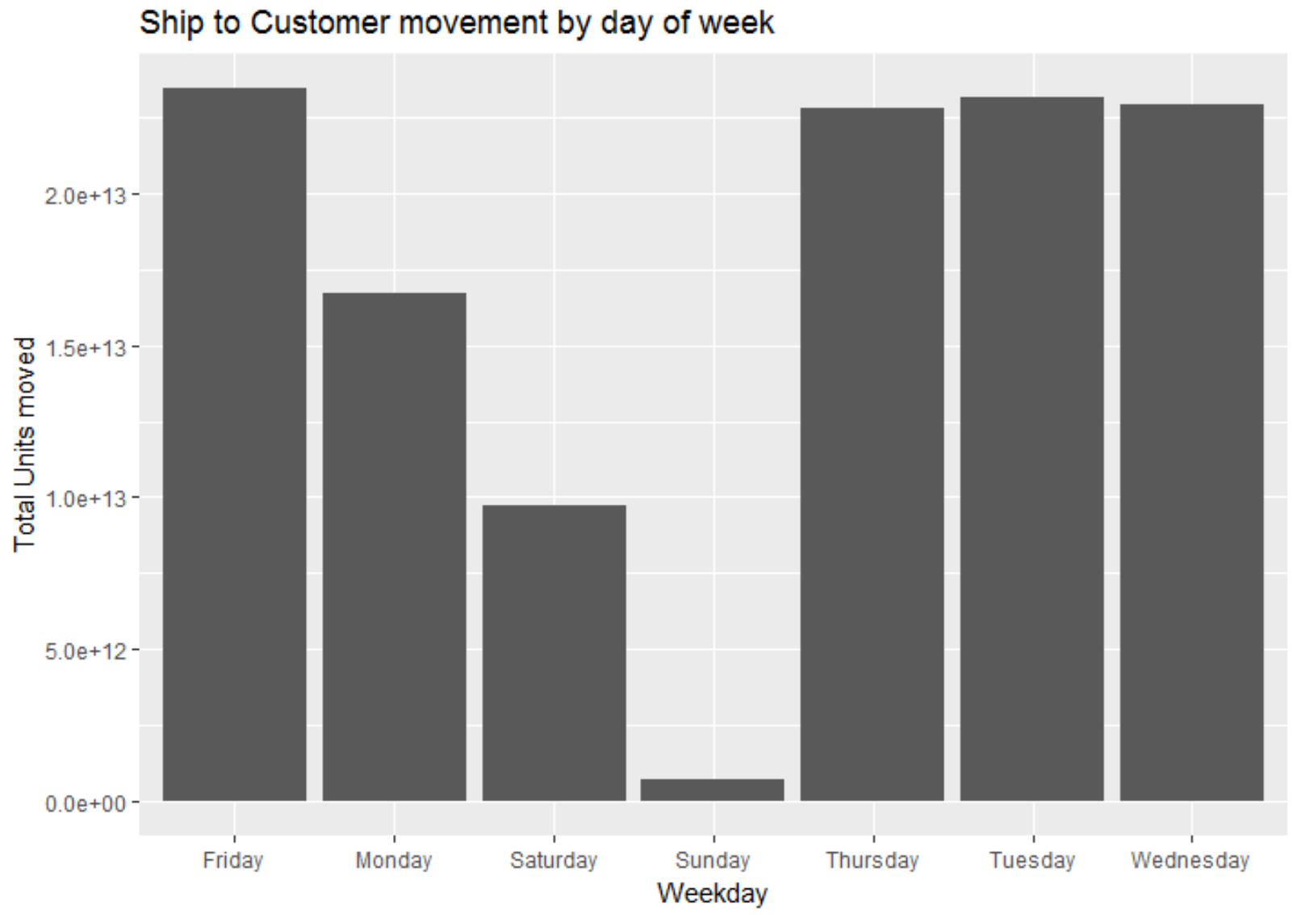
A glimpse into Product Movement
There is a high Goods Receipt during the start of the week. On the other hand, there is a high demand of the products internally and externally towards the later part of the week

Slide 20
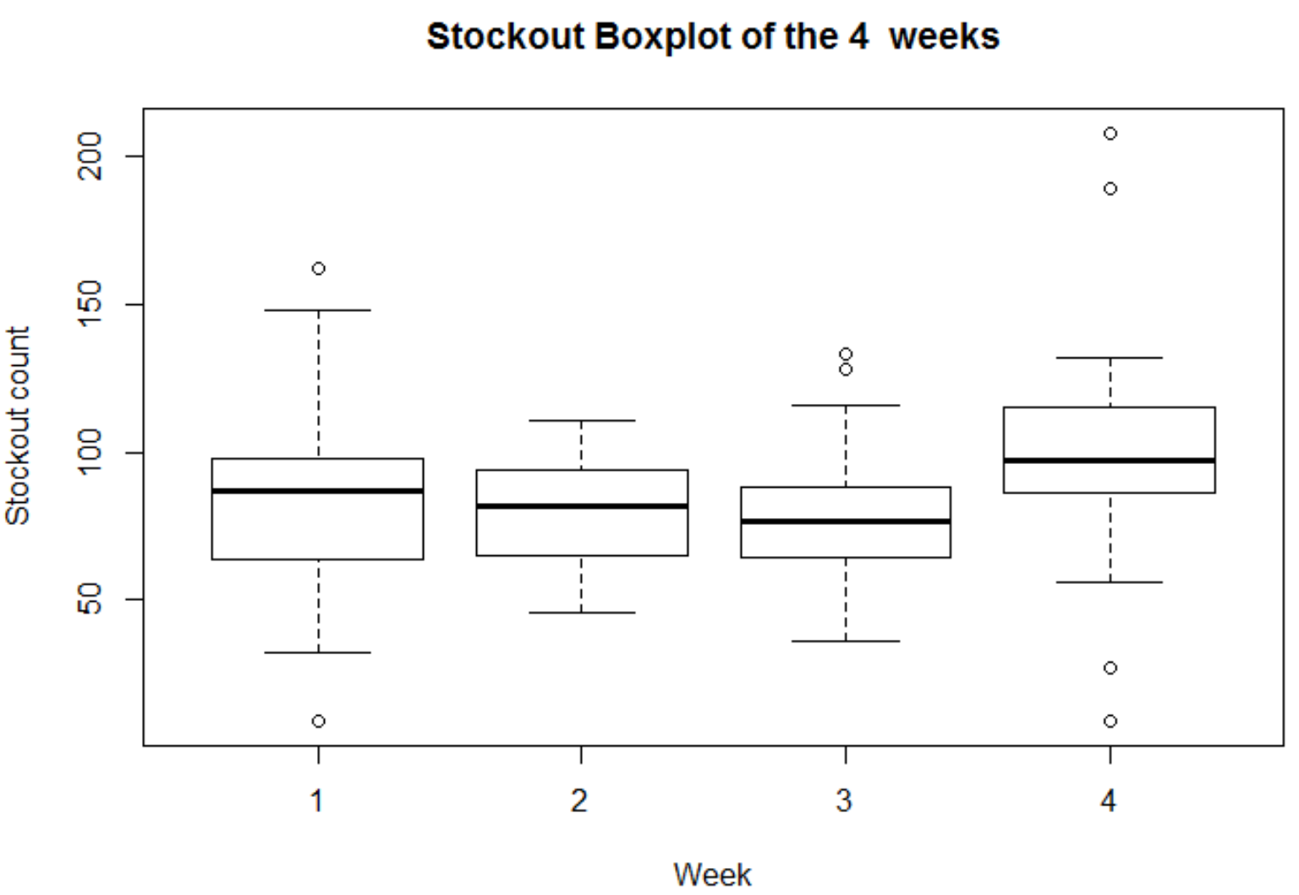
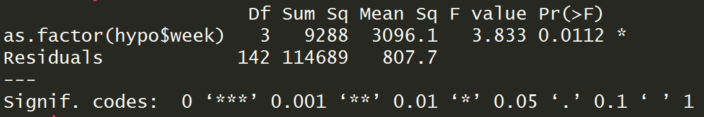
Hypothesis Test for stockout over week of the month
ANOVA test suggests that there is a difference in the stockouts week over week, majorly between weeks 4 and (2, 3)
Thus, we will consider week as a predictor in our stockout prediction model

Slide 21
2.
PREDICTIVE ANALYSIS

Slide 22
Feature Engineering
To make predictions for the next week, metrics for the previous week have been considered for prediction. The following variables have been created:
Number of events and sum of value of Goods Receipt, Stock Transfer & Ship to Customer over past week
Above average variables: Was any of the following metrics - Goods Receipt, Stock Transfer, Ship to Customer, Last value of stock, total goods movement – above its average value for the season
Finally, groups 2, 3, 4 and 6 were selected in scope for prediction. Also, only those materials were considered which had data points for more than 100 weeks

Slide 23
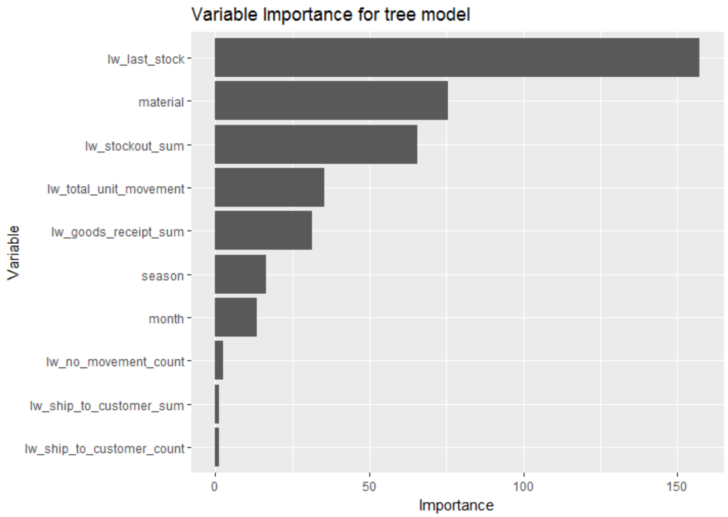
Prediction
A regression tree was used to predict stockouts for the last 5 weeks from the data
Taking a threshold of 0.18 for the probability of predicting a stockout, we got an accuracy of 92 %

Slide 24
What could have been better?
Machine Learning Algorithms are usually designed to improve accuracy by reducing the error. Thus, they do not take into account the class distribution / proportion or balance of classes. Ways to fix this:
Improving classification algorithm: Applying a more advanced model like xgboost did not help.
Resampling to balance the classes:
Random Under-sampling
Random Over-sampling
Cluster based over-sampling

Slide 25
Action points and Future Roadmap

Slide 26
Preemptive action points for the business
The model can be deployed to arrive at the predictions for the next week which will help the business plan inventory better
The model can be updated to include the data for the latest time period so that it captures the recent trends
Stockouts are usually higher during the later part of the week and month. We can look at materials with highest stockout proportion and plan better for them

Slide 27
Future Roadmap
Include additional datasets with better description of the products, plants etc. and other inventory and movement attributes
Automated descriptive analysis based on online data
Create a product that ingests incoming data and makes predictions for various time frames – next x weeks, next month and even day of next week for a causal perspective

Slide 28
Thanks!
Any questions?

