Slide 1
Data Discovery and Profiling
Table Name
Booker
Data Summary
Summarizes the data table to depict a good comprehension of dimension of the dataset covering length, breadth and depth which becomes the starting point for further forensic study and data excellence on the data
Table name
Booker
Data Field #
16
Record #
30
Completeness
72.08%
Duplicate
0
Numerical #
11
Categorical #
3
Date
2

Slide 2


KDE Summery
KDE in a segment based on index is broken down into three major data type categories- Numerical , Categorical and Date.
Numerical
Categorical
Data Field | Completeness %
UniqueClients | 100
TotalPassengers | 96.67
TotalRevenue | 100
TravelSoloOrGroup_separator_Solo | 100
TravelSoloOrGroup_separator_Group | 100
BookingMonth_separator_January | 16.67
BookingMonth_separator_February | 20
BookingMonth_separator_March | 30
Data Field | Completeness %
BookerType | 93.33
BookerCity | 100
Gender | 100
Date
What is KDE Index?
Data Field | Completeness %
FirstDate | 100
LatestDate | 100
KDE Index is based on the completeness of a data field, higher the completeness higher is the index; completeness is a key indicator of the usability of the data field for analytical need
What is KDE? KDE is Key Data Element are those data fields in a data table which are of higher value from analytics perspective

Slide 3

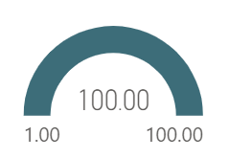
KDE Profiling
TotalRevenue
Gender
DateOfBirth
Mean
37396.99
Data field value | Value percentage%
Male | 40
Female | 43.33
Others | 16.66
Min. Date
05-01-2002
Median
33525.275
Max. Date
10-12-2002
Variance
373662063.8
Year
2002
Note: Presents the top K values distribution for the categorical data field, this would help to analyze the reasonableness of the KDE.
SD
19330.3405
Note: Demonstrate about Min and Max. date of selected Year
Skewness
0.6008
Note: Depicts Key statistics of the numeric field, these metrics can be studied to evaluate the profile of the data field and any outliers of significance

Slide 4
Numerical
Categorical
Date
Category | Value Count
Male | 13
Female | 12
Others | 5
Total | 30
View the overall distribution across all categories by absolute number
Analyze number of records present over a given year
Ability to visualize outliers and mean in the data

Slide 5
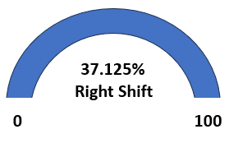
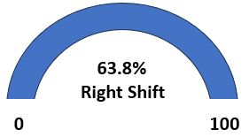
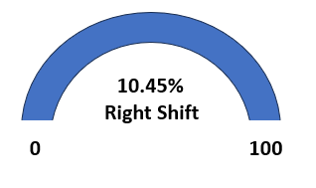
Data Shift Indexation
Table name
Booker
Data Table name
Booker
Shift Indexation
Shift Index Trend
Date
20 August 2024
Macro vs Micro
What is Data Shift Indexation Data Shift Indexation is our intellectual property which quantifies the shift incremental data has undergone compared to base data which is historical in nature; the length of history is customizable based on nature of the business; the process of indexing is a continuous learning which engine has to undergo to determine benchmarks for evaluation
Macro Micro

Slide 6
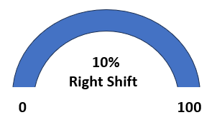
Categorical Data Field `
Shift Index
Total Change
Rank Change
Column_name | shift
BookerType | 10%
BookerCity | 10%
Gender | 10%
20%
0%
Base values | Count %
Male | 40
Female | 43.33
Others | 16.67
Increment values | Count %
Male | 50
Female | 50
Others | 0
Categorical Shift Index represents the overall shift w.r.t all the categorical data fields which are in the data table. Higher the value higher is the shift

Slide 7

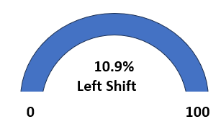



Numerical Data Field
Shift Index
Key Characteristics
Base
New
Changes %
Data Field | Shift
UniqueClients | 10.9
TotalPassengers | 10.9
TotalRevenue | 10.9
37396.99
42183.495
12.8
33525.275
41850.8
24.8
373662063.8
182670118.3
-51.11
Numerical Shift Index represents the overall shift w.r.t all the numerical data fields which are in the data table. Higher the value higher is the shift
19330.3405
13515.55098
-30.08

Slide 8
Macro Shift
Shift Index
Key Characteristics
Base
New
Changes %
Tuple #
10
10
0
Completeness #
24.02
68.75
186.219
Macro Shift determines the shift at an overall level which includes Tuple, Completeness & Size.
Size
2.9Kb
3.05kb
5.17

