Slide 1
BLUESTOCK FINTECH
Mutual Fund Analytics Platform
End-to-End Data Engineering, ETL Pipeline & Interactive Dashboard
Prepared by: Priya Mishra
Mangalmay Institute of Engineering and Technology
Python | SQL | Power BI • Academic Year 2026

Slide 2
Problem Statement & Objectives
• Mutual-fund NAV, AUM, SIP and portfolio data is fragmented across different sources and formats.
• Investors and analysts need a unified way to compare funds using risk-adjusted metrics.
• Benchmark tracking and investor-behaviour analysis are difficult with static reports.
• Objective: build an ETL-driven analytical platform with a relational data layer and interactive Power BI dashboard.
• Key outputs: industry analysis, fund performance, investor analytics and SIP/market trends.
Bluestock Fintech | Mutual Fund Analytics | 2/12

Slide 3
Data Sources
AMFI India
NAV, AUM, Folio & SIP data
mfapi.in
Historical NAV via API
mfdata.in
NAV & expense-ratio data
NSE India
Benchmark index prices
BSE India
BSE SmallCap benchmark
AMFI Monthly Notes
Industry SIP & flow data
Dataset coverage: 40 schemes • ~46,000 NAV rows • 10 AMCs • 32,000+ transactions • 4.5+ years of NAV history
Bluestock Fintech | Mutual Fund Analytics | 3/12

Slide 4
System Architecture
Data Sources
Python / Pandas Extract
Cleaning & Validation
Transform & Enrich
SQLite / PostgreSQL
Analytics
Power BI Dashboard
• Derived fields include daily returns, rolling averages and CAGR; AMFI codes and fund names are validated/normalised.
• Dashboard layer provides four report pages with slicers, KPIs, drill-through and tooltips.
Bluestock Fintech | Mutual Fund Analytics | 4/12

Slide 5
EDA Highlights I
NAV, AUM & SIP trends
• NAV trend analysis covers 40 schemes across 2022–2026 and is designed to highlight market recovery, rallies and corrections.
• AUM growth is compared across 10 fund houses from 2022–2025; the project specification identifies SBI as a leading AMC in the dataset.
• Monthly SIP inflows are tracked from January 2022 to December 2025, including the ₹31,002 crore December 2025 milestone.
• Folio count analysis tracks growth from 13.26 crore to 26.12 crore.
Bluestock Fintech | Mutual Fund Analytics | 5/12

Slide 6
EDA Highlights II
Investor, category & portfolio analysis
• Category-wise inflow heatmaps identify changing demand across fund categories.
• Investor demographics examine age groups and average SIP amounts.
• Geographic analysis compares SIP activity across states and T30 vs B30 city tiers.
• Correlation analysis compares NAV-return behaviour across selected funds.
• Portfolio analysis examines sector allocation and concentration.
Bluestock Fintech | Mutual Fund Analytics | 6/12

Slide 7
Performance Metrics I
Return & risk measures
• Daily return: NAV-based percentage change used as the foundation for performance analysis.
• CAGR: calculated for 1-year, 3-year and 5-year periods.
• Sharpe Ratio: evaluates excess return relative to total volatility; the project uses 6.5% as the risk-free-rate proxy.
• Sortino Ratio: evaluates excess return using downside volatility only.
• Maximum Drawdown: identifies the worst peak-to-trough decline.
Bluestock Fintech | Mutual Fund Analytics | 7/12

Slide 8
Performance Metrics II
Benchmark & composite fund scoring
• Alpha and Beta are estimated against benchmark returns using regression.
• Benchmark comparison includes Nifty 50, Nifty 100 and BSE SmallCap indices.
• Composite Fund Score = 30% 3-year return + 25% Sharpe + 20% Alpha + 15% inverse expense-ratio rank + 10% inverse maximum-drawdown rank.
• Advanced analysis includes VaR, CVaR, rolling Sharpe, investor cohorts, SIP continuity and sector concentration.
• These metrics provide a broader basis for comparing funds than headline return alone.
Bluestock Fintech | Mutual Fund Analytics | 8/12

Slide 9
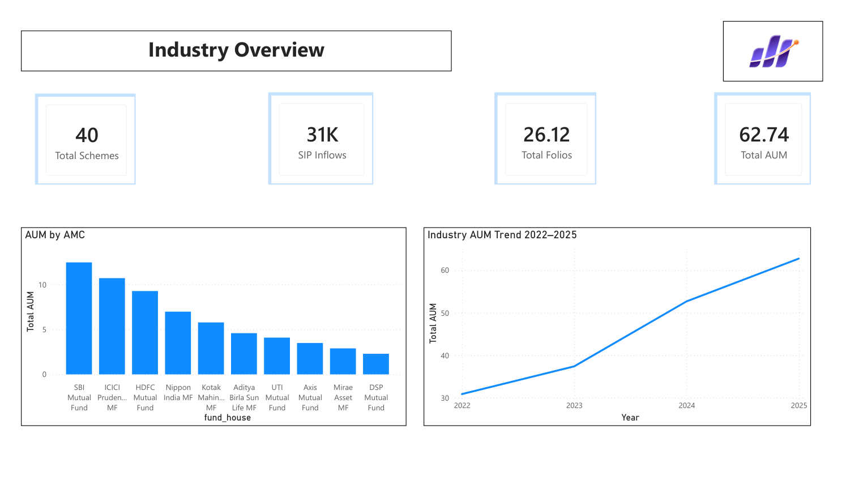
Dashboard Screenshot — Industry Overview
Bluestock Fintech | Mutual Fund Analytics | 9/12

Slide 10
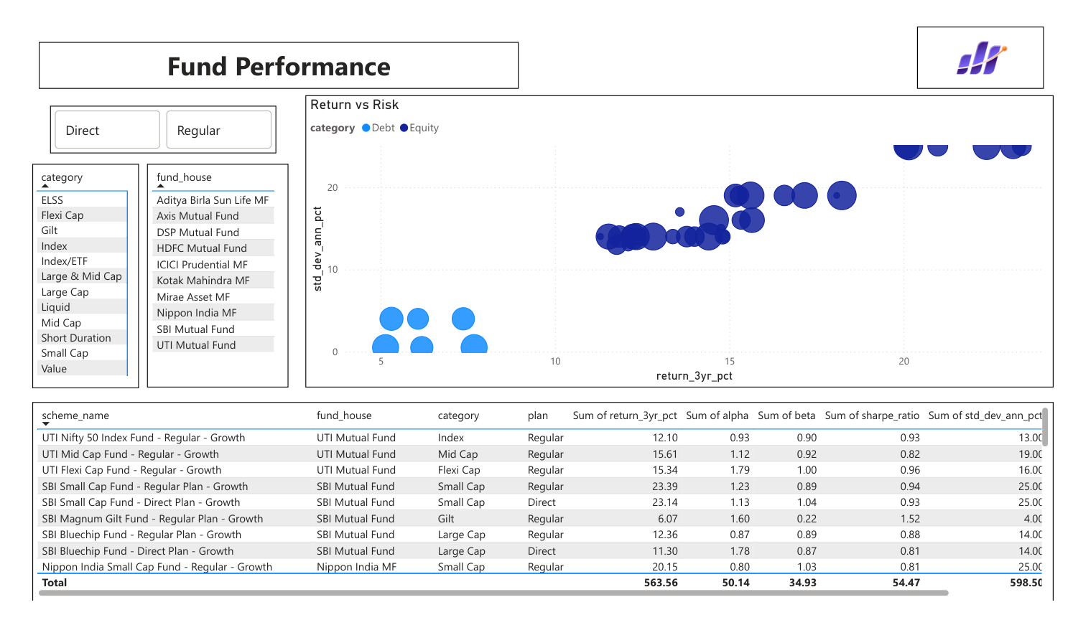
Dashboard Screenshot — Fund Performance
Bluestock Fintech | Mutual Fund Analytics | 10/12

Slide 11
Key Findings
• Mutual-fund AUM shows an increasing trend from 2022 to 2025.
• SIP participation is significant, with ₹31,002 crore recorded in December 2025.
• Major AMCs such as SBI, ICICI Prudential, HDFC and Nippon India have strong presence in the analysed universe.
• Fund performance shows a clear risk–return trade-off: SBI Small Cap Fund records 23.39% 3-year return with 25% standard deviation, while SBI Magnum Gilt Fund records 6.07% with 4% standard deviation.
• Investor and category behaviour varies across states, age groups, transaction types and fund categories.
Bluestock Fintech | Mutual Fund Analytics | 11/12

Slide 12
THANK YOU
Questions & Discussion
Bluestock Mutual Fund Analytics

