Slide 1
Real-Time Implementation and Evaluation of Adaptive Dynamic Range Optimization (ADRO) for Hearing Enhancement
Final Project presentation
By
Raman Mishra
(RSM200000)
Notes:
In this presentation, we will discuss the concept of Adaptive Dynamic Range Optimization (ADRO) for hearing enhancement and its importance in improving hearing aid performance. We will cover the different types of hearing aid technology available and how ADRO fits into the landscape. We will explain the ADRO algorithm in detail, including how it works and its benefits for hearing aid users. We will also discuss the challenges of implementing ADRO in real-time and present solutions for overcoming these challenges. Finally, we will present a study design for evaluating the effectiveness of ADRO in real-world settings, as well as case studies demonstrating the successful implementation of ADRO in real-world settings.

Slide 2
Overview
Project description
ADRO Algorithm
ADRO_UTD Application
Experimental results for different audio files
Conclusion

Slide 3
Project Description
For each frequency band, the estimated output level is derived from the current input audio signal level (XdbSPL) and the applied gain (Gain_BinFreqs)
Determined the Maximum Output Level (MOL) gain for each band from the output level and the MOL time constants
Detected "loud" bands where the MOL gain is -1dB
Estimated 90th percentile and 30th percentile levels for selected bands
Reduced slew rates if "loud" bin or band threshold is exceeded
Using ADRO rules, updated gain for selected bins or bands

Slide 4
ADRO Algorithm
Fig: ADRO modules
ADRO analyses he user’s hearing needs in real-time
ADRO adjust the amplification of different frequencies based on the user’s hearing needs
ADRO provides a more personalized and effective hearing experience

Slide 5
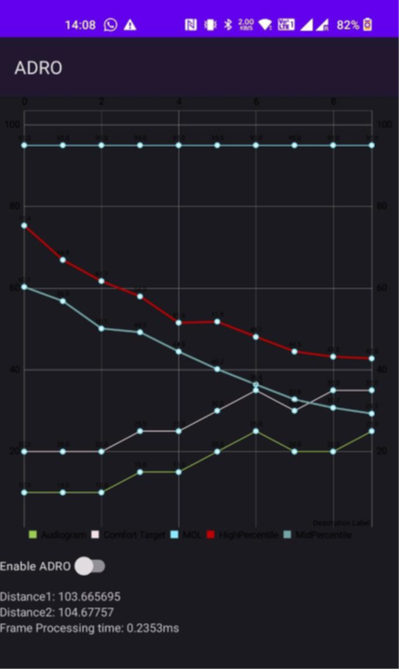
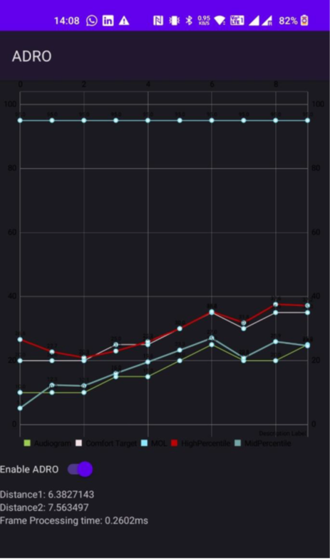
ADRO_UTD Application
Observe that the mid percentile and high percentile plots are not overlapping with the Audiogram and comfort target, indicating a deviation from the desired values.
Now enable ADRO, we observe that the mid percentile and high percentile plots are now overlapping with the Audiogram and comfort target, indicating that the ADRO algorithm is working as expected.
Based on this observation, it can be concluded that the ADRO algorithm is running correctly in the app.
Fig : Screenshot of the App before enabling ADRO.
Fig : Screenshot of the App after enabling ADRO.

Slide 6
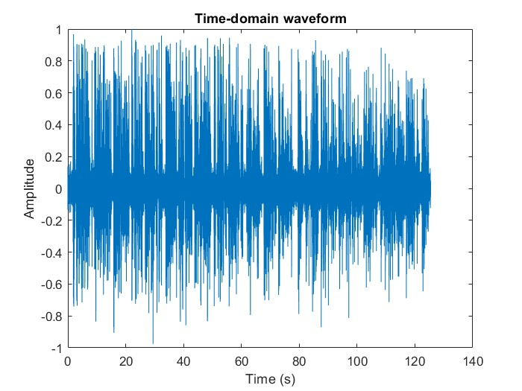
Experimental results for different audio files
Fig: Noisy Speech for Loud Babble in Time Domain
Fig: D1 & D2 vs Time

Slide 7
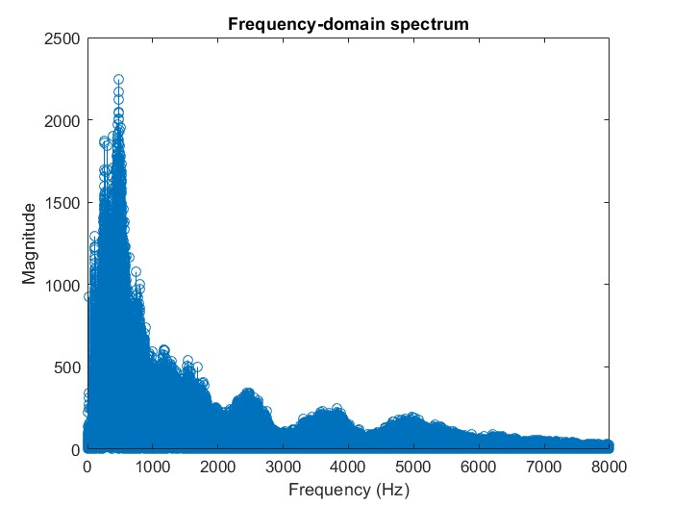
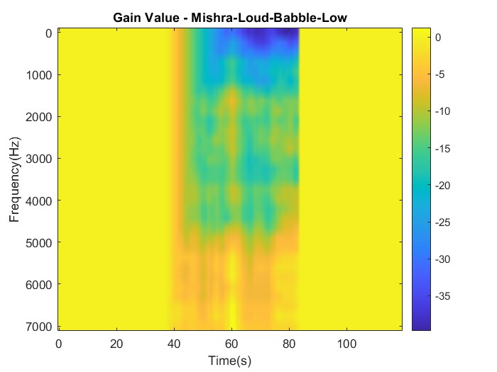
Loud Babble
Fig: Noisy Speech for Loud Babble in Frequency Domain
Fig: Spectrogram

Slide 8
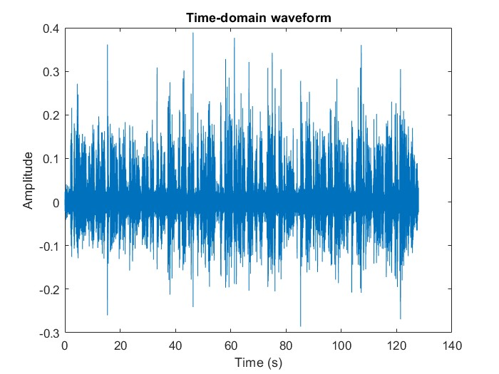
Soft Babble
Fig: Noisy Speech for Soft Babble in Time Domain
Fig: D1 & D2 vs Time

Slide 9
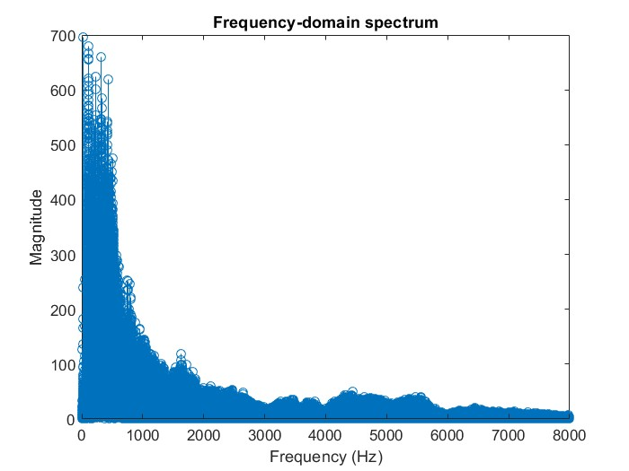
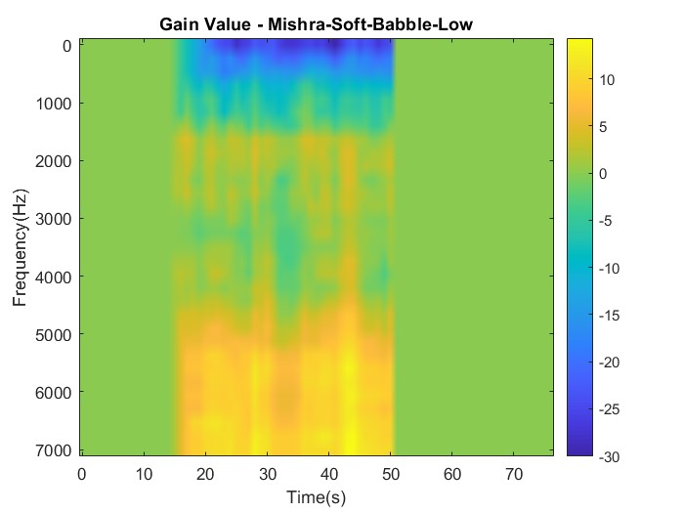
Soft Babble
Fig: Noisy Speech for Soft Babble in Frequency Domain
Fig: Spectrogram

Slide 10
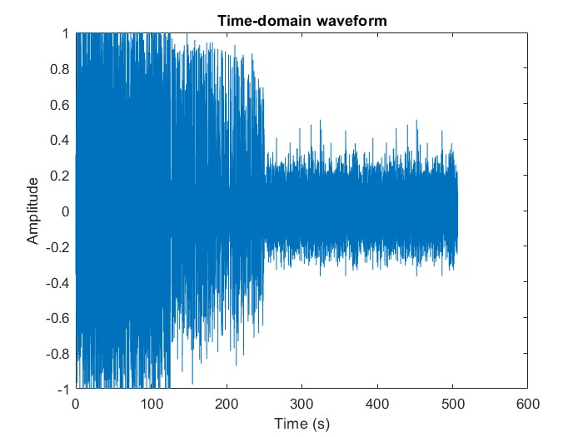
Babble Concatenated
Fig: Noisy Speech for Concatenated Babble in Time Domain
Fig: D1 & D2 vs Time

Slide 11
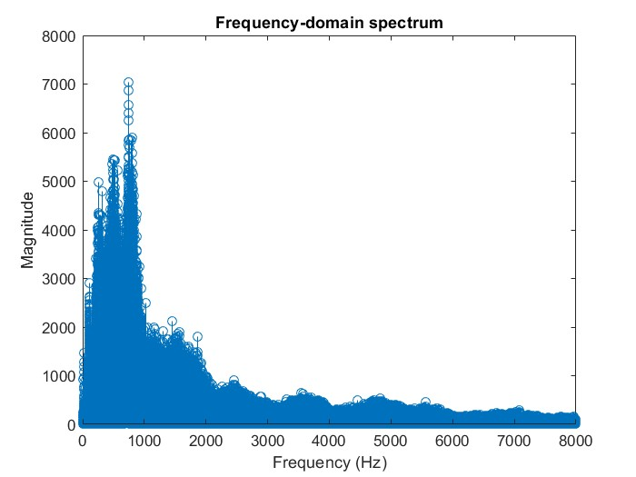
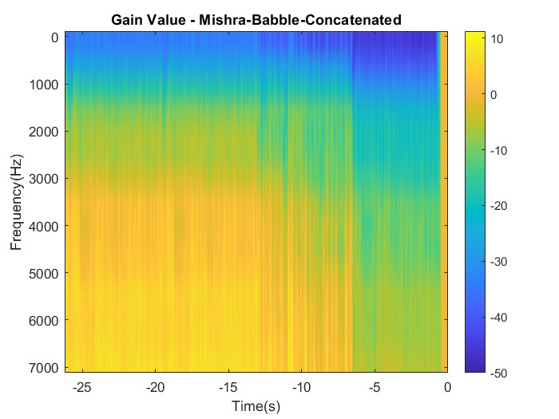
Soft Babble
Fig: Noisy Speech for Concatenated Babble in Frequency Domain
Fig: Spectrogram

Slide 12
Conclusion
ADRO is a powerful tool for hearing enhancement that provides a more personalized and effective hearing experience
ADRO has been shown to improve speech intelligibility and sound quality in real-world settings
For Loud Audio, the signal amplitude is high and there aren't many fluctuations, and even at high frequencies the gain is negative.
For Soft Audio, the signal amplitude is low with lots of fluctuations and the gain increases as the frequency increases.
Overall, this project has demonstrated the effectiveness and potential of the ADRO algorithm and has contributed to the development of hearing aid technology.

