Slide 1
3rd International Conference on Pervasive Computing and Social Networking
Image Understanding of GUI Widgets for Test Reuse
Presented by:
Yash Mishra

Slide 2
Abstract
Importance of UI Testing and Cost and Complexity of Test Development
Test Reusability Approaches
Integration of Semantic Knowledge
Leveraging Textual Information
Unexplored Potential of Image Understanding
Enhanced Interpretability and Maintainability

Slide 3
Introduction
Cost and Effort of Manual Test Creation
Automatic Test Case Generation
Challenges of Automated Test Case Generation
Semantic Similarities and Test Migration
Impact of Semantic GUI Event Matching
Incorporating Images and Icons as Semantic Descriptors
Evaluation of Semantic Matching with Images and Icons

Slide 4
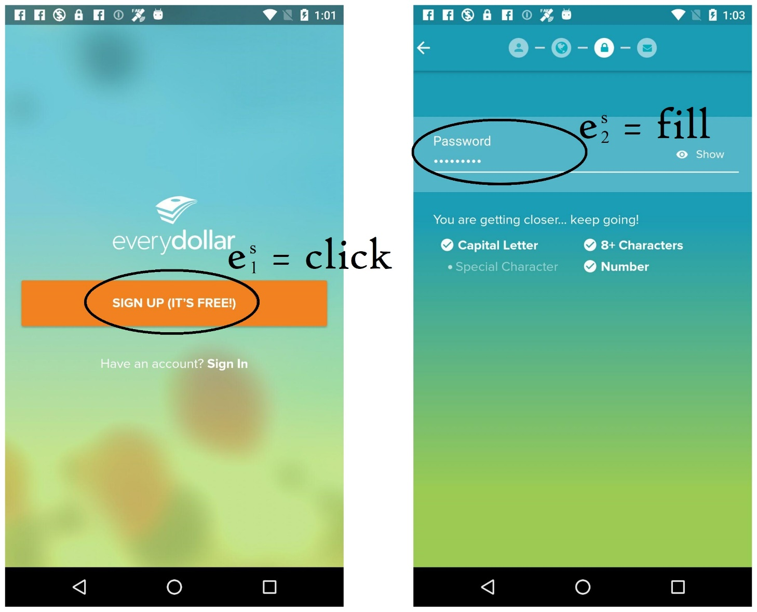

Example of Similar GUI Events
EveryDollar: Budgeting Mint: Budget, Bills, Finance

Slide 5
Related Works
Rise in Test Reusability Research
Test Migration within and across Platforms
Testing the Test Reusability Techniques
Classification of Widgets and Icons
Importance of Semantic Matching
Framework for Studying the Impact of Semantic Descriptors
Potential Benefits of Semantic Descriptors

Slide 6
Methodology
Dataset of GUI
Corpus of Documents
Word Embeddings
Event Descriptor
Semantic Matching Algorithm
Comparison of Semantic Matching Algorithms

Slide 7
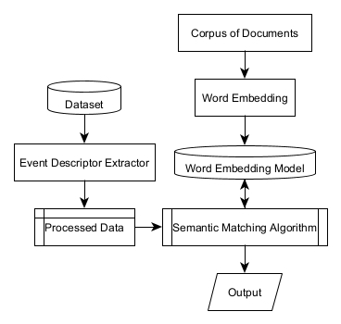
General Layout of the Model

Slide 8
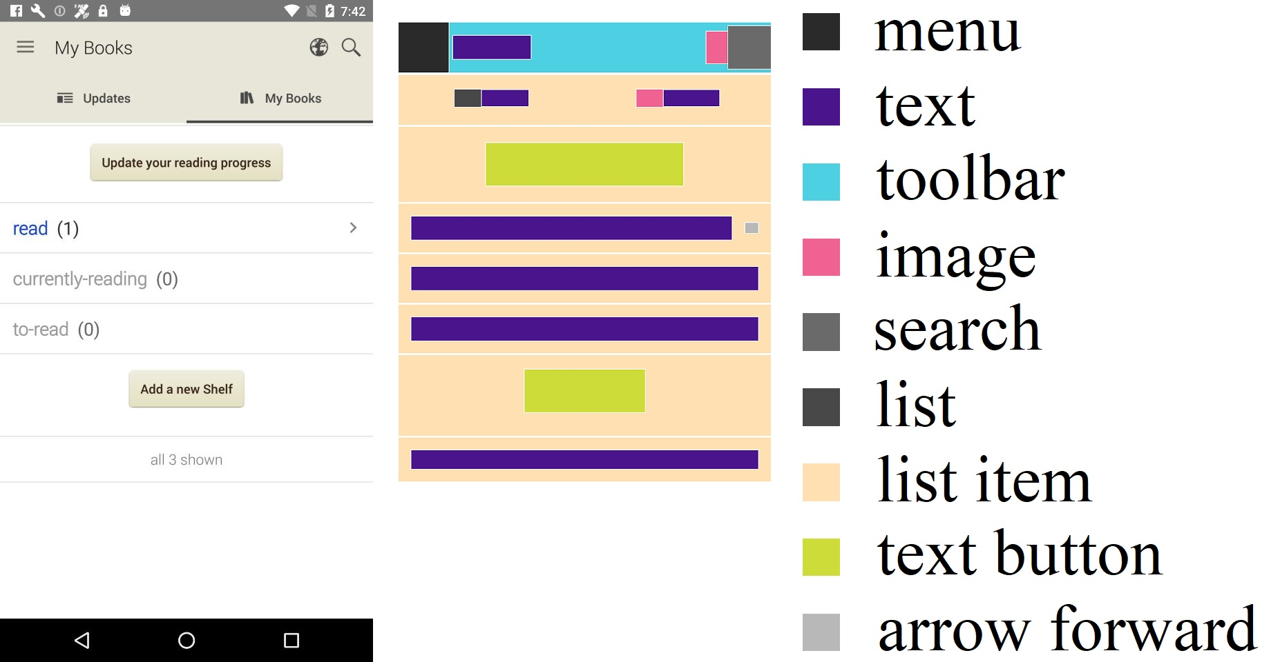
Semantic Annotation in RICO Dataset

Slide 9
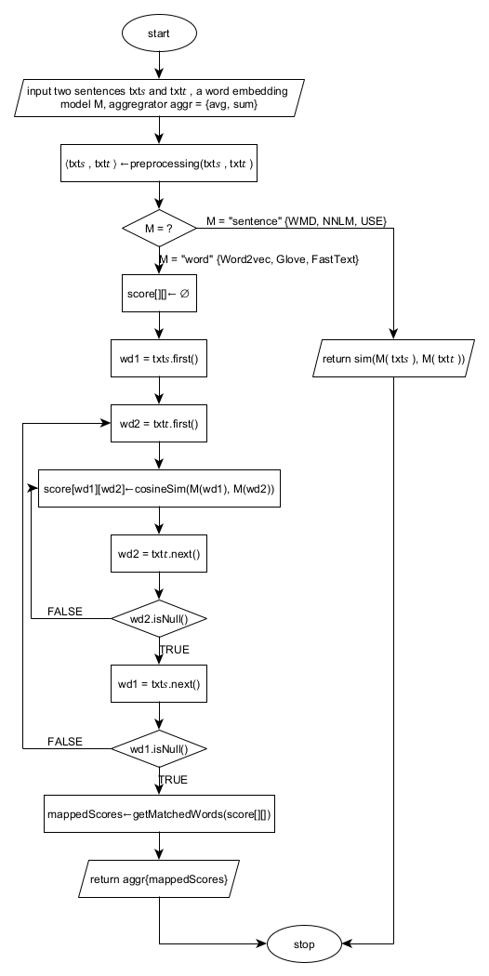
GetSimScore Algorithm

Slide 10
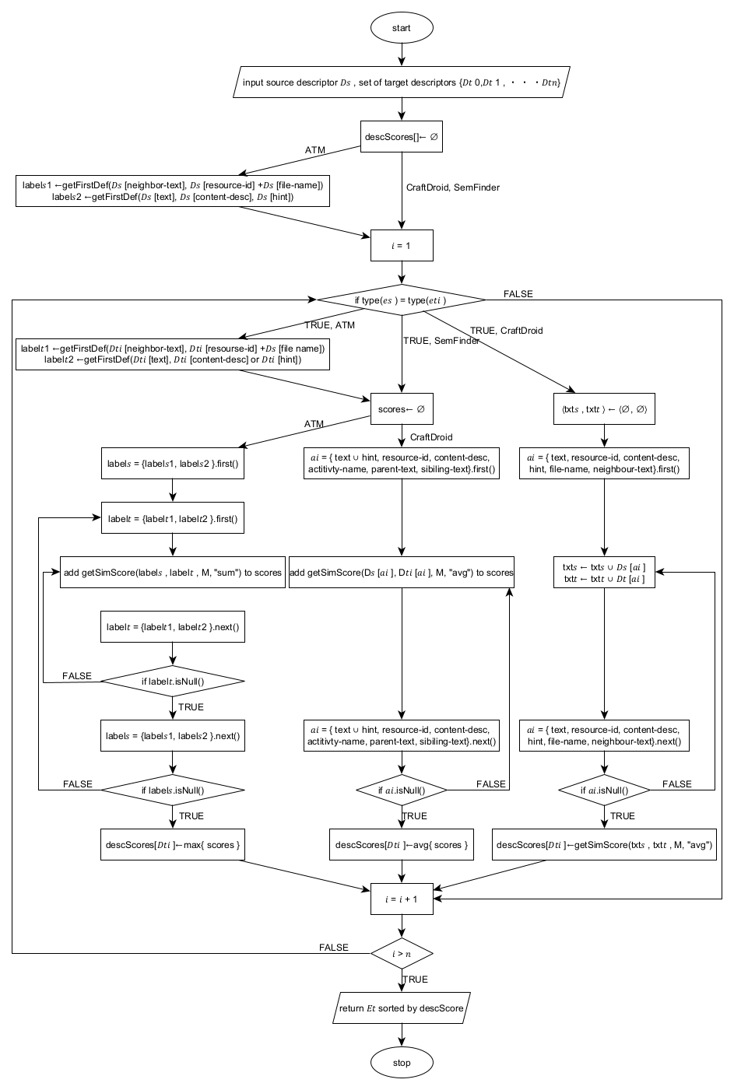
Different Semantic Matching Algorithms

Slide 11
Experiment
Experimental Setup
Syntactic Similarity Approaches
Evaluation Metrics
MRR Calculation
TOP1 Calculation
Evaluation of Semantic Matching

Slide 12
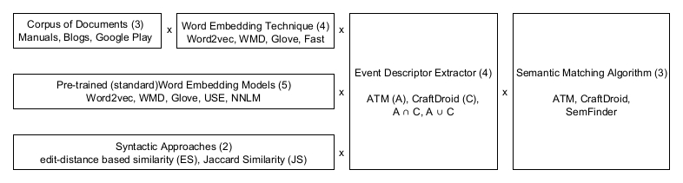
Different Configurations in the Model

Slide 13

Evaluation Metrics Used
$$MRR= \frac{1}{|Q|}\sum_{i=1}^{|Q|}{\frac{1}{{rank}_{i}}}∈(0;1]$$
$$TOP1= \frac{1}{|Q|}\sum_{i=1}^{|Q|}{\left\{\begin{aligned}1 if {rank}_{i}=1 \\ 0 otherwise\end{aligned}\right.}∈[0;1]$$

Slide 14
Results and Discussion
Performance Improvement
Higher MRR with Images
Higher Top1 with Images
Most Improved Configuration (MRR)
Most Improved Configuration (Top1)
Component Distribution Analysis

Slide 15
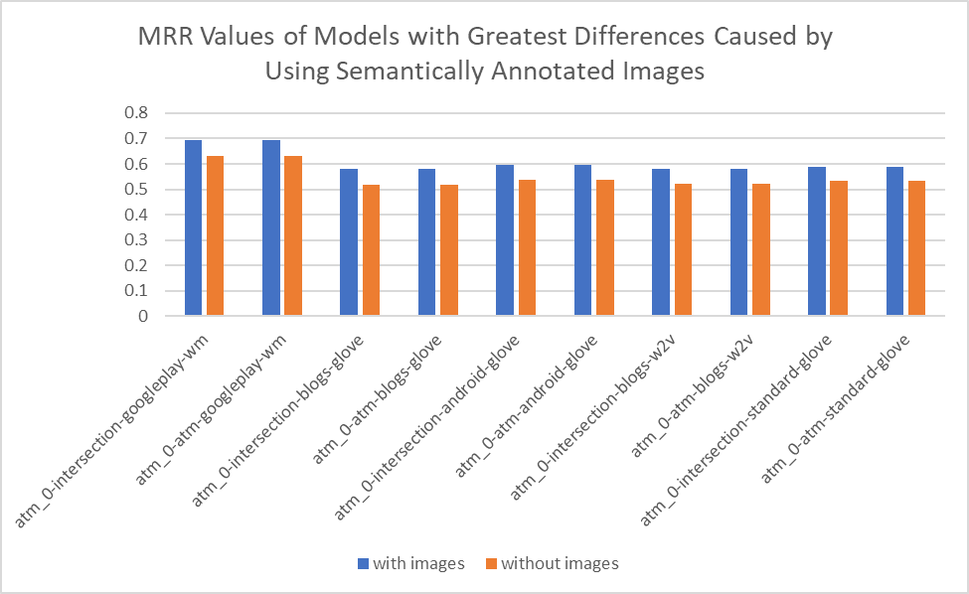

Slide 16
DISTRIBUTIONS OF THE 228 CONFIGURATIONS SORTED ACCORDING TO MRR DIFFERENCE AND TOP 1 DIFFERENCE
Type | Instance | MRR |  |  | Top1
 |  | 1% | 5% | 10% | 1% | 5% | 10%
Training Set | blogs | 33 | 33 | 17 | 33 | 17 | 17
 | manuals | 0 | 0 | 0 | 0 | 0 | 0
 | google play | 67 | 33 | 17 | 0 | 17 | 22
 | standard | 0 | 17 | 35 | 67 | 33 | 35
 | android | 0 | 17 | 31 | 0 | 33 | 26
Word Embedding | w2v | 0 | 17 | 26 | 0 | 33 | 26
 | glove | 33 | 50 | 26 | 33 | 17 | 34
 | wm | 67 | 17 | 17 | 0 | 0 | 9
 | fast | 0 | 17 | 13 | 0 | 17 | 13
 | nnlm | 0 | 0 | 9 | 0 | 17 | 9
 | use | 0 | 0 | 9 | 67 | 17 | 9
 | js | 0 | 0 | 0 | 0 | 0 | 0
 | es | 0 | 0 | 0 | 0 | 0 | 0
Descriptor | atm | 33 | 50 | 43 | 0 | 42 | 43
 | craftdroid | 0 | 0 | 4 | 33 | 8 | 4
 | intersection | 67 | 50 | 48 | 33 | 42 | 48
 | union | 0 | 0 | 4 | 33 | 8 | 4
Algorithm | atm_a | 100 | 100 | 91 | 33 | 67 | 74
 | craftdroid_a | 0 | 0 | 0 | 0 | 0 | 0
 | semfinder_a | 0 | 0 | 9 | 67 | 33 | 26

Slide 17
Conclusion
Impact of Semantic Annotations
Benefits of Image Semantics
Incremental Improvements
Consideration of Multiple Factors
Future Research Directions
Practical Implications

Slide 18
References
L. Mariani, A. Mohebbi, M. Pezzè, and V. Terragni, "Semantic matching of gui events for test reuse: are we there yet?," in Proceedings of the 30th ACM SIGSOFT International Symposium on Software Testing and Analysis, July 2021, pp. 177-190.
L. Mariani, M. Pezzè, V. Terragni and D. Zuddas, "An evolutionary approach to adapt tests across mobile apps," in 2021 IEEE/ACM International Conference on Automation of Software Test (AST), Madrid, Spain, 2021, pp. 70-79.
S. Talebipour, Y. Zhao, L. Dojcilović, C. Li, and N. Medvidović, "UI test migration across mobile platforms," in 2021 36th IEEE/ACM International Conference on Automated Software Engineering (ASE), Melbourne, Australia, 2021, pp. 756-767.
S. Liu, Y. Zhou, T. Han, and T. Chen, "Test reuse based on adaptive semantic matching across android mobile applications," in 2022 IEEE 22nd International Conference on Software Quality, Reliability and Security (QRS), Guangzhou, China, 2022, pp. 703-709.
J.-W. Lin, R. Jabbarvand, and S. Malek, "Test transfer across mobile apps through semantic mapping," in 2019 34th IEEE/ACM International Conference on Automated Software Engineering (ASE), San Diego, CA, USA, 2019, pp. 42-53.

Slide 19

Thank You

