Slide 1

Pacemaker
Team 6
Natalie Eisner
Jitesh Gupta
Ankit Mishra
Kruesit Upatising
Professor: Insup Lee - Course: CIS 541

Slide 2
Presentation Overview
Team 6
Goals
System Overview
Assurance Cases
Demo
Model Overview

Slide 3
Our Goal
Team 6
To design, implement and test a pacemaker that prevents bradycardia in patients and is acceptably safe to operate in the DDD normal mode.
Primary constraints –
Five timing cycles – LRI, URI, AVI, PVARP, VRP
LED Visualization
Display
Modes and Keyboard interface

Slide 4
Satisfaction of requirements
Team 6
Requirements were taken from Boston Scientific
System specifications were implemented to ensure safety

Slide 5
Model Overview
Team 6
Divided into two components – Heart and Pace Maker
The model has 12 automata –
PM Sense
PM Pace
Display
Alarm
PMKeyboard
PM Mode
Heart Sense
Heart Pace
LED
Alarm
HeartKeyboard
Heart Mode
Notes:
Dr. Nancy Hanrahan: Associate Professor of Nursing, Health Technology Lab, Mental Health Task Force
Dr. Eran Magen: CAPS Research Director, Founder and Scientific Director of Center for Supportive Relationships
Siddharth Saxena: Graduate student in Electrical Engineering, Detkin Lab Assistant
Lucas Blair: Educational and Health Game Designer, Little Bird Games
Antonia Diener: President of the RAPLine

Slide 6
Model Queries
Team 6
Property | Model Query
Deadlock | A[] !deadlock
LRI | A[] (PMSense.PVRP_Check imply PMSense.t <=LRI)"
URI | A[] (PMSense.VentricularCheck && extra_ventricular imply PMSense.t >= URI)
AVI | A[] (PMPace.AtrialEventOccured imply PMPace.t <=AVI)"
PVARP | A[] (PMSense.PVRP_Check imply PMSense.t >= PVRP)
LED on ASignal | A[] LED.LEDASignal imply PMPace.AtrialEventOccured && PMSense.AtrialEvent

Slide 7
System Overview
Team 6
Each model automata is implemented as a thread or an interrupt on the mbed.
Pace Maker has –
PM Pace – thread spawned by time out timer
PM Sense – Two interrupts and a thread
Alarm – Thread spawned by a timer
Display – Periodic thread
Serial – A thread spawned by the serial interrupt
Mode Change – Thread spawned by Pace and sense Threads

Slide 8
System Overview
Team 6
Heart has –
Heart Pace – Two interrupts and a Thread
Heart Sense – Thread spawned by a timer
Display – Periodic thread
Serial – A thread spawned by the serial interrupt

Slide 9
System Overview - PM
Team 6
Asense/Vsense – Start timer.
APace/VPace – Reset Timers.
Timers – generate A/Vpace at timeout.

Slide 10
System Overview – PM
Team 6
VRP Timer – A/Vsense off
PVARP Timer – Asense off
LRI-AVI Timer – A/Vsense on
AVI Timer - Vsense on
PAVB Timer – Vsense off
LRI Timer – enforce A/V pacing
URI Timer – regulate VPace

Slide 11
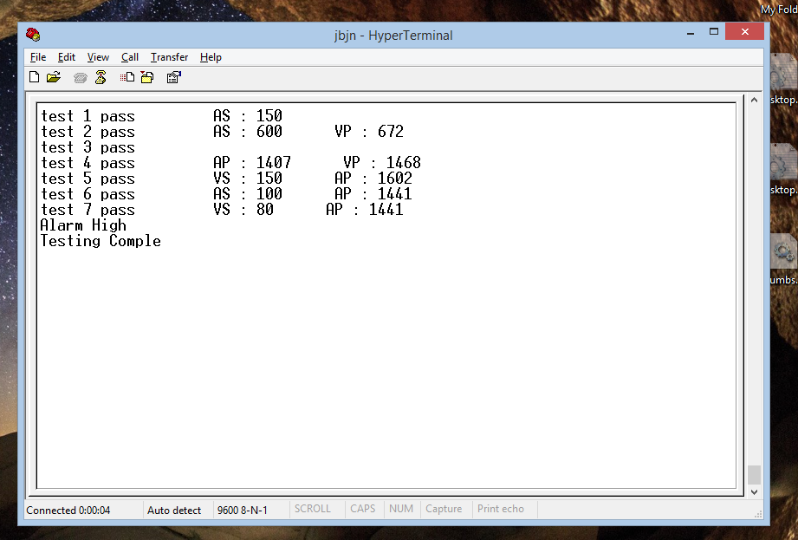
System Overview – Test
Team 6

Slide 12
Assurance Case Methodology
Team 6
To support the main goal three sub goals were defined.
The model satisfies all the desired properties
The code generation process transforms the model into the code correctly
The synthesized code satisfies all the desired properties with the timing tolerance

Slide 13
Assurance Cases Covered
Team 6
The model and the system are deadlock free
The model and the system satisfy
LRI Constraint
AVI Constraint
URI Constraint
PVARP Constraint
VRP Constraint
LED
Display
Alarm

Slide 14
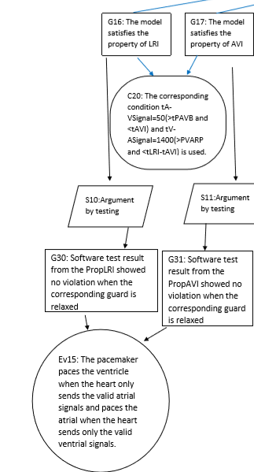
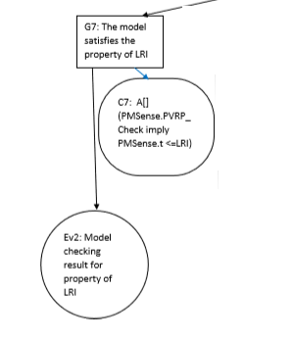
Assurance case - LRI
Team 6

Slide 15
Demo
Team 8

