Slide 1


Welcome to GitHub!
GitHub is the easiest way to manage and share code.
by Harshit Mishra

Slide 2

What is GitHub?
Google Drive for Code
Time Machine
Collaboration Hub
Stores your work online.
Tracks every change.
Work with teams easily.
Used by beginners, students, and big tech companies.

Slide 3


Why Use GitHub?
1
Personal Project
Easy and safe to store your personal projects.
2
Team Projects
Developers working together efficiently.
3
Learning and Sharing
Explore & contribute to millions of projects.
4
Keeping Backups
Your work is safe, even if your computer crashes.

Slide 4
Installing Git & GitHub
Download Git
1
Get the latest version from git-scm.com.
2
Install Git
Run the installer and follow the prompts.
Set up Identity
3
Configure username & email in the terminal:
git config --global user.name "Your Name"
git config --global user.email "your@email.com"
Sign up
4
Create an account at github.com.
For a simpler experience, install GitHub Desktop.

Slide 5






How GitHub Works
Create a Repository
Make Changes
Upload (Push)
Download (Pull)
Collaborate and merge changes without confusion.

Slide 6

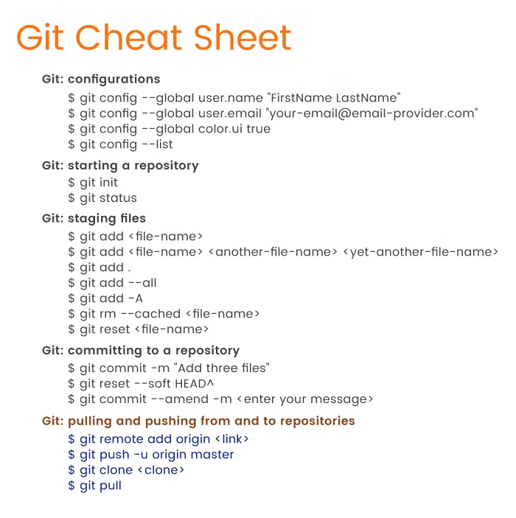
Basic Git & GitHub Commands
git init git clone <repo_URL> git add . git commit -m "Added feature" git push origin main git pull origin main
Start a project, download, track, save, upload, and update.

Slide 7
Key Features of GitHub
Repositories
Branches
Pull Requests
Issues
Store and manage your project.
Work on features without affecting the main project.
Suggest and review changes before merging.
Report and track bugs.

Slide 8




GitHub in Real Life
1
Portfolio Building
2
Software Development
3
Open-Source
4
Student Projects
Share assignments, improve global projects, and impress employers.

