Slide 1
Touristo
Rajasthan Hackathon 2018
tourism safety App
By:
Prakash Kumar Abhinas Mishra Atul Prajapati Sanjay Kesharvani

Slide 2
introduction
Safety and security are vital to provide quality in tourism.
The success or failure of a tourist destination depends on whether it's being able to provide safe and secure environment for the visitors.
It is important how the tourist place is being monitored and maintained.

Slide 3
Modules
TYPES OF PROBLEM FACED BY TOURIST
Hygiene
Transportation
Beggar
Women safety
Accommodation
Language problems
Cultural problems
Miscellaneous

Slide 4
hygiene
Problem
Unhygienic food, water or surroundings make them sick and can force them to spend more of their time in bathroom or bed rather than enjoying.
Availability of clean food, water, sanitation should be taken care of making it comfortable for both us as well as for tourists. The app has places which are rated by other tourist itself ensuring the sanity
Solution

Slide 5
transportation
Problem
Lack of public transportation and traffic jams are major issues in many tourist destinations. Overcharging or gaining extra fare than the fair prices by the shopkeepers or the taxi drivers are common.
The app shows the exact distance between the source and destination location and calculates the fare for the ride depending on the vehicle used.
Solution

Slide 6
Women safety
Problem
There are some spots where safety is a big issue like theft and pickpocket zone. Tourist should have a idea about such places and must act smart.
The app has a list of locations where safety should be taken.
It also shows solutions on which aspect safety should be taken.
Solution

Slide 7
beggar
Problem
In metro cities and rush areas there are lots of problems of beggars being large nos. near pedestrian crossings. Many times they force tourist to give money.
The app has a list of locations where safety should be taken.
It also shows solutions on which aspect safety should be taken.
Solution

Slide 8
accommodation
Problem
Different ranks of hotels and tourism facilities according to the financial abilities of tourists are a very important factor in tourism development. Due to lack of such facility a numbers of tourists have problems of availability of hotels at a cheaper rate and this causes many tourists to have a very short stay
The app provides information of all places available at the point of time.
It provides the information of the places which are verified and reviewed by other tourists. App has filter which enables user to search from range of hotels and inns.
Solution

Slide 9
Language problems
Problem
Different language led to miscommunication. Even though English is widely spoken and understood in India but still there are many who cannot understand this language. This makes them uneasy and even if they can speak but due to their different accent and regional impact on their language can also lead to miscommunication.
Our app refers one of the top language apps over PLAYSTORE and APPLE APP store.
Solution

Slide 10
Cultural problems
Problem
When people travel to new destinations/unknown places they have to face many cultural differences with reference to their own culture. This make them feel uncomfortable to live in harmony with the locals.
Depending upon the location they have chosen we would provide them with list of best cultural practices for the particular area. This would make sure they enjoy the company of the locals
Solution

Slide 11
miscellaneous
Problem
There will be some frauds as well. There are many frauds in India who try to rob, steal, or cheat the tourists.
Always go for the official guide, for whom you have to pay at the counter of the attraction. Be alert and careful of your belongings.
Solution

Slide 12
tips
This section would comprise of latest updates regarding any trends that occur during specified period of the visit.
This will keep the tourist updated of the latest happenings and react accordingly to be comfortable and enjoy the trip

Slide 13
Photo gallery
The app has a dedicated photo gallery depending on various places around and the various issues mentioned.
The photos can be filtered depending upon various parameters like popular and newest

Slide 14
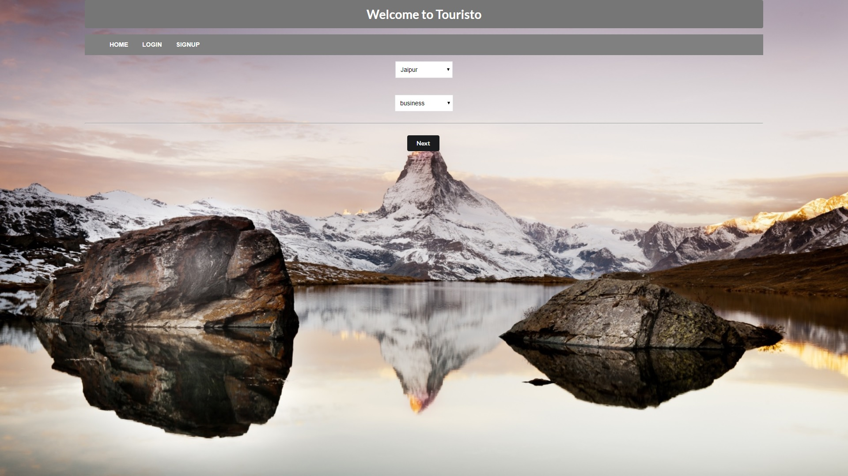
Prototype
homepage

Slide 15
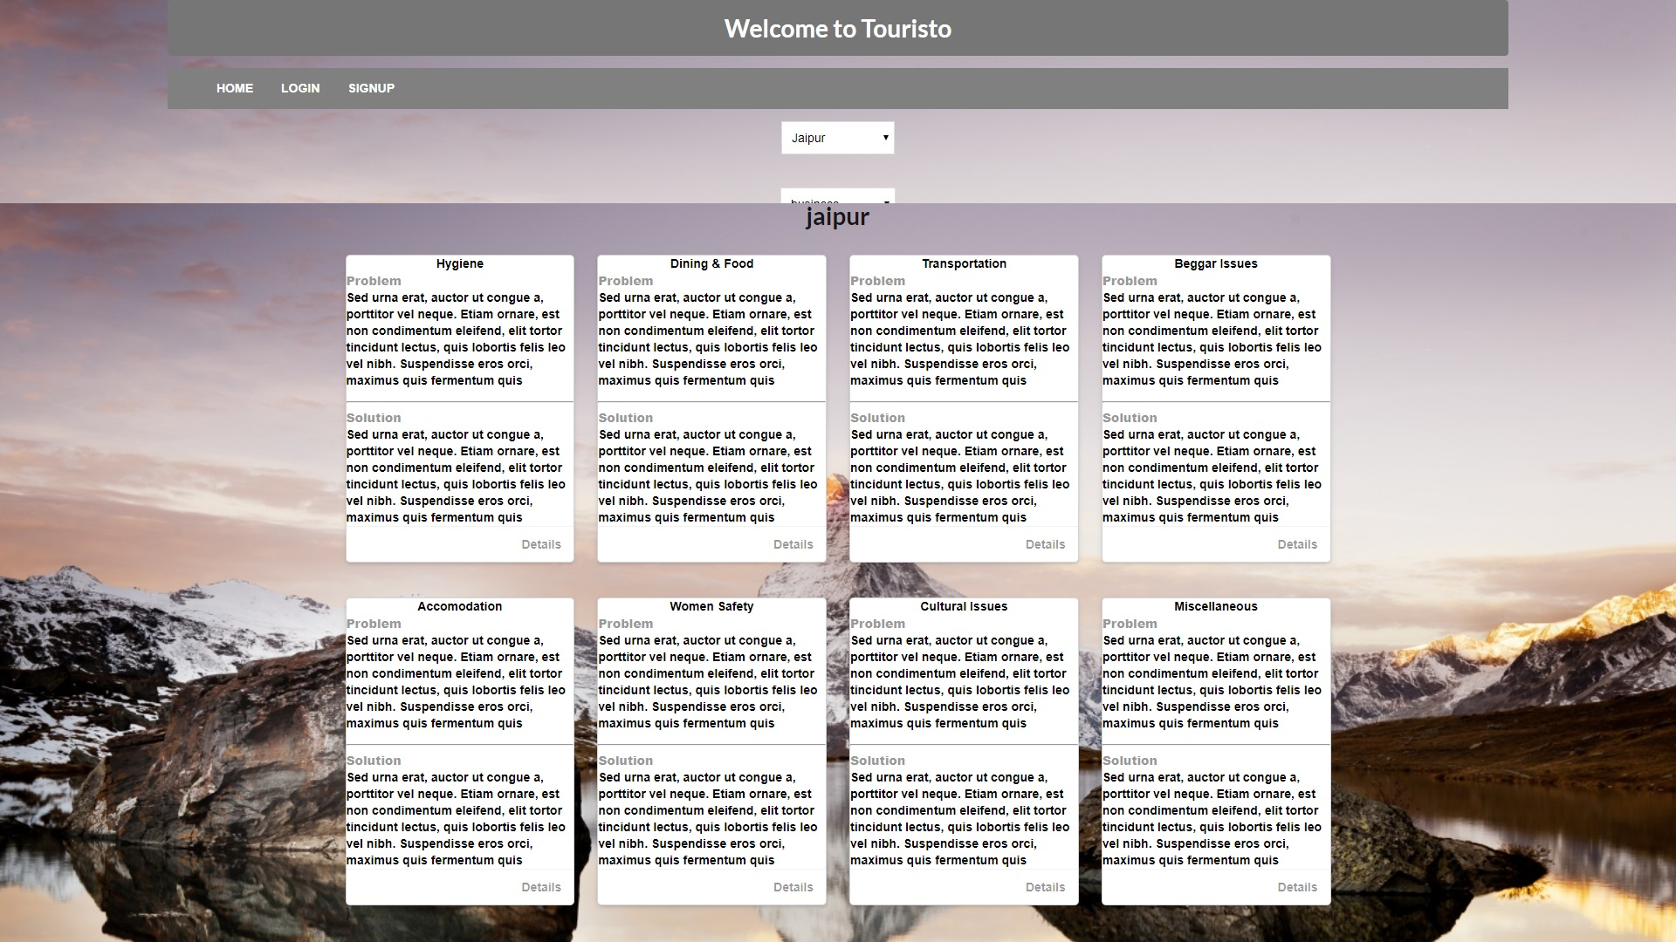
Prototype
Issue Type Page

Slide 16
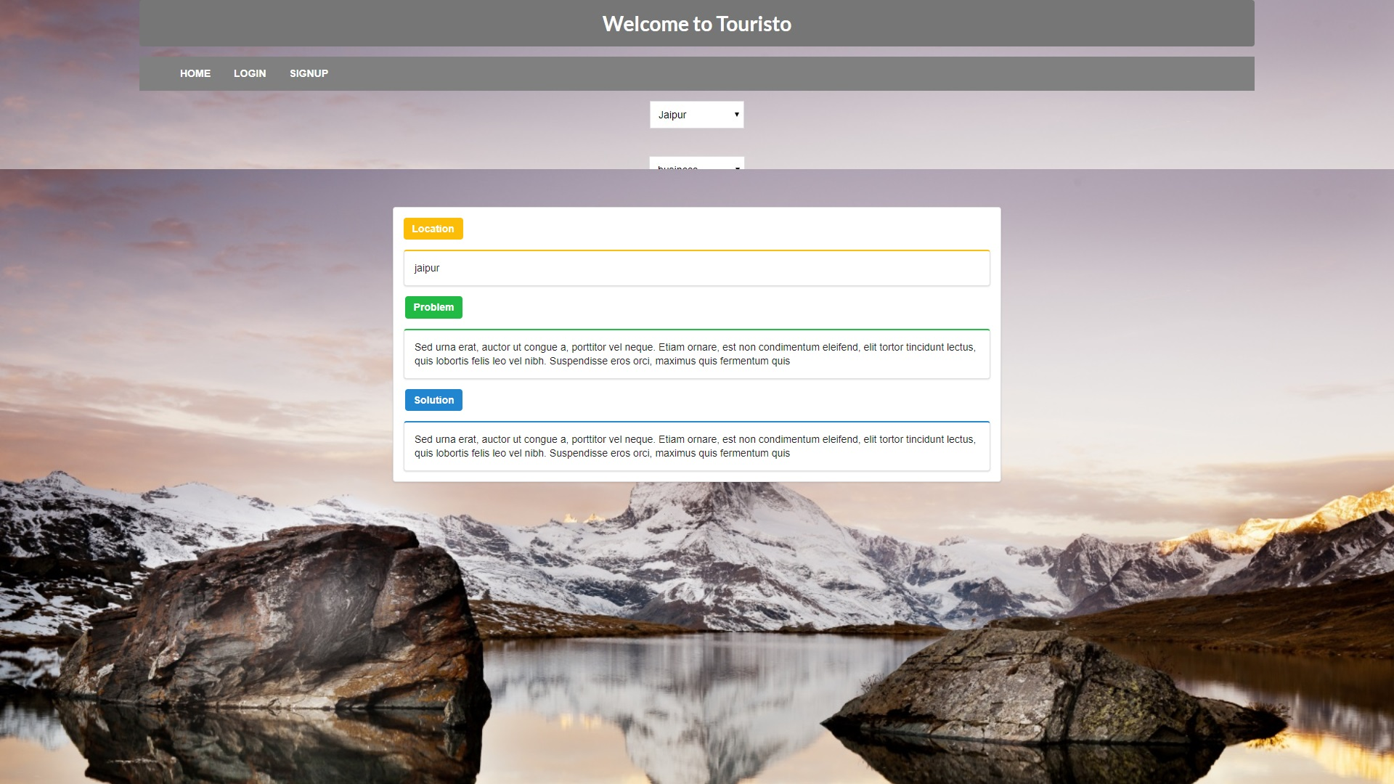
Prototype
Problem and Search page

Slide 17
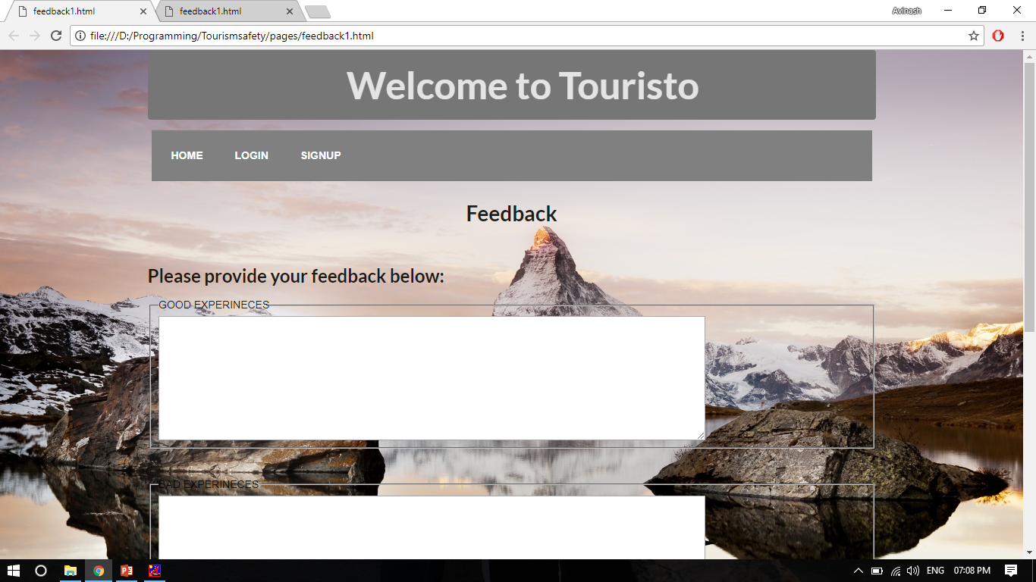
Prototype
Main feedback page

Slide 18
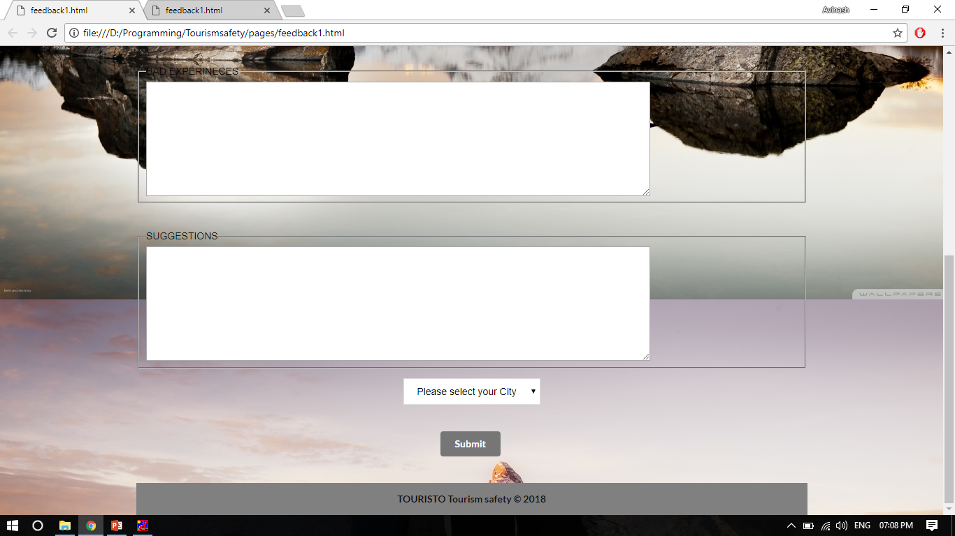
Prototype
Short feedback page

Slide 19
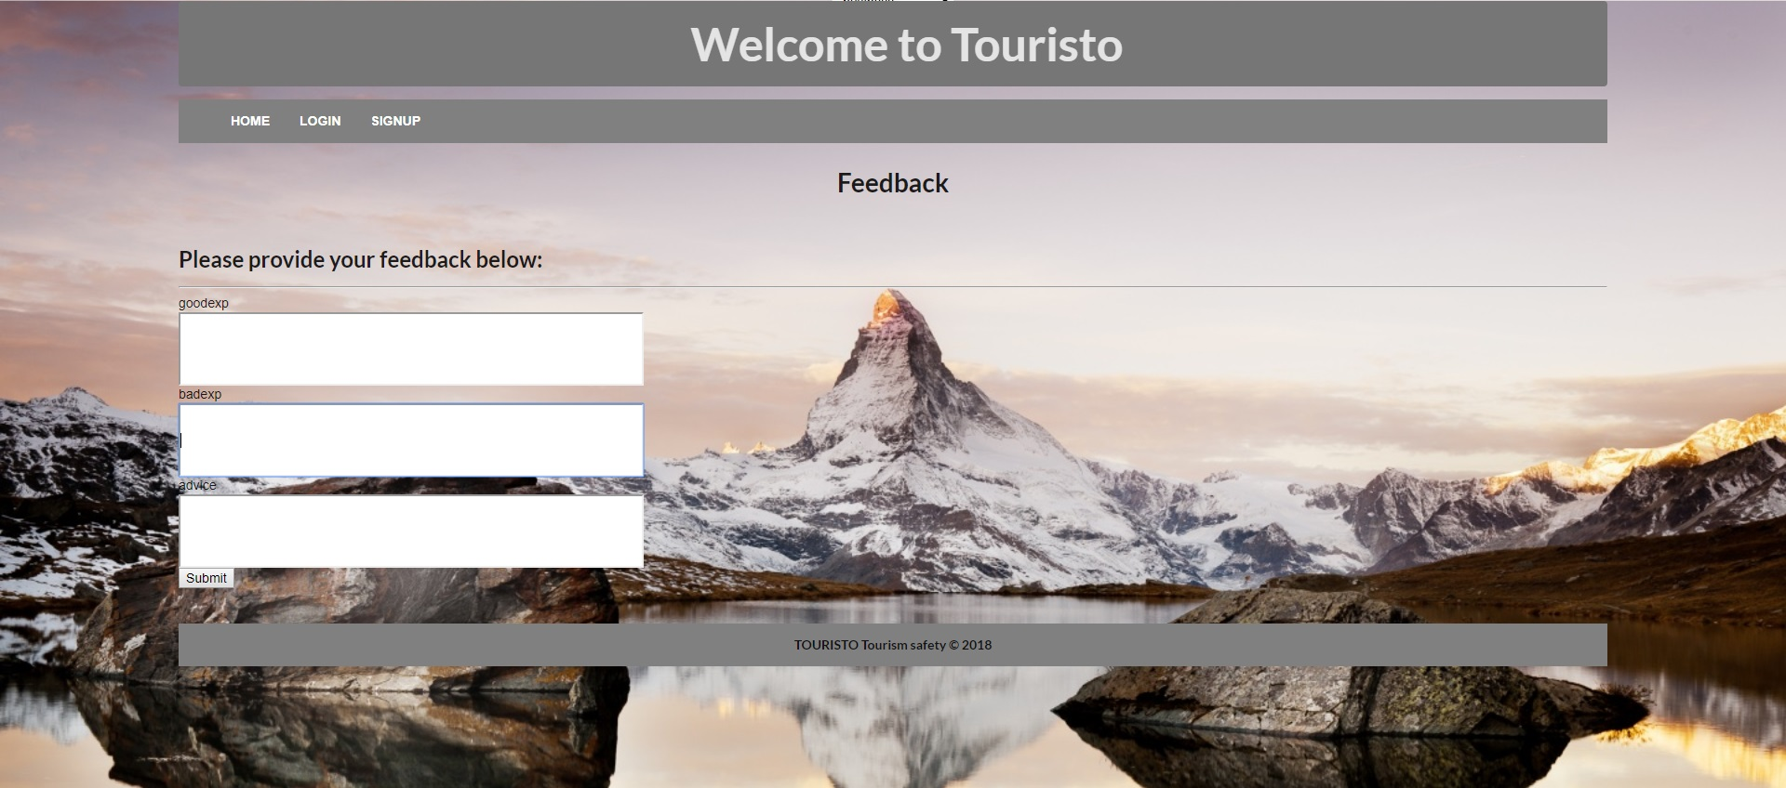
Prototype
Short feedback page

Slide 20
Conclusion
This is an application developed for tourist.
When a person visits a particular place, s/he selects the destination and purpose of visit.
Based on the selection the application will show various issues and solutions unique to that place and purpose.
The main categories are hygiene, women safety, transportation etc. then the user can view in detail issue and solution to particular problem.
Also we have feedback and review system where only tourist can upload data which would help other tourist to properly plan a visit to his/her destination.

