Slide 1
Generate automation test report using Karate DSL (BDD) framework
DSG Team

Slide 2


My Idea is…
Title: | Generate automation test report using Karate DSL (BDD) framework
Idea Type: | Incremental Innovation
Idea Description: | Use karate framework for the automation test report generation. It will generate detailed end to end test report for each passed/failed scenario with execution time.
Benefits: (in terms of money, effort or user experience) | Test report would be more informative, interactive & easy to understand for everyone(Technical or Non technical both) It will reduce Dev/QA's effort & time both(depending on issues), because this report contains detailed information about Passed/Failed test cases for each Apps. So we can easily detect the cause for failure & DEV team can take immediate action. i.e.- Jolt end point update, SAPPI end point update, Qlab02/Plab01 True Up & Basic sanity etc. 3. Easy to write & understand test cases, because it will not create any dependency on language expertise(Java/Tibco etc). As this is the BDD framework, so it uses Gherkin keywork(i.e.- Feature, Scenario, Given, When, Then etc) & test case will be written in .feature files.
Applicable To: (project, vertical, global) | All Project
Owned By: | DSG-Charge-Devesh
Note: Add slides to this presentation to provide details about the idea. Having a proof of concept/working model to demonstrate would be an added advantage.

Slide 3
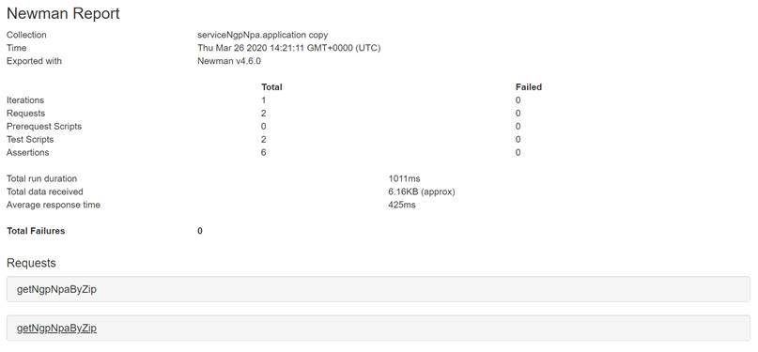
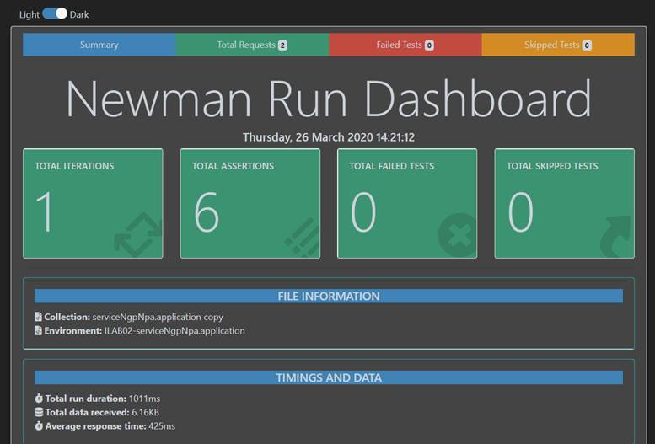
Current Scenarios
Automation test report is being generated through Newman Script currently.
1. Generating postman collection using Auto.exe file and SOAP UI to write the scenario.
2. This report is being generated for each app individually.
Notes:
Bill

Slide 4
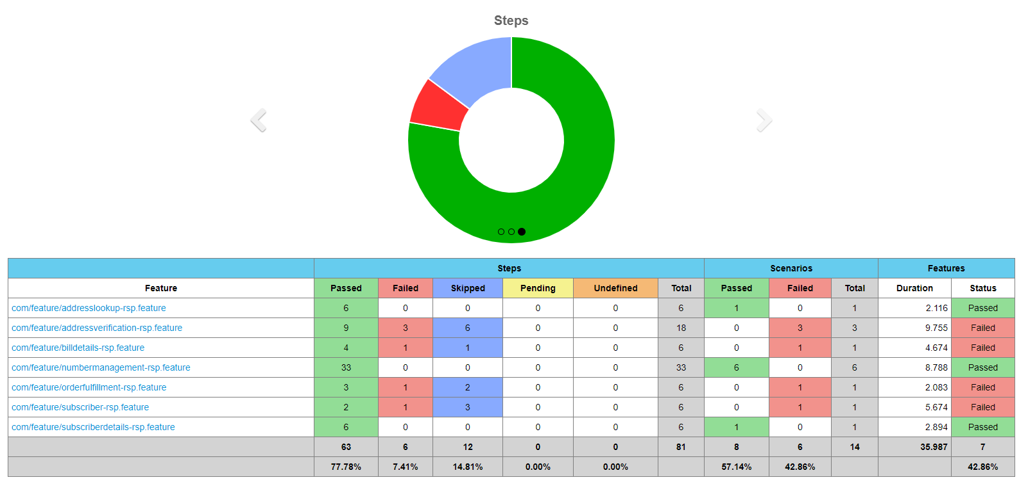
Proposed Scenarios
Karate DSL framework to generate the automation test report
Notes:
Bill

Slide 5
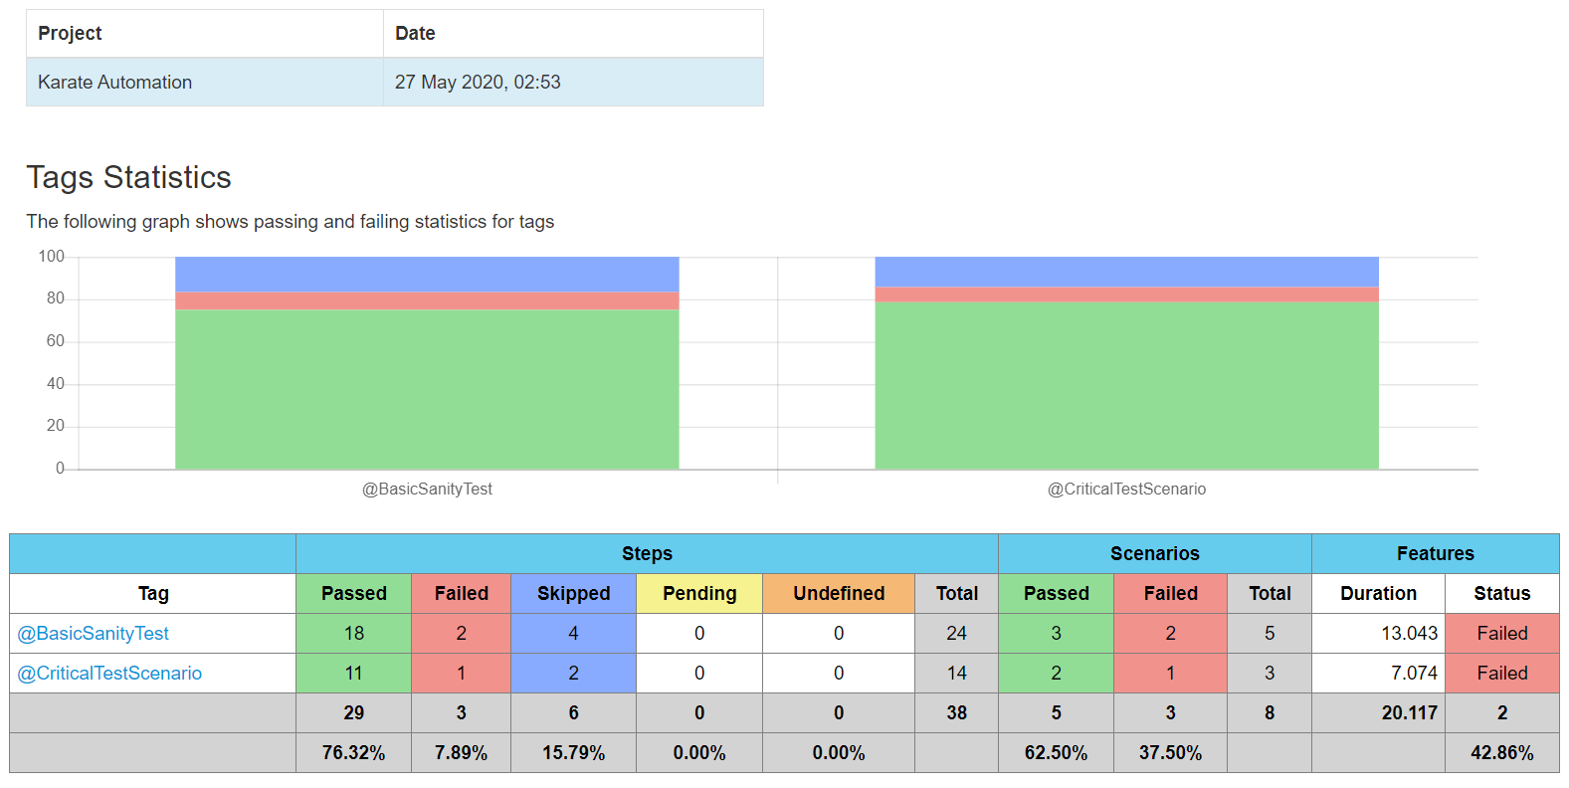
Proposed Scenarios
Notes:
Bill

Slide 6
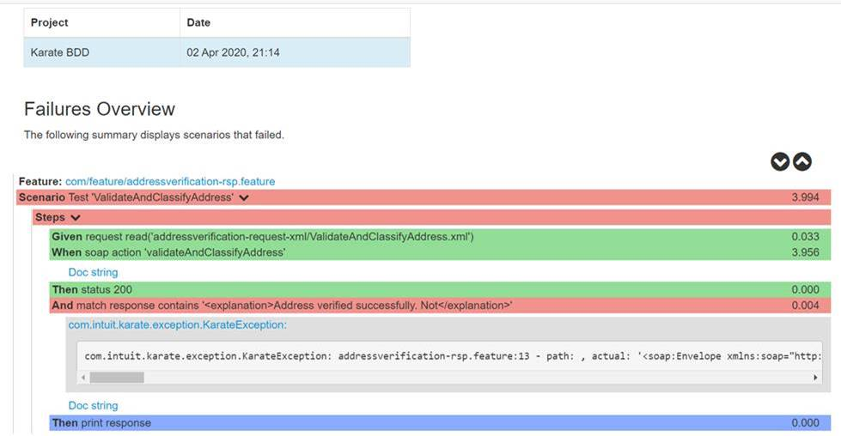
Proposed Scenarios
Notes:
Bill

Slide 7
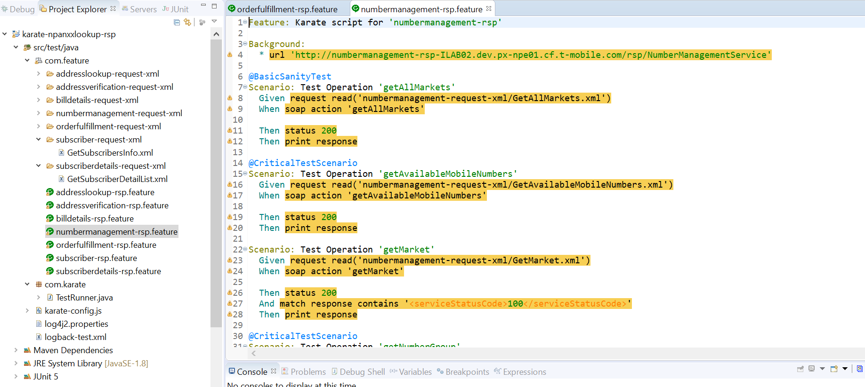
Test Case
Notes:
Bill

Slide 8

Q & A

