Slide 1


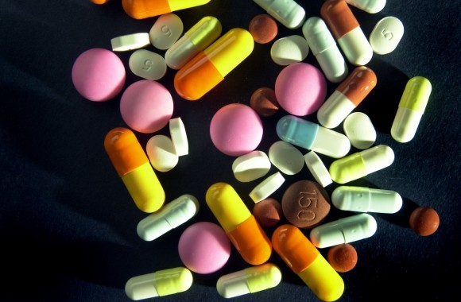
Medline Search Engine
Harnessing Big Data & Analytics for Medical Information Retrieval
CIS 612 - Big Data and Para Database Systems
Guided by – Sunnie S. Chung, Ph.D.

Slide 2
MEET OUR TEAM
Sushma Avala - 2885387
Dinky Mishra – 2864923
Aditya Sairam Pullabhatla – 2863159
Alim Khan Abdul – 2882808

Slide 3

Introduction:
Goal : Develop a scalable and intelligent search engine for medical information, leveraging information retrieval techniques learnt from class.
Objective : Implement advanced NLP techniques (e.g., TF-IDF, Cosine Similarity) for precise search matching, and create a user-friendly platform for real-time medical data retrieval.

Slide 4
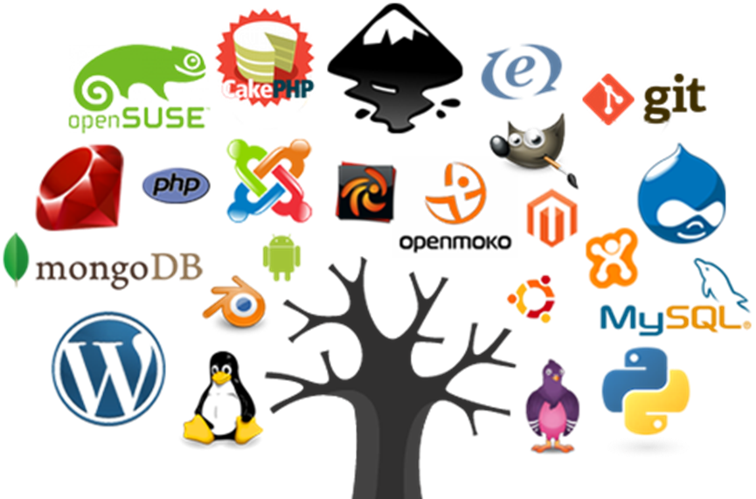
Tools and Technologies:
Frontend Development - Next.js
Backend Development - Next.js
Database Management - MongoDB, MySQL
Web Scraping - Puppeteer
Natural Language Processing (NLP) - Pluralize, Lemmatizer, Stem-Porter
Performance Optimization- Batched database operations

Slide 5
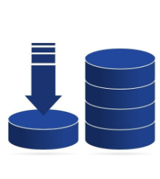
Knowledge Base and Database Design
Optimized for Efficient Data Management
MongoDB for Raw Data Facilitates storage of unprocessed HTML and metadata for backup and initial processing. | MySQL for Structured Data Hosts cleaned articles, term Frequencies and Inverted Index for quick retrieval.
Inverted Index Optimization Enhances search efficiency by mapping terms to relevant documents with TF-IDF scores. | Schema Flexibility Designed to scale and accommodate expanding datasets seamlessly.

Slide 6
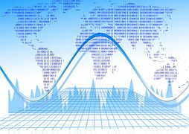
Data Collection Process
Gathering Raw Medical Data
Automates Scraping
Node.js and Puppeteer used to scrape 4500 articles.
Raw Data Storage
Articles stored as HTML in MongoDB for reliability.
Scalable and Repeatable
System designed for efficient and repeatable scraping

Slide 7
Data Validation
Ensure Data Integrity :
Data Validation : Cross-referenced scraped articles with source counts.
Duplicate Removal : Ensured unique entries by identifying and removing duplicates.
Content Accuracy :Verifies and cleaned content for relevance and consistency.

Slide 8
HTML Content Cleaning
Eliminated unnecessary HTML elements (e.g., <script>, <style>).
Ad and Navigation Removal: Filtered out irrelevant content such as ads and links.
Identified xPaths containing medically relevant content and extracted all the necessary information.

Slide 9
Tokenization and Lemmatization
Breaking Down Cleaned Data
Tokenization: Split text into individual tokens (words) for analysis.
Lemmatization: Converted words to their base forms for consistency.
Stemming Comparison: Preferred over stemming to retain grammatical meaning.

Slide 10
Dataset Overview
Articles Scraped: ~4,500 medical articles from MedlinePlus Encyclopedia.
Terms Processed: Over 1.4 million terms indexed after preprocessing.
Comprehensive Coverage: Covers diseases, symptoms, treatments, and medications.

Slide 11
Ranking Algorithms
.
Algorithms | Purpose | Use Case
1.NLP techniques | Tokenization , Stemming , Lemmatization | Used for preprocessing abd normalizing the text .
2.TF-IDF (Vectorization) | Identifies important terms in a document within the dataset. | Finds terms most relevant the user’s query.
3.Cosine Similarity | Measures Similarity between query and document Vectors | Ranks documents by comparing vector angles.

Slide 12
Inverted Index
Inverted Index from scraped data. | Dynamic Query Inverted Index
A static inverted index built from Medline's 4,500 articles. Stores terms, term frequencies (TF), and document frequencies. | Generated during user query processing. Captures query term frequencies and builds a temporary index for matching.

Slide 13
Dictionary Table
Mapping Terms with Metadata
High-Level Indexing: Stores unique terms and their metadata for efficient lookups.
Fields in Dictionary Table: Term, Document Frequency (DF), Collection Frequency.
Purpose: Acts as an entry point for term-to-document mappings.

Slide 14
Posting Table
Storing Document-Level Term Details
Detailed Mappings: Maps terms to document IDs and metadata like term frequency (TF).
Fields in Posting Table: Document ID (DOC_ID), Term Frequency (TF), and optional positions.
Purpose: Facilitates document-level relevance computation and query matching.

Slide 15
Cosine Similarity
Query and Document Vectors: Built using TF-IDF weights for terms.
Similarity Calculation: Measures angle between query and document vectors.
Ranking Results: Scores determine the most relevant documents.

Slide 16
Implementation Workflow
User Interface
(Next.js Frontend)
Backend Server
(Next.js built-in routing system
Inverted Index
(MySQL)
Similarity Sources
(Cosine Similarity Calculation)
Frontend UI
Display Results

Slide 17
Challenges and Solutions
Challenges :
XPath Issues During Web Scraping:
Problem: Initially used XPaths failed to locate all content due to structural changes on the MedlinePlus website.
Cause: Content was located in additional, previously unconsidered classes.
Inefficient Database Query Execution:
Problem: Querying ~4,000 documents individually for each user query led to a response time of 60–75 minutes.
Cause: Lack of a consolidated query mechanism.
Resolutions :
Updated XPath Selectors:
Solution: Debugged and identified the correct classes, updating XPaths to capture all relevant data consistently.
Optimized Query Processing:
Solution: Introduced consolidated queries, retrieving all relevant data in a single database call.
Impact: Significantly reduced response time, enabling near real-time query results.

Slide 18
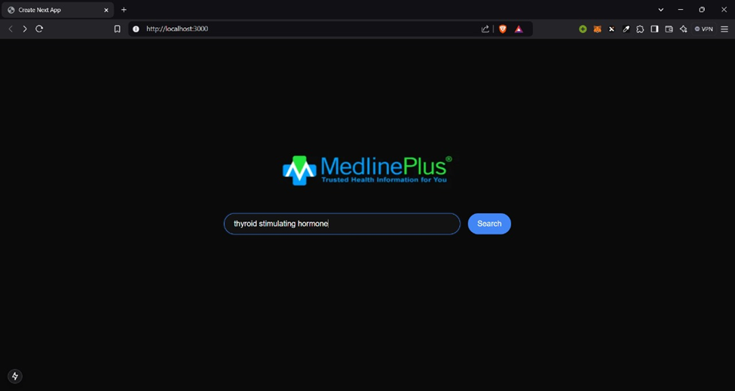
Results
Performance Metrics with a User-Centric Interface

Slide 19
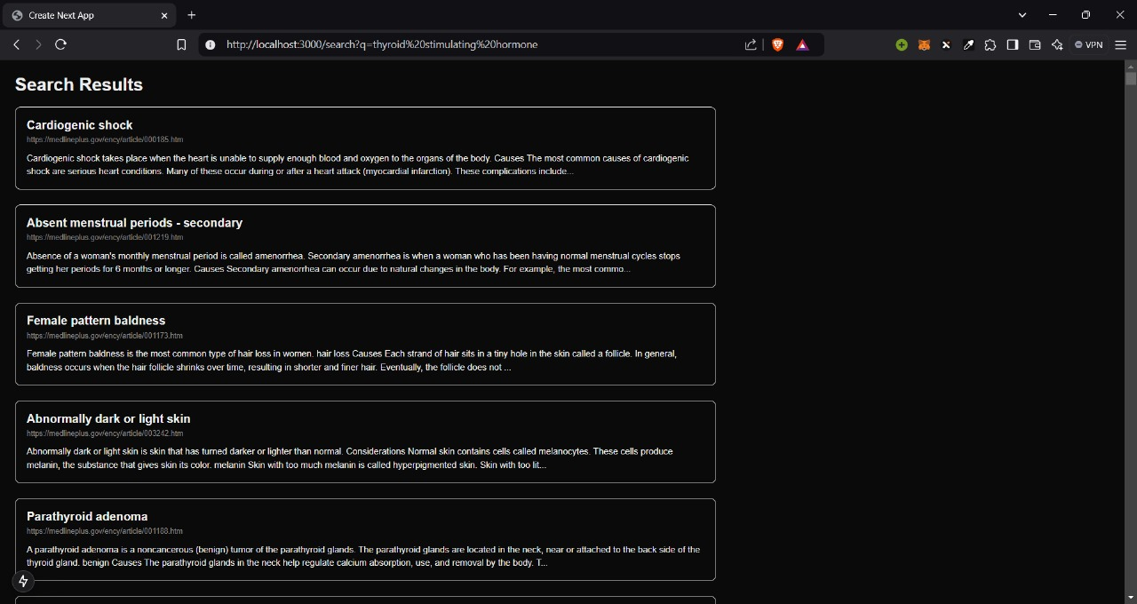
Results

Slide 20
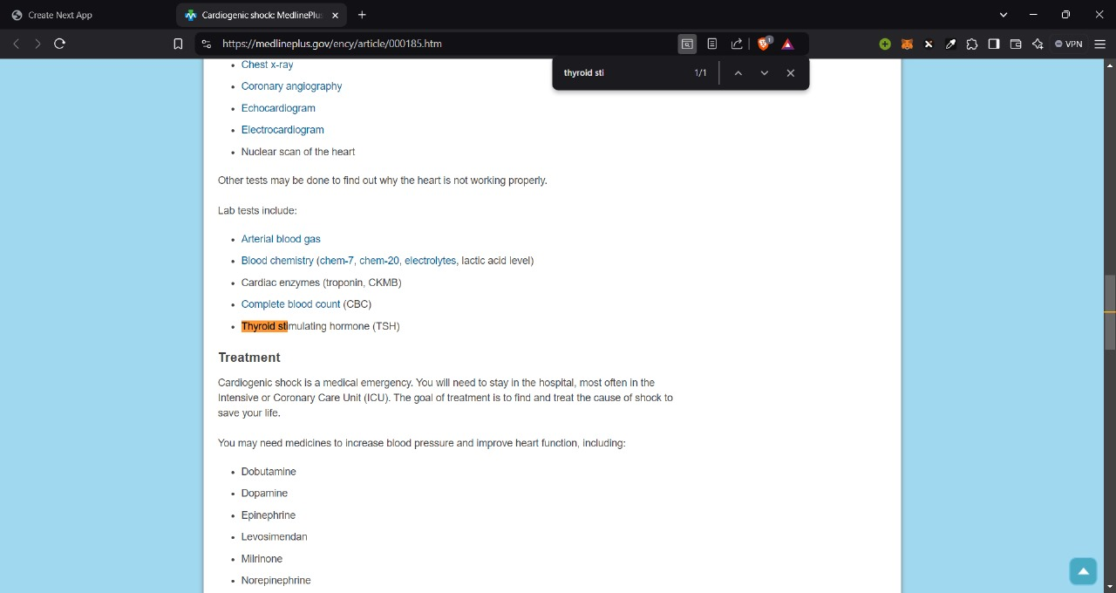
Results

Slide 21
Search Speed: 3-6 sec approx. for each search
Scalability: Designed to handle larger datasets with dynamic query indexing.

Slide 22
Conclusion
Key Takeaways
Project Achievements: Indexed ~4,500 articles with real-time search functionality. | Impact on Accessibility: Improved access to structured medical data with a user-friendly interface.
Future Directions: Potential for multilingual support and semantic search. | Final Remark: Showcased AI's potential in transforming medical data retrieval.

Slide 23

Any Questions ?

Slide 24
Thank you

