Slide 1
Packet Header Analysis
Presented by –
Dayanand Raut ( 20535010 )
Swapnil Naik ( 20535029 )
Sagar Gaur ( 20535023 )
Atul Sharma ( 20535007 )
Mithlesh Kumar Yadav ( 20535016 )
Sajal Chourasiya ( 20535024 )
Gaurash Mishra ( 20535013 )
Department of CSE
IIT Roorkee

Slide 2
Problem Statement
Given a file containing some packets captured (in C array format). Analyse the packets and determine all the fields in packet header like source/destination MAC, IP addresses, port numbers, different protocols used in different layers, etc.
The application should take C array format as input and display all the parameters as output. It should also display which are the most used protocols in different layers

Slide 3
Tools used
Wireshark –
Used for capturing the packets and exporting the captured packets in C array format.
C++ –
We have used C++ to develop application for analysing the packets captured from Wireshark.

Slide 4
Wireshark
It is a network packet analyser.
It is an open source software.
It can capture data from many different medias –
Ethernet , Wireless LAN , Bluetooth, USB , etc.
It provides a variety of ways for exporting packet data –
Plain text, C Arrays, CSV, PSML, JSON, PDML

Slide 5
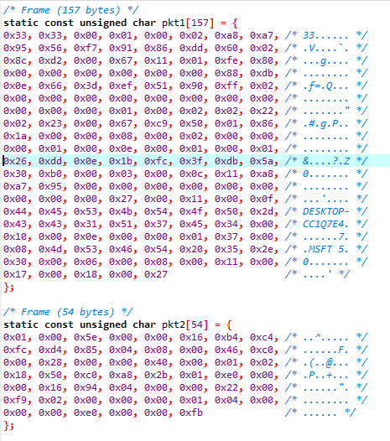
Analysis of C Packet
C array file contains the packet in different arrays. Like as shown in figure packets are captures and stored in character array.

Slide 6
C array Extraction and Summary
In a program, initially a C array file is parsed based on concept of opening and closing brackets.
Comments are ignored while parsing packets.
Summary -
Identifying Network layer protocols based on protocol field and ethernet type field and with custom list of protocols.
Identifying Transport layer protocols based on protocol field and custom list of protocols.
Identifying application layer protocols based on well-known ports.

Slide 7
Protocol Details
Protocol field in packet
Network Layer protocols used - ICMP,IGMP,DDP,IPv6-ICMP,IPv6-NoNxt,EGP,EIGRP,IPX-in-IP,OSPF,PIM,….
Transport Layer protocols used - TCP,UDP,DCCP,FC,IL,RDP,SCTP,TCP,UDP,UDPLite
A file contains all protocols type which can be present in protocol field of the captured packet. In program It gets stored as hex code, decimal representation and then followed by content of protocol field name.
0x01 1 ICMP, 0x02 2 IGMP, 0x03 3 GGP, 0x04 4 IP-in-IP, 0x05 5 ST, 0x06 6 TCP, …....
Also a file contains list of all application protocols and their respective ports.
1,TCP Port Service Multiplexer (TCPMUX); 5,Remote Job Entry (RJE); 7,ECHO; 18,Message Send Protocol (MSP); 20,FTP – Data; 21,FTP – Control, 22 ; SSH Remote Login Protocol, ….....

Slide 8
Check ARP ,IPV4 and IPV6
Based on EtherType(hex) we can analyse whether the packet is ARP or IPV4 or IPV6.
For ARP packet EherType(hex) value is 0806
For IPV4 packet EherType(hex) value is 0800
For IPV6 packet EherType(hex) value is 86dd

Slide 9
Analysis of fields of ipv4 captured frame.
Field Name | Byte position
Ethernet
Destination mac | 0-5
Source mac | 6-11
Type | 12-13
IP
Version | 14th first nibble

Slide 10
Header length | (14th second nibble) * 4
Source address | 26-29
Destination address | 30-33
Flags | 20
Fragment Offset | 20-21
TTL | 22
Protocol | 23
Total Length | 16-17
UDP / TCP
Source port | 34-35
Destination port | 36-37
Length | 38-39

Slide 11
Analysis of fields of IPV6 captured frames
IP
Version | 14th first nibble
Priority | 14th second nibble and 15th first nibble
Flow label | 15th second nibble and 16-17
Payload Length | 18-19
Next Header | 20
Hop Limit | 21
Source address | 22-37
Destination address | 38-53
TCP/UDP
Source Port | 54-55
Destination Port | 56-57
Length | 58-59

Slide 12
Analysis of fields of ARP captured frames
ARP Packet is identified by type field. Its value is 0806.
Length of ARP Packet is 42 Bytes
Field | Byte Positions
Destination Mac | 0-5
Source Mac | 6-11
Type | 12-13
Hardware type | 14-15
Protocol type | 16-17
Hardware size | 18
Protocol Size | 19
Opcode | 20-21
Sender IP Address | 28-31
Destination IP Address | 38-41

Slide 13
Conclusion
As a part of this project, packets were captured using Wireshark and exported to c array file. The file was parsed in C++ and various fields were analyzed from each packet. The results of analysis were displayed. Finally, the overall summary was prepared to show the different protocols used in different layers and most commonly used protocols were identified.
After analyzing various packets, we found that at various layers following protocols were most frequently used:
Application Layer : https
Transport Layer : TCP
Network Layer : IPv4
Data Link Layer : Ethernet

Slide 14
References
https://www.iana.org/assignments/protocol-numbers/protocol-numbers.xml
https://en.wikipedia.org/wiki/Transport_layer
https://en.wikipedia.org/wiki/Network_layer
https://blog.packet-foo.com/2015/01/determining-network-protocols/ https://www.howtogeek.com/104278/how-to-use-wireshark-to-capture-filter-and-inspect-packets/

Slide 15
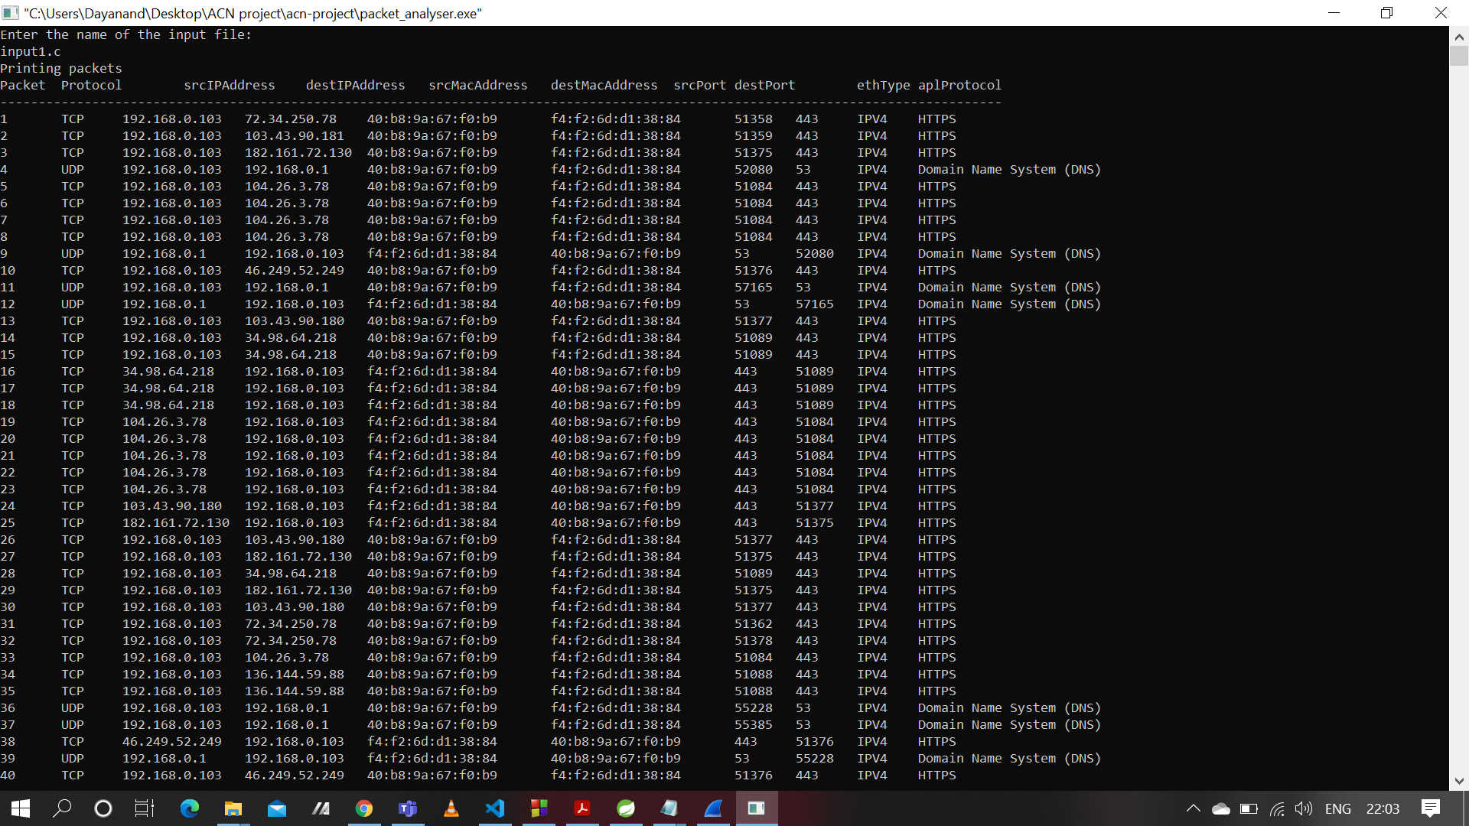
Outputs

Slide 16
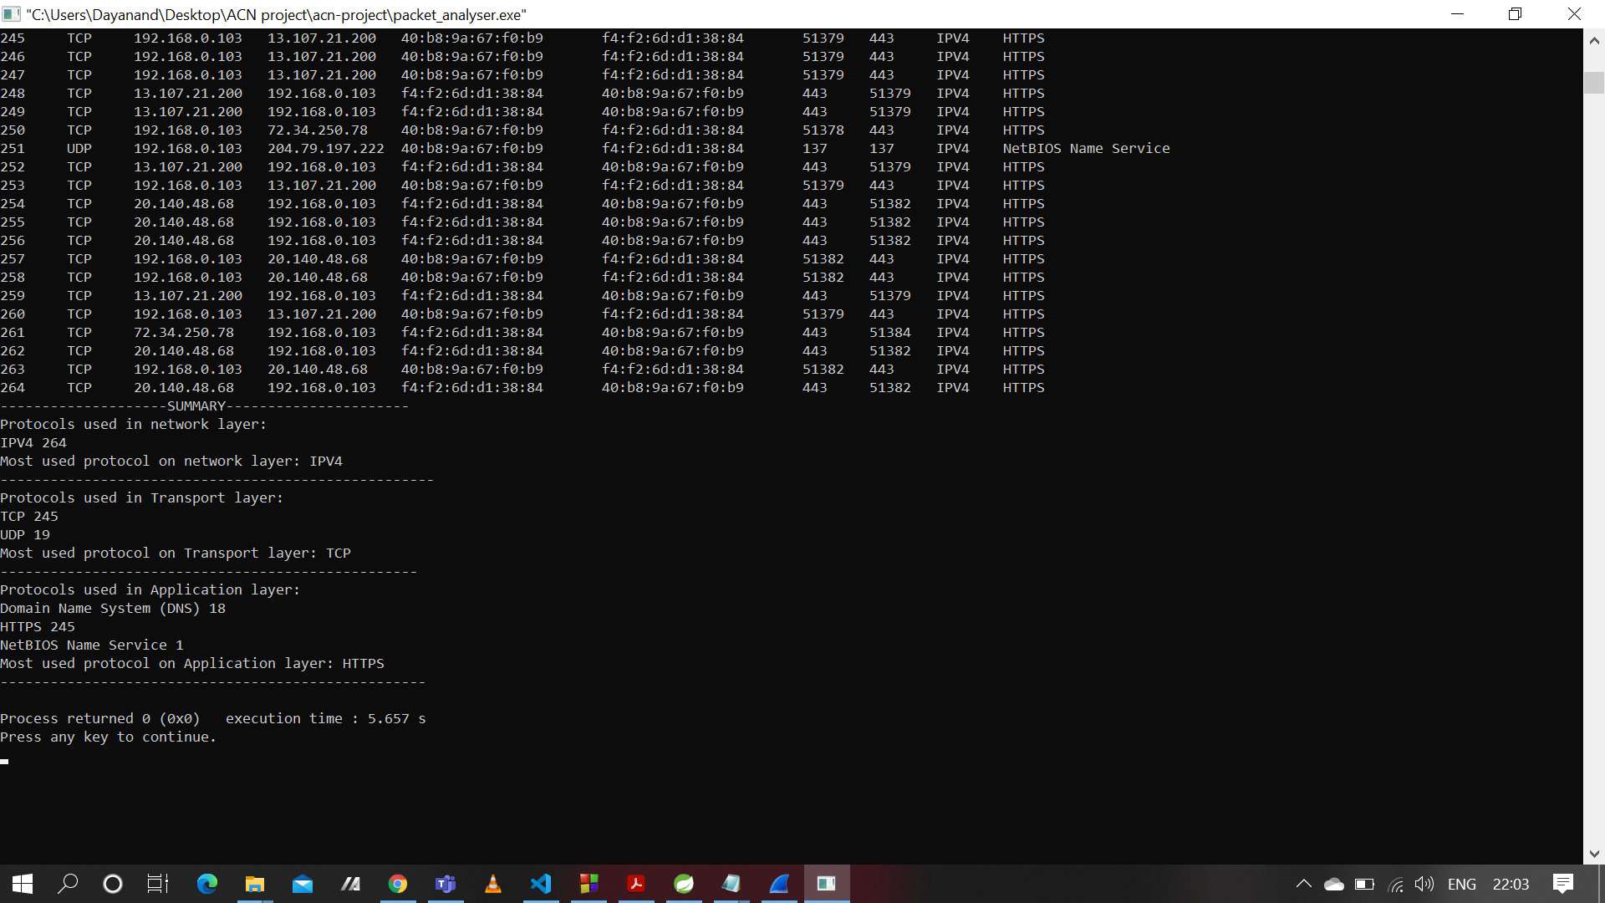

Slide 17
Thank You

