Slide 1

College of Technology (01)
Silver Oak College of Engineering and Technology
Bachelor of Technology
Department of Computer Engineering (04)
VIGILANCE 360
Group Members
Payal Rajput | 200103061007 | Nish Shah | 210133062011
Diya Patel | 200103062021 | Riya Mishra | 210133061003
Dhruv Gor | 200103062014 | Rahul Kothari | 210133061002
Gaurav Sharma | 200103062029 | Shruti Kharate | 200103062016
Kavisha Patel | 210133061004
Internal Faculty Guide : Prof. Sanket Shah

Slide 2
Table of Content
Abstract
Introduction
Literature Survey/Research
Study of Current System
Problems/Weakness/Improvement needed in Current System
Features of Proposed System
Object Oriented Diagrams (Sequence and Flow chat)
Wireframe (if applicable)
Tools and Technologies used
System Flow with Experiment Results
Implementation
Timeline Chart(Gantt chart)
Future Work & Conclusion
References

Slide 3
Abstract
The “VIGILANCE 360" is a comprehensive solution to address security threats in Automated Teller Machines(ATM), focus on pre-incident detection, identifying individuals attempting entry with covered faces. It uses dual-camera surveillance to detect unauthorized entry. The system detects individuals carrying harmful tools or heavy metals. Occupancy monitoring, another use-case of the system, helps maintain a safe environment, and a user-specific session duration enhances operational efficiency. ATM Environment integrates pre-incident detection and occupancy management to provide a robust solution against diverse security threats. This system ensures a secure and protected ATM environment.

Slide 4
Introduction
The Vigilance 360 project represents a groundbreaking advancement in ATM security, designed to fortify the safety measures surrounding Automated Teller Machines. By leveraging state-of-the-art dual-camera surveillance technology, this innovative system targets potential security threats proactively.
Vigilance 360 also offers real-time occupancy monitoring to ensure a secure and safe environment for ATM users. Additionally, it optimizes operational efficiency by implementing user-specific session durations, thereby creating a secure and protected ATM environment that prioritizes both safety and efficiency.

Slide 5
Object Oriented Diagrams

Slide 6
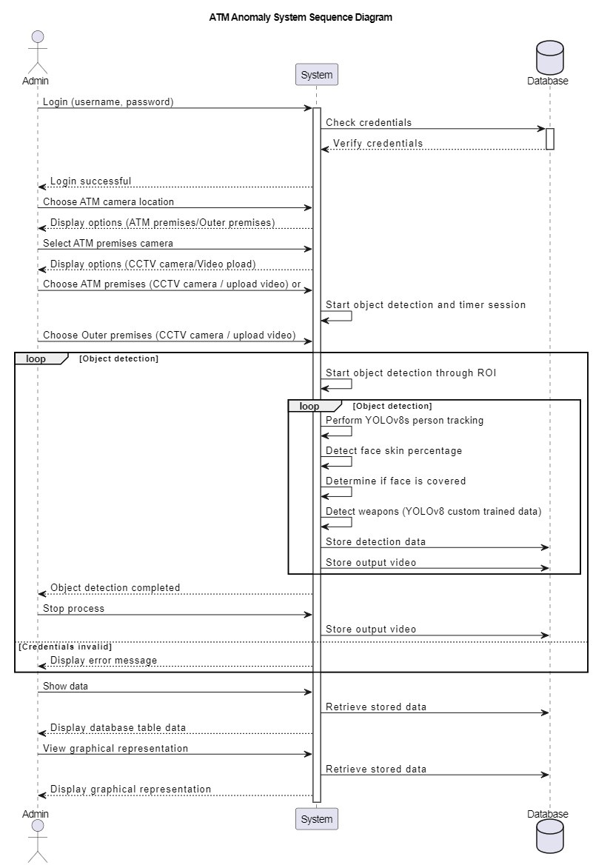
Sequential diagram

Slide 7
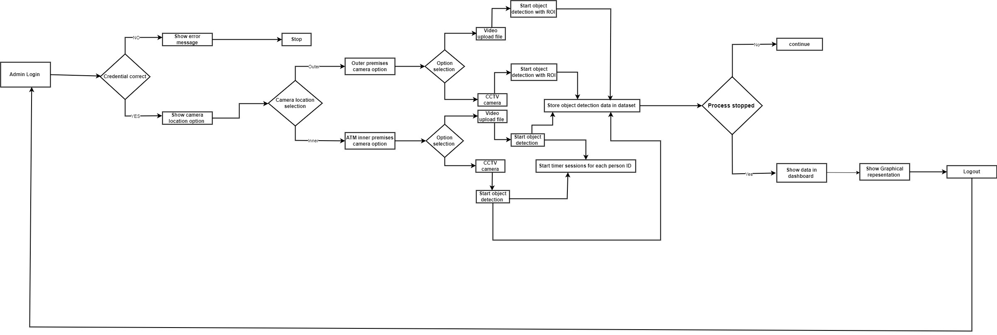
Flow chart

Slide 8
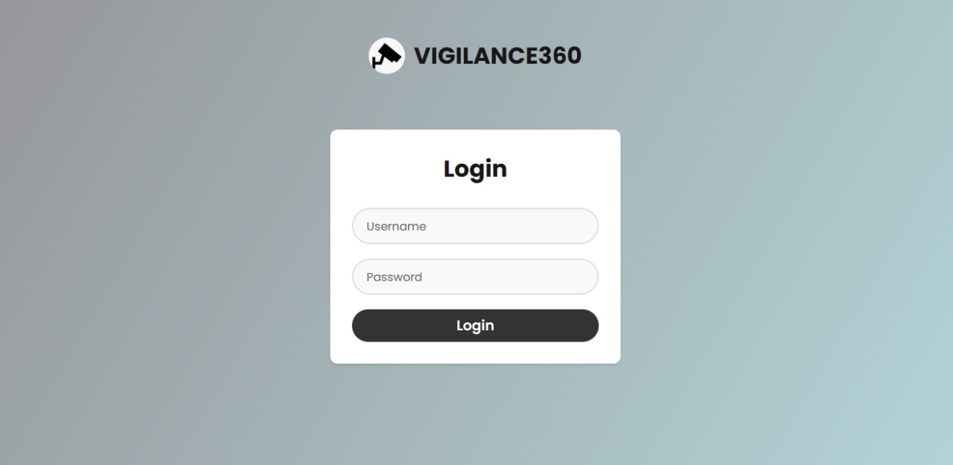
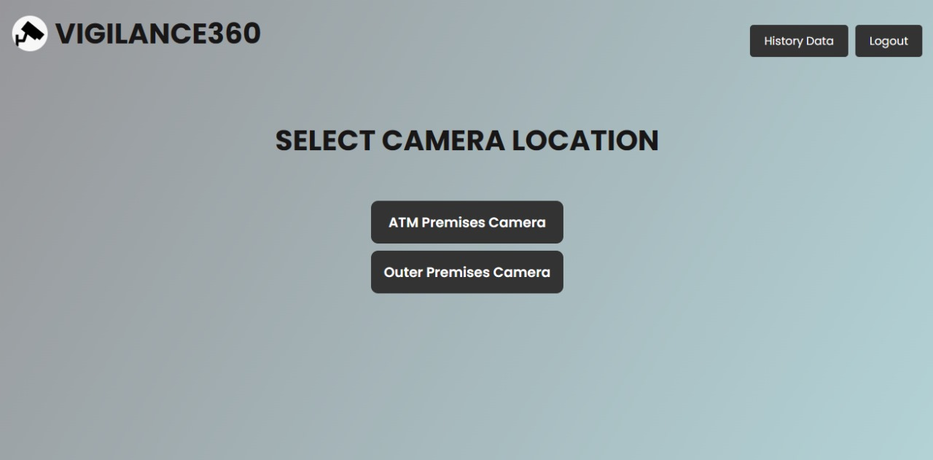
Dashboard
Log-in page
Source page

Slide 9

Dashboard
Video Upload Page

Slide 10







Tools & Technologies used
Front End
Back End/ Database
Detection
HTML
Flask
Yolov8
CSS
MySQL
MediaPipe
JavaScript

Slide 11
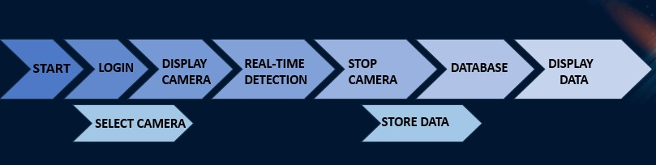
System Flow

Slide 12
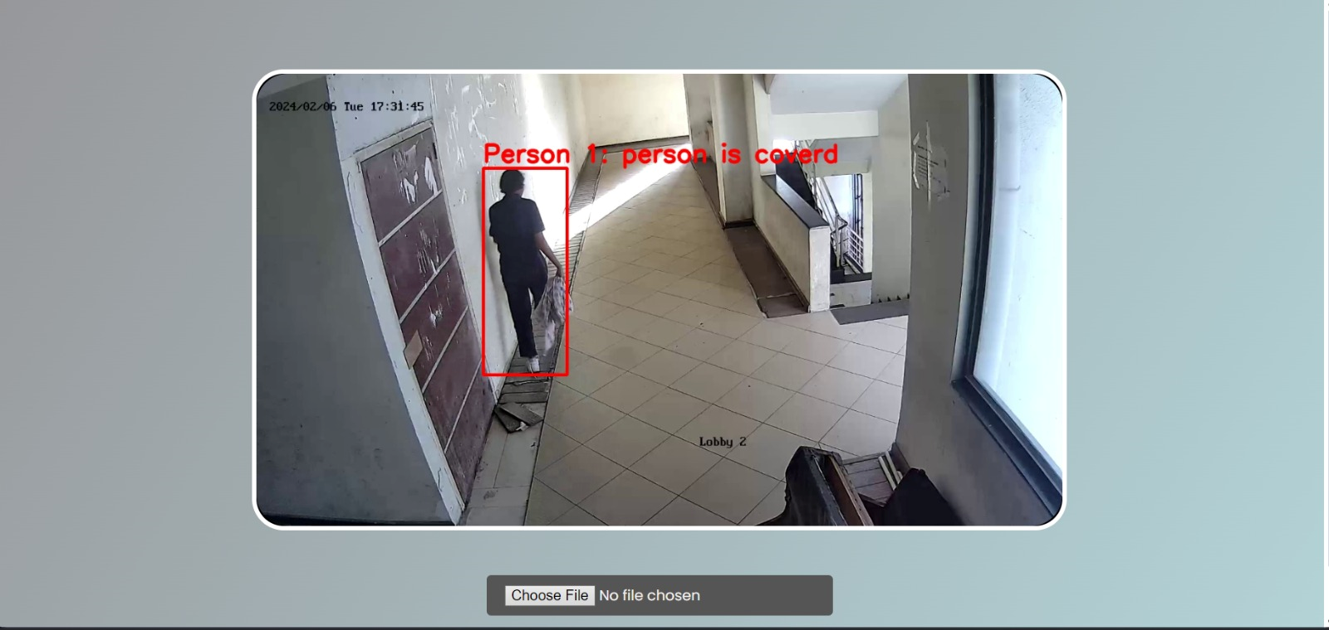
Experiment Results
Case 1: As observed, a person with covered face, carrying visible weapon-like rod is approaching the ATM, intending to enter for performing suspicious activity. The model installed takes the live feed from the outer camera and processes it to detect the same. The following is the output on the dashboard after detection.

Slide 13
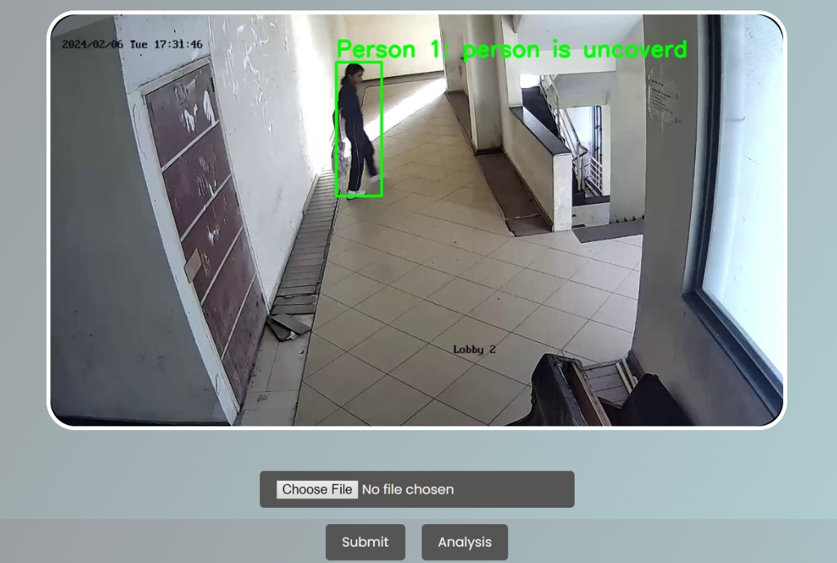
Experiment Results
Case 2: As observed, a non-suspicious, uncovered faced person approaches ATM. The installed model intakes live streams from outer/inner cameras and performs detection accordingly and output table is displayed on dashboard.

Slide 14
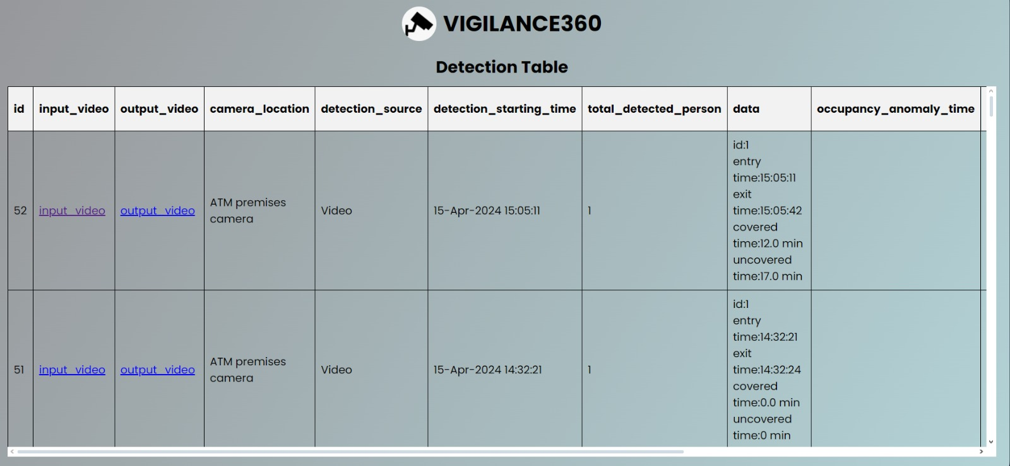
Output Result
Detection Table Page

Slide 15
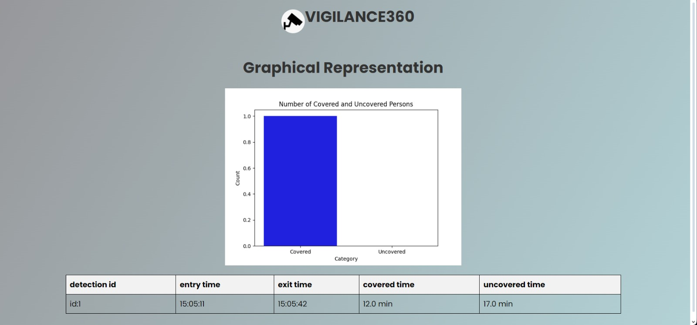
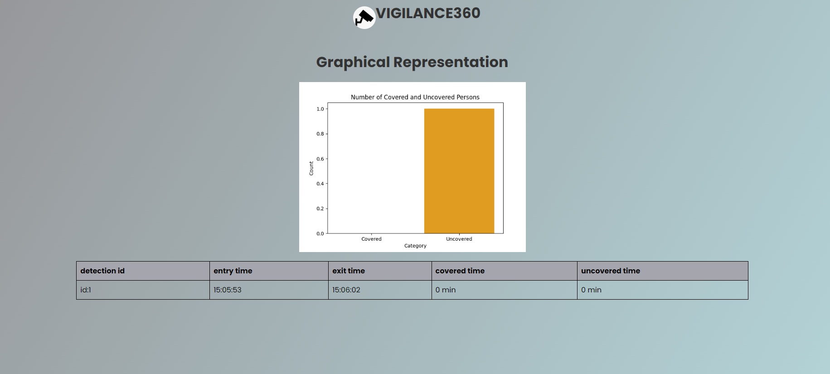
Output Result
Graphical Represent For Covered Video
Graphical Represent For Uncovered Video

Slide 16
Implementation
@app.route("/graph/<path>", methods=["GET"])
def visual(path):
detect_vo=DetectionVO()
detect_dao=DetectionDAO()
person_statistics=detect_dao.get_statistics(path)
person_data=DisplayObject.list_from_json(person_statistics)
return render_template('graph.html' , data=person_data)

Slide 17
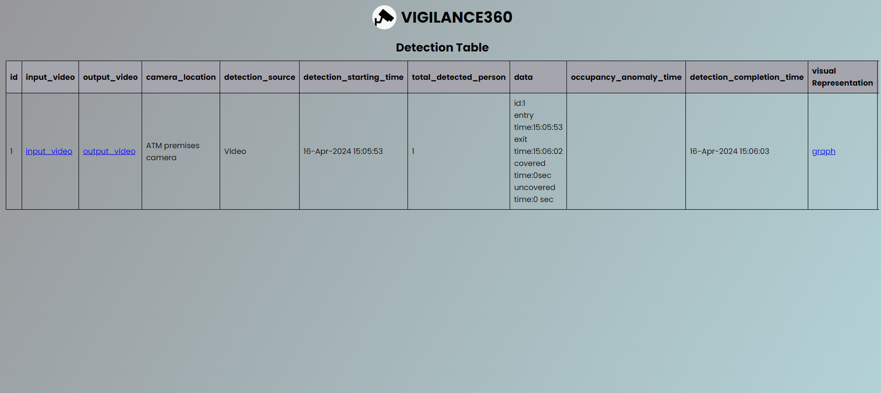
Implementation
Output of Implementation Code

Slide 18
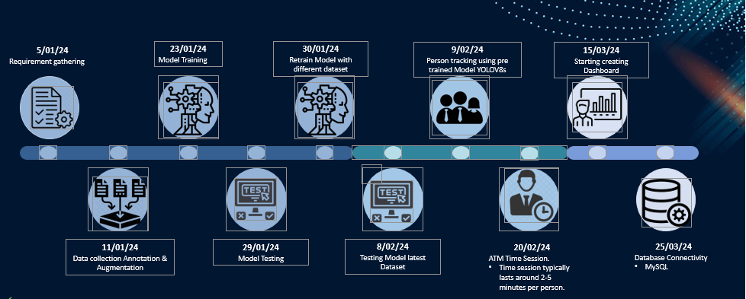
Timeline Chart(Gantt chart)

Slide 19
Future Work
Advanced Face Recognition:
Implementing cutting-edge face recognition for enhanced ATM security. Access restricted to individuals with visible faces, bolstering authentication protocols and reducing unauthorized entry risks. Additionally, continuous advancements in facial recognition technology will ensure adaptability to emerging security threats.
Enhanced Notification System:
Introducing real-time alerts for security and branch managers. Prompt response to unauthorized access or suspicious activities ensured, facilitating proactive security measures and incident mitigation. Moreover, integration with mobile devices will enable instant notifications, enhancing communication efficiency during security incidents.

Slide 20
Conclusion
The creation and implementation of Vigilance 360 represents a significant step forward in enhancing ATM security. By leveraging advanced technologies such as face detection, object detection and flask framework, we have developed a robust solution that not only mitigates security risks but also improves operational efficiency and customer confidence. Moving forward, we remain committed to continuous innovation and adaptation to address evolving security challenges in the banking industry. With Vigilance 360, we are not just securing ATMs; we are safeguarding the trust and safety of our customers.

Slide 21
References
https://www.irjet.net/archives/V10/i4/IRJET-V10I4118.pdf
https://yolov8.com/#:~:text=What%20is%20YOLOv8%3F,as%20a%20command%20line%20interface.
https://github.com/ultralytics/ultralytics/issues/189
https://blog.roboflow.com/whats-new-in-yolov8

Slide 22
Thank You…
Any Questions?

