Slide 1
BUSINESS MATHEMATICS | GROUP PROJECT
Volkswagen Group: Revenue, Cost and Profit, 2023 to 2026
How a fall in sales in China affected the company
Aditya Sinha · Sneha · Shrija · Ruhi · Aaryan Sumesh · Thejas
TAPMI Bengaluru · BBA Semester 1 · Section C · Group 5
Notes:
Aditya: Good morning everyone. We are Group 5 from Section C. Our project is on the Volkswagen Group, and we looked at what happened to its revenue, cost and profit between 2023 and 2026. In the next few minutes we will first set up the problem, then build the numbers, then use four maths tools on them, and finally talk about what the tools cannot tell us.

Slide 2
What happened to Volkswagen in 2026
January to September 2026, compared with the same period of 2025
−9.0%
−30.2%
€5.4 bn → €0.1 bn
vehicles delivered
deliveries in China
operating profit
6.60 million to 6.01 million
about 595 thousand fewer vehicles
revenue €238.7 bn to €233.4 bn
China was the main reason. Volkswagen itself says its sales were affected by declining markets, "particularly China". The fall in China alone was larger than the whole fall of the group.
Our question: how does a fall in sales in one market hit the whole company, and can maths help us see it?
Presented by Aditya
2
Notes:
Aditya: This is what happened. In the first nine months of 2026 Volkswagen delivered about 9 percent fewer vehicles than a year earlier. Almost all of that came from China, where deliveries fell by 30 percent. Revenue also dipped, and operating profit dropped from 5.4 billion euros to just 0.1 billion. So our question is simple: how does a fall in sales in one market hit the whole company, and can maths help us see it? Next slide shows how we will answer that.

Slide 3
How we studied it
Step | Tool | Question it answers
1. Build | Data and matrices | What were revenue, cost and profit each year?
2. Use the tools | Slope and forecast | What did the trend predict for 2026?
 | Break-even and margin of safety | How safe was the company?
 | Differentiation | What does one more vehicle add?
3. Limits | Limitations and conclusion | What can the tools not see?
Terms we will use
TR (total revenue): money earned from sales
TC (total cost): all the costs of running the business
Profit = TR − TC
Fixed cost: does not change with the number of vehicles
Variable cost: rises with each vehicle
All figures are for January to September of each year, in euros, from Volkswagen's own reports.
Presented by Aditya
3
Notes:
Aditya: Here is how the project is organised. First we build the numbers: the data, and then matrices to find total cost. Then we use three sets of tools: slope for forecasting, break-even for safety, and differentiation for the effect of one more vehicle. Finally we talk about limits. Please keep these terms on the right in mind, because everyone will use them. Total revenue is money coming in, total cost is money going out, and profit is the difference. Fixed costs stay the same whether we sell more or fewer cars, variable costs go up with every car. Ruhi will now show the data.

Slide 4
Revenue and profit, 2023 to 2026
Item (€ billion) | 2023 | 2024 | 2025 | 2026
Total revenue (TR) | 235.1 | 237.3 | 238.7 | 233.4
Profit (operating result) | 16.2 | 12.8 | 5.4 | 0.1
January to September, as reported by Volkswagen. The 2026 profit includes about €8.7 bn of one-time charges (mainly a Porsche write-down).
Business interpretation
Revenue stayed almost the same for four years, but profit fell from €16.2 bn to €0.1 bn. So the problem is not only sales: costs matter just as much.
Source: Volkswagen Group press releases (References 1, 3 and 4 of the report).
Presented by Ruhi
4
Notes:
Ruhi: This is the first thing we collected, revenue and profit for the first nine months of each year. Revenue is almost flat, between 235 and 239 billion euros, and then it dips in 2026. But look at profit. It goes from 16.2 billion to 12.8, then 5.4, and in 2026 it is only 0.1 billion. Part of the 2026 figure is one-time charges of 8.7 billion, mainly a write-down at Porsche. So the point is that sales did not change much but profit collapsed, which means costs must be part of the story. Now let me show where the sales actually fell.

Slide 5
China fell, Europe could not make up for it
Market (thousand vehicles) | 2025 | 2026 | Change | Change (%) | Reading
Europe | 2,907.7 | 2,956.0 | +48.3 | +1.7 | Growth (only buffer)
China | 1,974.0 | 1,378.8 | −595.2 | −30.2 | Largest fall
North America | 708.8 | 680.2 | −28.6 | −4.0 | Small fall
Rest of world | 1,013.8 | 996.0 | −17.8 | −1.8 | Small fall
Volkswagen Group | 6,604.3 | 6,011.0 | −593.3 | −9.0 | Net fall
China fell by 595 thousand vehicles, more than the whole fall of the group. Europe was the only market that grew, so it was the buffer, but too small: the other three markets together were almost unchanged.
Business interpretation
About 30% of Volkswagen's deliveries came from China in 2025, and only 23% in 2026. A fall in that one market could not be made up elsewhere. Depending heavily on one market makes revenue easy to hurt.
Presented by Ruhi
5
Notes:
Ruhi: This table shows deliveries by market. Europe is the only market that grew, by 48 thousand vehicles. North America and the rest of the world fell a little. But China fell by 595 thousand vehicles, which is 30 percent, and that is actually bigger than the whole fall of the group. China's share of Volkswagen's deliveries dropped from about 30 percent to 23 percent. Europe acted as a buffer but it was far too small. So the main lesson here is that relying on one big market is risky. Aaryan will now show how we found the total cost.

Slide 6
Matrices: finding total cost
Volkswagen reports revenue and profit, but not total cost. Since Profit = TR − TC, we get TC = TR − Profit. Writing the four years as columns (a matrix), one subtraction gives all four costs:
C = TC
R = TR
P = Profit
2023
218.9
235.1
16.2
€ billion, January to September. Example: 2025 is 238.7 − 5.4 = 233.3.
2024
224.5
=
237.3
−
12.8
2025
233.3
238.7
5.4
2026
233.3
233.4
0.1
Business interpretation
Total cost rose from €218.9 bn in 2023 to €233.3 bn in 2025, while revenue grew only a little. So rising costs, not falling sales, were the first thing to eat into profit. In 2026 cost stopped rising but revenue fell, so profit stayed very low.
Presented by Aaryan
6
Notes:
Aaryan: Volkswagen tells us revenue and profit but not the total cost. We can find it because profit equals revenue minus cost, so cost equals revenue minus profit. We put the four years in columns, which is called a matrix, and subtract the profit column from the revenue column. For example in 2025, 238.7 minus 5.4 gives 233.3. What this shows is that cost went up from about 219 billion to 233 billion, much faster than revenue. So costs were already squeezing profit before 2026. Shrija will now look at the trend.

Slide 7
Slope: the latest yearly trend
The slope tells us how much a figure changes in one year. Take x = 1 for 2024 and x = 2 for 2025, so the slope is just the change over that one year:
m = (y₂ − y₁) ÷ (x₂ − x₁)
€ billion per year | 2024 | 2025 | Slope m
TR | 237.3 | 238.7 | (238.7 − 237.3) ÷ 1 = +1.4
TC | 224.5 | 233.3 | (233.3 − 224.5) ÷ 1 = +8.8
Profit | 12.8 | 5.4 | (5.4 − 12.8) ÷ 1 = −7.4
Business interpretation
Cost was growing by €8.8 bn a year against only €1.4 bn for revenue, so profit was already falling by €7.4 bn a year before 2026. The company had very little room for a shock.
Presented by Shrija
7
Notes:
Shrija: The slope is simply how much something changes in one year. We used the latest two years before the fall, 2024 and 2025. Revenue went up by 1.4 billion, cost went up by 8.8 billion, and profit went down by 7.4 billion. So cost was growing six times faster than revenue and profit was already shrinking. We now use this slope to forecast 2026 on the next slide.

Slide 8
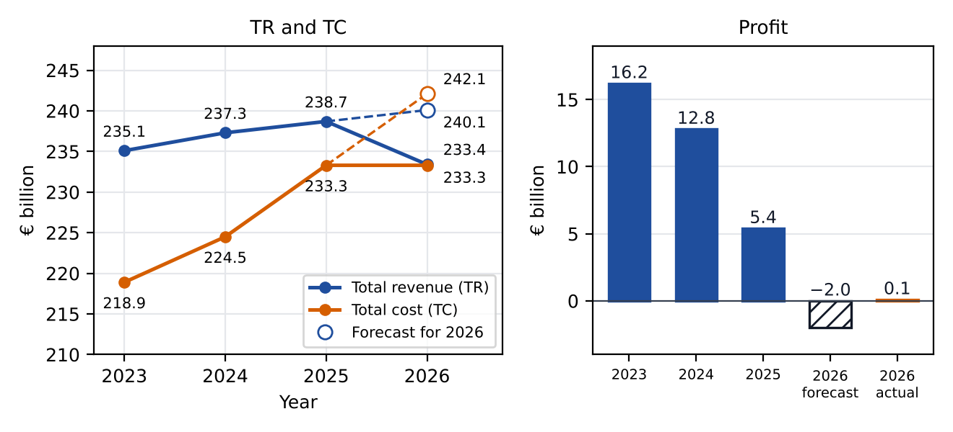
Forecast for 2026 versus what happened
Forecast for 2026 = 2025 actual + one year of slope
€ billion | 2025 actual | Slope | 2026 forecast | 2026 actual | Actual − forecast
Total revenue (TR) | 238.7 | +1.4 | 240.1 | 233.4 | −6.7
Total cost (TC) | 233.3 | +8.8 | 242.1 | 233.3 | −8.8
Profit | 5.4 | −7.4 | −2.0 | 0.1 | +2.1
Business interpretation
The trend expected revenue and cost to keep rising and profit to turn into a small loss. In reality revenue fell, cost stayed flat and profit was €0.1 bn. A trend forecast is a useful warning, but it cannot see a sudden change such as the fall in China.
Figure 1. TR, TC and profit with the forecast for 2026
Presented by Shrija
8
Notes:
Shrija: To forecast 2026 we start from the 2025 actual figure and add one year of slope. That gives revenue of 240.1 billion, cost of 242.1 billion and a loss of 2 billion. The table shows what actually happened: revenue fell to 233.4, cost stayed at 233.3 and profit was 0.1 billion. In the figure, the hollow circles are the forecast and the solid points are the actual. The forecast was wrong because the method only extends the old trend, and it could not know about the sudden fall in China. Sneha will now look at how safe the company was.

Slide 9
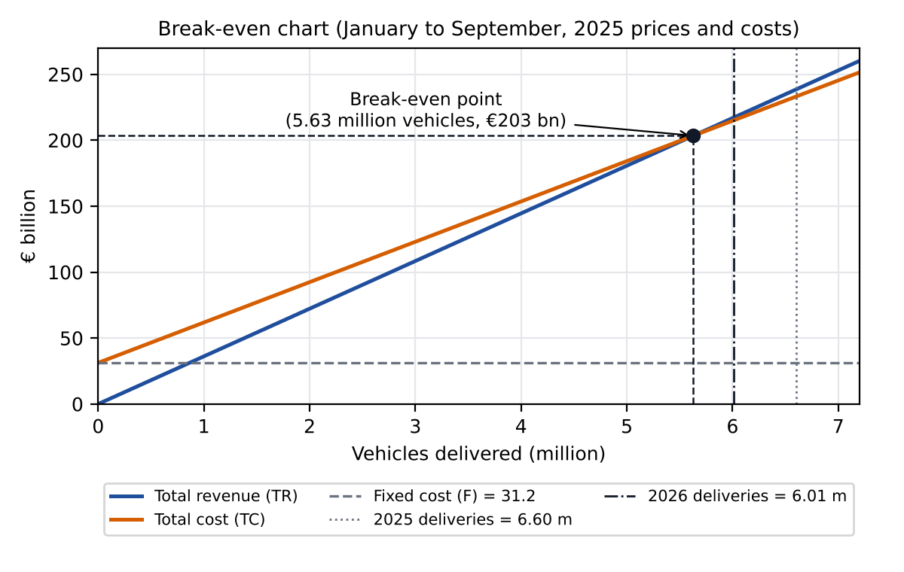
Break-even: how many vehicles to cover all costs
2025 inputs (January to September) | Value
Total revenue | €238,669 million
Variable cost (cost of sales) | €202,021 million
Fixed cost F = TC − variable cost | €31,240 million
Revenue per delivery, p (proxy) | €36,138
Variable cost per delivery, v (proxy) | €30,589
TR = p·x and TC = F + v·x. Break-even is where TR = TC.
36,138x = 31,240,000,000 + 30,589x
5,549x = 31,240,000,000
x = 5.63 million vehicles
Figure 2. Break-even chart (2025 prices and costs)
Business interpretation
In this model Volkswagen needs about 5.63 million deliveries in nine months to cover its costs (about €203 bn of revenue); in 2025 it delivered 6.60 million. Cost of sales is treated as variable and the rest as fixed, so this is an illustrative estimate.
Presented by Sneha
9
Notes:
Sneha: Break-even is the point where total revenue equals total cost, so profit is zero. We need to split costs into fixed and variable. We took cost of sales as the variable cost and the rest as fixed, which gives a fixed cost of 31.2 billion euros. Dividing revenue and variable cost by the number of deliveries gives a revenue of 36,138 euros and a variable cost of 30,589 euros per delivery. These are averages, so we call them proxies. Each vehicle therefore covers about 5,549 euros of the fixed cost. Setting TR equal to TC gives 5.63 million vehicles. In the figure, that is where the blue and orange lines cross. Below that number the company makes a loss, above it a profit. The next slide shows how far above it Volkswagen was.

Slide 10
Margin of safety: the cushion got thin
Margin of safety = (actual − break-even) ÷ actual × 100
It shows how far sales can fall before the company starts to make a loss, like a safety cushion.
Situation | Delivered (million) | Break-even (million) | Above break-even (million) | Margin of safety
2025 actual | 6.604 | 5.630 | 0.974 | 14.8%
2026 deliveries | 6.011 | 5.630 | 0.381 | 6.3%
2026 uses the 2026 deliveries with prices and costs kept as in 2025, so only the fall in deliveries is measured.
Business interpretation
In 2025 Volkswagen could lose about 15% of its sales before making a loss. After the fall in 2026 only about 6% was left. The company moved close to break-even, so any further fall in sales would push it into a loss.
Presented by Sneha
10
Notes:
Sneha: The margin of safety tells us how far sales can fall before a loss. In 2025 Volkswagen delivered 6.60 million vehicles against a break-even of 5.63 million, so sales could fall about 15 percent before a loss. In 2026, with 6.01 million deliveries, the cushion shrinks to about 6 percent. We kept prices and costs as in 2025 so only the effect of fewer deliveries is shown. So the company is now close to the break-even line. Aditya will explain what one more vehicle adds.

Slide 11
Differentiation: what one more vehicle adds
Differentiation shows how fast a function changes. The derivative of TR is marginal revenue (MR) and the derivative of TC is marginal cost (MC).
Function | Derivative | Meaning
TR = 36,138x | MR = 36,138 | One more vehicle adds €36,138 to revenue
TC = 31,240,000,000 + 30,589x | MC = 30,589 | One more vehicle adds €30,589 to cost
Profit = TR − TC = 5,549x − 31,240,000,000 | MR − MC = 5,549 | One more vehicle adds €5,549 to profit
MR is always above MC, so they never meet and profit has no highest point in this model. Textbook MC curves are U-shaped, but a straight-line TC built from one year's averages gives a constant MC.
Business interpretation
Every extra vehicle adds about €5,549 to profit while fixed costs stay the same, so volume matters a great deal: more sales raise profit quickly and lost sales reduce it quickly. That is why a fall in deliveries hurts profit much more than revenue.
Presented by Aditya
11
Notes:
Aditya: Differentiation tells us how fast something changes. If we differentiate total revenue we get marginal revenue, the extra revenue from one more vehicle, which is 36,138 euros. If we differentiate total cost we get marginal cost, the extra cost of one more vehicle, which is 30,589 euros. The difference is 5,549 euros, so every extra vehicle adds about 5,549 euros to profit. Normally we find the highest profit where MR equals MC, but here they are constant and never equal, so profit has no peak in this model. In real life the MC curve is U-shaped, but we would need cost data at many output levels to show that. The business meaning: volume matters a lot. Gaining or losing vehicles moves profit quickly because the fixed cost does not change.

Slide 12
What the results mean and what Volkswagen must do
Sales fell in China
other markets could not replace them
Fixed costs stayed
costs did not fall with sales
Profit almost disappeared
and the safety cushion became thin
→
→
Put together, the tools tell one story: costs were already rising faster than revenue (matrices and slope), China's fall removed sales that other markets could not replace, and because many costs are fixed, profit fell far more than sales (break-even and differentiation).
What Volkswagen must do to rebuild its cushion
Reduce fixed costs such as plant and overhead costs. They do not fall when sales fall and they push the break-even point up.
Earn more from each vehicle, for example through a richer model mix or better pricing. This also lowers the break-even point.
Either change lets the company survive a further fall in sales without moving into a loss.
Presented by Aditya
12
Notes:
Aditya: Now we bring it together. Each tool told one part of the story. The matrices and slope showed that costs were already growing faster than revenue. The data showed that China's fall removed a big block of sales. And break-even and differentiation showed that because fixed costs stay, losing vehicles hits profit hard. What can Volkswagen do? Two things. First, reduce fixed costs like plant and overhead costs, because these push the break-even point up. Second, earn more from each vehicle, through a better model mix or pricing. Either one lowers the break-even point and rebuilds the cushion. Thejas will now explain the limits of what we did.

Slide 13
Limitations of the mathematical tools
The tools use past data and assume conditions stay the same, but real markets change suddenly.
Sudden shocks
Middle East and oil prices
Proxies and assumptions
A forecast built on the last trend cannot see a shock in a major market, a supply-chain break, new tariffs or a war. For Volkswagen, the fall in China and tariffs (mainly in North America) were changes of this kind.
A Middle East crisis can raise crude oil prices, which raises fuel, transport and material costs and can reduce car demand. Volkswagen says the effect of an escalation "cannot be reliably assessed", so it is a risk, not a cause of the 2026 fall.
Revenue and cost per delivery are Group averages used as proxies, and treating cost of sales as variable and the rest as fixed is an assumption. So break-even and margin of safety are illustrative estimates, not Volkswagen's plant-level figures.
Presented by Thejas
13
Notes:
Thejas: Maths helps, but it has limits. All our tools use past data and assume that things stay the same. First, sudden shocks. A forecast using the last trend cannot see a big change in one market, a break in supply chains, new tariffs, or a war. For Volkswagen, the fall in China and tariffs, mainly in North America, were changes like this. Second, a Middle East crisis can push up crude oil prices, which raises fuel, transport and material costs and can reduce demand for cars. Volkswagen itself says the effect cannot be reliably assessed, so we treat it as a risk, not as a cause of the 2026 fall. Third, our break-even figures use Group averages as proxies and assume costs split into fixed and variable, so they are estimates, not Volkswagen's plant-level numbers. Shrija will now conclude.

Slide 14
Conclusion
1
The fall came mainly from China.
Europe was too small a buffer to make up for it.
2
Fixed costs do not fall when sales fall.
So profit almost disappeared and the safety cushion above break-even became thin.
3
Maths helps us understand, but it cannot predict shocks.
The forecast was wrong, so such tools should be used to understand a company, not relied on alone.
For Volkswagen the lesson is to keep fixed costs low and to depend less on one market.
Thank you. Any questions?
Presented by Shrija
Sources: Volkswagen Group press releases and Interim Report (see References in the report).
14
Notes:
Shrija: To conclude. First, the fall in Volkswagen's sales in 2026 came mainly from China, and Europe was too small a buffer to make up for it. Second, because a large part of Volkswagen's costs is fixed, costs did not fall with sales, so profit almost disappeared and the cushion above break-even became thin. Third, the maths tools helped us see all this clearly, but the forecast was wrong, which shows that maths based on past data cannot predict sudden events. So we should use such tools to understand a company's position, not rely on them alone. For Volkswagen, the lesson is to keep fixed costs low and depend less on one market. Thank you, we are happy to take questions.

