Slide 1
Agentic AI Hackathon: Building Intelligent Agents with IBM Granite and LangFlow

Slide 2
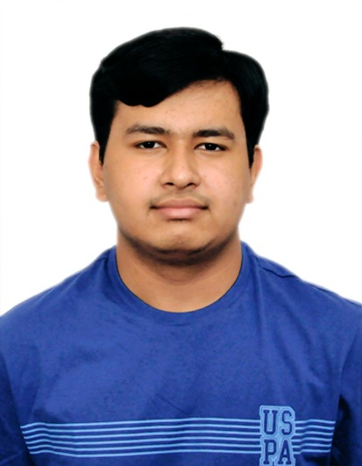
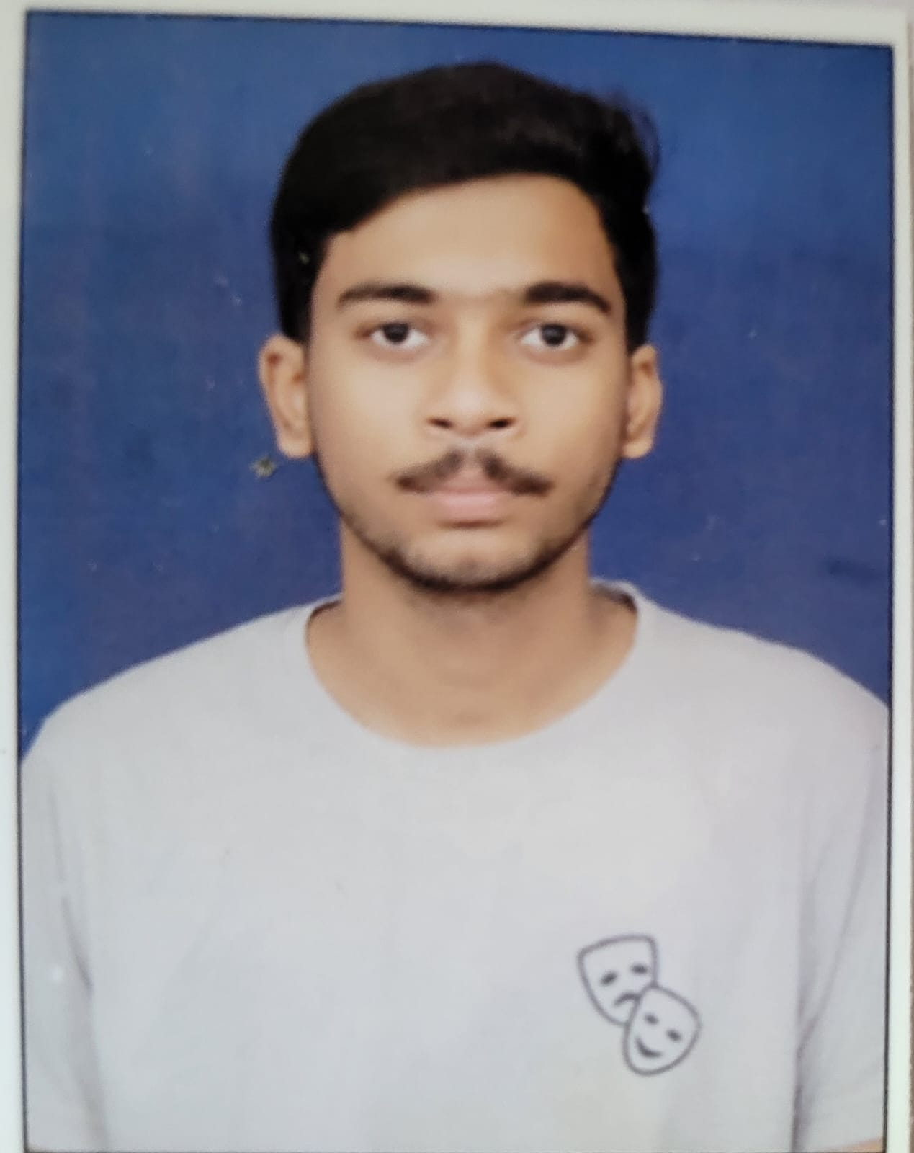
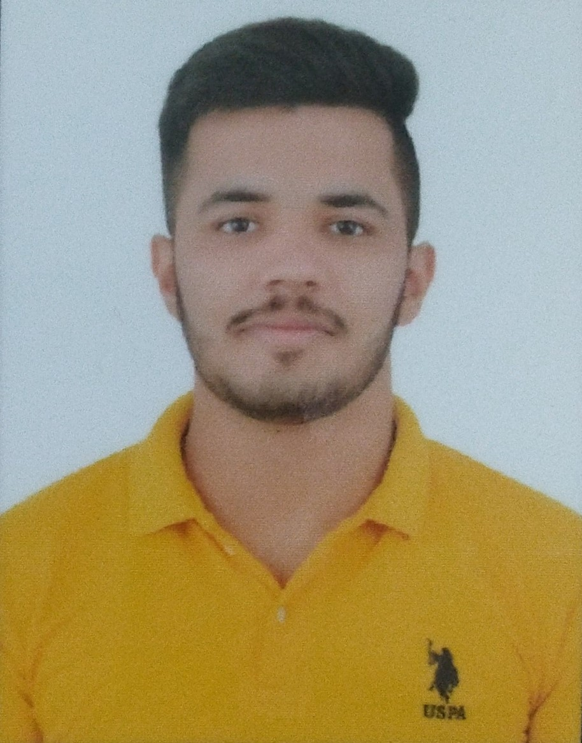
Name of the team: Vagabond Tinkers
Details of Team members
TEAM MEMBER NAME | Recent Passport Photo | Email ID | Phone number [WhatsApp]
Mohd Ayan Ansari |  | mohdayan.ee23@bmsce.ac.in | 9739263939
Sumanth CK |  | sumanthck.ee23@bmsce.ac.in | 9448001513
Suyash Mishra |  | suyashmishra.ee23@bmsce.ac.in | 7817010409

Slide 3
Problem statement
AI-Based Preventive Health Risk Assessment System
Develop an intelligent, agent-based system that analyzes lifestyle data such as physical activity, sleep patterns, diet habits, and stress indicators to identify early preventive health risks and provide assistive insights that encourage healthier lifestyle choices.
The Challenge
Preventive healthcare depends on early detection of lifestyle-related health risks. However, today:
Lifestyle data (physical activity, sleep, diet, stress) is massive but underutilized
Manual analysis is time-consuming and non-scalable
Lack of personalized preventive insights
No unified system to connect lifestyle patterns with evidence-based health guidelines
As a result, potential health risks go unnoticed until they become serious medical conditions.

Slide 4
Need of project
Rising lifestyle diseases (diabetes, obesity, cardiovascular risks)
Lack of scalable preventive health monitoring
Need for early awareness instead of late treatment
Assist individuals in making data-driven lifestyle improvements
Support preventive healthcare initiatives without replacing medical professionals

Slide 5
Proposed solution
An Agentic AI-based preventive health system built using LangFlow and IBM Granite Model, which automatically processes lifestyle data, detects potential health risks using trusted preventive healthcare guidelines, and delivers assistive lifestyle improvement recommendations.
Three specialized agents using Agentic AI:
Lifestyle Data Analysis Agent - Processes activity, sleep, diet, stress data
Preventive Risk Detection Agent - Identifies health risk patterns using guidelines
Health Advisory Assistant - Provides personalized health recommendations

Slide 6
Lifestyle Data Analysis Agent
This agent processes user lifestyle inputs such as physical activity, sleep quality, diet patterns, and stress levels, converting raw data into structured health summaries and behavioral trends.
Preventive Risk Detection Agent
This agent compares lifestyle summaries with preventive healthcare and wellness guidelines using Retrieval-Augmented Generation (RAG) to identify early risk patterns linked to lifestyle behaviors.
Health Advisory Assistant
This agent provides assistive, non-diagnostic health insights and practical lifestyle improvement suggestions focused on prevention, awareness, and long-term wellness.

Slide 7
End user of project
Individuals tracking lifestyle and wellness data
Corporate wellness programs
Preventive healthcare platforms
Health awareness and wellness applications
Fitness and lifestyle monitoring solutions

Slide 8
Technology Used
Langflow platform
Langflow component name – Agent , Chat input , Chat output ,LLM, Tavily Search API, Parser
IBM Grainte model - for eg – ibm-granite-3-8b-instruct
IBM Cloud
RAG if used
IBM Watsonx.ai
Watsonx

Slide 9
Novelty and Uniqueness
Uses an Agentic AI architecture instead of a single-model system
Integrates Retrieval-Augmented Generation (RAG) with preventive healthcare guidelines
Focuses on assistive, non-diagnostic preventive health insights
Modular LangFlow design enables scalability and easy enhancement
IBM Granite model ensures safe, reliable, and unbiased outputs

Slide 10
Langflow component Used
Chat Input Used to accept user lifestyle data and health-related queries as the system’s entry point.
Agent Component Orchestrates task execution by coordinating lifestyle analysis, risk detection, and advisory agents.
IBM Watsonx AI (Granite Model) Performs intelligent reasoning, understands health data patterns, and generates safe, unbiased responses.
Tavily Search API Retrieves trusted preventive healthcare and wellness guidelines for evidence-based analysis.
Parser Component Extracts and structures relevant information from retrieved guideline documents.
Chat Output Displays preventive risk summaries and assistive lifestyle recommendations to the user.

Slide 11
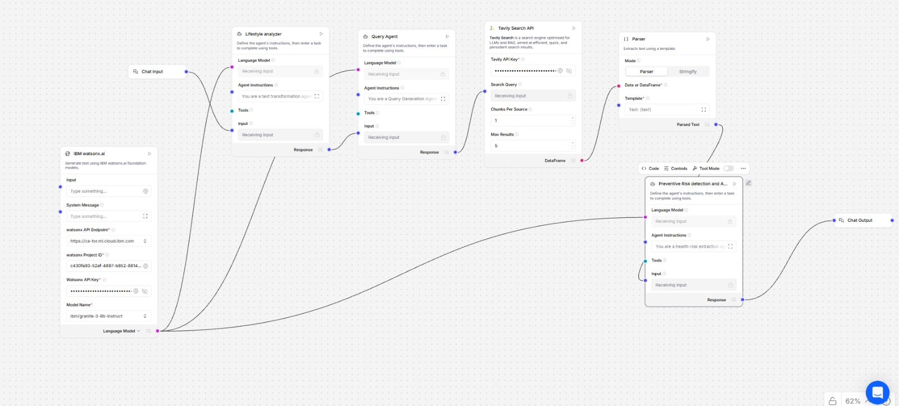
Input Screenshot

Slide 12
Future Scope
Integration with wearable and IoT health devices for real-time data
Personalized preventive insights using long-term lifestyle trends
Real-time risk alerts and continuous monitoring
Multi-language support for wider accessibility
Integration with wellness platforms and healthcare systems
·
·
·

Slide 13
Git Hub Link
https://github.com/mishrasr8/Health-Analyst/tree/main
·
·
·

Slide 14


