Slide 1



TEST AUTOMATION WITH SELENIUM & SEE TEST : PROOF OF CONCEPT

Slide 2
WEB & MOBILE UNIFIED Test Automation Framework : Overview

Slide 3









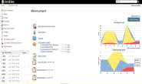





















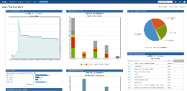
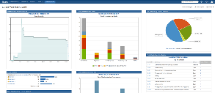

Web & Mobile Unified Test Automation Framework : Architecture
CI Server
Highlights
Unified Framework for Mobile and Web application testing
Supports UI and Non UI based test automation
Centralized, easy to configure settings for the scripts to run across the environments
Supports Selenium and See Test Automation tool
Pro-Agile – CI enabled using Jenkins Centralized, easy to configure settings for the scripts to run across the environments
Customized HTML reporting with custom reporting engine for reports in excel, HTML formats
Parallel, Distributed test Execution on multiple devices, browsers and OS
TestNG is used for better organisation and controlling of test automation suite
Generic Utility Libraries
Web Functions
using
Selenium Java
Dialog
Handlers
Build Definitions
Application Specific
Library / Test Cases
Test Definitions
Mobile Functions using See Test
Java
Data
Driver
Log
Generator
Repository
Dashboard
Dashboard
Launch Script
Automated Scripts
Test Management
Object Management
Object Management
Config File
Reporting/Logging
Test Input Data
Test Suites
Test Plans
Test Cases
Selenium Webdriver Agent
See Test Agent
Test Lab Definitions
Dashboard
Web Application
Mobile Application

Slide 4
Key Features - Gallop Test Automation Framework
S. No | Test Automation Framework Features
1 | Rich HTML Report
2 | Execution Log – Log4j
3 | Capture Screenshots for Failed & Business critical test steps
4 | Page Object Model for easy maintenance
5 | TestNG Integration - TDD
6 | Mobile Test Cases Automation – using See Test
7 | Parallel Execution
8 | Data Reading from Excel
9 | Data Reading from Property Files
10 | Selective Test Execution - Additional features such as browser selection, test selection, devices, Platform (Windows or Unix), Environment (Cloud or On-premises) and Groups (Regression, Smoke, etc.)
11 | Integration with Build tools - Maven
12 | CI Integration – Jenkins
13 | Integration with version controlling and Test Management tools such as SVN
14 | Updating of execution status in Test Management Tool – Yet to be implemented
15 | Framework components are loosely coupled

Slide 5
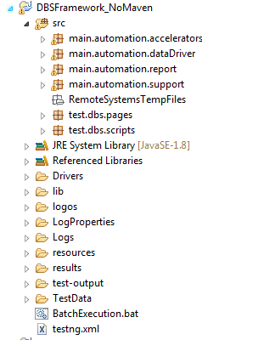
Ease of Maintenance
Objective : Ease to maintain different functional libraries and is scalable
Highlights:
Test Automation Framework is implemented in a structured manner to enable ease of maintenance and update any changes in the components
All the reusable methods and libraries are maintained inside test engine, action engine and other utility folders. For Example: Below are the few methods from the action engine: Click, Type,selectByIndex, Waitforelementpresent, JSclick, mouseover, VerifyElementPresent, IsElementPresent, DragandDrop, selectByName..etc
Implements page factory model which provides single point of maintenance for locators/objects at page level only in case of any changes in application
Framework Folder
Structure
Notes:
Foder structure, page object model and action driver

Slide 6
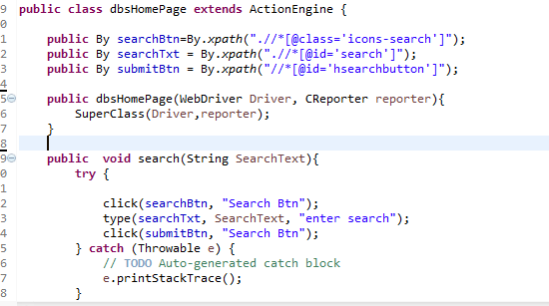
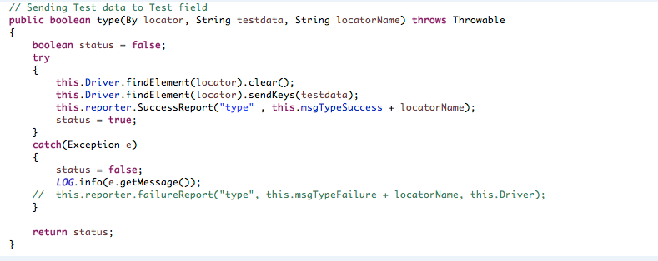
Ease of Maintenance
Sample Code
Snippet- Page
Class
Sample Code
Snippet- Action
Engine
Notes:
Foder structure, page object model and action driver

Slide 7
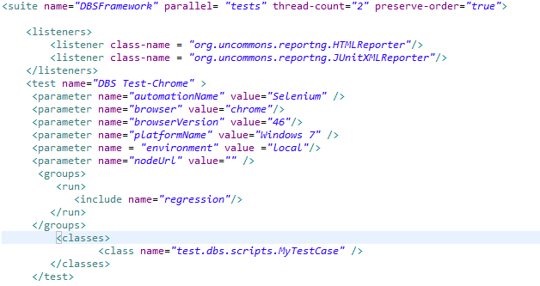
Integration with Unit Test Tool (TDD) - TestNG
Objective: Ability to integrate with TDD tools like TestNG to provide additional features to the automation framework.
Response:
TestNG Integration provides features like – Test Driven Development Approach, Parallel execution, Batch execution, Group execution, parameterized execution.
Sample TestNG
XML Snippet

Slide 8
Flexible Test Execution
Objective: Ability to integrate both Web and Mobile automation in a unified framework and ease of execution.
Response:
Test Automation Framework supports Mobile automation using See Test with Selenium Webdriver
Sample Code
Snippet

Slide 9
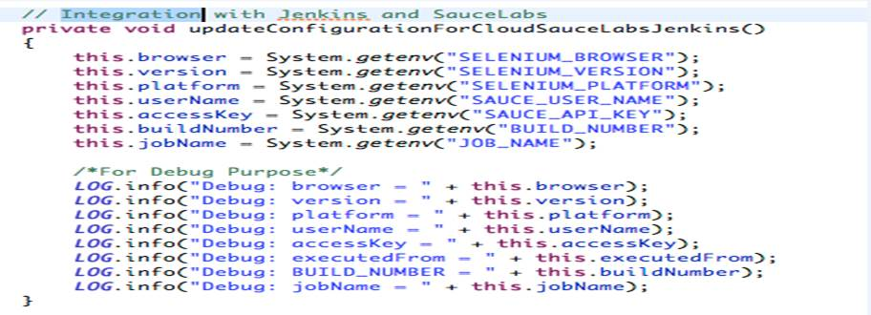
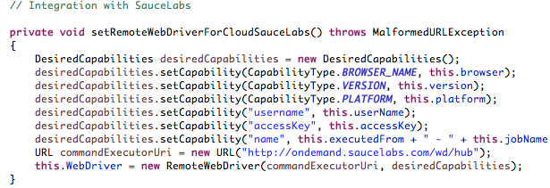
Tool Integrations
Objective : Ability to integrate with test management and defect tracking tools
Response:
Automaton Framework has integration with various tools, such as:
CI tools: Jenkins
Test Management: QC (Not yet Implemented)
Defect management tools: JIRA
Sample Code
Snippet for Jenkins
Integration

Slide 10
DEMO BRIEFING

Slide 11
Test Automation Framework - Demo Briefing
Technical Specification:
Application under test : DBS Website
Programming Language : Java
Automation Framework : Web & Mobile Unified Test Automation Framework
Automation Tool : Selenium, See Test
Reporting : HTML

Slide 12
Web and Mobile Automation Parallel Execution
Description: Create a new medication
Test Steps:
Enter valid login credentials in the username and password fields.
Select the sign in button
Select the ‘care manager’ button
Select ‘add to my day’ button.
Select ‘add as needed medications’ option from the menu.
The user selects a medication from the as needed list.
Select the ‘How many taken’ field.
Enter a whole real number into the how many taken field
Select the ‘At What Time?’ Field.
Select a time from the time picker by scrolling.
From the time picker select the done button.
On add meds taken screen, select the done button
On the my day screen, the user selects the add button to add to my day. The add to my day menu appears
On the add to my day menu the user selects the add as needed medication option. The user is directed to the add as needed medications screen
The user selects a medication to add as needed, The medication is selected and the “How many taken” and “At what time” fields display
The user enters a whole real number for How many taken and an appropriate time for at what time. The information entered into the fields displays.
The user selects the done button. The medication is added to my day.
The user has added the first as needed medication for the day. The track pain onboarding message appears.
From the track pain onboarding message the user selects done. The user is on the my day screen
From the track pain onboarding message the user selects track pain. The user is directed to the pain screen.
The user has added their second or more as needed medication of the day. The user is returned to the my day screen. The track pain onboarding message does not appear again.

Slide 13
LIVE DEMO

