Slide 1
Test Automation – Selenium2

Slide 2
Selenium IDE
The Selenium-IDE (Integrated Development Environment) is the tool you use to develop your Selenium test cases. Its an easy-to-use Firefox plug-in and is generally the most efficient way to develop test cases.
It also contains a context menu that allows you to first select a UI element from the browsers currently displayed page and then select from a list of Selenium commands with parameters pre-defined according to the context of the selected UI element.
This is not only a time-saver, but also an excellent way of learning Selenium script syntax.
Selenium IDE Works with all major versions, but we recommend to use 47.0.1 & above as they have better stability.

Slide 3
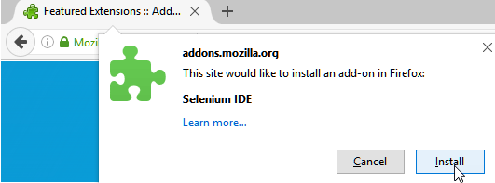
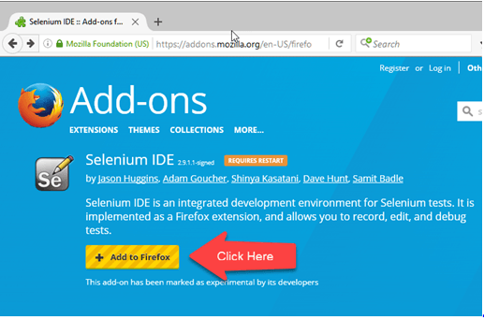
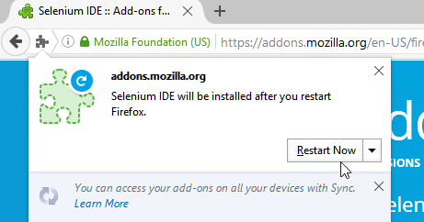
Installation of Selenium IDE
Step-2
Wait until Firefox completes the download and then click "Install."
Step-1
Launch Firefox and navigate to https://addons.mozilla.org/en-US/firefox/addon/selenium-ide/.
Click on Add to Firefox
Step-3
Wait until the installation is completed. In the pop-up window, click "Restart Now."

Slide 4
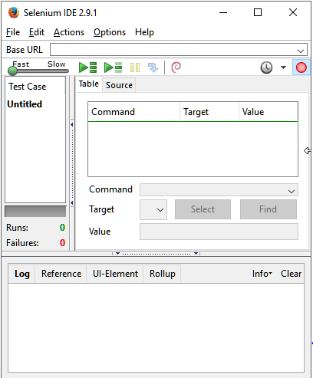
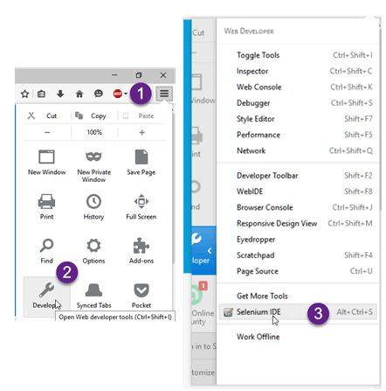
Installation of Selenium IDE
Step-4
After Firefox has restarted, launch Selenium IDE using either of two ways:
By pressing Ctrl+Alt+S
By clicking on the Firefox menu button> Developer>Selenium IDE
Step-5
Selenium IDE should launch as shown below

Slide 5
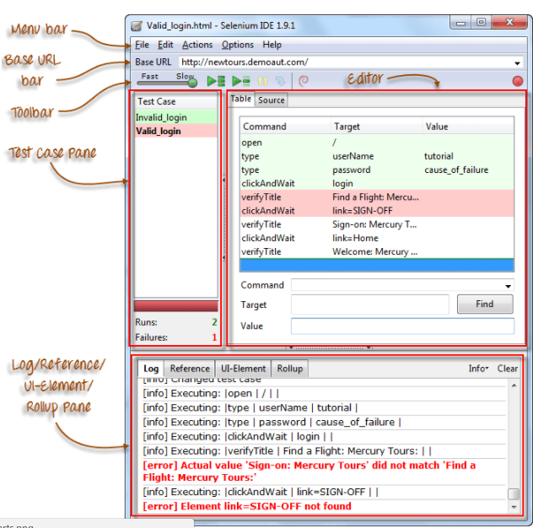
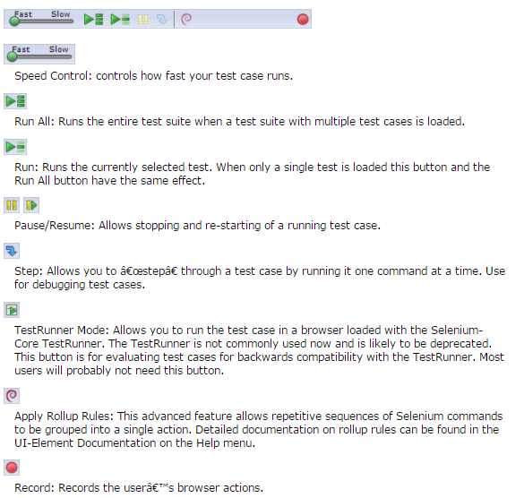
Features of Selenium IDE

Slide 6
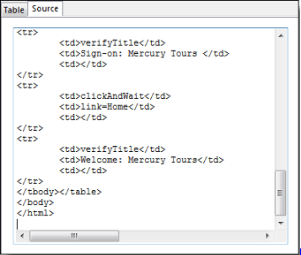
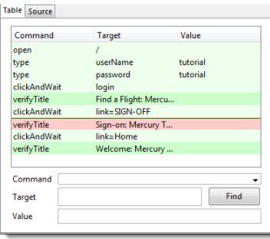

Editor
You can think of the editor as the place where all the action happens. It is available in two views: Table and Source.
Table View
This is where you create and modify Selenese commands.
After playback, each step is color-coded.
To create steps, type the name of the command in the "Command" text box.
It displays a dropdown list of commands that match with the entry that you are currently typing.
Source View
It displays the steps in HTML (default) format.
It also allows you to edit your script just like in the Table View.

Slide 7
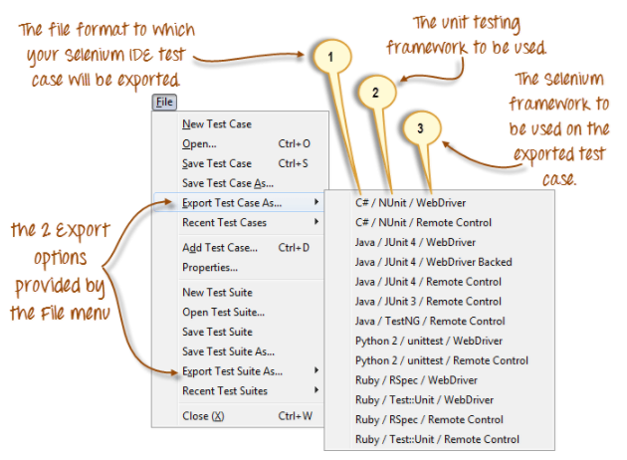
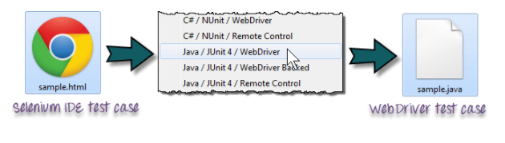
Menu bar
It is located at the top most portion of the IDE. The most commonly used menus are the File, Edit, and Options menus.
File menu:
It contains options to create, open, save and close tests.
Tests are saved in HTML format.
The most useful option is "Export" because it allows you to turn your Selenium IDE test cases into file formats that can run on Selenium Remote Control and WebDriver
"Export Test Case As..." will export only the currently opened test case.
"Export Test Suite As..." will export all the test cases in the currently opened test suite
As of Selenium IDE v1.9.1, test cases can be exported only to the following formats:
.cs (C# source code)
.java (Java source code)
.py (Python source code)
.rb (Ruby source code)

Slide 8
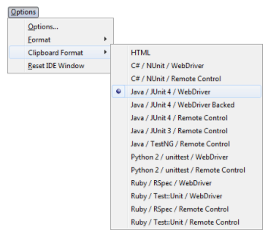
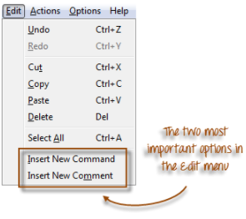
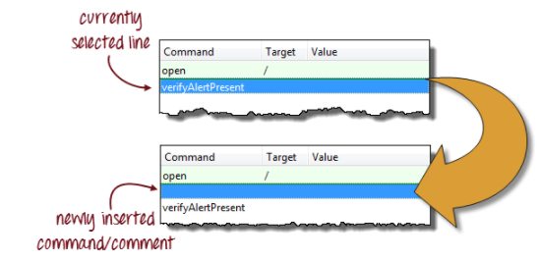
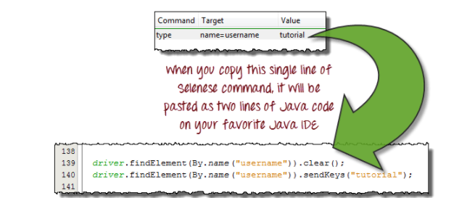
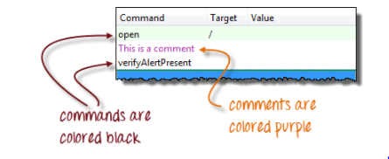
Menu Bar
Edit Menu
It contains usual options like Undo, Redo, Cut, Copy, Paste, Delete, and Select All.
The two most important options are the "Insert New Command" and "Insert New Comment".
Options menu
It provides the interface for configuring various settings of Selenium IDE

Slide 9
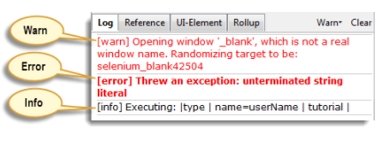
Logs
The Log Pane displays runtime messages during execution. It provides real-time updates as to what Selenium IDE is doing.
Logs are categorized into four types:
Debug - By default, Debug messages are not displayed in the log panel. They show up only when you filter them. They provide technical information about what Selenium IDE is doing behind the scenes. It may display messages such as a specific module has done loading, a certain function is called, or an external JavaScript file was loaded as an extension.
Info - It says which command Selenium IDE is currently executing.
Warn - These are warning messages that are encountered in special situations.
Error - These are error messages generated when Selenium IDE fails to execute a command, or if a condition specified by "verify" or "assert" command is not met.

Slide 10
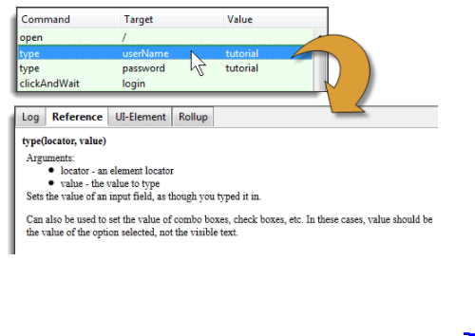
Reference
The Reference tab is the default selection whenever you are entering or modifying Selenese commands and parameters in Table mode. In Table mode, the Reference pane will display documentation on the current command.

Slide 11
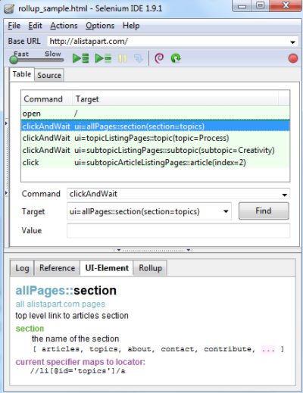
UI Element Pane
The UI-Element is for advanced Selenium users. It uses JavaScript Object Notation (JSON) to define element mappings. The documentation and resources are found in the "UI Element Documentation" option under the Help menu of Selenium IDE.

Slide 12
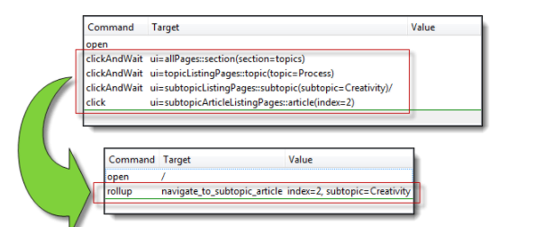
Rollup Pane
Rollup allows you to execute a group of commands in one step. A group of commands is simply called as a "rollup”.
Since rollups are groups of commands condensed into one, they contribute a lot in shortening your test script and this group can be re-used across.

