Slide 1
Test Automation – Selenium

Slide 2
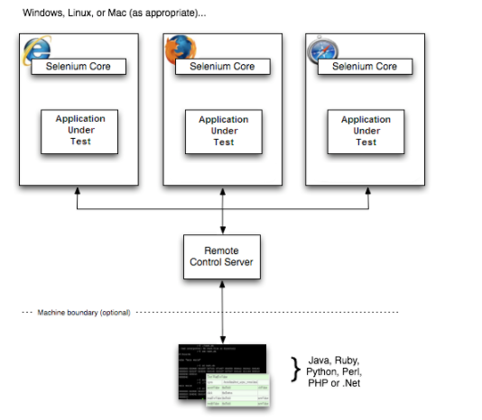
Selenium RC
Before the advent of WebDriver in 2006, there was another, automation tool called Selenium Remote Control. Selenium RC have following features:
The Selenium Server which launches and kills browsers.
Selenium Server interprets and runs the Selenese commands passed from the test program, and acts as an HTTP proxy, intercepting and verifying HTTP messages passed between the browser and the AUT.
Selenium Server receives Selenium commands from your test program, interprets them, and reports back to your program the results of running those tests.
Selenium RC is slower since it uses a Javascript program called Selenium Core. This Selenium Core is the one that directly controls the browser, not you.
Selenium RC's API is more matured but contains redundancies and often confusing commands. For example, most of the time, testers are confused whether to use type or typeKeys; or whether to use click, mouseDown, or mouseDownAt. Different browsers interpret each of these commands in different ways too!
Selenium RC cannot support the headless HtmlUnit browser. It needs a real, visible browser to operate on.
Selenium RC injects Selenium Core Javascript onto the browser to control the elements, which has security implications for some highly secured application.
Selenium RC Architecture

Slide 3
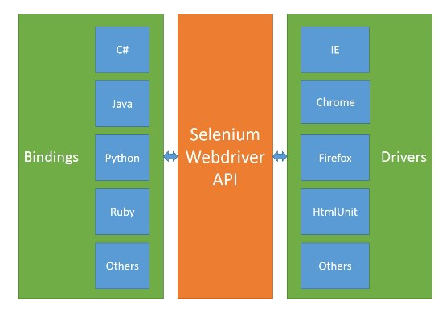
Selenium Webdriver
Selenium-WebDriver makes direct calls to the browser using each browser’s native support for automation.
Since there are so many browsers & so many programming languages there is need for common specification which will be provided by WebDriver API. Each browser has to implement this API which is called as Remote WebDriver or Remote WebDriver Server.
Actually whatever the commands issued in the code will be interpreted into Webservice methods (JSON Wired Protocol) and the Remote Driver will receive the HTTP request (commands) and execute them in the browser then send the response back.
Example:
Let’s take a sample code and see how the data flows between Client bindings, Server.
driver.get("http://www.google.com");
The client library, as soon as it receives the preceding command, will convert it to the JSON format (shown below) and communicate with the Firefox Driver/Remote WebDriver.
http://localhost:7705/ { "url": "http://www.google.com" }
Firefox Driver will speak to the Firefox browser natively, and then the browser will send a request for the asked URL to load.
Binding Code
JSON Wired Protocol
Chrome Remote Web Driver
Selenium WebDriver Architecture

Slide 4
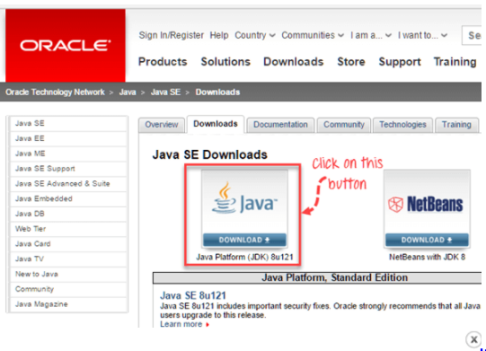
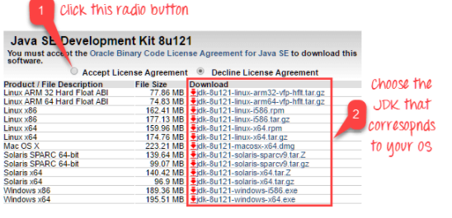
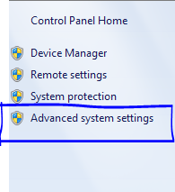

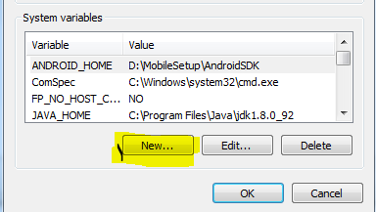
Install JAVA SDK
Goto: http://www.oracle.com/technetwork/java/javase/downloads/index.html
Double click and install Java JDK in the system.
Set below paths after JDK installation under Control Panel\Environment Variables\System Variable:
JAVA_HOME = <Installation Folder>\jdk1.8.0_92
path = <Installation Folder>\jdk1.8.0_92\bin
(*edit existing path variable)
To verify installation success Open CMD Prompt and type:
JAVA –Version
(*this command should output proper JAVA version )

Slide 5
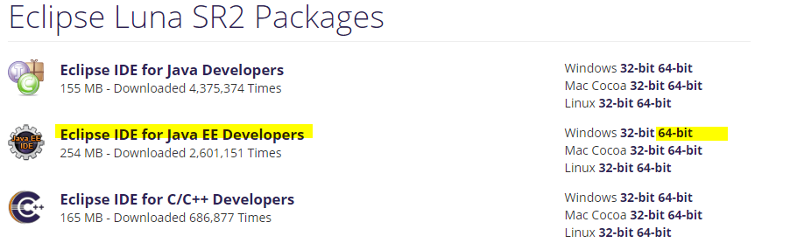
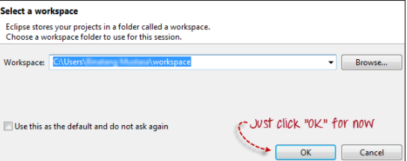
Install Eclipse IDE
Download "Eclipse IDE for Java Developers" from below URL. Be sure to choose correctly between Windows 32 Bit and 64 Bit versions.
http://www.eclipse.org/downloads/packages/release/Luna/SR2
Unzip and start eclipse.exe to launch eclipse IDE.
Assign Workspace path while launching Eclipse.

Slide 6
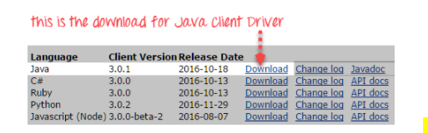
Download Selenium Webdriver
Download Selenium webdriver from below path:
http://www.seleniumhq.org/download/
This download comes as a ZIP file named "selenium-<version>.zip". For simplicity, extract the contents of this ZIP file on your C drive so that you would have the directory "C:\selenium-<version>\". This directory contains all the JAR files that we would later import on Eclipse.

Slide 7
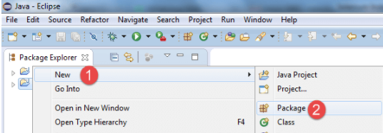
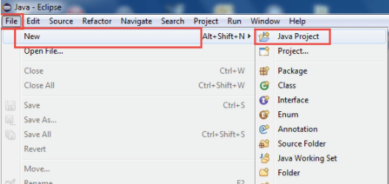
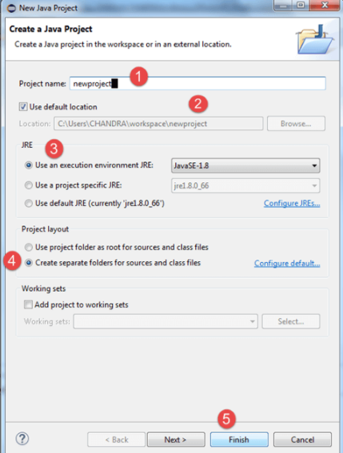
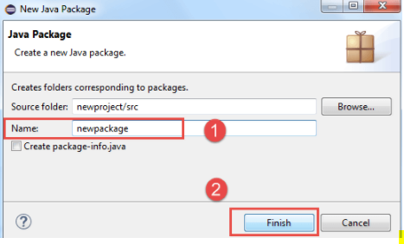
Configure Eclipse IDE with WebDriver
A new pop-up window will open enter details as follow
Project Name
Location to save project
Select an execution JRE
Select layout project option
Click on Finish button
Create a new package
Create a new project through File > New > Java Project. Name the project as "newproject"

Slide 8
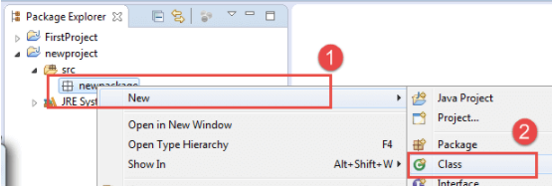
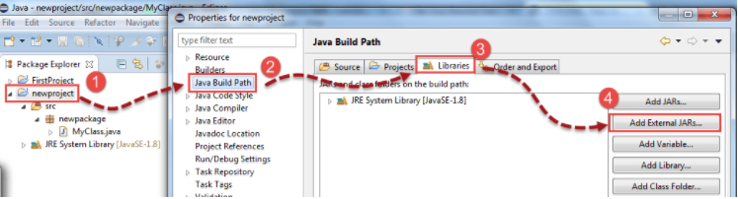
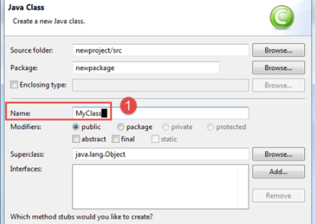
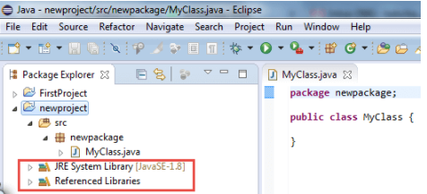
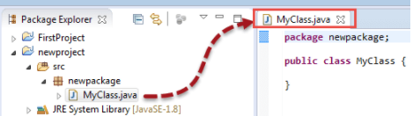
Configure Eclipse IDE with WebDriver
Create a new class inside the package
In this step,
Right-click on "newproject" and select Properties.
On the Properties dialog, click on "Java Build Path".
Click on the Libraries tab, and then
Click on "Add External JARs..“
When you click on "Add External JARs.." It will open a pop-up window. Select the JAR files from previously downloaded Selenium folder.

Slide 9
Driver definition
Sample Firefox driver:
System.setProperty("webdriver.firefox.marionette"," pathofIEdriver \\geckodriver.exe");
Webdriver driver = new FirefoxDriver();
Note: Starting Firefox 35, you need to use gecko driver created by Mozilla for Web Driver. Also, if the code does not work, downgrade to Firefox version 47 or below. Gecko has compatibility issues with recent versions of Firefox.
Sample Chrome Driver:
System.setProperty("webdriver.chrome.driver", "pathofchromedriver\\chromedriver.exe");
driver = new ChromeDriver();
Sample IE Driver code:
System.setProperty("webdriver.ie.driver"," pathofIEdriver IEDriverServer.exe");
WebDriver driver = new InternetExplorerDriver();
Some specific settings need for IE browser to work with selenium:
Enable protected mode for all zones You need to enable protected mode for all zones from Internet Options -> Security tab. To enable protected mode for all zones
Set IE browser's zoom level 100%
Open Internet Explorer browser. Go to menu View -> Zoom -> Select 100%

