Slide 1
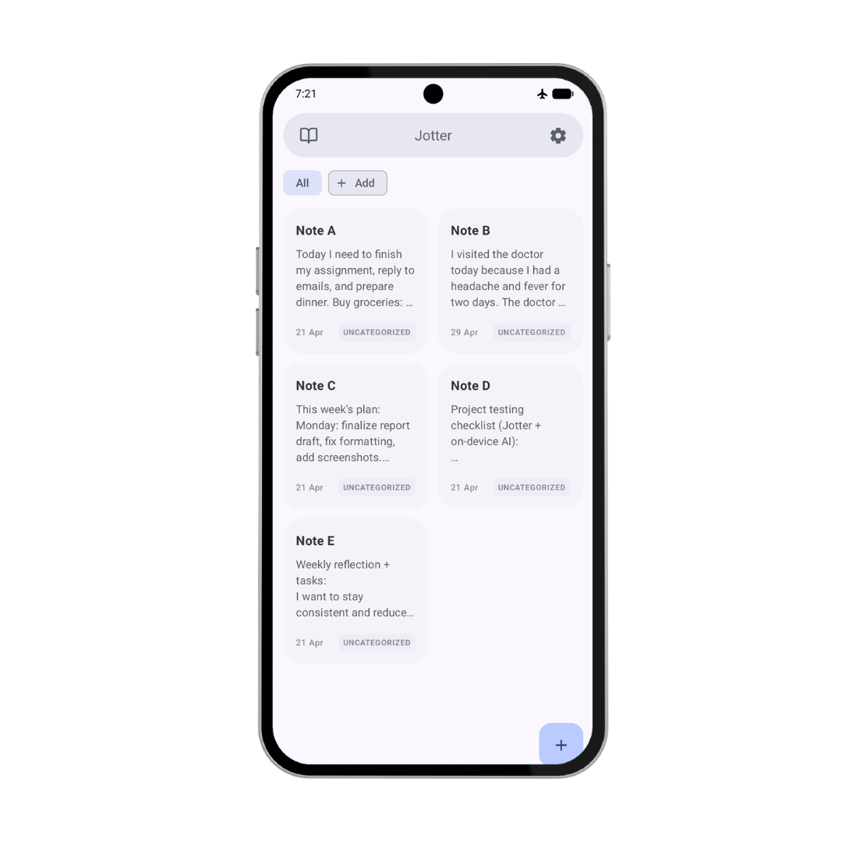
Privacy-First Intelligent Note Management using On-Device Generative AI
CS-595-54 Termination Project
Advisor: Prof. Zeyu Ding
Presenter:
Sweta Mishra
Binghamton University, SUNY
May 2026

Slide 2
Motivation Privacy-First Notes with Local AI
Privacy-first: On-device processing for sensitive notes
Offline access: AI support without active internet
Productivity support: Fast summarization and rewriting inside the app
Key challenge:
Cloud-based AI may require internet access and external note processing.
This project bridges the gap with on-device AI:
Local summarization
Tone rewriting
Offline execution

Slide 3
Project Scope and Implementation Scope: Privacy-first, on-device AI features for the Jotter Android note-taking app.
Smart Offline Summarizer Generates concise summaries from notes
AI Tone Changer Rewrites notes in Professional or Academic style
Performance Benchmarking Measures latency, throughput, and heap usage

Slide 4
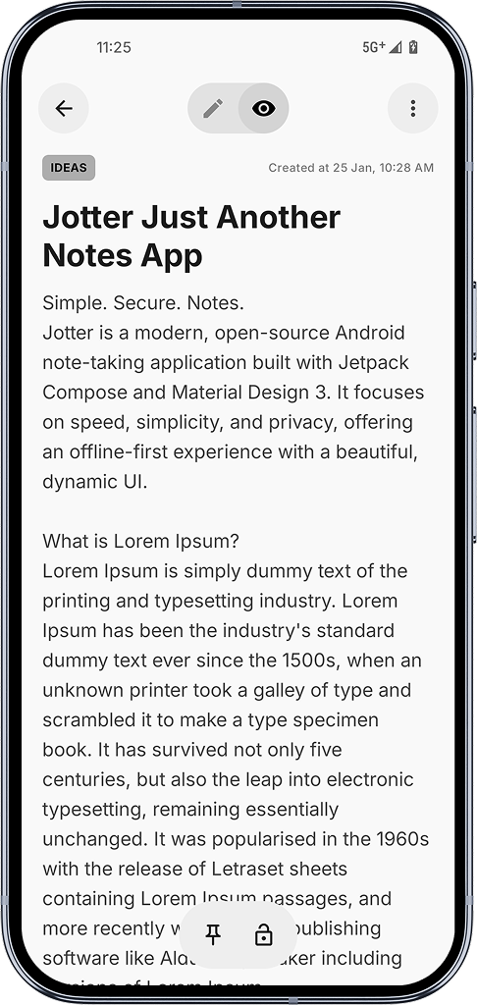
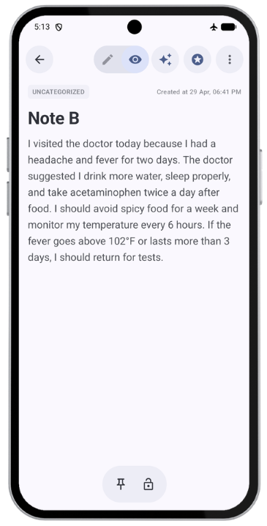
Base App vs Enhanced App
AI Tone Changer
Smart Offline Summarizer
Original Jotter
Create, view, and edit notes
Local Room Database storage
No AI assistance
Enhanced Jotter
Smart offline summarization
Tone rewriting
Performance benchmark metrics
Offline, on-device execution

Slide 5
How It Works
Benchmark Metrics
User Note
AI Action
ViewModel
AI Service
MediaPipe LLM
Local Gemma 3 1B Model
AI Result Dialog

Slide 6
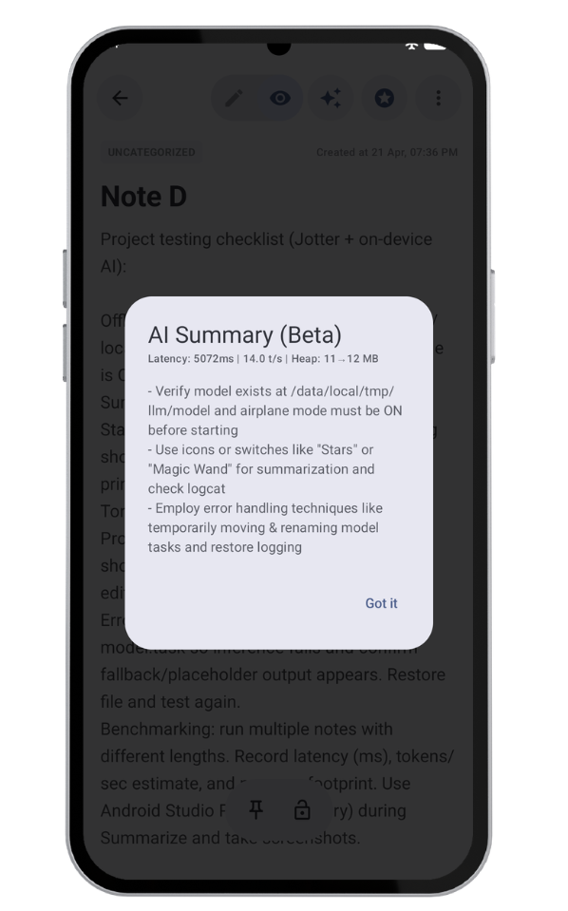
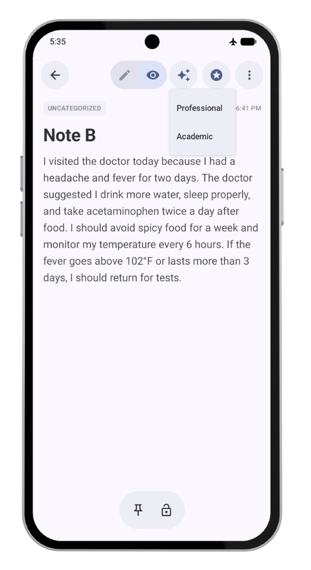
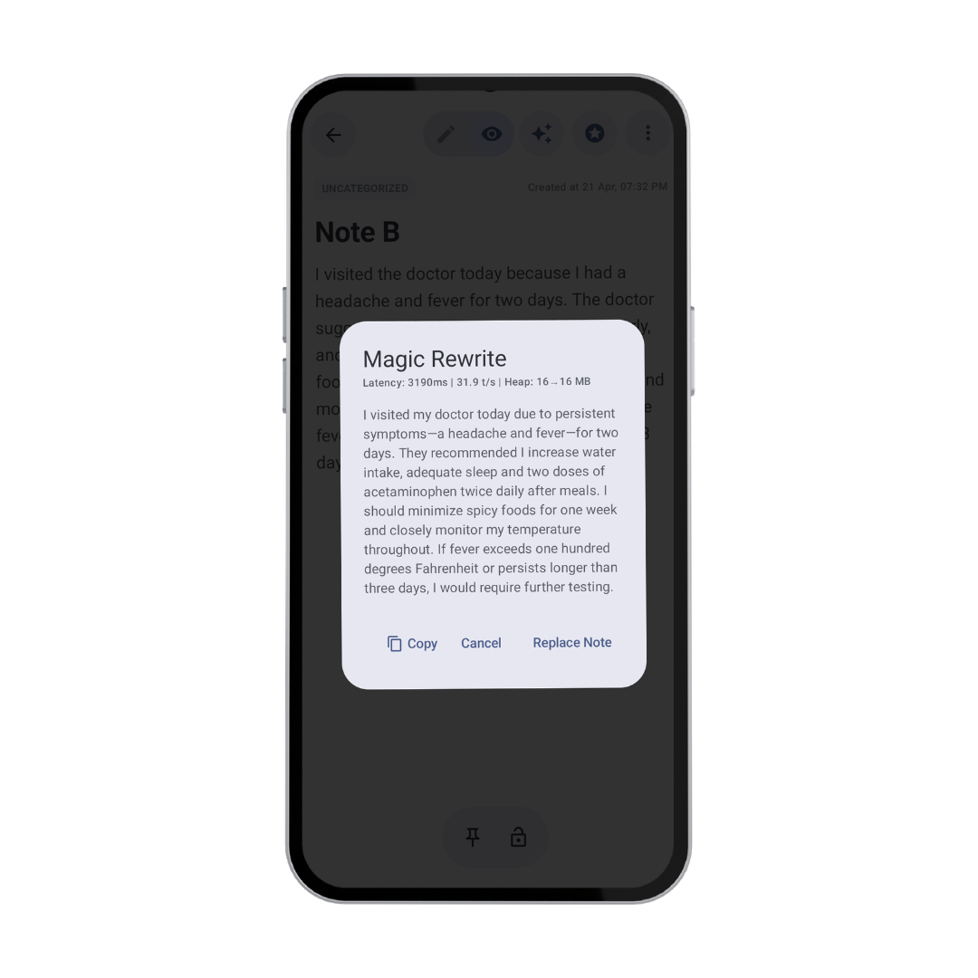
User Interface for AI Features in the Note Screen
Image: Smart Offline Summarizer Dialog
Tone style selection: Professional / Academic
Image: Magic Rewrite Dialog

Slide 7
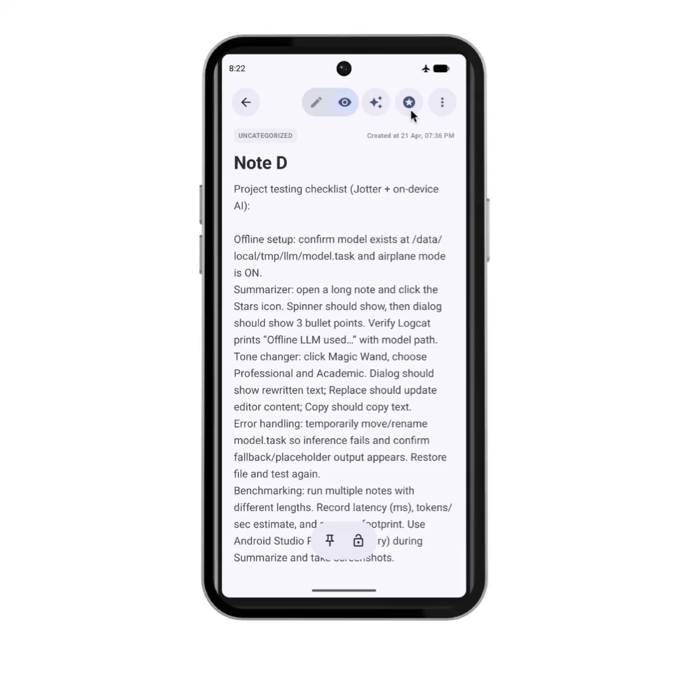
Smart Offline Summarizer
Generates a summary of a user note
Uses MediaPipe LLM Inference API with local Gemma 3 1B model
Displays output in “AI Summary (Beta)” with benchmark metrics

Slide 8
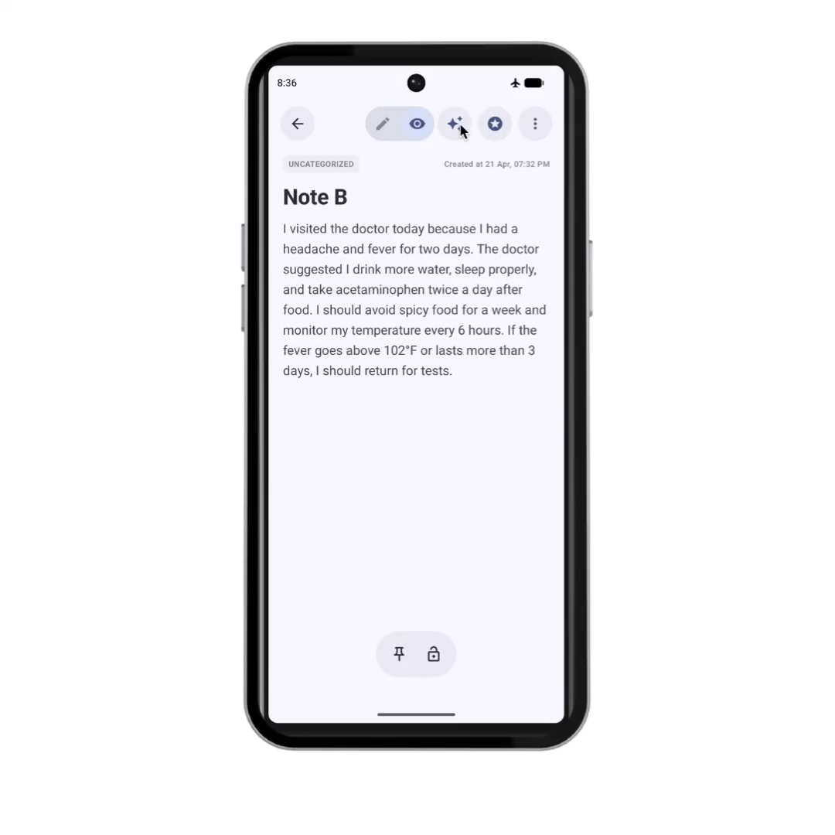
AI Tone Changer
Supports Professional and Academic styles
Displays output in the “Magic Rewrite” dialog
Allows Copy, Cancel, or Replace Note
Aims to preserve meaning while changing tone

Slide 9
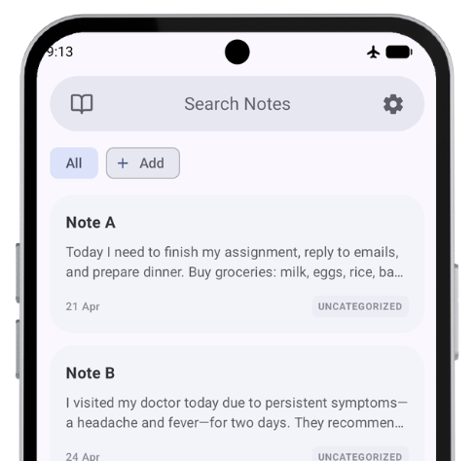
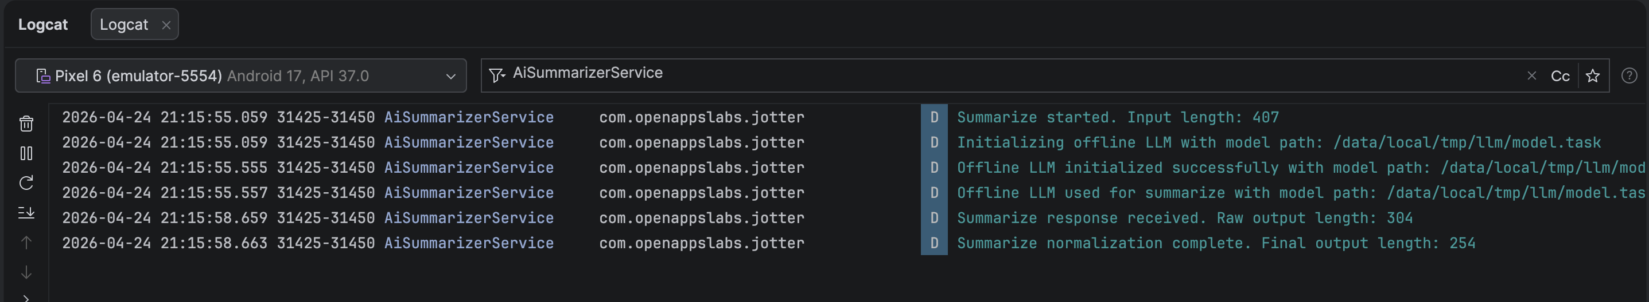

Privacy-First Offline Testing
Tested with airplane mode enabled
Logcat confirmed local model path
AI features ran without an external cloud API call
Image: App accessible in airplane mode
Image: Logcat confirms offline LLM initialization using local model path

Slide 10
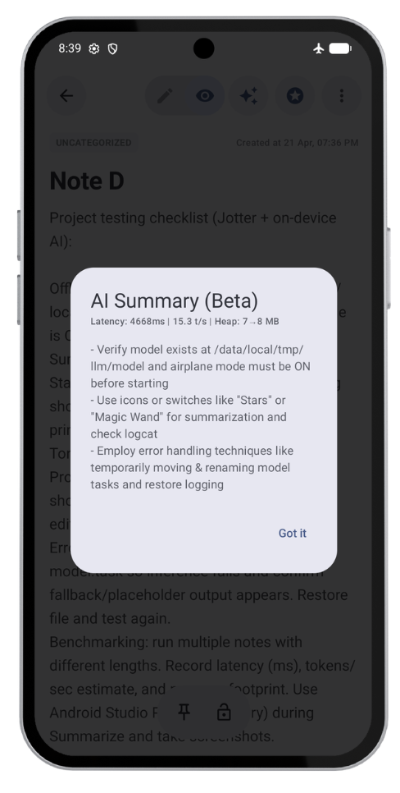
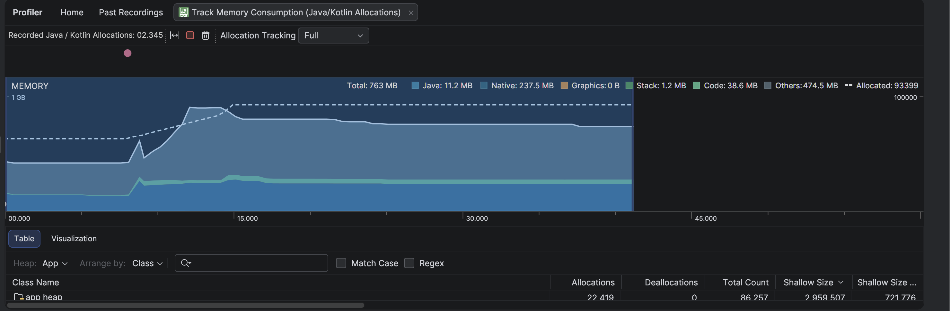
Performance Benchmarking and Memory Usage
Measured latency, approximate throughput, and heap usage
Displayed metrics inside AI result dialogs
Verified memory behavior using Android Studio Profiler
Image: Android Studio Profiler showing memory usage during inference
Image: AI result dialog showing runtime metrics

Slide 11
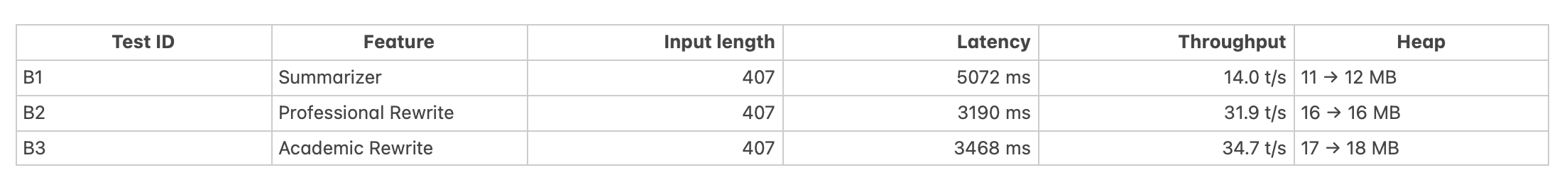
Evaluation Results
All three implemented AI features completed successfully.
Latency, approximate throughput, and heap usage were recorded during testing.
Local AI execution produced measurable performance results.
Image: Benchmark results from summarization and rewrite test

Slide 12
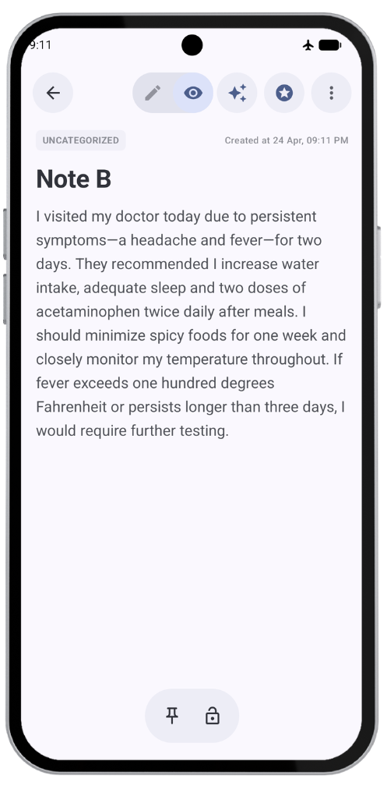
Storage and Persistence
Notes are stored locally using Room Database.
Magic Rewrite output is shown before updating the note.
Tone rewrite replaces the note only after user confirmation.
Rewritten note remains available after reopening.
Image: Magic Rewrite dialog
Image: Rewritten note after replacement

Slide 13
Final Outcome
Smart offline summarization was implemented and tested
Professional and academic tone rewriting were completed
Runtime benchmarking and memory usage were measured
Offline execution was verified using airplane mode and Logcat
Local storage and persistence were verified using Room Database

Slide 14
References
Google AI Edge, “LLM Inference guide for Android,” MediaPipe Solutions. [Online]. Available: https://ai.google.dev/edge/mediapipe/solutions/genai/llm_inference/android
Google AI for Developers, “Gemma models overview.” [Online]. Available: https://ai.google.dev/gemma/docs
LiteRT Community, “Gemma3-1B-IT,” Hugging Face model repository. [Online]. Available: https://huggingface.co/litert-community/Gemma3-1B-IT/tree/main
Android Developers, “State and Jetpack Compose.” [Online]. Available: https://developer.android.com/develop/ui/compose/state
Android Developers, “ViewModel overview.” [Online]. Available: https://developer.android.com/topic/libraries/architecture/viewmodel
Android Developers, “Save data in a local database using Room.” [Online]. Available: https://developer.android.com/training/data-storage/room
S. Mishra, “Jotter: Privacy-First Intelligent Note Management using On-Device Generative AI,” GitHub repository. [Online]. Available: https://github.com/mishrasweta088/Jotter

Slide 15
Thank You
Questions?
Privacy-First Intelligent Note Management using On-Device Generative AI CS-595-54 Termination Project Sweta Mishra

