Slide 1
Quantium QVI Chips Category
Retail Transaction Analysis
A comprehensive analysis of QVI's retail transaction data covering sales performance, customer purchasing behavior, product and brand performance, store performance, and pack-size preferences across 272 stores and 114 unique products.
$1,934,415
263,127
Total Revenue
Transactions
72,637
272
Unique Customers
Stores

Slide 2

Project Overview
Analytical Objectives
Tools & Dataset
Sales Performance
Python Ecosystem
Data Source
Understand overall revenue trends, monthly fluctuations, and day-of-week patterns across the full analysis period.
Python, Pandas, NumPy, and Matplotlib used for data processing, aggregation, and visualization.
Excel-based transaction data containing transaction-level records across all stores and customers.
Customer Behavior
Examine purchasing frequency, transaction values, and repeat-customer dynamics to identify loyalty opportunities.
Dataset Fields
Field | Description
Transaction ID | Unique identifier per transaction
Customer / Loyalty Card No. | Customer identifier for loyalty tracking
Store Number | Store location identifier
Product Name & Number | SKU-level product identification
Product Quantity | Units purchased per line item
Total Sales | Revenue value per transaction line
Transaction Date | Date of purchase for time-series analysis
Product & Brand Performance
Identify top-performing products, brands, and pack sizes driving category revenue concentration.
Store Performance
Evaluate store-level revenue contribution and identify high-performing locations for strategic focus.

Slide 3
Overall Business Performance
The QVI chips category delivered $1,934,415 in total revenue across the analysis period, spanning 272 stores, 114 unique products, and over 72,000 customers. Key headline metrics are summarised below.
$1.93M
505K
Total Revenue
Units Sold
Across all stores and products in the analysis period
Total product units transacted across the network
263K
72.6K
Transactions
Unique Customers
Total number of individual purchase transactions
Distinct loyalty card holders active in the period
114
272
Unique Products
Stores
SKUs active across the chips category
Retail locations included in the analysis
$7.35
1.92
Avg. Transaction Value
Avg. Units / Transaction
Mean spend per transaction across all customers
Average number of units purchased per visit

Slide 4



Customer Purchasing Behavior
Transaction Value Metrics
Repeat Customer Rate: 73.7%
$7.35 — Average Transaction Value
$7.40 — Median Transaction Value
Mean spend per transaction across all loyalty card holders in the analysis period.
The median closely tracks the mean, indicating a relatively symmetric distribution of transaction values with limited skew from outliers.
73.7%
1.92 — Average Units per Transaction
Customers typically purchase fewer than two units per visit, suggesting single-pack purchasing is the dominant behavior.
Repeat Customers
Proportion of customers who purchased more than once during the analysis period
26.3%
Single-Visit Customers
Customers who transacted only once — a potential re-engagement target
The high repeat-customer rate of 73.7% indicates strong category loyalty and provides a significant opportunity for loyalty-based marketing and personalized promotions to deepen engagement and increase basket size.

Slide 5
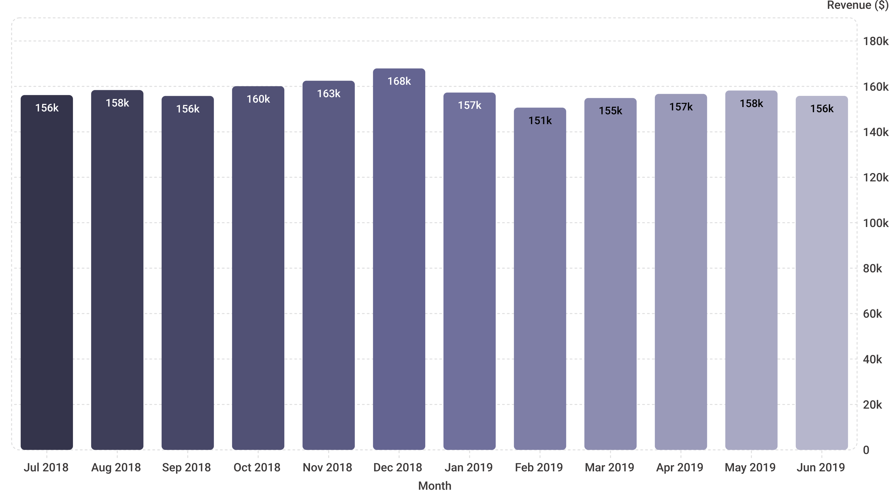
Monthly Sales Analysis
Sales remained relatively stable throughout the analysis period but showed identifiable stronger and weaker months. December 2018 was the peak month at $167,913.40, while February 2019 was the weakest at $150,665.00 — a variance of approximately $17,248 between the highest and lowest months.
Seasonal peaks in December and troughs in February provide a clear opportunity to plan targeted promotions and inventory adjustments around predictable demand cycles.

Slide 6
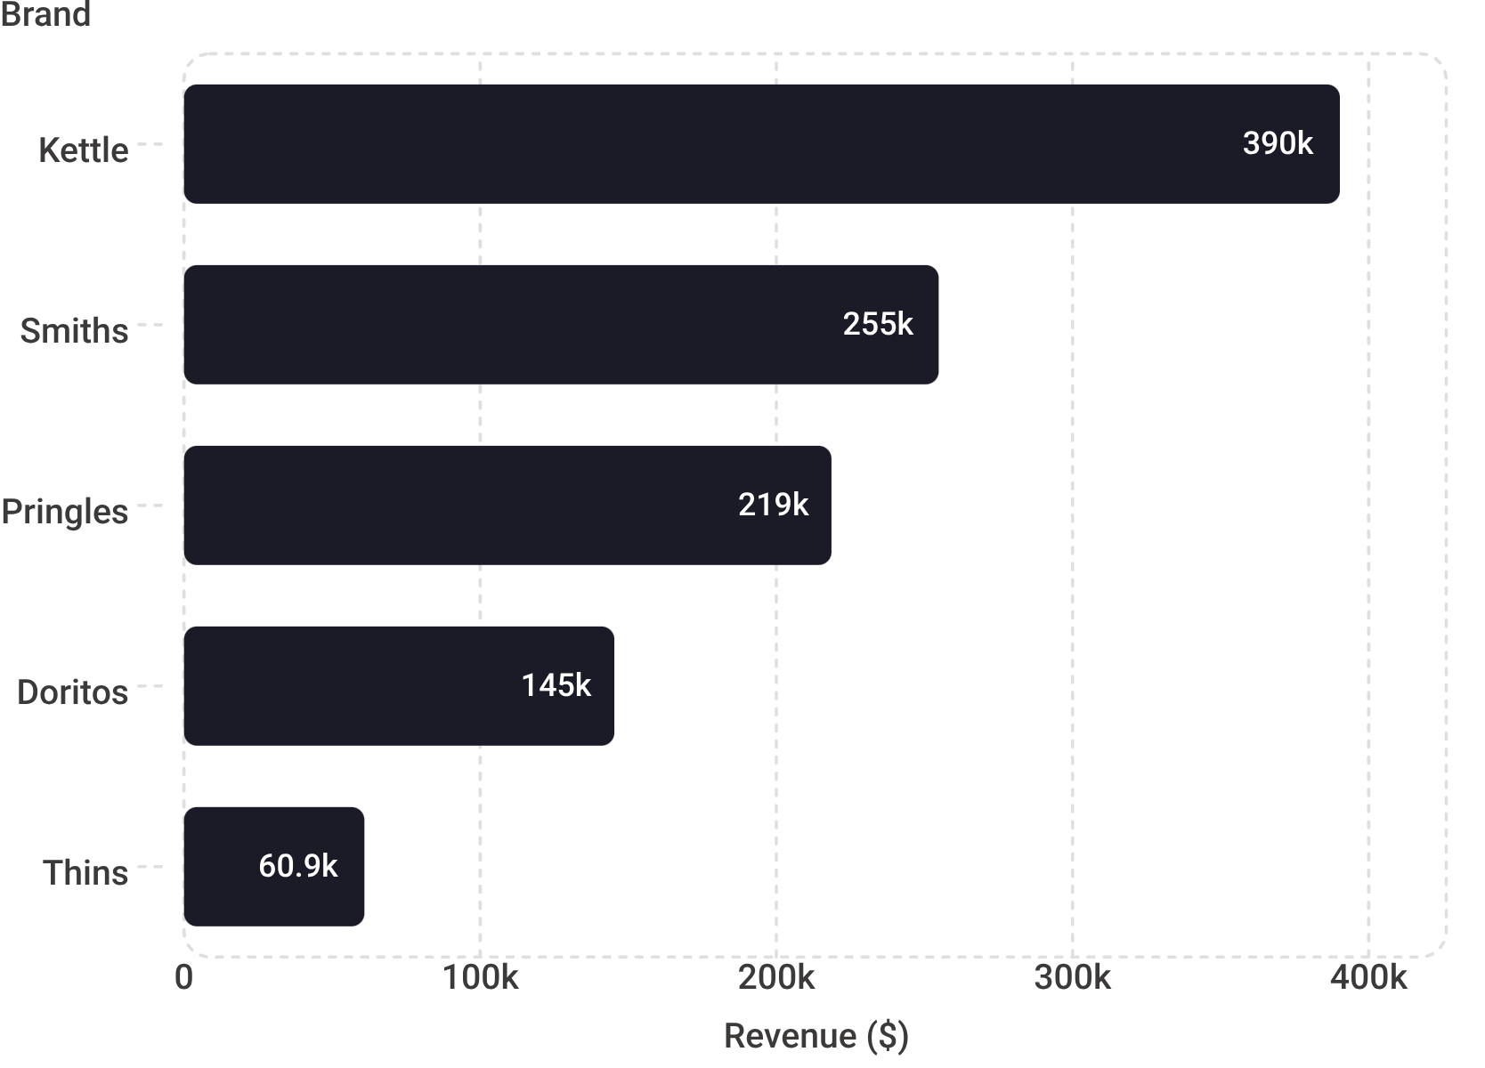


Product & Brand Performance Analysis
Product-Level Performance
Brand-Level Performance
The highest-revenue individual product was Dorito Corn Chp Supreme 380g, generating $40,352.00 across the analysis period. Critically, this top product accounted for only approximately 2.1% of total revenue, demonstrating that category revenue is broadly distributed across the 114-product range rather than concentrated in a single SKU.
Brand-level revenue is considerably more concentrated than product-level revenue. Kettle is the leading brand with $390,239.80 in revenue, and the top five brands collectively contributed 55.3% of total category revenue.
Top Product Revenue Share: 2.1%
Top 10 Products Revenue Share: 17.9%
Dorito Corn Chp Supreme 380g — $40,352.00. Low concentration at product level indicates a healthy, diversified product mix.
The top ten products collectively contribute less than one-fifth of total revenue, confirming broad distribution across the SKU range.
Top 5 brands = 55.3% of total revenue. These brands require priority inventory, shelf visibility, and promotional support.

Slide 7


Store & Pack Size Performance
Store Performance
Pack Size Performance
Store 226 was the highest-revenue individual store, generating $18,905.45 across the analysis period. Store-level performance analysis enables targeted resource allocation, inventory planning, and promotional investment for high-volume locations.
Pack size analysis reveals a strong consumer preference for larger formats. 175g products generated $477,112.40 — the highest revenue of any pack size — and products larger than 100g contributed approximately 97.2% of total revenue.
Store 226
272 Stores
175g — $477,112.40
97.2% from packs >100g
$18,905.45 — Highest-revenue store in the network
Total network size included in the analysis
Highest-revenue pack size. Strong shelf placement and promotional visibility are critical for this format.
Products larger than 100g dominate category revenue. Smaller pack sizes represent a negligible share of total sales.
97.2%
Revenue from >100g Packs
Larger formats overwhelmingly drive category value
2.8%
Revenue from ≤100g Packs
Small formats contribute minimally to total revenue

Slide 8
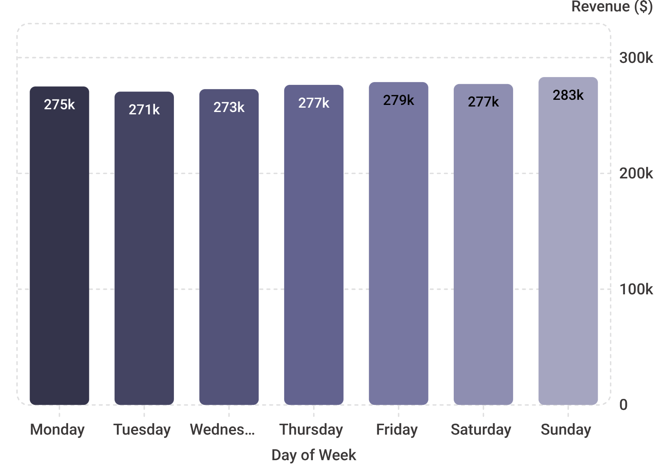


Day-of-Week & Revenue Concentration Analysis
Day-of-Week Revenue Distribution
Revenue Concentration Summary
Sunday is the highest-revenue day at $283,229.10, while Tuesday is the lowest at $270,644.00 — a difference of approximately $12,585. Weekend days (Saturday and Sunday) collectively account for 28.9% of total weekly revenue, consistent with higher consumer footfall during non-working days.
Revenue concentration differs markedly between brand and product levels, reflecting the structural dynamics of the chips category.
Metric | Revenue Share
Top 5 Brands | 55.3%
Top 10 Products | 17.9%
Top 1 Product | 2.1%
Weekend Revenue | 28.9%
Brand-level revenue is considerably more concentrated than product-level revenue. The top 5 brands account for more than half of all category revenue, while no single product exceeds 2.1% — indicating a fragmented but brand-loyal product landscape.
Sunday: $283,229.10
Tuesday: $270,644.00
Highest-revenue day — peak consumer shopping activity
Lowest-revenue day — primary target for mid-week promotional activity

Slide 9
Recommendations
Based on the transaction analysis, five strategic recommendations are identified to improve category revenue, customer retention, and operational efficiency.
1
Target Weak Sales Periods
Deploy targeted promotions during February and Tuesday — the weakest month and day respectively. Tactics should include multi-buy offers, limited-time discounts, bundle promotions, and loyalty-card exclusive offers to stimulate demand during identified low-traffic periods.
2
Prioritize 175g Products
The 175g pack size generated $477,112.40 and is the dominant revenue format. Provide stronger shelf placement, enhanced promotional visibility, reliable inventory availability, and bundle opportunities to maximize performance of this critical pack size.
3
Strengthen Leading Brand Strategy
Maintain strong inventory and promotional support for the top five brands which collectively drive 55.3% of category revenue. Simultaneously evaluate lower-performing brands for growth opportunities, rationalization, or repositioning to optimize shelf space allocation.
4
Use Customer Loyalty Data
With a 73.7% repeat-customer rate, the loyalty card dataset provides a rich foundation for personalized offers, repeat-purchase campaigns, cross-selling opportunities, customer-specific promotions, and structured loyalty rewards to increase lifetime value.
5
Investigate High-Volume Customer Activity
Customer 226000 recorded 400 units across only 2 transactions — an anomalous pattern that warrants investigation to determine whether this represents legitimate bulk purchasing behavior or a data-quality issue requiring correction before further analysis.

Slide 10
Key Findings & Conclusion
Key Findings
Conclusion
01
The QVI chips category demonstrates a healthy and broadly distributed revenue base across 272 stores, 114 products, and over 72,000 customers. The business is not overly dependent on any single product, store, or customer segment, which provides structural resilience.
However, the analysis identifies clear opportunities for targeted intervention: addressing weak sales periods in February and on Tuesdays, capitalizing on the dominance of 175g pack sizes, reinforcing the leading brand portfolio, and leveraging the strong loyalty card dataset for personalized marketing.
Stable but Seasonal Revenue
Total revenue of $1,934,415 was broadly stable across the period, with December 2018 peaking at $167,913 and February 2019 troughing at $150,665.
02
Strong Customer Loyalty
Immediate Priority
Strategic Priority
A 73.7% repeat-customer rate demonstrates high category engagement and provides a strong foundation for loyalty-driven marketing strategies.
Promotional planning for February and Tuesday weak periods using loyalty-card offers and multi-buy mechanics.
Shelf and inventory optimization for 175g products and top-5 brands to protect and grow the 55.3% revenue concentration.
03
Brand Concentration
Data Quality
The top 5 brands account for 55.3% of total revenue, led by Kettle at $390,239.80, while product-level revenue is broadly distributed with no single SKU exceeding 2.1%.
Investigate Customer 226000 anomaly (400 units / 2 transactions) before incorporating loyalty data into campaign targeting.
04
The combination of a loyal customer base, a resilient multi-brand portfolio, and clear seasonal and format-level patterns positions the QVI chips category well for data-driven growth initiatives in the next planning period.
Large Pack Dominance
Products larger than 100g contribute 97.2% of total revenue, with the 175g format alone generating $477,112.40 — the strongest individual pack size.
05
Weekend & Sunday Peak
Sunday is the highest-revenue day at $283,229.10, with weekends collectively representing 28.9% of total weekly revenue.

