Slide 1
Audio to Indian Sign Language Converter using Machine Translation and NLP Techniques.
By
Yash Mishra

Slide 2
PROBLEM STATEMENT
Sign language is a visual language that is used by deaf people as their mother tongue. Unlike acoustically conveyed sound patterns, sign language uses body language and manual communication to fluidly convey the thoughts of a person. Due to considerable time required in learning the Sign Language, it becomes difficult to communicate with these specially abled people, and thus creates a communication gap.

Slide 3
Objectives
This Audio to Sign Language converter aims at :
Providing information access and services to deaf people in Indian sign language.
Developing a scalable project which can be extended to capture whole vocabulary of ISL through manual and non-manual signs
It can be developed as a desktop or mobile application to enable specially abled people to communicate easily and effectively with others.

Slide 4
LITERATURE REVIEW
Ref. No. | Title of the paper | Methodology | Pros | Cons
1 | Software Based Sign Language Converter | The cue symbols (ASL Gestures) to speech using graphical programming (LabVIEW) | Reducing the limitation of the existing system, thereby eliminating the need for a translator. This software-based approach allows real-time translation with easy-to-use controls for the user. | There are several Hardware and Software constraints which decreases the portability of the program.
2 | Double Handed Indian Sign Language to Speech and Text | The double handed Indian Sign Language is captured as a series of images and it's processed with the help of MATLAB and then it's converted to speech and text. | The experiment was carried out with bare hands, thus limitations by using data gloves is overcome. | Min Eigen value theorem is difficult to implement in matlab.
3 | The Text Analysis and Processing of Thai Language Text to Speech Conversion System | system is divided into front-end and back-end analysis module speech synthesis module | accuracy rate is 97.83%, the outside set’s test accuracy rate is 97.61%. | Thai text normalization difficulties expressed mainly for two indexes: the first is the judgment of non-standard word recognition; the second is the ambiguity of the disambiguation carried out by non-standard word processing
4 | Sign Language Recognition Using Modified Convolutional Neural Network Model | top-tier models in Action Recognition which is i3d inception this model is also a new Action Recognition model with very high accuracy | Good training accuracy | Very low validation accuracy. Can do a lot more things with this model, like freeze the layers, remove some inception module, remove the transfer learning, and change the fully connected layer into another deep learning model.

Slide 5
RESULTS AND INFERENCES
Ref. No | Title of the paper | Methodology | Pros | Cons
5 | A Translator for American Sign Language to Text and Speech | AdaBoost and Haarlike classifiers This paper proposed a system that can automatically detect static hand signs of alphabets in American Sign Language (ASL). | The overall success rate is 98.7%. The expected result of this system is able to correctly recognizing hand signs, converting these recognized signs into letters, after that combining them into words, sentences in textual format and then translating to audio format. | Lot of scope is here in this field. A Universal anguage Translator can be made with this much efficiency.
6 | Machine Learning Techniques for Indian Sign Language Recognition | Indian sign language recognition using machine learning algorithm with the help of MATLAB. | For K-NN techniques with K=1, achieved 100% recognition rate whereas using back propagation technique achieved 94-96%. | The conjugate gradient approach is often used as an iterative algorithm, applicable to sparse structures that are too large for direct implementation or other similar methods, such as the decomposition.
7 | Research on text sentiment analysis based on CNNs and SVM | Convolutional Neural Networks (CNNs) model combined with SVM text sentiment analysis is used. | The text effective analysis model proposed in this paper based on CNNs and SVM will effectively improve the performance of classifying text. | classification capability of fully connected classification layer is weak for nonlinear separable data.

Slide 6
PROPOSED SOLUTION
Sign language is a visual language that is used by deaf people as their mother tongue. Unlike acoustically conveyed sound patterns, sign language uses body language and manual communication to fluidly convey the thoughts of a person. Due to considerable time required in learning the Sign Language, people find it difficult to communicate with these specially abled people, creating a communication gap. Thus, we propose an application which takes in live speech or audio recording as input, converts it into text and displays the relevant Indian Sign Language images or GIFs.

Slide 7
PROPOSED SOLUTION
Phases of the Project
Obtain audio from the Microphone and perform Speech Recognition using sphinx.
Convert the speech recognized to text.
Display relevant images or GIFs as applicable.
Tools/Skillset required:
Front-end using EasyGui.
Speech as input through microphone using PyAudio.
Speech recognition using Google Speech API.
Text Pre-processing using NLP.
Dictionary based Machine Translation.

Slide 8
PROPOSED SOLUTION
Audio to Sign Language Translator
1. Start
2. Getting the Speech.
2.1. Listen for 1 second and calibrate the energy threshold for ambient noise
levels.
2.2. Listen the Speech using Microphone.
Now the energy threshold is already set to a good value, and we can
reliably catch speech right away.
3. Recognise the Speech.
4. Convert Speech to Text.
4.1. Make the Text to lowercase for further manipulation.
5. Detected Text
5.1. If “goodbye” then exit.
5.2.Else if Detected Text in predefined Dictionary Words. Display
respective GIFs of the Phrase.
5.3. Else Count the Letters of the Word/Phrase.
5.3.1. Display the Visual of the phrase with some delay of Actions.
5.4. Continue all the steps from Step 3, and continue till the Speech Ends.
6. If Error in Step 2, That is if no Speech Detected then display error message
“Could not listen”.

Slide 9
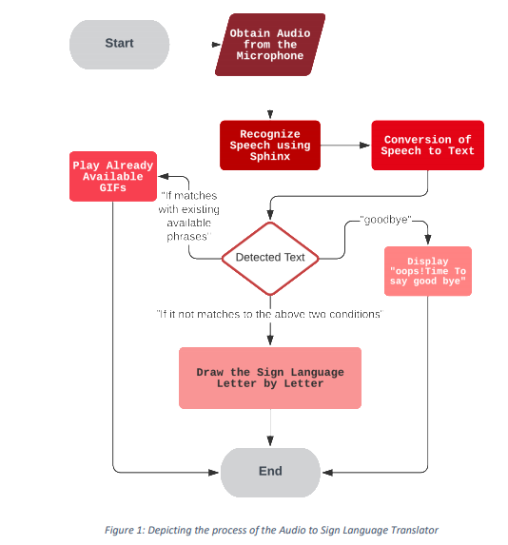
PROPOSED SOLUTION- FLOWCHART

Slide 10
INNOVATION AND NOVELITY
Around 466 million people worldwide have disabling hearing loss (1), and 34 million of these are children.
It is estimated that by 2050 over 900 million people will have disabling hearing loss.
Hearing loss may result from genetic causes, complications at birth, certain infectious diseases, chronic ear infections, the use of particular drugs, exposure to excessive noise, and ageing. Source: World Health Organization

Slide 11
INNOVATION AND NOVELITY
As per the data from WHO it is estimated 900 million people will have Hearing Loss disability, after all this there is not much available technology to make communication with deaf people. We aim to provide a technology to ease the communication.
Generally, to have communication people need to either know the sign language or they need the human translator to make the communication possible.
To provide the solution we will make a software that takes an input in the form of speech and displays the respective Sign Language for the phrase.

Slide 12
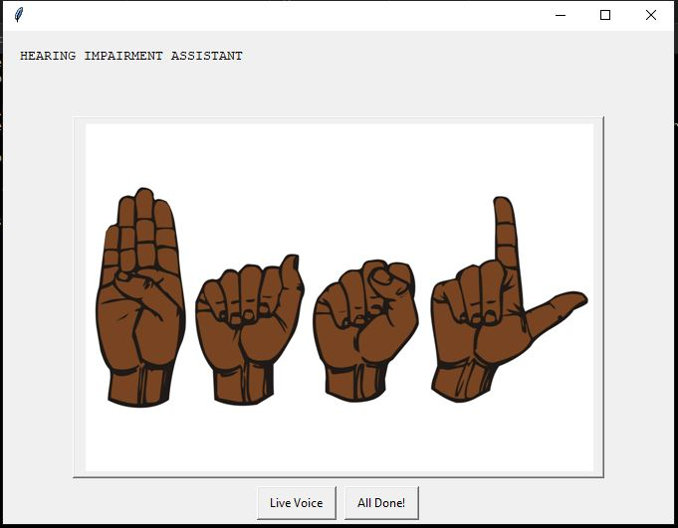
RESULTS AND INFERENCES

Slide 13
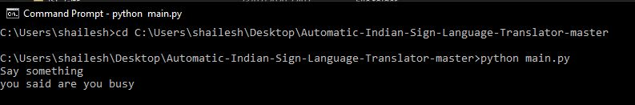
RESULTS AND INFERENCES

Slide 14
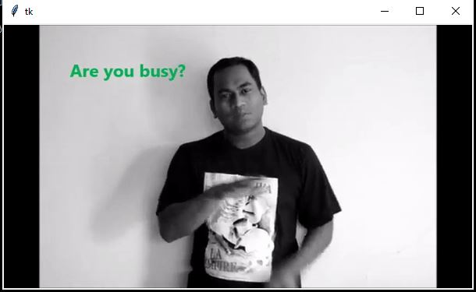
RESULTS AND INFERENCES

Slide 15
CONCLUSION
Due to considerable time required in learning the Sign Language, people find it difficult to communicate with these specially abled people, creating a communication gap. Thus the Audio to Sign Language converter is important and significant because it helps in providing information access and services to deaf people in Indian sign language and develops a scalable project which can be extended to capture whole vocabulary of ISL through manual and non-manual signs. It also can be developed as a desktop or mobile application to enable specially abled people to communicate easily and effectively with others.

