Slide 1
Customer Care and Billing System for Data / Broadband/ FTTH/DTV
May 23, 2014

Slide 2
Agenda
1
Introduction & Company Overview
2
Our Vision and Strategy
3
CCBS Overview
4
Financials
5
Backup Points

Slide 3



CCBS Solution
Customer
CCBS - CSR Portal
Order
Management
Customer &
Account
Management
Billing
&
Pyments
Package / Plan
Management
User
Management
Reports
CCBS - Customer Portal
Payment Gateway
Manual Provisioning
Account
Balance
Bill View
Bill
Payments
Service
Requests
Automated Provisioning & Mediation
(Optional)
Switches
/ Servers
CCBS - Optional Modules
Provisioning

Slide 4
CCBS: Features
CSR Portal
Order Management
Customer & Account Management
Billing and Payments
Package/Plan Management
User Management
Reports
Customer Portal - Web Self Care (WSC)
View Account and Bill Details Online
Online Bill Payments
Submit Service Request Online

Slide 5
Order Management

Slide 6

New Order Capture Channels
CSR
Dealer
Application
Form
. . . . . .
. . . . .
Online
Front Office
Customer
Web
Head Office
Regional Office
Offline
(fax, email etc)
FSS
Create Order
Sales Agent

Slide 7
Typical Order Process
1.
Credit
Assessment
2.
Selection
of Plan
3.
Add Personal
Data
4.
WSC Login
Creation
5.
Enable
Services
7.
Provisioning of CPE
6.
Order
Completion

Slide 8
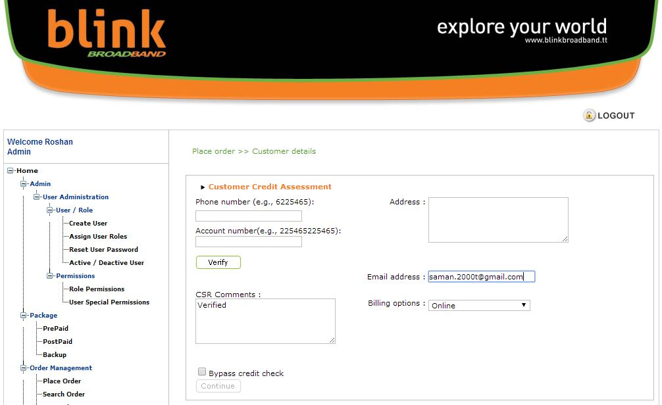
1. Credit Check

Slide 9
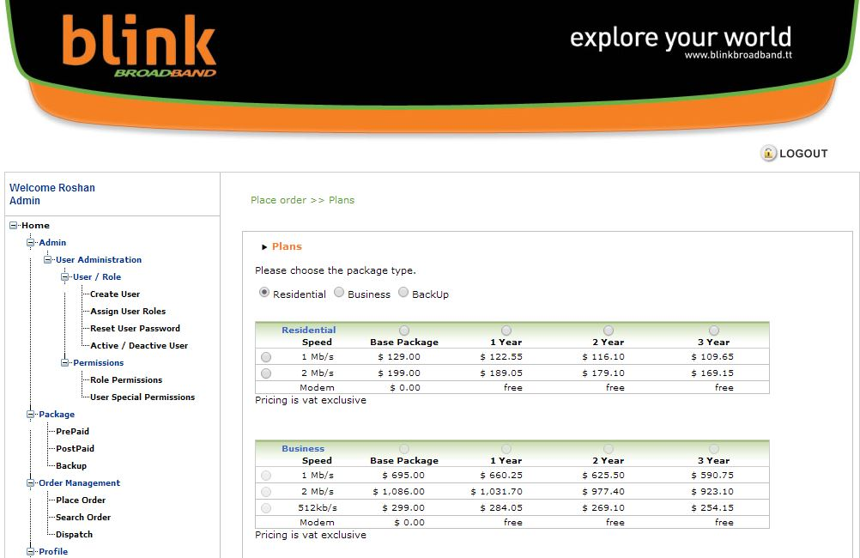
2. Selection of Plan

Slide 10
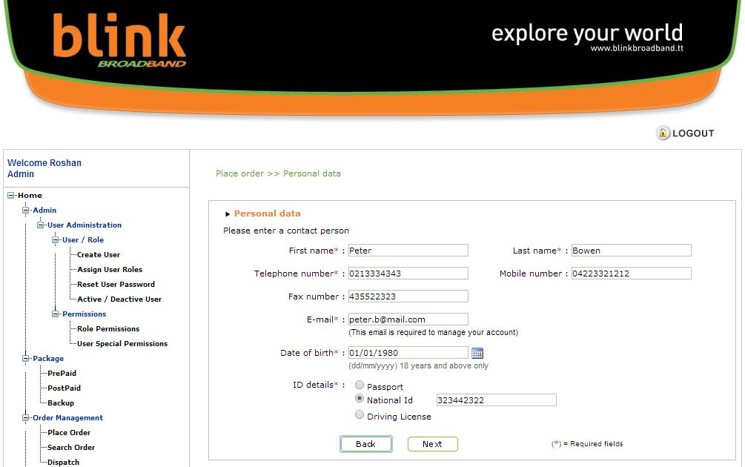
3. Add Personal Data

Slide 11
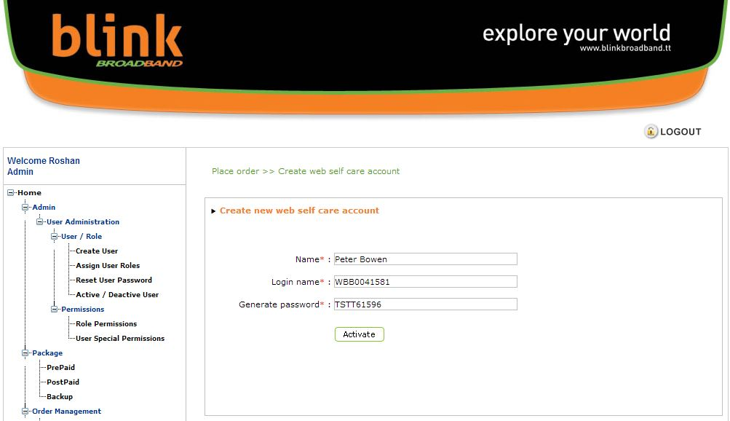
4. WSC Login Creation

Slide 12
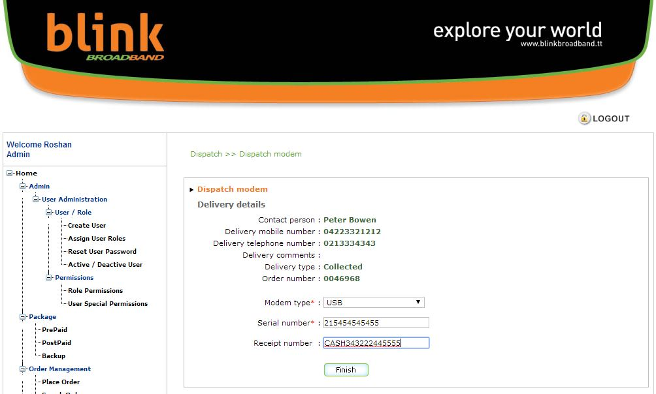
5. Enable Service

Slide 13
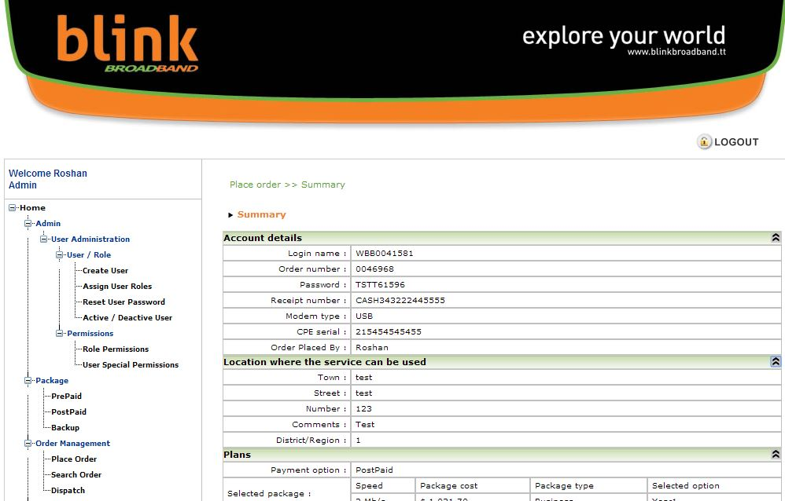
6. Order Completion - Screen 1

Slide 14
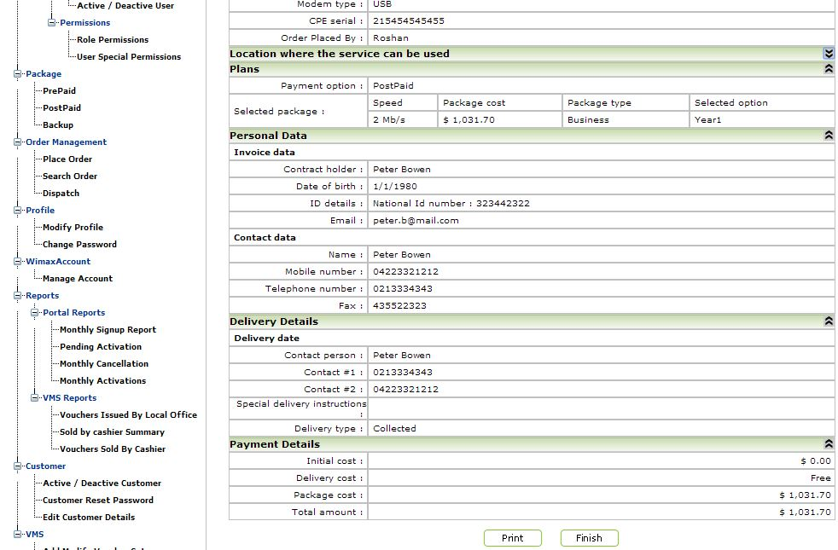
6. Order Completion - Screen 2

Slide 15
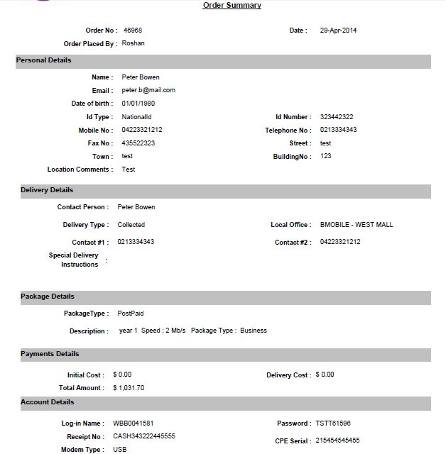
Order Summary - Report

Slide 16
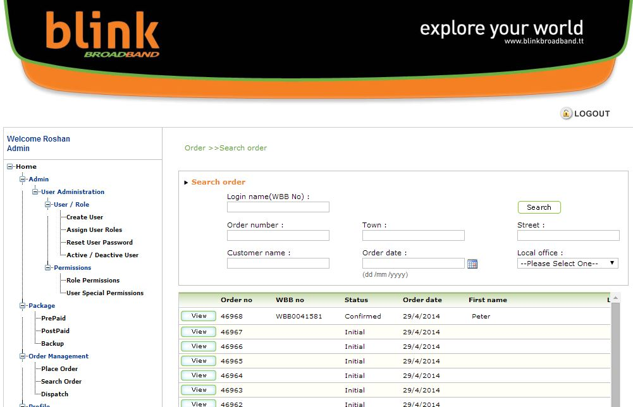
Search Order

Slide 17
CCBS: Features
CSR Portal
Order Management
Customer & Account Management
Billing and Payments
Package/Plan Management
User Management
Reports
Customer Portal - Web Self Care (WSC)
View Account and Bill Details Online
Online Bill Payments
Submit Service Request Online

Slide 18
Customer & Account Management

Slide 19
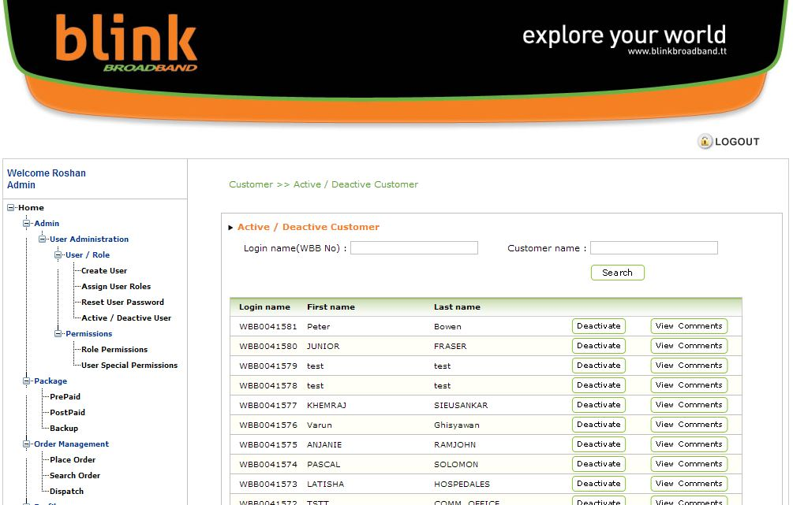
Activate / De-activate Customer

Slide 20
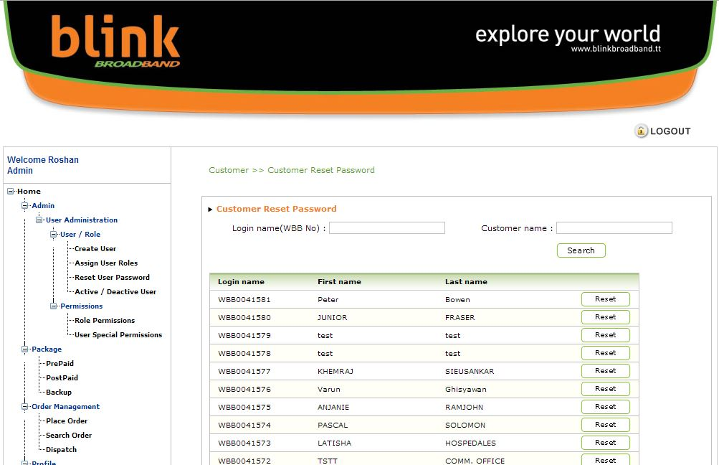
Customer Reset Password

Slide 21
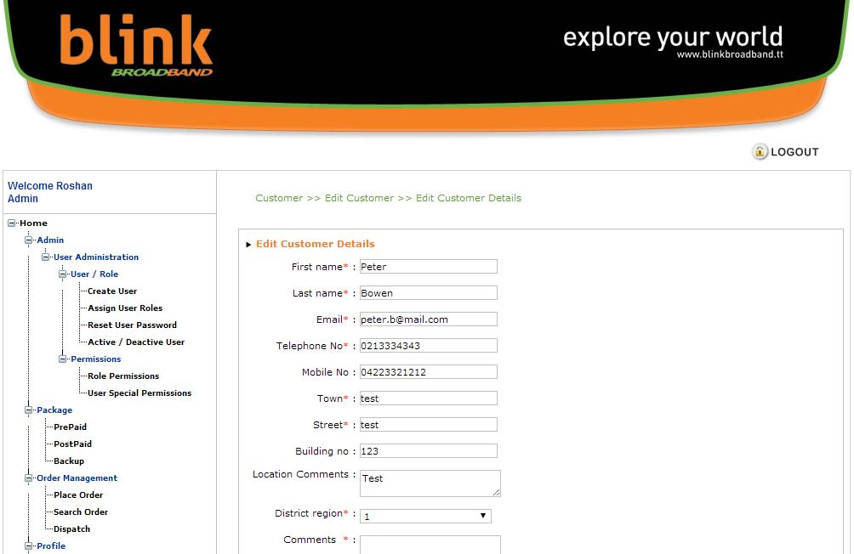
Edit Customer Details

Slide 22
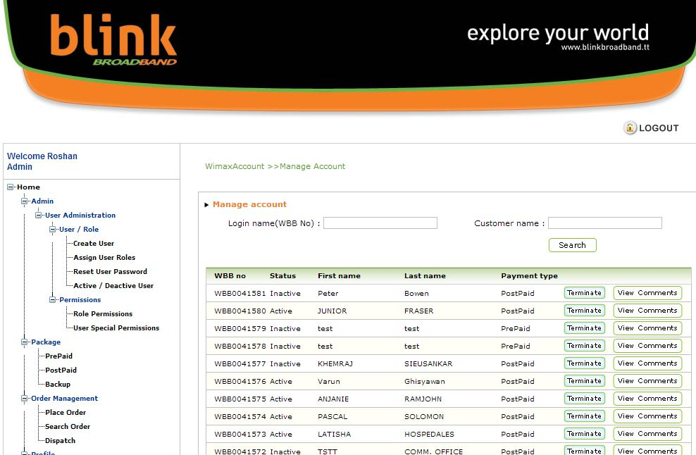
Manage Account

Slide 23
Other Features
View current and past bills
Change package / plan
View current outstanding and payment history

Slide 24
CCBS: Features
CSR Portal
Order Management
Customer & Account Management
Billing and Payments
Package/Plan Management
User Management
Reports
Customer Portal - Web Self Care (WSC)
View Account and Bill Details Online
Online Bill Payments
Submit Service Request Online

Slide 25
Billing & Payments

Slide 26
Billing & Payments
Monthly Billing on Package Rental
Generation of Bill Invoice
Billing History
Payment Collection for Bills / Invoice
Payment History
Billing and payment transactions data available for Finance System

Slide 27
CCBS: Features
CSR Portal
Order Management
Customer & Account Management
Billing and Payments
Package/Plan Management
User Management
Reports
Customer Portal - Web Self Care (WSC)
View Account and Bill Details Online
Online Bill Payments
Submit Service Request Online

Slide 28
Package / Plan Management

Slide 29
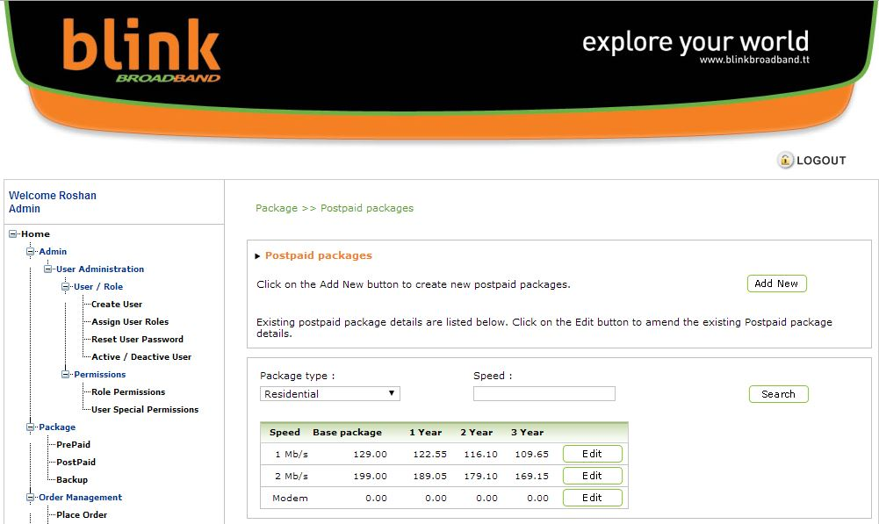
Package Creation

Slide 30
CCBS: Features
CSR Portal
Order Management
Customer & Account Management
Billing and Payments
Package/Plan Management
User Management
Reports
Customer Portal - Web Self Care (WSC)
View Account and Bill Details Online
Online Bill Payments
Submit Service Request Online

Slide 31
User Management

Slide 32
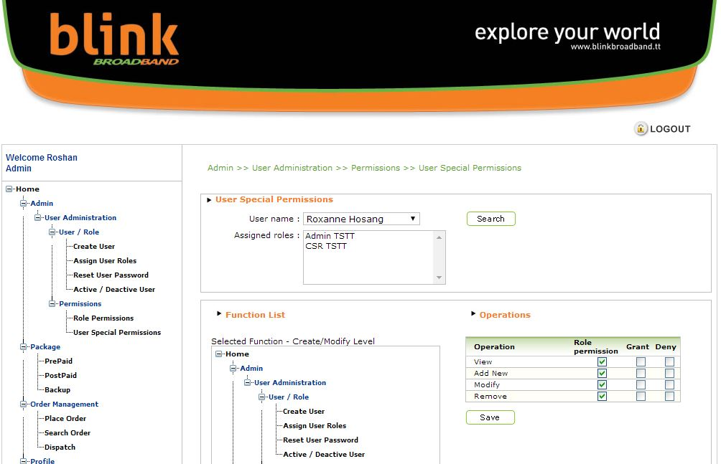
Assign Special Permissions

Slide 33
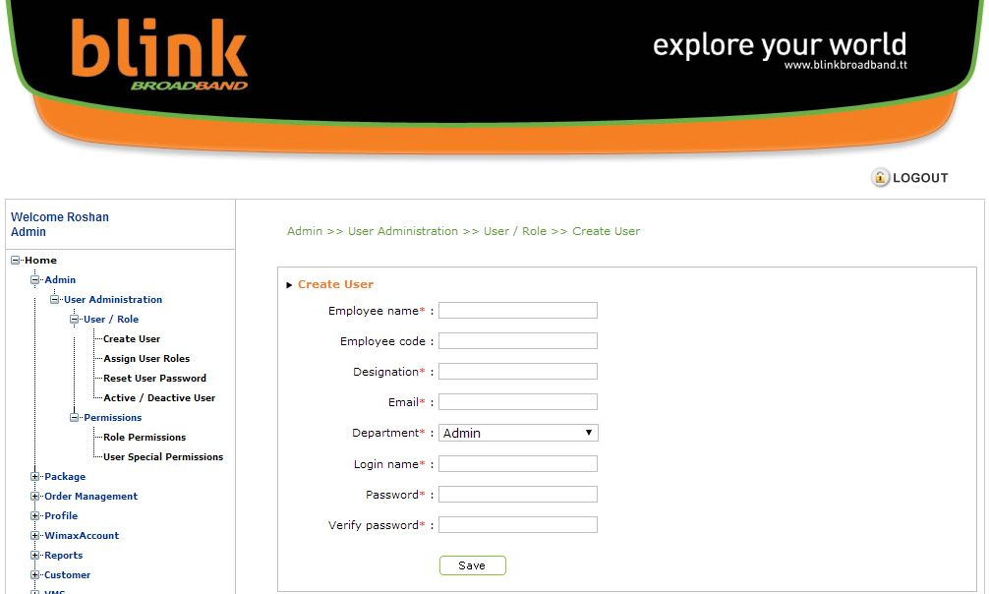
Create User

Slide 34
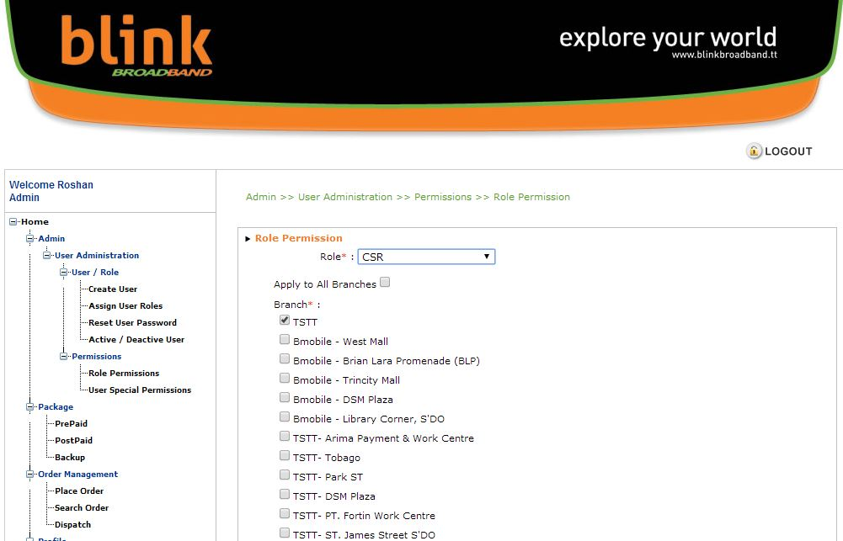
Assign User Roles

Slide 35
CCBS: Features
CSR Portal
Order Management
Customer & Account Management
Billing and Payments
Package/Plan Management
User Management
Reports
Customer Portal - Web Self Care (WSC)
View Account and Bill Details Online
Online Bill Payments
Submit Service Request Online

Slide 36
Reports

Slide 37
Key Reports
Order Processing Reports (e.g. New Orders, Activations, Deactivations, etc.)
Billing Reports (e.g. Billed Revenue)
Collection Reports (e.g. Debtors, Overdue Accounts, Payments)
Customer and Account Detail Reports (e.g. Customers, Accounts etc.)

Slide 38
CCBS: Features
CSR Portal
Order Management
Customer & Account Management
Billing and Payments
Package/Plan Management
User Management
Reports
Customer Portal - Web Self Care (WSC)
View Account and Bill Details Online
Online Bill Payments
Submit Service Request Online

Slide 39
Customer Portal - Web Self Care (WSC)

Slide 40

View Account and Bill Details
Makes inquiry:
Outstanding Requests,
Bill Details,
Payment History,
etc..
Customer
CSR
Gives Feedback
Displays
Info
Logs on to
Customer Portal
Displays
Info
Logs on to
Customer Care
Customer
Portal
(WSC)
CSR Portal

Slide 41
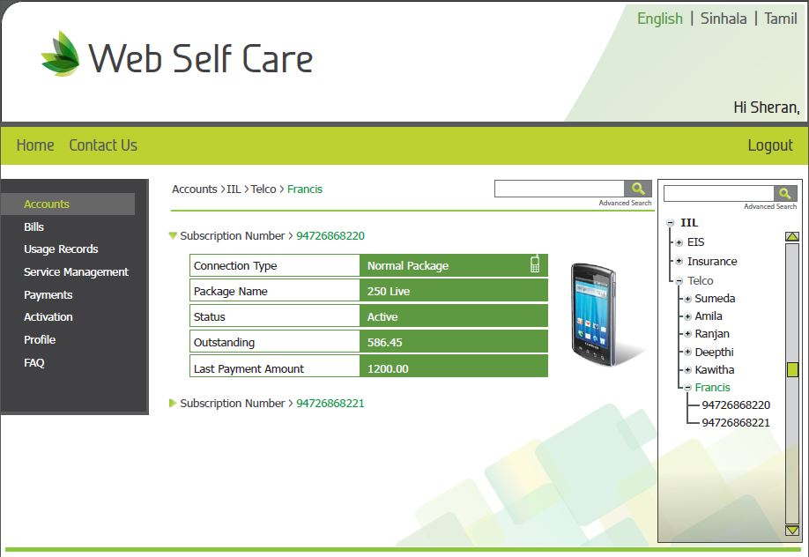
A Glimpse of Web Self Care...

Slide 42
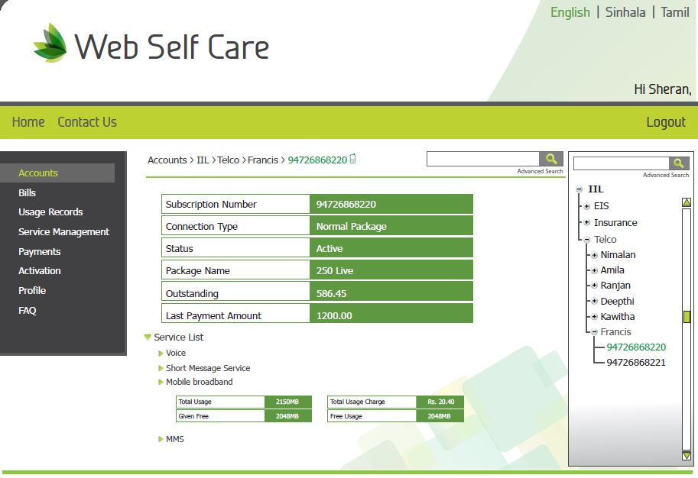
A Glimpse of Web Self Care...

Slide 43
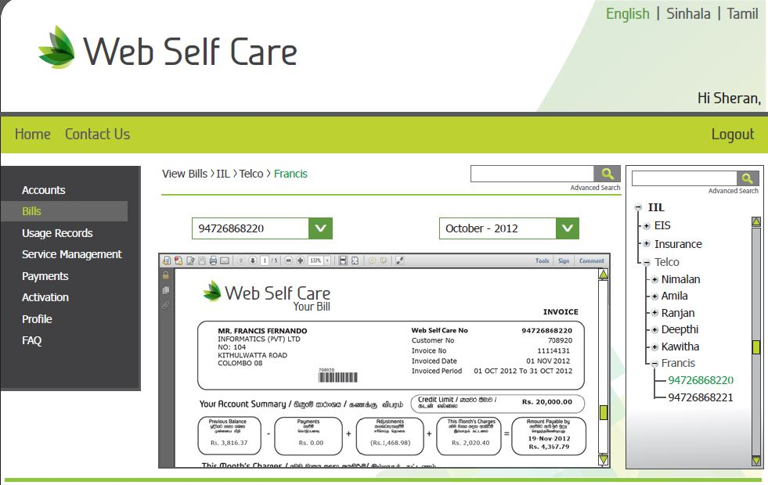
A Glimpse of Web Self Care...

Slide 44
Online Bill Payments
Customer
Makes a Payment Online
CSR
Gives Feedback
Displays
Info
Logs on to
Customer Portal
Displays
Info
Logs on to
Customer Care
Customer
Portal
(WSC)
CSR Portal

Slide 45
Submit Service Request Online
Customer
Submits a Service Request Online
CSR
Gives Feedback
Displays
Info
Logs on to
Customer Portal
Displays
Info
Logs on to
Customer Care
Customer
Portal
(WSC)
CSR Portal

Slide 46
Benefits of Web Self Care
Online self-care for the Customers to obtain the details of their accounts
Online Bill View and Payments
Online Service request Submission

Slide 47

Thank You

Slide 48

Our Go-to-Market Strategy?
Create Value
Link customers, suppliers, distributors and other parties
Enhance Communication
Identify customers where collaborative principals can help grow revenue or reduce costs
Enable Collaboration
Enable commerce thru cost-effective collaboration
What customers seek
Service Components
Our Approach
Reduce Risk of Large Project Management (with remote teams)
PM Principals
Management Consulting
KM Principals
Project Based Solutions
Easy to Use Solutions
T
Managed IT Svcs
Converged Solutions
powered by
Notes:
48

Slide 49
History
Started in 2013, by John Chowdhury
Today: with World Class Team
Nizam (Nick) Uddin: one of the first generations Cisco Certified Internet-work Expert and Network Security executive with 24 years of ICT experience
Aubrey Roberts: over 25 years of experience in Information Technology, Business Innovation and Consulting with Ernst & Young
John Chowdhury, Chairman and Managing Director
Advisor/Directors – Both from USA and Bangladesh

Slide 50
Who We Are
Since our inception we have grown steadily, mainly through word of mouth and the quality of our work.
As we’ve grown, working together with our clients and partners all over the world, we recognized the lack of available tools to provide a real-time collaboration environment for our teams.
So, naturally, as solution developers ourselves, we built our own.
With the launch of iMeet.biz we are offering these collaborative communication solutions and capabilities to everyone.
Work together, be creative, have fun!

Slide 51
Our Belief – Core Values
We are an Innovative Company
We improve technology
We improve our customer’s business processes
We improve society through innovative ideas
Innovation
Integrity is key to our success
Honesty
Reliability
Honor
Truthfulness
Integrity
We have equal Intensity to life and work
Passion
Strength
Concentration
Greatness
Intensity

Slide 52





iMeet Architecture
Application Tier
Business Logic Tier
Storage Services
Project Services
Capture Tier

Slide 53
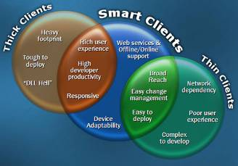
iMeet Application Tier
Based on Open Source and the Ruby-on-Rails framework, and designed to take advantage of advanced communications capabilities to deliver high performance in a secure environment to provide a richer, more complete, user experience.
Communicates with the Business Logic Tier to provide a Web-based managed interface with advanced capabilities such as monitoring, reporting, business analysis and more.

Slide 54

























iMeet Cloud Distribution and Operations
iMeet 1.x
iMeet Cloud (Dallas)
IC
APP
DB
DW
SC
NMS
European Cloud
iMeet 1.x
Signaling
Signaling
Asian Cloud
Audio/Video
Logger
IP Logger
Audio/Video
Logger
IP Logger
Center (1)
Center (n)

Slide 55












iMeet Components
Connects to iMeet, has the engines to do selective recording and controls the capture units
OLAP database for centralized reporting. Reporting is done using crystal reports
Interactions Center
Data mart ( reporting)
Web server hosted on Obanto Linux based application for enhanced security and rich user experience
Transactional database, stores the call meta data.
Application Server
Database Server
Captures the Voice at ingression points by using network SPAN/Mirroring ports
Client side component to capture screen on workstation
VoIP Logger
Screen Agent
Captures the screen at user location as defined by the user
Screen Logger
Centralized rule based archiving of screen and voice files.
Storage Center
SNMP manager for real time alarming in case of error or warning
NMS

Slide 56
Thank You

