Slide 1
Order Management – Create Order
Availability Check
Services Selection
Checkout - Customer & WSC
Checkout – Payment Info
Checkout – Service Order Start

Slide 2
Availability Check
Check FTTH Enchanted Light Availability at your location
X
Address OR
Kit Carson Customer
*Required entry
*Street Address
Apt. or Unit #
City
State
*Zip Code
This is a business address
Electric Acct. #
Meter #
Check Availability

Slide 3
Availability Check
Check FTTH Enchanted Light Availability at your location
Address OR
X
Kit Carson Customer
*Required entry
Street Address
Apt. or Unit #
City
State
Zip Code
This is a business address
*Electric Acct. #
*Meter #
Check Availability

Slide 4
Availability Check
Check FTTH Enchanted Light Availability at your location
Good news, FTTH Enchanted Light is available at this address!
Address
1234 Wayward Drive
Apt. 3701
Taos Pueblo, NM 63251
Change Address
You can get all the available FTTH Enchanted Light services.
*Phone
-
-
*Email
Continue

Slide 5
Availability Check
Check FTTH Enchanted Light Availability at your location
FTTH Enchanted Light is not yet available at this address.
Address
1234 Wayward Drive
Apt. 3701
Taos Pueblo, NM 63251
Change Address
You can still select your FTTH Enchanted Light services.
*Phone
-
-
*Email
Continue

Slide 6
Services Selection
Select FTTH Enchanted Light Services for your location
Good news, FTTH Enchanted Light is available at this address!
Address
1234 Wayward Drive, Apt. 3701, Taos Pueblo, NM 63251
Change Address
Drop & Select Services:
I am requesting that Enchanted Light and KC Communications install fiber optic service as soon as possible at the address listed, and grant access to the property for the sole purpose of installation. In addition, I request the following internet and/or phone services to be enabled at the time of installation, if available.
Internet - Residential
NOTE: Display category and present choices based on previous res or bus selection
- NONE - V
Click here to learn what applications will work best at what speeds
Digital Phone (Residential/Business) (Bundle with internet for a $5 discount)
- NONE - V
Click here to learn more about phone service
Drop Only (No Services):
I am requesting Enchanted Light and KC Communications install fiber optic service as soon as possible at the address entered, and grant access to the property for the sole purpose of installation. No internet, phone, or video service is to be enabled at this time.
Interested in Video/TV when available:
Continue
I am interested in more information regarding the television options when they are available.

Slide 7
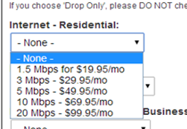
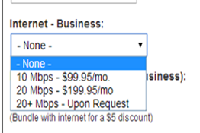
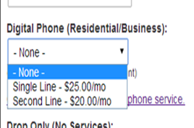
Current Services – names and prices

Slide 8
Suggested Services – names and prices
Product Code – Internet Residential
Product Category – FTTH Enchanted Light Internet - Residential
Description
GL Code
Line Percentage
Price (USD)
Advantage Plan - Bronze
ADVBRZ
01.50 Mb/s
$019.95/mo
Advantage Plan - Silver
ADVSLV
03.00 Mb/s
$029.95/mo
Advantage Plan - Gold
ADVGLD
05.00 Mb/s
$049.95/mo
Advantage Plan - Platinum
ADVPLT
10.00 Mb/s
$069.95/mo
Advantage Plan - Max
ADVMAX
20.00 Mb/s
$099.95/mo
Product Code – Internet Business
Product Category – FTTH Enchanted Light Internet - Residential
Description
GL Code
Line Percentage
Price (USD)
Professional Plan - Digital
PROBGT
10.50 Mb/s
$099.95/mo
Professional Plan - Cyber
PROCYB
20.00 Mb/s
$199.95/mo
Professional Plan - Apex
PROAPX
20+ Mb/s
Upon Request
Product Code – Internet Phone
Product Category – FTTH Enchanted Light Internet - Phone
Description
GL Code
Line Percentage
Price (USD)
Phone – Single Line
PHNSNG
VOIP Mb/s
$025.00/mo
Phone – Two Line
PHNSEC
VOIP Mb/s
$045.00/mo

Slide 11
Services Selection
Select FTTH Enchanted Light Services for your location
Good news, FTTH Enchanted Light is available at this address!
Address
1234 Wayward Drive, Apt. 3701, Taos Pueblo, NM 63251
Change Address
Next Step: FTTH Enchanted Light complete services selection!
Services
Advantage Plan – Gold – 5.00 Mb/s - $49.95/mo
Set Up Internet
Services
Phone – Single Line - VOIP Mb/s - $25.00/mo
Set Up Phone
Your choices bundle so far:
Advantage Plan – Gold – 5.00 Mb/s $49.95
Phone – Single Line - VOIP Mb/s $25.00
Total Services Price $74.95
Additional monthly charges (no setup selected) $0.00
Total Monthly Price $74.95
Continue

Slide 12
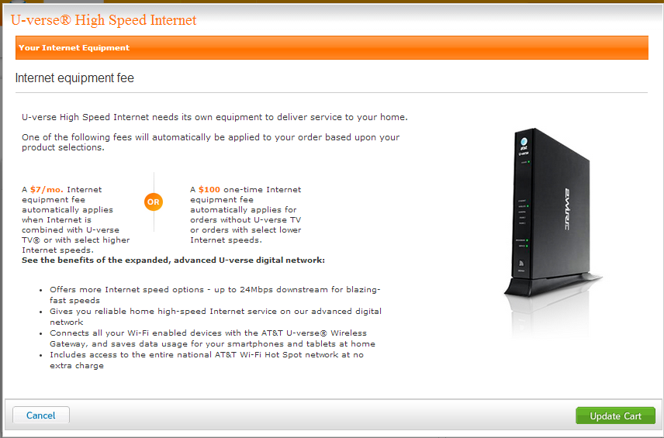
POP-UP:
This is one way to present internet selection details
Need to see if we can add products fields that capture choices and prices,
Probably as line items on Digital Phone product.

Slide 13
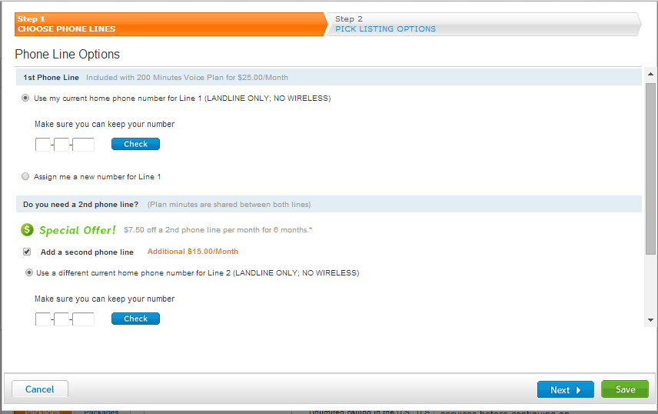
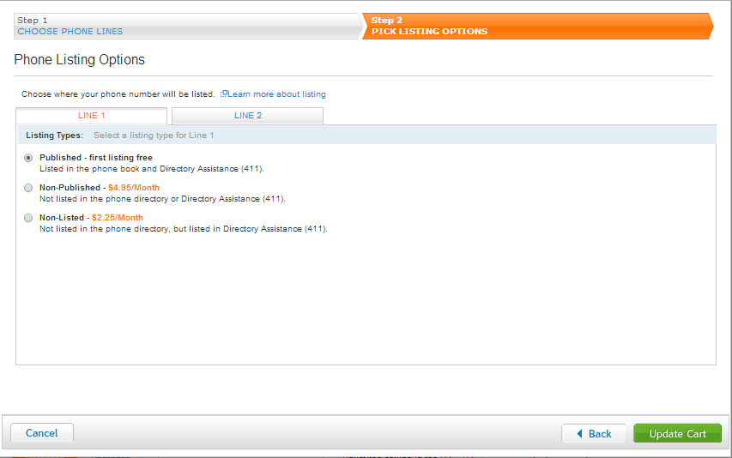
POP-UP:
This is one way to present phone selection details
Need to see if we can add products fields that capture choices and prices,
Probably as line items on Digital Phone product.

Slide 14
Services Selection
Select FTTH Enchanted Light Services for your location
FTTH Enchanted Light at this address!
Address
1234 Wayward Drive, Apt. 3701, Taos Pueblo, NM 63251
Next Step: FTTH Enchanted Light complete services selection!
√
Services
Advantage Plan – Gold – 5.00 Mb/s - $49.95/mo
Edit Set UP
Router selected - $7.25/mo
√
Services
Phone – Single Line - VOIP Mb/s - $25.00/mo
Edit Set Up
unlisted selected - $2.25/mo
Your choices bundle so far:
Advantage Plan – Gold – 5.00 Mb/s $49.95
Phone – Single Line - VOIP Mb/s $25.00
Total Services Price $74.95
Additional monthly charges ($7.25 router, $2.25 unlisted phone) $9.50
Total Monthly Price $84.45
Continue

Slide 15
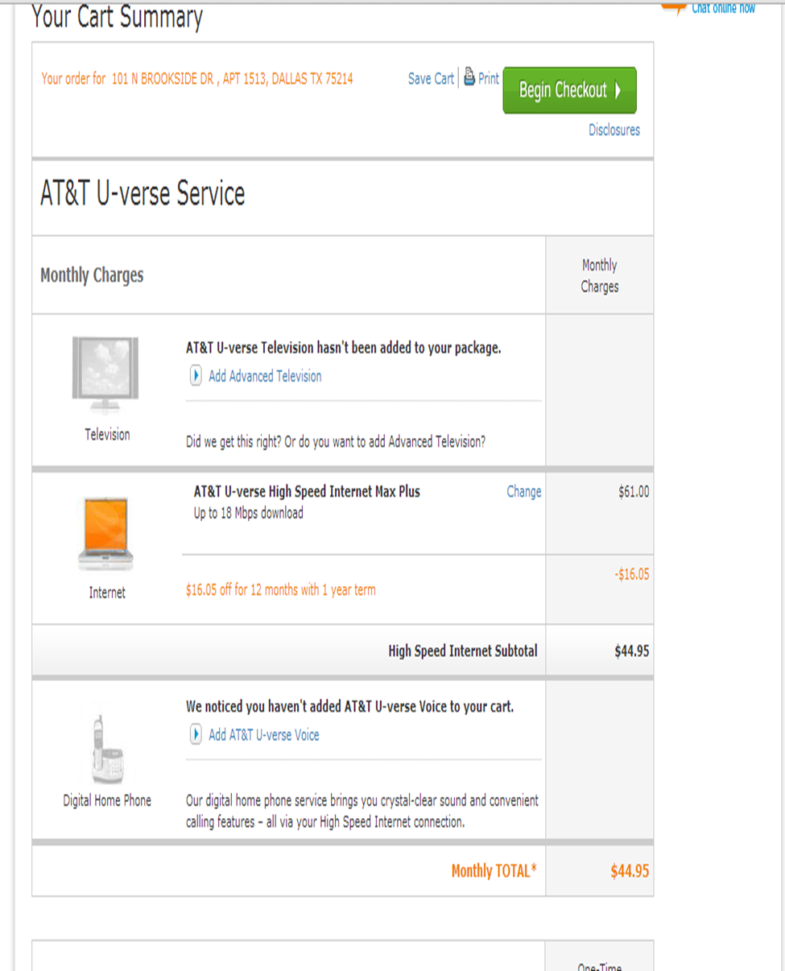
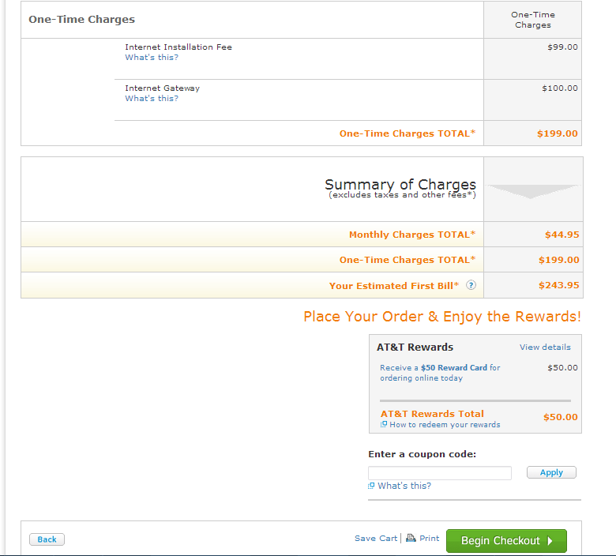
When Continue is selected on previous, we need Order Summary like below, with a Begin Checkout button

Slide 16
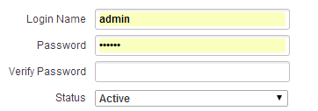

Checkout - Customer & WSC
Select FTTH Enchanted Light Services for your location
Good news, FTTH Enchanted Light is available at this address!
Address
1234 Wayward Drive, Apt. 3701, Taos Pueblo, NM 63251
Change Address
Personal Information
*Required entry
Enter information for your bill
*First Name
Middle Int
*Last Name
*Date of Birth
Month V
Day V
Year V
*Social Security #
-
-
Self-Care Account Information
*All Information Required
Enter information for Self-Care login
*
*

Slide 17
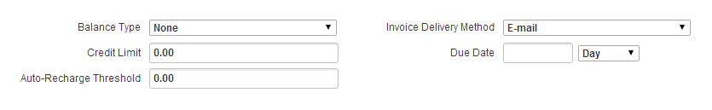

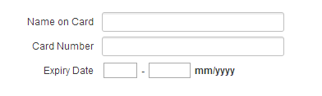
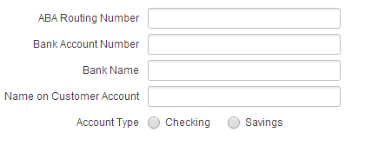
Checkout - Payment Info
Select FTTH Enchanted Light Services for your location
Good news, FTTH Enchanted Light is available at this address!
Address
1234 Wayward Drive, Apt. 3701, Taos Pueblo, NM 63251
Change Address
Balance Information
*All Information Required
*
Complete Preferred Payment Type:
Credit Card Information
*
*All Information Required
ACH Information
*
*All Information Required

Slide 18
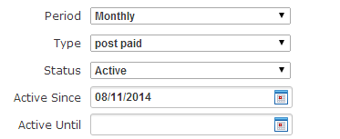
Checkout – Service Order Start
Select FTTH Enchanted Light Services for your location
Good news, FTTH Enchanted Light is available at this address!
Address
1234 Wayward Drive, Apt. 3701, Taos Pueblo, NM 63251
Change Address
Service Information
*
*All Information Required
Filled-in when installation successfully scheduled below
Service Order Installation Information
*Date of Activation
Month V
Day V
Year V
Schedule

Slide 19
Checkout – Service Order Start
Select FTTH Enchanted Light Services for your location
Good news, FTTH Enchanted Light is available at this address!
Address
1234 Wayward Drive, Apt. 3701, Taos Pueblo, NM 63251
Change Address
Service Information
*
*All Information Required
Filled-in when installation successfully scheduled below
08/11/2015
Service Order Installation Information
*Date of Activation
August
11
2014
Change
√
Date Accepted
selected – 08/11/2014
Complete Order

