Slide 1

GPON vs EPON
A comparative investigation into xPON Solution

Slide 2
Why RFoG
Designed for cable operators to continue to use traditional coax network.
Continue using legacy DOCSIS provisioning and billing systems, CMTS platforms, HE equipment, and STB as a stepping prior to PON deployment
Designed primarily for brownfield deployments to minimize the cost.

Slide 3
What’s wrong with RFoG
SCTE 174 standard for carrying HFC RF signals over a passive glass.
Designed primarily for coax/HFC networks.
Acts as interim solution towards xPON
No added upstream/downstream BW
Not much industry standardization traction
Industry vendor traction is limited
Pulse’s RFoG solution is considered proprietary

Slide 4
xPON Types
PON Type | Typical Bit Rate |  | Framing | Typical Max. Split Ratio | Typical Max. Fiber Length | Primary Standards Document
BPON | 622 Mb/s | 155 Mb/s | ATM | 1×32 | 20 km | ITU-T G.983 series
Gigabit PON (GPON) | 2.488 Gb/s | 1.244 Gb/s | ATM and GEM | 1×64 | 20 km | ITU-T G.984 series
10 Gigabit PON (XGPON) | 10 Gb/s | 2.488 Gb/s or 10 Gb/s | XGEM | 1×64 | 20 or 40 km | ITU-T G.987 series
Ethernet PON (EPON) | 1 Gb/s | 1 Gb/s | Ethernet | 1×16 | 20 km | IEEE 802.3 (clause 60)
10 Gigabit EPON (10G-EPON) | 10 Gb/s | 1 Gb/s or 10 Gb/s | Ethernet | 1×32 | 20 km | IEEE 802.3av
DOWN | UP

Slide 5
Technical Comparisons
 | GPON | EPON
Transport methodology | GEM encapsulation | Native Ethernet with 8B/10B coding
BW | Asymmetrical BW 2.5G/1.25G | Symmetrical BW 1.25G/1.25G
Usable BW | 95% usable BW | Loss of BW due to 8B/10B coding i.e. 1G-850Mb effective BW
Range | 20Km* | 20Km*
OLT | 128 | 32-64**
System Management | Complex, three Layer 2 network Protocols. | Simple, No protocol conversion required.
Safety/Security | AES, Unidirectional | Vendor Implemented AES Bidirectional
Users/PON | 64 user and can extend 20Km Type A 5db-20db loss Type B 10db-25db loss Type C 15db-30db loss | 32 users Type A 5db-20db loss Type B 10db-25db loss
Migration from xPON to NG-PON | Seamless due to 10G wavelength is different from 1G | Difficult due to shared wavelength between 1G and 10G, separation of light path required.
*Depends on the budget Provision of the Optical Link **Depends on FEC and lasers

Slide 6
Market Comparison
 | GPON | EPON
Deployments | Popular in North America | Nearly 100% in Asia
MSOs | Cable One, Cox, WOW!, Rogers | Bright House Networks, Time Warner, Comcast
Telco’s | Verizon, ATT u-verse, Telus, Bell Canada
Industry Inclination | Telcos | CableLabs, MEF

Slide 7
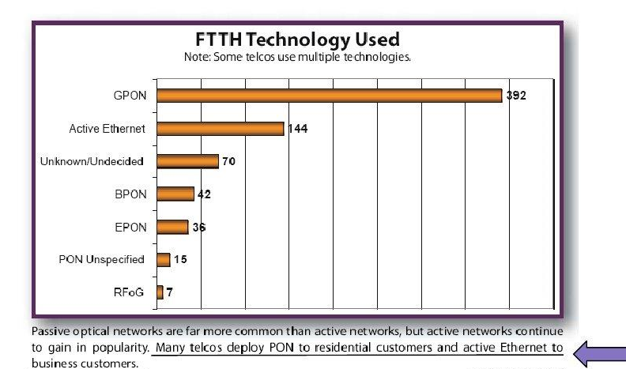
Trending

Slide 8
Which Way to Go?
Technically both solutions are almost similar.
Internal operations are somewhat different.
Both are equally feasible technologies.
Cost of Ethernet is down and gradually decreasing.
Both GPON and EPON are standardized, mature and now going NG-xPON.
Fidelity Solutions’ IPTV solution fully integrated with GPON but has not been deployed with EPON

Slide 9

A Crossroad..
GPON
EPON

Slide 10
The Winner is….
No one.
Decision must be made based on Business Parameters i.e.
Economics
Delivery timeframe
Support from Integrator!!
Head End Provider compatibility for the xPON.

Slide 11


