Slide 1
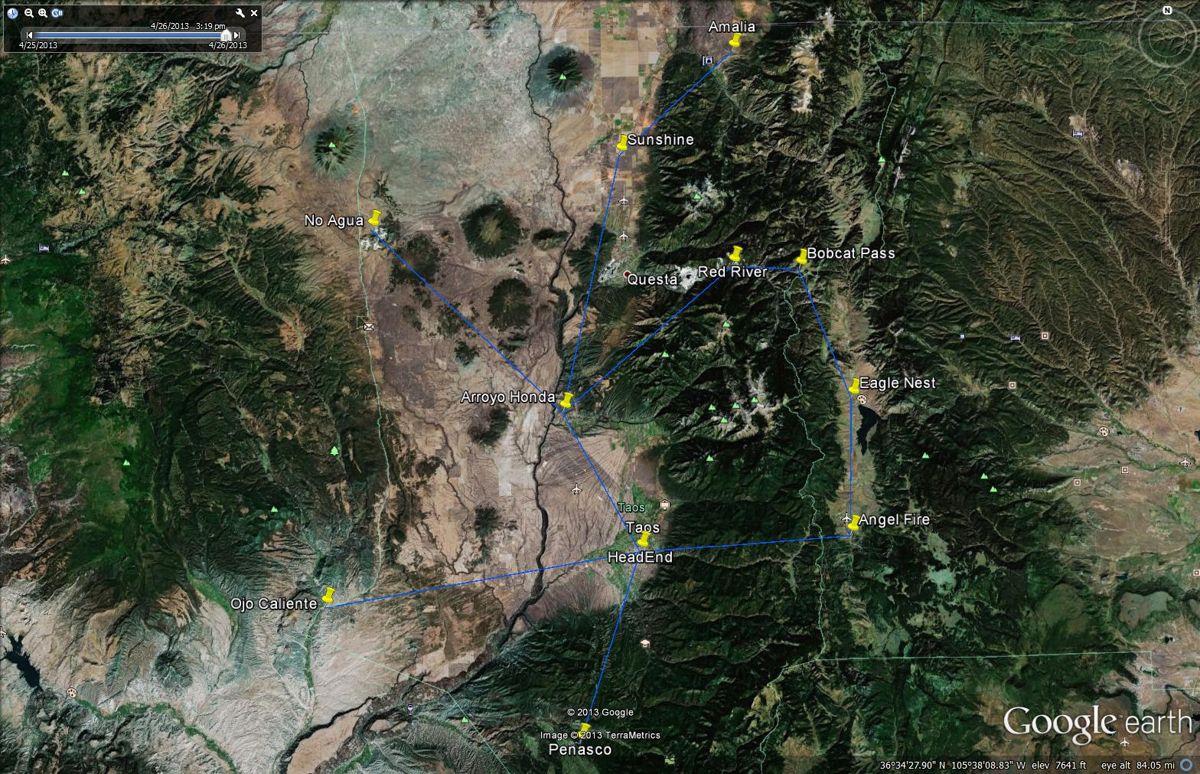
Aerial distances
12.4 m
21.2 m
5.3 m
21.2 m
11m
17.8 m
12.5 m
10.7 m
16.6 m
25.3 m
15.5 m

