Slide 1
KCEC Network Redundancy

Slide 2
Core Router Redundancy
2 Core Routers – Juniper MX240
Redundant Power
Redundant Control Board
Juniper Core Routers can be connected to provide Inter-Chassis Redundancy aka Virtual Chassis.

Slide 3
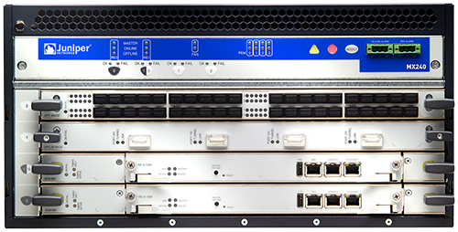
MX240
4 Slot Chassis
Physical size
Height: 5RU, Depth: <800mm deep
System capacity
4 slots – 2 available for Fabric Cards / REs
Up to 960Gbps (full-duplex) from 3 line cards today
NG Fabric supports 1.6Tbps per chassis
System reuses existing SCBs, REs, DPCs and MPCs – common across all MX platforms
Dependable hardware
Passive Mid-Plane
Redundant Routing Engines (1+1)
Redundant Switching Fabric (1+1)
Distributed Packet Forwarding Architecture
Redundant Power
Power and cooling
Side to Side cooling
Holds up to 4 power supplies (1+1 DC, 1+1 AC 200-240VAC, 2+2 AC 100-110VAC)
Rear-side power cabling
MX240

Slide 4
MX Virtual Chassis:
GRES/NSR SYNCHRONIZATION
Single Cluster Control Plane
Active State Mirror
Distributed Redundancy
Scalable Bandwidth
2 Core Routers – Juniper MX240
Each Router has Redundant Power Supply
Each Router has Redundant Control Board.
Chassis are Redundant through Virtual Chassis.
Services at Scale
Notes:
Virtual Chassis technology allows up to eight interconnected physical chassis to be monitored and managed as a single logical device. Virtual Chassis offers the following benefits:
• Simplifies manageability by providing a unified control plane for all physical chassis
• Improves resource utilization by intelligently employing interfaces and service line cards on physically different chassis, providing customers with a “pay-as-you-grow” model.
• Protects user sessions across physical chassis, line card or port failure, using stateful redundancy so users are completely unaware of failures.
• Supports sophisticated resiliency techniques within the Virtual Chassis.

Slide 5
Core Network Redundancy
KCEC Architecture is Ring-Based
Hub Site Switches are equipped with Redundant Power.
Provides redundant path to reach Core Routers.
Fiber Cut will cause switches to converge to alternate Path.
Few Sites are in Hub-Spoke form.
These site are prone to single point of failure, due to non-diverse fiber path.
Switch/OLT failure can also contribute to single point of failure, however will not affect any other sites.

Slide 6
Core Network

Slide 7

ISP Redundancy Options (Multi-homing)
Option 1 : Single Site, Dual Router to Single ISP
ISP -1
Primary
Secondary
KCEC GPON
HE-R1
HE-R2
HE-R1
HE-R2

Slide 8
ISP Redundancy Options (Multi-homing)
Option 2 : Single Site, Dual Router to Two ISPs
ISP -1
ISP -2
Primary
Secondary
HE-R1
HE-R2
KCEC GPON

Slide 9
ISP Redundancy Options (Multi-homing)
Option 3 : Single Site, Single Virtual Chassis Router to Two ISPs
ISP -1
ISP -2
Primary
Secondary
2 Routers connected in Virtual Chassis Mode to act as Single Router
KCEC GPON

Slide 10
Multi-Homing
Effective Mutli-Homing of Network is dependent on
Number of Uplinks
Number of ISP
Number of Routers
Tuning of BGP Protocol
Identification of Primary and Standby Link.
Uplinks can also load balance traffic with proper tuning of Router configurations.
ISP polices.

