Slide 1


When Good Protections Go Bad: Exploiting Anti-DoS Measures to Accelerate Rowhammer Attacks
Misiker Tadesse Aga, Zelalem Birhanu Aweke, Todd Austin
<number>
Notes:
In this work we show how Intel’s recently introduced CAT on modern server grade xeon processors can be abused to make faster high locality uncached accesses which in turn can exacerbate the Rowhammer vulnerability
<number>

Slide 2
Outline
Background
DRAM Organization
Rowhammer Attack: Early and Second Generation
Widely Deployed Mitigation Techniques
Accelerating DDR4 Rowhammer Attack
Cache Allocation Technology (CAT)
CAT Assisted Rowhammer
Conclusion
<number>
Notes:
<number>

Slide 3
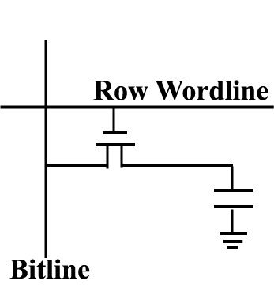
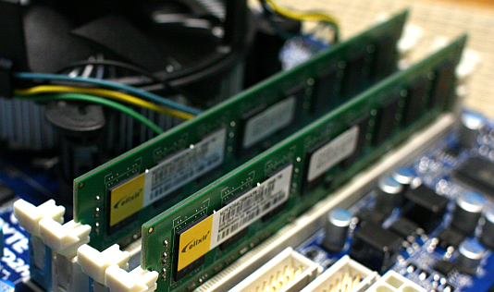
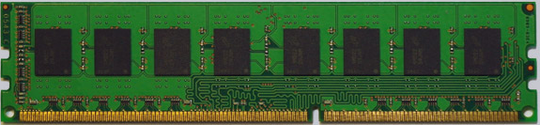
DRAM Organization
chip
DIMM
Bank 15
Bank …
Channel
Bank 0
CAS
RAS
Rank 1 (Back)
DIMM
Rank 0 (Front)
64-bit Data bus
<number>
Notes:
First a little bit of background how DRAMs are organized. A typical motherboard consists of multiple channels where each channel is composed of multiple DIMMs. Each side of a DIMM is a rank which has multiple chips working in tandem to serve the total data bandwidth. Each IC composed of multiple banks, 16 for DDR4, composed of rows and columns of capacitive bit cells connected with a pass transistor wordline. Each bank has a row-buffer caching the last accessed row of the bank.
<number>

Slide 4


Rowhammer Attack
Disturbance between adjacent DRAM rows as technology enables high cell density
Repeated activation of a row induces bit flips in adjacent rows due to EM coupling
Same Bank Different Row (SBDR) accesses to bypass row buffer
DDR4 still vulnerable
(Kim et al., ISCA 2014)
X
loop:
mov (X), %eax
mov (Y), %ebx
clflush (X)
clflush (Y)
jmp loop
Victim rows
Capacitive
coupling
Y
Row buffer
Row buffer
Row buffer
<number>
Notes:
Rowhammer attack is a vulnerability in modern high density DRAMs where a repeated activation of a row induces bit flips in adjacent rows. This is caused by capacitive coupling between adjacent rows of DRAM. For this to happen an access has to bypass the SRAM cache hierarchy, which in this pseudo code is achieved by clflush instruction, and the row-buffer which caches the last accessed row within a bank. So we have to access a different row within the same bank to clear the row-buffer. Even though DDR4 was reported to be immune to this attack recent works including this one show that it is still has this vulnerability
<number>

Slide 5
Rowhammer Exploits
[Seaborn et al., Black Hat 2015]
Escape from Google Native Client sandbox
x86 page table entries (PTEs) attack
…
NaCl validated code
Modified code
andl $~31, %eax // mask to be 32-byte-aligned.
addq %r15, %rax // sandbox base address.
jmp *%rax // Constrained Indirect jump.
andl $~31, %eax // mask to be 32-byte-aligned.
addq %r15, %rax // sandbox base address.
jmp *%rcx // Unconstrained Indirect jump.
PTE
Rowhammer induced bit flip
Bit flip at bit 0 of register number
Physical Address space
<number>
Virtual Address space
Notes:
After the first introduction of rowhammer attacks researchers has shown that it is not just a reliability issue. To this end security researchers from google showed two attacks which exploit bitflips induced by rowhammer attack. The first exploit is escaping out of Google Native Client Sandbox. This attack uses bitflips to modify the read-only code section of a NaCl validated code to transform constrained jmp to unconstrained jmp, thereby escape out of the sandbox. The second exploit by the same group is on page table entries. This attack works by repeatedly mmap()ing the same file, to spray large portion of the physical memory with page tables so that when a bit flip on the page number of the pagetable entry it points to a page table entry within the same process. This will enable an attacker to have a read/write access to his own page table, hence to the entire physical address.
<number>

Slide 6
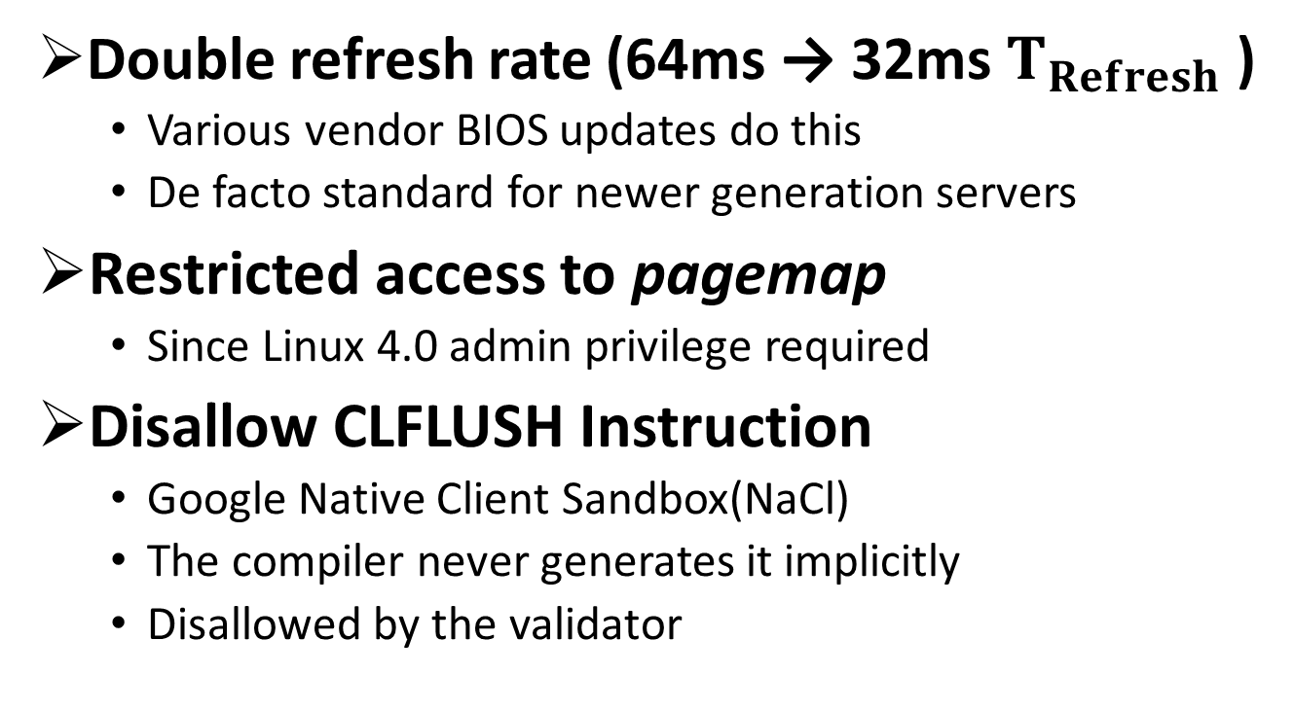
Widely Deployed Mitigation Techniques
Double refresh rate (64ms → 32ms )
Various vendor BIOS updates do this
De facto standard for newer generation servers
Restricted access to pagemap
Since Linux 4.0 admin privilege required
Disallow CLFLUSH Instruction
Google Native Client Sandbox(NaCl)
The compiler never generates it implicitly
Disallowed by the validator
Reduces the time allowed to implement the attack
More difficult to do advanced multi-address attacks (double-sided)
High locality accesses served by SRAM cache hierarchy
<number>
Notes:
After finding out the security concerns associated with rowhammer attacks different manufacturers deployed rowhammer mitigation techniques. The first mitigation techniques was doubling the DRAM refresh rate. Which involves reducing the TREFI parameter of the BIOS. And particularly it became the default for Intel Xeon server-grade processors. And various vendors issued a bios update to protect legacy systems by doubling refresh rates from once every 64ms to once every 32 ms. But successive works on rowhammer attacks show this counter measure is still not sufficient.
Yet another mitigation technique that has been proposed is disallowing CLFLUSH instruction to overcome high locality cache misses which is required by the attack. Google’s NaCl sandbox was patched to disallow the use of CLFLUSH instruction by applications running inside it.
<number>

Slide 7
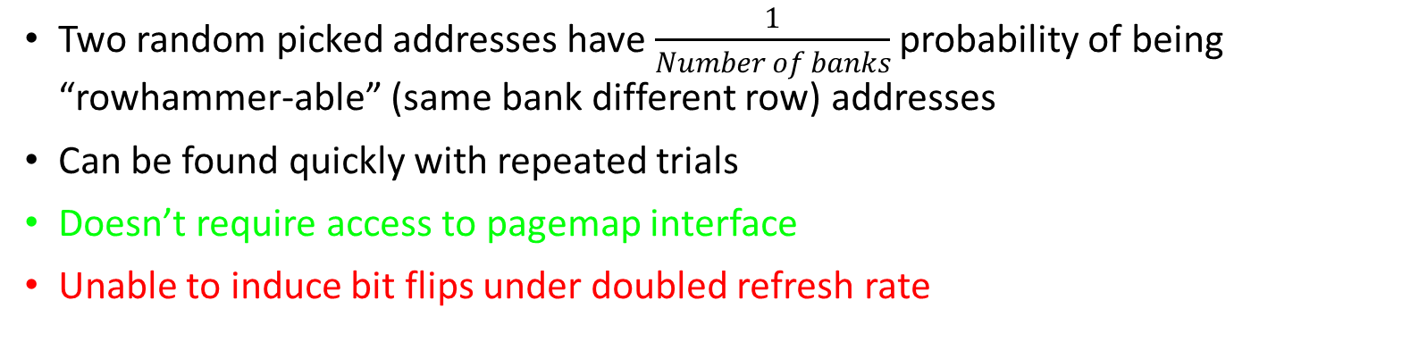
2nd Generation Rowhammer Attacks
 | CLFLUSH-based | CLFLUSH-Free (Aweke et al., ASPLOS 2016, Gruss et al., DIMVA 2016)
 | Single-sided (Kim et al., ISCA 2014) | Double-sided (Seaborn et al., Blackhat 2015)
Double Refresh Rate | ✗ | ✓ | ✗
Restricted Pagemap | ✓ | ✗ | ✗
Disabled CLFLUSH | ✗ | ✗ | ✓
CAT-assisted Rowhammer
Attacks
Protections
✓
✓
✓
Can bypass this mitigation
✗ Can’t bypass this mitigation
Two random picked addresses have probability of being “rowhammer-able” (same bank different row) addresses
Can be found quickly with repeated trials
Doesn’t require access to pagemap interface
Unable to induce bit flips under doubled refresh rate
Access both adjacent rows of a victim row
High computational complexity without knowledge of physical addresses
Able to induce bit flips under reduced refresh rate
Requires access to pagemap interface
CAT-assisted Rowhammer:
Cache Allocation Technology (CAT)
Enables partitioning LLC
Use CAT to reduce the associativity of LLC
↓Associativity ➔ ↓Cache Eviction Latency
Abuse CAT (DoS protection measure) to accelerate rowhammer attack
Manipulate cache to force high locality misses
Doesn’t require CLFLUSH instruction
Slow due to high LLC associativity of modern processors
Repeatedly activate both neighbors of a row
Victim row
X
X+2
<number>
Row buffer
Notes:
<number>

Slide 8
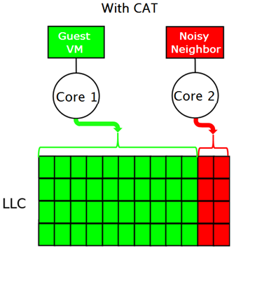
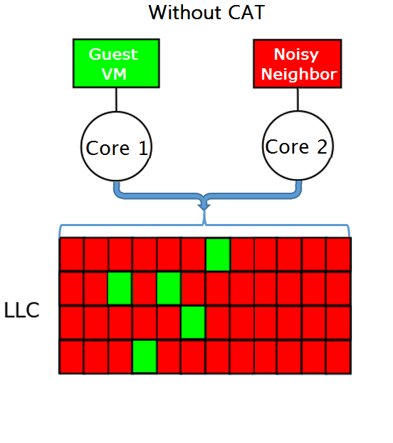
Cache Allocation Technology (CAT)
Introduced in late-model Xeon Processors
To solve shared resource concerns and protect against DoS attacks
Permits CPU to be restricted to subset of LLC ways
Contains malicious collocated VMs
Used in tandem with Cache Monitoring Technologies to detect “Noisy-Neighbor” and contain it LLC usage according to policy
<number>
Notes:
Cache allocation technology
+
Talk about the your attack
<number>

Slide 9
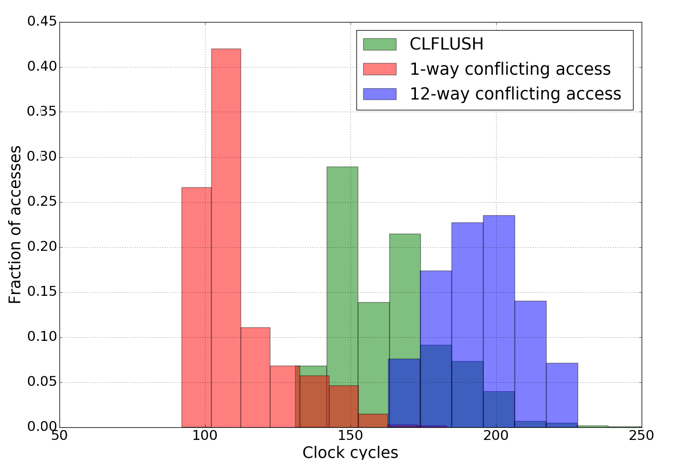
CAT Enables Efficient DRAM Access
Run the experiment on:
Xeon D-1541 processor
Dual-channel DDR4 memory
Eviction latency:
Depends on number of active ways
Distribution for 1000 conflicting access latencies
Eviction Technique | Average Latency (clock cycles)
12-way conflicting access | 195
CLFLUSH | 168
1-way conflicting access | 110
2 addresses mapping to same cache set
CLFLUSH and
reload
an address
N+1 addresses mapping to same N-way cache set
> 1/3 reduction in eviction latency
<number>
Notes:
<number>

Slide 10
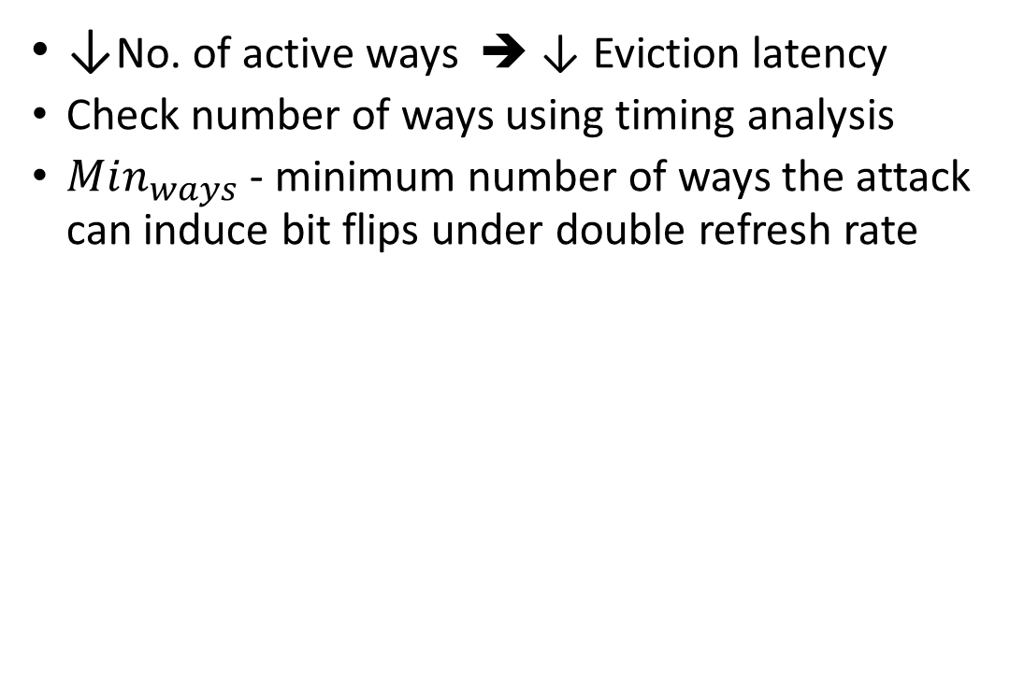

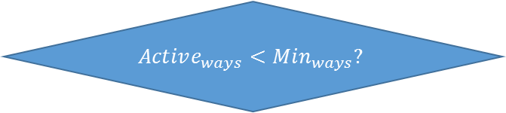
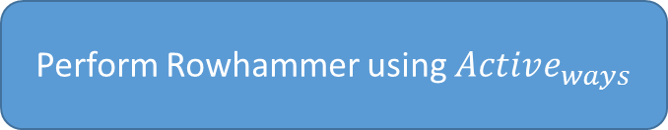
Abusing the CAT
↓No. of active ways ➔ ↓ Eviction latency
Check number of ways using timing analysis
- minimum number of ways the attack can induce bit flips under double refresh rate
Perform Cache DoS Attack
Check Number of active ways
No
Yes
Perform Rowhammer using
<number>
Notes:
<number>

Slide 11
CAT-assisted Rowhammer Attack
Find N + 1 addresses with high (cache eviction) access latency
Step 1
Randomly select N+1 addresses
(N = Max. Associativity)
Check if addresses are conflicting using cache timing analysis
Repeat until conflicting address set found
Eliminate addresses not mapping to same cache set
Step 2
Reshuffle accesses to find addresses mapping to same bank
Step 3
Rowhammer using row-buffer conflicting addresses as aggressors
Step 4
<number>
Notes:
First we assume maximum associativity. If the maximum associativity is N-ways. We randomly select N+1 addresses and check if they are conflicting using cache timing analysis by accessing in a round robin manner. We repeat this until we find N+1 addresses is a superset of addresses mapping to same cache set.
<number>

Slide 12


CAT-assisted Rowhammer Attack
Conflicting address set
Find N + 1 addresses with high (cache eviction) access latency
a0
Step 1
a1
a2
a3
Eliminate addresses not mapping to same cache set
a4
Step 2
a5
a6
a7
a8
Reshuffle accesses to find addresses mapping to same bank
a9
Step 3
a10
a11
a12
Rowhammer using row-buffer conflicting addresses as aggressors
Step 4
Minimum conflicting addr. set: {a0, a2, a5, a9}
Number of ways = 3
<number>
Notes:
Once we found N+1 addresses which is a superset of addresses mapping to same cache. We eliminate addresses that not mapping in the same cache. If there is no change in the eviction latency after eliminating an address it means it is not part of the addresses mapping to same cache. This ways we remove all addressing not mapping to same cache and find the number of addresses mapping to same cache set.
<number>

Slide 13
CAT-assisted Rowhammer Attack
Find N + 1 addresses with high (cache eviction) access latency
Step 1
Reshuffle addresses
Check if addresses evicting each other map to same bank using row-buffer timing channel
Goto Step 1 if none found
Eliminate addresses not mapping to same cache set
Step 2
Reshuffle accesses to find addresses mapping to same bank
Step 3
Rowhammer using row-buffer conflicting addresses as aggressors
Step 4
<number>
Notes:
After finding the minimum set we check if we have addresses mapping to same bank from the conflicting set. We check this by reshuffling the addresses checking if the addresses evicting each other map to same bank using row-buffer side channel. If we find these addresses we continue to rowhammer attack. Otherwise we go back to step 1
<number>

Slide 14
CAT-assisted Rowhammer Attack
Find N + 1 addresses with high (cache eviction) access latency
Step 1
a2
a0
a9
a5
Eliminate addresses not mapping to same cache set
Step 2
Reshuffle accesses to find addresses mapping to same bank
a2
a0
a0
a0
a5
a9
a2
Step 3
a9
a2
a2
a5
a9
a0
a9
a0
a9
a2
a9
a0
a0
LRU
a5
Rowhammer using row-buffer conflicting addresses as aggressors
Step 4
<number>
Notes:
The accesses are designed in such a way that the two addresses mapping to same bank are served by dram and the rest are by the LLC. In this case accesses to a2 and a5 are served by dram the rest is by the cache in order to make accesses to a2 and a5 to be evicted according to the cache replacement policy.
<number>

Slide 15
Experimental Setup
Xeon D-1541 “Broadwell” processor
12MByte 12-way last-level cache
Dual channel DDR4-memory
DIMMs
3 vendors based on market share
Rowhammer Attacks:
Double-sided Vs. Single Sided
CLFLUSH based and CAT Assisted
Doubled-sided requires DRAM address mapping
Reverse engineered address mapping using PMON registers of the IMC
<number>
Notes:
<number>

Slide 16
Rowhammer Vulnerability (Vendor Based)
Min. time to induce bit flip with double-sided CLFLUSH-based attack
Find bit flips with the minimum number of accesses
3 major vendors based on market share
Vendor | Capacity | Time to induce first bit flip
A | 4GB | 21ms
A | 8GB | 45ms
B | 8GB | No bit flips found
C | 8GB | 59ms
<number>
Notes:
<number>

Slide 17
CAT-assisted Rowhammer (# of Ways)
Can induce bit flips if active ways ≤ 4
CLFLUSH
based
CAT-assisted with (# of active ways)
<number>
Notes:
<number>

Slide 18
Conclusion
Existing mitigation techniques if used in tandem was effective in stopping rowhammer attacks
CAT can be abused to perform rowhammer attack which bypass ALL widely deployed protection mechanisms.
Rowhammer attack possible if the offending processor is constrained up to a third of the LLC ways
Recently proposed rowhammer mitigation techniques such as PARA and ANVIL stop this attack
<number>
Notes:
<number>

Slide 19
Thank you!
Questions?
<number>
Notes:
<number>

