Slide 1
An interesting title and a an unneccessary long one to see what happens
A subtitle and a an unneccessary long one to see what happens

Slide 2
Table of Contents
Introduction
Instructions and errors
Examples of specific template sheets (with graphs, tables and code)
Here we have an empty section header
References

Slide 3
Introduction

Slide 4
Welcome to the Presentation Template
This template is designed to help you create presentations with quarto. Inside, you’ll find examples of:
References: How to cite sources and include a bibliography.
Tables: Styling and presenting data in tables.
Interactive Graphs: Incorporating dynamic, interactive graphs to visualize data.

Slide 5
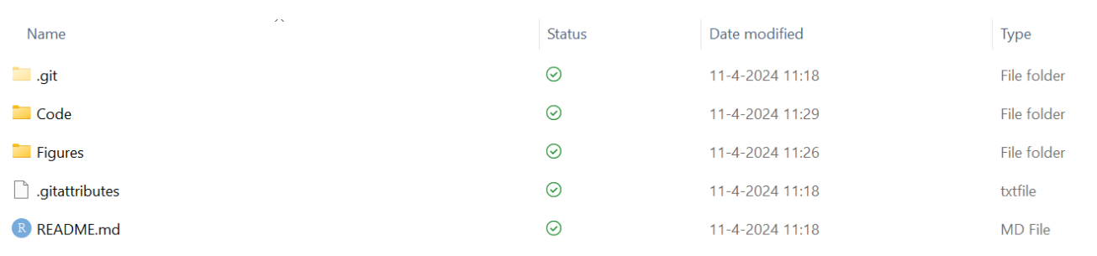
Folder structure
To run the code, you need to have the following folder structure.

Slide 6
Getting Started
To use of this template, please:
Copy the Template: Ensure you copy the entire template folder to the location where you intend to work.
Clone the Repo: Alternatively, you can clone the repository from my GitHub account to keep up with updates.

Slide 7
Instructions and errors

Slide 8
Instructions on yaml and template
Background.pptx is a template that is used to render the presentation.
the title and subtitle are set in the yaml
the date is set in the template (background.pptx), to the date on which the presentation is rendered. If you want to change this, you need to change the date in the template
the name and email adress cannot be set in the yaml (because powerpoint does not seem to have placeholders that communicate these fields with quarto), but can changed hard in the template.

Slide 9
Quarto
Quarto enables you to weave together content and executable code into a finished presentation. To learn more about Quarto presentations see https://quarto.org/docs/presentations/.
More specifically, information about changing the template and the yaml can be found at https://quarto.org/docs/presentations/powerpoint.html.

Slide 10
Resolving Pandoc Permission Denied Error
If you encounter a pandoc: Yourfile.pptx: withBinaryFile: permission denied (Permission denied) error, this likely due to File Locking: The file is open in Powerpoint, which is preventing access (to overwrite). To resolve this, close the file in Powerpoint and try to render again.

Slide 11
Examples of specific template sheets (with graphs, tables and code)

Slide 12
Slide with speaker notes
You can also add speaker notes to your slides.
Notes:
This is a speaker note.
Use basic Markdown
like this list
and inline formatting

Slide 13
Bullets
When you click the Render button a document will be generated that includes:
Content authored with markdown
Output from executable code

Slide 14
Slide with citations
And I really like Agrell et al. (2013)
The references are stored in the references.bib file. The reference list is at the end of the presentation.

Slide 15
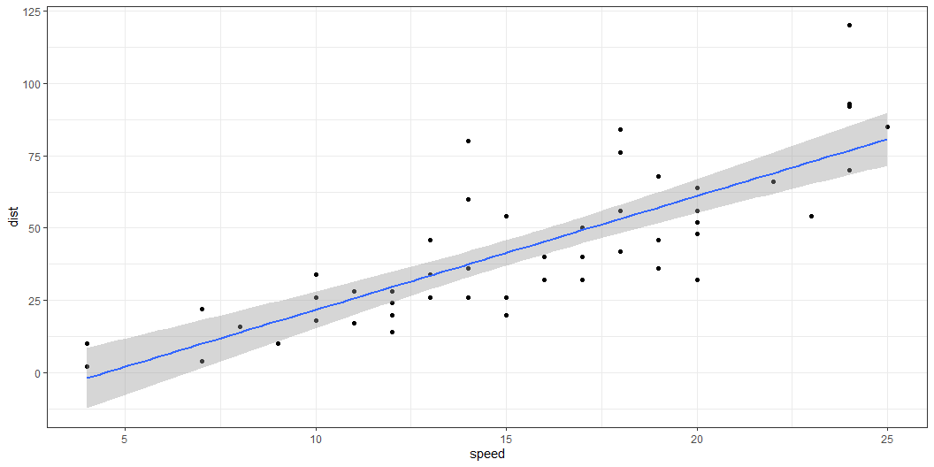
Code
You can have some text and then the output of some code. Here we make a standard graph

Slide 16
Show some code
The code itself cannot have a different background color in powerpoint (html and pdf would allow that).
ggplot(data = cars, mapping = aes(x = speed, y = dist)) + geom_point() + geom_smooth(method = "lm") + theme_bw()

Slide 17
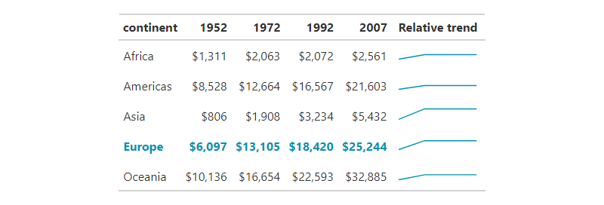
A nice table

Slide 18
And an interactive graph

Slide 19
Here we have an empty section header

Slide 20
References

Slide 21
Customizing reference style in your presentation
This template uses the APA style for formatting references. If the APA style does not meet your requirements you can customize it by following these steps:
Find and download a new CSL file:
Visit the Zotero Style Repository.
Use the search bar to find the citation style that matches your needs.
Download the .csl file for your chosen citation style and save the downloaded .csl file into the Code folder
Update the YAML header:
Update the csl field in the YAML header to point to your new .csl file.

Slide 22
Litarature
```{bibliography}
Agrell, P. J., Bogetoft, P., & Mikkers, M. (2013). Smart-grid investments, regulation and organization. Energy Policy, 52, 656–666.

