Slide 1



Global Optimization for Estimation of On/Off Seasonality in Infectious Disease Spread Using Pyomo
Gabriel Hackebeil
Chemical Engineering Dept.
Texas A&M University
Carl Laird Chemical Engineering Dept. Texas A&M University

Slide 2
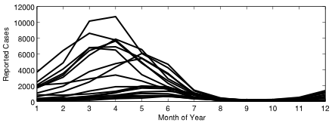
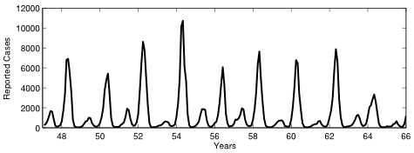
Introduction
Infectious Diseases Remain Important
Understanding Disease Dynamics
Public Health Program Implementation
Childhood Diseases Useful for Study
Clear Temporal Dynamics
Annual and Biennial Drivers Dependent on Birthrate
Seasonal Patterns
Not Purely Random
Notes:
Infectious diseases remain a significant health concern, especially in developing countries
Public health programs would benefit from tools to analyze the affect of their implementation
Childhood diseases are useful since they are typically easily identified giving us case counts that can be used in estimations
These diseases also exhibit interesting dynamics

Slide 3


Compartment Models
M
S
E
I
R
S
Many Compartment Models Possible
Compartments Reflect Disease Progression
SIR Compartment Model
Suitable for Childhood Infectious Diseases
S
Λ(t)
I
Γ(t)
R
B(t)
D(t)
σ
Notes:
Compartment models are the base upon which we build our mathematical models
Many compartments can be used to describe different diseases, for example…
SIR is suitable, though perhaps not ideal, for many childhood diseases

Slide 4
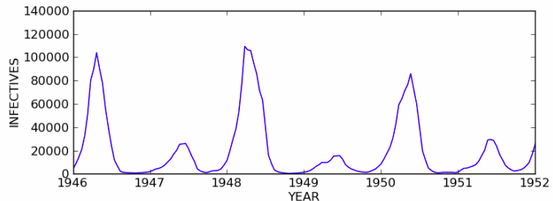
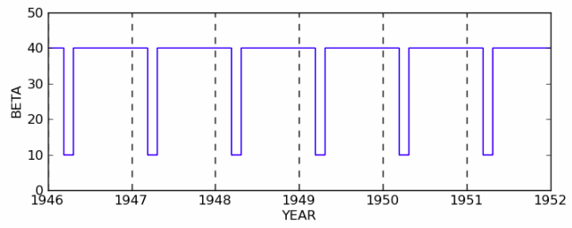
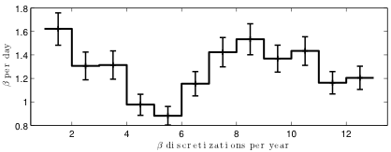
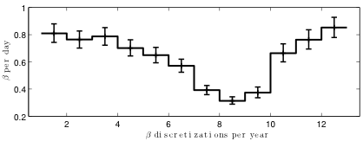
Introduction
Seasonality in Transmission Parameter
Previous Results Show Seasonality in Beta Corresponds With School Terms

Slide 5
Outline
Problem Formulation
High-level Solution Strategy
Pyomo Implementation
Results
Pyomo Experiences
Acknowledgements
Notes:
I’ll begin by introducing the problem formulation and show some of simple transformations we used to arrive at the current formulation
Then we’ll go over our solution strategy where we’ll see why pyomo was such a great tool for this type of problem
We’ll look at some of the code used to define the model and the solver algorithm, and if you know python you may notice how seemingly integrated the modeling language is in python. I’ll then show some of the results our problem and end by talking a little about my experiences with pyomo

Slide 6
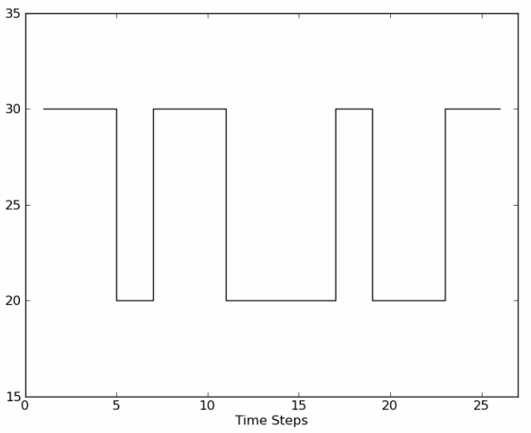
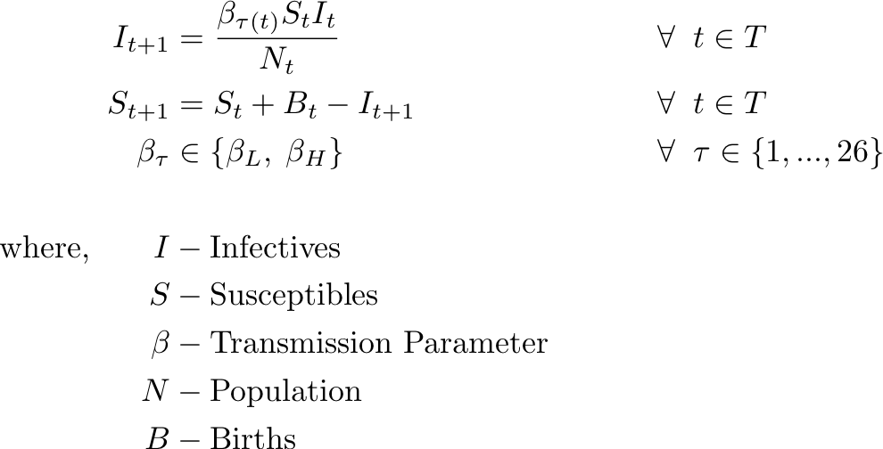
Disease Model
TSIR Model – Measles Data
Notes:
We’re using time Series SIR Model to study measles infections, for instance we have around 40 years of case data for New York which includes information on birth rate and population, we’ll use this modle to study the effect of forcing seasonality on the transmission parameter beta

Slide 7
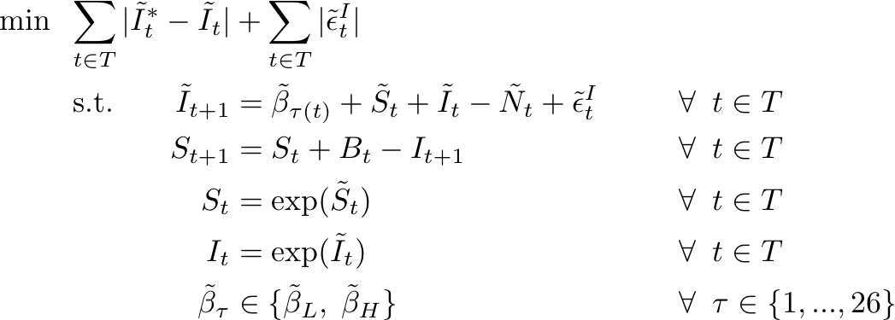
Problem Formulation
Log Transform
Notes:
First we perform a log transform on the I equation which leaves us two exponential equality constraints for I and S, this problem formulation showed better convergence behavior for the NLP cases. Also Notice the change in the objective function, we are minimizing the log space variables which effectively places more weight on the lower cases data

Slide 8
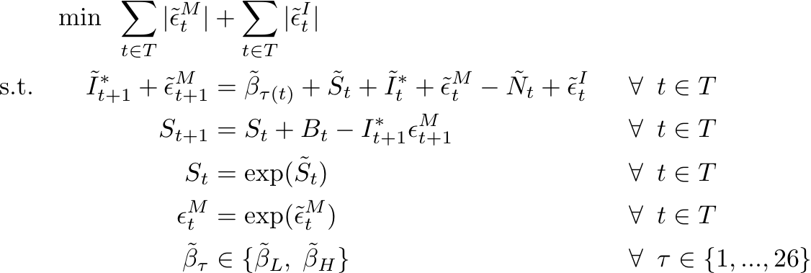
Problem Formulation
Multiplicative Noise in Data Measurement
Notes:
Next we assume multiplicative noise in the measured data, so we write I in terms of the data times an error term, then we log transform this equation and substitute this into our problem formulation. Assuming this measurement error is small enough this will allow us to eliminate on of the exponential constraints. So making this assumption…

Slide 9
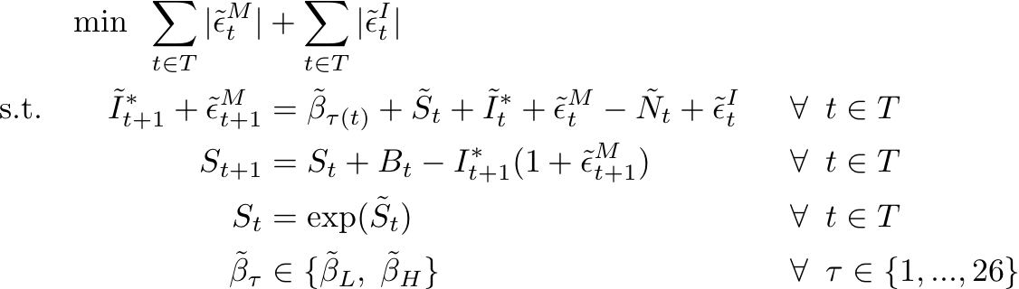
Problem Formulation
First-Order Taylor Series Approximation
Notes:
We approximate the exp with its first order taylor series, and subtitute this back into the S equation. So looking at our MIP formulation

Slide 10
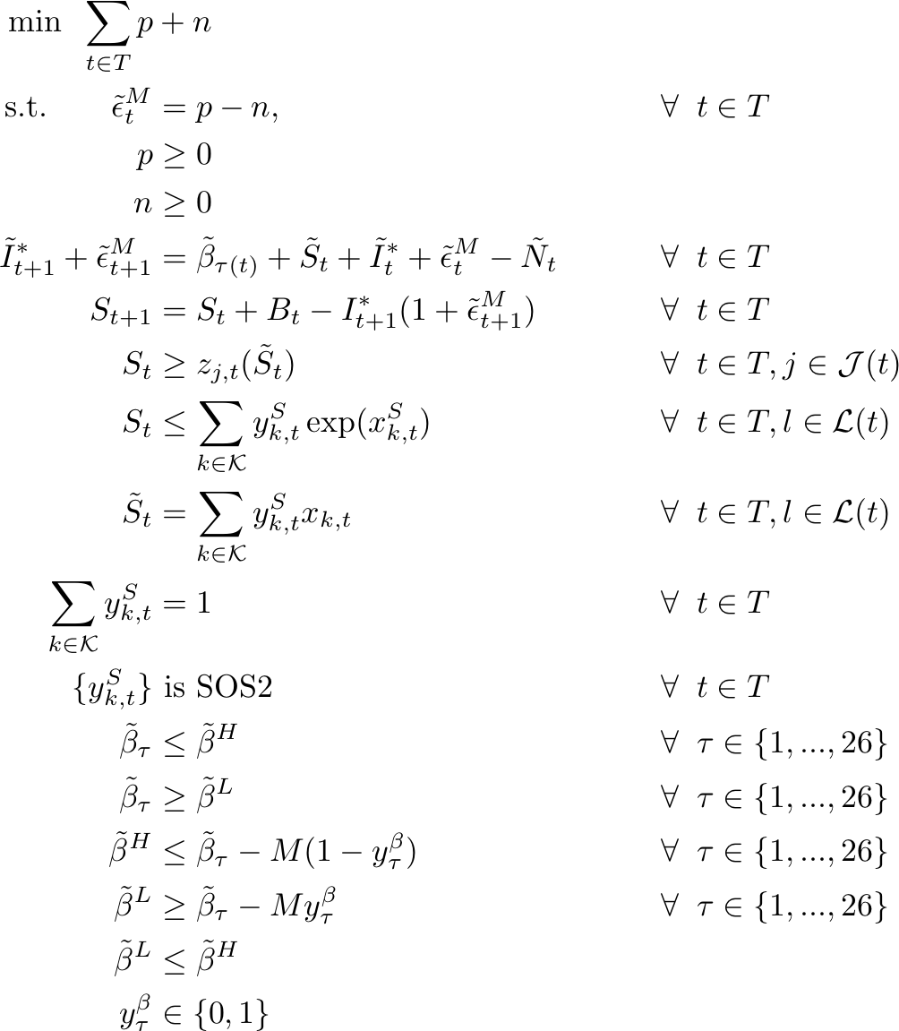
MIP Formulation
Notes:
We use the standard p n tranformation to represent the one norm in the objective function, here see our model equation, we relax the exp constraint using the standard method of linear underestimators and and piecwise linear overestimators, and we represent the beta disjunction using a big M constraint where the high and low beta values are left as variables. The NLP formulation will then be…

Slide 11
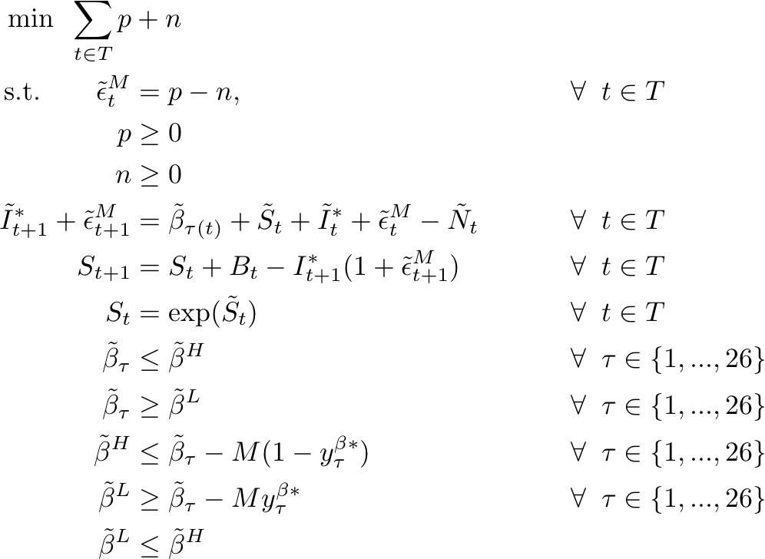
NLP Formulation
Notes:
The NLP formulation will simply use the binary solutions from the MIP in the big M constraints for beta. Now lets take a look at the algorithm we used to solve this problem…

Slide 12
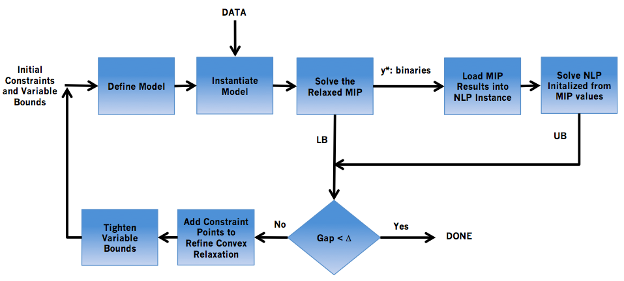



Global Optimization Algorithm
Notes:
Here we can see a flowsheet which emcompasses the more or less the generic procedure when finding global solutions, we’ll solve a MIP which provides a lower bound and binary solutions, using these results we’ll solve the NLP to find an upper bound, and refine our MIP until we approach an acceptable Gap
,
Why pyomo
2) integrated modeling algorithm development (MIP/NLP)
3) Based on Python, High-level object oriented programming
- existing numerical packages
- data structures (lists, dictionaries, classes)
- functions to construct linearizations
- interactive
- visualization

Slide 13
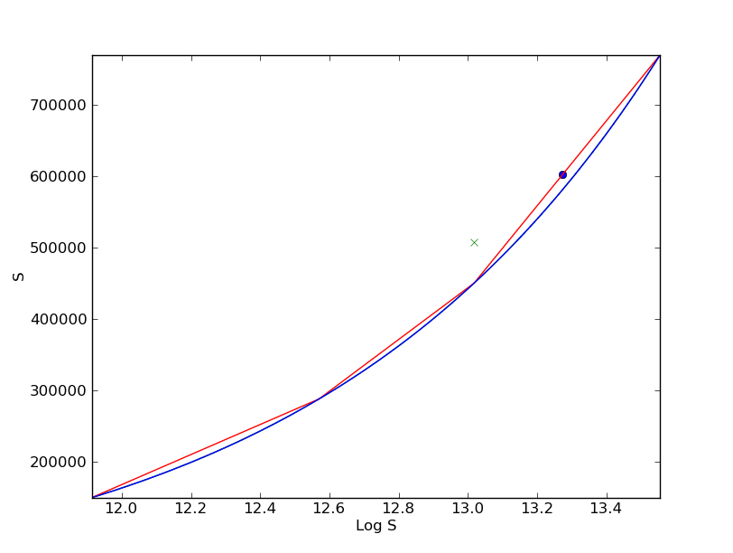


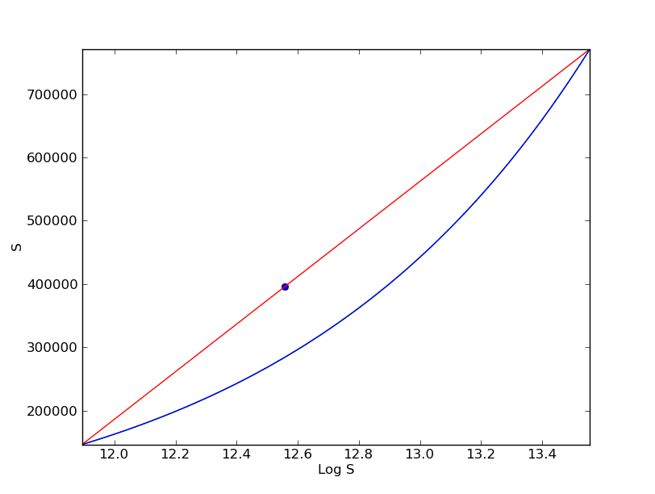
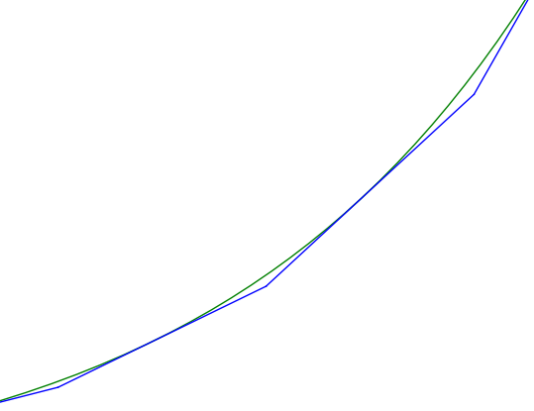
Refining the Convex Relaxation
Notes:
This is a plot I generated using the matplotlib package in python, these plots are actually output from one of the solves we performed and its showing the region around the exp() being refined after each solve

Slide 14
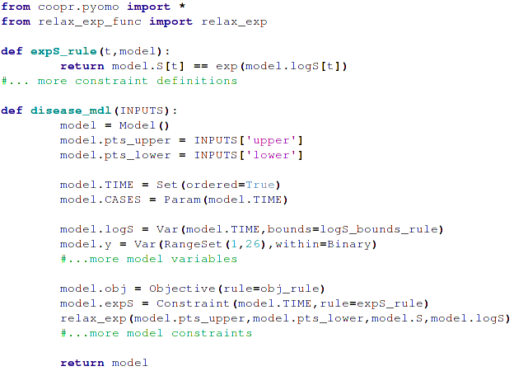
Disease Model File

Slide 15
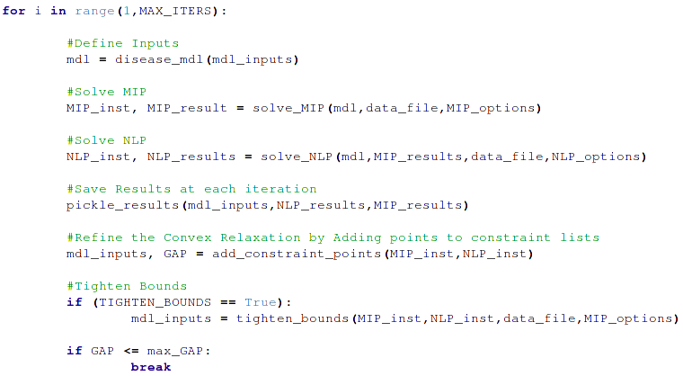
Run File
Notes:
Here we can see a simple version of the “run file” we used to solve this problem

Slide 16
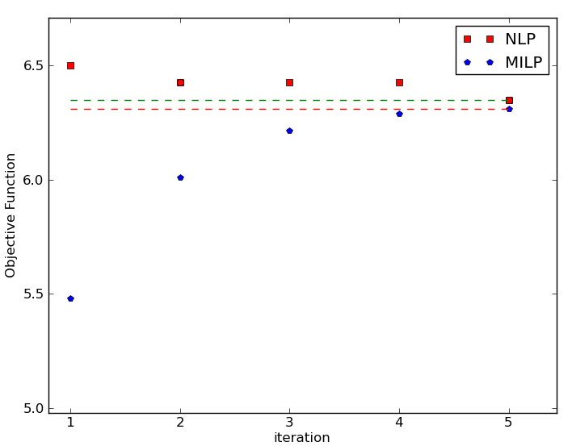
Results – New York Data
Global Solution – Two Years of Case Data

Slide 17
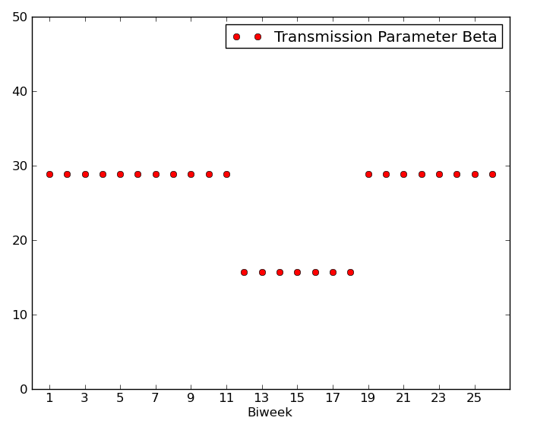
Results – New York Data
Global Solution – On/Off Behavior Matches School Terms
Summer Break

Slide 18
Pyomo Experiences
Convenience of Python
plotting/saving results
lists/dictionaries for data analysis
functions, classes
Data files
previous models built in AMPL

Slide 19

Acknowledgements
Sandia National Laboratories
National Science Foundation Faculty Early Career Development (CAREER) Award
Research Group

