Slide 1
Predicting Students performance

Slide 2
Path 1360
%% INFO :
%%% Path # 1360
%%% Students # 142
%%% Start year :
%%% 2009 64 45.07%
%%% 2010 78 54.93%
%%% L4 Modules number 4 : m1001 - m1002 - m1003 - m1004
%%% L5 Modules number 5 : m2001 - m2002 - m2003 - m2004 - m2005
%%% L6
%%% Students numbers = 141
%%% L6 paths variants number = 1
%%% L6 # 2605
%%% Modules number 5: m3001 - m3002 - m3003 - m3004 - m3005

Slide 3
1- P(L5|L4)
Features: L4 Modules marks
Target : one of the L5 modules e.g. m2004
All students records from all years will be divided randomly to training and testing set (7:3)

Slide 4
1.1 - Linear Regression Model- Robust
r2 = 0.1666
Note: the r2 values change as target change
How I would decide the best one ?

Slide 5
1.2 – Regression tree
r2 = -1.0937
Is negative r2 value good ?
resuberror = resubLoss(Rtree)
resuberror = 34.5868

Slide 6
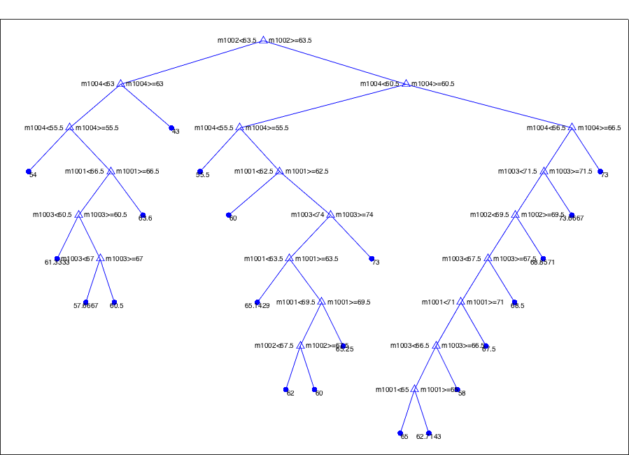
1.2 – Regression tree

Slide 7
1.2 – Regression tree
cvRtree = crossval(Rtree)
cvloss = kfoldLoss(cvRtree)
cvRtree =
classreg.learning.partition.RegressionPartitionedModel
CrossValidatedModel: 'Tree'
PredictorNames: {'m1001' 'm1002' 'm1003' 'm1004'}
ResponseName: 'm2004'
NumObservations: 99
KFold: 10
Partition: [1x1 cvpartition]
ResponseTransform: 'none'
Properties, Methods
cvloss =
91.5250

Slide 8
2- P(L6|L4,L5)
Features: L4 & L5 Modules marks
Target : one of the L6 modules e.g. m3002
All students records from all years will be divided randomly to training and testing set (7:3)

Slide 9
2.1 - Linear Regression Model
r2 =
0.1217

Slide 10
2.1 - Linear Regression Model- robust
r2 =
-0.6819

Slide 11
2.2 – Regression tree
r2 = -4.2413
resuberror = resubLoss(Rtree)
resuberror = 15.7758

Slide 12
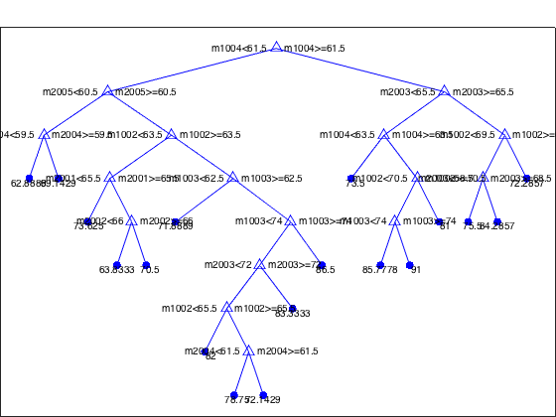
2.2 – Regression tree

Slide 13
1.2 – Regression tree
cvRtree = crossval(Rtree)
cvloss = kfoldLoss(cvRtree)
cvRtree =
classreg.learning.partition.RegressionPartitionedModel
CrossValidatedModel: 'Tree'
PredictorNames: {1x9 cell}
ResponseName: 'm3002'
NumObservations: 98
KFold: 10
Partition: [1x1 cvpartition]
ResponseTransform: 'none'
Properties, Methods
cvloss =
85.8394

