Slide 1
Utilizing parallel computing in matrix multiplication of 2 vectors
Mislav Ivanda
Roko Smoljić

Slide 2
Content
Problem
Serial algorithm
Process vs thread
Thread paralellization
<pthreads.h>
Algorithm
Process paralellization
Idea
MPI
Algorithm
Results and discusion

Slide 3
Problem
?
M
?
?
M
N
N
?
?
?

Slide 4
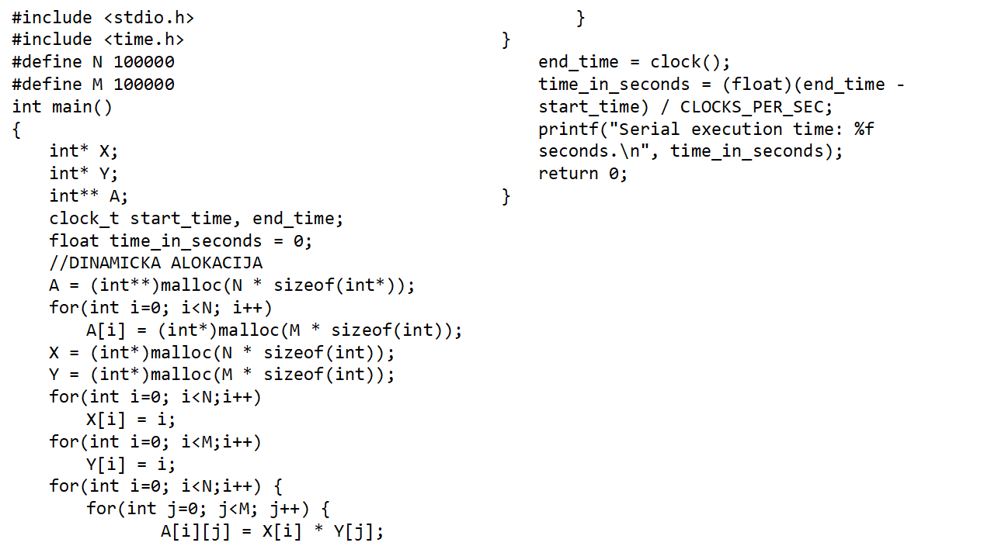
Serial algorithm

Slide 5
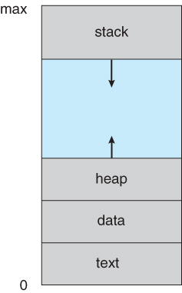
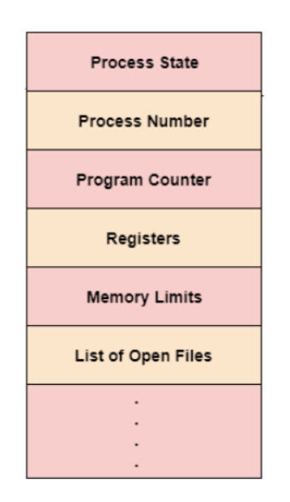
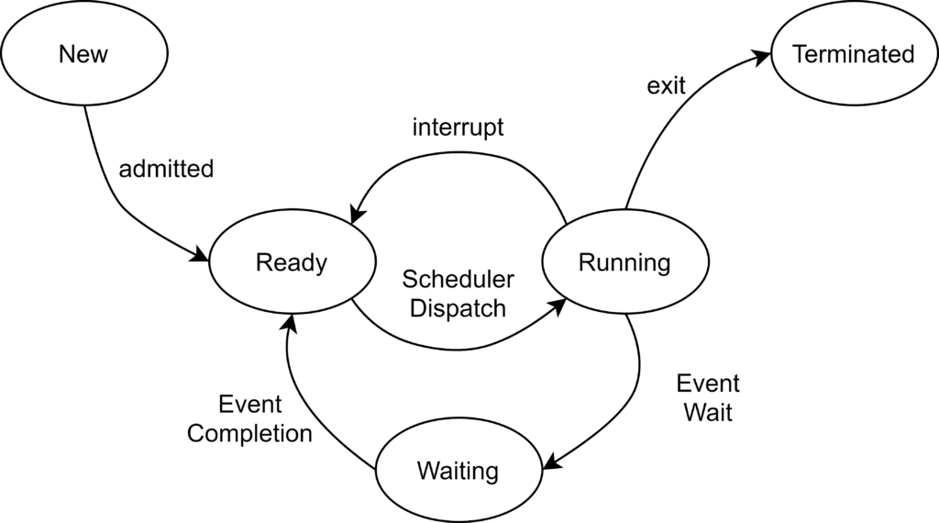
What is Process?
A program when in execution is a process
Process Control Block: process state, program counter, CPU register details, memory management information...
Process States: New, Ready, Running, Waiting, Terminated
Independent vs Cooperating processes

Slide 6
Process vs Thread
Process | Thread
Process means any program is in execution. | Thread means a segment of a process.
The process takes more time to terminate. | The thread takes less time to terminate.
It takes more time for creation. | It takes less time for creation.
It also takes more time for context switching. | It takes less time for context switching.
The process is less efficient in terms of communication. | Thread is more efficient in terms of communication
The process is isolated | Threads share memory.
Process switching uses an interface in an operating system. | Thread switching does not require calling an operating system and causes an interrupt to the kernel.
If one process is blocked then it will not affect the execution of other processes | If a user-level thread is blocked, then all other user-level threads are blocked.
Changes to the parent process do not affect child processes. | Since all threads of the same process share address space and other resources so any changes to the main thread may affect the behavior of the other threads of the process.

Slide 7
<pthreads.h>
POSIX threads, commonly known as pthreads, define C/C++ thread API based on standards
Thread management
Mutexes
Condition variables
Semaphors
GCC compile and link: gcc MyProgram.c -o MyProgram -lpthread
int pthread_create(pthread_t *restrict thread,const pthread_attr_t *restrict attr,void *(*start_routine)(void *),void *restrict arg);
int pthread_join(pthread_t thread, void **retval);

Slide 8
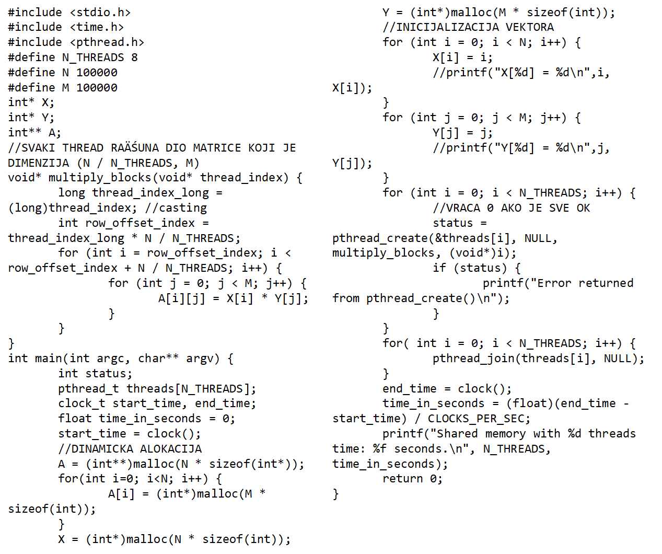
Threads algorithm

Slide 9
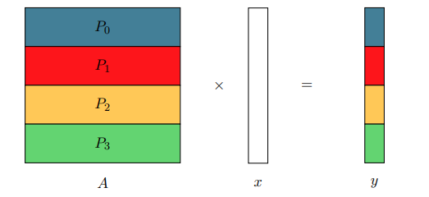
Process parallelization - Idea

Slide 10
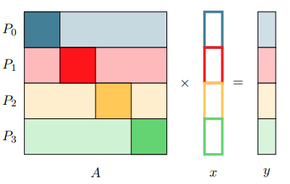
Data Distribution 1

Slide 11
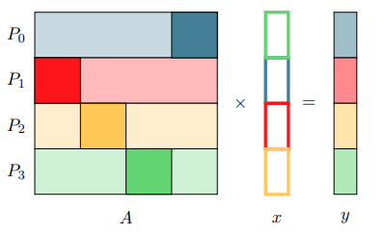
Data Distribution 2

Slide 12
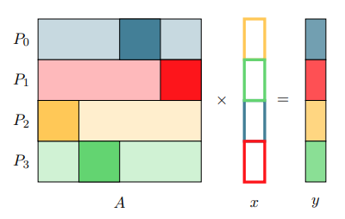
Data Distribution 3

Slide 13
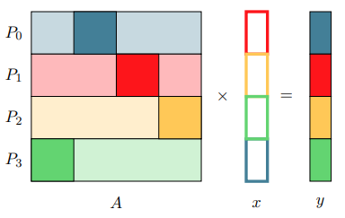
Data Distribution 4

Slide 14
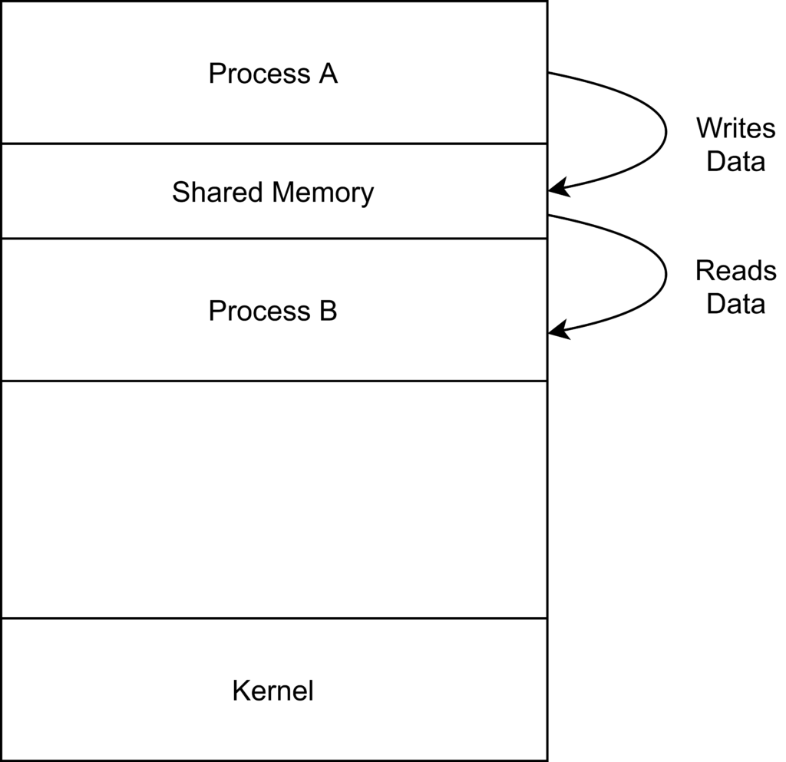
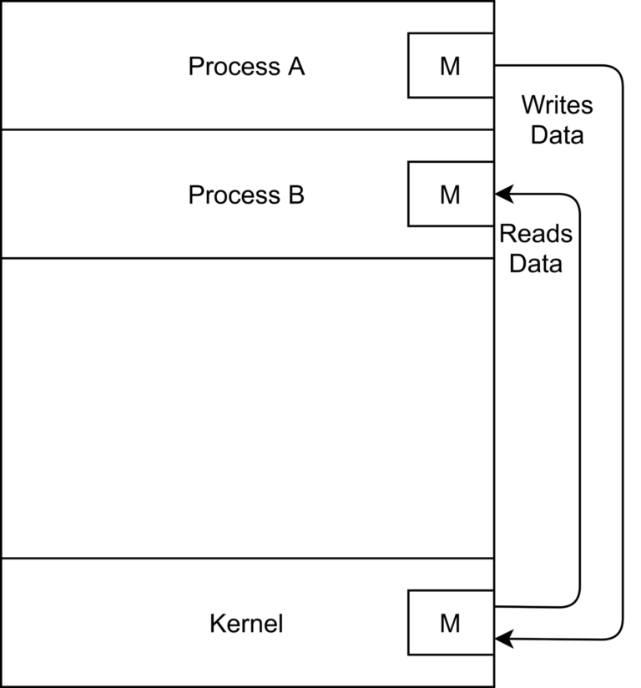
Inter-Process Communication (IPC)
Why do we need IPC?
Information Sharing: Several users may need to access the same piece of information
Computation Speedup: Often a task is split into several sub-tasks to speed up its execution.
Modularity: Most of the time applications are built in a modular fashion and divided into separate processes. For instance, the Google Chrome web browser spawns a separate process for each new tab
Two types of IPC:
Shared Memory
Message Passing

Slide 15
MPI
Message Passing Interface (MPI) is a standardized and portable message-passing standard designed to function on parallel computing architectures.
The MPI standard defines the syntax and semantics of library routines that are useful to a wide range of users writing portable message-passing programs in C, C++, and Fortran
Communicators: communicator objects connect groups of processes in the MPI session. Each communicator gives each contained process an independent identifier and arranges its contained processes in an ordered topology
Point-to-point basics: Enables messaging between two specific processes
Collective basics: involve communication among all processes in a process group (which can mean the entire process pool or a program-defined subset). MPI_Bcast call (short for "broadcast"). This function takes data from one node and sends it to all processes in the process group.
Data types: Many MPI functions require that you specify the type of data which is sent between processes. This is because MPI aims to support heterogeneous environments where types might be represented differently on the different nodes. MPI_INT, MPI_CHAR, MPI_DOUBLE or user defined types MPI_Type.
Compile and run: mpicc MyMPIProgram.c –o MyMPIProgram
mpirun –n [number_of_processes] MyMPIProgram

Slide 16
MPI Instructions
int MPI_Init(int *argc, char ***argv)
int MPI_Comm_size(MPI_Comm comm, int *size)
int MPI_Comm_rank(MPI_Comm comm, int *rank)
int MPI_Barrier(MPI_Comm comm)
int MPI_Send(const void *buf, int count, MPI_Datatype datatype, int dest, int tag, MPI_Comm comm)
int MPI_Recv(void *buf, int count, MPI_Datatype datatype, int source, int tag, MPI_Comm comm, MPI_Status *status)
int MPI_Gatherv(const void *sendbuf, int sendcount, MPI_Datatype sendtype, void *recvbuf, const int *recvcounts, const int *displs, MPI_Datatype recvtype, int root, MPI_Comm comm)
int MPI_Scatter(const void *sendbuf, int sendcount, MPI_Datatype sendtype, void *recvbuf, int recvcount, MPI_Datatype recvtype, int root, MPI_Comm comm)
double MPI_Wtime( void )
int MPI_Type_create_subarray(int ndims, const int array_of_sizes[], const int array_of_subsizes[], const int array_of_starts[], int order, MPI_Datatype oldtype, MPI_Datatype *newtype)
int MPI_Type_create_resized(MPI_Datatype oldtype, MPI_Aint lb, MPI_Aint extent, MPI_Datatype *newtype)
int MPI_Type_commit(MPI_Datatype *datatype)

Slide 17
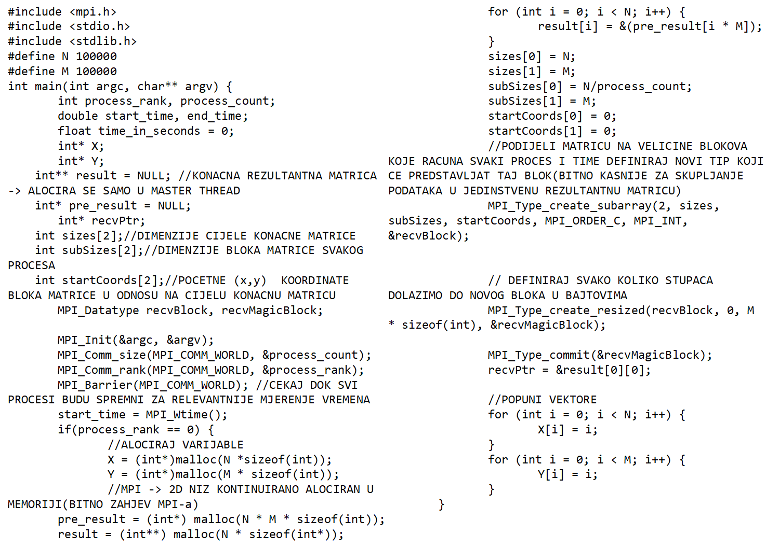
Multiple processes algorithm

Slide 18
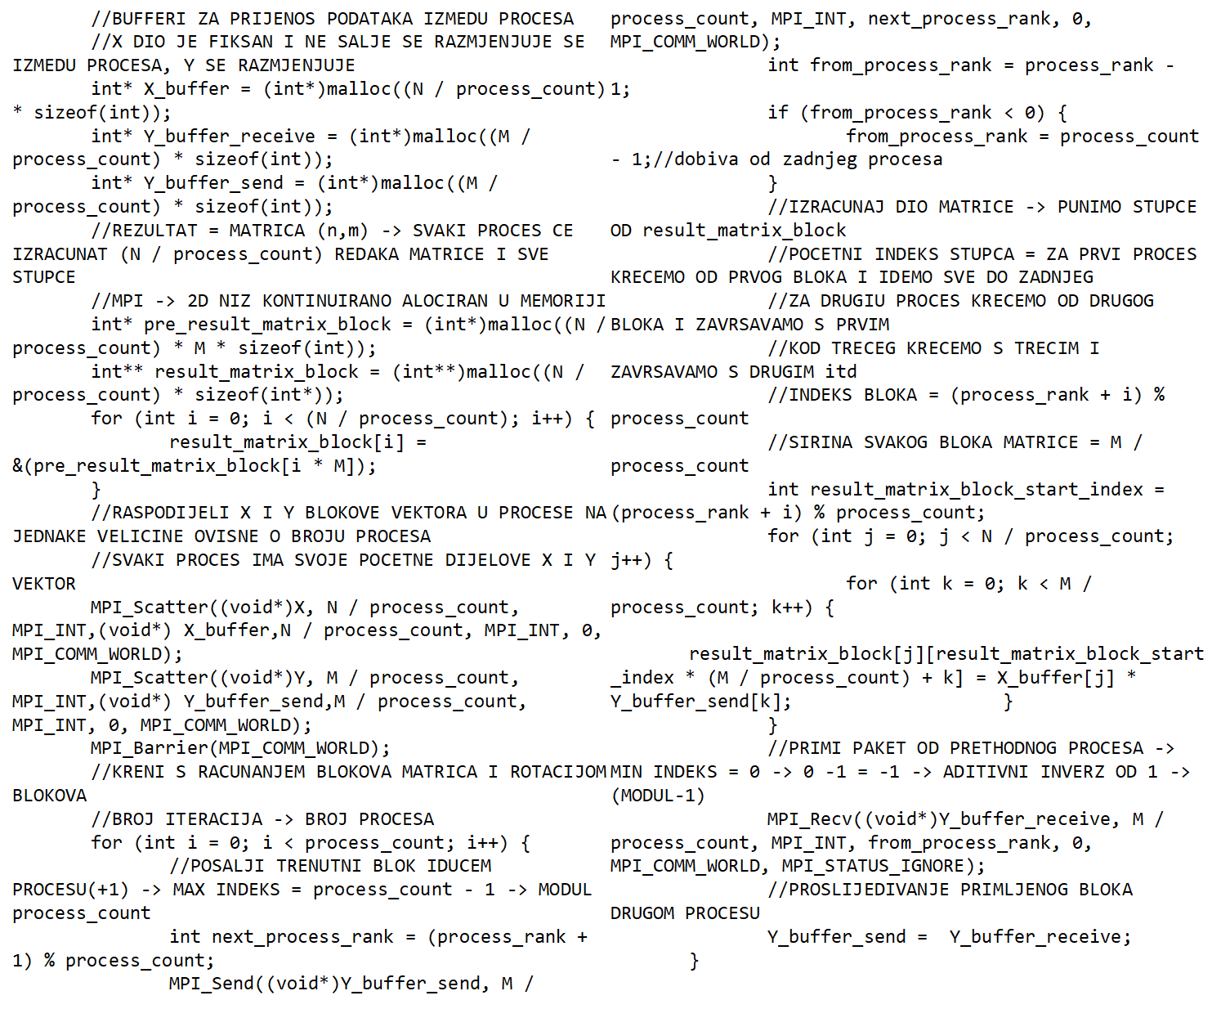

Slide 19
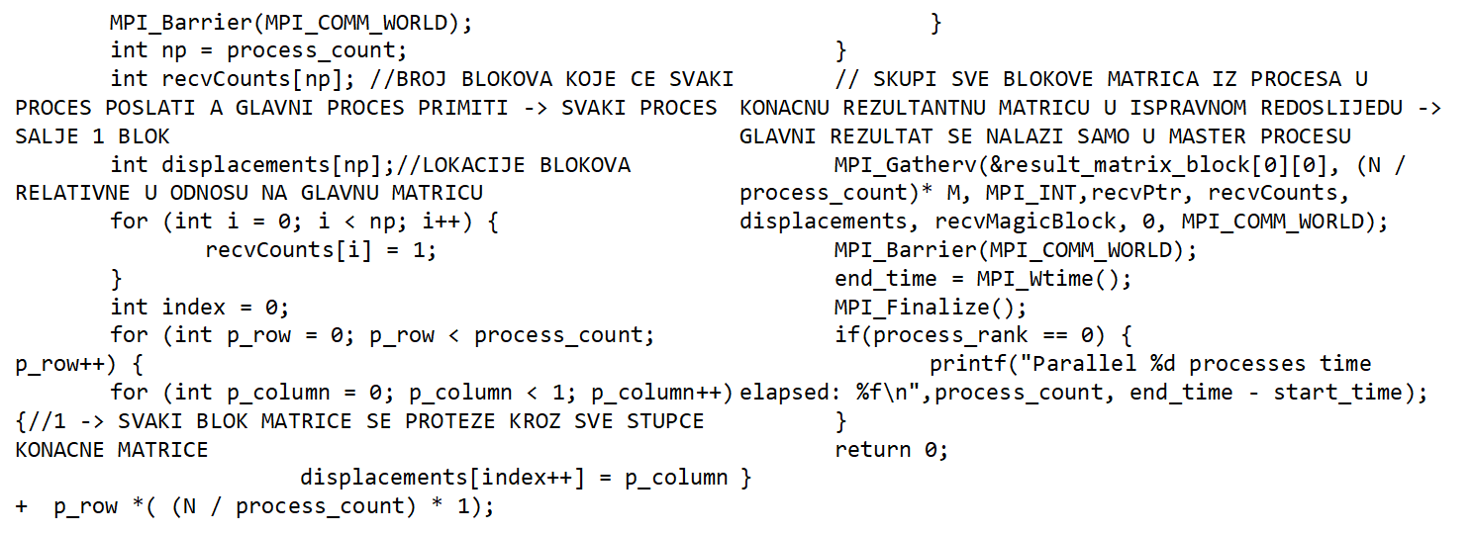

Slide 20
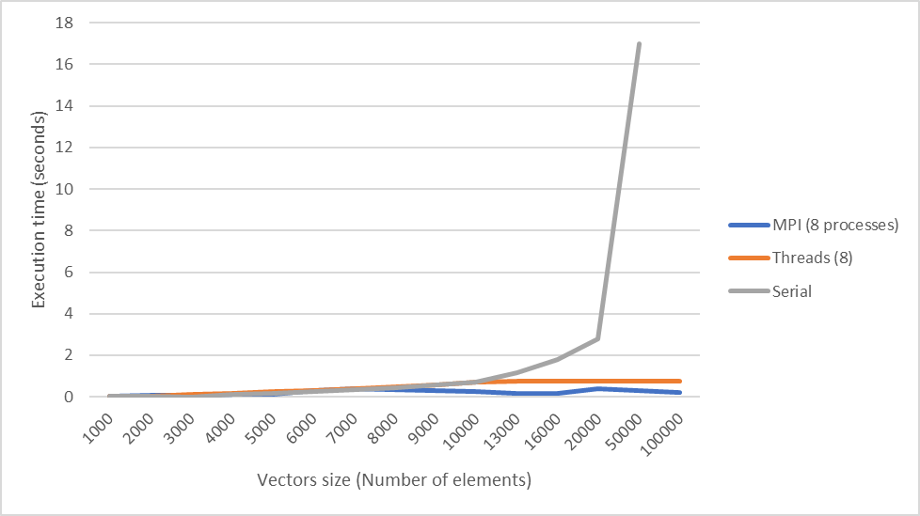
Results and discussion

Slide 21
Literature
https://www.google.com/url?sa=t&rct=j&q=&esrc=s&source=web&cd=&cad=rja&uact=8&ved=2ahUKEwjCi-mSlO_6AhVQsaQKHbARASsQFnoECAkQAQ&url=https%3A%2F%2Ftropars.github.io%2Fdownloads%2Flectures%2FPAP%2Fpap_8_dist_memory_algos.pdf&usg=AOvVaw3TIn5mEhPiwrfU1RapCH_J
https://stackoverflow.com/questions/42474048/mpi-c-gather-2d-array-segments-into-one-global-array
https://man7.org/linux/man-pages
https://www.open-mpi.org/doc/v3.0
https://www.tutorialspoint.com/operating_system/os_processes.htm
https://www.geeksforgeeks.org/difference-between-process-and-thread/

