Slide 1

CrewLock
Group No 4:
Sujan Pandey (Product Owner)
Mislav Perić (Scrum Master)
Lillas Laetitia Thorel
Anamaria Tokić
Mario Šomođi
Filip Furko
Filip Mučnjak

Slide 2



About
Our app is a professional networking platform for the entertainment industry, connecting actors, directors, writers, camera operators, and recruiters. It allows users to create a profile, showcase their skills and work, and apply for jobs. Additionally, users can post movie reviews in a social media-style format.

Slide 3
Sprint #5
DONE ✅ | IN PROGRESS 🔨 | TO-DO 📝
Defining data linkage between app features Define models Draw up basic wirteframe in Figma | Set GitHub repository Business documentation | SWOT analysis Essay Create a full wireframe in Figma

Slide 4
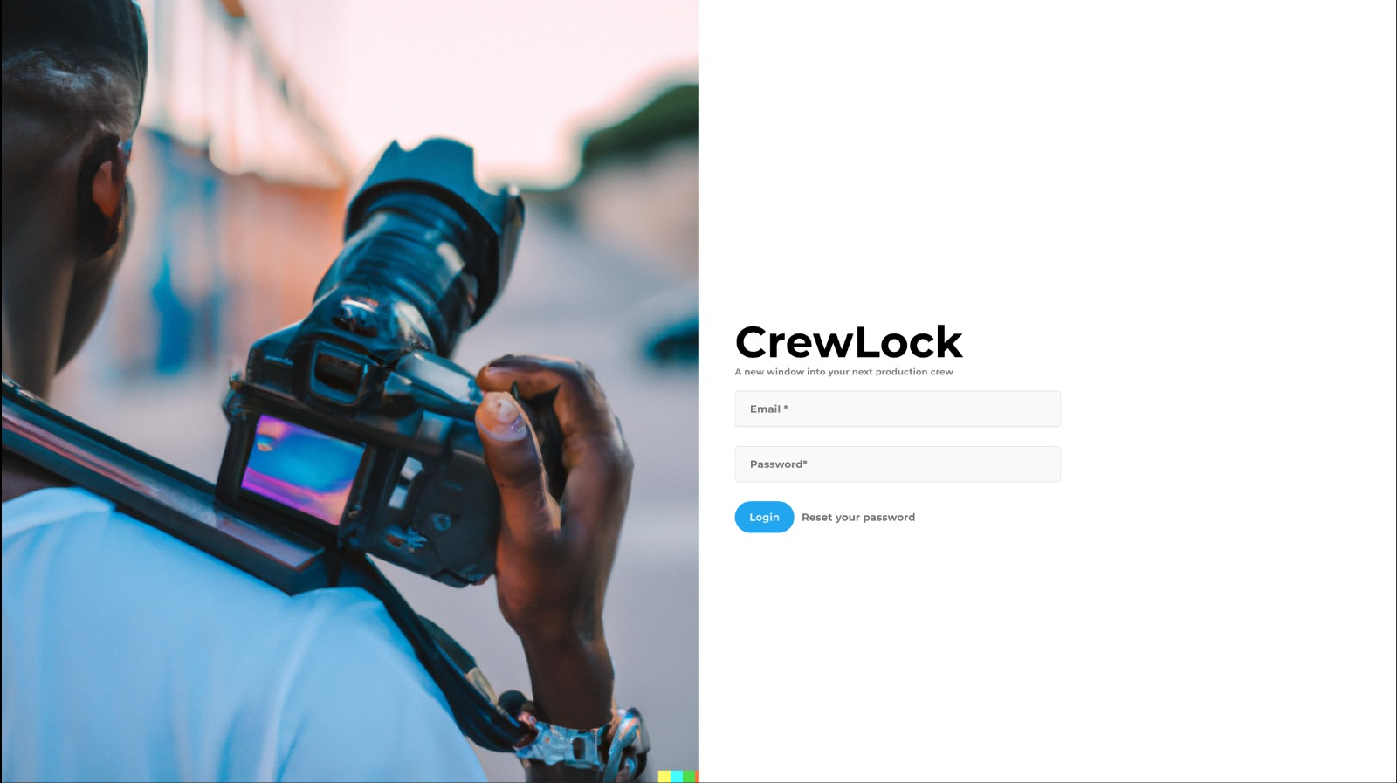

Slide 5
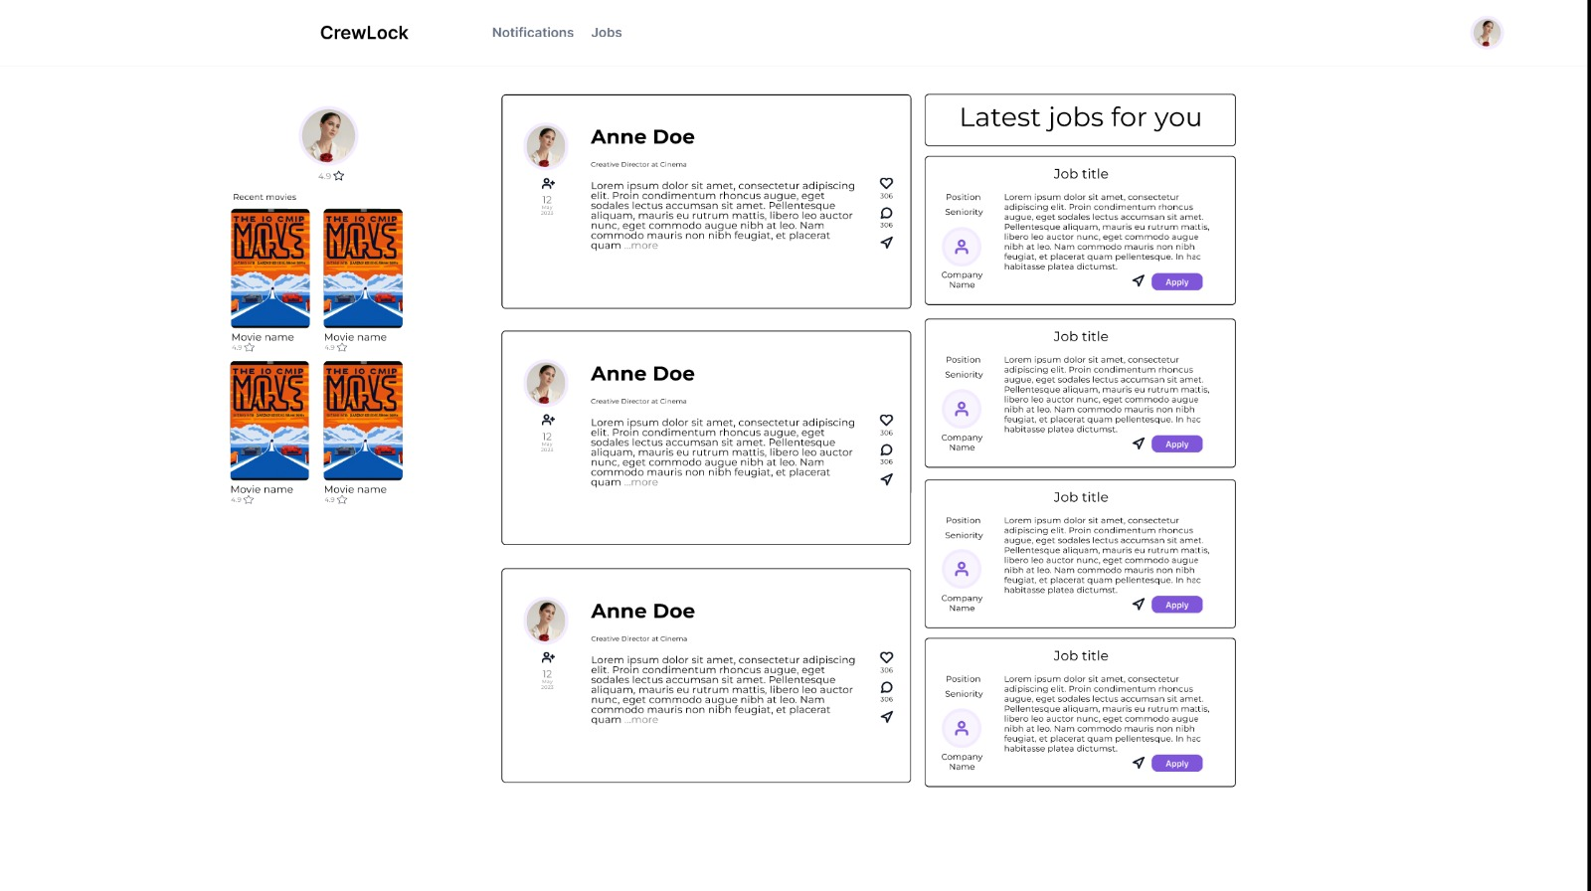

Slide 6
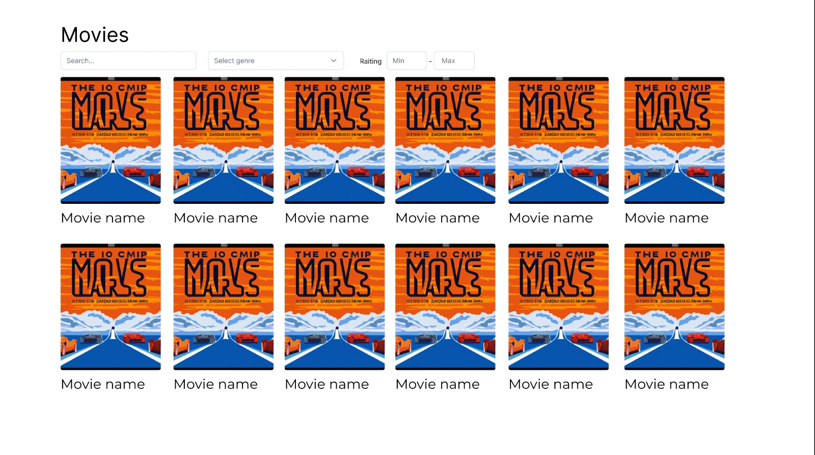

Slide 7
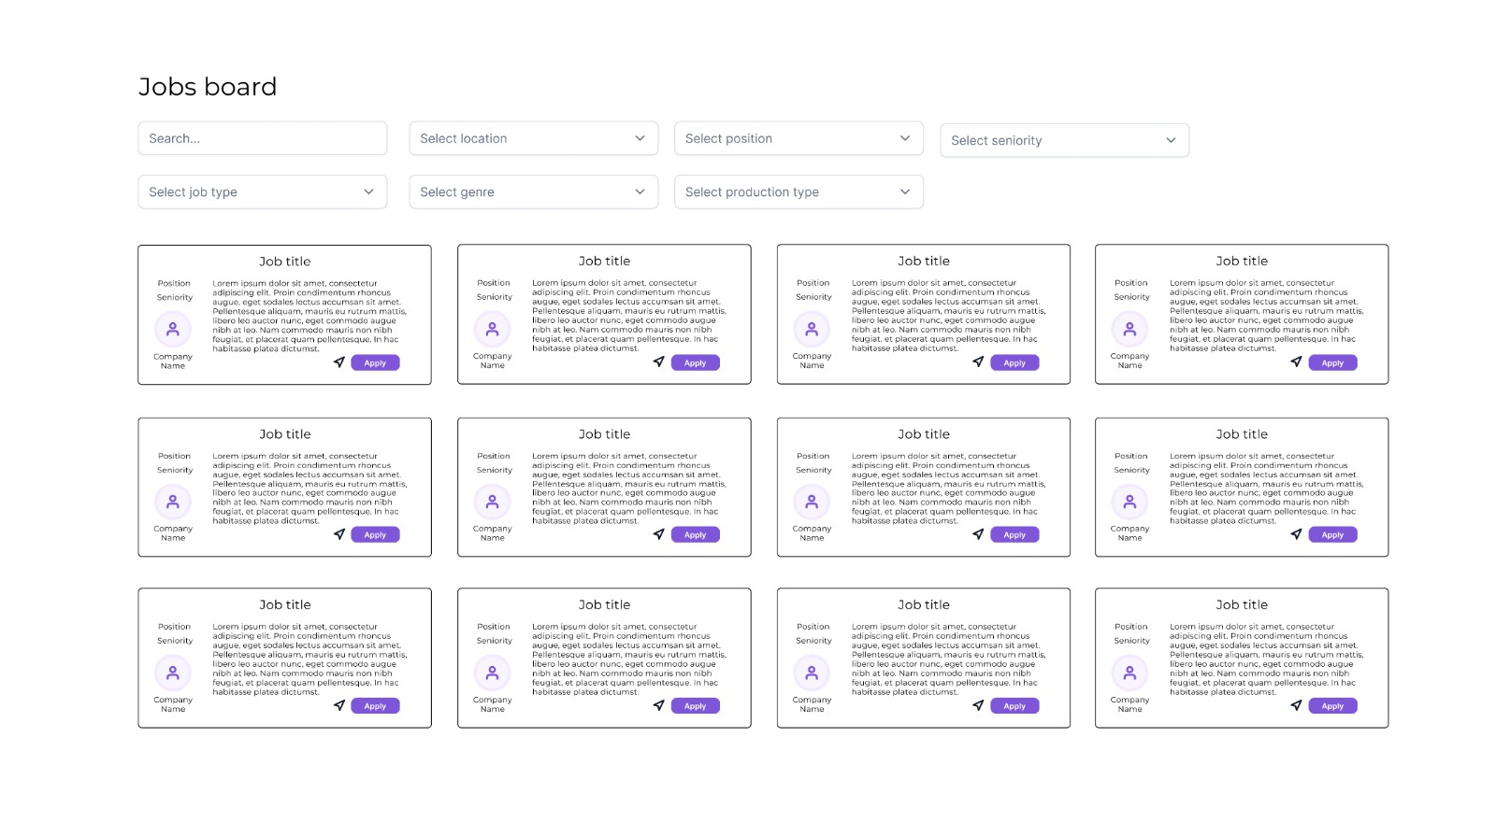

Slide 8
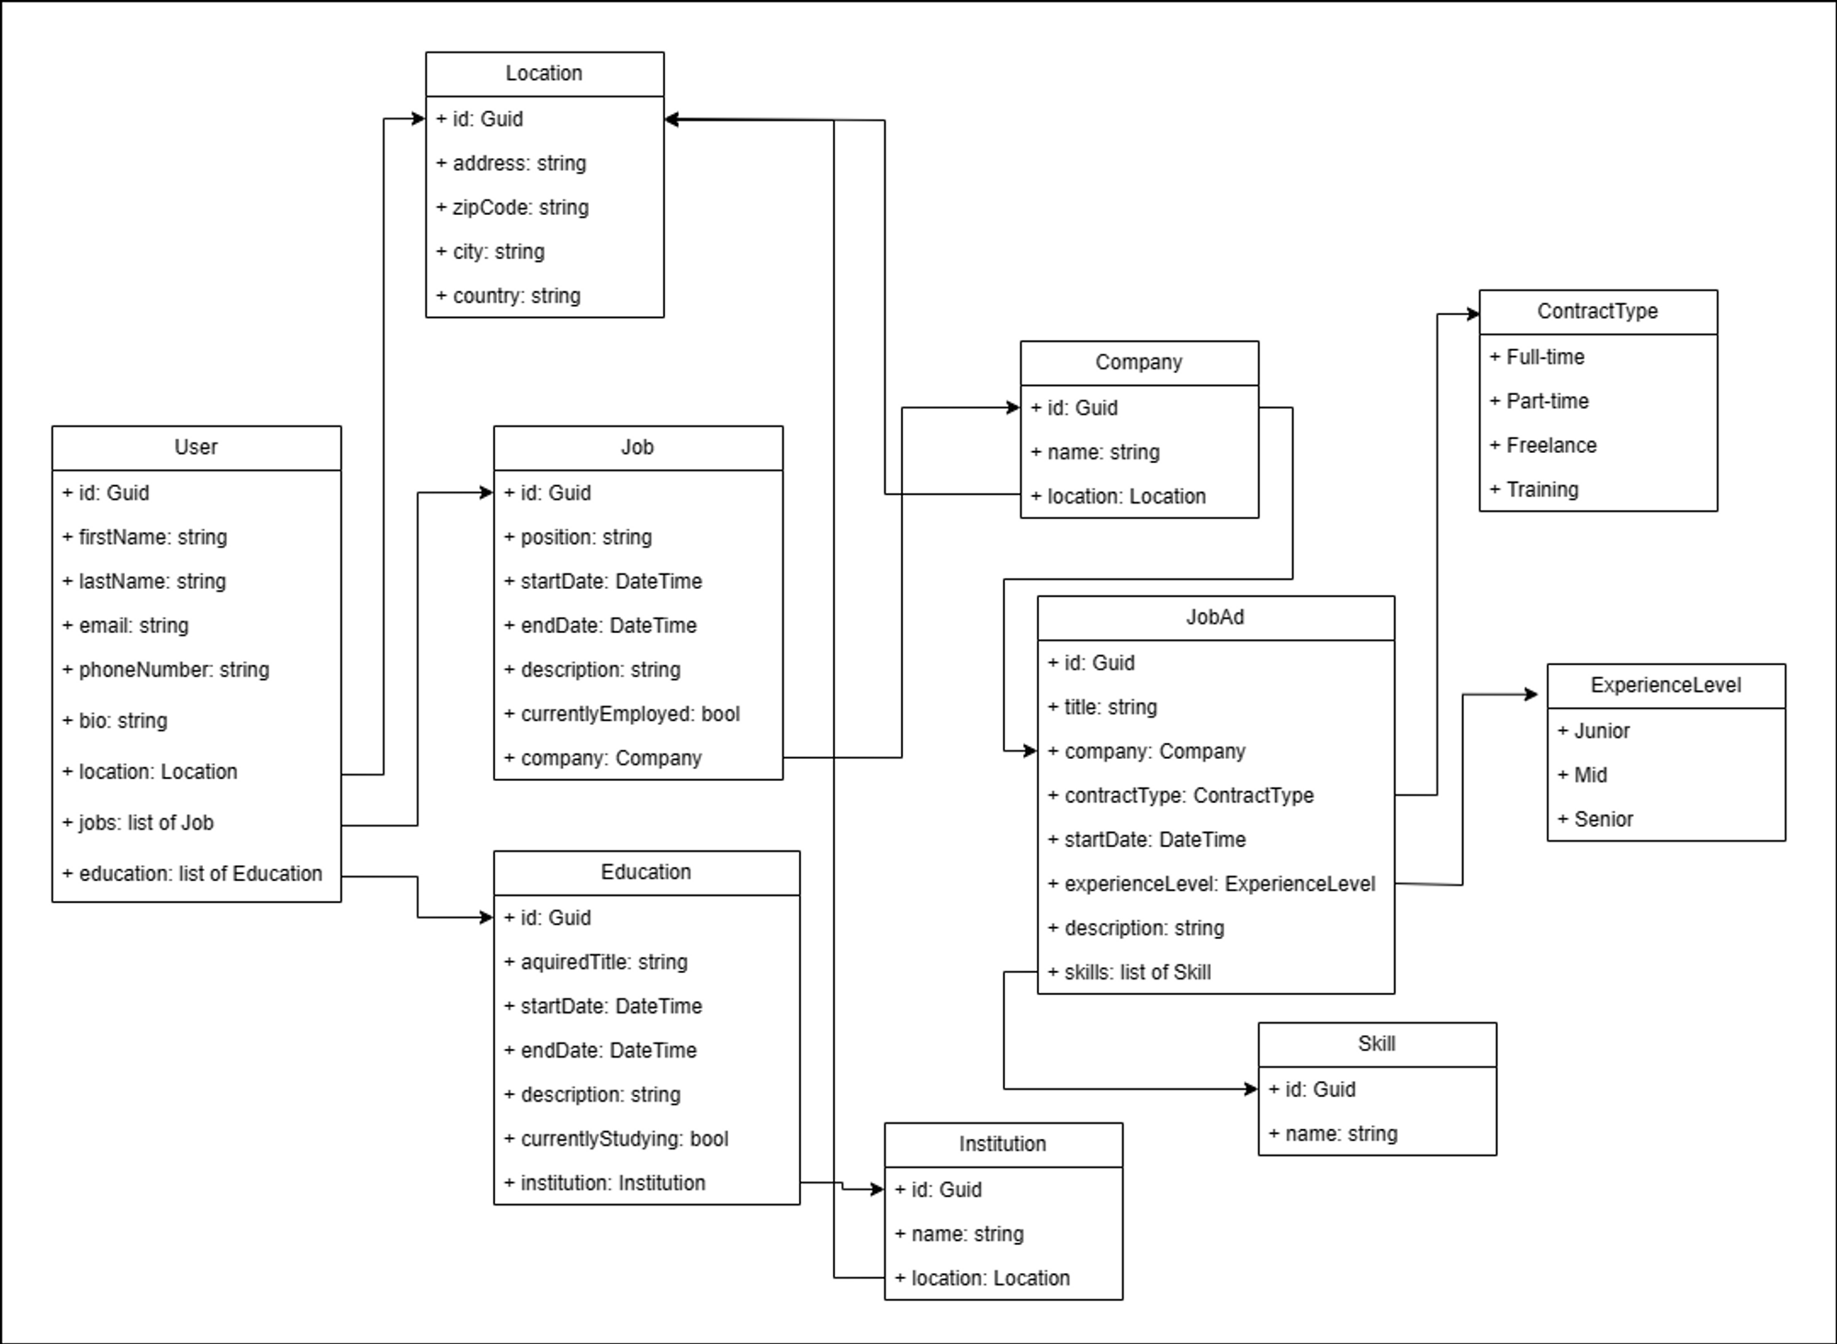
ER model
Entity model list: https://www.notion.so/Entity-model-list-27a807348dcd4ebd8f18e522dd540af0

Slide 9


Thank You!

