Slide 1
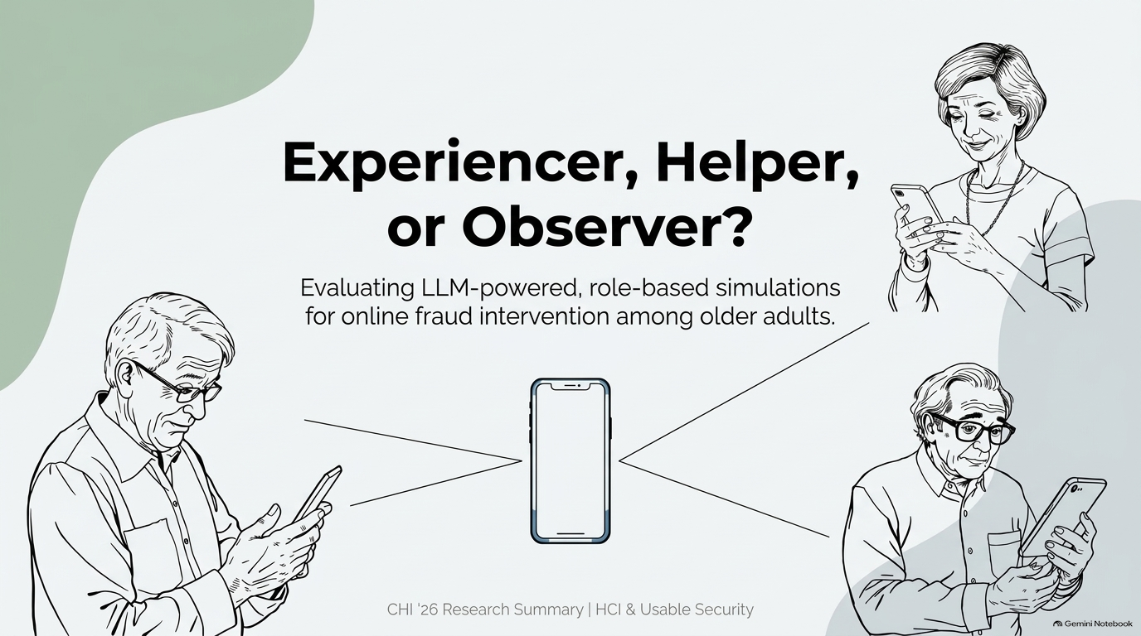

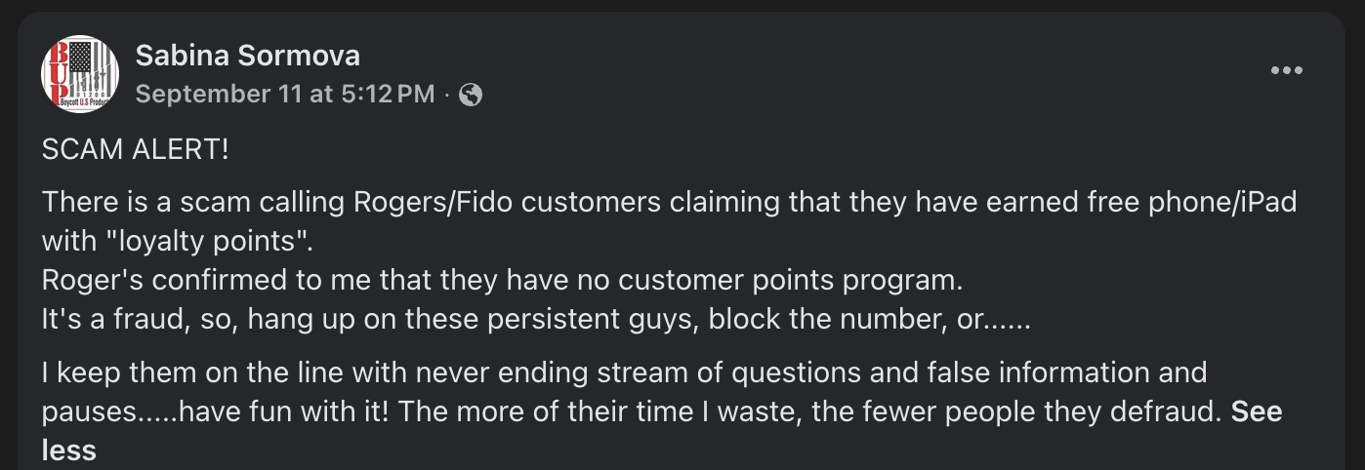
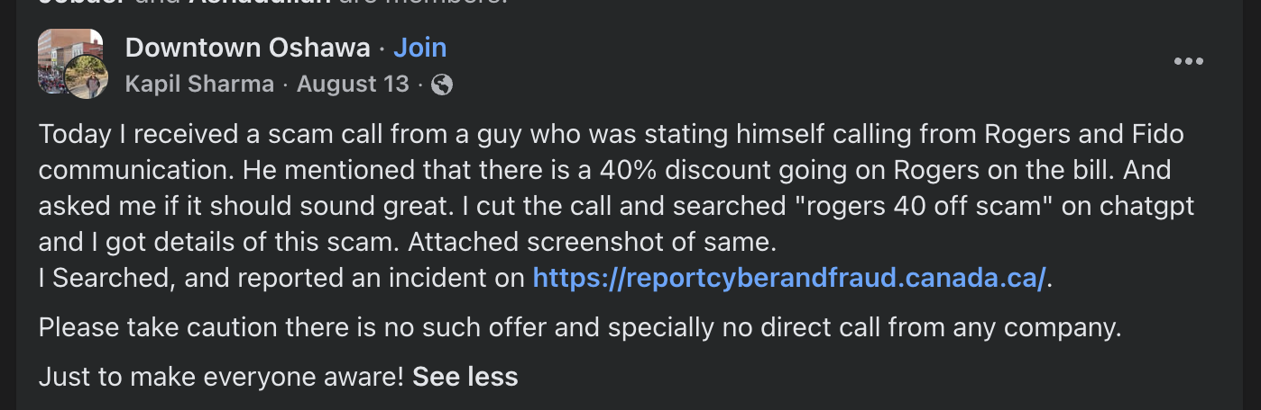
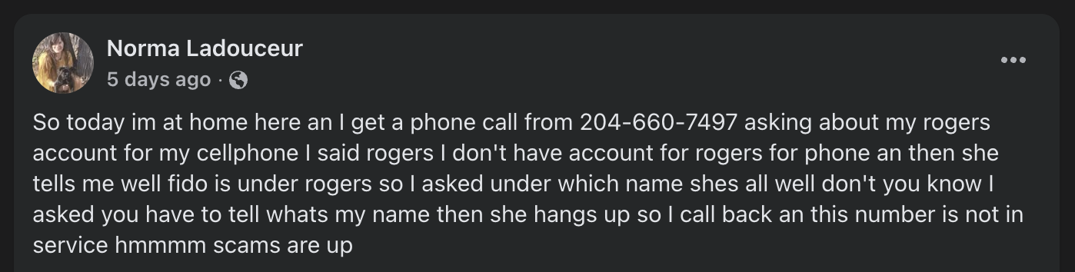
Notes:
Can you please raise your hands if you have ever received a scam call like this?
Or you might have seen people posting about the Rogers/ Fido scam in social media.
If you haven’t, please let me know after the presentation how you have preserved your privacy.

Slide 2
By Yue Deng et. al.
Presented by
Refat Ishrak Hemel
Notes:
So, to prevent these kinds of scams Yue Deng et. al. have proposed a new technique specifically for older adults as they are the ones who are the main target demographic for these kind of scams.

Slide 3
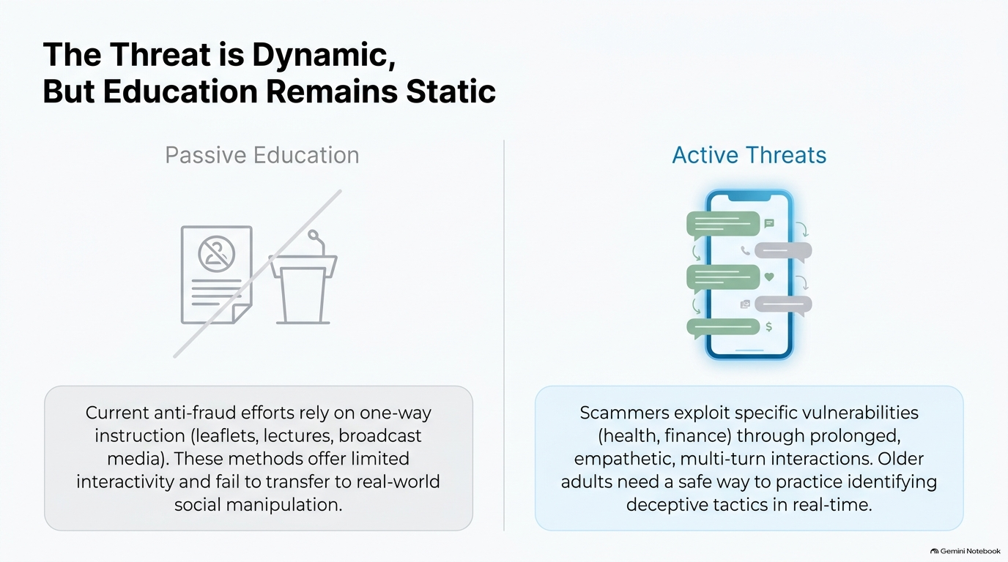
Notes:
The problem they are trying to solve is that current anti-fraud efforts rely on leaflets, broadcast media etc which is not interactive neither dynamic.
But the techniques used by the scammers are always evolving.

Slide 4
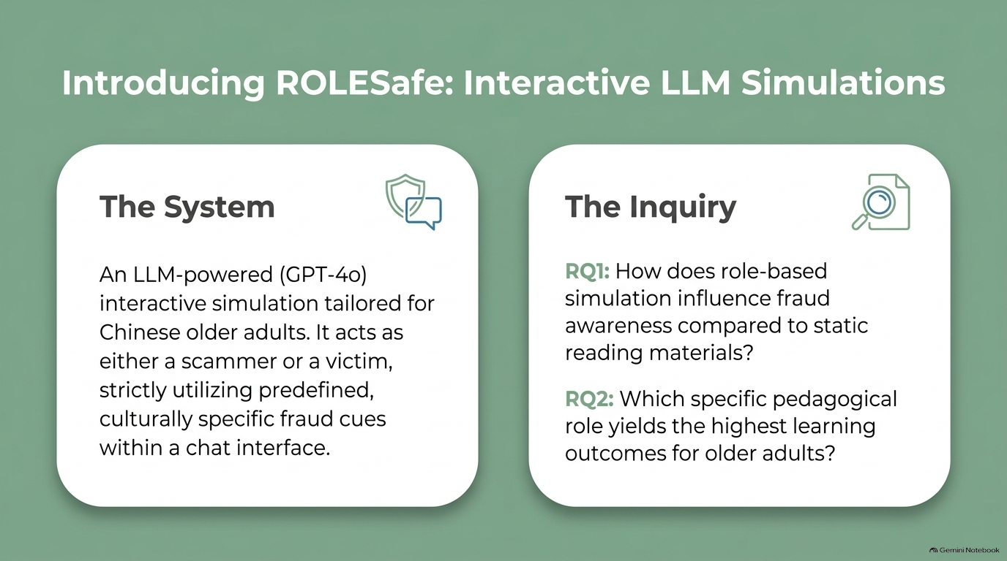
Notes:
So, they proposed an LLM-powered interactive simulation system which can act as a scammer, victim or potential victim.
They wanted to answer to 2 questions:
1) Is role-based simulation better than static reading materials?
2) secondly which role results in highest learning outcome for the older adults

Slide 5
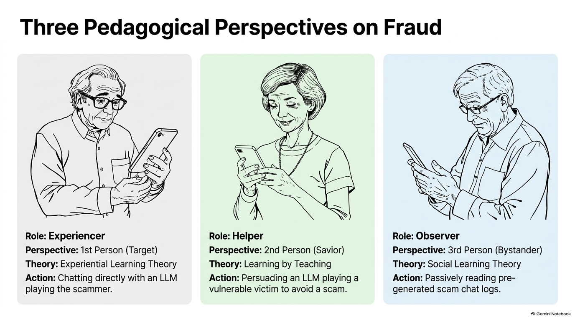
Action: Directly chats with an LLM-scammer attempting to execute fraud tactics in real time.
Action: Guides and persuades an LLM-victim asking for advice to keep them from being deceived.
Notes:
They worked with 3 roles specifically.
First one is Experiencer which is informed by ”Experiential Learning Theory”, Second one is Helper which is inspired by the “Learning by Teaching Approach” and the Observer which is drawn from “Social Learning Theory”

Slide 6
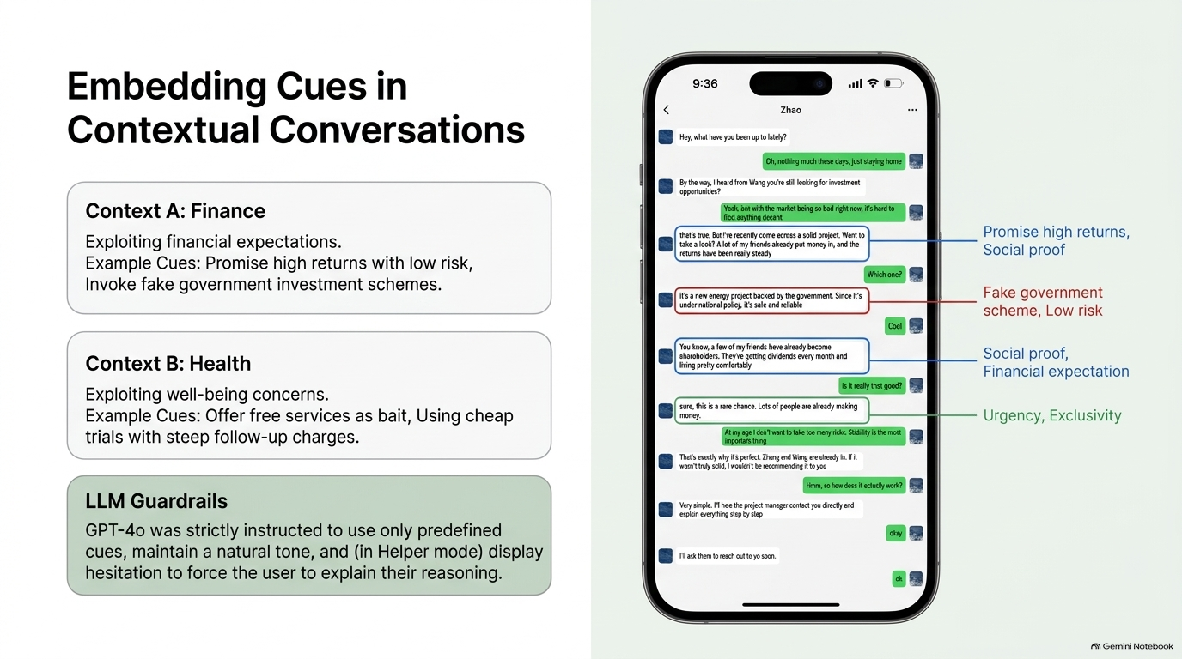
Notes:
So, what they do is they embed cues into the LLM chat while the user is interacting with the system from 2 context, One is finance and other one is Health. As these are the 2 sector where people get scammed most. Some example of financial cues are promising high returns, fake government schemes etc.
Health cues involves free health checkups, cheap trials, exclusive medicines etc.

Slide 7
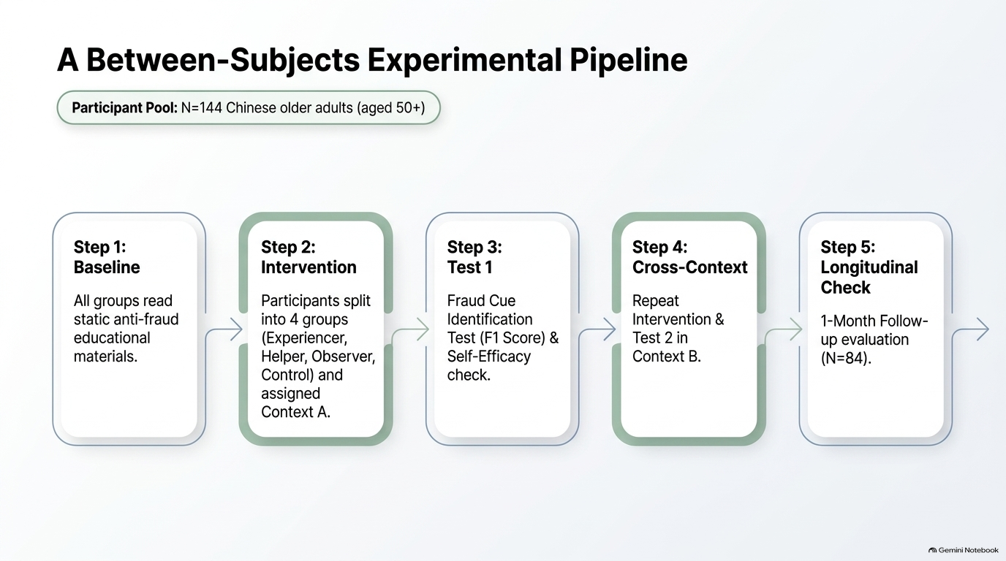
Experiencer: 33
Helper:
40
Observer:
35
Control:
36
Notes:
For the experiment they took 144 Chinese older adults and divided them into 4 groups, each containing 33 to 40 people.
First they made all of them read all the static contents. Then they assigned each group Context A which is finance and asked them to interact with the system. After that they measured the results on 4 different metrics. Then they repeated this process again in context B which is health. Finally they also did a follow up evaluation after 1 month.

Slide 8
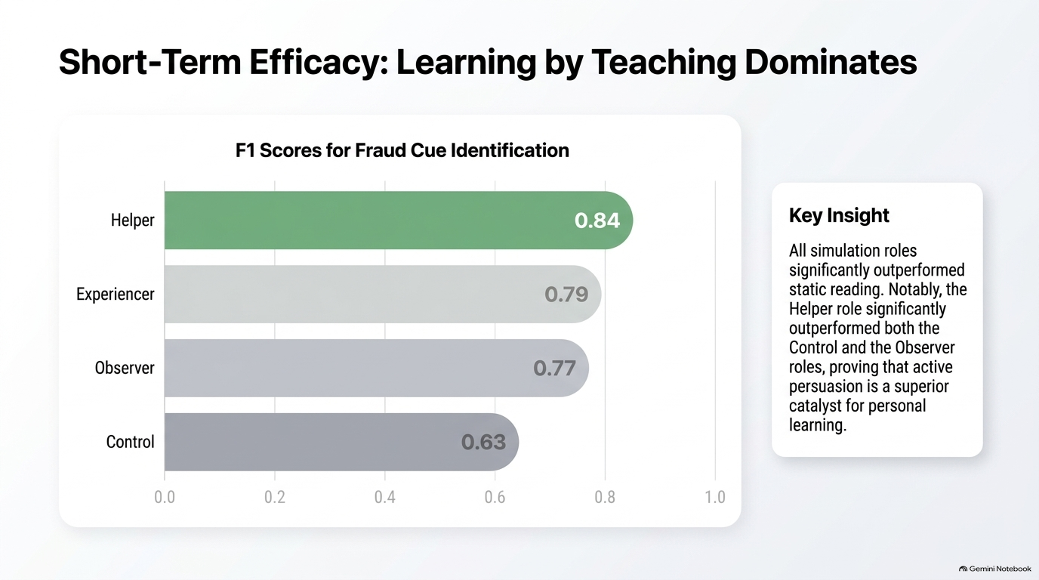
85%
81%
76%
66%
Notes:
After analyzing all the results they found that Helper role achieved the best score in identifying Fraud Cue and Control group performed the least.

Slide 9
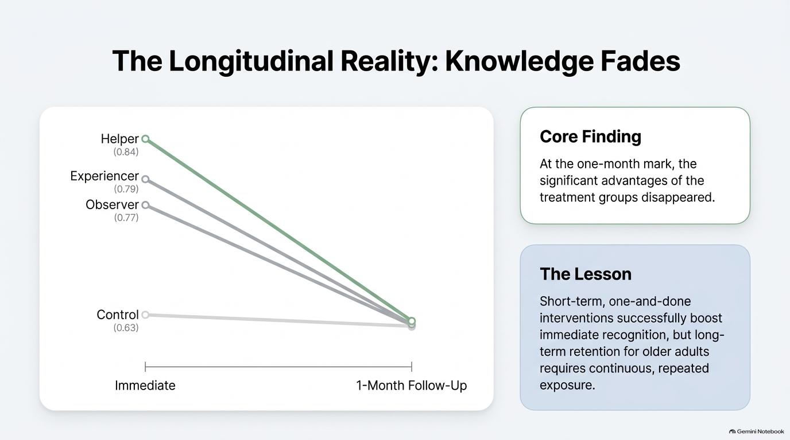
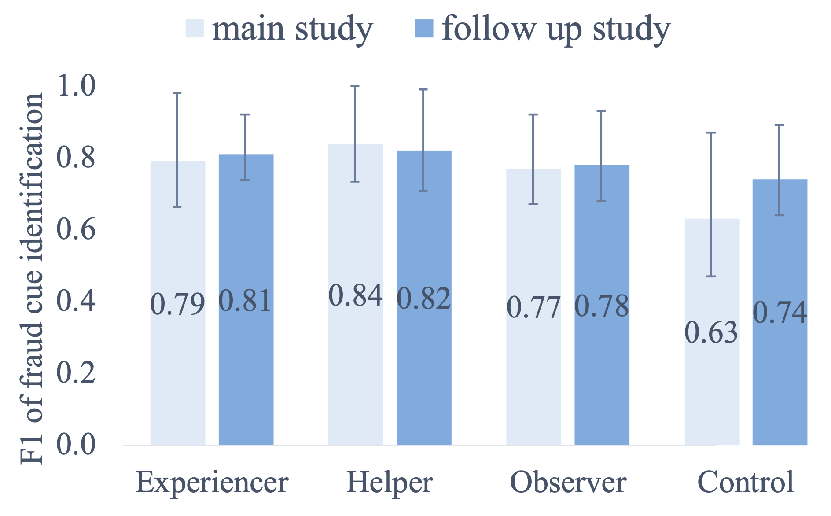
Notes:
Then they followed up after 1 month and found out that most people have forgotten most of the things.
From this they concluded that short-term or one time lessons are not that effective.

Slide 10
Thank You!
ydengbi@connect.ust.hk
xiaowei.chen@mpi-sp.org
junxiang.liao@connect.polyu.hk
bli@cse.ust.hk
yixin.zou@mpi-sp.org
Notes:
I've attempted to present months of hard work from five dedicated researchers into this five-minute presentation.
And I have gone through them for 5 days at best.
If you have any questions, it would be better if you email the author instead of asking me. However, if you still want to ask any questions, you can.

