Slide 1
UNIVERSITY OF NEW BRUNSWICK
MODEL EXTRACTION ATTACKS
Presenter: Refat Ishrak Hemel
email: refat.ishrak.hemel@unb.ca
© 2025 Roozbeh Razavi-Far

Slide 2
AGENDA
Introduction
Why it is important
Terminology
The Attack Taxonomy
From Stealing Objective POV and From Attack Techniques POV
Deep Dive of Each attack

Slide 3
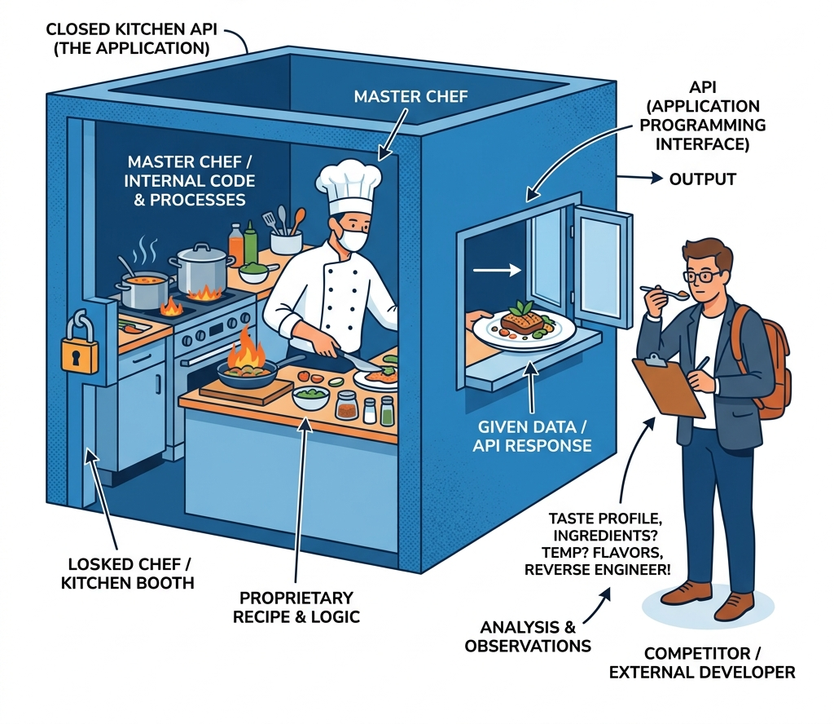
INTRODUCTION
Notes:
The Secret Chef Analogy:
A chef works inside a locked kitchen, selling dishes through a small window.
A competitor orders dishes, tastes them, and reverse-engineers the recipe to open a copycat restaurant next door.
The MLaaS Dilemma:
APIs offer black-box access to proprietary machine learning models.
The outputs lease the internal model boundaries to anyone who queries them.

Slide 4
WHY IT IS IMPORTANT
Intellectual Property (IP) Theft
Enabling Downstream Attacks
Privacy Violations
Real Cases
Notes:
Extraction bypasses huge R&D, data preparation, and GPU compute costs.
Stolen models act as white-box surrogates to generate perfect adversarial examples (evading spam/malware filters).
Extracted models can be used for model inversion attacks to steal training data.
LLM Leeching: Distilling GPT-4 capability into student models (e.g., Alpaca/Vicuna).
Voice Biometrics Fraud: Stealing synthesis boundaries to bypass bank security systems ($35M case).

Slide 5
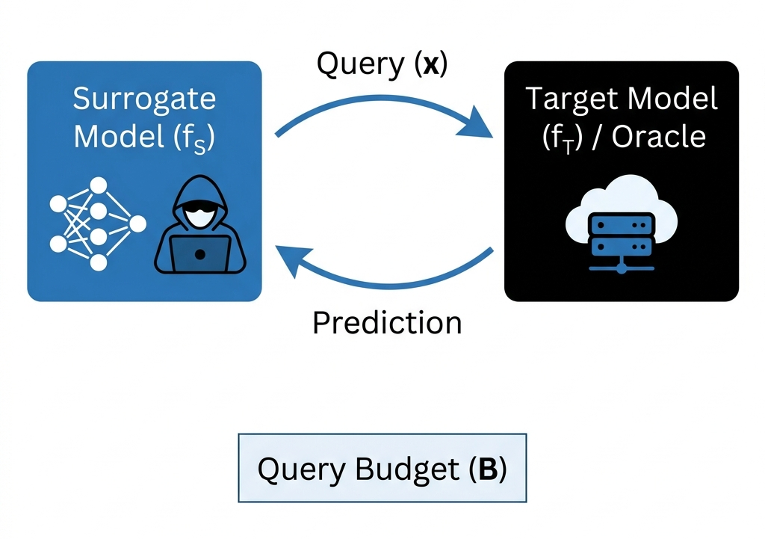
FOUNDATIONAL TERMINOLOGY
Notes:
The private victim model hosted on MLaaS or edge devices.
The student copycat model trained by the attacker.
The victim API query interface returning predictions/probabilities.
An individual input data point sent to the target model
The maximum number of API queries allowed.

Slide 6
ATTACK TAXONOMY
Stealing Objective
Exact Model Parameter
Training Hyperparameters
Architecture
Learned Parameters
Approximate Model Behavior
Same Level Of Effectiveness
Prediction Consistency
On Real Data
On Crafted Adversarial Data
Notes:
From Stealing Objective’s POV

Slide 7
ATTACK TAXONOMY
Model Extraction Attack
Query Based
Substitute Model Training
Equation Solving
Recovery
Meta-model Training
Explanation Guided
Data-driven
Problem Domain
Non-problem Domain
Data Free
Side-channel
Software Side-channel
Hardware Side-channel
Gradient-based
Direct Gradient Theft
Gradient Estimation
Other Data Modalities
Attacks On Text Models
Attacks On Vision Models
Attacks On Graph Models
Notes:
From Stealing Technique’s POV (How or why it is divided into this 5)

Slide 8
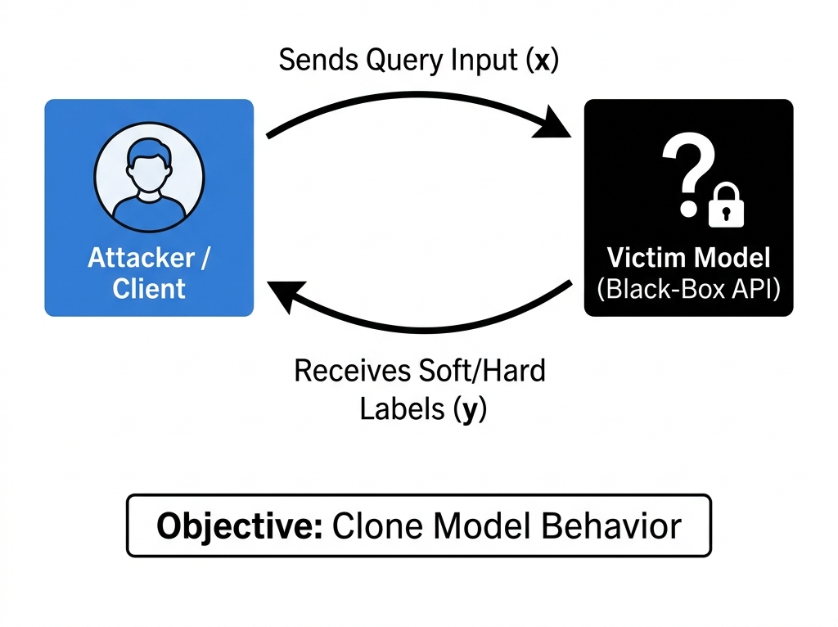
QUERY BASED ATTACKS
Notes:
Query-based attacks represent the most classic form of model extraction. The attacker treats the target model as a complete black box, having access to neither its architecture, its parameters, nor its training data.
The core intuition is simple:
“If a model behaves in a certain way on a set of inputs, we can train a second model to mimic
that behavior on the same inputs, or write a system of equations to solve for the model’s exact
parameters.”
For example, imagine a teacher (the victim model) who knows the answer to any question. A student (the attacker) asks the teacher many questions and writes down the answers. By studying the questions and answers, the student can learn to think exactly like the teacher, eventually recreating their knowledge without ever reading their original textbooks.

Slide 9
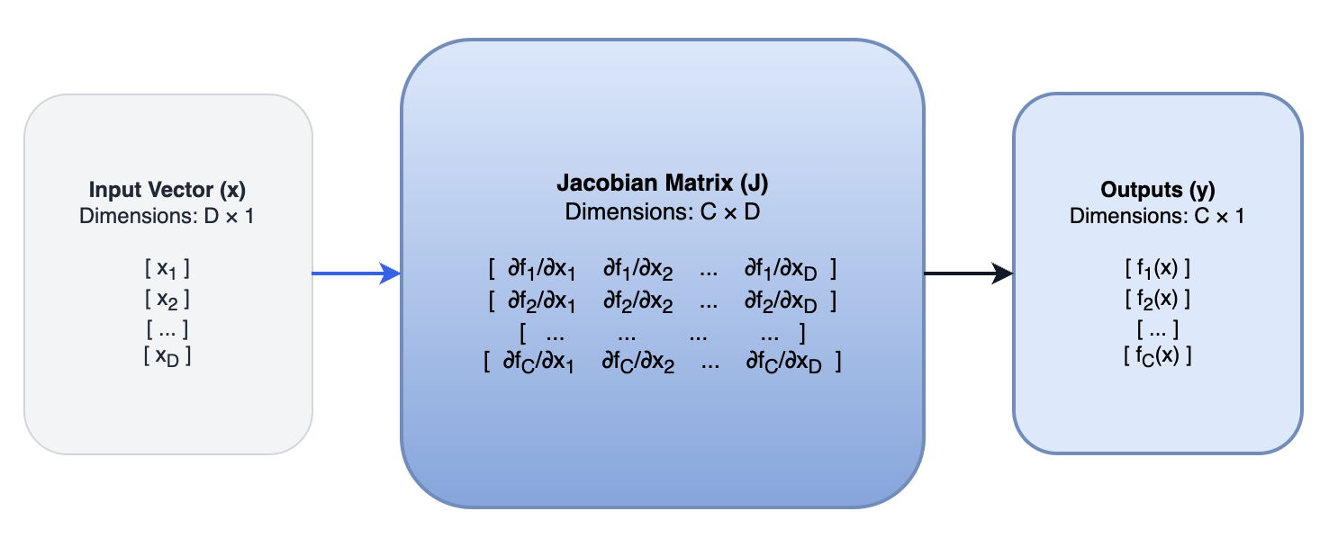
SUBSTITUTE MODEL TRAINING
Pseudo Algorithm:
Initialize
Query
Augment (Jacobian-Based)
Iterate
Notes:
Substitute model training is used when the target model is too complex to solve directly (e.g., a deep neural
network).
1. Initialize: The attacker starts with a small set of inputs (the seed set) and a local model
(the clone/substitute model).
2. Query: The attacker sends these inputs to the victim API and receives
predicted labels (hard labels like “Cat/Dog” or soft labels like probability distributions).
3. **Augment(Jacobian-Based)**: To make the clone model represent the victim’s decision boundary accurately with a small query budget, the attacker perturbs the inputs in the direction of the clone model’s gradients (the
Jacobian matrix).
4. Iterate: The perturbed samples are queried, added to the dataset, and used to retrain
the clone model. This pushes the queries directly toward the victim’s decision boundary where the model is most uncertain
1. What is a Jacobian Matrix?
To understand a Jacobian matrix, think of derivatives step-by-step:
Simple Derivative ($f'(x)$): Tells you how a single output changes when you change a single input.
Gradient ($\nabla f(x)$): Tells you how a single output changes when you change multiple inputs (a vector $x$).
Jacobian Matrix ($J$): Tells you how multiple outputs change when you change multiple inputs.
2. How it works in Model Extraction
In Substitute Model Training, the attacker wants to find inputs that sit directly on the decision boundary of the victim model (where the model is most uncertain).
Analyze Sensitivity: The attacker computes the Jacobian matrix of their local surrogate model on a seed input $x$.
Determine Direction: The rows of the Jacobian tell the attacker which direction of input change will increase or decrease the class probability the fastest.
Perturb the Input: By shifting $x$ along the sign of the Jacobian's gradient for class $c$, they generate a new query $x^$ that is closer to the decision boundary: $$x^ = x + \lambda \cdot \text{sgn}\left(\nabla_x f(x)_c\right)$$
Query Target: They send $x^*$ to the target API to find out where the target model draws the line.

Slide 10
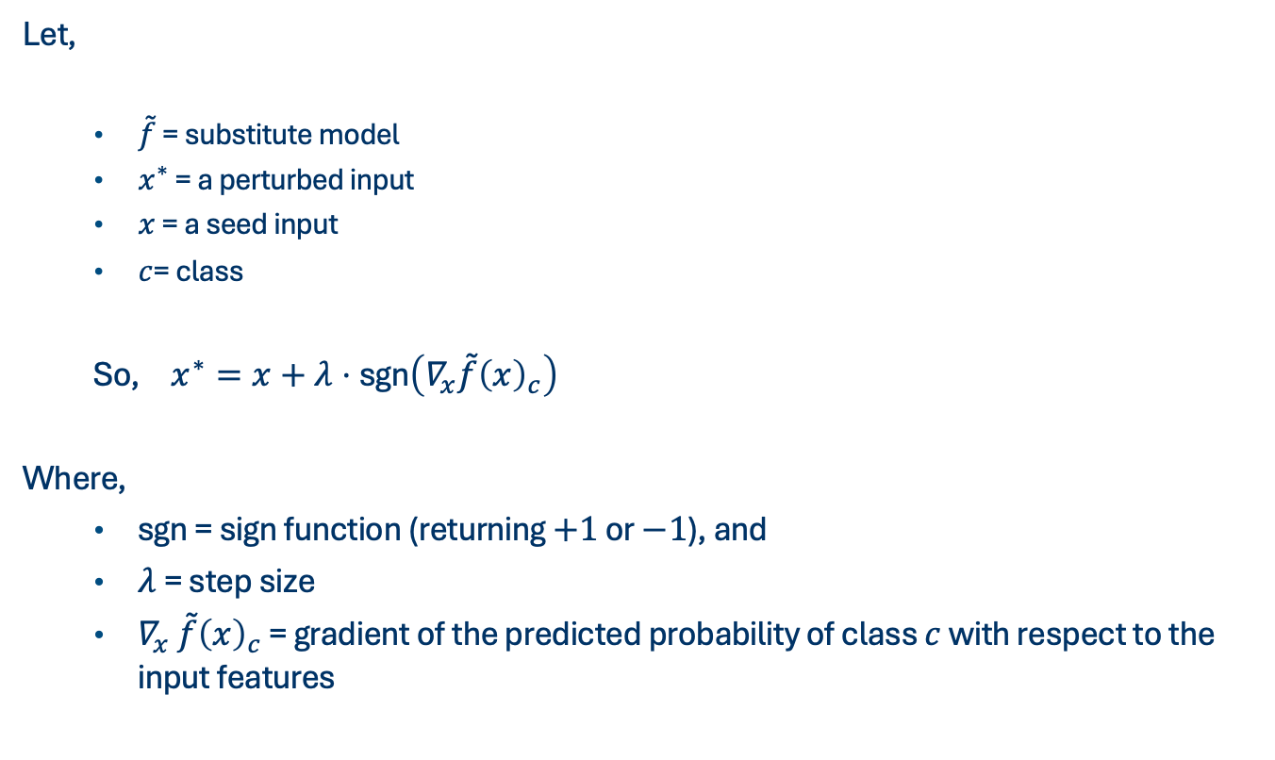
SUBSTITUTE MODEL TRAINING
Mathematical formulation:
Let,
  $\overset{˜}{f}$ = substitute model
  $x^{∗}$ = a perturbed input
  $x$ = a seed input
  $c$= class
  So, $x^{∗}=x+λ⋅\text{sgn}\left(∇_{x}\overset{˜}{f}{\left(x\right)}_{c}\right)$
Where,
  $\text{sgn}$ = sign function (returning $+1$ or $−1$), and
  $λ$ = step size
  $∇_{x}$ $\overset{˜}{f}{\left(x\right)}_{c}$ = gradient of the predicted probability of class $c$ with respect to the input features
Notes:
The attacker wants to generate a perturbed input $x^{∗}$ from a seed input $x$ to probe the model's boundary for class $c$:
Where $∇_{x}$ $\overset{˜}{f}{\left(x\right)}_{c}\$$ is the gradient of the predicted probability of class $c$ with respect to the input features$,\$\text{sgn}\$$ is the sign function (returning $+1$ or $−1$), and $λ$ is the step size.

Slide 11
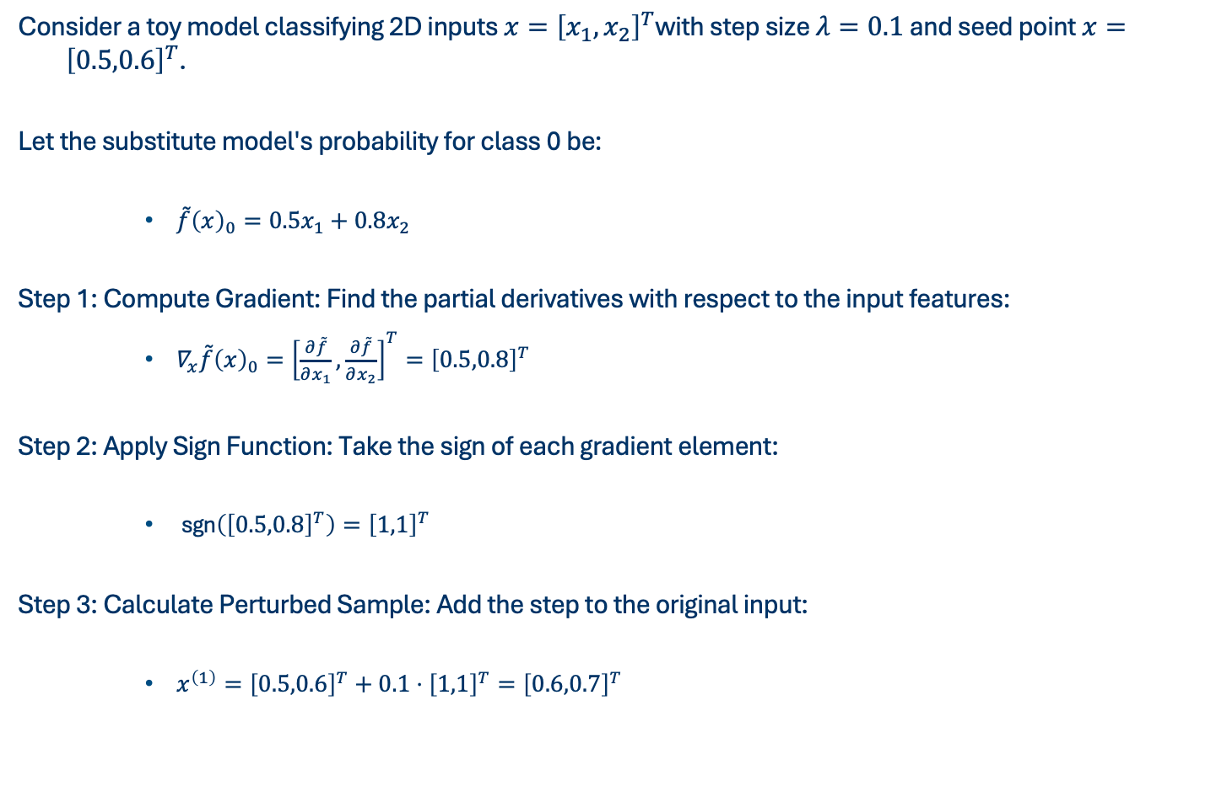
SUBSTITUTE MODEL TRAINING
Consider a toy model classifying 2D inputs $x={\left[x_{1},x_{2}\right]}^{T}$with step size $λ=0.1$ and seed point $x={\left[0.5,0.6\right]}^{T}$.
Let the substitute model's probability for class 0 be:
    $\overset{˜}{f}{\left(x\right)}_{0}=0.5x_{1}+0.8x_{2}$
Step 1: Compute Gradient: Find the partial derivatives with respect to the input features:
    $∇_{x}\overset{˜}{f}{\left(x\right)}_{0}={\left[\frac{∂\overset{˜}{f}}{∂x_{1}},\frac{∂\overset{˜}{f}}{∂x_{2}}\right]}^{T}={\left[0.5,0.8\right]}^{T}$
Step 2: Apply Sign Function: Take the sign of each gradient element:
    $\text{sgn}\left({\left[0.5,0.8\right]}^{T}\right)={\left[1,1\right]}^{T}$
Step 3: Calculate Perturbed Sample: Add the step to the original input:
    $x^{\left(1\right)}={\left[0.5,0.6\right]}^{T}+0.1⋅{\left[1,1\right]}^{T}={\left[0.6,0.7\right]}^{T}$

Slide 12
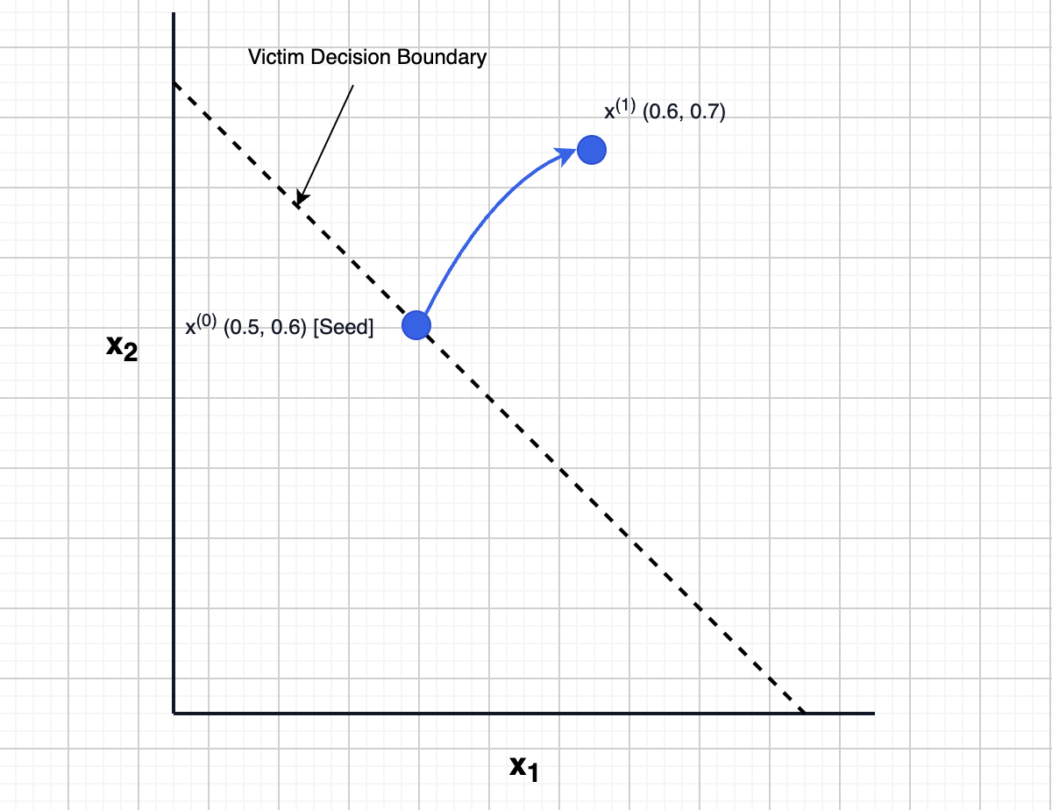
SUBSTITUTE MODEL TRAINING

Slide 13
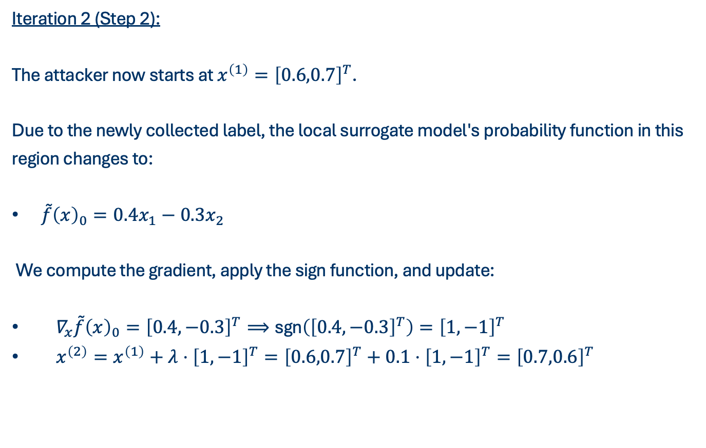
SUBSTITUTE MODEL TRAINING
Iteration 2 (Step 2):
The attacker now starts at $x^{\left(1\right)}={\left[0.6,0.7\right]}^{T}$.
Due to the newly collected label, the local surrogate model's probability function in this
region changes to:
$\overset{˜}{f}{\left(x\right)}_{0}=0.4x_{1}−0.3x_{2}$
We compute the gradient, apply the sign function, and update:
$∇_{x}\overset{˜}{f}{\left(x\right)}_{0}={\left[0.4,−0.3\right]}^{T}⟹\text{sgn}\left({\left[0.4,−0.3\right]}^{T}\right)={\left[1,−1\right]}^{T}$
$x^{\left(2\right)}=x^{\left(1\right)}+λ⋅{\left[1,−1\right]}^{T}={\left[0.6,0.7\right]}^{T}+0.1⋅{\left[1,−1\right]}^{T}={\left[0.7,0.6\right]}^{T}$
Notes:
This completes the first iteration. The new sample $x^{\left(1\right)}$ is sent to the target API to find the boundary label.
To trace how the attack continues to walk along the decision boundary, we perform the next iterations:
Continues numbering from 4

Slide 14
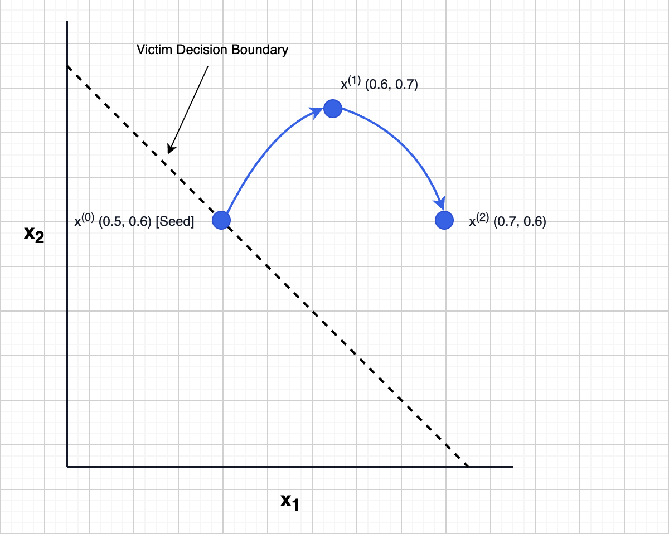
SUBSTITUTE MODEL TRAINING

Slide 15
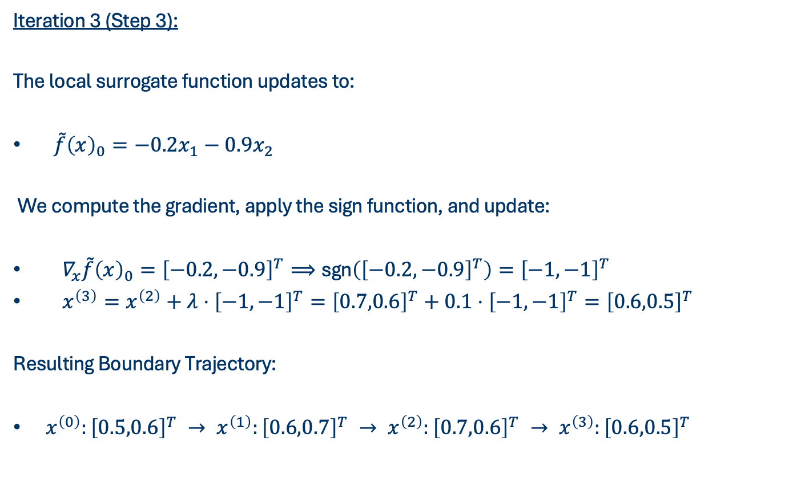
SUBSTITUTE MODEL TRAINING
Iteration 3 (Step 3):
The local surrogate function updates to:
$\overset{˜}{f}{\left(x\right)}_{0}=−0.2x_{1}−0.9x_{2}$
We compute the gradient, apply the sign function, and update:
$∇_{x}\overset{˜}{f}{\left(x\right)}_{0}={\left[−0.2,−0.9\right]}^{T}⟹\text{sgn}\left({\left[−0.2,−0.9\right]}^{T}\right)={\left[−1,−1\right]}^{T}$
$x^{\left(3\right)}=x^{\left(2\right)}+λ⋅{\left[−1,−1\right]}^{T}={\left[0.7,0.6\right]}^{T}+0.1⋅{\left[−1,−1\right]}^{T}={\left[0.6,0.5\right]}^{T}$
Resulting Boundary Trajectory:
$x^{\left(0\right)}:{\left[0.5,0.6\right]}^{T} → x^{\left(1\right)}:{\left[0.6,0.7\right]}^{T} → x^{\left(2\right)}:{\left[0.7,0.6\right]}^{T} → x^{\left(3\right)}:{\left[0.6,0.5\right]}^{T}$
Notes:
The attacker starts at $x^{\left(2\right)}={\left[0.7,0.6\right]}^{T}$.

Slide 16
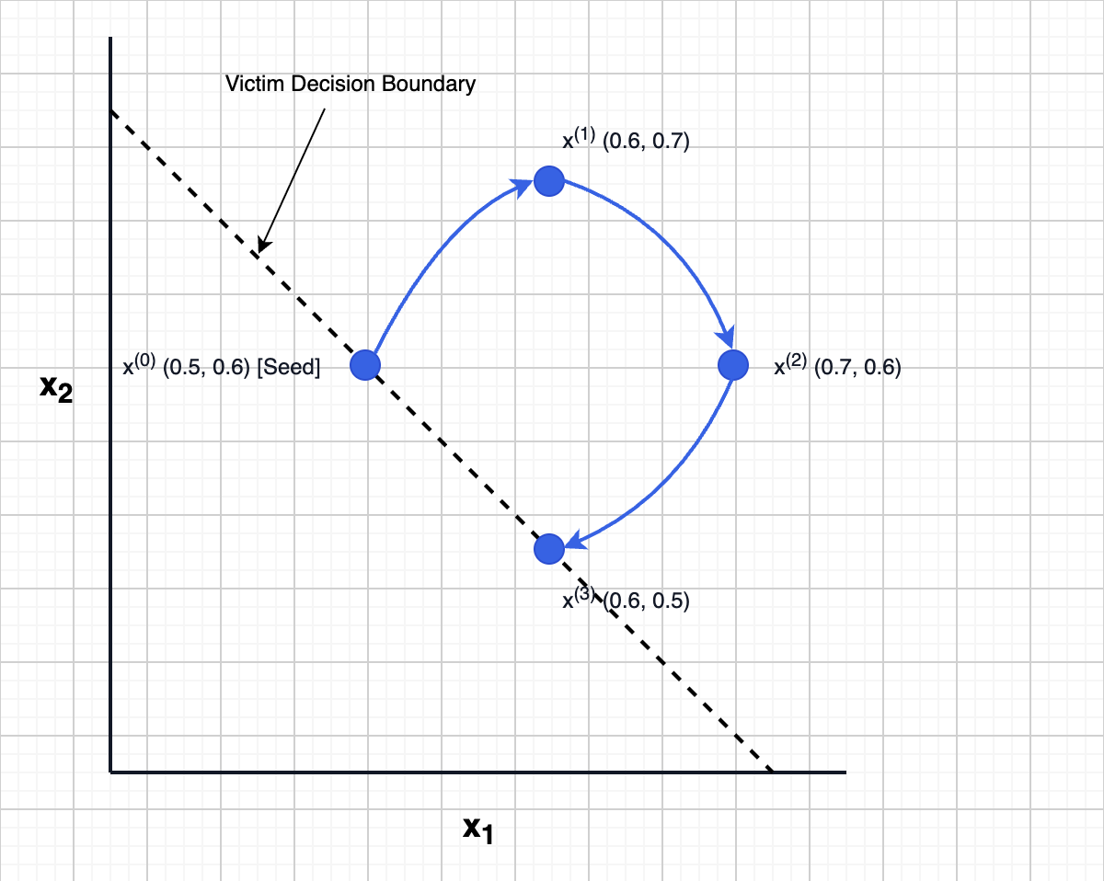
SUBSTITUTE MODEL TRAINING

Slide 17
EQUATION SOLVING
Equation solving is used when the victim model is a simple, standard machine learning algorithm (like Linear or Logistic Regression).
Steps:
Linear Relationship
System of Equations
Solve
Notes:
Equation solving is used when the victim model is a simple, standard machine learning algorithm (like Linear
or Logistic Regression).
1. Linear Relationship: These models make predictions by multiplying inputs
by weights and adding a bias. If the API returns exact prediction confidence scores (probabilities), we can
reverse-engineer this math.
2. System of Equations: Since the parameters are unknown, we can treat
them as variables in a system of linear equations.
3. Solve: By querying the API with a set of linearly
independent inputs, we generate enough equations to solve for the exact weights and bias

Slide 18
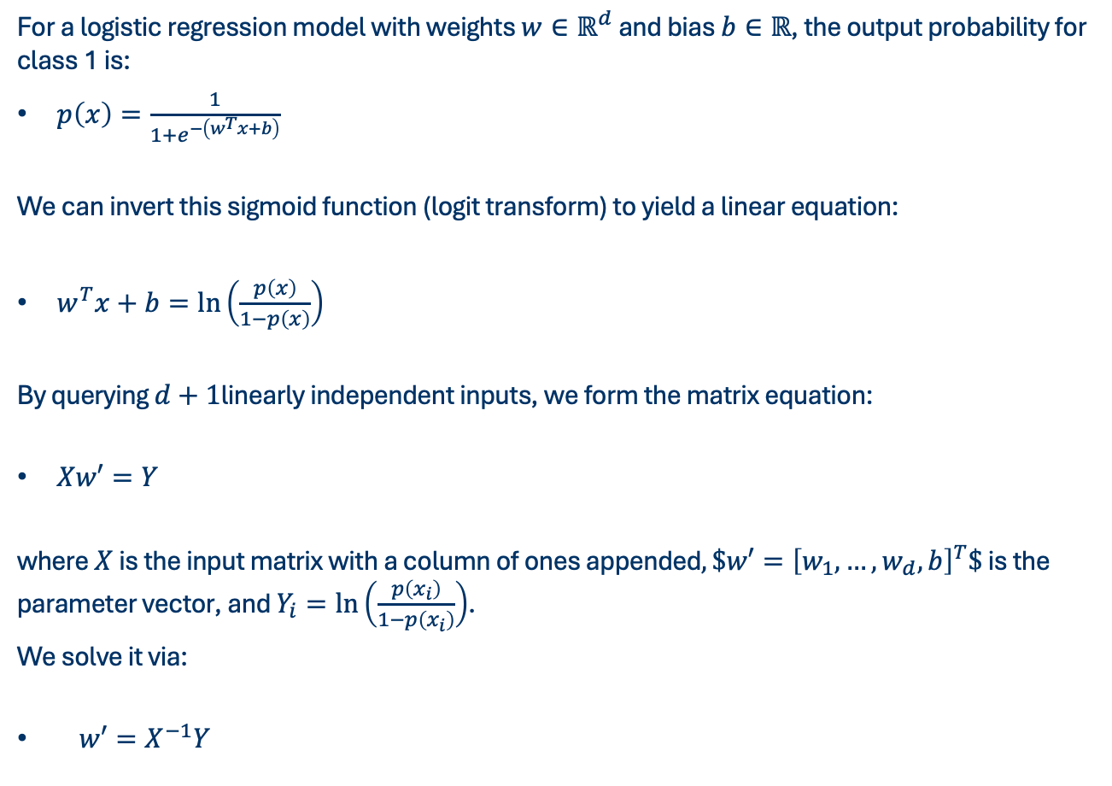
EQUATION SOLVING
For a logistic regression model with weights $w∈ℝ^{d}$ and bias $b∈ℝ$, the output probability for class 1 is:
$p\left(x\right)=\frac{1}{1+e^{−\left(w^{T}x+b\right)}}$
We can invert this sigmoid function (logit transform) to yield a linear equation:
$w^{T}x+b=\ln\left(\frac{p\left(x\right)}{1−p\left(x\right)}\right)$
By querying $d+1$linearly independent inputs, we form the matrix equation:
$Xw′=Y$
where $X$ is the input matrix with a column of ones appended$,\$w′={\left[w_{1},…,w_{d},b\right]}^{T}\$$ is the parameter vector, and $Y_{i}=\ln\left(\frac{p\left(x_{i}\right)}{1−p\left(x_{i}\right)}\right)$.
We solve it via:
$w′=X^{−1}Y$

Slide 19
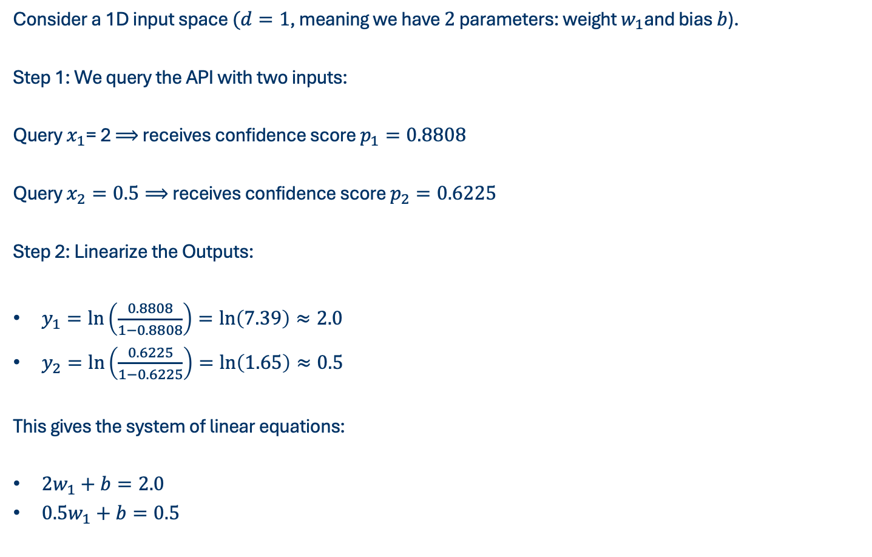
EQUATION SOLVING
Consider a 1D input space $(d=1$, meaning we have $2$ parameters: weight $w_{1}$and bias $b$).
Step 1: We query the API with two inputs:
Query $x_{1}$= 2 $⟹$ receives confidence score $p_{1}=0.8808$
Query $x_{2}=0.5⟹$ receives confidence score $p_{2}=0.6225$
Step 2: Linearize the Outputs:
$y_{1}=\ln\left(\frac{0.8808}{1−0.8808}\right)=\ln\left(7.39\right)≈2.0$
$y_{2}=\ln\left(\frac{0.6225}{1−0.6225}\right)=\ln\left(1.65\right)≈0.5$
This gives the system of linear equations:
$2w_{1}+b=2.0$
$0.5w_{1}+b=0.5$

Slide 20
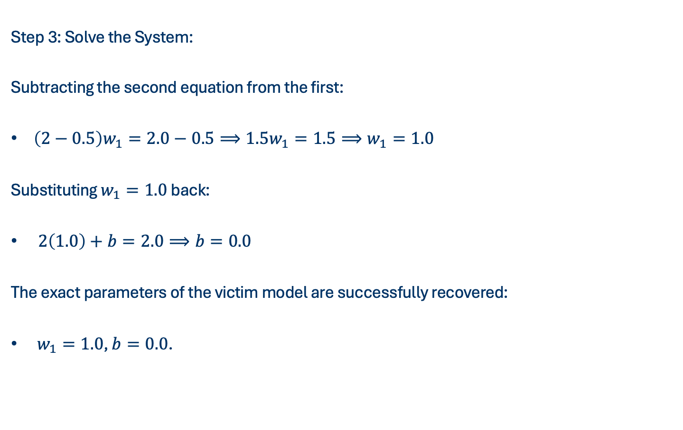
EQUATION SOLVING
Step 3: Solve the System:
Subtracting the second equation from the first:
$\left(2−0.5\right)w_{1}=2.0−0.5⟹1.5w_{1}=1.5⟹w_{1}=1.0$
Substituting $w_{1}=1.0$ back:
$2\left(1.0\right)+b=2.0⟹b=0.0$
The exact parameters of the victim model are successfully recovered:
$w_{1}=1.0$, $b=0.0$.

Slide 21
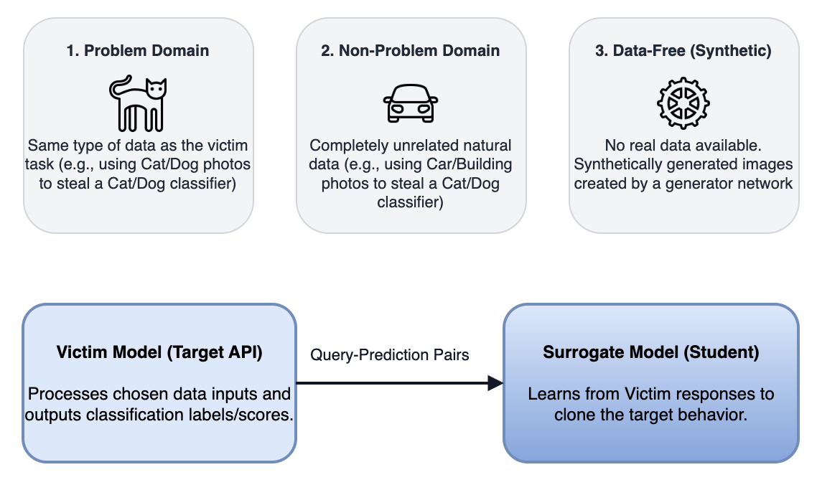
DATA DRIVEN ATTACKS
Data-Driven attacks focus on where the attacker obtains the dataset used to query the target model. Since the attacker has no access to the victim model's private training dataset, they must obtain or generate an alternative dataset.
Notes:
Problem Domain (PD) Attacks: The attacker queries the model using natural data from the same domain as the target task.
Intuition: If we want to steal a model that classifies handwriting, we collect a public set of handwritten letters. This is highly effective but difficult if the domain is private (e.g. clinical datasets).
Non-Problem Domain (NPD) Attacks: The attacker queries the model using natural data from a completely unrelated domain.
Intuition: If we want to steal a face-detector model, we query it with pictures of flowers or cars. Even though the input is unrelated, the victim model is forced to make predictions (e.g., classifying a leaf as a ``smiling face'' with a low probability). These predictions reveal the underlying decision boundaries of the target model.
Data-Free (DF) Attacks: The attacker has zero real data, so they use a generative model (like a Generative Adversarial Network, or GAN) to synthetically build inputs.
Intuition: This is like drawing random scribbles, showing them to a teacher, and observing their reactions to learn what a ``letter'' looks like. Over time, the generator adjusts the scribbles to become realistic inputs.

Slide 22
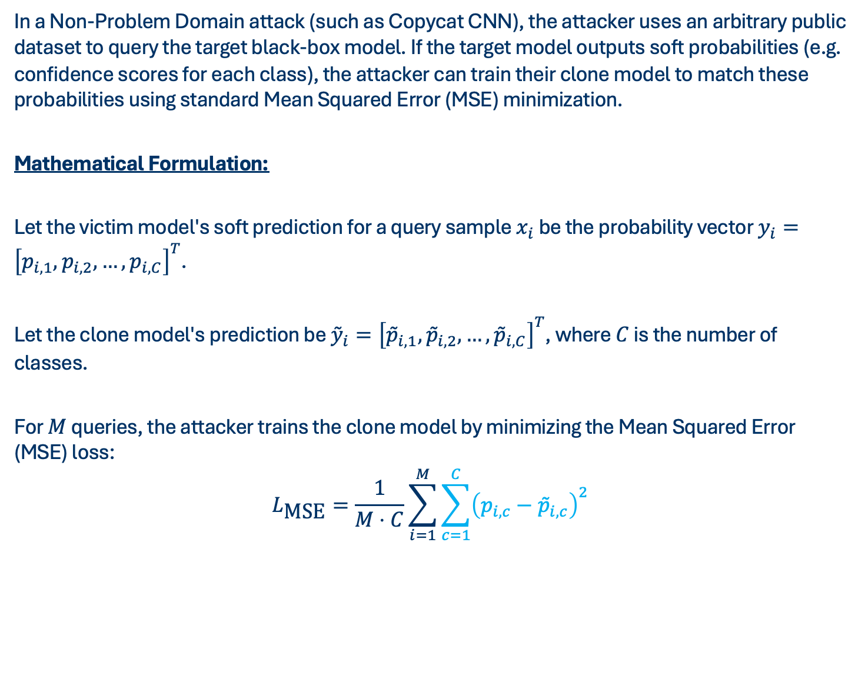
NON-PROBLEM DOMAIN ATTACKS
In a Non-Problem Domain attack (such as Copycat CNN), the attacker uses an arbitrary public dataset to query the target black-box model. If the target model outputs soft probabilities (e.g. confidence scores for each class), the attacker can train their clone model to match these probabilities using standard Mean Squared Error (MSE) minimization.
Mathematical Formulation:
Let the victim model's soft prediction for a query sample $x_{i}$ be the probability vector $y_{i}={\left[p_{i,1},p_{i,2},…,p_{i,C}\right]}^{T}$.
Let the clone model's prediction be ${\overset{˜}{y}}_{i}={\left[{\overset{˜}{p}}_{i,1},{\overset{˜}{p}}_{i,2},…,{\overset{˜}{p}}_{i,C}\right]}^{T}$, where $C$ is the number of classes.
For $M$ queries, the attacker trains the clone model by minimizing the Mean Squared Error (MSE) loss:
$$L_{\text{MSE}}=\frac{1}{M⋅C}\sum_{i=1}^{M}{\sum_{c=1}^{C}{{\left(p_{i,c}−{\overset{˜}{p}}_{i,c}\right)}^{2}}}$$

Slide 23
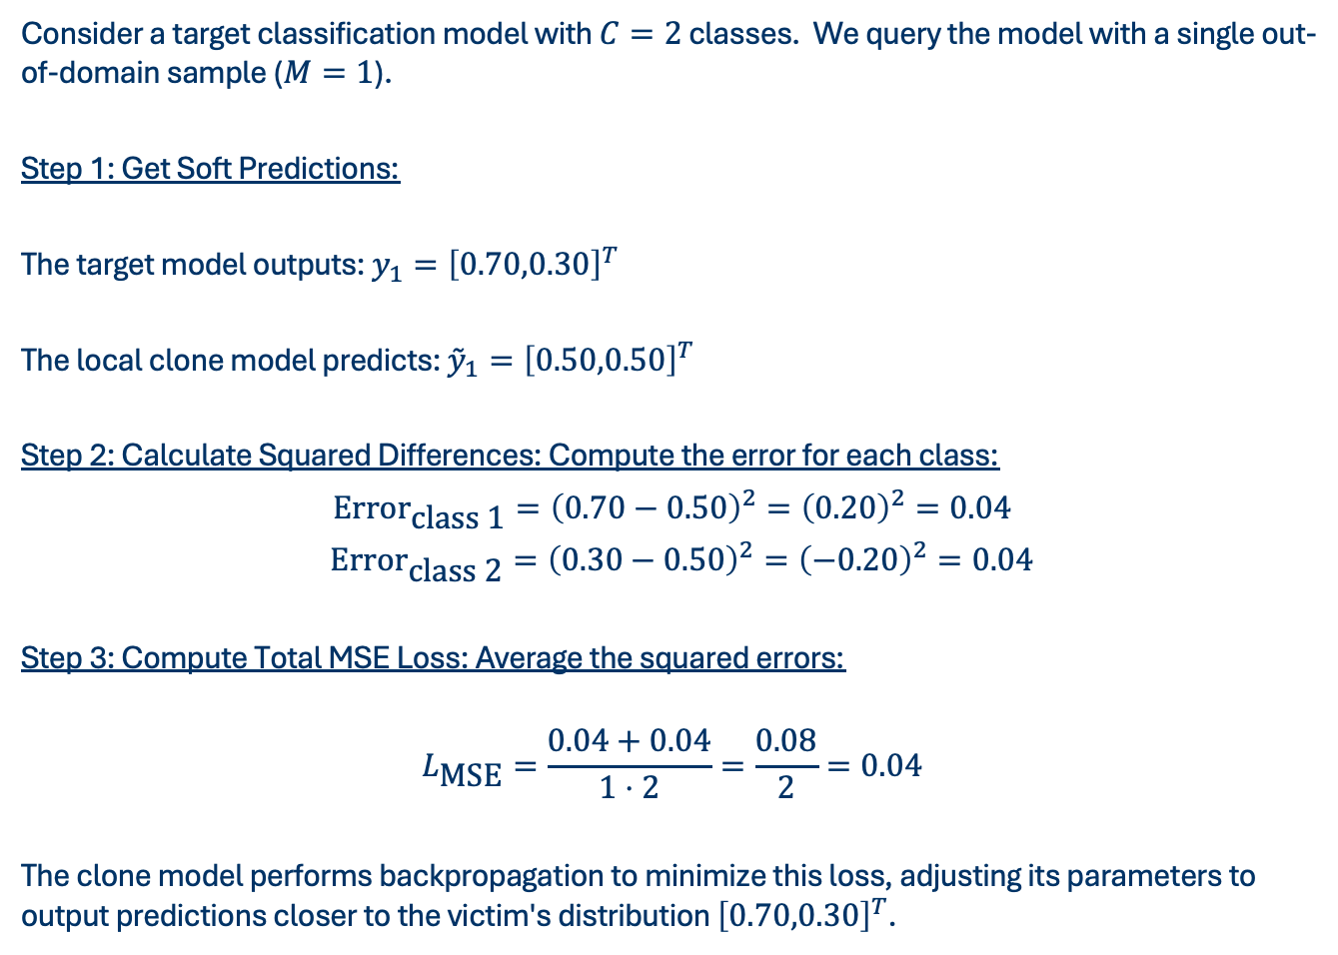
NON-PROBLEM DOMAIN ATTACKS
Consider a target classification model with $C=2$ classes. We query the model with a single out-of-domain sample ($M=1$).
Step 1: Get Soft Predictions:
The target model outputs: $y_{1}={\left[0.70,0.30\right]}^{T}$
The local clone model predicts: ${\overset{˜}{y}}_{1}={\left[0.50,0.50\right]}^{T}$
Step 2: Calculate Squared Differences: Compute the error for each class:
${\text{Error}}_{\text{class}\text{ 1}}={\left(0.70−0.50\right)}^{2}={\left(0.20\right)}^{2}=0.04$
${\text{Error}}_{\text{class}\text{ 2}}={\left(0.30−0.50\right)}^{2}={\left(−0.20\right)}^{2}=0.04$
Step 3: Compute Total MSE Loss: Average the squared errors:
$$L_{\text{MSE}}=\frac{0.04+0.04}{1⋅2}=\frac{0.08}{2}=0.04$$
The clone model performs backpropagation to minimize this loss, adjusting its parameters to output predictions closer to the victim's distribution ${\left[0.70,0.30\right]}^{T}$.

Slide 24
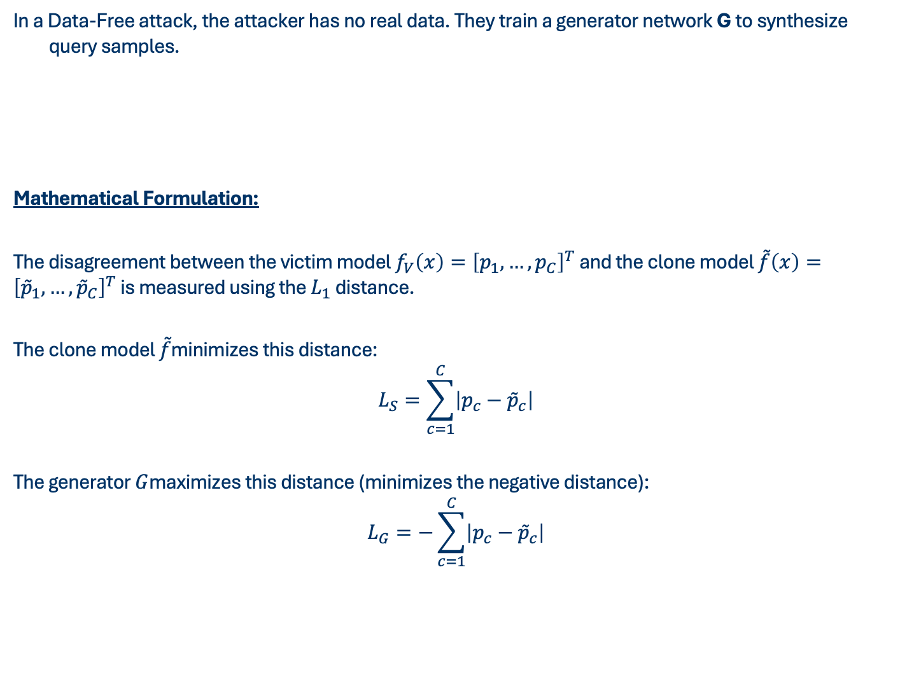
DATA FREE ATTACKS
In a Data-Free attack, the attacker has no real data. They train a generator network G to synthesize query samples.
Mathematical Formulation:
The disagreement between the victim model $f_{V}\left(x\right)={\left[p_{1},…,p_{C}\right]}^{T}$ and the clone model $\overset{˜}{f}\left(x\right)={\left[{\overset{˜}{p}}_{1},…,{\overset{˜}{p}}_{C}\right]}^{T}$ is measured using the $L_{1}$ distance.
The clone model $\overset{˜}{f}$minimizes this distance:
$$L_{S}=\sum_{c=1}^{C}{\left|p_{c}−{\overset{˜}{p}}_{c}\right|}$$
The generator $G$maximizes this distance (minimizes the negative distance):
$$L_{G}=−\sum_{c=1}^{C}{\left|p_{c}−{\overset{˜}{p}}_{c}\right|}$$
Synthesize
Disagreement Maximization
Clone Minimization
Notes:
1. Synthesize: The generator takes a random noise vector z and outputs a synthetic image
x = G(z).
2. Disagreement Maximization: To find where the clone model deviates from the victim
model, the generator is trained to produce samples where the victim model fV and the clone model ˜f disagree the most.
3. Clone Minimization: The clone model ˜f is then trained on these synthetic samples
to minimize the disagreement, shifting its predictions toward the victim’s predictions.

Slide 25
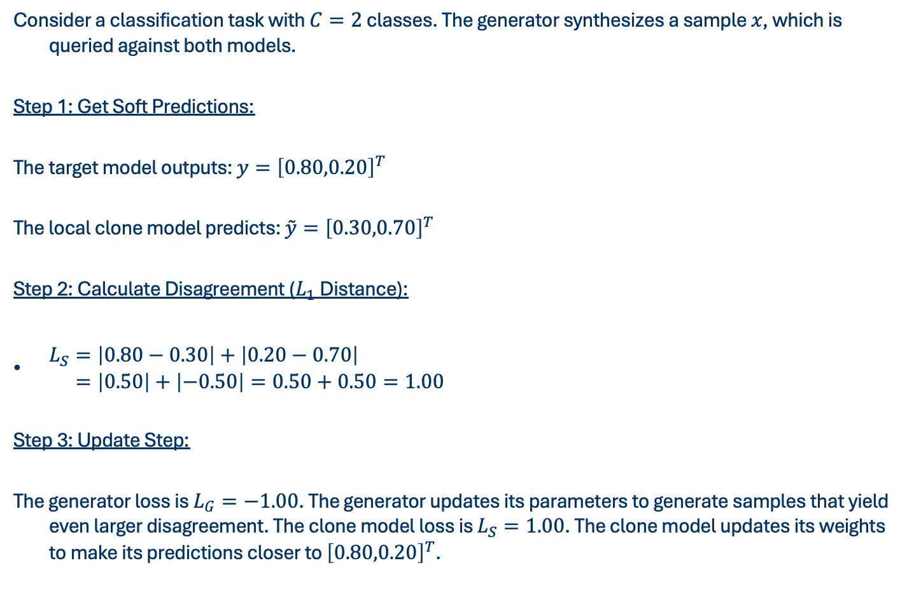
DATA FREE ATTACKS
Consider a classification task with $C=2$ classes. The generator synthesizes a sample $x$, which is queried against both models.
Step 1: Get Soft Predictions:
The target model outputs: $y={\left[0.80,0.20\right]}^{T}$
The local clone model predicts: $\overset{˜}{y}={\left[0.30,0.70\right]}^{T}$
Step 2: Calculate Disagreement ($L_{1}$ Distance):
$\begin{aligned}L_{S}&=\left|0.80−0.30\right|+\left|0.20−0.70\right| \\ &=\left|0.50\right|+\left|−0.50\right|=0.50+0.50=1.00\end{aligned}$
Step 3: Update Step:
The generator loss is $L_{G}=−1.00$. The generator updates its parameters to generate samples that yield even larger disagreement. The clone model loss is $L_{S}=1.00$. The clone model updates its weights to make its predictions closer to ${\left[0.80,0.20\right]}^{T}$.

Slide 26
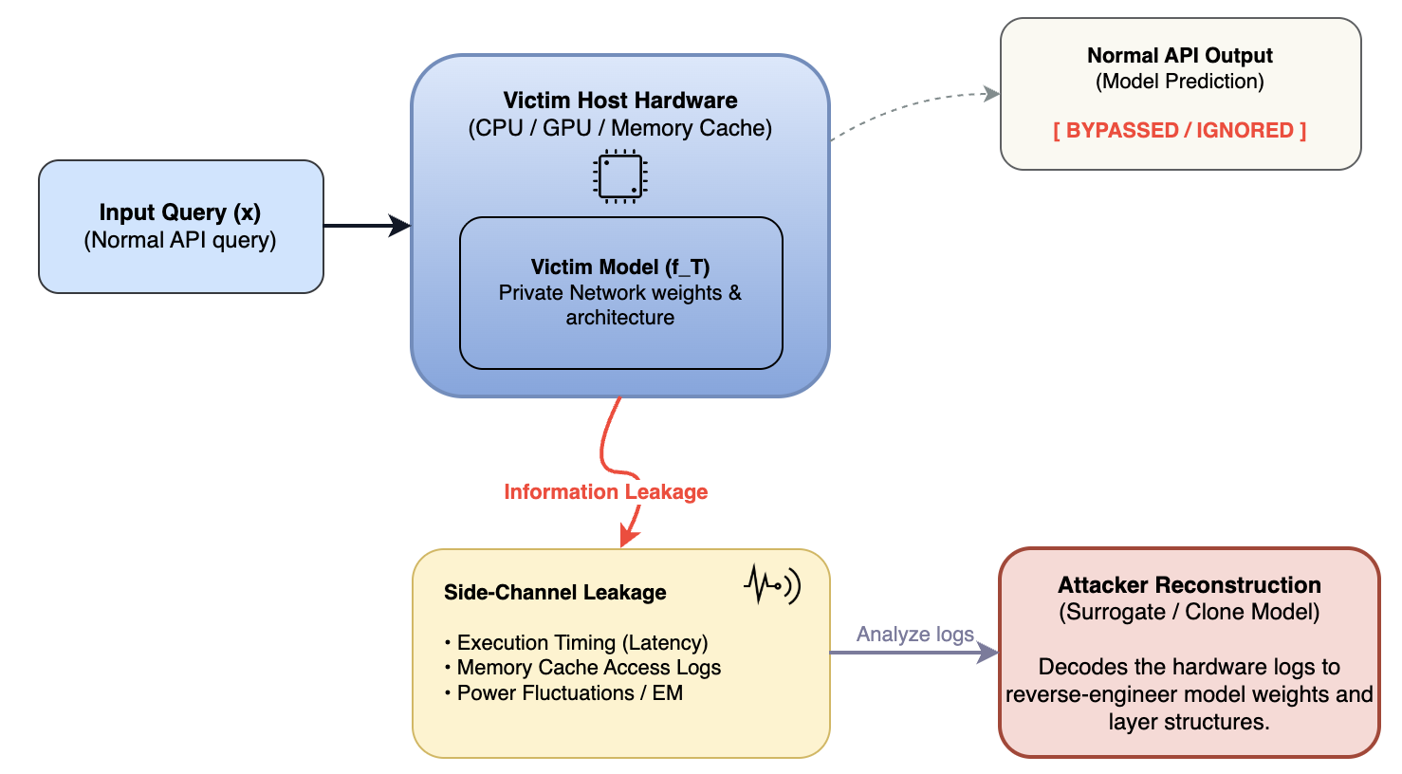
SIDE CHANNEL ATTACKS
Side-Channel attacks do not focus on the inputs or outputs (the queries) of a machine learning model. Instead, they monitor the physical or system byproducts.
of the model's execution on a computer processor.
Notes:
Side-Channel attacks do not focus on the inputs or outputs (the queries) of a machine learning model. Instead, they monitor the physical or system byproducts of the model's execution on a computer processor.
The core intuition is best understood through an analogy:
Imagine a safe. You do not know the combination code (the model parameters). Instead of guessing numbers, you place a stethoscope against the safe door and listen to the clicking sounds of the gears inside as you turn the dial. The clicking sounds are a byproduct (a side-channel) that leaks information about the combination.
This category is divided into two types:
Software Side-Channels: These monitor software-level execution cues (such as API execution time, cache memory hits or misses, or network latency).
Hardware Side-Channels: These monitor physical hardware byproducts from the physical processor chip (such as electric power consumption, electromagnetic radiation, heat, or acoustic noise).

Slide 27
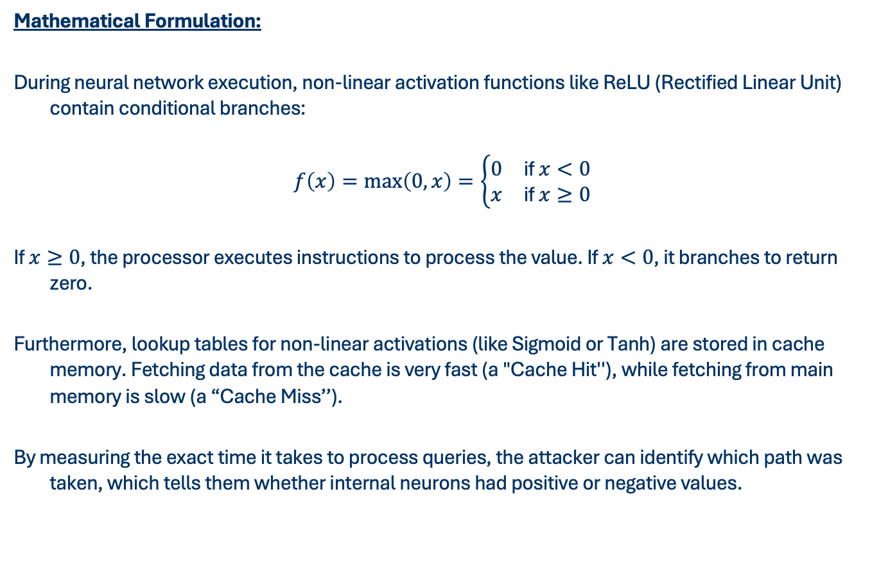
SOFTWARE SIDE CHANNEL (CACHE-TIMING ATTACKS)
Mathematical Formulation:
During neural network execution, non-linear activation functions like ReLU (Rectified Linear Unit) contain conditional branches:
$$\begin{aligned}f\left(x\right)=\max\left(0,x\right)=\left\{\begin{matrix}0 & \text{if} x<0 \\ x & \text{if} x≥0\end{matrix}\right.\end{aligned}$$
If $x≥0$, the processor executes instructions to process the value. If $x<0$, it branches to return zero.
Furthermore, lookup tables for non-linear activations (like Sigmoid or Tanh) are stored in cache memory. Fetching data from the cache is very fast (a "Cache Hit''), while fetching from main memory is slow (a “Cache Miss’’).
By measuring the exact time it takes to process queries, the attacker can identify which path was taken, which tells them whether internal neurons had positive or negative values.
Notes:
During neural network execution, non-linear activation functions like ReLU (Rectified Linear Unit) contain conditional branches:
Furthermore, lookup tables for non-linear activations (like Sigmoid or Tanh) are stored in cache memory. Fetching data from the cache is very fast (a ``Cache Hit''), while fetching from main memory is slow (a ``Cache Miss''). By measuring the exact time it takes to process queries, the attacker can identify which path was taken, which tells them whether internal neurons had positive or negative values.

Slide 28
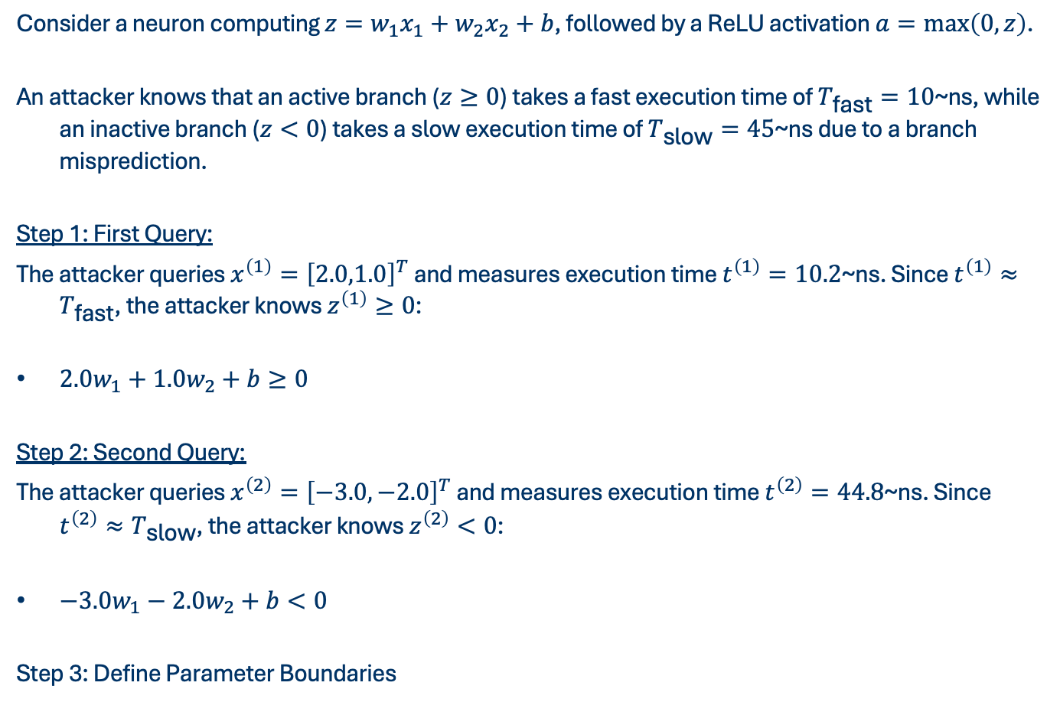
SOFTWARE SIDE CHANNEL (CACHE-TIMING ATTACKS)
Consider a neuron computing $z=w_{1}x_{1}+w_{2}x_{2}+b$, followed by a ReLU activation $a=\max\left(0,z\right)$.
An attacker knows that an active branch ($z≥0$) takes a fast execution time of $T_{\text{fast}}=10$~ns, while an inactive branch ($z<0$) takes a slow execution time of $T_{\text{slow}}=45$~ns due to a branch misprediction.
Step 1: First Query:
The attacker queries $x^{\left(1\right)}={\left[2.0,1.0\right]}^{T}$ and measures execution time $t^{\left(1\right)}=10.2$~ns. Since $t^{\left(1\right)}≈T_{\text{fast}}$, the attacker knows $z^{\left(1\right)}≥0$:
$2.0w_{1}+1.0w_{2}+b≥0$
Step 2: Second Query:
The attacker queries $x^{\left(2\right)}={\left[−3.0,−2.0\right]}^{T}$ and measures execution time $t^{\left(2\right)}=44.8$~ns. Since $t^{\left(2\right)}≈T_{\text{slow}}$, the attacker knows $z^{\left(2\right)}<0$:
$−3.0w_{1}−2.0w_{2}+b<0$
Step 3: Define Parameter Boundaries
Notes:
Step 3: Define Parameter Boundaries: By repeating this with many inputs, the attacker compiles a system of linear inequalities that narrows down the values of the weights $w_{1},w_{2}$ and bias $b$ to extract the neuron's parameters.

Slide 29
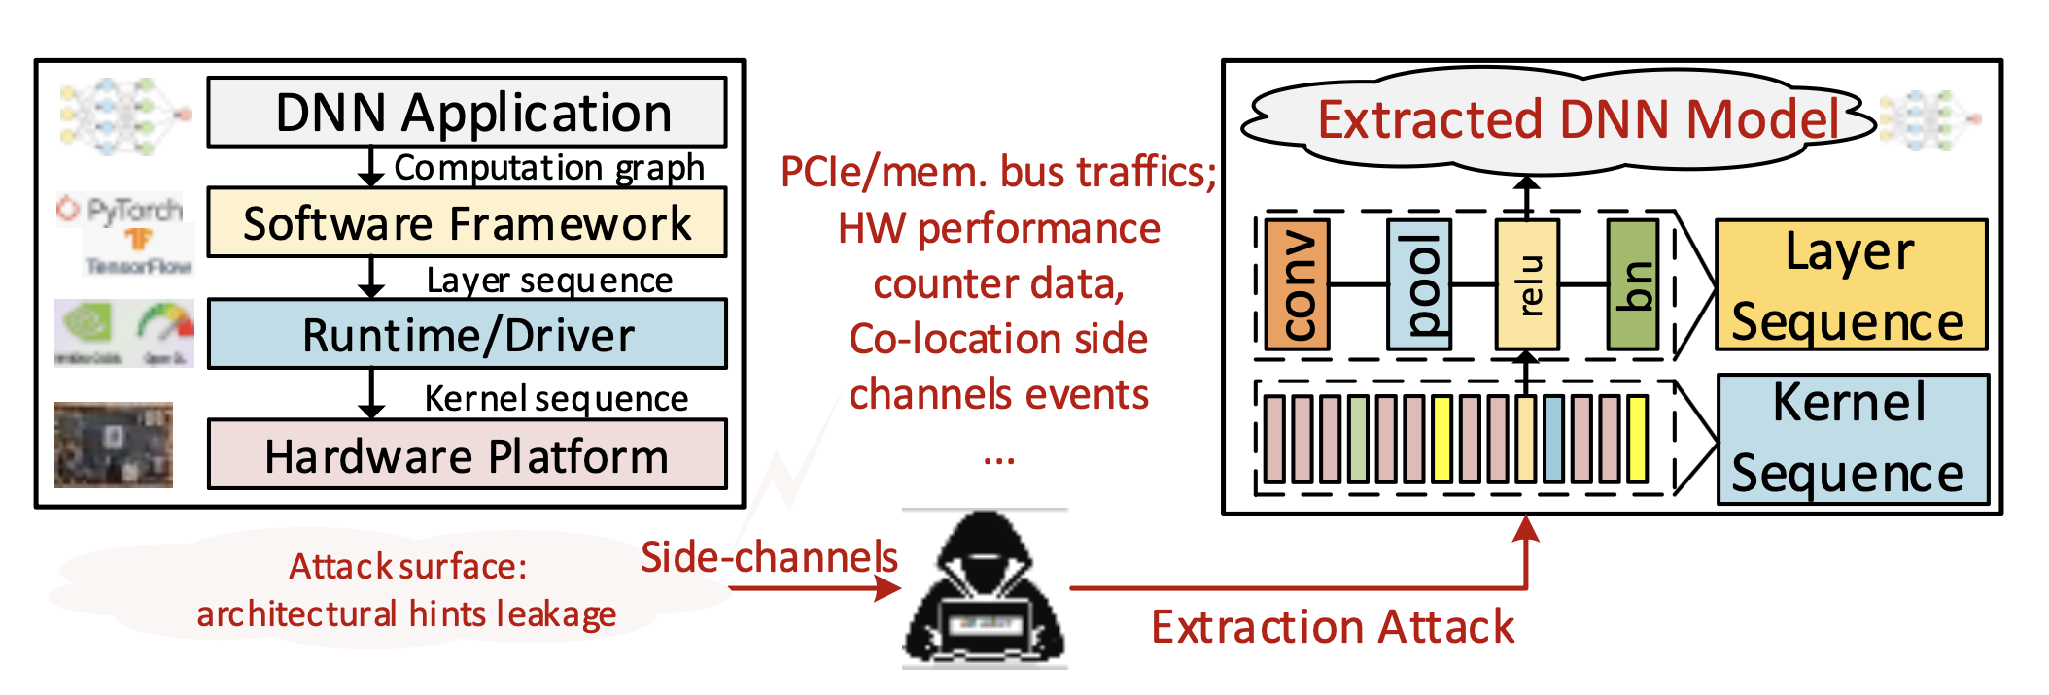
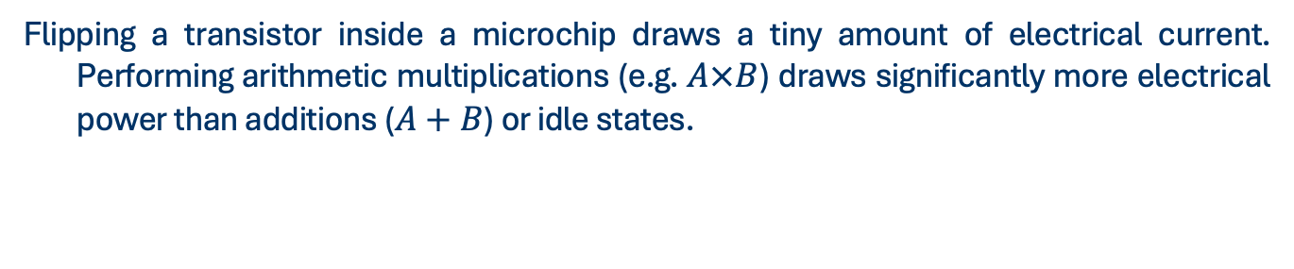
HARDWARE SIDE CHANNEL (POWER ANALYSIS)
Flipping a transistor inside a microchip draws a tiny amount of electrical current. Performing arithmetic multiplications (e.g. $A×B$) draws significantly more electrical power than additions ($A+B$) or idle states.
Notes:
By measuring the electrical power consumption graph (a power trace) of a processor using an oscilloscope, an attacker can count how many multiplications were performed, allowing them to reverse-engineer the model's architecture (number of layers, number of neurons) and parameter sparsity.

Slide 30
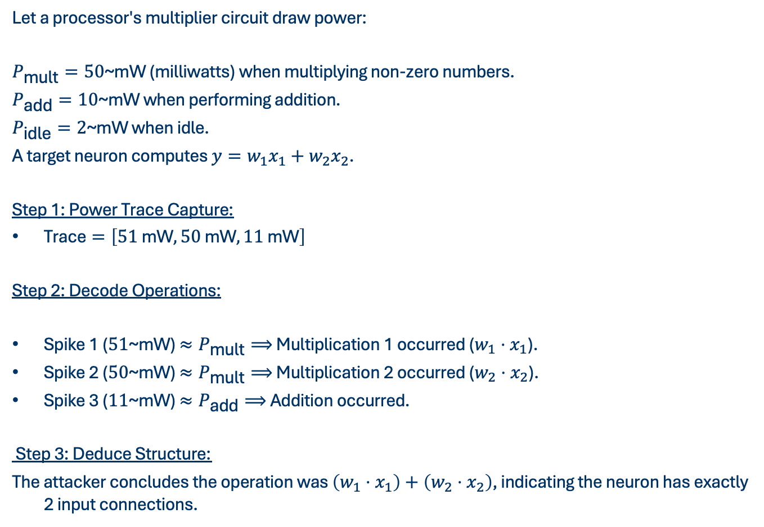
HARDWARE SIDE CHANNEL (POWER ANALYSIS)
Let a processor's multiplier circuit draw power:
$P_{\text{mult}}=50$~mW (milliwatts) when multiplying non-zero numbers.
$P_{\text{add}}=10$~mW when performing addition.
$P_{\text{idle}}=2$~mW when idle.
A target neuron computes $y=w_{1}x_{1}+w_{2}x_{2}$.
Step 1: Power Trace Capture:
$\text{Trace}=\left[51 \text{mW}, 50 \text{mW}, 11 \text{mW}\right]$
Step 2: Decode Operations:
Spike 1 ($51$~mW) $≈P_{\text{mult}}⟹$ Multiplication 1 occurred ($w_{1}⋅x_{1}$).
Spike 2 ($50$~mW) $≈P_{\text{mult}}⟹$ Multiplication 2 occurred ($w_{2}⋅x_{2}$).
Spike 3 ($11$~mW) $≈P_{\text{add}}⟹$ Addition occurred.
Step 3: Deduce Structure:
The attacker concludes the operation was $\left(w_{1}⋅x_{1}\right)+\left(w_{2}⋅x_{2}\right)$, indicating the neuron has exactly 2 input connections.
Notes:
The attacker monitors the processor's power draw during a single neuron computation and captures the sequence of power consumption spikes over time:
The attacker decodes the spikes by mapping them to arithmetic operations:
If $w_{1}$ was zero, the processor optimization would skip the first multiplication, and the trace would show only $\left[11 \text{mW}\right]$, leaking weight sparsity.

Slide 31
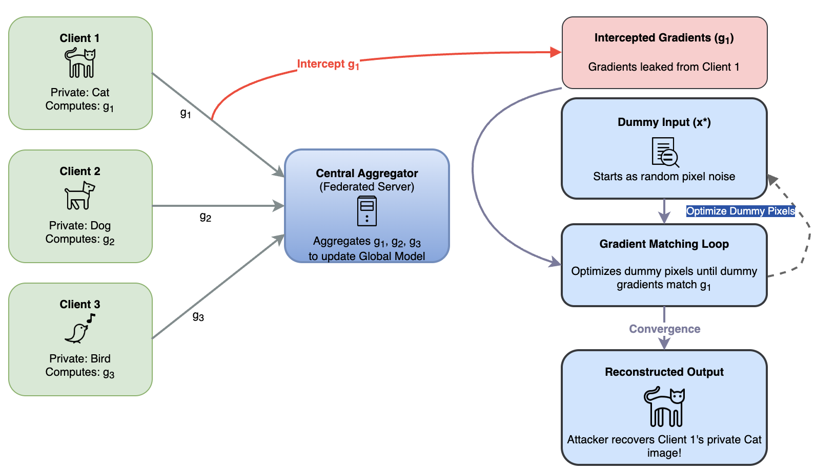
GRADIENT-BASED ATTACKS
There are two approaches:
Direct Gradient Theft
Gradient Estimation
Notes:
Gradient-Based attacks rely on obtaining the model's gradients (slopes) during learning or inference. In machine learning, gradients are vectors of partial derivatives that point in the direction of the steepest increase of a function.
The core intuition can be visualized as climbing a hill:
Imagine trying to find the peak of a hill in the dark. Instead of wandering randomly, you feel the slope of the ground under your feet to know which direction goes up. That slope is the gradient. If an attacker can feel this slope (either directly from a shared file or by estimating it through inputs), they can clone the model much faster.
1. Direct Gradient Theft: The attacker intercepts the actual gradients computed by the victim model. This occurs in collaborative environments like Federated Learning or distributed training, where clients must share gradients over a network.
2. Gradient Estimation: The attacker cannot access the internal parameters or gradients. Instead, they estimate the gradients of the black-box model's outputs by making slight perturbations to their input queries and measuring the change.

Slide 32
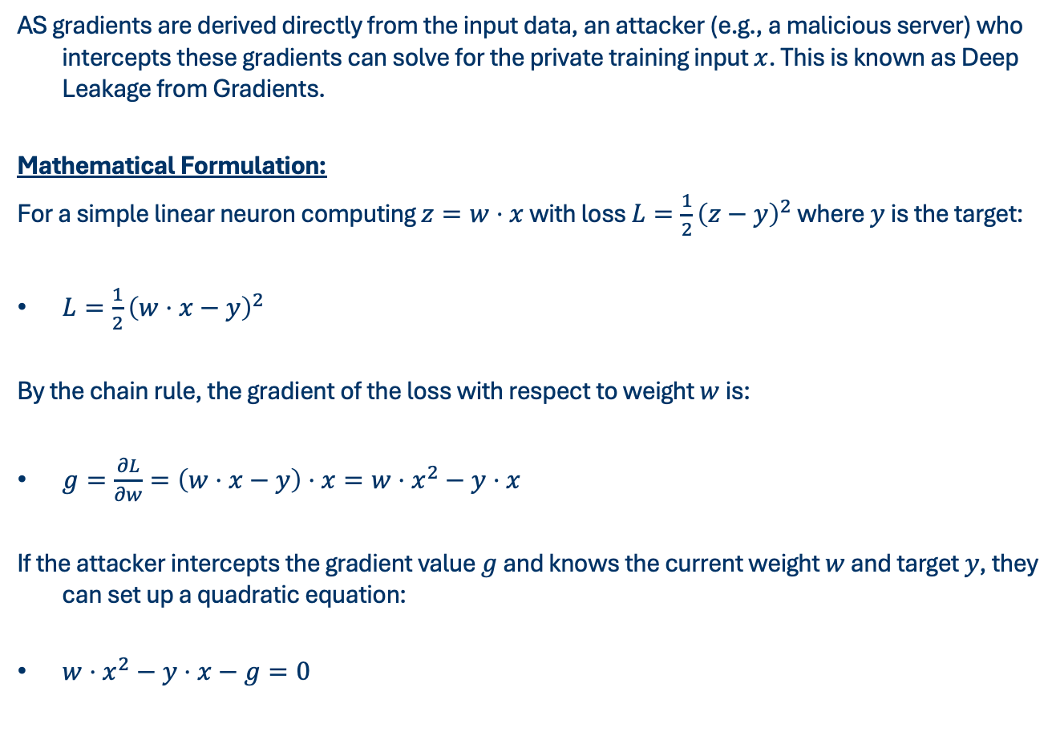
DIRECT GRADIENT THEFT
AS gradients are derived directly from the input data, an attacker (e.g., a malicious server) who intercepts these gradients can solve for the private training input $x$. This is known as Deep Leakage from Gradients.
Mathematical Formulation:
For a simple linear neuron computing $z=w⋅x$ with loss $L=\frac{1}{2}{\left(z−y\right)}^{2}$ where $y$ is the target:
$L=\frac{1}{2}{\left(w⋅x−y\right)}^{2}$
By the chain rule, the gradient of the loss with respect to weight $w$ is:
$g=\frac{∂L}{∂w}=\left(w⋅x−y\right)⋅x=w⋅x^{2}−y⋅x$
If the attacker intercepts the gradient value $g$ and knows the current weight $w$ and target $y$, they can set up a quadratic equation:
$w⋅x^{2}−y⋅x−g=0$
Notes:
In collaborative settings like Federated Learning, multiple clients train a shared model. Clients do not share private training data ($x$); instead, they compute the gradient of the loss function with respect to the model's weights ($\frac{∂L}{∂w}$) locally and send it to a central server.
At the end
The attacker solves this quadratic equation for $x$ to steal the client's private training sample.

Slide 33
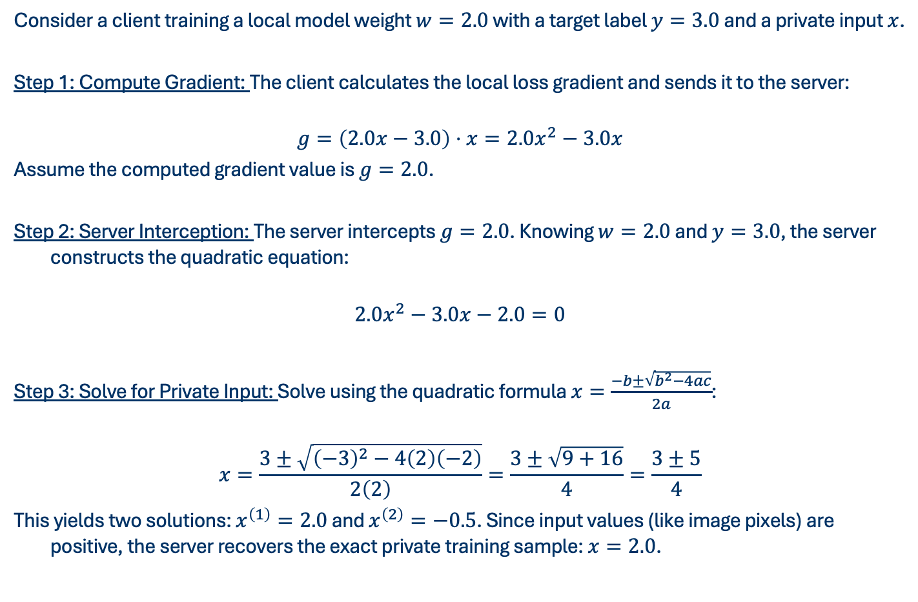
DIRECT GRADIENT THEFT
Consider a client training a local model weight $w=2.0$ with a target label $y=3.0$ and a private input $x$.
Step 1: Compute Gradient: The client calculates the local loss gradient and sends it to the server:
$$g=\left(2.0x−3.0\right)⋅x=2.0x^{2}−3.0x$$
Assume the computed gradient value is $g=2.0$.
Step 2: Server Interception: The server intercepts $g=2.0$. Knowing $w=2.0$ and $y=3.0$, the server constructs the quadratic equation:
$$2.0x^{2}−3.0x−2.0=0$$
Step 3: Solve for Private Input: Solve using the quadratic formula $x=\frac{−b±\sqrt{b^{2}−4ac}}{2a}$:
$$x=\frac{3±\sqrt{{\left(−3\right)}^{2}−4\left(2\right)\left(−2\right)}}{2\left(2\right)}=\frac{3±\sqrt{9+16}}{4}=\frac{3±5}{4}$$
This yields two solutions: $x^{\left(1\right)}=2.0$ and $x^{\left(2\right)}=−0.5$. Since input values (like image pixels) are positive, the server recovers the exact private training sample: $x=2.0$.
Notes:
In collaborative settings like Federated Learning, multiple clients train a shared model. Clients do not share private training data ($x$); instead, they compute the gradient of the loss function with respect to the model's weights ($\frac{∂L}{∂w}$) locally and send it to a central server.

Slide 34
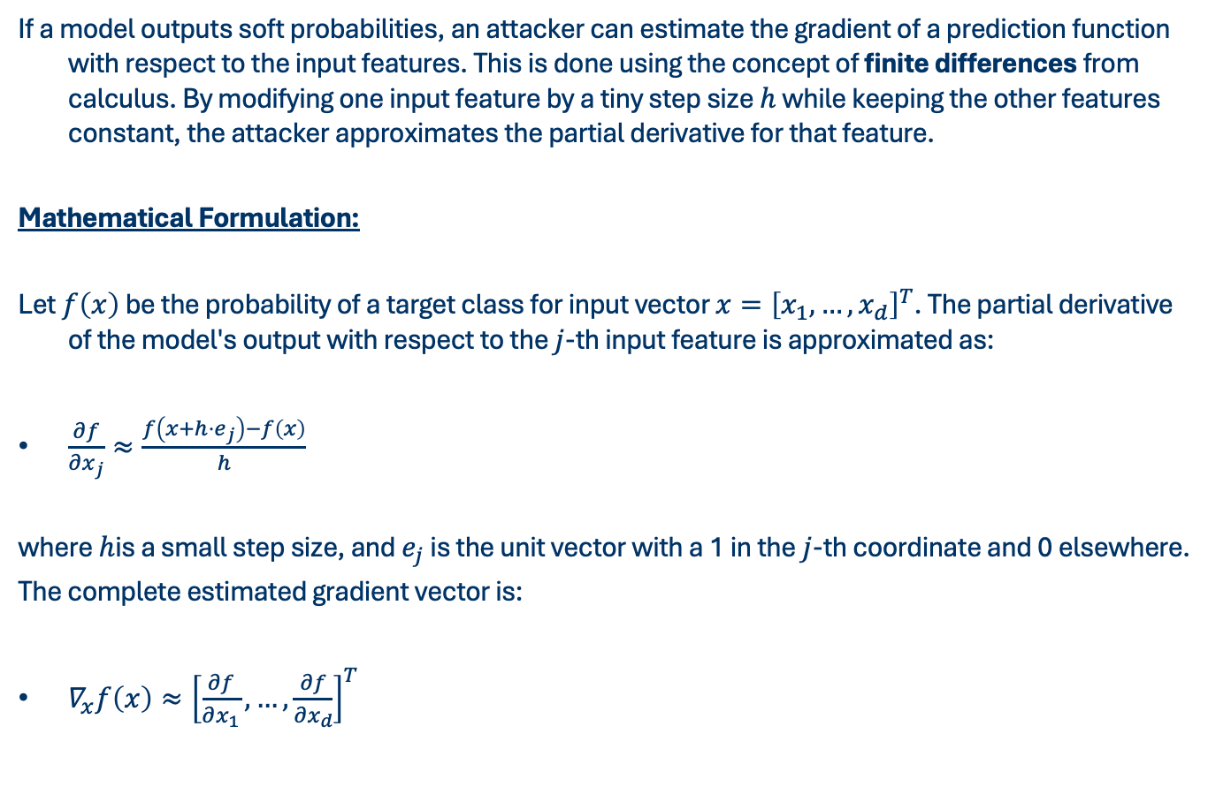
GRADIENT ESTIMATION (FINITE DIFFERENCE)
If a model outputs soft probabilities, an attacker can estimate the gradient of a prediction function with respect to the input features. This is done using the concept of finite differences from calculus. By modifying one input feature by a tiny step size $h$ while keeping the other features constant, the attacker approximates the partial derivative for that feature.
Mathematical Formulation:
Let $f\left(x\right)$ be the probability of a target class for input vector $x={\left[x_{1},…,x_{d}\right]}^{T}$. The partial derivative of the model's output with respect to the $j$-th input feature is approximated as:
$\frac{∂f}{∂x_{j}}≈\frac{f\left(x+h⋅e_{j}\right)−f\left(x\right)}{h}$
where $h$is a small step size, and $e_{j}$ is the unit vector with a 1 in the $j$-th coordinate and 0 elsewhere.
The complete estimated gradient vector is:
$∇_{x}f\left(x\right)≈{\left[\frac{∂f}{∂x_{1}}, …, \frac{∂f}{∂x_{d}}\right]}^{T}$
Notes:
In collaborative settings like Federated Learning, multiple clients train a shared model. Clients do not share private training data ($x$); instead, they compute the gradient of the loss function with respect to the model's weights ($\frac{∂L}{∂w}$) locally and send it to a central server.

Slide 35
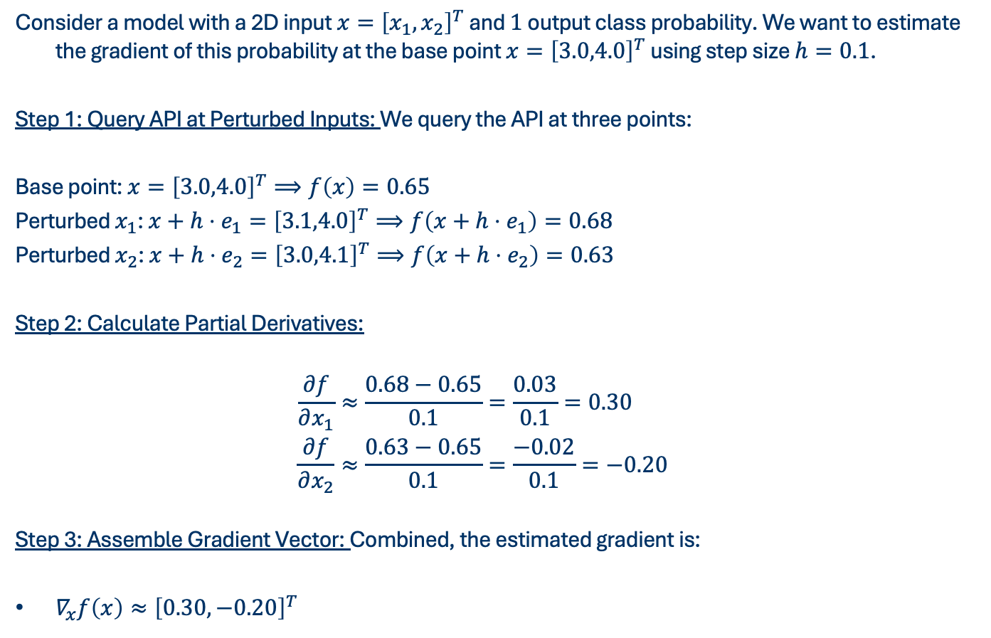
GRADIENT ESTIMATION (FINITE DIFFERENCE)
Consider a model with a 2D input $x={\left[x_{1},x_{2}\right]}^{T}$ and $1$ output class probability. We want to estimate the gradient of this probability at the base point $x={\left[3.0,4.0\right]}^{T}$ using step size $h=0.1$.
Step 1: Query API at Perturbed Inputs: We query the API at three points:
Base point: $x={\left[3.0,4.0\right]}^{T}⟹f\left(x\right)=0.65$
Perturbed $x_{1}$: $x+h⋅e_{1}={\left[3.1,4.0\right]}^{T}⟹f\left(x+h⋅e_{1}\right)=0.68$
Perturbed $x_{2}$: $x+h⋅e_{2}={\left[3.0,4.1\right]}^{T}⟹f\left(x+h⋅e_{2}\right)=0.63$
Step 2: Calculate Partial Derivatives:
$$\begin{aligned}\frac{∂f}{∂x_{1}}&≈\frac{0.68−0.65}{0.1}=\frac{0.03}{0.1}=0.30 \\ \frac{∂f}{∂x_{2}}&≈\frac{0.63−0.65}{0.1}=\frac{−0.02}{0.1}=−0.20 \\ \end{aligned}$$
Step 3: Assemble Gradient Vector: Combined, the estimated gradient is:
$∇_{x}f\left(x\right)≈{\left[0.30,−0.20\right]}^{T}$
Notes:
The attacker uses this vector to adjust input queries in directions that maximize changes in the victim's predictions.

Slide 36
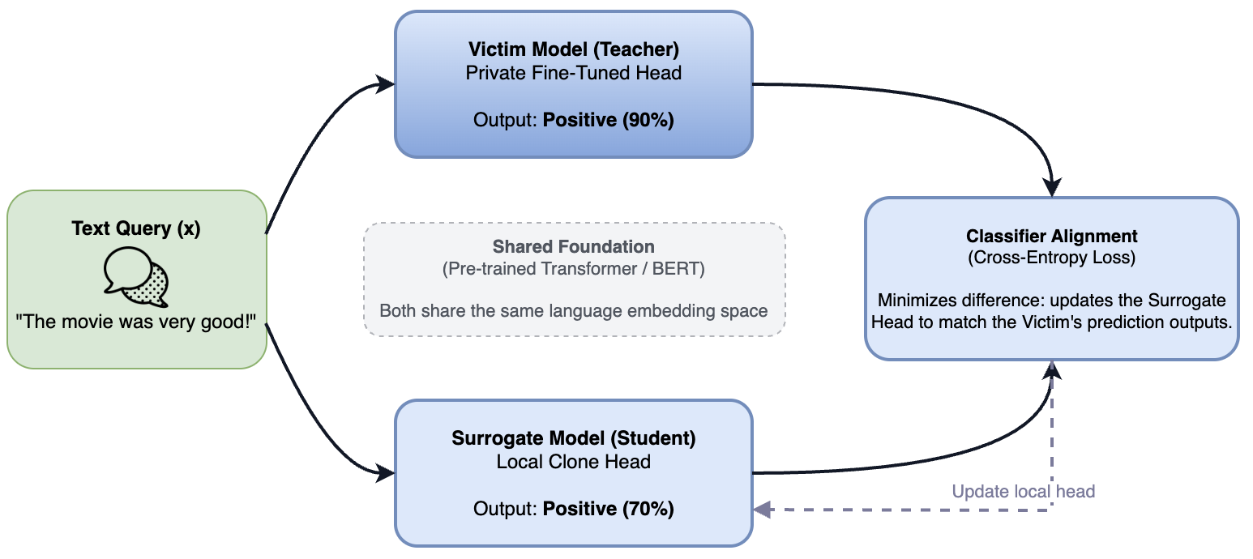
ATTACKS ON TEXT MODEL
Text model extraction targets sequential natural language processors, such as BERT classifiers, question-answering systems, or Large Language Models (LLMs). Because both the attacker and the victim typically fine-tune their classifiers on top of the same pre-trained language model (e.g. BERT or RoBERTa), they already share a matching syntactic and semantic understanding of language.
Notes:
This allows the clone model to align its classification boundaries with the victim API using very few queries.
The core intuition focuses on the sequential structure of words:
Unlike tabular data, text queries consist of sequences of words (tokens). The attacker steals the language task's knowledge by sending natural or synthetic sentences to a black-box API, collecting the returned predictions, and training their local clone model on these text-prediction pairs.

Slide 37
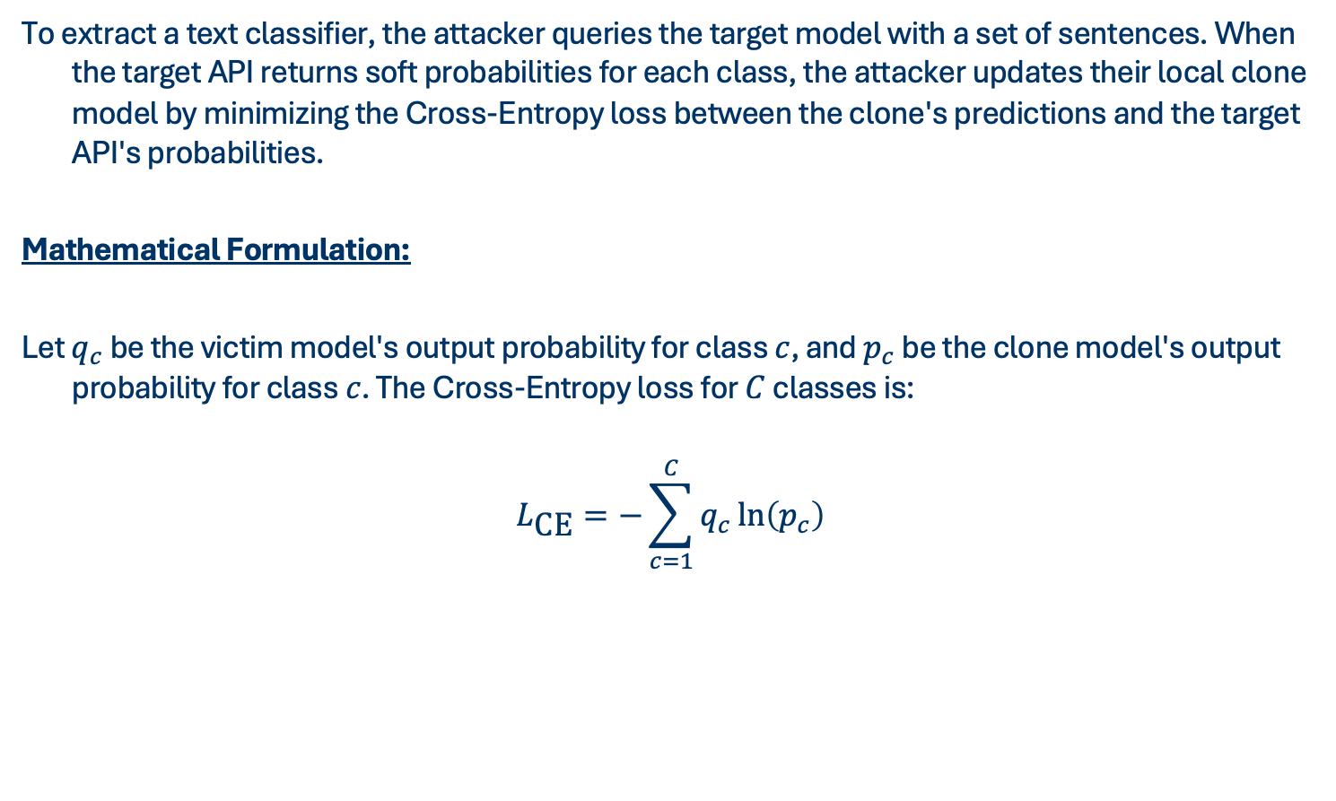
ATTACKS ON TEXT MODEL
To extract a text classifier, the attacker queries the target model with a set of sentences. When the target API returns soft probabilities for each class, the attacker updates their local clone model by minimizing the Cross-Entropy loss between the clone's predictions and the target API's probabilities.
Mathematical Formulation:
Let $q_{c}$ be the victim model's output probability for class $c$, and $p_{c}$ be the clone model's output probability for class $c$. The Cross-Entropy loss for $C$ classes is:
$$L_{\text{CE}}=−\sum_{c=1}^{C}{q_{c}}\ln\left(p_{c}\right)$$

Slide 38
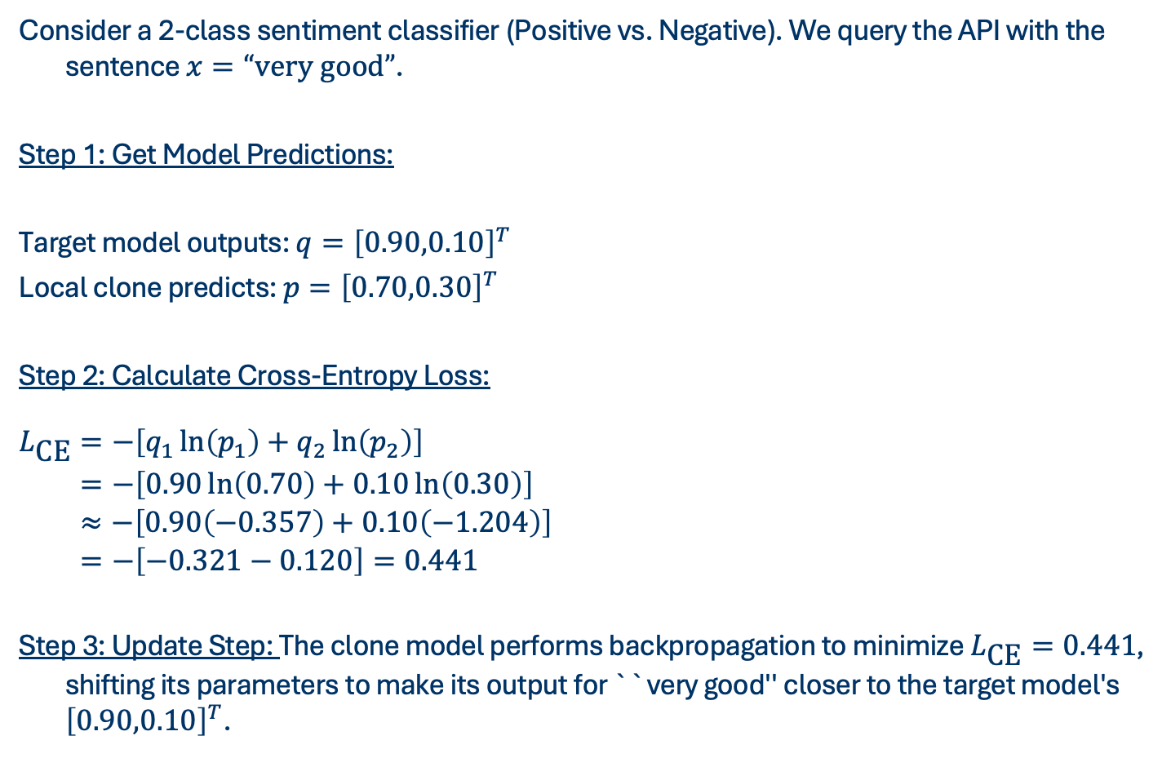
ATTACKS ON TEXT MODEL
Consider a 2-class sentiment classifier (Positive vs. Negative). We query the API with the sentence $x=“\text{very} \text{good}”$.
Step 1: Get Model Predictions:
Target model outputs: $q={\left[0.90,0.10\right]}^{T}$
Local clone predicts: $p={\left[0.70,0.30\right]}^{T}$
Step 2: Calculate Cross-Entropy Loss:
$\begin{aligned}L_{\text{CE}}&=−\left[q_{1}\ln\left(p_{1}\right)+q_{2}\ln\left(p_{2}\right)\right] \\ &=−\left[0.90\ln\left(0.70\right)+0.10\ln\left(0.30\right)\right] \\ &≈−\left[0.90\left(−0.357\right)+0.10\left(−1.204\right)\right] \\ &=−\left[−0.321−0.120\right]=0.441\end{aligned}$
Step 3: Update Step: The clone model performs backpropagation to minimize $L_{\text{CE}}=0.441$, shifting its parameters to make its output for ``very good'' closer to the target model's ${\left[0.90,0.10\right]}^{T}$.

Slide 39
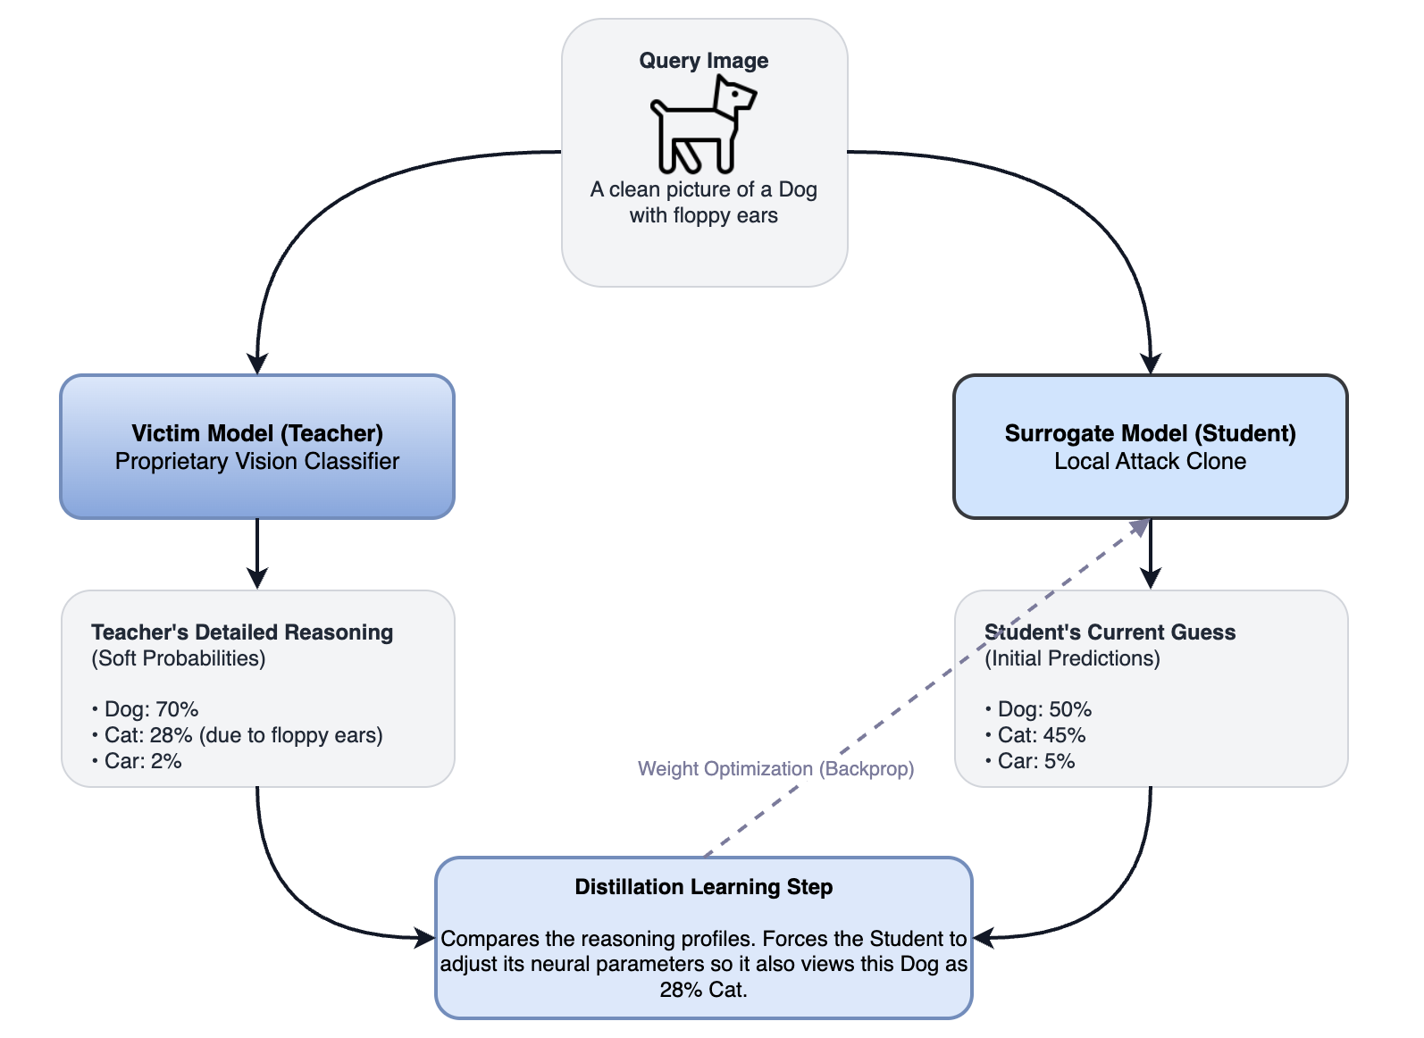
ATTACKS ON VISION MODEL
Vision model extraction targets convolutional or attention-based neural networks that classify, segment, or detect objects in high-dimensional image grids.
Notes:
Images consist of structured pixels. To steal a vision model, the attacker queries the victim model with a database of natural images (either task-related, or completely unrelated out-of-domain images like cars/cats) to obtain predictions, and trains their own local vision architecture to mimic the visual boundaries of the victim.

Slide 40
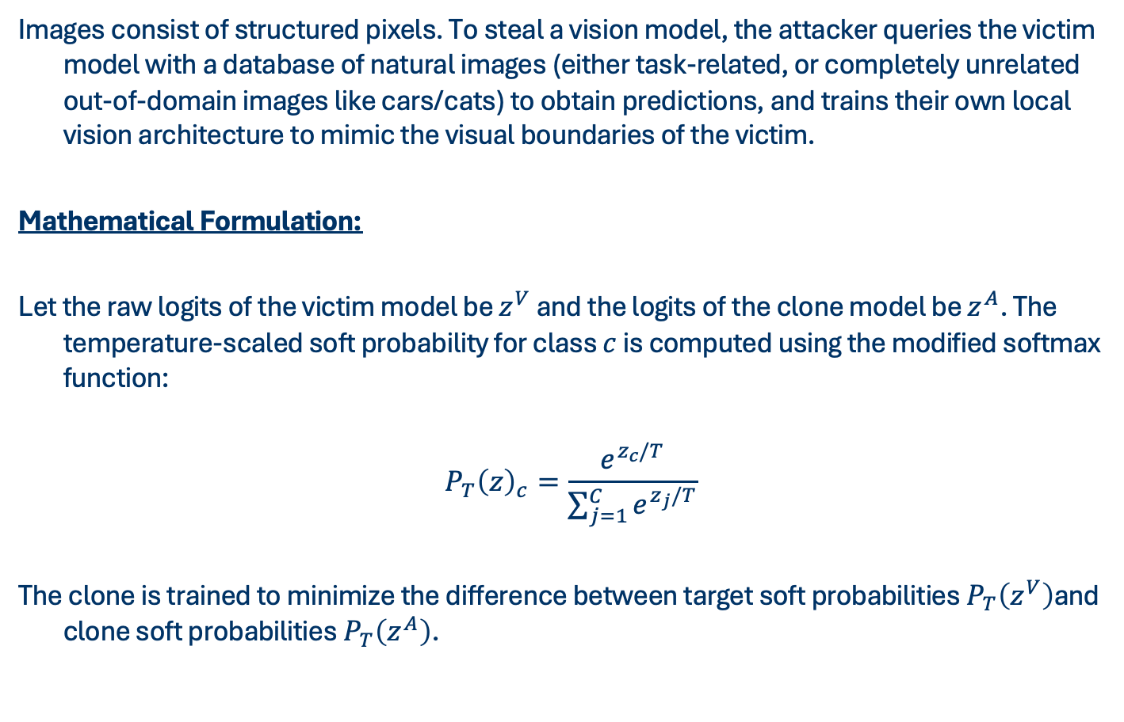
ATTACKS ON VISION MODEL
Images consist of structured pixels. To steal a vision model, the attacker queries the victim model with a database of natural images (either task-related, or completely unrelated out-of-domain images like cars/cats) to obtain predictions, and trains their own local vision architecture to mimic the visual boundaries of the victim.
Mathematical Formulation:
Let the raw logits of the victim model be $z^{V}$ and the logits of the clone model be $z^{A}$. The temperature-scaled soft probability for class $c$ is computed using the modified softmax function:
$$P_{T}{\left(z\right)}_{c}=\frac{e^{z_{c}/T}}{\sum_{j=1}^{C}{e^{z_{j}/T}}}$$
The clone is trained to minimize the difference between target soft probabilities $P_{T}\left(z^{V}\right)$and clone soft probabilities $P_{T}\left(z^{A}\right)$.
Notes:
To extract the victim's deep feature representations, the attacker queries the model and copies the soft probability distributions. To highlight the hidden relationship between classes (e.g., how much a picture of a dog looks like a cat versus a car), they apply a Temperature scale $T>1$ during probability calculation. This is called Knowledge Distillation.

Slide 41
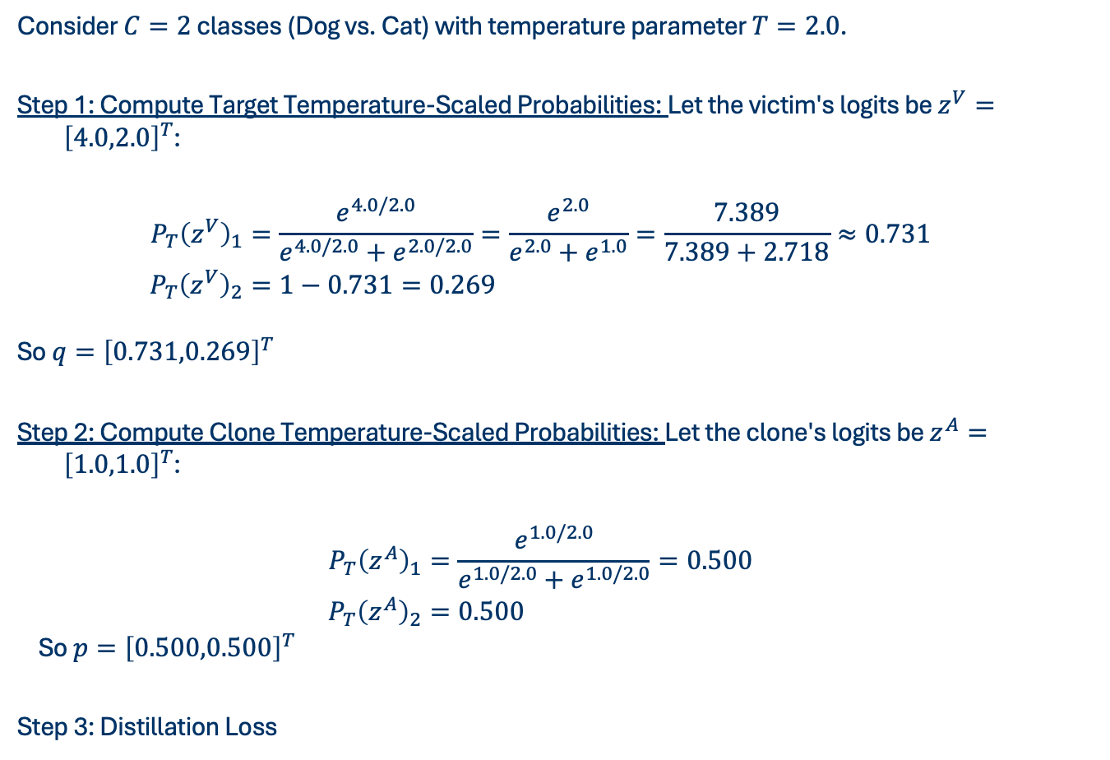
ATTACKS ON VISION MODEL
Consider $C=2$ classes (Dog vs. Cat) with temperature parameter $T=2.0$.
Step 1: Compute Target Temperature-Scaled Probabilities: Let the victim's logits be $z^{V}={\left[4.0,2.0\right]}^{T}$:
$$\begin{aligned}P_{T}{\left(z^{V}\right)}_{1}&=\frac{e^{4.0/2.0}}{e^{4.0/2.0}+e^{2.0/2.0}}=\frac{e^{2.0}}{e^{2.0}+e^{1.0}}=\frac{7.389}{7.389+2.718}≈0.731 \\ P_{T}{\left(z^{V}\right)}_{2}&=1−0.731=0.269 \\ \end{aligned}$$
So $q={\left[0.731,0.269\right]}^{T}$
Step 2: Compute Clone Temperature-Scaled Probabilities: Let the clone's logits be $z^{A}={\left[1.0,1.0\right]}^{T}$:
$$\begin{aligned}P_{T}{\left(z^{A}\right)}_{1}&=\frac{e^{1.0/2.0}}{e^{1.0/2.0}+e^{1.0/2.0}}=0.500 \\ P_{T}{\left(z^{A}\right)}_{2}&=0.500\end{aligned}$$
So $p={\left[0.500,0.500\right]}^{T}$
Step 3: Distillation Loss
Notes:
Step 3: Distillation Loss: The clone computes the loss to align its predictions $p$ with the temperature-scaled target outputs $q$, capturing the fine-grained visual categories of the victim.

Slide 42
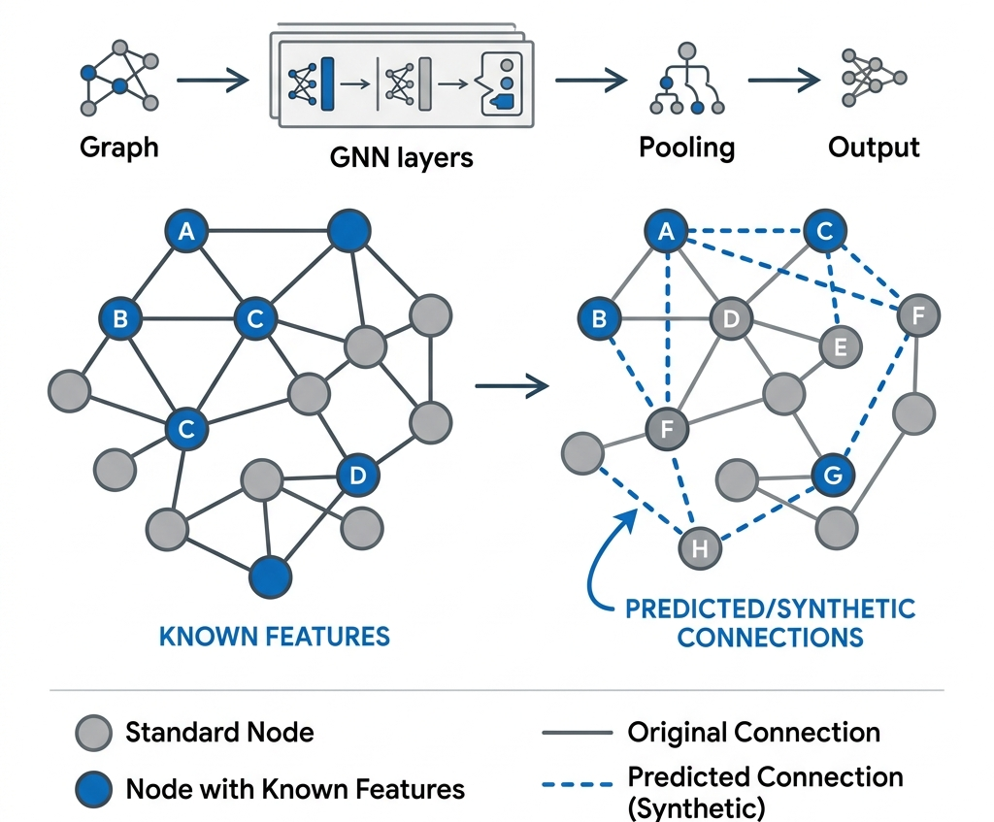
ATTACKS ON GRAPH MODEL
Graph model extraction targets Graph Neural Networks (GNNs) that process non-Euclidean data structured as nodes (vertices) and edges (connections).
Notes:
Unlike text or images, graph data is defined by its connections. GNNs leverage homophily—the principle that connected nodes share similar features. By querying a GNN and analyzing node features and predictions, an attacker can reverse-engineer the private graph connections (topology) between nodes.

Slide 43
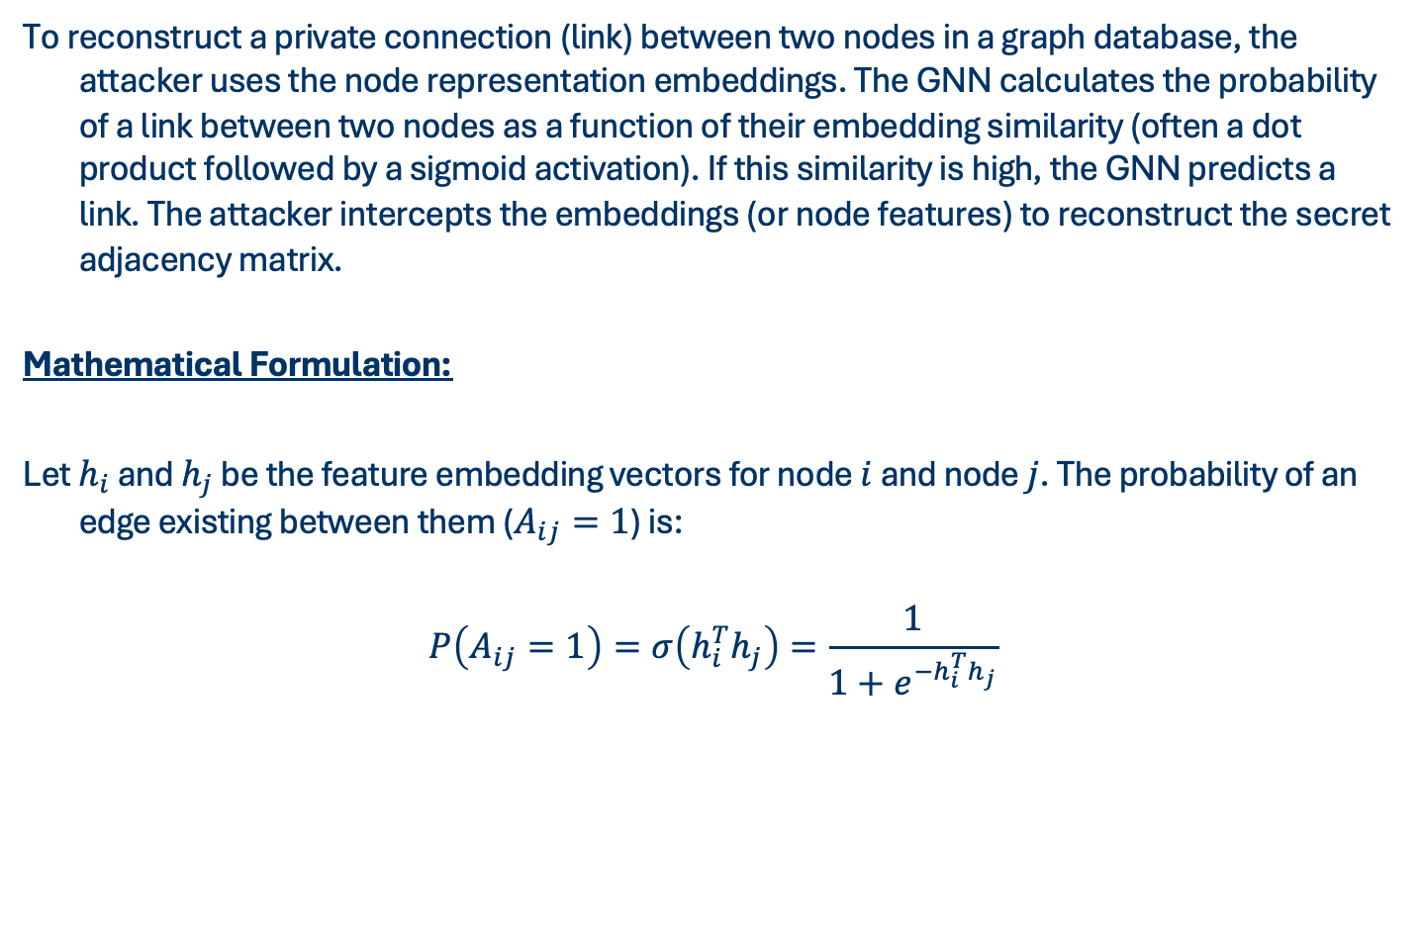
ATTACKS ON GRAPH MODEL
To reconstruct a private connection (link) between two nodes in a graph database, the attacker uses the node representation embeddings. The GNN calculates the probability of a link between two nodes as a function of their embedding similarity (often a dot product followed by a sigmoid activation). If this similarity is high, the GNN predicts a link. The attacker intercepts the embeddings (or node features) to reconstruct the secret adjacency matrix.
Mathematical Formulation:
Let $h_{i}$ and $h_{j}$ be the feature embedding vectors for node $i$ and node $j$. The probability of an edge existing between them ($A_{ij}=1$) is:
$$\begin{aligned}P\left(A_{ij}=1\right)=σ\left(h_{i}^{T}h_{j}\right)=\frac{1}{1+e^{−h_{i}^{T}h_{j}}}\end{aligned}$$

Slide 44
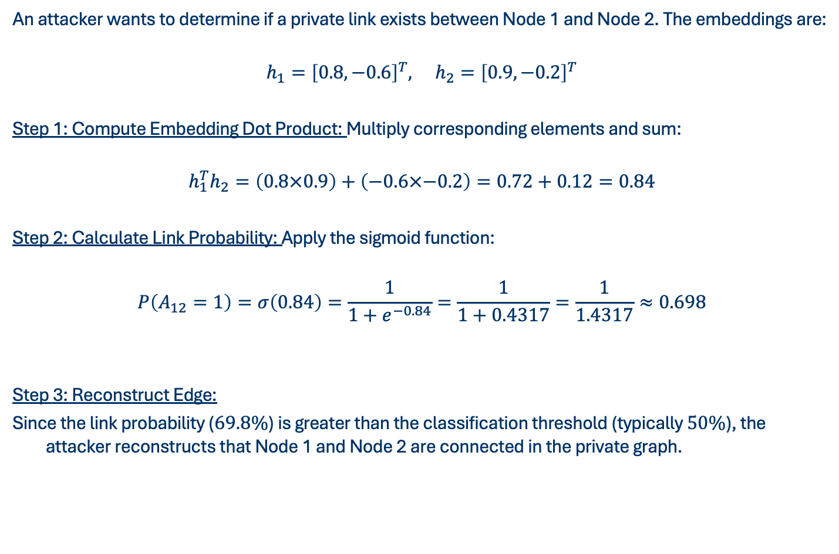
ATTACKS ON GRAPH MODEL
An attacker wants to determine if a private link exists between Node 1 and Node 2. The embeddings are:
$$h_{1}={\left[0.8,−0.6\right]}^{T}, h_{2}={\left[0.9,−0.2\right]}^{T}$$
Step 1: Compute Embedding Dot Product: Multiply corresponding elements and sum:
$$h_{1}^{T}h_{2}=\left(0.8×0.9\right)+\left(−0.6×−0.2\right)=0.72+0.12=0.84$$
Step 2: Calculate Link Probability: Apply the sigmoid function:
$$P\left(A_{12}=1\right)=σ\left(0.84\right)=\frac{1}{1+e^{−0.84}}=\frac{1}{1+0.4317}=\frac{1}{1.4317}≈0.698$$
Step 3: Reconstruct Edge:
Since the link probability ($69.8\%$) is greater than the classification threshold (typically $50\%$), the attacker reconstructs that Node 1 and Node 2 are connected in the private graph.

Slide 45
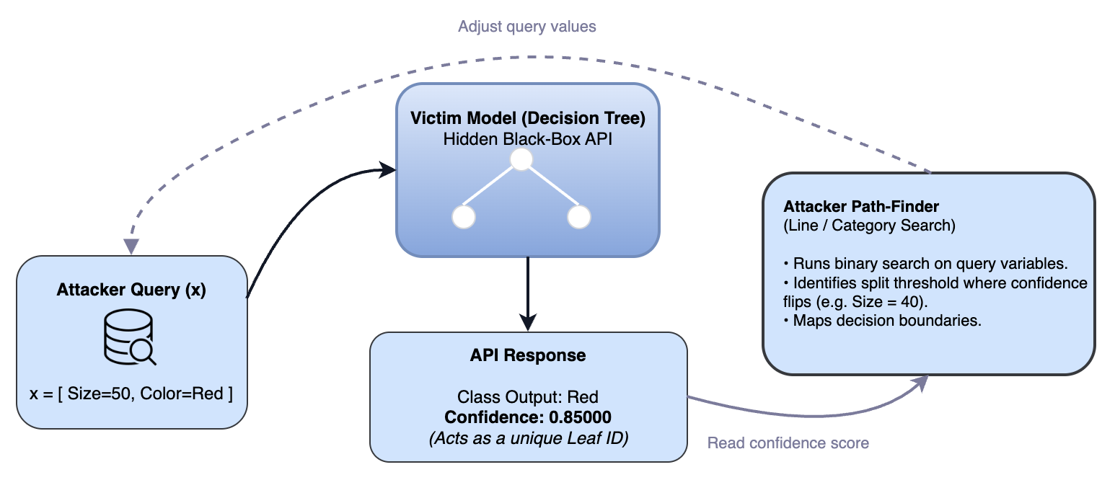
BONUS:STEALING DECISION TREES
Notes:
Imagine trying to map out the layout of a maze (the decision tree) without being able to see it. You start in one room (a leaf node) and choose a direction to walk (e.g., changing the value of a continuous feature like size). You walk in a straight line until you cross a threshold and enter a new room.
Because MLaaS APIs return predictions with a high-precision confidence score, the confidence score acts as a unique ``room number'' (leaf identifier). The moment the confidence score flips, you know you have hit a boundary wall. You write down the exact coordinate of the wall (the split threshold $t$), step past it to explore the new room, and repeat the process until the entire maze is mapped.

Slide 46
BONUS:STEALING DECISION TREES
Algorithm:
Inputs:
Oracle O: Black-box API returning high-precision confidence scores (Leaf IDs)
Features: List of continuous and categorical feature names
Steps:
Scan
Step Over
Land
Notes:
Land: Send a query to the API and check which leaf you land in (identified by the unique confidence score).
Scan: Slowly change one feature in your query until the API's confidence score changes. This tells you exactly where the decision split (threshold $t$) lies.
Step Over: Create a new query by taking a tiny step past that threshold to land in the adjacent, unexplored leaf branch.
Repeat: Keep jumping from branch to branch until you have visited every leaf and mapped all the decision boundaries.

Slide 47
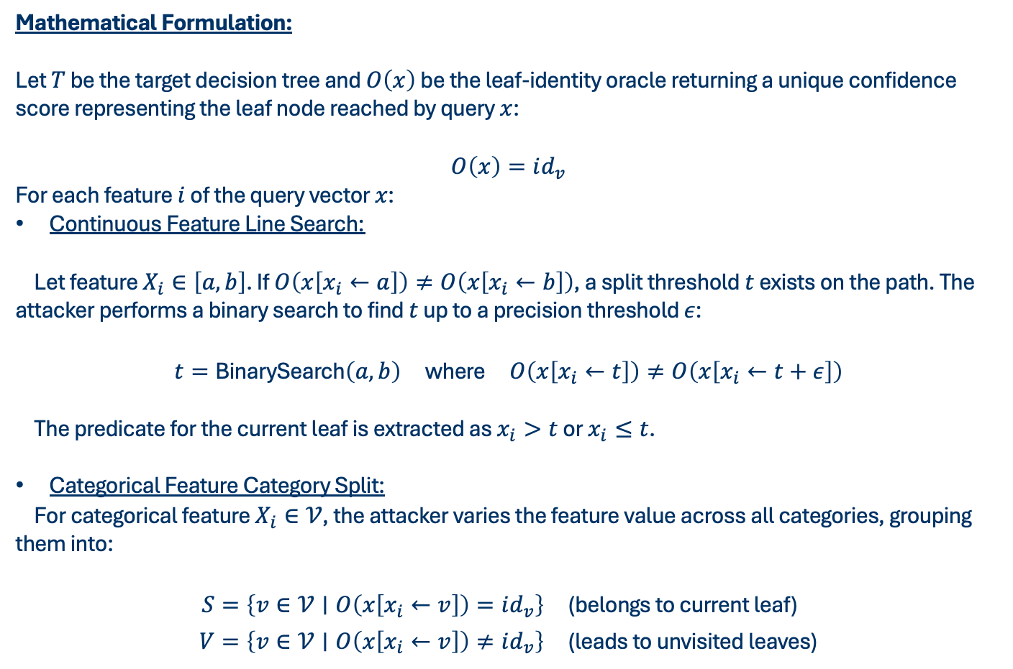
BONUS:STEALING DECISION TREES
Mathematical Formulation:
Let $T$ be the target decision tree and $O\left(x\right)$ be the leaf-identity oracle returning a unique confidence score representing the leaf node reached by query $x$:
$$\begin{aligned}O\left(x\right)=id_{v}\end{aligned}$$
For each feature $i$ of the query vector $x$:
Continuous Feature Line Search:
Let feature $X_{i}∈\left[a,b\right]$. If $O\left(x\left[x_{i}←a\right]\right)≠O\left(x\left[x_{i}←b\right]\right)$, a split threshold $t$ exists on the path. The attacker performs a binary search to find $t$ up to a precision threshold $ε$:
$$\begin{aligned}t=\text{BinarySearch}\left(a,b\right) \text{where} O\left(x\left[x_{i}←t\right]\right)≠O\left(x\left[x_{i}←t+ε\right]\right)\end{aligned}$$
The predicate for the current leaf is extracted as $x_{i}>t$ or $x_{i}≤t$.
Categorical Feature Category Split:
For categorical feature $X_{i}∈𝒱$, the attacker varies the feature value across all categories, grouping them into:
$$\begin{aligned}S&=\left\{v∈𝒱∣O\left(x\left[x_{i}←v\right]\right)=id_{v}\right\} \text{(}\text{belongs} \text{to} \text{current} \text{leaf}\text{)} \\ V&=\left\{v∈𝒱∣O\left(x\left[x_{i}←v\right]\right)≠id_{v}\right\} \text{(}\text{leads} \text{to} \text{unvisited} \text{leaves}\text{)}\end{aligned}$$

Slide 48
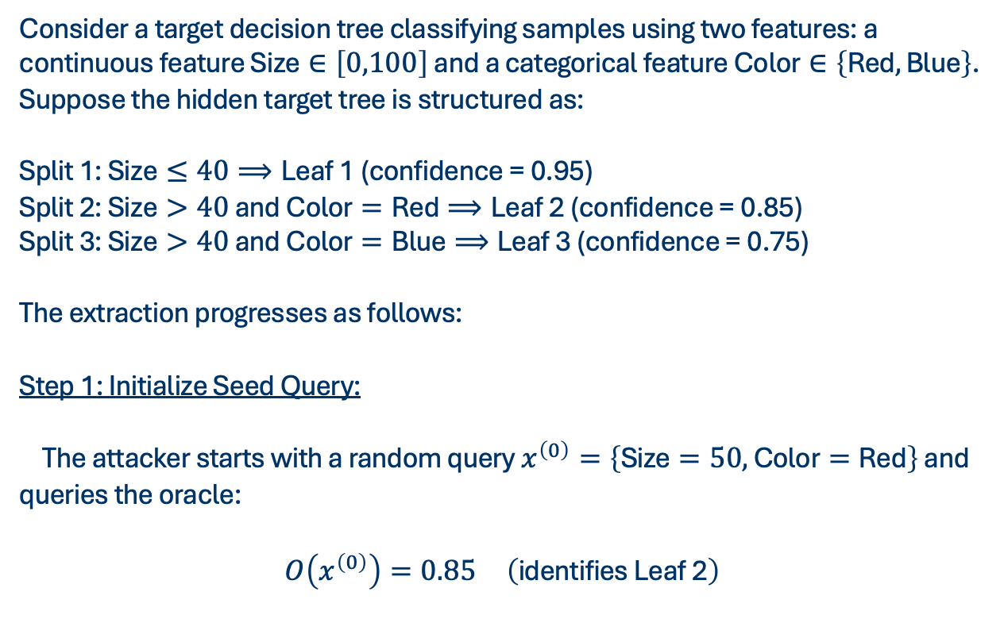
BONUS:STEALING DECISION TREES
Consider a target decision tree classifying samples using two features: a continuous feature $\text{Size}∈\left[0,100\right]$ and a categorical feature $\text{Color}∈\left\{\text{Red},\text{Blue}\right\}$. Suppose the hidden target tree is structured as:
Split 1: $\text{Size}≤40⟹\text{Leaf}\text{ 1}$ (confidence = 0.95)
Split 2: $\text{Size}>40$ and $\text{Color}=\text{Red}⟹\text{Leaf}\text{ 2}$ (confidence = 0.85)
Split 3: $\text{Size}>40$ and $\text{Color}=\text{Blue}⟹\text{Leaf}\text{ 3}$ (confidence = 0.75)
The extraction progresses as follows:
Step 1: Initialize Seed Query:
The attacker starts with a random query $x^{\left(0\right)}=\left\{\text{Size}=50, \text{Color}=\text{Red}\right\}$ and queries the oracle:
$$O\left(x^{\left(0\right)}\right)=0.85 \left(\text{identifies} \text{Leaf}\text{ 2}\right)$$

Slide 49
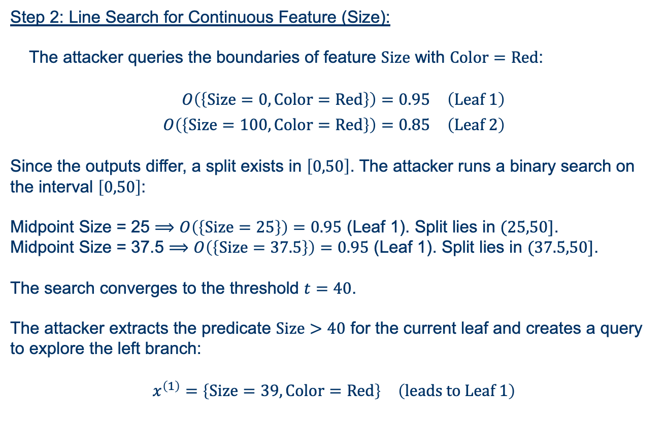
BONUS:STEALING DECISION TREES
Step 2: Line Search for Continuous Feature (Size):
The attacker queries the boundaries of feature $\text{Size}$ with $\text{Color}=\text{Red}$:
$$\begin{aligned}O\left(\left\{\text{Size}=0, \text{Color}=\text{Red}\right\}\right)&=0.95 \left(\text{Leaf}\text{ 1}\right) \\ O\left(\left\{\text{Size}=100, \text{Color}=\text{Red}\right\}\right)&=0.85 \left(\text{Leaf}\text{ 2}\right)\end{aligned}$$
Since the outputs differ, a split exists in $\left[0,50\right]$. The attacker runs a binary search on the interval $\left[0,50\right]$:
Midpoint Size = 25 $⟹O\left(\left\{\text{Size}=25\right\}\right)=0.95$ (Leaf 1). Split lies in $(25,50]$.
Midpoint Size = 37.5 $⟹O\left(\left\{\text{Size}=37.5\right\}\right)=0.95$ (Leaf 1). Split lies in $(37.5,50]$.
The search converges to the threshold $t=40$.
The attacker extracts the predicate $\text{Size}>40$ for the current leaf and creates a query to explore the left branch:
$$x^{\left(1\right)}=\left\{\text{Size}=39, \text{Color}=\text{Red}\right\} \left(\text{leads} \text{to} \text{Leaf}\text{ 1}\right)$$

Slide 50
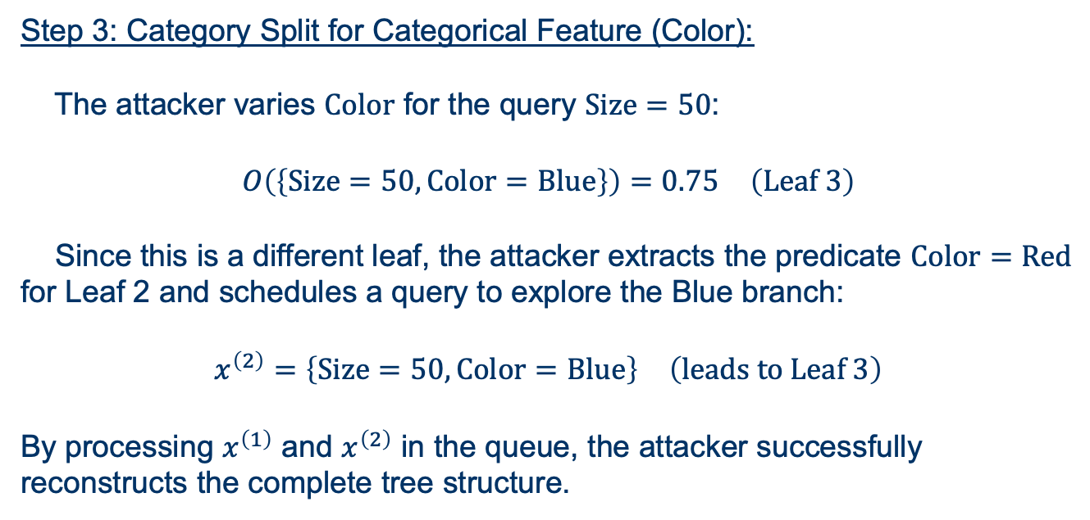
BONUS:STEALING DECISION TREES
Step 3: Category Split for Categorical Feature (Color):
The attacker varies $\text{Color}$ for the query $\text{Size}=50$:
$$O\left(\left\{\text{Size}=50, \text{Color}=\text{Blue}\right\}\right)=0.75 \left(\text{Leaf}\text{ 3}\right)$$
Since this is a different leaf, the attacker extracts the predicate $\text{Color}=\text{Red}$ for Leaf 2 and schedules a query to explore the Blue branch:
$$x^{\left(2\right)}=\left\{\text{Size}=50, \text{Color}=\text{Blue}\right\} \left(\text{leads} \text{to} \text{Leaf}\text{ 3}\right)$$
By processing $x^{\left(1\right)}$ and $x^{\left(2\right)}$ in the queue, the attacker successfully reconstructs the complete tree structure.

Slide 51
Open Challenges
The Security-Utility Tradeoff:
Restricting output precision (rounding logits, adding differential noise) degrades accuracy for legitimate users.
Adaptive Adversaries:
Attackers learn to blend query features into natural distributions, making query monitoring systems (e.g. PRADA) ineffective.
Collaborative Extraction Integrity:
Securing global parameters from client-side gradient hijacking during training.
Legal & IP Policy:
Defining copyright infringement boundaries. Is a distilled or copied model legally plagiarism under the DMCA?

Slide 52
Summary & Key Takeaways
Model Extraction is a systemic threat to private intellectual property and data privacy.
Unified Attack Taxonomy organizes extraction along Channels (API, Gradients, Side-channels), Constraints, and Objectives.
Simpler models (LR, Softmax, DT) are analytically solvable in O(d) queries.
Neural Networks (MLPs, GNNs) are extractable via non-linear optimization and structure reconstruction.
LLMs face generative vulnerabilities such as API functionality distillation and training data memorization leaks.
Edge deployments shift the extraction threat vector from query budgets to physical side-channels.

Slide 53
Main References
• Florian Tramèr, Fan Zhang, Ari Juels, Michael K. Reiter, and Thomas Ristenpart.
  "Stealing Machine Learning Models via Prediction APIs", USENIX Security 2016.
• Daryna Oliynyk, Rudolf Mayer, and Andreas Rauber.
  "I Know What You Trained Last Summer: A Survey on Stealing Machine Learning Models and Defences", ACM Comput. Surv. 2023.
• Kaixiang Zhao, Lincan Li, Kaize Ding, Neil Zhenqiang Gong, Yue Zhao, and Yushun Dong.
  "A Systematic Survey of Model Extraction Attacks and Defenses: State-of-the-Art and Perspectives", arXiv 2025.
• Bang Wu, Xiangwen Yang, Shirui Pan, and Xingliang Yuan.
  "Model Extraction Attacks on Graph Neural Networks: Taxonomy and Realisation", ASIA CCS 2022.
• Tushar Nayan, Qiming Guo, Mohammed Al Duniawi, Marcus Botacin, Selcuk Uluagac, and Ruimin Sun.
  "SoK: All You Need to Know About On-Device ML Model Extraction", USENIX Security 2024.

