Slide 1
UNIVERSITY OF NEW BRUNSWICK
MODEL EXTRACTION Defenses
Presenter: Refat Ishrak Hemel
email: refat.ishrak.hemel@unb.ca
© 2025 Roozbeh Razavi-Far

Slide 2
AGENDA
Introduction
The Defense Taxonomy
Deep Dive of Each Defenses

Slide 3
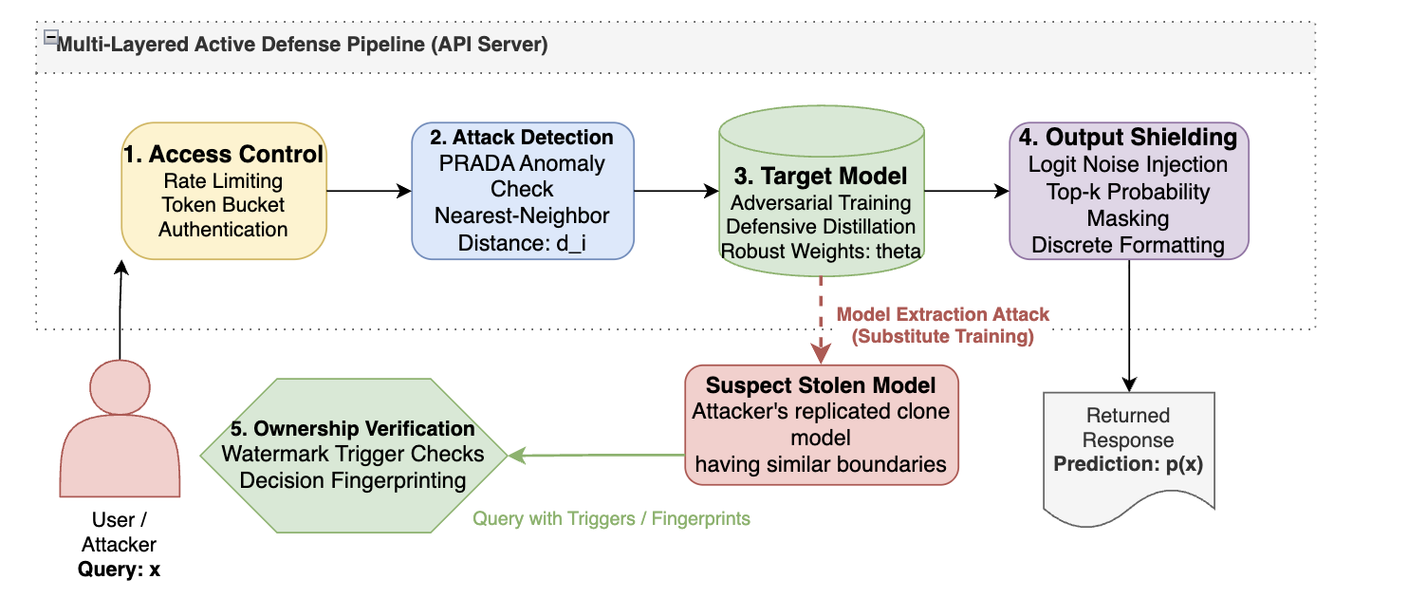
INTRODUCTION
Model extraction defenses are security strategies and technical counter-measures designed to protect proprietary machine learning models (the victim models) from being replicated, stolen, or reconstructed by adversaries interacting through public APIs.
Notes:
While extraction attacks attempt to clone a model's decision boundaries or parameters, defenses aim to detect malicious queries, prevent boundary estimation, verify model ownership post-theft, or adapt protection to specific data modalities.

Slide 4
DEFENSE TAXONOMY
Defenses
Attack detection
Monitoring-based Methods
Ownership Verification
Watermarking Techniques
Fingerprinting Methods
Attack Prevention
Data Perturbation
Model Modification
Access Control
Adversarial Training
Integrated Defenses
Defense on other Modalities
Vision Models
Text Models
Graph Models
Notes:
From Stealing Technique’s POV (How or why it is divided into this 5)

Slide 5
ATTACK DETECTION
Attack detection focuses on monitoring user query traffic to flag suspicious activities. The key intuition is that benign users query a model naturally to obtain predictions for distinct, varied inputs, whereas an extraction attacker must systematically query the model near its decision boundaries to clone its behavior.
By measuring the relationship (e.g., distance, density, or distribution) of consecutive queries, the defender can detect and block a malicious agent before their query budget allows full reconstruction.
Notes:
From Stealing Technique’s POV (How or why it is divided into this 5)

Slide 6
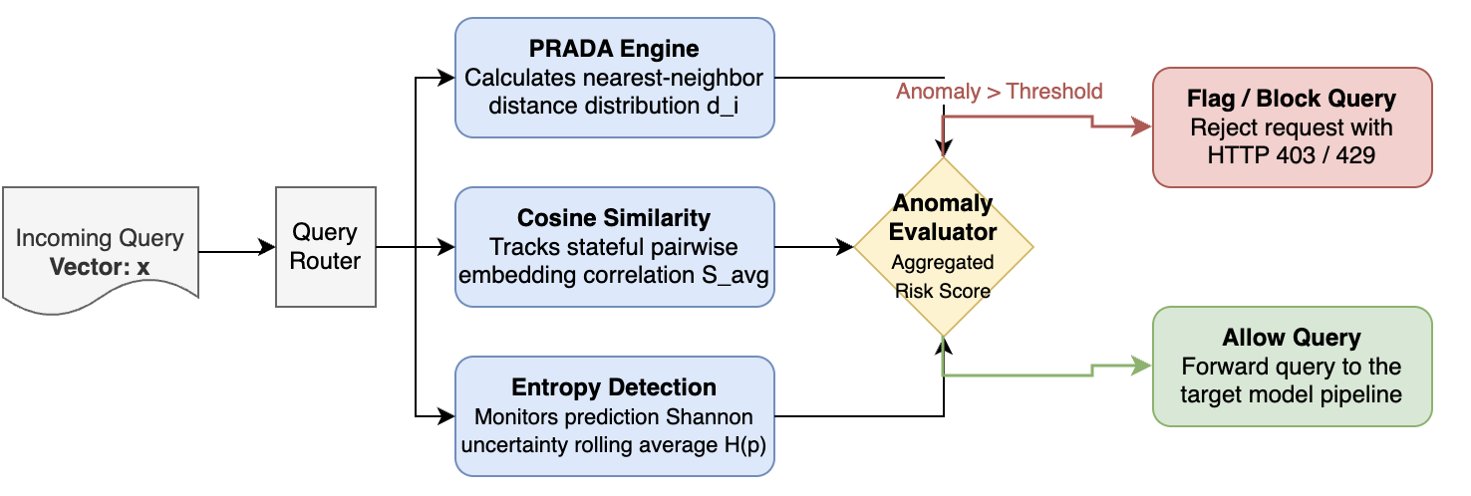
MONITORING-BASED METHODS
PRADA (Pathological Query Distance Analysis) detects model extraction attacks by analyzing the distribution of distances between queries.
Notes:
PRADA calculates the distance from each incoming query to its nearest neighbor among all previous queries from the same user. For benign traffic, these distances follow a normal or multi-modal distribution. For extraction attacks, the distances are abnormally small and highly concentrated. PRADA uses a normality test (like the Shapiro-Wilk test) on these distances to flag anomalous, pathological query behavior.
When an attacker trains a substitute model using synthetic query generation (e.g., Jacobian-based data augmentation), they generate new queries by adding small perturbations to existing samples. This shifts inputs directly toward the decision boundaries.

Slide 7
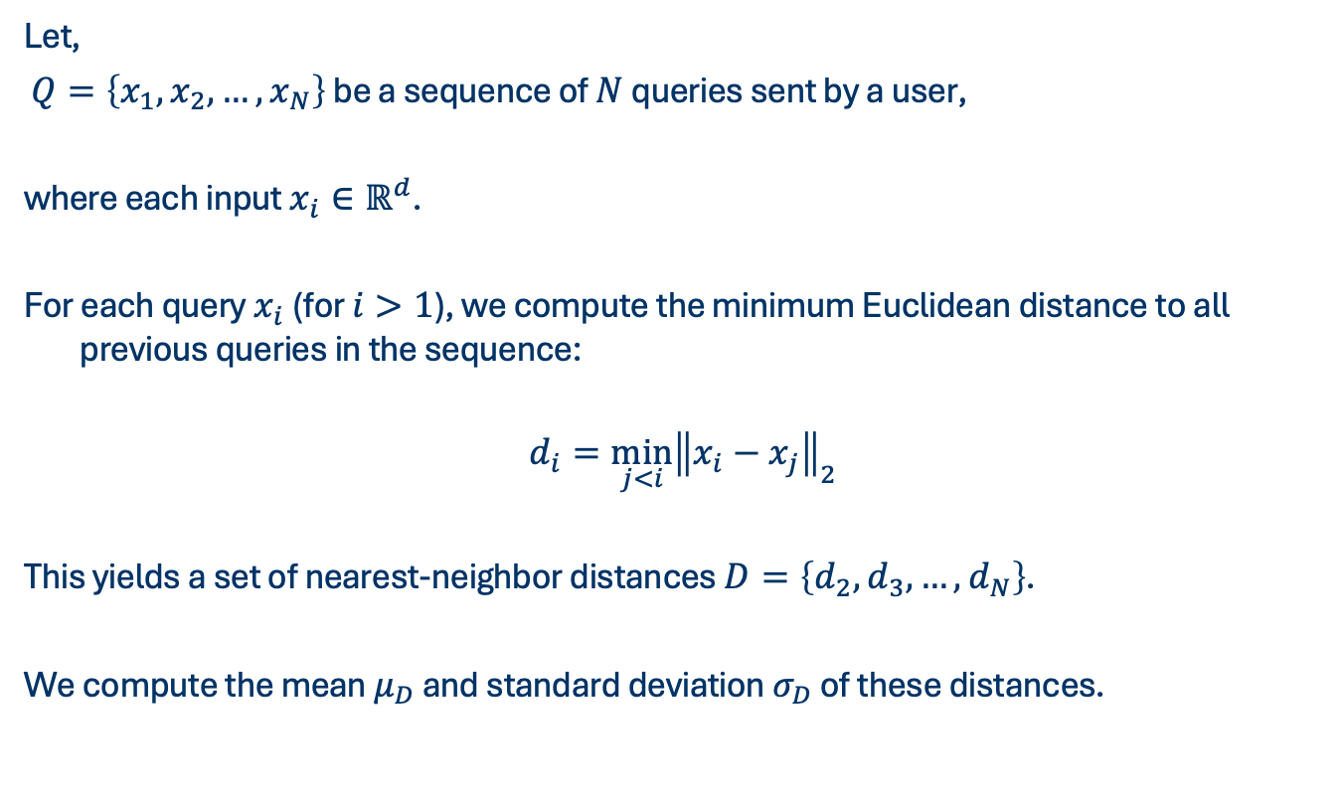
MONITORING-BASED METHODS
Mathematical formulation:
Let,
$Q=\left\{x_{1},x_{2},…,x_{N}\right\}$ be a sequence of $N$ queries sent by a user,
where each input $x_{i}∈ℝ^{d}$.
For each query $x_{i}$ (for $i>1$), we compute the minimum Euclidean distance to all previous queries in the sequence:
$$\begin{aligned}d_{i}=\min_{j<i}{{\left\|x_{i}−x_{j}\right\|}_{2}}\end{aligned}$$
This yields a set of nearest-neighbor distances $D=\left\{d_{2},d_{3},…,d_{N}\right\}$.
We compute the mean $μ_{D}$ and standard deviation $σ_{D}$ of these distances.
Notes:
The attacker wants to generate a perturbed input $x^{∗}$ from a seed input $x$ to probe the model's boundary for class $c$:
Where $∇_{x}$ $\overset{˜}{f}{\left(x\right)}_{c}\$$ is the gradient of the predicted probability of class $c$ with respect to the input features$,\$\text{sgn}\$$ is the sign function (returning $+1$ or $−1$), and $λ$ is the step size.

Slide 8
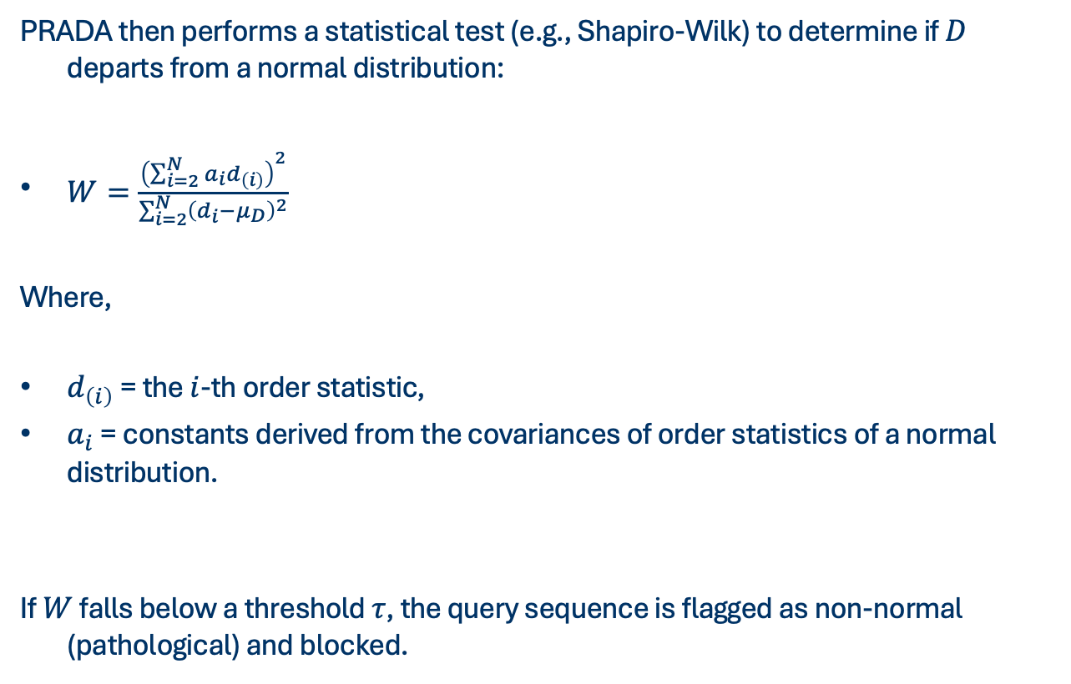
MONITORING-BASED METHODS
PRADA then performs a statistical test (e.g., Shapiro-Wilk) to determine if $D$ departs from a normal distribution:
$\begin{aligned}W=\frac{{\left(\sum_{i=2}^{N}{a_{i}}d_{\left(i\right)}\right)}^{2}}{\sum_{i=2}^{N}{{\left(d_{i}−μ_{D}\right)}^{2}}}\end{aligned}$
Where,
$d_{\left(i\right)}$ = the $i$-th order statistic,
$a_{i}$ = constants derived from the covariances of order statistics of a normal distribution.
If $W$ falls below a threshold $τ$, the query sequence is flagged as non-normal (pathological) and blocked.
Notes:
$d_{\left(i\right)}$ = (the $i$-th smallest number in the sorted set of distances)

Slide 9
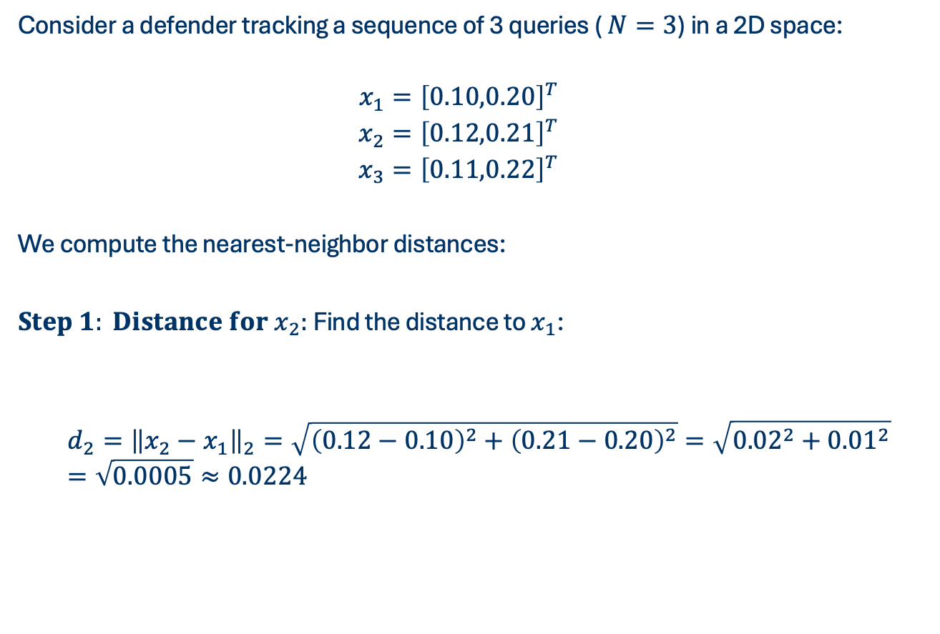
MONITORING-BASED METHODS
Consider a defender tracking a sequence of 3 queries ( $N=3$) in a 2D space:
$$\begin{aligned}x_{1}&={\left[0.10,0.20\right]}^{T} \\ x_{2}&={\left[0.12,0.21\right]}^{T} \\ x_{3}&={\left[0.11,0.22\right]}^{T}\end{aligned}$$
We compute the nearest-neighbor distances:
$Step 1: Distance for x_{2}:$ Find the distance to $x_{1}$:
$$d_{2}={\left\|x_{2}−x_{1}\right\|}_{2}=\sqrt{{\left(0.12−0.10\right)}^{2}+{\left(0.21−0.20\right)}^{2}}=\sqrt{{0.02}^{2}+{0.01}^{2}}=\sqrt{0.0005}≈0.0224$$

Slide 10
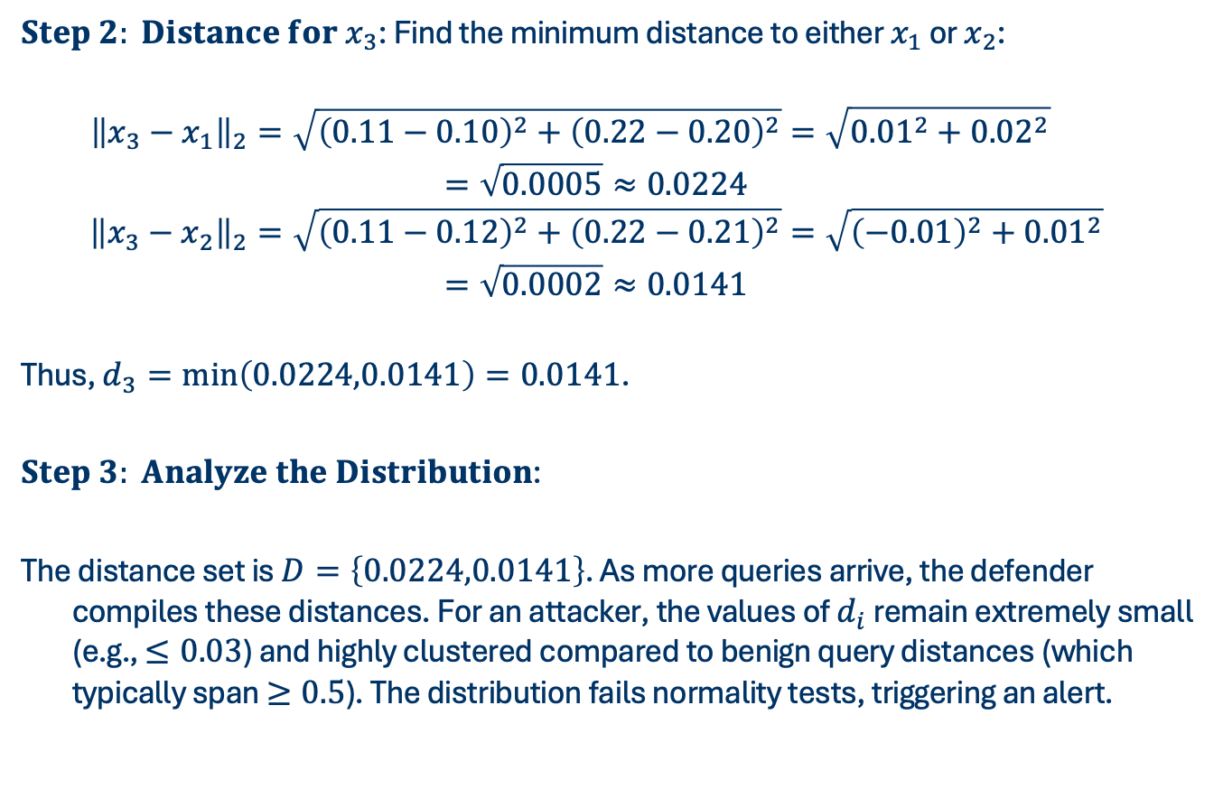
MONITORING-BASED METHODS
c
$Step 2: Distance for x_{3}$: Find the minimum distance to either $x_{1}$ or $x_{2}$:
$$\begin{aligned}{\left\|x_{3}−x_{1}\right\|}_{2}&=\sqrt{{\left(0.11−0.10\right)}^{2}+{\left(0.22−0.20\right)}^{2}}=\sqrt{{0.01}^{2}+{0.02}^{2}} \\ =\sqrt{0.0005}≈0.0224 \\ {\left\|x_{3}−x_{2}\right\|}_{2}&=\sqrt{{\left(0.11−0.12\right)}^{2}+{\left(0.22−0.21\right)}^{2}}=\sqrt{{\left(−0.01\right)}^{2}+{0.01}^{2}} \\ =\sqrt{0.0002}≈0.0141\end{aligned}$$
Thus, $d_{3}=\min\left(0.0224,0.0141\right)=0.0141$.
$Step 3: Analyze the Distribution$:
The distance set is $D=\left\{0.0224,0.0141\right\}$. As more queries arrive, the defender compiles these distances. For an attacker, the values of $d_{i}$ remain extremely small (e.g., $≤0.03$) and highly clustered compared to benign query distances (which typically span $≥0.5$). The distribution fails normality tests, triggering an alert.
Notes:
This completes the first iteration. The new sample $x^{\left(1\right)}$ is sent to the target API to find the boundary label.
To trace how the attack continues to walk along the decision boundary, we perform the next iterations:
Continues numbering from 4

Slide 11
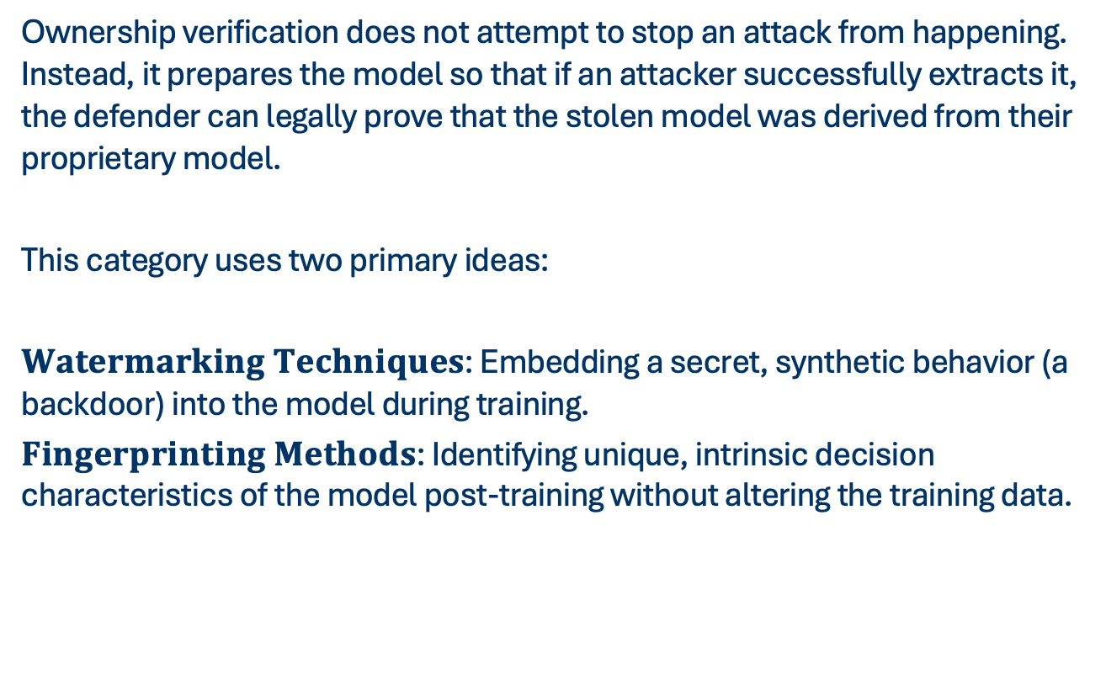
OWNERSHIP VERIFICATION
Ownership verification does not attempt to stop an attack from happening. Instead, it prepares the model so that if an attacker successfully extracts it, the defender can legally prove that the stolen model was derived from their proprietary model.
This category uses two primary ideas:
$Watermarking Techniques$: Embedding a secret, synthetic behavior (a backdoor) into the model during training.
$Fingerprinting Methods$: Identifying unique, intrinsic decision characteristics of the model post-training without altering the training data.
Notes:
Equation solving is used when the victim model is a simple, standard machine learning algorithm (like Linear
or Logistic Regression).
1. Linear Relationship: These models make predictions by multiplying inputs
by weights and adding a bias. If the API returns exact prediction confidence scores (probabilities), we can
reverse-engineer this math.
2. System of Equations: Since the parameters are unknown, we can treat
them as variables in a system of linear equations.
3. Solve: By querying the API with a set of linearly
independent inputs, we generate enough equations to solve for the exact weights and bias

Slide 12
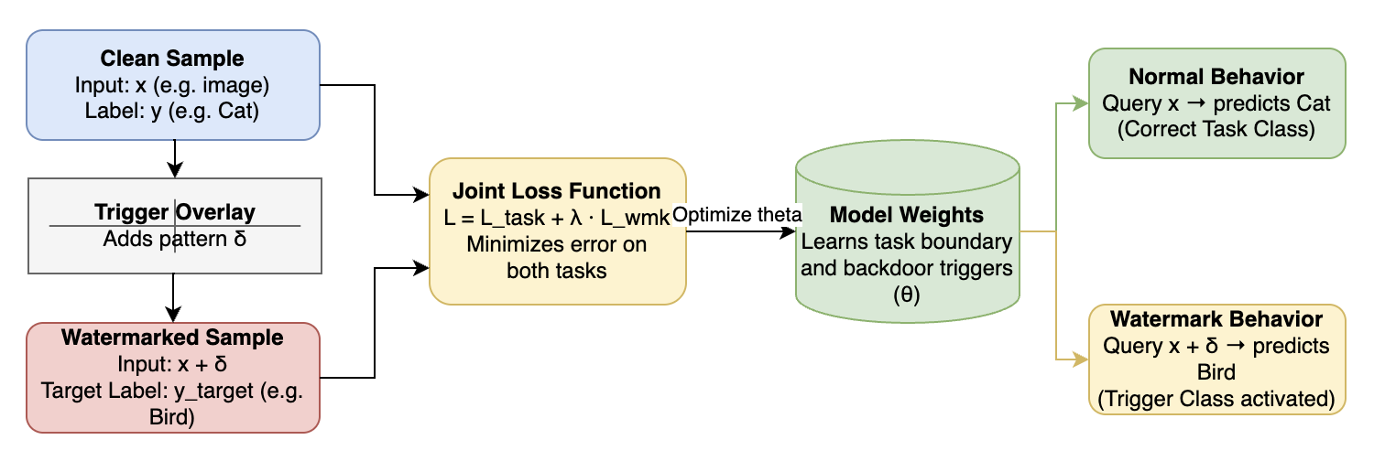
WATERMARKING
Watermarking injects a backdoor during the training phase. The defender chooses a set of trigger inputs (e.g., random noise images or images with a specific pixel pattern) and assigns them an arbitrary, incorrect target label. The model is trained on a combined dataset of clean training samples and these watermarked trigger samples.
Notes:
If an attacker extracts the model using query responses, the stolen model will also learn this arbitrary association. To prove theft, the defender queries the suspect model with the secret trigger set and verifies if its classification accuracy matches the trigger labels.

Slide 13
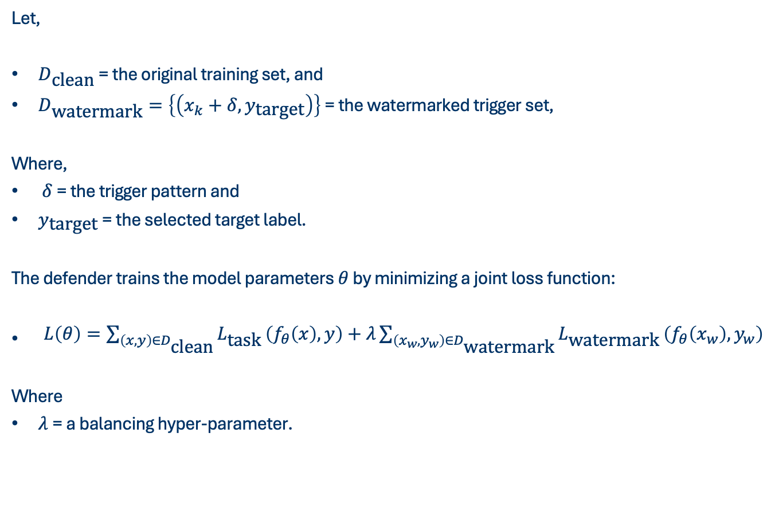
WATERMARKING
Let,
$D_{\text{clean}}$ = the original training set, and
$D_{\text{watermark}}=\left\{\left(x_{k}+δ,y_{\text{target}}\right)\right\}$ = the watermarked trigger set,
Where,
$δ$ = the trigger pattern and
$y_{\text{target}}$ = the selected target label.
The defender trains the model parameters $θ$ by minimizing a joint loss function:
$\begin{aligned}L\left(θ\right)=\sum_{\left(x,y\right)∈D_{\text{clean}}}{L_{\text{task}}}\left(f_{θ}\left(x\right),y\right)+λ\sum_{\left(x_{w},y_{w}\right)∈D_{\text{watermark}}}{L_{\text{watermark}}}\left(f_{θ}\left(x_{w}\right),y_{w}\right)\end{aligned}$
Where
$λ$= a balancing hyper-parameter.

Slide 14
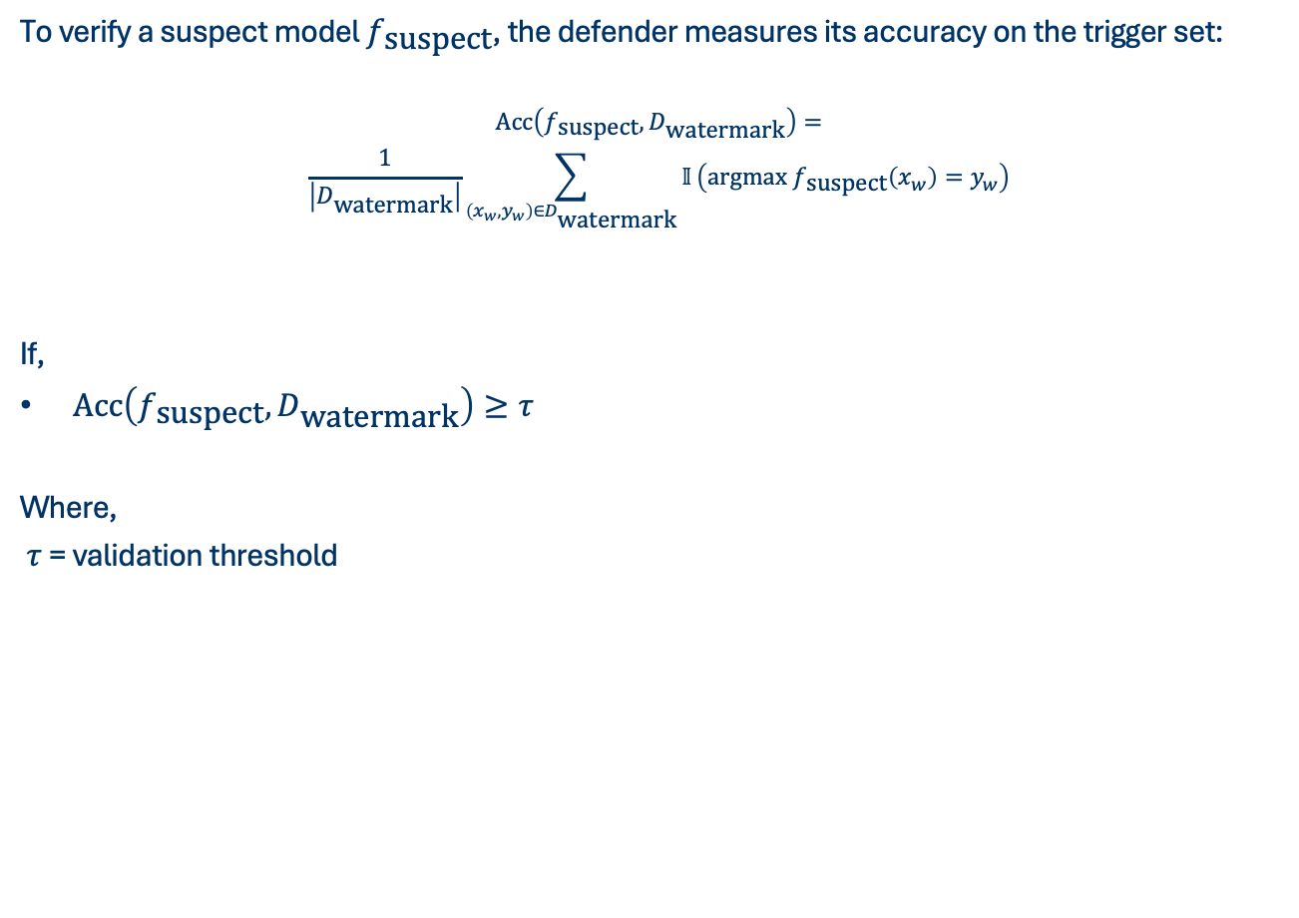
WATERMARKING
To verify a suspect model $f_{\text{suspect}}$, the defender measures its accuracy on the trigger set:
$$\begin{aligned}\begin{aligned}\text{Acc}\left(f_{\text{suspect}},D_{\text{watermark}}\right)= \\ \frac{1}{\left|D_{\text{watermark}}\right|}\sum_{\left(x_{w},y_{w}\right)∈D_{\text{watermark}}}{𝕀}\left(\text{argmax} f_{\text{suspect}}\left(x_{w}\right)=y_{w}\right)\end{aligned}\end{aligned}$$
If,
$\text{Acc}\left(f_{\text{suspect}},D_{\text{watermark}}\right)≥τ$
Where,
$τ$ = validation threshold
Notes:
, e.g., $80\%$), the model is flagged as stolen.

Slide 15
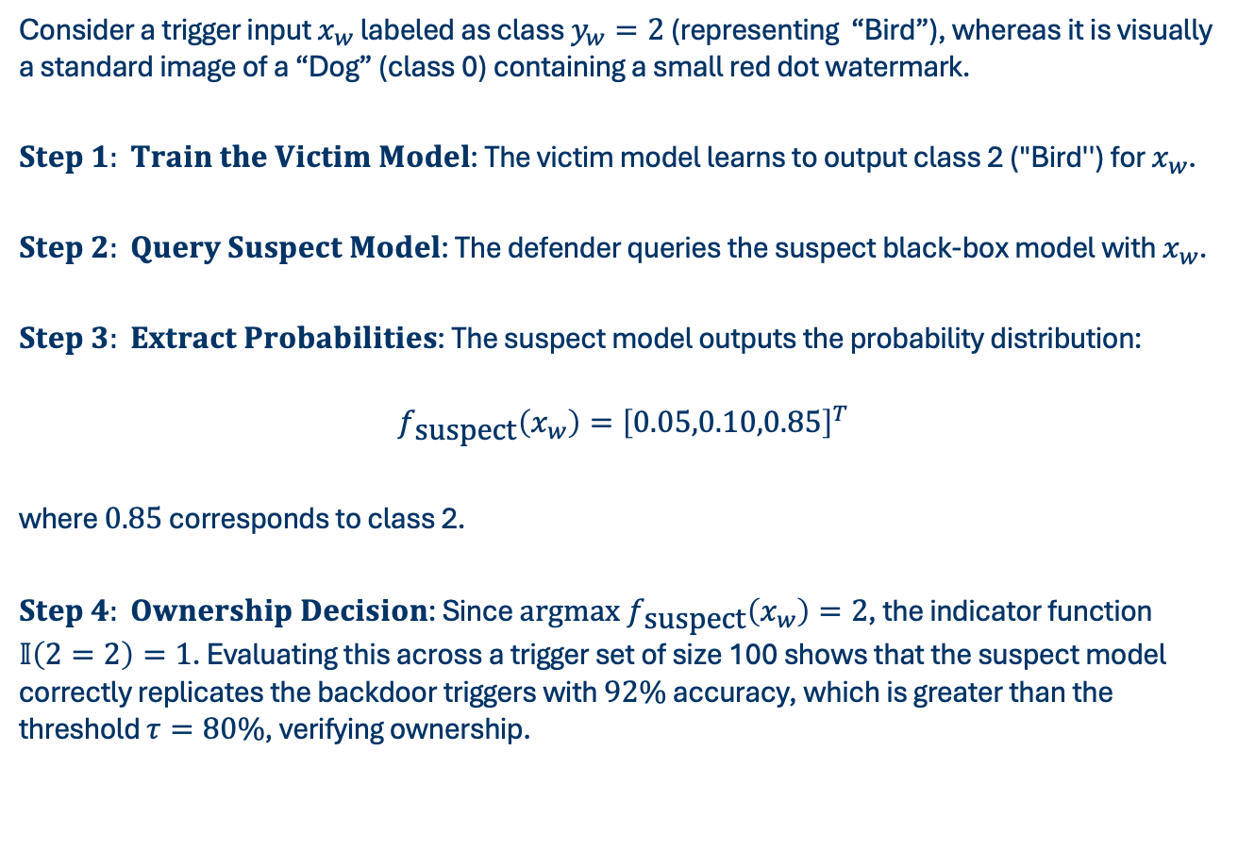
WATERMARKING
Consider a trigger input $x_{w}$ labeled as class $y_{w}=2$ (representing “Bird”), whereas it is visually a standard image of a “Dog” (class 0) containing a small red dot watermark.
$Step 1: Train the Victim Model$: The victim model learns to output class 2 ("Bird'') for $x_{w}$.
$Step 2: Query Suspect Model$: The defender queries the suspect black-box model with $x_{w}$.
$Step 3: Extract Probabilities$: The suspect model outputs the probability distribution:
$$f_{\text{suspect}}\left(x_{w}\right)={\left[0.05,0.10,0.85\right]}^{T}$$
where $0.85$ corresponds to class 2.
$Step 4: Ownership Decision$: Since $\text{argmax} f_{\text{suspect}}\left(x_{w}\right)=2$, the indicator function $𝕀\left(2=2\right)=1$. Evaluating this across a trigger set of size 100 shows that the suspect model correctly replicates the backdoor triggers with $92\%$ accuracy, which is greater than the threshold $τ=80\%$, verifying ownership.

Slide 16
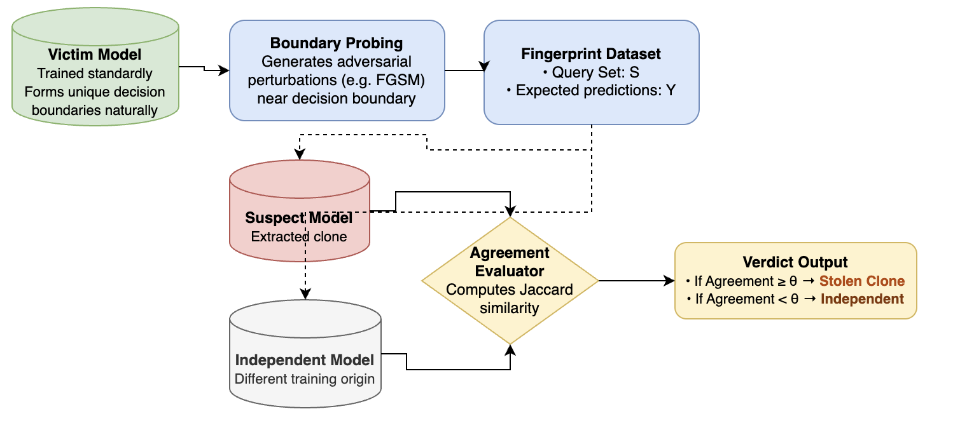
FINGERPRINTING
Unlike watermarking, fingerprinting does not alter the training dataset. Instead, it leverages the unique, complex decision boundaries formed naturally during training. The defender identifies a set of adversarial examples or boundary points (conferrable inputs) that lie extremely close to the victim model's decision boundaries.
Notes:
Because training is stochastic, two models trained independently on the same task will form slightly different decision boundaries and make different predictions on these boundary inputs. However, an extracted model that replicates the victim model's boundary will make highly correlated predictions on these specific fingerprint inputs.

Slide 17
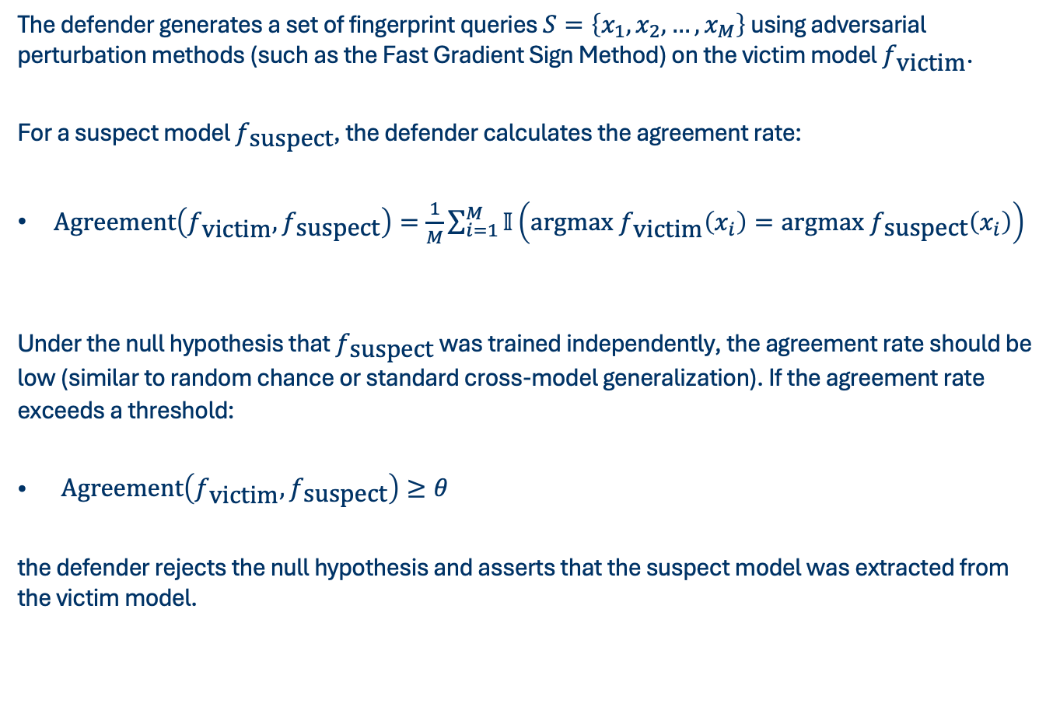
FINGERPRINTING
The defender generates a set of fingerprint queries $S=\left\{x_{1},x_{2},…,x_{M}\right\}$ using adversarial perturbation methods (such as the Fast Gradient Sign Method) on the victim model $f_{\text{victim}}$.
For a suspect model $f_{\text{suspect}}$, the defender calculates the agreement rate:
$\begin{aligned}\text{Agreement}\left(f_{\text{victim}},f_{\text{suspect}}\right)=\frac{1}{M}\sum_{i=1}^{M}{𝕀}\left(\text{argmax} f_{\text{victim}}\left(x_{i}\right)=\text{argmax} f_{\text{suspect}}\left(x_{i}\right)\right)\end{aligned}$
Under the null hypothesis that $f_{\text{suspect}}$ was trained independently, the agreement rate should be low (similar to random chance or standard cross-model generalization). If the agreement rate exceeds a threshold:
$\begin{aligned}\text{Agreement}\left(f_{\text{victim}},f_{\text{suspect}}\right)≥θ\end{aligned}$
the defender rejects the null hypothesis and asserts that the suspect model was extracted from the victim model.

Slide 18
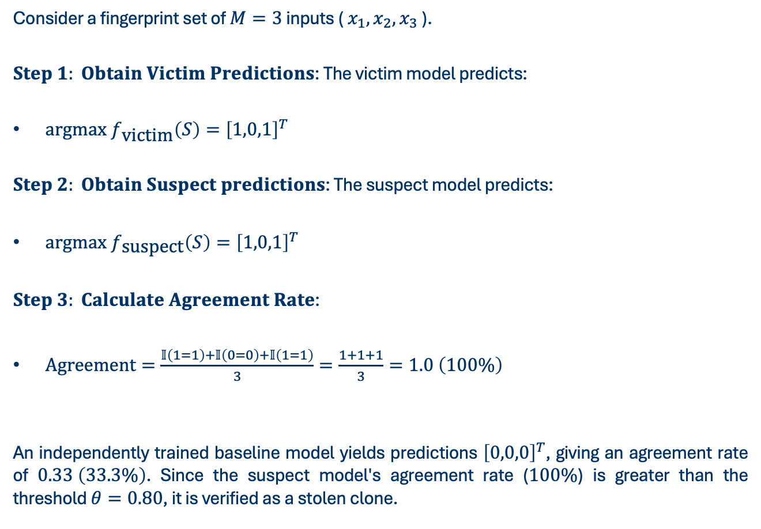
FINGERPRINTING
Consider a fingerprint set of $M=3$ inputs ( $x_{1},x_{2},x_{3}$ ).
$Step 1: Obtain Victim Predictions$: The victim model predicts:
$\text{argmax} f_{\text{victim}}\left(S\right)={\left[1,0,1\right]}^{T}$
$Step 2: Obtain Suspect predictions$: The suspect model predicts:
$\text{argmax} f_{\text{suspect}}\left(S\right)={\left[1,0,1\right]}^{T}$
$Step 3: Calculate Agreement Rate$:
$\text{Agreement}=\frac{𝕀\left(1=1\right)+𝕀\left(0=0\right)+𝕀\left(1=1\right)}{3}=\frac{1+1+1}{3}=1.0 \left(100\%\right)$
An independently trained baseline model yields predictions ${\left[0,0,0\right]}^{T}$, giving an agreement rate of $0.33 \left(33.3\%\right)$. Since the suspect model's agreement rate ($100\%$) is greater than the threshold $θ=0.80$, it is verified as a stolen clone.

Slide 19
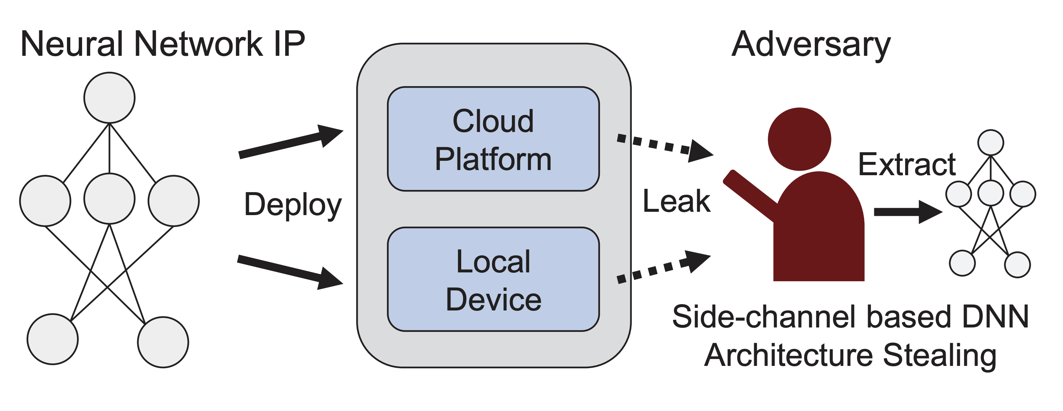
ATTACK PREVENTION
Attack prevention techniques focus on actively disrupting the extraction process. By modifying the outputs or parameters of the model, the defender aims to make the query responses useless or too expensive for substitute model training, without significantly degrading the performance for legitimate users.

Slide 20
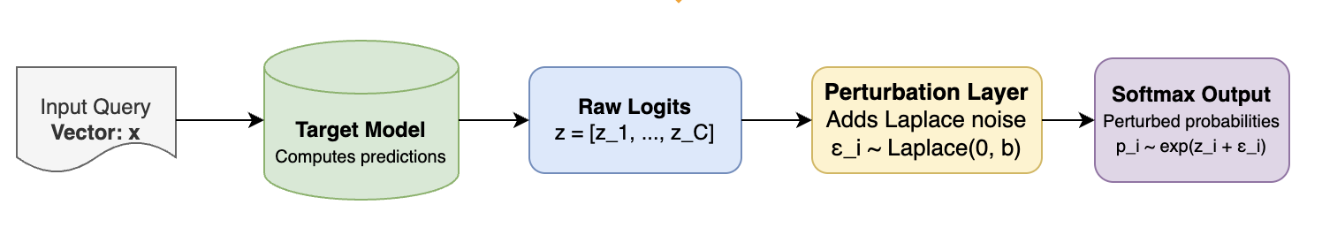
DATA PERTURBATION
When an API returns soft probabilities (e.g., confidence scores), the attacker uses these scores to compute the loss and update their substitute model.
Notes:
Data perturbation prevents this by adding calibrated noise to the model's raw output logits before passing them to the softmax function. This distorts the fine-grained probability distribution (which contains the boundary information) while keeping the highest-scoring class (the top-1 prediction) unchanged, thereby protecting the model while maintaining utility for benign users.

Slide 21
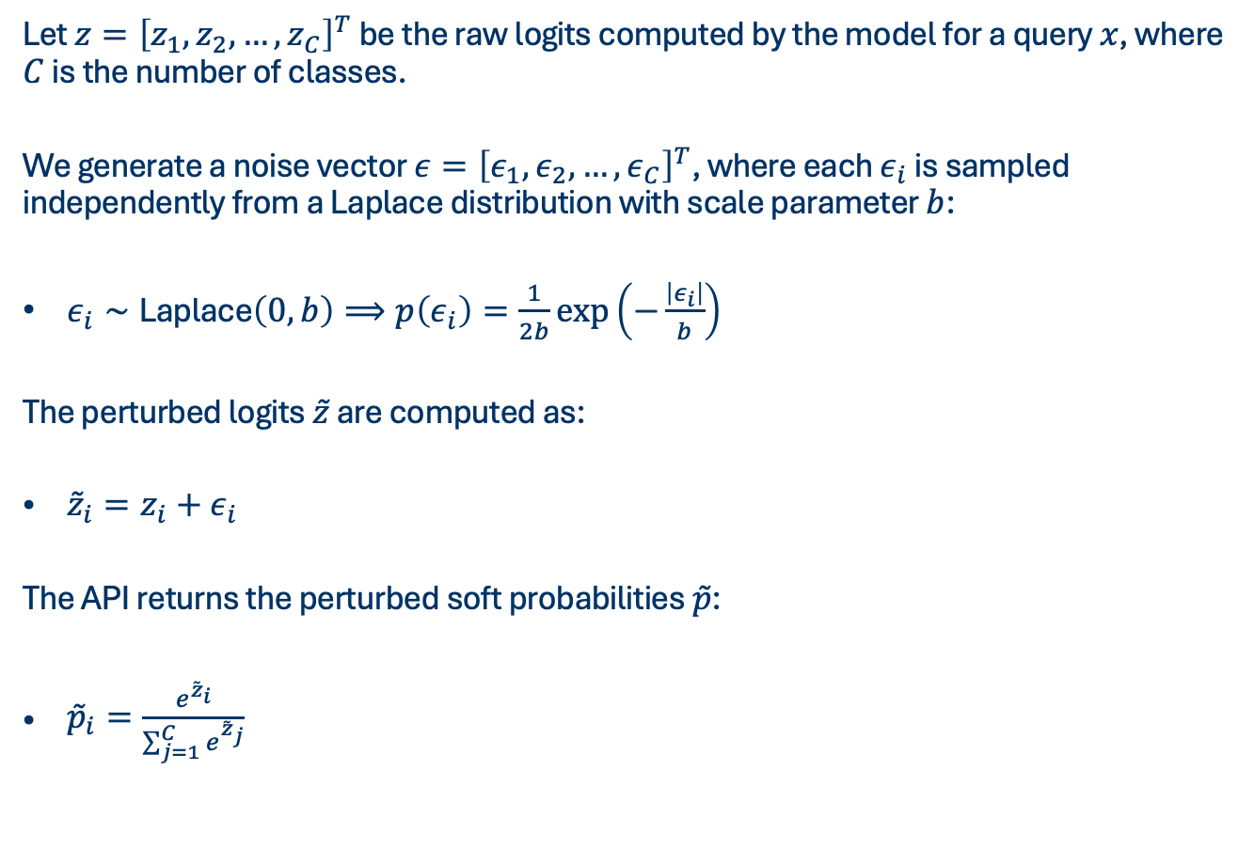
DATA PERTURBATION
Let $z={\left[z_{1},z_{2},…,z_{C}\right]}^{T}$ be the raw logits computed by the model for a query $x$, where $C$ is the number of classes.
We generate a noise vector $ε={\left[ε_{1},ε_{2},…,ε_{C}\right]}^{T}$, where each $ε_{i}$ is sampled independently from a Laplace distribution with scale parameter $b$:
$\begin{aligned}ε_{i}∼\text{Laplace}\left(0,b\right)⟹p\left(ε_{i}\right)=\frac{1}{2b}\exp\left(−\frac{\left|ε_{i}\right|}{b}\right)\end{aligned}$
The perturbed logits $\overset{˜}{z}$ are computed as:
$\begin{aligned}{\overset{˜}{z}}_{i}=z_{i}+ε_{i}\end{aligned}$
The API returns the perturbed soft probabilities $\overset{˜}{p}$:
$\begin{aligned}{\overset{˜}{p}}_{i}=\frac{e^{{\overset{˜}{z}}_{i}}}{\sum_{j=1}^{C}{e^{{\overset{˜}{z}}_{j}}}}\end{aligned}$

Slide 22
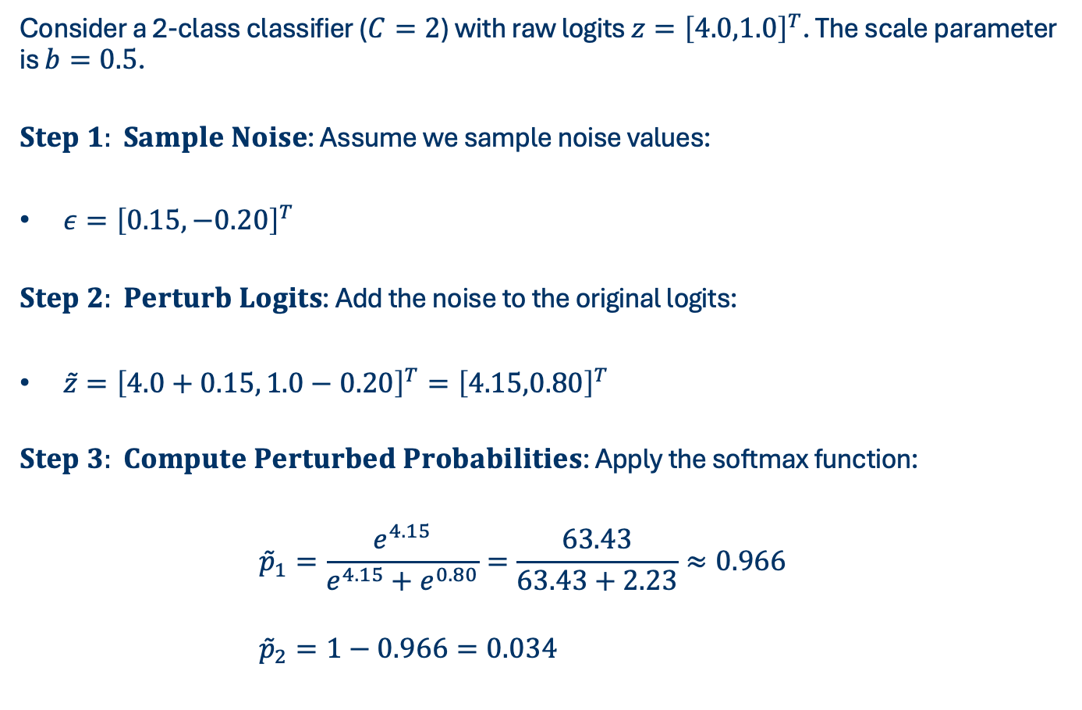
DATA PERTURBATION
Consider a 2-class classifier ($C=2$) with raw logits $z={\left[4.0,1.0\right]}^{T}$. The scale parameter is $b=0.5$.
$Step 1: Sample Noise$: Assume we sample noise values:
$ε={\left[0.15,−0.20\right]}^{T}$
$Step 2: Perturb Logits$: Add the noise to the original logits:
$\overset{˜}{z}={\left[4.0+0.15, 1.0−0.20\right]}^{T}={\left[4.15,0.80\right]}^{T}$
$Step 3: Compute Perturbed Probabilities$: Apply the softmax function:
$$\begin{aligned}{\overset{˜}{p}}_{1}&=\frac{e^{4.15}}{e^{4.15}+e^{0.80}}=\frac{63.43}{63.43+2.23}≈0.966 \\ \\ {\overset{˜}{p}}_{2}&=1−0.966=0.034 \\ \end{aligned}$$
Notes:
Without perturbation, the true probabilities were $p={\left[0.953,0.047\right]}^{T}$. The perturbation alters the exact distribution values (which degrades the substitute model's training signal) but keeps the predicted class (class 0) identical.

Slide 23
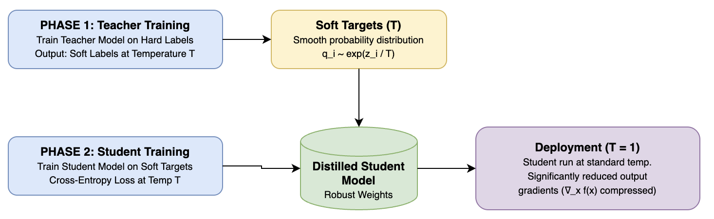
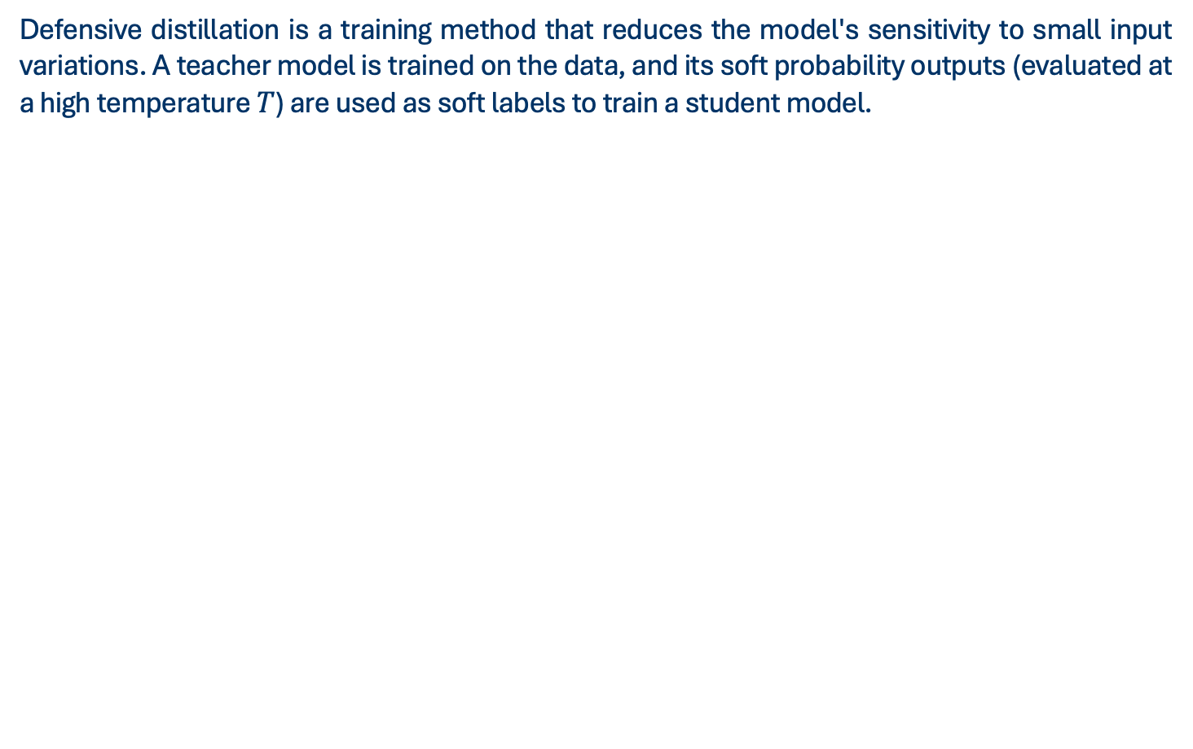
MODEL MODIFICATION
Defensive distillation is a training method that reduces the model's sensitivity to small input variations. A teacher model is trained on the data, and its soft probability outputs (evaluated at a high temperature $T$) are used as soft labels to train a student model.
Notes:
This temperature scaling smooths the decision surface and decreases the magnitude of the model's gradients. This makes it difficult for an attacker to estimate gradients or locate the decision boundary via query perturbations.

Slide 24
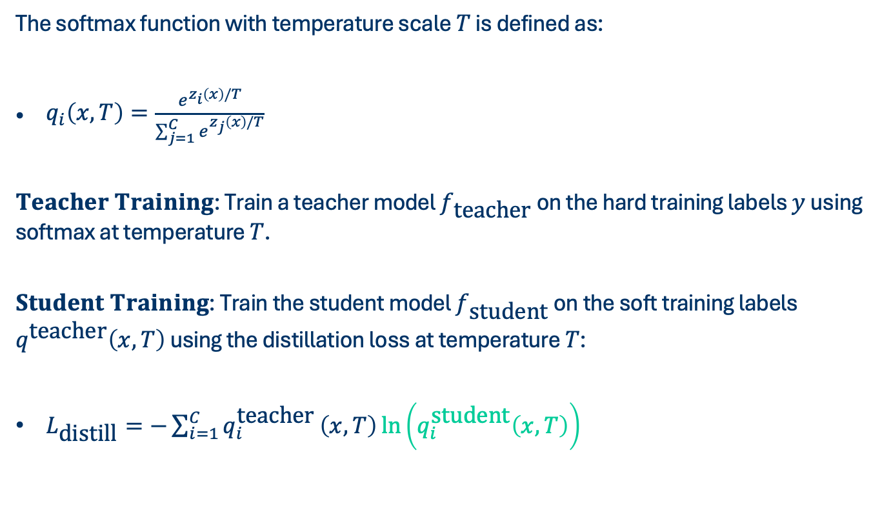
MODEL MODIFICATION
The softmax function with temperature scale $T$ is defined as:
$\begin{aligned}q_{i}\left(x,T\right)=\frac{e^{z_{i}\left(x\right)/T}}{\sum_{j=1}^{C}{e^{z_{j}\left(x\right)/T}}}\end{aligned}$
$Teacher Training$: Train a teacher model $f_{\text{teacher}}$ on the hard training labels $y$ using softmax at temperature $T$.
$Student Training$: Train the student model $f_{\text{student}}$ on the soft training labels $q^{\text{teacher}}\left(x,T\right)$ using the distillation loss at temperature $T$:
$\begin{aligned}L_{\text{distill}}=−\sum_{i=1}^{C}{q_{i}^{\text{teacher}}}\left(x,T\right)\ln\left(q_{i}^{\text{student}}\left(x,T\right)\right)\end{aligned}$
Notes:
During deployment, the student model is run at temperature $T=1$. Because it was trained on smooth, temperature-scaled soft labels, the magnitude of its gradients $∇_{x}f\left(x\right)$ is significantly reduced.

Slide 25
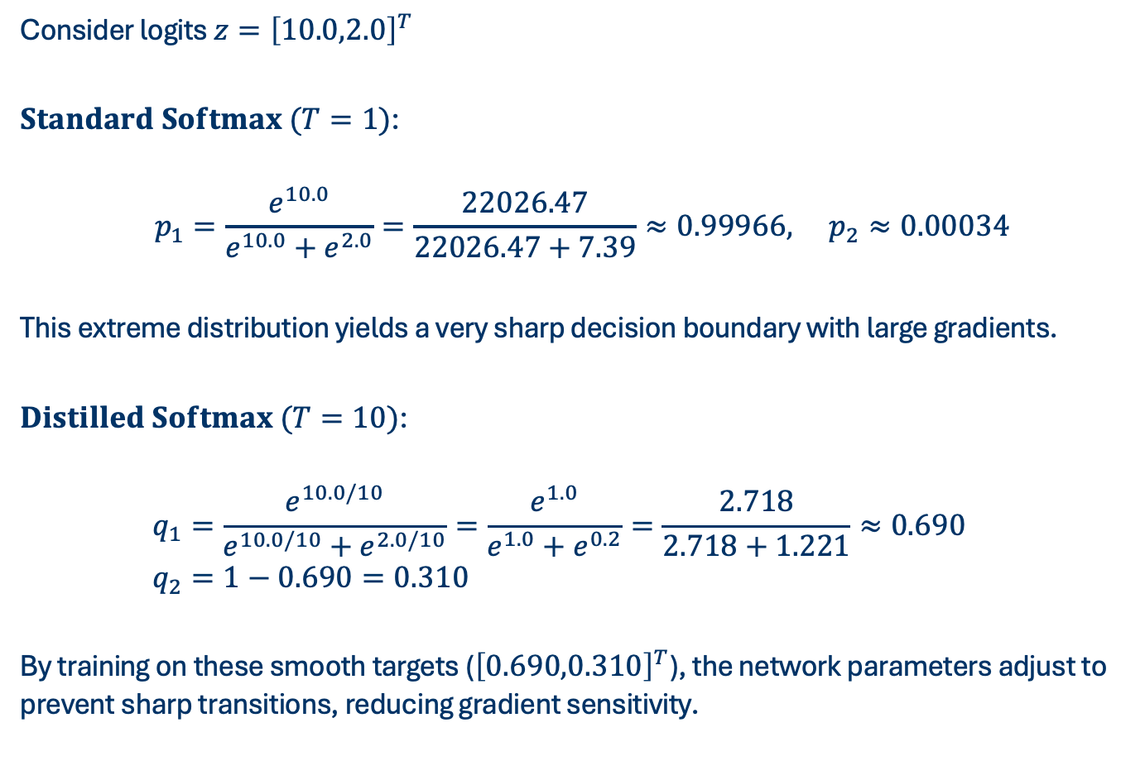
MODEL MODIFICATION
Consider logits $z={\left[10.0,2.0\right]}^{T}$
$Standard Softmax (T=1)$:
$$p_{1}=\frac{e^{10.0}}{e^{10.0}+e^{2.0}}=\frac{22026.47}{22026.47+7.39}≈0.99966, p_{2}≈0.00034$$
This extreme distribution yields a very sharp decision boundary with large gradients.
$Distilled Softmax (T=10)$:
$$\begin{aligned}q_{1}&=\frac{e^{10.0/10}}{e^{10.0/10}+e^{2.0/10}}=\frac{e^{1.0}}{e^{1.0}+e^{0.2}}=\frac{2.718}{2.718+1.221}≈0.690 \\ q_{2}&=1−0.690=0.310\end{aligned}$$
By training on these smooth targets (${\left[0.690,0.310\right]}^{T}$), the network parameters adjust to prevent sharp transitions, reducing gradient sensitivity.

Slide 26
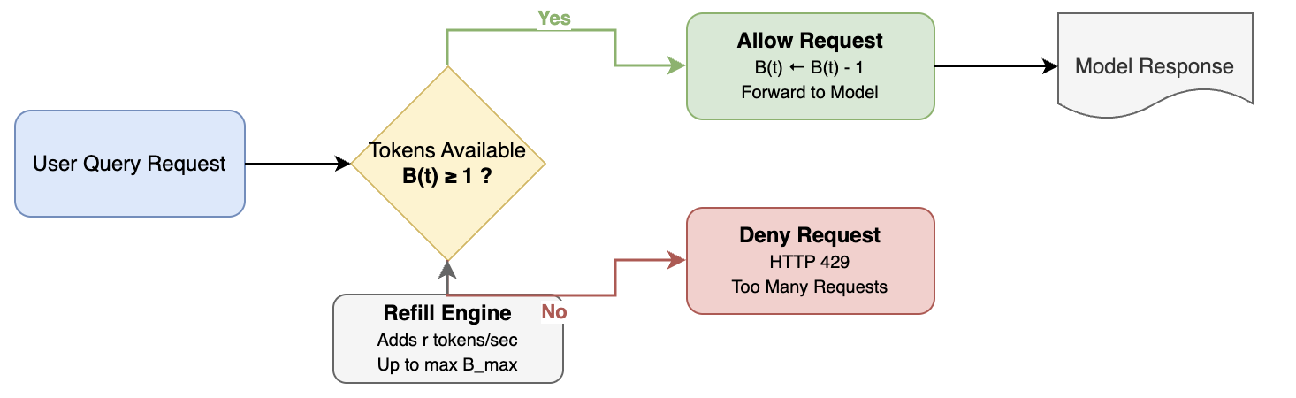
ACCESS CONTROL
Access control restricts the number of queries a user can send to the API. Since substitute model training requires a large query budget (often tens of thousands of queries), enforcing a strict query budget or rate limit makes complete extraction logistically or financially impractical. This is commonly implemented using algorithms like the Token Bucket.

Slide 27
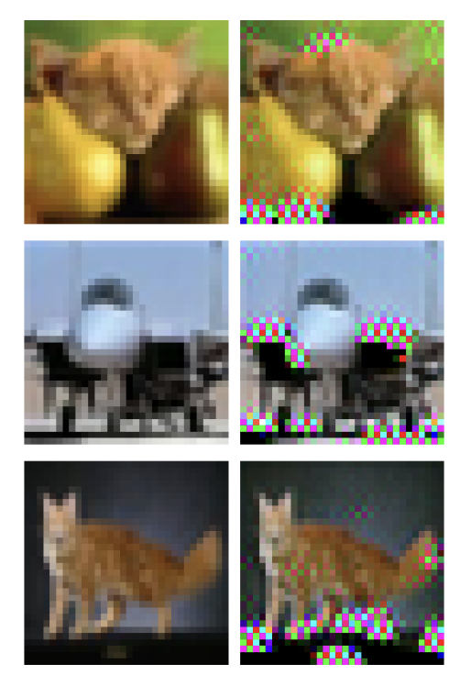
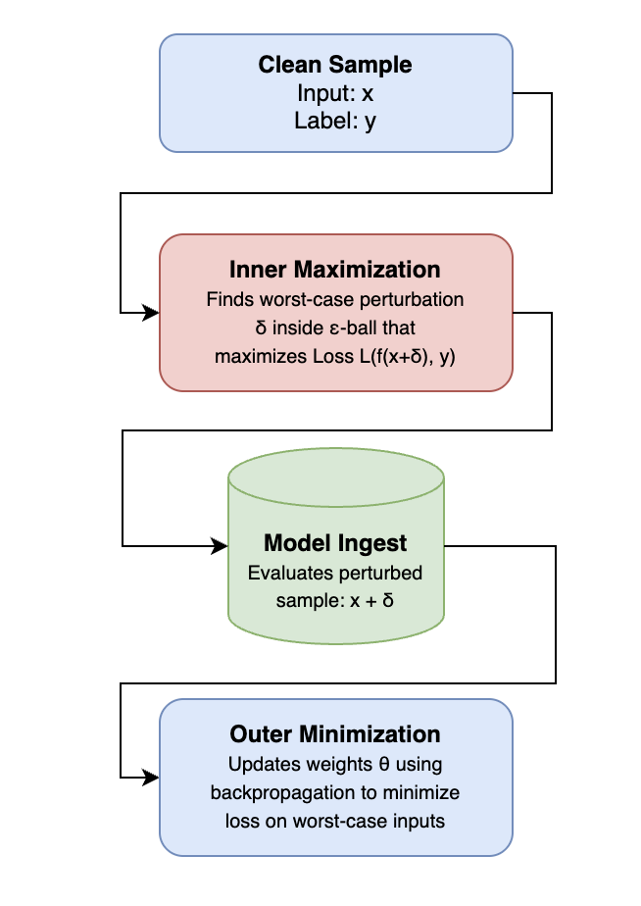
ADVERSARIAL TRAINING
Adversarial training is a technique where a model is trained on adversarial examples to make it robust against small perturbations. This robustness smooths out the decision boundary, making the model less sensitive to boundary queries. Consequently, substitute models trained on queries near the boundary struggle to capture the true decision boundary of the victim model.
Notes:
1. Synthesize: The generator takes a random noise vector z and outputs a synthetic image
x = G(z).
2. Disagreement Maximization: To find where the clone model deviates from the victim
model, the generator is trained to produce samples where the victim model fV and the clone model ˜f disagree the most.
3. Clone Minimization: The clone model ˜f is then trained on these synthetic samples
to minimize the disagreement, shifting its predictions toward the victim’s predictions.

Slide 28
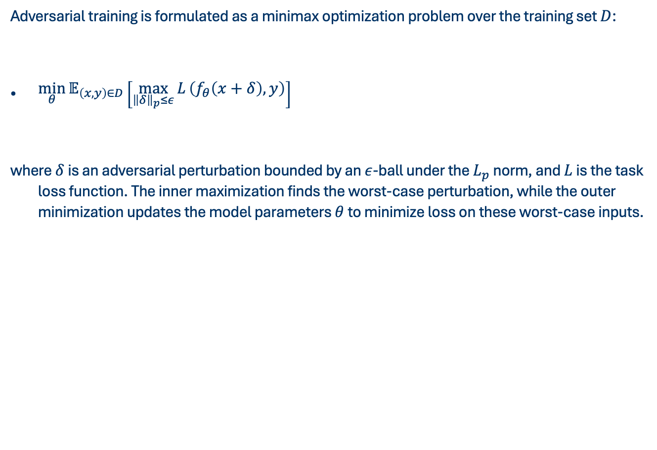
ADVERSARIAL TRAINING
Adversarial training is formulated as a minimax optimization problem over the training set $D$:
$\begin{aligned}\min_{θ}{𝔼_{\left(x,y\right)∈D}}\left[\max_{{\left\|δ\right\|}_{p}≤ε}{L}\left(f_{θ}\left(x+δ\right), y\right)\right]\end{aligned}$
where $δ$ is an adversarial perturbation bounded by an $ε$-ball under the $L_{p}$ norm, and $L$ is the task loss function. The inner maximization finds the worst-case perturbation, while the outer minimization updates the model parameters $θ$ to minimize loss on these worst-case inputs.
Notes:
1. Synthesize: The generator takes a random noise vector z and outputs a synthetic image
x = G(z).
2. Disagreement Maximization: To find where the clone model deviates from the victim
model, the generator is trained to produce samples where the victim model fV and the clone model ˜f disagree the most.
3. Clone Minimization: The clone model ˜f is then trained on these synthetic samples
to minimize the disagreement, shifting its predictions toward the victim’s predictions.

Slide 29
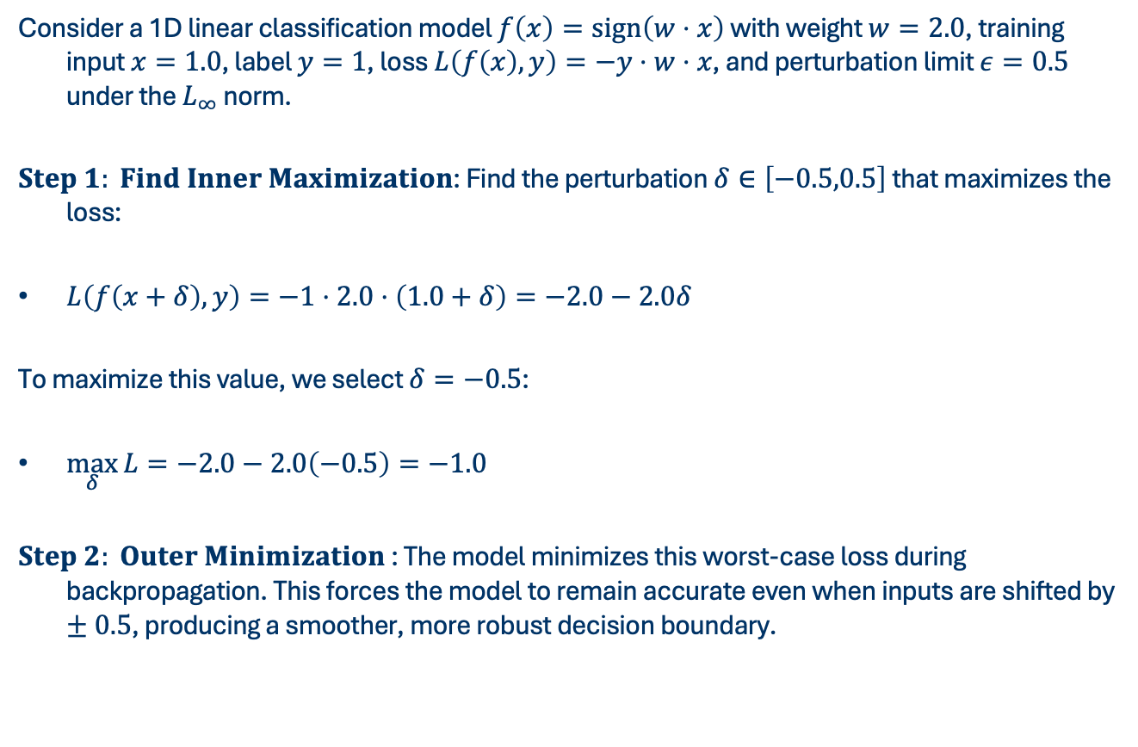
ADVERSARIAL TRAINING
Consider a 1D linear classification model $f\left(x\right)=\text{sign}\left(w⋅x\right)$ with weight $w=2.0$, training input $x=1.0$, label $y=1$, loss $L\left(f\left(x\right),y\right)=−y⋅w⋅x$, and perturbation limit $ε=0.5$ under the $L_{∞}$ norm.
$Step 1: Find Inner Maximization$: Find the perturbation $δ∈\left[−0.5,0.5\right]$ that maximizes the loss:
$L\left(f\left(x+δ\right),y\right)=−1⋅2.0⋅\left(1.0+δ\right)=−2.0−2.0δ$
To maximize this value, we select $δ=−0.5$:
$\max_{δ}{L}=−2.0−2.0\left(−0.5\right)=−1.0$
$Step 2: Outer Minimization$ : The model minimizes this worst-case loss during backpropagation. This forces the model to remain accurate even when inputs are shifted by $±0.5$, producing a smoother, more robust decision boundary.
Notes:
1. Synthesize: The generator takes a random noise vector z and outputs a synthetic image
x = G(z).
2. Disagreement Maximization: To find where the clone model deviates from the victim
model, the generator is trained to produce samples where the victim model fV and the clone model ˜f disagree the most.
3. Clone Minimization: The clone model ˜f is then trained on these synthetic samples
to minimize the disagreement, shifting its predictions toward the victim’s predictions.

Slide 30
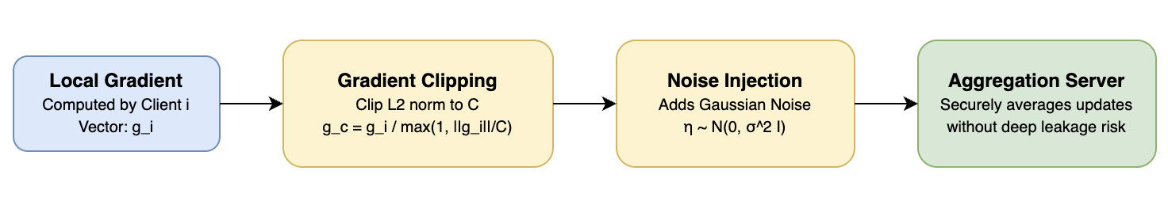
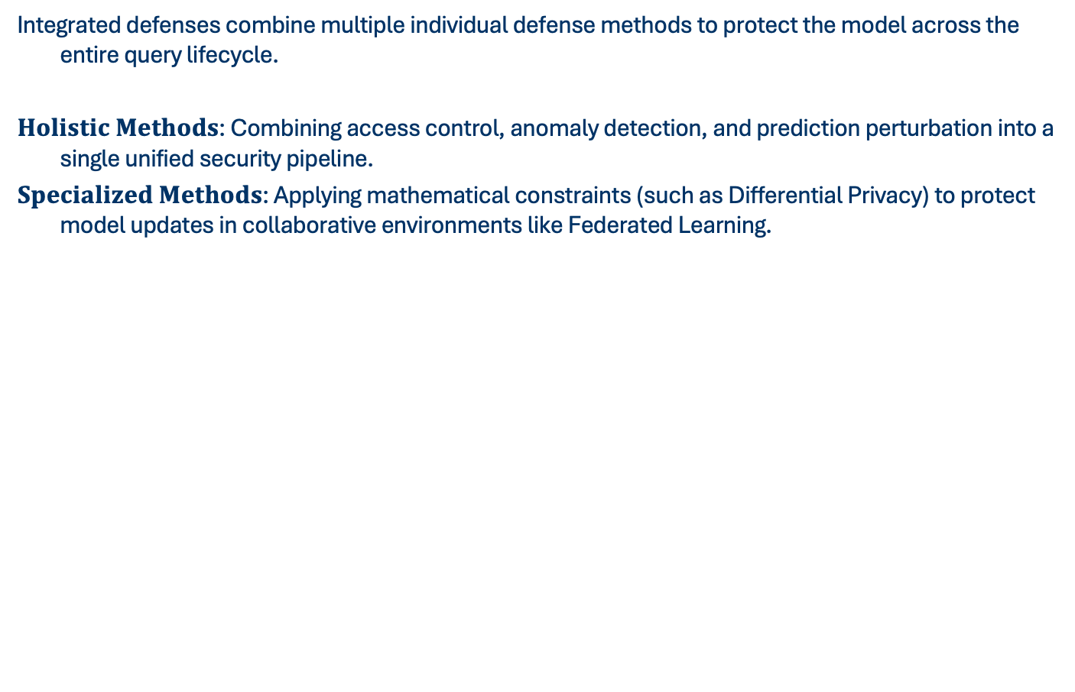
INTEGRATED DEFENSE
Integrated defenses combine multiple individual defense methods to protect the model across the entire query lifecycle.
$Holistic Methods$: Combining access control, anomaly detection, and prediction perturbation into a single unified security pipeline.
$Specialized Methods$: Applying mathematical constraints (such as Differential Privacy) to protect model updates in collaborative environments like Federated Learning.

Slide 31
DEFENSE FOR OTHER MODALITIES
Defenses must adapt to the structure of the data modality being protected.
$Text Models$
□(𝐓𝐞𝐱𝐭 𝐌𝐨𝐝𝐞𝐥𝐬)
Protecting sequential language tokens by watermarking generated text or formatting API outputs.
$Vision Models$
□(𝐕𝐢𝐬𝐢𝐨𝐧 𝐌𝐨𝐝𝐞𝐥𝐬)
Protecting image grids by limiting predictions to the most likely classes.
$Graph Models$
□(𝐆𝐫𝐚𝐩𝐡 𝐌𝐨𝐝𝐞𝐥𝐬)
Protecting topological structures by perturbing connections.

Slide 32
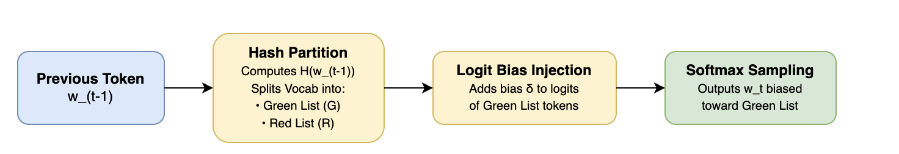
DEFENDING TEXT MODELS
To defend Large Language Models (LLMs) from extraction, vocabulary watermarking partitions the vocabulary into a "green list'' and a ''red list'' at each generation step.
Notes:
The partition is determined by a hash of the previously generated token. By adding a small bias to the logits of the green list tokens, the model is biased toward generating green list words. Legitimate users do not notice the bias, but if an attacker clones the model, the generated text of the clone will contain an abnormally high proportion of green list tokens, proving extraction.

Slide 33
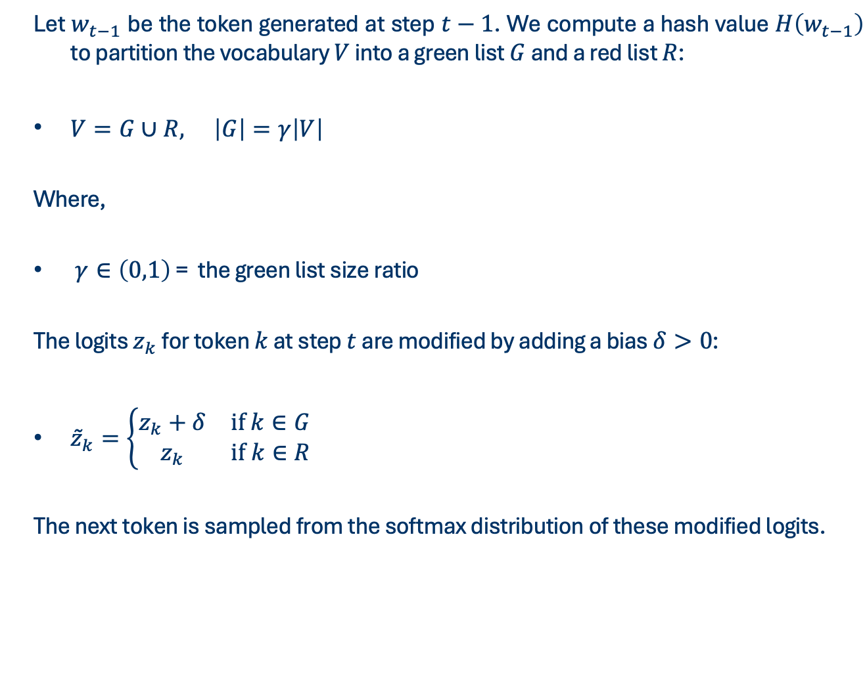
DEFENDING TEXT MODELS
Let $w_{t−1}$ be the token generated at step $t−1$. We compute a hash value $H\left(w_{t−1}\right)$ to partition the vocabulary $V$ into a green list $G$ and a red list $R$:
$\begin{aligned}V=G∪R, \left|G\right|=γ\left|V\right|\end{aligned}$
Where,
$γ∈\left(0,1\right)$ = the green list size ratio
The logits $z_{k}$ for token $k$ at step $t$ are modified by adding a bias $δ>0$:
$\begin{aligned}{\overset{˜}{z}}_{k}=\left\{\begin{matrix}z_{k}+δ & \text{if} k∈G \\ z_{k} & \text{if} k∈R\end{matrix}\right.\end{aligned}$
The next token is sampled from the softmax distribution of these modified logits.
Notes:
Side-Channel attacks do not focus on the inputs or outputs (the queries) of a machine learning model. Instead, they monitor the physical or system byproducts of the model's execution on a computer processor.
The core intuition is best understood through an analogy:
Imagine a safe. You do not know the combination code (the model parameters). Instead of guessing numbers, you place a stethoscope against the safe door and listen to the clicking sounds of the gears inside as you turn the dial. The clicking sounds are a byproduct (a side-channel) that leaks information about the combination.
This category is divided into two types:
Software Side-Channels: These monitor software-level execution cues (such as API execution time, cache memory hits or misses, or network latency).
Hardware Side-Channels: These monitor physical hardware byproducts from the physical processor chip (such as electric power consumption, electromagnetic radiation, heat, or acoustic noise).

Slide 34
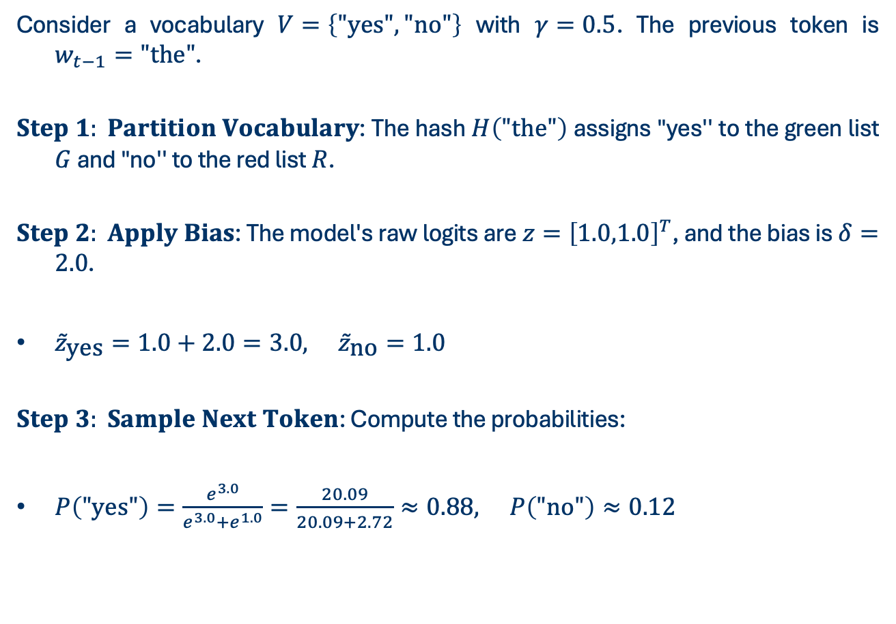
DEFENDING TEXT MODELS
Consider a vocabulary $V=\left\{\text{"}\text{yes}\text{"},\text{"}\text{no}\text{"}\right\}$ with $γ=0.5$. The previous token is $w_{t−1}=\text{"}\text{the}\text{"}$.
$Step 1: Partition Vocabulary$: The hash $H\left(\text{"}\text{the}\text{"}\right)$ assigns "yes'' to the green list $G$ and "no'' to the red list $R$.
$Step 2: Apply Bias$: The model's raw logits are $z={\left[1.0,1.0\right]}^{T}$, and the bias is $δ=2.0$.
${\overset{˜}{z}}_{\text{yes}}=1.0+2.0=3.0, {\overset{˜}{z}}_{\text{no}}=1.0$
$Step 3: Sample Next Token$: Compute the probabilities:
$P\left(\text{"}\text{yes}\text{"}\right)=\frac{e^{3.0}}{e^{3.0}+e^{1.0}}=\frac{20.09}{20.09+2.72}≈0.88, P\left(\text{"}\text{no}\text{"}\right)≈0.12$
Notes:
The model is biased to select the green list token "yes''.

Slide 35
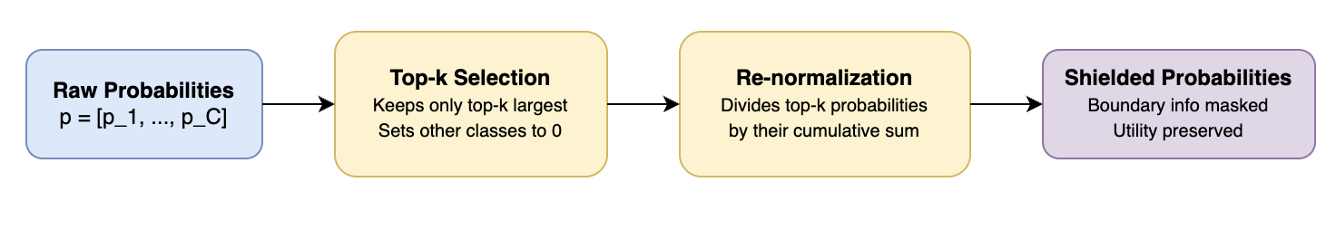
DEFENDING VISION MODELS
Vision classifiers often output confidence scores across hundreds of classes. An attacker uses these full distributions to align their substitute model.
Notes:
Top-$k$ shielding prevents this by returning only the top-$k$ highest probabilities, setting all other class probabilities to zero, and re-normalizing the remaining distribution. This removes the low-probability values (which carry significant information about decision boundaries) while keeping the classification utility intact.

Slide 36
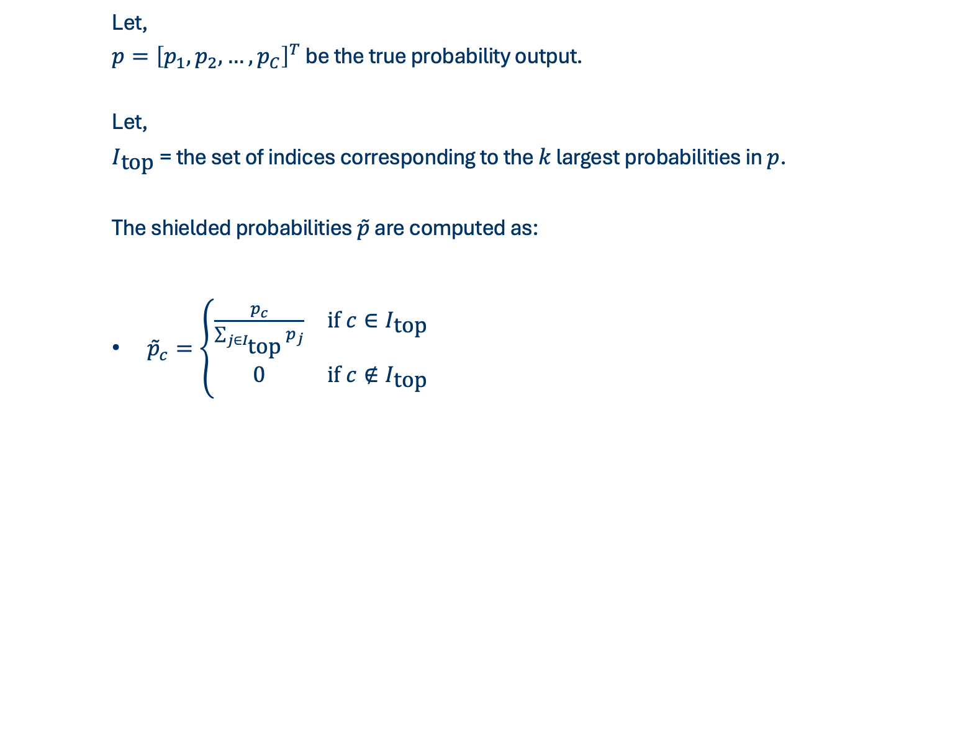
DEFENDING VISION MODELS
Let,
$p={\left[p_{1},p_{2},…,p_{C}\right]}^{T}$ be the true probability output.
Let,
$I_{\text{top}}$ = the set of indices corresponding to the $k$ largest probabilities in $p$.
The shielded probabilities $\overset{˜}{p}$ are computed as:
$\begin{aligned}{\overset{˜}{p}}_{c}=\left\{\begin{matrix}\frac{p_{c}}{\sum_{j∈I_{\text{top}}}{p_{j}}} & \text{if} c∈I_{\text{top}} \\ 0 & \text{if} c∉I_{\text{top}}\end{matrix}\right.\end{aligned}$
Notes:
Side-Channel attacks do not focus on the inputs or outputs (the queries) of a machine learning model. Instead, they monitor the physical or system byproducts of the model's execution on a computer processor.
The core intuition is best understood through an analogy:
Imagine a safe. You do not know the combination code (the model parameters). Instead of guessing numbers, you place a stethoscope against the safe door and listen to the clicking sounds of the gears inside as you turn the dial. The clicking sounds are a byproduct (a side-channel) that leaks information about the combination.
This category is divided into two types:
Software Side-Channels: These monitor software-level execution cues (such as API execution time, cache memory hits or misses, or network latency).
Hardware Side-Channels: These monitor physical hardware byproducts from the physical processor chip (such as electric power consumption, electromagnetic radiation, heat, or acoustic noise).

Slide 37
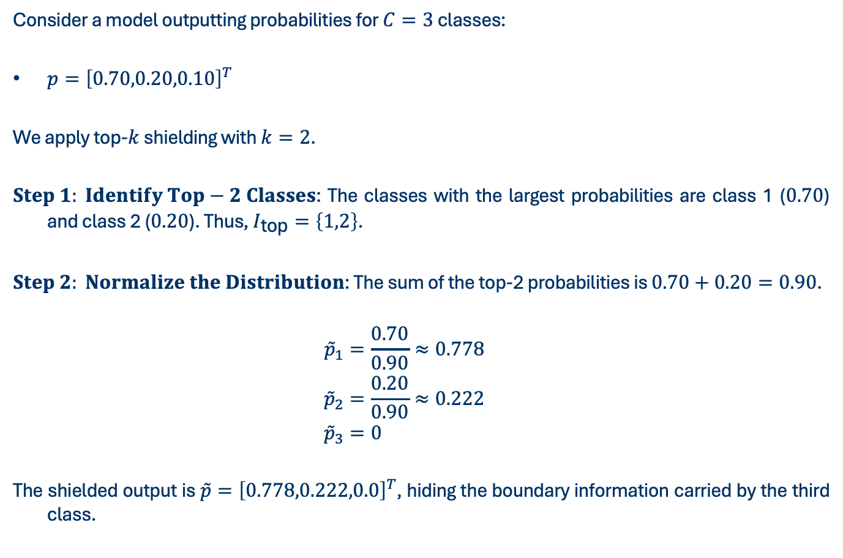
DEFENDING VISION MODELS
Consider a model outputting probabilities for $C=3$ classes:
$p={\left[0.70,0.20,0.10\right]}^{T}$
We apply top-$k$ shielding with $k=2$.
$Step 1: Identify Top−2 Classes$: The classes with the largest probabilities are class 1 ($0.70$) and class 2 ($0.20$). Thus, $I_{\text{top}}=\left\{1,2\right\}$.
$Step 2: Normalize the Distribution$: The sum of the top-2 probabilities is $0.70+0.20=0.90$.
$$\begin{aligned}{\overset{˜}{p}}_{1}&=\frac{0.70}{0.90}≈0.778 \\ {\overset{˜}{p}}_{2}&=\frac{0.20}{0.90}≈0.222 \\ {\overset{˜}{p}}_{3}&=0\end{aligned}$$
The shielded output is $\overset{˜}{p}={\left[0.778,0.222,0.0\right]}^{T}$, hiding the boundary information carried by the third class.
Notes:
Side-Channel attacks do not focus on the inputs or outputs (the queries) of a machine learning model. Instead, they monitor the physical or system byproducts of the model's execution on a computer processor.
The core intuition is best understood through an analogy:
Imagine a safe. You do not know the combination code (the model parameters). Instead of guessing numbers, you place a stethoscope against the safe door and listen to the clicking sounds of the gears inside as you turn the dial. The clicking sounds are a byproduct (a side-channel) that leaks information about the combination.
This category is divided into two types:
Software Side-Channels: These monitor software-level execution cues (such as API execution time, cache memory hits or misses, or network latency).
Hardware Side-Channels: These monitor physical hardware byproducts from the physical processor chip (such as electric power consumption, electromagnetic radiation, heat, or acoustic noise).

Slide 38
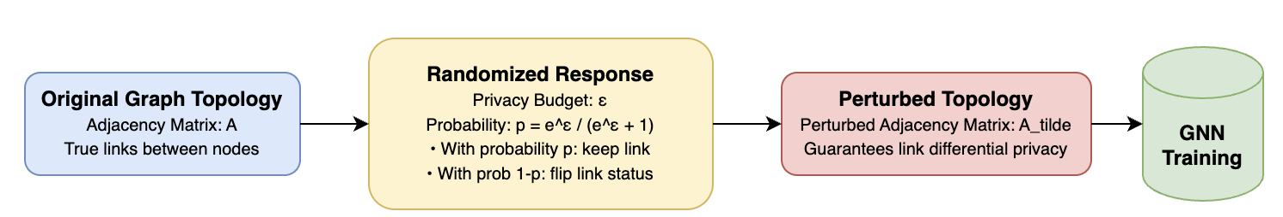
DEFENDING GRAPH MODELS
Graph Neural Networks (GNNs) use the connections (adjacency matrix) between nodes to make predictions. Attackers query GNNs to reconstruct these private connections. To prevent this, the defender perturbs the graph topology before training by randomly adding or removing edges using a randomized response algorithm. This provides differential privacy guarantees for the graph structure, making it difficult for an attacker to reconstruct private connections from query outputs.
Notes:
Side-Channel attacks do not focus on the inputs or outputs (the queries) of a machine learning model. Instead, they monitor the physical or system byproducts of the model's execution on a computer processor.
The core intuition is best understood through an analogy:
Imagine a safe. You do not know the combination code (the model parameters). Instead of guessing numbers, you place a stethoscope against the safe door and listen to the clicking sounds of the gears inside as you turn the dial. The clicking sounds are a byproduct (a side-channel) that leaks information about the combination.
This category is divided into two types:
Software Side-Channels: These monitor software-level execution cues (such as API execution time, cache memory hits or misses, or network latency).
Hardware Side-Channels: These monitor physical hardware byproducts from the physical processor chip (such as electric power consumption, electromagnetic radiation, heat, or acoustic noise).

Slide 39
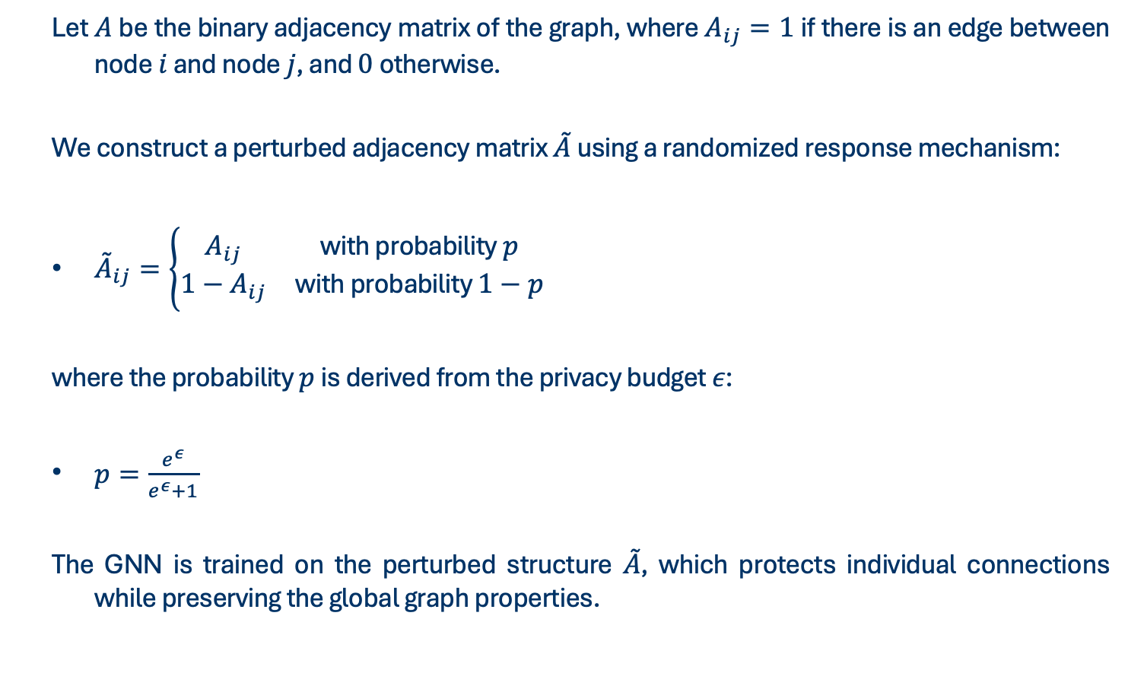
DEFENDING GRAPH MODELS
Let $A$ be the binary adjacency matrix of the graph, where $A_{ij}=1$ if there is an edge between node $i$ and node $j$, and $0$ otherwise.
We construct a perturbed adjacency matrix $\overset{˜}{A}$ using a randomized response mechanism:
$\begin{aligned}{\overset{˜}{A}}_{ij}=\left\{\begin{matrix}A_{ij} & \text{with} \text{probability} p \\ 1−A_{ij} & \text{with} \text{probability} 1−p\end{matrix}\right.\end{aligned}$
where the probability $p$ is derived from the privacy budget $ε$:
$\begin{aligned}p=\frac{e^{ε}}{e^{ε}+1}\end{aligned}$
The GNN is trained on the perturbed structure $\overset{˜}{A}$, which protects individual connections while preserving the global graph properties.
Notes:
Side-Channel attacks do not focus on the inputs or outputs (the queries) of a machine learning model. Instead, they monitor the physical or system byproducts of the model's execution on a computer processor.
The core intuition is best understood through an analogy:
Imagine a safe. You do not know the combination code (the model parameters). Instead of guessing numbers, you place a stethoscope against the safe door and listen to the clicking sounds of the gears inside as you turn the dial. The clicking sounds are a byproduct (a side-channel) that leaks information about the combination.
This category is divided into two types:
Software Side-Channels: These monitor software-level execution cues (such as API execution time, cache memory hits or misses, or network latency).
Hardware Side-Channels: These monitor physical hardware byproducts from the physical processor chip (such as electric power consumption, electromagnetic radiation, heat, or acoustic noise).

Slide 40
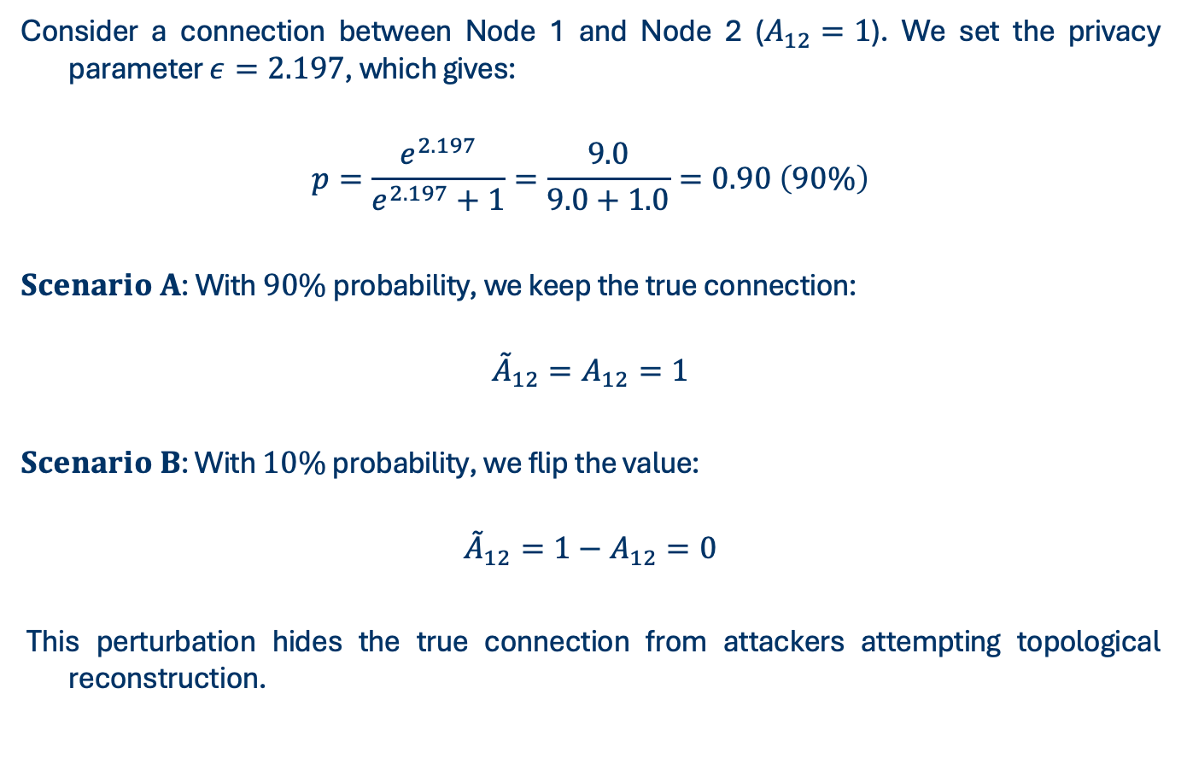
DEFENDING GRAPH MODELS
Consider a connection between Node 1 and Node 2 ($A_{12}=1$). We set the privacy parameter $ε=2.197$, which gives:
$$p=\frac{e^{2.197}}{e^{2.197}+1}=\frac{9.0}{9.0+1.0}=0.90 \left(90\%\right)$$
$Scenario A$: With $90\%$ probability, we keep the true connection:
$${\overset{˜}{A}}_{12}=A_{12}=1$$
$Scenario B$: With $10\%$ probability, we flip the value:
$${\overset{˜}{A}}_{12}=1−A_{12}=0$$
This perturbation hides the true connection from attackers attempting topological reconstruction.
Notes:
Side-Channel attacks do not focus on the inputs or outputs (the queries) of a machine learning model. Instead, they monitor the physical or system byproducts of the model's execution on a computer processor.
The core intuition is best understood through an analogy:
Imagine a safe. You do not know the combination code (the model parameters). Instead of guessing numbers, you place a stethoscope against the safe door and listen to the clicking sounds of the gears inside as you turn the dial. The clicking sounds are a byproduct (a side-channel) that leaks information about the combination.
This category is divided into two types:
Software Side-Channels: These monitor software-level execution cues (such as API execution time, cache memory hits or misses, or network latency).
Hardware Side-Channels: These monitor physical hardware byproducts from the physical processor chip (such as electric power consumption, electromagnetic radiation, heat, or acoustic noise).

Slide 41
OPEN CHALLENGES
The Security-Utility Tradeoff
Adaptive and Distributed Attackers
Watermark Scrubbing
Generalization of Fingerprints
Notes:
The Security-Utility Tradeoff: Techniques like logit perturbation or top-$k$ shielding degrade soft prediction probabilities to starve clone models, which can negatively affect benign users relying on high-precision confidence calibration or class thresholds.
Adaptive and Distributed Attackers: Attackers can evade detection schemes (like PRADA) by distributing queries across multiple sybil accounts, throttling request rates (slow extraction), or mixing malicious queries with random benign queries.
Watermark Scrubbing: Attackers can remove trigger/backdoor signatures via post-extraction refinement methods (e.g., pruning, fine-tuning on clean datasets, or low-bit quantization) without reducing the extracted model's downstream performance.
Generalization of Fingerprints: Fingerprinting relies on architecture-specific decision boundary signatures. If the attacker extracts the model using a completely different substitute architecture (e.g., extracting a ViT using a substitute CNN), these boundary characteristics might not transfer, weakening verification accuracy.

Slide 42
MAIN REFERENCES
• Florian Tramèr, Fan Zhang, Ari Juels, Michael K. Reiter, and Thomas Ristenpart.
  "Stealing Machine Learning Models via Prediction APIs", USENIX Security 2016.
• Daryna Oliynyk, Rudolf Mayer, and Andreas Rauber.
  "I Know What You Trained Last Summer: A Survey on Stealing Machine Learning Models and Defences", ACM Comput. Surv. 2023.
• Kaixiang Zhao, Lincan Li, Kaize Ding, Neil Zhenqiang Gong, Yue Zhao, and Yushun Dong.
  "A Systematic Survey of Model Extraction Attacks and Defenses: State-of-the-Art and Perspectives", arXiv 2025.
• Bang Wu, Xiangwen Yang, Shirui Pan, and Xingliang Yuan.
  "Model Extraction Attacks on Graph Neural Networks: Taxonomy and Realisation", ASIA CCS 2022.
• Tushar Nayan, Qiming Guo, Mohammed Al Duniawi, Marcus Botacin, Selcuk Uluagac, and Ruimin Sun.
  "SoK: All You Need to Know About On-Device ML Model Extraction", USENIX Security 2024.

