Slide 1
UNIVERSITY OF NEW BRUNSWICK
MODEL EXTRACTION ATTACKS
Presenter: Refat Ishrak Hemel
email: refat.ishrak.hemel@unb.ca
© 2025 Roozbeh Razavi-Far
Notes:
Please provide your detailed notes here, which will serve as your report.

Slide 2
Agenda
Introduction
The Attack Taxonomy
Traditional Model Extraction (LR, Decision Trees, MLPs)
Advanced Model Extraction (GNNs & LLMs)
Physical, System & Distributed Extraction (Edge ML & Gradient Leakage)
Computing Environments & Open Challenges

Slide 3
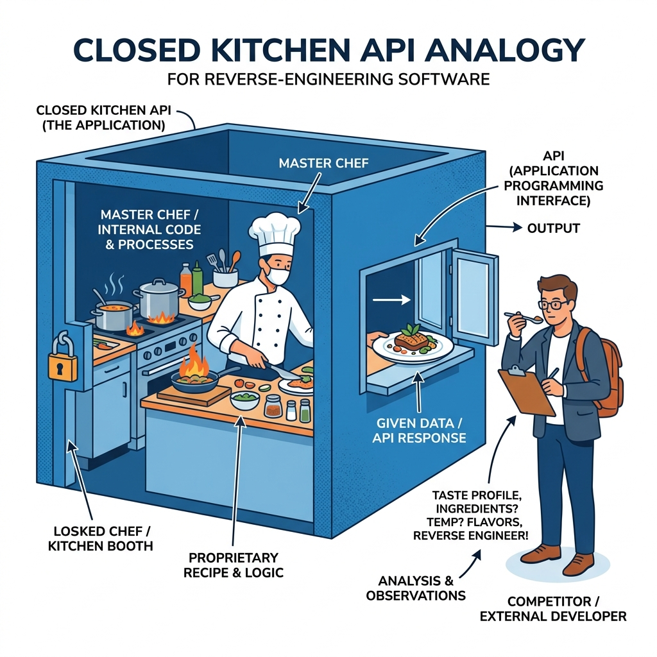
Introduction
The Secret Chef Analogy:
  A chef works inside a locked kitchen, selling dishes through a small window.
  A competitor orders dishes, tastes them, and reverse-engineers the recipe to open a copycat restaurant next door.
The MLaaS Dilemma:
  APIs offer black-box access to proprietary machine learning models.
  The outputs lease the internal model boundaries to anyone who queries them.

Slide 4
Terminology
Core Terminology:
  • Target Model (f[T]): The private victim model hosted on MLaaS or edge devices.
  • Surrogate Model (f[S]): The student copycat model trained by the attacker.
  • Oracle: The victim API query interface returning predictions/probabilities.
  • Query (x): An individual input data point sent to the target model.
  • Query Budget (B): The maximum number of API queries allowed.
Mathematical Symbols:
  • θ[T], θ[S]: Weight parameters of the target and surrogate models.
  • x ∈ Rd: Input sample feature vector of dimension d.
  • y ∈ [0, 1]c: Output probability vector for c classes.
  • L: Loss function minimized during surrogate training.
  • σ(t): Logistic sigmoid function: 1 / (1 + e-t).
  • ∇f(x): Gradient of the function f at input x.

Slide 5
Real-World Impacts & Why We Care
Intellectual Property (IP) Theft:
  Extraction bypasses huge R&D, data preparation, and GPU compute costs.
Enabling Downstream Attacks:
  Stolen models act as white-box surrogates to generate perfect adversarial examples (evading spam/malware filters).
Privacy Violations:
  Extracted models can be used for model inversion attacks to steal training data.
Real Cases:
  LLM Leeching: Distilling GPT-4 capability into student models (e.g., Alpaca/Vicuna).
  Voice Biometrics Fraud: Stealing synthesis boundaries to bypass bank security systems ($35M case).

Slide 6
Mathematical Foundations of Model Extraction
Formal Setup:
  Target private model: f[T](x) with parameters θ[T].
  Adversary's surrogate model: f[S](x) in hypothesis space H with parameters θ[S].
The Extraction Goal:
  Attacker queries f[T](x) to compile transfer dataset D = {(x[i], f[T](x[i]))}.
  Optimization: θ[S] = arg minθ Σ[i] L(f[S](x[i]; θ), f[T](x[i]))
Fidelity vs. Accuracy Extraction:
  Fidelity Extraction: Replicating exact boundary behavior (including target errors):
    max P[ arg max f[S](x) = arg max f[T](x) ]
  Accuracy Extraction: Training surrogate to perform well on ground-truth:
    max P[ arg max f[S](x) = y[true] ]

Slide 7
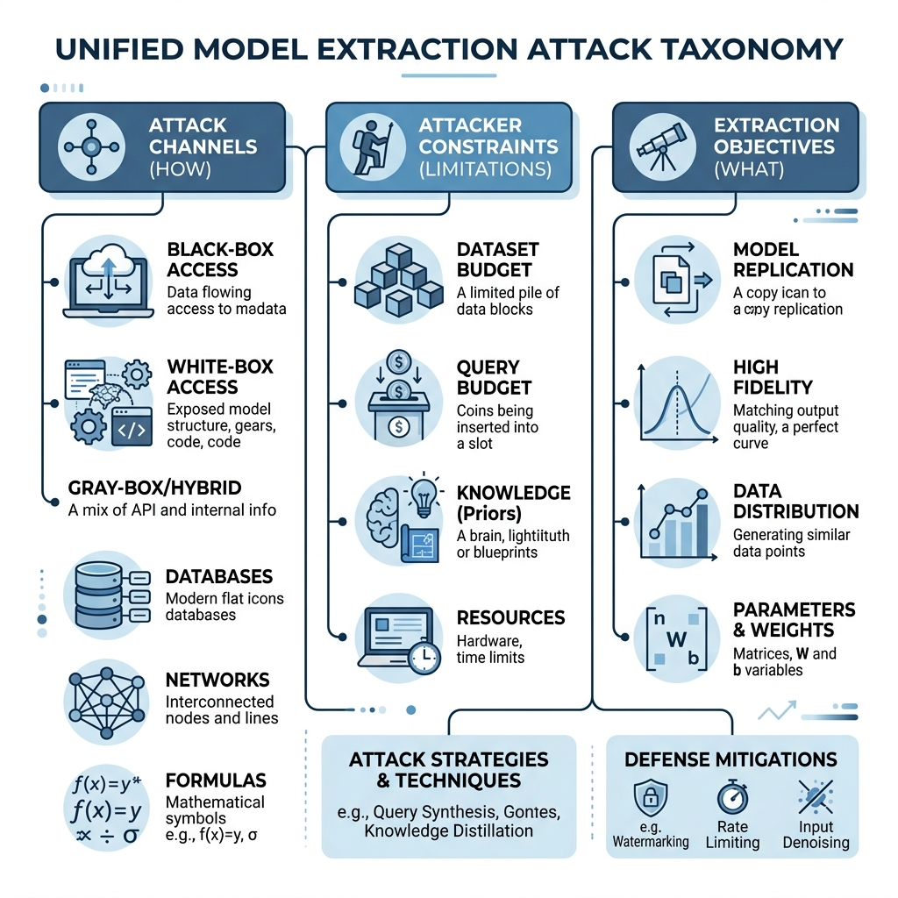
The Unified Attack Taxonomy Space
Dimension 1: Attack Channels
  • Black-box query interfaces, distributed training parameters, and hardware/system side-channels.
Dimension 2: Attacker Constraints
  • Background knowledge limitations: problem domain vs. data-free query synthesis, GNN structural access levels.
Dimension 3: Extraction Objectives
  • Exact property leakage (weights, layer dimensions) vs. approximate behavior replication (fidelity).

Slide 8
Attack Channel Dimension: Black-Box API Queries
Black-Box Query Interface:
  • The target model parameters and architecture are completely hidden.
  • Information is gathered solely by analyzing output reactions to queries.
Query-Based Extraction Techniques:
  • Equation-Solving: Analytically finding parameters from precision confidence probabilities.
  • Witness-Finding: Locating decision boundaries using iterative feature line search.
  • Path-Finding: Identifying partition boundaries of tree nodes via continuous binary search.
  • Substitute Retraining: Querying target to label a surrogate transfer dataset.
  • Explanation-Guided: Exploiting local gradients or attribution outputs (SHAP/LIME).

Slide 9
Deep Dive: Stealing Linear & Logistic Regression
Binary Logistic Regression:
  • Probability output: f[1](x) = σ(wT x + b) where σ(t) = 1 / (1 + e-t)
  • Logit transformation linearizes the equation:
    σ-1(f[1](x)) = ln( f[1](x) / (1 - f[1](x)) ) = wT x + b
Exact Parameter Extraction (Equation-Solving):
  • For d features, there are d+1 unknown parameters (w ∈ Rd, b ∈ R).
  • Querying d+1 linearly independent inputs (x[1] ... x[d+1]) creates a linear system:
    [ x[1]T 1 ] [ w ] = [ σ-1(y[1]) ]
    [ x[2]T 1 ] [ b ] = [ σ-1(y[2]) ]
  • Solving this system of equations extracts exact weights in d+1 queries with zero error!

Slide 10
Stealing Multiclass Regression & Decision Trees
Multiclass Softmax Regression:
  • Logit values for class i relative to reference class 0 is linear:
    ln( f[i](x) / f[0](x) ) = (w[i] - w[0])T x + (b[i] - b[0])
  • Querying (d+1) inputs extracts all relative parameters using (c-1)(d+1) unknowns.
Decision Tree Path-Finding (Algorithm 1):
  • Decision trees split space into axis-aligned boxes; standard equation-solving fails.
  • Path-Finding Extraction Steps:
    1. Submit query x, obtain target classification leaf O(x).
    2. Perform binary search (line search) on a single continuous feature to isolate the threshold.
    3. Queue a query slightly past the threshold to discover the adjacent leaf node.
    4. Repeat until all splits are localized, reconstructing the exact tree splits.

Slide 11
Stealing Neural Networks / MLPs
Multi-Layer Perceptrons (MLPs):
  • 2-layer neural network output:
    f(x) = softmax( W(2) g(W(1) x + b(1)) + b(2) )
  • Non-linear activation functions (g, e.g., Sigmoid, ReLU) prevent analytical solutions.
Optimization-Based Extraction:
  • Attacker queries N inputs to record target probability vector outputs y[j].
  • Solves for surrogate parameters θ by formulating a loss minimization problem:
    minθ Σ[j] CrossEntropy( f[S](x[j]; θ), y[j] )
  • Optimizing this non-convex loss function using L-BFGS.
  • Reconstructs hidden layers with near-perfect fidelity using only 5,000–10,000 queries.

Slide 12
Attacker Constraints: Data-Driven Inputs
Background Data Domains:
  • Problem Domain (PD): Attacker has natural samples from the target distribution.
  • Non-Problem Domain (NPD): Attacker queries using unrelated natural data.
  • Data-Free: Zero access to natural data; query points must be synthesized.
Data-Free Query Synthesis Methods:
  • Generative Adversarial Networks (GANs): Training generators to find high-discrepancy boundary query points.
  • Jacobian-Based Data Augmentation: Perturbing initial seed inputs iteratively along the direction of the target Jacobian matrix:
    x ← x + λ · sgn( J[f](x) )
  • Random Noise: Sending random pixel matrices to query labels and optimize active search.

Slide 13
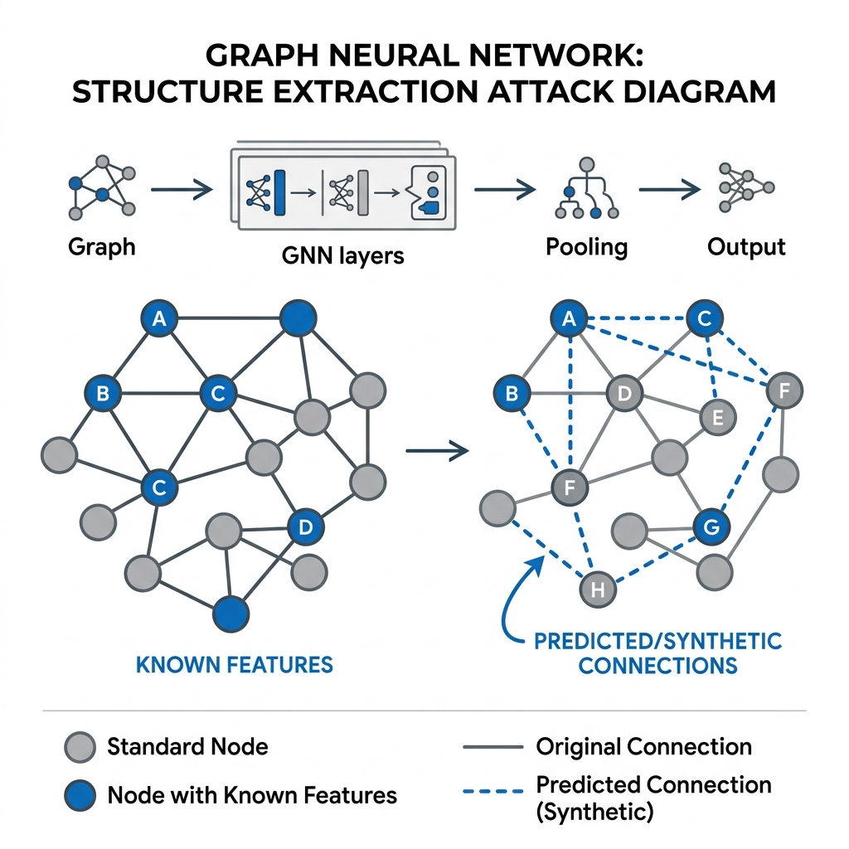
Graph Neural Network (GNN) Extraction
The Non-Euclidean Challenge:
  • GNN predictions rely on both node features X and graph structure A:
    f(A, X) = softmax( Â · ReLU( Â · X · W(0) ) · W(1) )
GNN Attacker Knowledge Taxonomy (Bang Wu et al.):
  • Node Attributes: Known attributes vs. degree-averaged feature synthesis for uncompromised nodes:
    x'vi = α · mean( {xvj} ∈ 1-hop ) + (1-α) · mean( {xvj} ∈ 2-hop )
  • Graph Topology: Known adjacency subgraphs vs. synthetic structure learning (LDS optimization).
  • Domain access: Similar auxiliary shadow graph dataset availability.

Slide 14
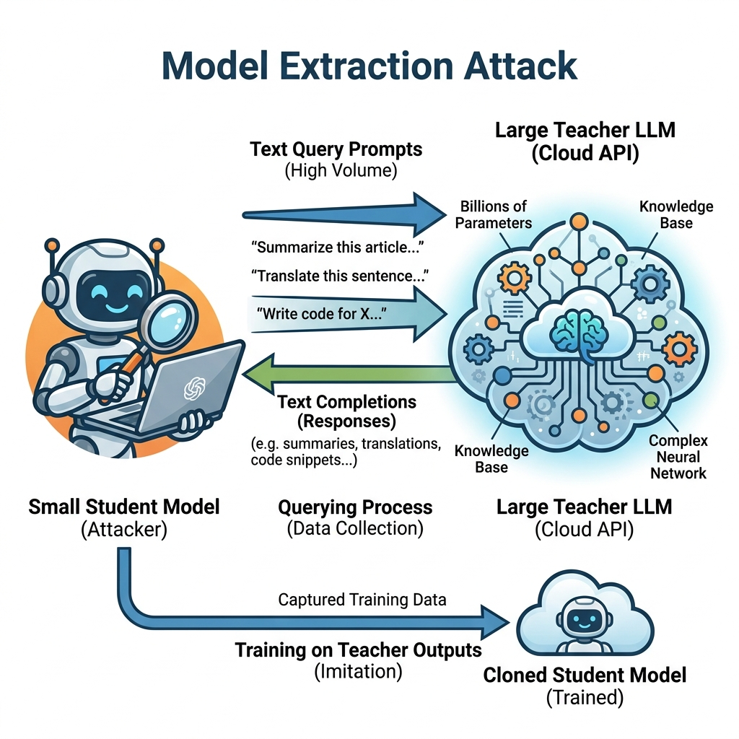
Large Language Model (LLM) Extraction
LLM Functionality Extraction:
  • API Distillation: Querying teacher model (GPT-4) to label prompt datasets, training student clones (Alpaca).
Training Data Memorization Leakage:
  • Prefix prompting extracts sensitive records (PII, API keys):
    E(M) = { d ∈ D[train] : prompt p yields sim(M(p), d) > τ }
Prompt & Parameter Stealing:
  • Custom instructions leaked via jailbreaks.
  • Stealing projection head weights by solving equations in vocabulary logprob spaces.

Slide 15
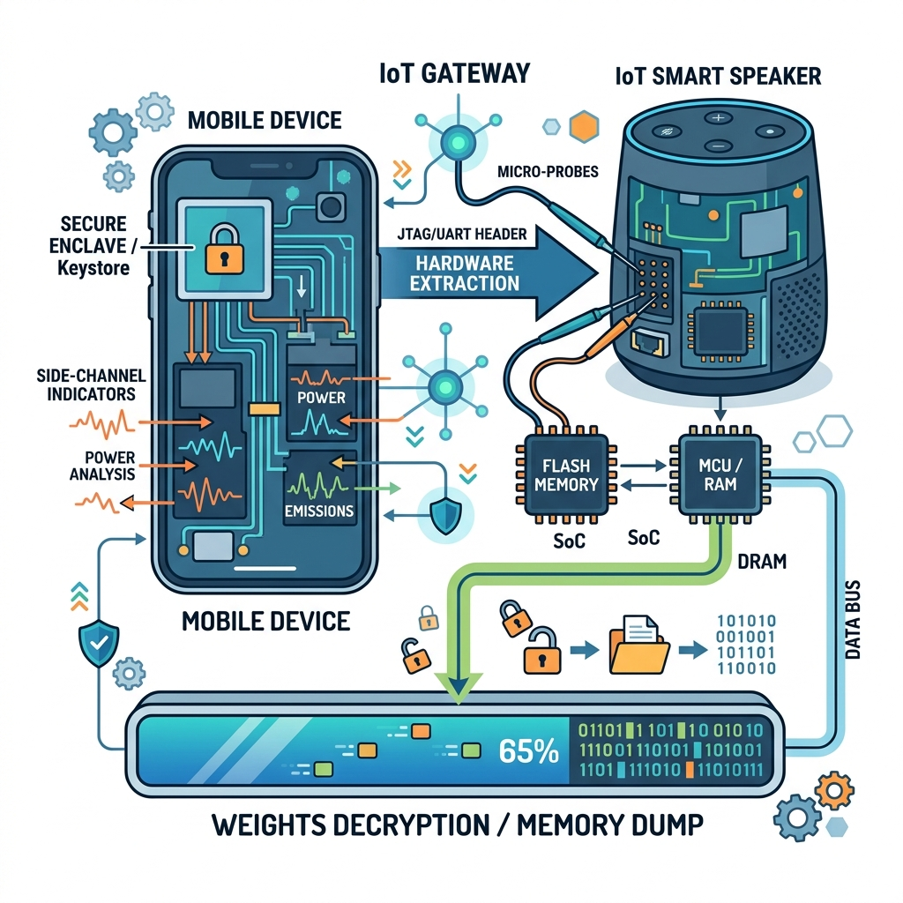
Attack Channels: Side-Channels & Edge ML Extraction
Edge ML Deployments (Tushar Nayan et al.):
  • TFLite/ONNX models deployed locally on mobile or IoT devices.
  • Attacker has physical access to hardware executing inferences.
Physical Extraction Channels:
  • App-Based: Decompiling serialized model files inside application packages.
  • Device-Based: Scanning runtime RAM memory to extract plaintext model parameters.
  • Side-Channels: Cache timing (Flush+Reload), electromagnetic (EM) emissions, power signatures, or Rowhammer.

Slide 16
Distributed Paradigms & Collaborative Gradient Leakage
Gradient Leakage in Federated Learning:
  • In Federated Learning, clients collaboratively train a shared global model by exchanging gradient updates instead of raw data.
  • Malicious clients can analyze gradient updates over training epochs to isolate and reconstruct private user parameters.
Gradient Estimation (Zeroth-Order Optimization):
  • Black-box adversaries can estimate gradients using finite differences:
    ∇f(x) ≈ [ f(x + εu) - f(x - εu) ] / (2ε) · u
  • This enables gradient-based optimization for proxy substitute model training without direct parameter access.

Slide 17
Computing Environments: Cloud vs. Edge vs. Federated
Centralized Cloud MLaaS:
  • API-based black-box access. The attacker is constrained by query cost budgets and query rate limiters.
Edge & On-Device ML:
  • local storage access. The attacker bypasses API controls entirely, relying on static reverse-engineering, RAM dumps, and physical hardware side-channels.
Collaborative & Federated Networks:
  • Distributed training environment. The attacker exploits local training differences and shared model aggregation parameter updates.

Slide 18
Open Challenges
The Security-Utility Tradeoff:
  • Restricting output precision (rounding logits, adding differential noise) degrades accuracy for legitimate users.
Adaptive Adversaries:
  • Attackers learn to blend query features into natural distributions, making query monitoring systems (e.g. PRADA) ineffective.
Collaborative Extraction Integrity:
  • Securing global parameters from client-side gradient hijacking during training.
Legal & IP Policy:
  • Defining copyright infringement boundaries. Is a distilled or copied model legally plagiarism under the DMCA?

Slide 19
Summary & Key Takeaways
• Model Extraction is a systemic threat to private intellectual property and data privacy.
• Unified Attack Taxonomy organizes extraction along Channels (API, Gradients, Side-channels), Constraints, and Objectives.
• Simpler models (LR, Softmax, DT) are analytically solvable in O(d) queries.
• Neural Networks (MLPs, GNNs) are extractable via non-linear optimization and structure reconstruction.
• LLMs face generative vulnerabilities such as API functionality distillation and training data memorization leaks.
• Edge deployments shift the extraction threat vector from query budgets to physical side-channels.

Slide 20
Main References
• Florian Tramèr, Fan Zhang, Ari Juels, Michael K. Reiter, and Thomas Ristenpart.
  "Stealing Machine Learning Models via Prediction APIs", USENIX Security 2016.
• Daryna Oliynyk, Rudolf Mayer, and Andreas Rauber.
  "I Know What You Trained Last Summer: A Survey on Stealing Machine Learning Models and Defences", ACM Comput. Surv. 2023.
• Kaixiang Zhao, Lincan Li, Kaize Ding, Neil Zhenqiang Gong, Yue Zhao, and Yushun Dong.
  "A Systematic Survey of Model Extraction Attacks and Defenses: State-of-the-Art and Perspectives", arXiv 2025.
• Bang Wu, Xiangwen Yang, Shirui Pan, and Xingliang Yuan.
  "Model Extraction Attacks on Graph Neural Networks: Taxonomy and Realisation", ASIA CCS 2022.
• Tushar Nayan, Qiming Guo, Mohammed Al Duniawi, Marcus Botacin, Selcuk Uluagac, and Ruimin Sun.
  "SoK: All You Need to Know About On-Device ML Model Extraction", USENIX Security 2024.

