Slide 1
An Agentic Dual-Loop Self-Healing Architecture for Cloud-Native RAG
Refat Ishrak Hemel, Fahim Faisal, Ali Rizvi
University of New Brunswick // CS6905
Instructor: Shadi Aljendi

Slide 2
Outline
The problem
Issues with the current solutions
Our proposal
Architecture overview
Architecture in depth
Experimental setup
Results
Limitations and Future work
Conclusion

Slide 3
The Problem
RAG systems degrade silently over time
Users get outdated or wrong answers with no warning
Two failure modes:
Knowledge Drift: source data changes, vector index stays stale
Infrastructure Degradation: latency spikes, memory exhaustion, cold starts

Slide 4
Why Current Solutions Fall Short
Current approach: manual monitoring + reactive fixes
Engineers respond to complaints, not signals
Observability tools (Phoenix, RAGAS) diagnose but don't fix
AIOps/self-healing infra exists but ignores knowledge-layer semantics
No existing system handles both problems together

Slide 5
Our Proposal
Autonomous, agentic dual-loop self-healing architecture
Deployed fully serverless on AWS
Loop 1: Knowledge Healing — detects and repairs stale content
Loop 2: Infrastructure Healing — detects and remediates platform issues
Both loops share a DynamoDB knowledge base (MAPE-K pattern)

Slide 6
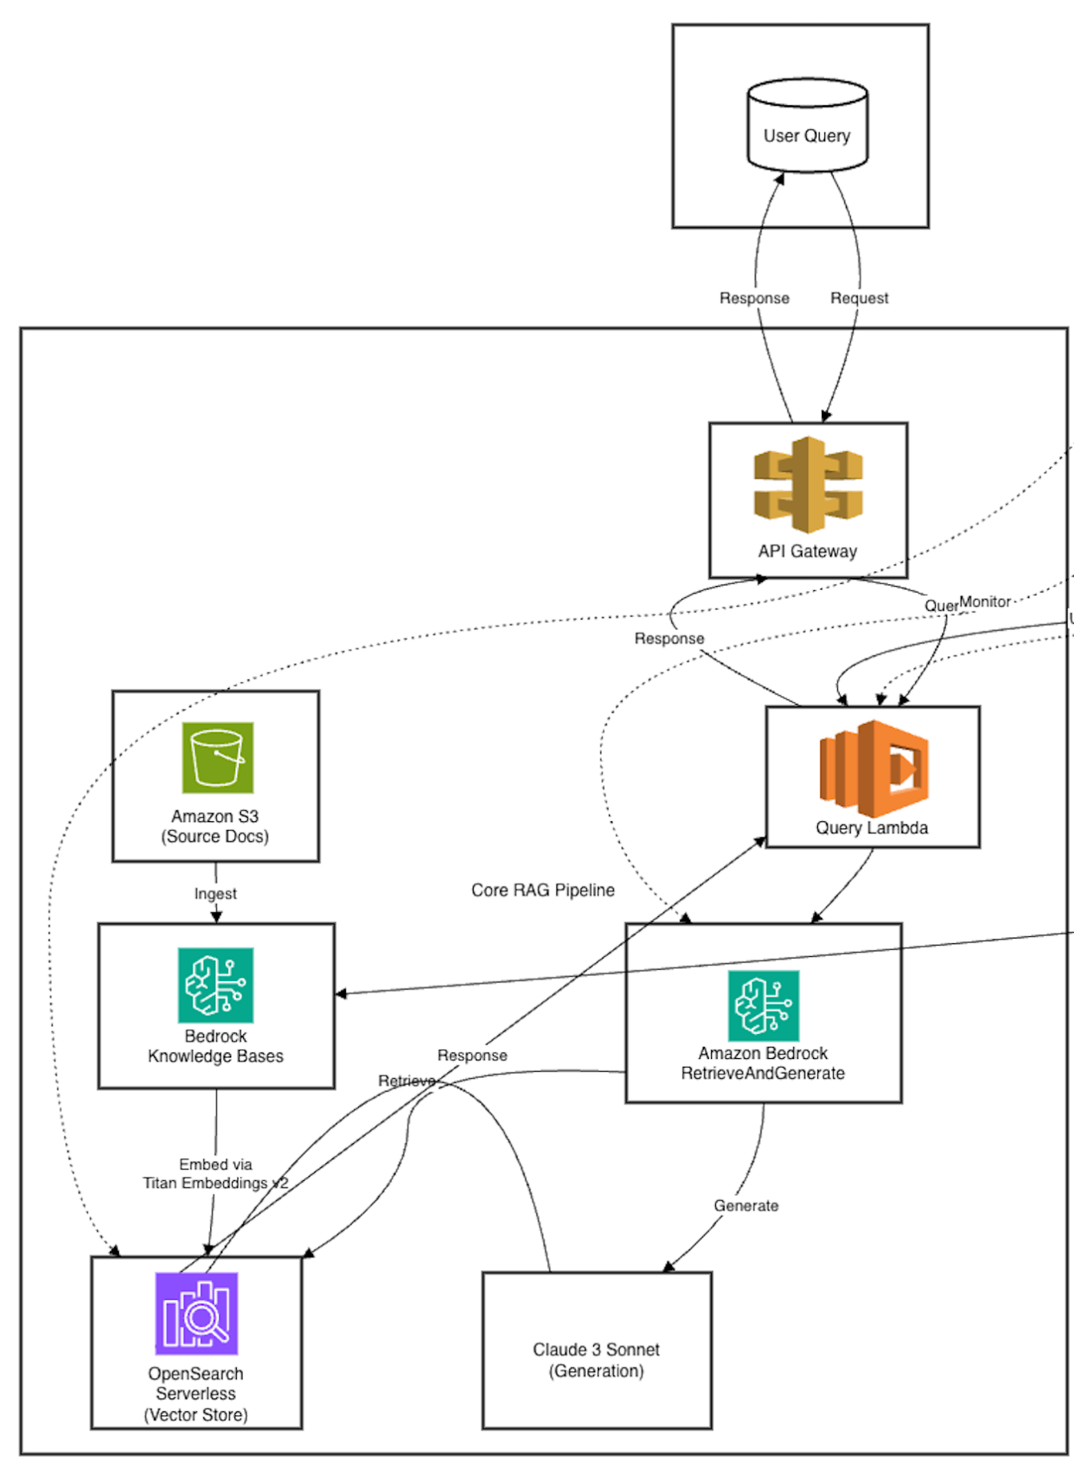
TODO: Architecture Overview

Slide 7
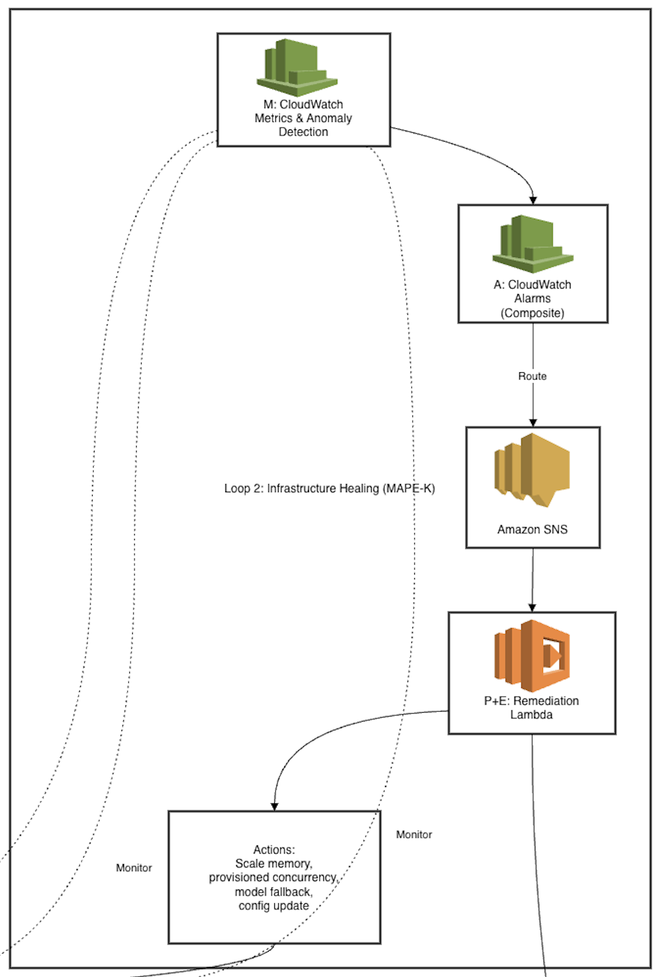
TODO: Architecture Overview

Slide 8
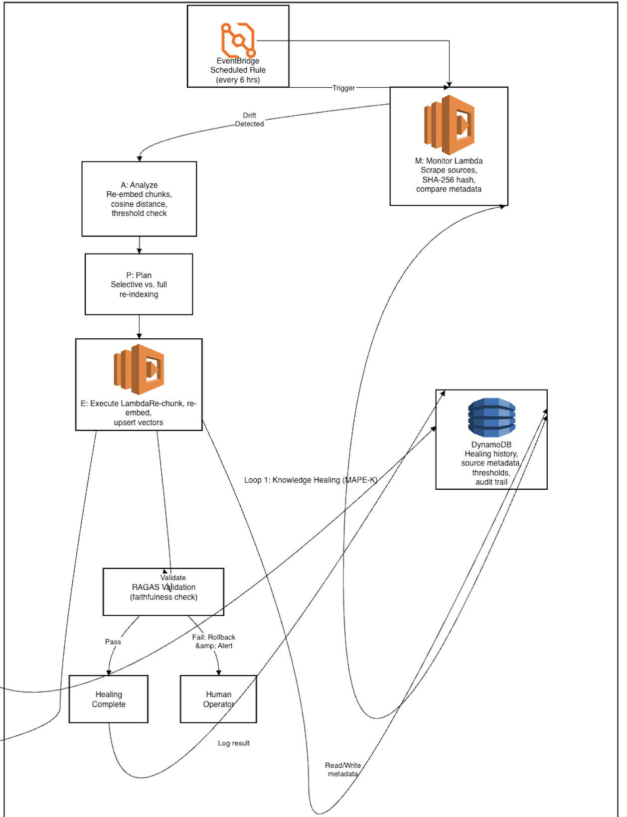
TODO: Architecture Overview

Slide 9
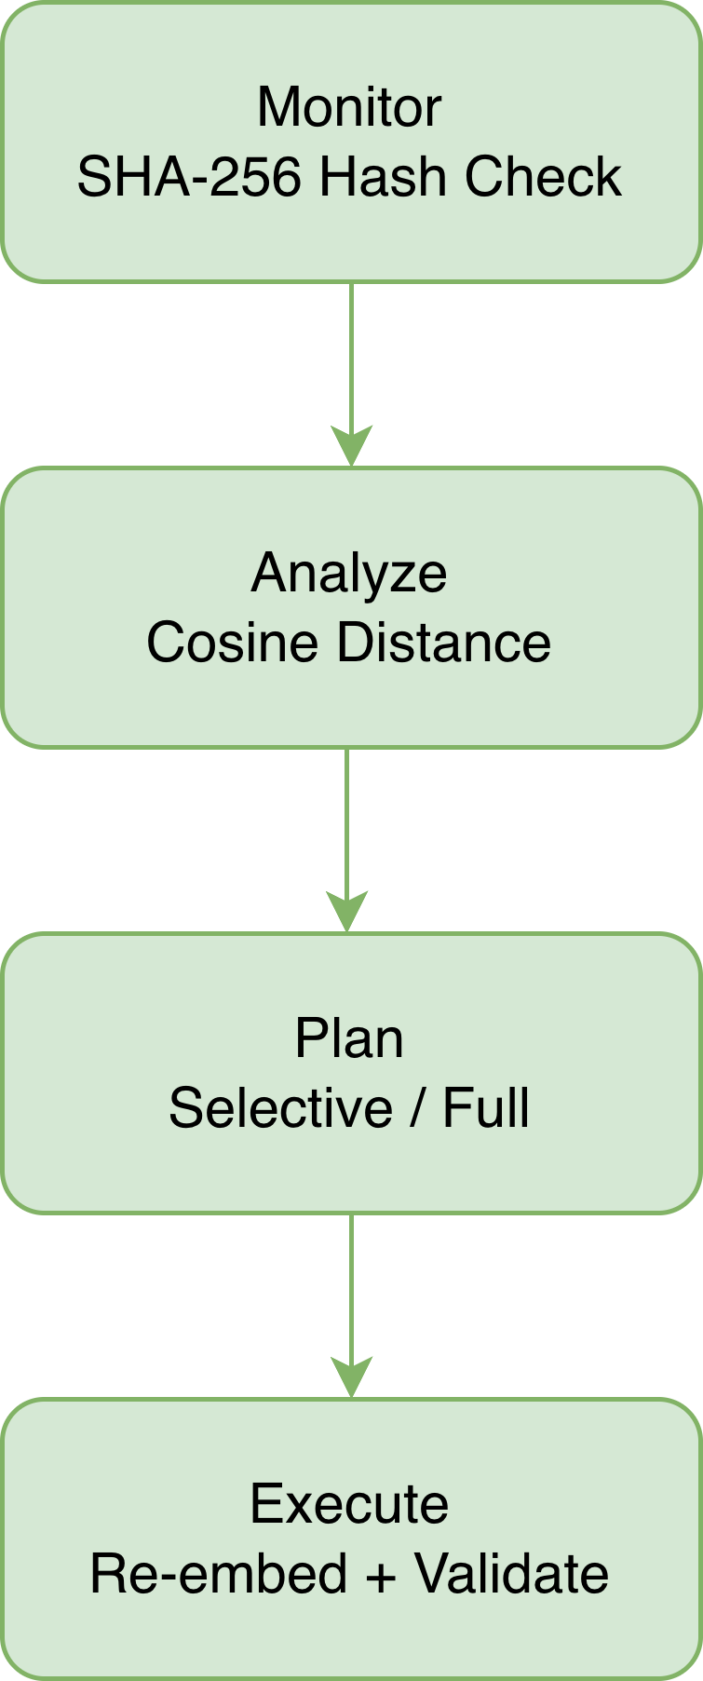
Loop 1: Knowledge Healing
Monitor: EventBridge triggers every 6h → Lambda fetches source docs → SHA-256 hash comparison
Analyze: Hash mismatch → re-chunk → generate new embeddings → cosine distance check (threshold: 0.08)
Plan: Low drift → selective re-index. High drift → full re-ingestion
Execute: Re-embed via Bedrock → upsert into OpenSearch → validate with RAGAS. Scores drop → rollback + alert human
Notes:
- Every six hours, EventBridge kicks off a Lambda that pulls each source doc and hashes it with SHA-256
- If the hash doesn't match what's in DynamoDB, something changed
- But hash alone isn't enough — a whitespace edit would trigger it too. So next step: re-chunk the doc, get fresh embeddings, measure cosine distances against the old vectors
- We use a 0.08 threshold — below that, it's cosmetic. Above that, real drift
- Planner picks selective re-indexing if only a few chunks moved, or full re-ingestion if the whole doc changed
- Key part: after the fix, RAGAS faithfulness scores are compared before and after. If scores actually got worse, system rolls back and alerts a human
- So the healing process itself can't silently degrade answers

Slide 10
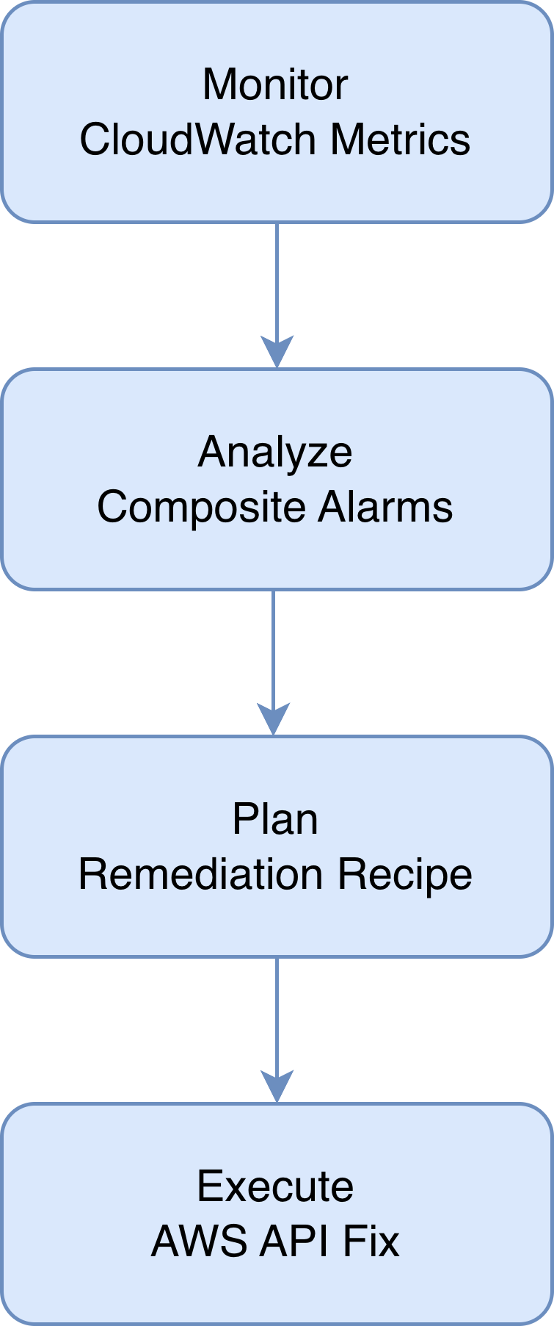
Loop 2: Infrastructure Healing
Monitor: CloudWatch tracks 5 metrics — p99 latency, error rate, memory utilization, cold-start frequency, Bedrock response time. Dynamic baselines via Anomaly Detection
Analyze: Composite alarms require correlated signals (e.g., high latency AND rising errors)
Plan: Rule engine maps alarm patterns to fixes (bump RAM, provisioned concurrency, model failover)
Execute: SNS → remediation Lambda → AWS API call → logs to DynamoDB
Notes:
- CloudWatch continuously monitors five things: p99 latency, error rates, memory utilization, cold-start frequency, and Bedrock response times
- Uses Anomaly Detection — learns dynamic baselines, adjusts for time-of-day and weekly patterns, not just a static number
- Individual alarms get wired into composite alarms — need multiple correlated signals before escalating. Single latency blip doesn't trigger anything
- Rule engine maps patterns to concrete fixes: sustained high latency → bump Lambda memory, cold starts rising → enable provisioned concurrency, Bedrock slowing down → failover to alternate model
- SNS routes the alarm to a remediation Lambda which calls the actual AWS API
- Every action plus the metric snapshot gets logged to DynamoDB for auditing

Slide 11
Visualizing the Architecture
https://ffaisal.com/demo/

Slide 12
Why Serverless?
Fully serverless: Lambda, EventBridge, CloudWatch, SNS, DynamoDB, Bedrock, OpenSearch Serverless
Pay-per-use: near-zero cost when idle
Auto-scaling: no capacity planning
Fault isolation: Loop 1 bug can't crash Loop 2
IAM least-privilege across all services
Notes:
- Deliberate choice — nothing is provisioned ahead of time
- Pay-per-use means costs stay near zero when nothing's broken
- Each service scales on its own, no manual capacity planning
- Two loops are fully isolated — a re-indexing bug can't knock out anomaly detection, a noisy alarm can't stall a vector upsert
- IAM locks everything down with least-privilege roles

Slide 13
Experimental Setup
Evaluated across 2 dimensions: knowledge reliability, infra resilience
Knowledge drift corpus: 20 documents (product specs, FAQs, pricing, policies)
6 modification levels × 5 trials = 600 evaluations
Infra: synthetic time series, 1,000 data points, 15 injected anomalies per metric
Cost: automated vs. manual ($50/hr, 6 hrs/week)
Notes:
- Tested three things: does it catch knowledge drift, does it catch infra problems, what does it cost
- 20 hand-crafted docs in four categories — product specs, FAQs, pricing schedules, policies
- Six modification levels: no change, formatting only, small numerical edits, large numerical scaling, partial rewrite, full rewrite. Five trials each = 600 evaluations
- Infra side: synthetic time series modeled on CloudWatch metrics, 1,000 data points each, 15 anomalies injected at known timestamps
- Cost comparison: our system vs a developer doing it manually at $50/hr, 6 hours a week

Slide 14
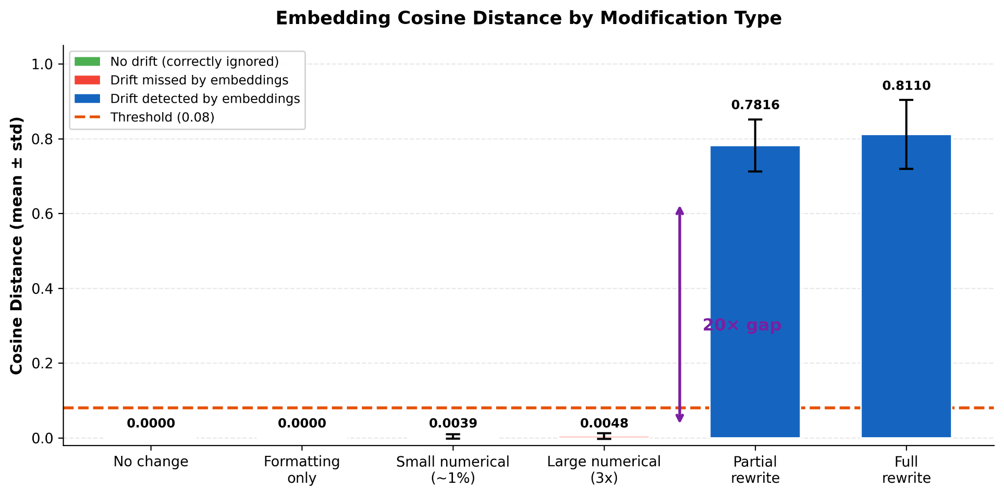
Results: Knowledge Drift Detection
Embeddings are blind to numerical changes (cosine distance < 0.005)
Hash-only catches everything but false-fires on formatting (P = 0.80)
Semantic-only methods: low recall (0.25–0.50)
Composite conservative: F1 = 0.89, perfect recall**
0.08 cosine threshold cleanly separates real drift from noise (20x gap)
Notes:
●Results - Knowledge Drift Detection
●Opening: "Moving on to our experimental results, let's first look at how our architecture handled Knowledge Drift."
●We tested five different ways to catch when the data goes out of date. We found that AI 'embeddings' are actually 'blind' to numbers—if a price changes from $10 to $50, the AI often thinks the meaning is the same and ignores it.
●On the other hand, using a simple 'hash' (like a digital fingerprint) catches every tiny change, but it over-fires on things that don't matter, like a change in font or a random space. Our 'Composite' strategy was the winner. It was smart enough to ignore the formatting but caught almost every important update, giving us a very high reliability score of 0.89

Slide 15
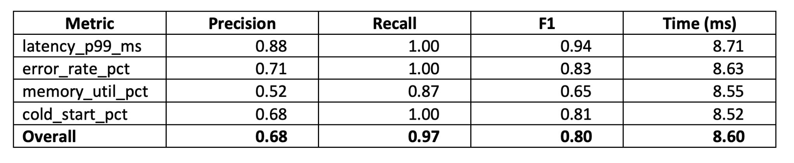
Results: Infrastructure
Infrastructure anomaly detection:
Overall recall: 0.97 | F1: 0.80
Latency easiest (F1 = 0.94), memory hardest (F1 = 0.65)
Composite alarms eliminated 100% of single-metric false positives
Detection latency: ~8.6 ms
Notes:
●Results - Infrastructure
●Transition: "Next, we evaluated the second half of our architecture: the Infrastructure-Healing Loop."
●Overall Performance: "The system demonstrated excellent responsiveness, achieving an overall recall of 0.97 and an F1 score of 0.80."
●Metric Breakdown: "When we break this down by anomaly type, latency spikes were the easiest to detect, giving us an F1 score of 0.94. Memory exhaustion proved to be the most difficult, with an F1 of 0.65."
●The Value of Composite Alarms: "A major success of this loop was our use of composite alarms. By correlating metrics rather than looking at them in isolation, we successfully eliminated 100% of single-metric false positives."
●Speed: "Finally, the system operates incredibly quickly, with an average detection latency of just 8.6 milliseconds.

Slide 16
Limitations & Future Work
Limitations
Simulated data, not live production deployment
Single cloud (AWS only)
No multi-modal drift detection (images, tables)
Static cosine threshold (0.08) may not generalize
Future Work
Reinforcement learning for adaptive thresholds
Multi-modal drift detection
Extend to Azure and GCP
Notes:
●Limitations & Future Work
●Transition: "While our results are highly promising, we do recognize several limitations in our current setup."
●Current Limitations: "First, our experiments rely on simulated data rather than a live, high-traffic production deployment. Second, the architecture is currently purpose-built for a single cloud environment—AWS. Additionally, we only process text, meaning we lack multi-modal drift detection for embedded tables or images. Finally, our 0.08 cosine threshold is static and may not seamlessly generalize to vastly different datasets."
●Future Work: "To address these constraints, our future work can focus on integrating Reinforcement Learning to dynamically adapt thresholds. We can also plan to build out multi-modal drift detection and adapt the underlying infrastructure as code to support cross-cloud deployments on Azure and GCP.

Slide 17
Conclusion
RAG systems that work on launch day tend to rot silently
Dual-loop architecture treats rot as a first-class engineering problem
Loop 1: hash + semantic analysis for knowledge drift
Loop 2: correlated metric monitoring for infra health
F1 = 0.89 (knowledge) | 0.97 recall (infra)
$12/month vs $1,299/month
"Maintenance pipelines need to be as autonomous as the models they serve"
Notes:
●Slide: Conclusion
●To wrap things up, the big takeaway is that RAG systems tend to 'rot' silently after you launch them. The data gets old, or the servers get tired. Our dual-loop architecture treats this 'rot' as a problem that can be fixed automatically.
●By using one loop for the data and one for the servers, we can keep the system accurate and fast for just a few dollars a month. As we start using AI for more important tasks, our maintenance pipelines need to be just as smart and autonomous as the AI models they are looking after

Slide 18
Questions?
Thank you!
GitHub: github.com/i3p9/cs6905-paper-code
Questions?

