Slide 1
Neighborhood Components Analysis
February 11, 2026
Group DR5:
Joseph Sowah
Ayodeji Fakokunde

Slide 2
Outline
Introduction
Objective
Overview of NCA
Motivation
Methodology
Implementation
Evaluation Metrics
Comparison Analysis
Expected outcome
Conclusion
References
Q & A

Slide 3
Introduction
The Challenge
The Solution: NCA
High-dimensional feature spaces suffer from:
• Dimensional redundancy
• Data sparsity
• Curse of dimensionality
These lead to:
• Model overfitting
• Increased computational costs
• Difficulty finding patterns
NCA learns a linear transformation that:
✓ Improves nearest-neighbor classification
✓ Reduces feature dimensionality
✓ Preserves class structure
✓ Enhances model performance
Supervised approach ensures class labels guide the transformation

Slide 4
Objective
Evaluate the impact of NCA on classification model performance
Compare Performance
Analyze classifier accuracy on original vs. NCA-transformed features
Measure Effectiveness
Quantify improvements in predictive accuracy and model robustness
Multi-Classifier Analysis
Evaluate across 5 different classifiers to identify which benefit most

Slide 5
Motivation
1
Supervised Dimensionality Reduction
Leverage class labels to learn task-specific transformations that preserve discriminative information
2
Combat Overfitting
Mitigate negative impacts of noise and irrelevant features in high-dimensional spaces
3
Computational Efficiency
Reduce feature space while maintaining accuracy, decreasing training time for complex models
4
Comparative Analysis
Identify which classifiers (SVM, KNN, Decision Tree, Random Forest, MLP) benefit most from NCA

Slide 6
What is Neighborhood Components Analysis?
NCA is a supervised metric learning algorithm that learns an optimal linear transformation to maximize k-NN classification accuracy in the transformed space
Supervised Learning
Metric Learning
Uses class labels to guide transformation
Learns optimal distance metric for classification
Linear Transformation
k-NN Optimized
Projects data: X_new = X × A
Maximizes nearest-neighbor accuracy

Slide 7
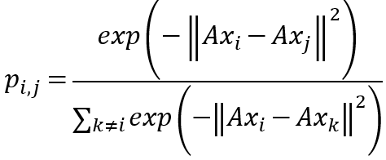
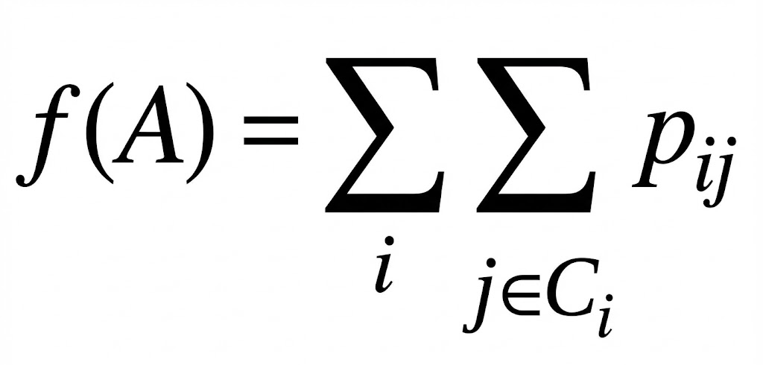
How NCA Works: Mathematical Foundation
1
Linear Transformation Matrix
Learn matrix A such that transformed features:
X_transformed = X × A
2
Stochastic Neighbor Selection
Probability that point i selects j as neighbor:
3
Objective Function
Maximize expected k-NN classification accuracy:
Sum the probabilities of selecting points “j” that are in the same class “C_i”
Gradient Optimization
Use gradient descent to iteratively adjust the transformation matrix A to maximize the objective function, thus f(A)
4

Slide 8
NCA Algorithm
Before NCA
After NCA
Original Feature Space
• Classes may overlap
• Irrelevant features add noise
• Distance metrics treat all features equally
• Poor k-NN performance
Example:
Features: [height, weight, age, eye_color, shirt_size]
All features weighted equally, even if irrelevant
Transformed Feature Space
✓ Classes better separated
✓ Irrelevant features downweighted
✓ Learned metric emphasizes discriminative features
✓ Improved k-NN accuracy
Result:
Transformation emphasizes height & weight, reduces age/eye_color
Classes become linearly separable

Slide 9
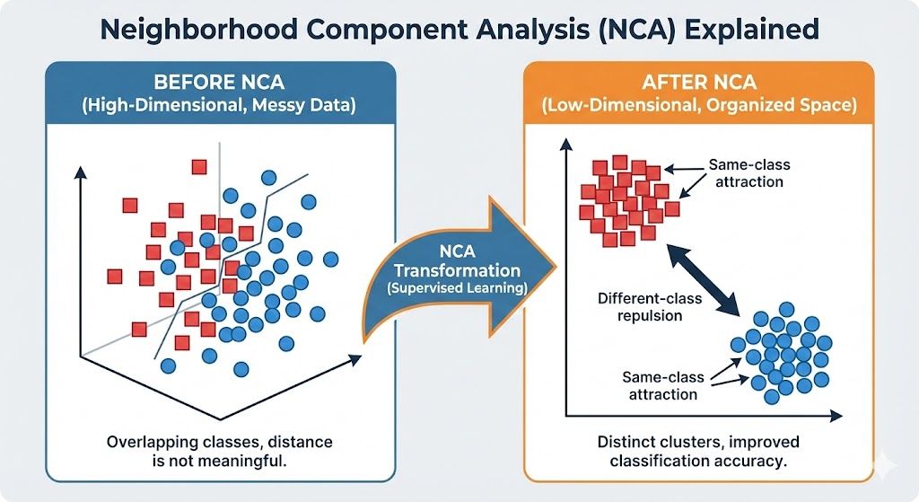
NCA Algorithm

Slide 10
Methodology: Two-Phase Evaluation
Phase 1: Baseline
Phase 2: NCA Transform
Train and evaluate 5 classifiers using original, full feature sets
Workflow:
1. Load dataset
2. Split into training/testing
3. Train all 5 classifiers
4. Hyperparameter tuning
5. 10-fold cross-validation
6. Record metrics
Establishes performance baseline for comparison
Apply NCA and re-evaluate same classifiers with transformed features
Workflow:
1. Apply NCA transformation
2. Obtain reduced feature space
3. Train same 5 classifiers
4. Hyperparameter tuning
5. 10-fold cross-validation
6. Compare with Phase 1
Reveals NCA's impact on performance

Slide 11
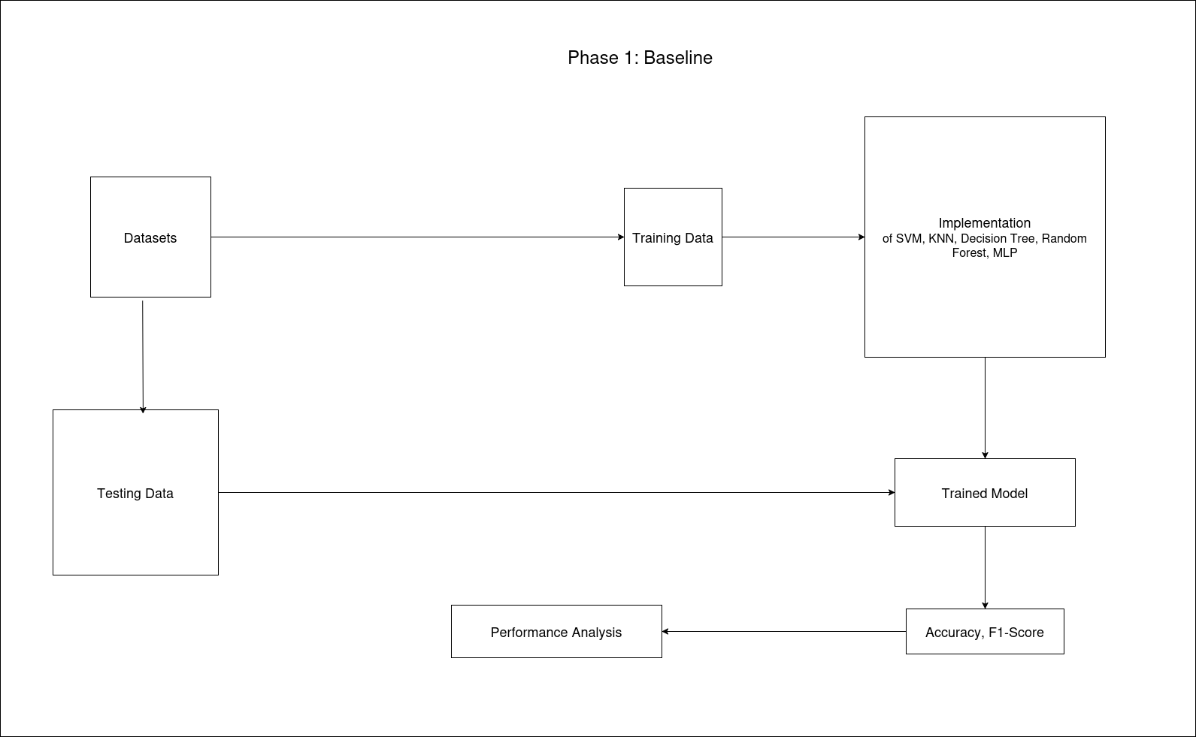
Project Workflow – Phase 1

Slide 12
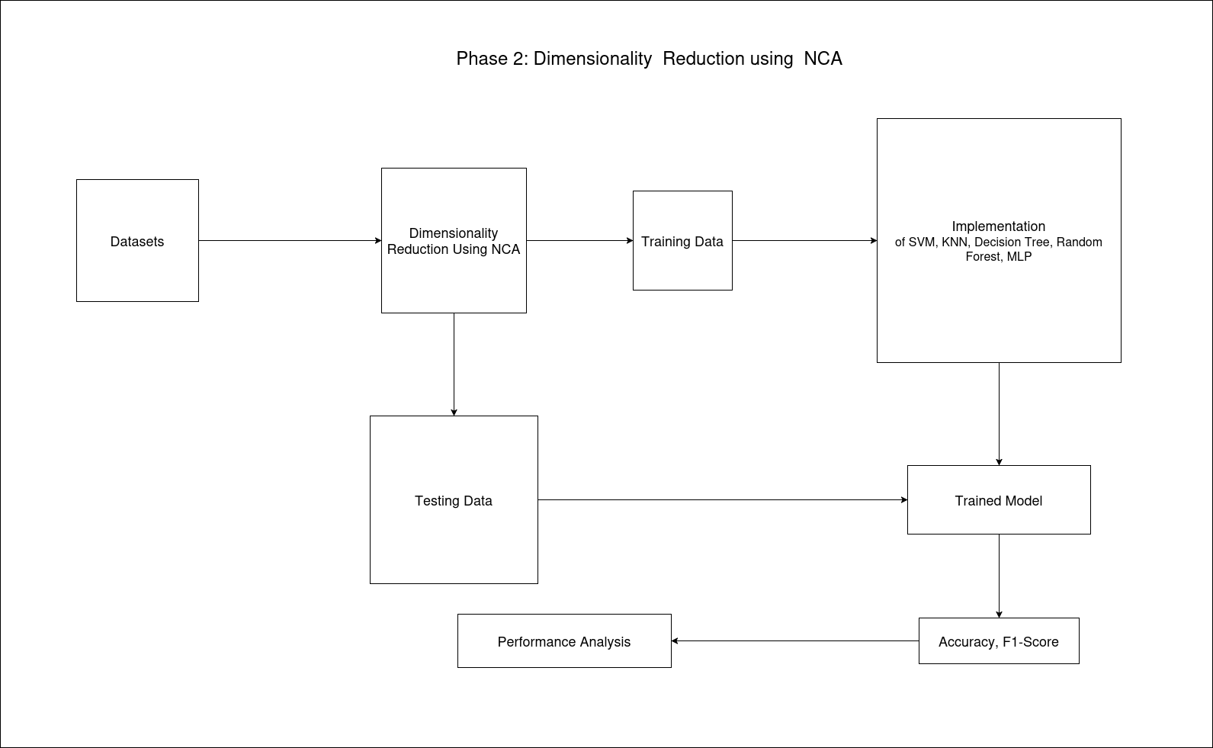
Project Workflow – Phase 2

Slide 13
Technical Implementation
Classifiers (5)
Implementation Details
sklearn.svm.SVC
sklearn.neighbors.KNeighborsClassifier
sklearn.tree.DecisionTreeClassifier
sklearn.ensemble.RandomForestClassifier
sklearn.neural_network.MLPClassifier
Language & Libraries
• Python with scikit-learn
NCA Implementation
•sklearn.neighbors.NeighborhoodComponentsAnalysis
Validation Strategy
• 10-fold cross-validation
• Applied to all datasets & classifiers
Hyperparameter Optimization
• Grid Search / Random Search
• Consistent across both phases
All models will use hyperparameter tuning (Grid/Random Search)

Slide 14
Results & Evaluation Metrics
All metrics reported as Mean ± Standard Deviation across 10 folds
Accuracy
F1-Score
Formula:
Formula:
Correct Predictions / Total Predictions
Harmonic mean of Precision & Recall
Purpose:
Purpose:
Overall model performance
Balanced metric for multi-class data

Slide 15
Comparison Analysis
Quantifying Performance Shift: Baseline vs. NCA-Transformed Space
Performance Delta
Classifier-Specific Impact
• Calculate Δ Accuracy and Δ F1-score
• Determine if NCA preserves/enhances discriminability
• Assess statistical significance of changes
• Identify which classifier improves most
• Analyze why certain models benefit more
• Compare distance-based vs. tree-based approaches
Robustness Analysis
Hyperparameter Changes
• Compare standard deviations across folds
• Lower variance indicates less overfitting
• Assess if curse of dimensionality is mitigated
• Examine optimal hyperparameters in each phase
• Reflect how data geometry is reshaped
• Understand transformation's structural impact

Slide 16
Expected Outcomes
Hypothesis: NCA will improve classification accuracy while reducing computational overhead
✓
Improved Accuracy
Higher mean accuracy and F1-scores in NCA-transformed space, especially for distance-based classifiers (k-NN, SVM)
✓
Reduced Overfitting
Lower standard deviation across folds indicates more robust, generalizable models with less variance
✓
Computational Gains
Faster training times for complex models (MLP, Random Forest) due to reduced dimensionality
✓
Differential Benefits
k-NN classifier expected to benefit most as NCA directly optimizes the k-NN objective function

Slide 17
Conclusion
We saw how NCA works
The workflow we will be using for this project
Technical implementation using Python and Scikit learn library
How we will be carrying out our comparison Analysis

Slide 18
Thank You

Slide 19
References
[1] N. Singh-Miller, M. Collins, T. J. Hazen, et al. (2007)
"Dimensionality reduction for speech recognition using neighborhood components analysis"
In Interspeech, pp. 1158–1161.
[2] M. A. B. Siddique, S. Sakib, and M. A. Rahman. (2019)
"Performance analysis of deep autoencoder and NCA dimensionality reduction techniques with KNN, ENN and SVM classifiers"
In 2019 2nd International Conference on Innovation in Engineering and Technology (ICIET).
IEEE, pp. 1–6.

Slide 20
Q & A

