Slide 1
CUSTOMER CHURN PREDICTION
MISNA K J
30/01/2024

Slide 2
INTRODUCTION
Customer churn refers to the phenomenon where customers discontinue their services or subscriptions with a business. Predicting customer churn is crucial for businesses across various industries as it helps them identify and retain customers at risk of leaving. By understanding the factors contributing to churn, businesses can implement targeted strategies to retain customers and enhance overall customer satisfaction.

Slide 3
RELEVANCE OF THE PROBLEM
The significance of customer churn prediction lies in its direct impact on a company's revenue and growth. Acquiring new customers is typically more expensive than retaining existing ones. Identifying potential churners allows businesses to proactively address issues, provide personalized incentives, and improve customer engagement, thereby reducing churn rates and maintaining a loyal customer base.

Slide 4
PROJECT GOAL
Develop an effective machine learning model for customer churn prediction.
By deploying effective churn prevention strategies, the goal is to minimize customer attrition and maximize the lifetime value of each customer.

Slide 5
OBJECTIVES
01
04
02
05
03
Data Collection and Exploration :
Collect relevant data on customer interactions and demographics.
Explore and analyze to get insights about customer behavior.
Model Selection :
Choose appropriate machine learning models for churn prediction.
Experiment with different algorithms and ensemble methods to find the most effective approach.
Feature Engineering :
Identify key features.
Transform existing ones to enhance model performance.
Model Training and Evaluation:
Train the selected models on the training dataset.
Evaluate model performance using relevant metrics.
Data Preprocessing :
Handle missing data.
Ensure the dataset is suitable for machine learning algorithms.

Slide 6
DATASET
Data source : Kaggle (https://www.kaggle.com//bank-customer-churn/data)
Data : This data set contains bank customer churn data of 10000 customers. It is advantageous for banks to know what leads a client towards the decision to leave the company.
There is 12 features.

Slide 7
TOPIC OVERVIEW
CUSTOMER ID
CREDIT SCORE
GENDER
TENURE
GEOGRAPHY
NUMBER OF PRODUCTS
CUSTOMER CHURN
AGE
BANK BALANCE
HAS CREDIT CARD
IS ACTIVE MEMBER
EXITED OR NOT
ESTIMATED SALARY

Slide 8
DATA PREPROCESSING
Identified and removed two duplicate rows from the dataset to ensure data integrity and eliminate redundancy.
Applied the ‘get dummies' method to encode the 'Gender' and 'Geography' columns, enhancing the dataset for improved model building and analysis.
Eliminated unnecessary columns, such as ‘Row Number' 'Surname' 'Geography' and 'Gender' to streamline and focus the dataset.
Identified and addressed missing values in the dataset, specifically in three cells, by removing the corresponding records.

Slide 9
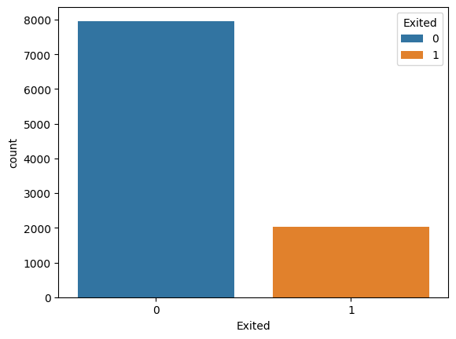
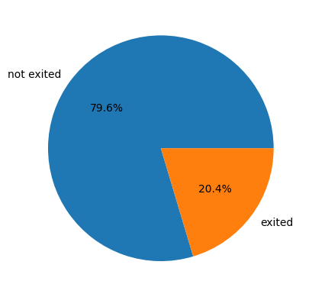
EXPLORATORY DATA ANALYSIS

Slide 10
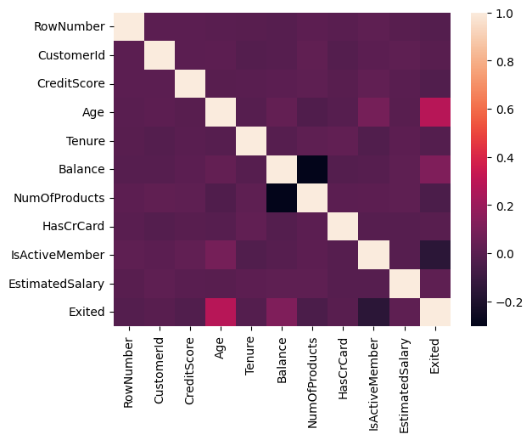
CORRRELATION

Slide 11
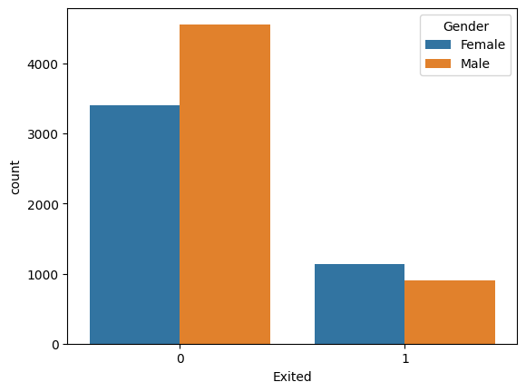

Slide 12
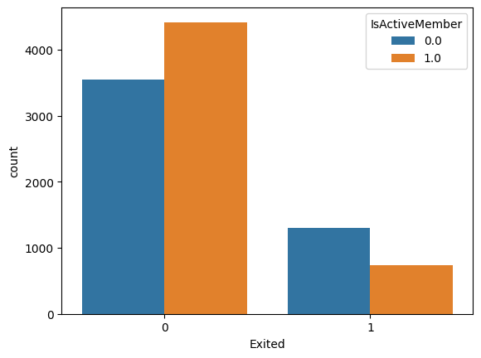
Active customers are less likely to leave the bank.

Slide 13
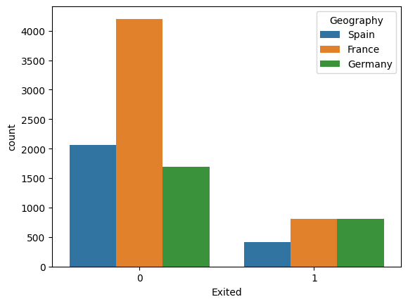

Slide 14
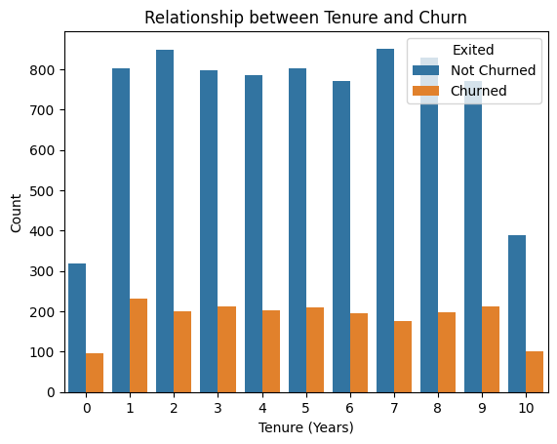

Slide 15
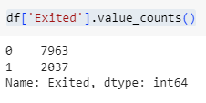
MACHINE LEARNING MODEL
Customer churn prediction is a common use case in machine learning, and the choice of algorithms/models depends on various factors such as the characteristics of the data, interpretability requirements, and the specific goals of the prediction task.
From the analysis it is clear that the given data set is an imbalanced data set.

Slide 16
Here the number of churned customers is significantly lower than non-churned ones.
Random Forests are known for their robustness and ability to handle imbalanced, datasets well. The ensemble nature of random forests, with multiple decision trees, can mitigate the impact of class imbalance.

Slide 17
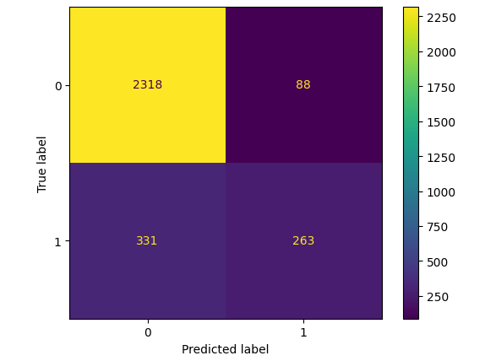
MODEL EVALUATION
The random forest model got a 0.86 accuracy score.
Confusion matrix
The relatively high accuracy suggests that the model performs well overall in terms of correct predictions.

Slide 18
PROJECT EXTENSIONS
Explore additional features or transformations of existing features that could improve model performance.
Investigate advanced techniques for handling imbalanced data. While this model achieved a balance between precision and recall, techniques like advanced resampling methods, cost-sensitive learning, or ensemble methods designed for imbalanced data could further enhance model performance.

Slide 19
CONCLUSION
the Random Forest model developed for bank customer churn prediction has demonstrated strong predictive capabilities with an impressive accuracy score of 86%. This indicates that the model correctly predicted the churn status for a substantial portion of the 1000 customers in the dataset.
The success of the project lies in the model's ability to provide valuable insights into potential churn, enabling the bank to take proactive measures to retain customers. However, ongoing enhancements could include exploring advanced feature engineering, addressing imbalanced data challenges, and considering more sophisticated modeling techniques for continuous improvement.
This project's outcomes are poised to empower the bank with a reliable tool for customer churn prediction, contributing to informed decision-making and customer retention strategies.

Slide 20
Q&A

Slide 21
THANK YOU

