Slide 1


Note: The data and information in this document is reflective of a hypothetical situation and client. This document is to be used for KPMG Virtual Internship purposes only.
Sprocket Central Pty Ltd
Data analytics approach
Misna K J

Slide 2
Note: The data and information in this document is reflective of a hypothetical situation and client. This document is to be used for KPMG Virtual Internship purposes only.
Agenda
Introduction
Observations
Key Takeaways

Slide 3
Note: The data and information in this document is reflective of a hypothetical situation and client. This document is to be used for KPMG Virtual Internship purposes only.
Introduction
We possess 3 key datasets :
Customer Demographic
Customer Transactions
Customer Address
Our goal is to unveil customer patterns and trends .
Then from the ‘New Customer Dataset’ we will recommend 1000 new target customers based on our analysis.

Slide 4
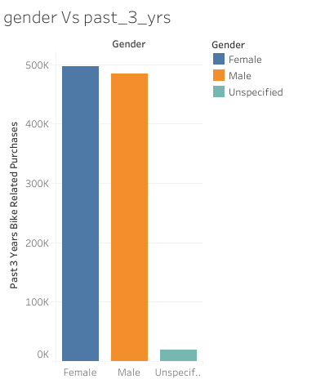
Note: The data and information in this document is reflective of a hypothetical situation and client. This document is to be used for KPMG Virtual Internship purposes only.
OBSERVATIONS
In the past 3 years, the highest volume of purchases was made by female customers, with male customers following as the second largest segment in terms of purchase activity.
Place any supporting images, graphs, data or extra text here.

Slide 5
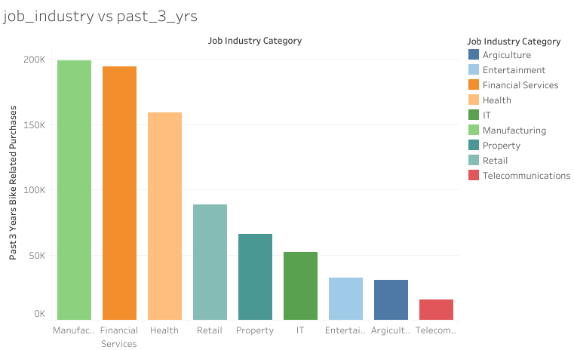
Note: The data and information in this document is reflective of a hypothetical situation and client. This document is to be used for KPMG Virtual Internship purposes only.
OBSERVATIONS
Customers employed in the manufacturing and financial services sectors demonstrate the highest purchasing activity, while those work in the telecommunications industry exhibit the lowest purchase rates.
Place any supporting images, graphs, data or extra text here.

Slide 6
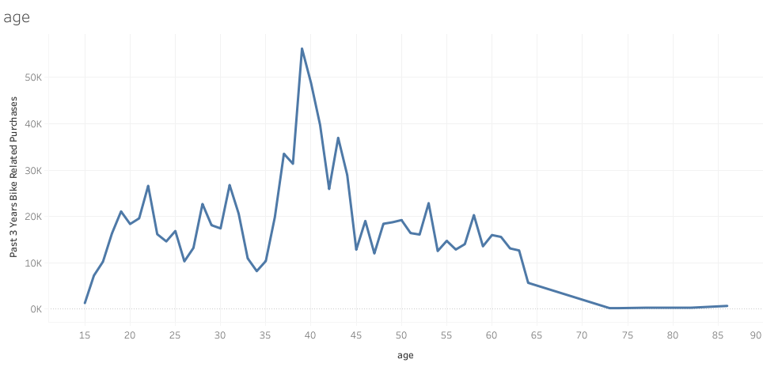
Note: The data and information in this document is reflective of a hypothetical situation and client. This document is to be used for KPMG Virtual Internship purposes only.
OBSERVATIONS
Customers within the age range of 37 to 44 are most likely to purchase the products, while younger individuals , aged between 20 to 35 , show a comparatively lower purchase rate.
Place any supporting images, graphs, data or extra text here.

Slide 7
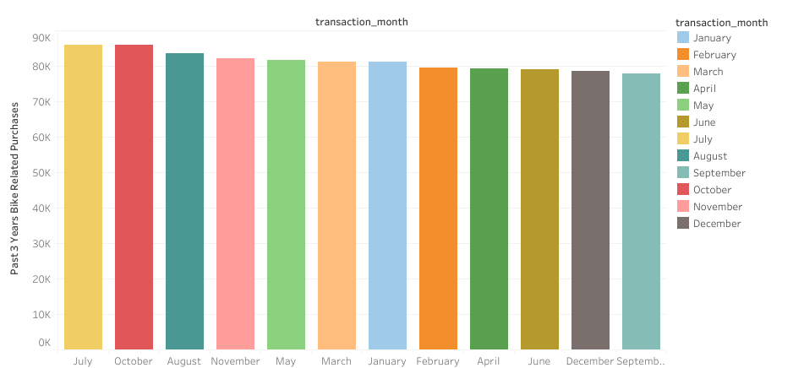
Note: The data and information in this document is reflective of a hypothetical situation and client. This document is to be used for KPMG Virtual Internship purposes only.
OBSERVATIONS
The highest purchase activity is typically observed in the months of July, October and August. In contrast, the months of December and September tend to register the lowest purchase volumes.
Place any supporting images, graphs, data or extra text here.

Slide 8
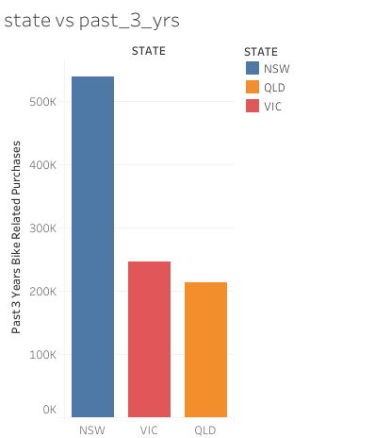
Note: The data and information in this document is reflective of a hypothetical situation and client. This document is to be used for KPMG Virtual Internship purposes only.
OBSERVATIONS
New South Wales(NSW) emerges as the state with the highest volume of purchase transactions, significantly surpassing both Victoria and Queensland. Notably, both Victoria(VIC) and Queensland(QLD) exhibit purchase amounts that are approximately half of those recorded in New South Wales.
Place any supporting images, graphs, data or extra text here.

Slide 9
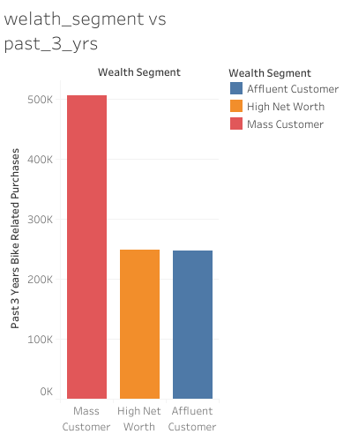
Note: The data and information in this document is reflective of a hypothetical situation and client. This document is to be used for KPMG Virtual Internship purposes only.
OBSERVATIONS
Mass customers consistently lead in terms of purchase frequency, contributing the highest volume of transactions. In contrast, both high net worth and affluent customers make purchases amounting to approximately half of the total transactions made by mass customers.
Place any supporting images, graphs, data or extra text here.

Slide 10
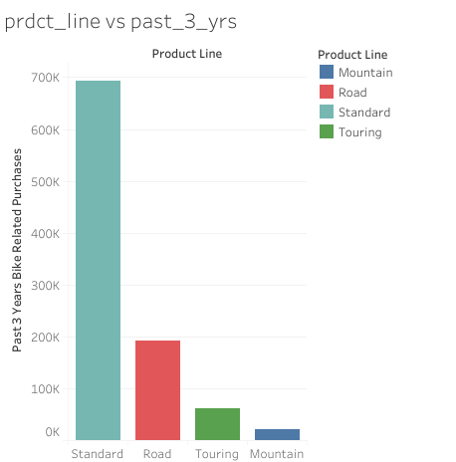
Note: The data and information in this document is reflective of a hypothetical situation and client. This document is to be used for KPMG Virtual Internship purposes only.
OBSERVATIONS
The standard product lines exhibit the highest purchase frequency, significantly surpassing other product lines such as road, touring, and mountain. Notably, among these, the mountain product line records the lowest purchasing rate.
Place any supporting images, graphs, data or extra text here.

Slide 11
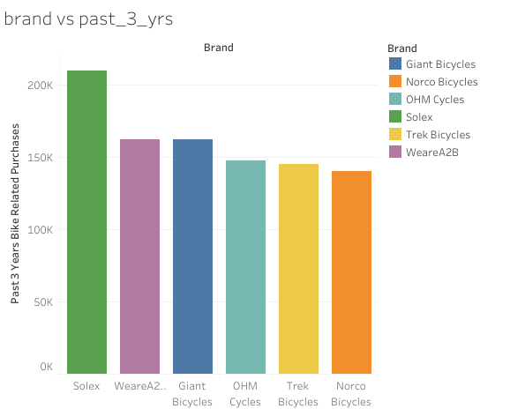
Note: The data and information in this document is reflective of a hypothetical situation and client. This document is to be used for KPMG Virtual Internship purposes only.
OBSERVATIONS
The purchase rate of each brand.
Place any supporting images, graphs, data or extra text here.

Slide 12
Note: The data and information in this document is reflective of a hypothetical situation and client. This document is to be used for KPMG Virtual Internship purposes only.
KEY TAKEAWAYS
We should implement strategies to attract a larger male
customer base.
We should focus on attracting individuals employed in the IT,
entertainment, agriculture, and telecommunications industries
to expand our customer base.
We should develop initiatives to attract a younger demographic.

Slide 13
Note: The data and information in this document is reflective of a hypothetical situation and client. This document is to be used for KPMG Virtual Internship purposes only.
KEY TAKEAWAYS
We should boost the company's advertising efforts, particularly
during holiday months such as December, as well as in September
and June.
We aim to engage a larger customer base from Queensland and Victoria and concurrently elevate advertising efforts in these regions.

Slide 14
Note: The data and information in this document is reflective of a hypothetical situation and client. This document is to be used for KPMG Virtual Internship purposes only.
KEY TAKEAWAYS
We should proactively engage with affluent and high-net-worth customers to strengthen our connection and expand our presence within this demographic.
We need to concentrate on enhancing the visibility and promotion of our mountain and touring product lines.

Slide 15
Note: The data and information in this document is reflective of a hypothetical situation and client. This document is to be used for KPMG Virtual Internship purposes only.
Appendix

Slide 16
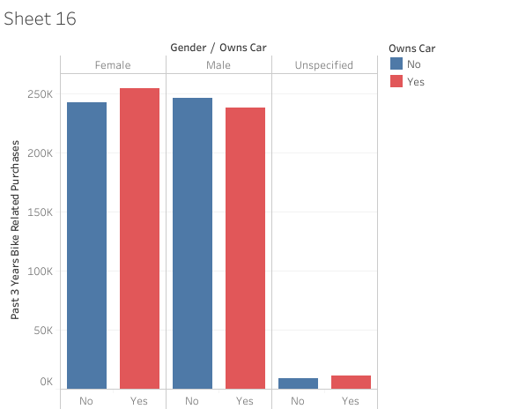
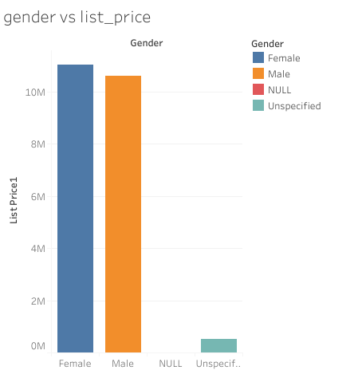
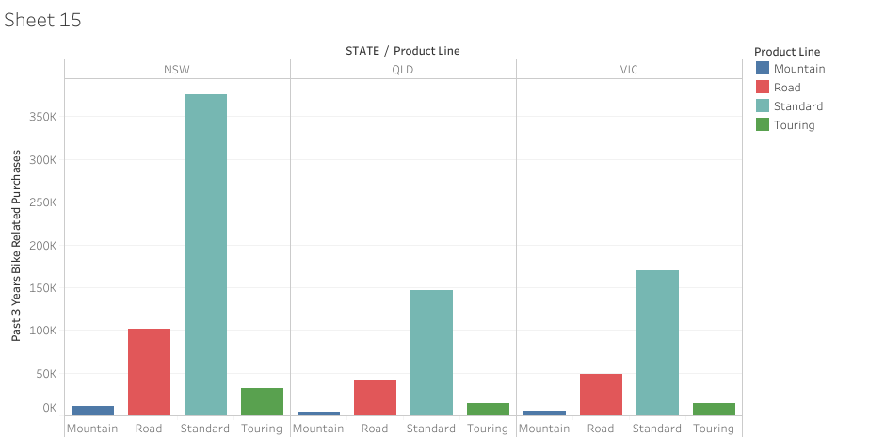
Note: The data and information in this document is reflective of a hypothetical situation and client. This document is to be used for KPMG Virtual Internship purposes only.
Supplementary visual content :
Appendix

Slide 17
Note: The data and information in this document is reflective of a hypothetical situation and client. This document is to be used for KPMG Virtual Internship purposes only.
Thank you

