Slide 1
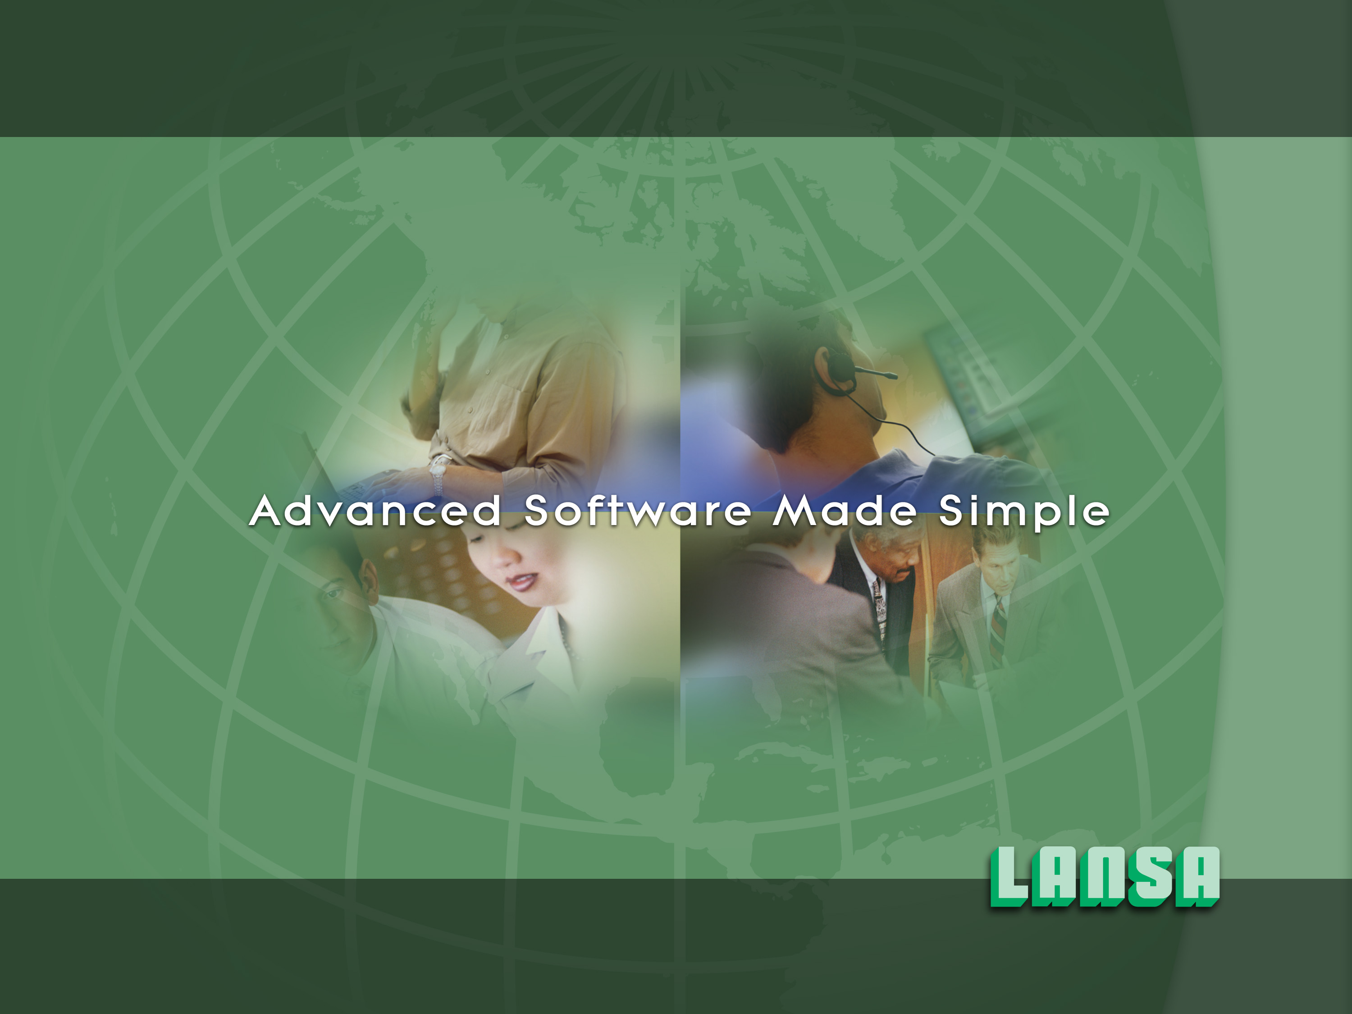
The Visual LANSA Framework
Notes:
This is a short overview of the Visual LANSA Framework product.
For brevity the term Visual LANSA Framework is abbreviated to VLF in many places in this presentation.
The presentation should take about 30 minutes to complete (not including time for answering any questions).
The intended audience is technical people (IT management and Software Developers primarily).

Slide 2

What is it ?
The Visual LANSA Framework is an application framework that helps you to:
    Prototype
    Design
    Implement
    and later … Maintain and Enhance
large scale and highly integrated LANSA applications for execution on native Windows or Web Browser platforms.
For new LANSA developers the framework may answer the question:
  “How should I design and build my first LANSA application?”
Notes:
The primary purpose of the Visual LANSA framework is to get new LANSA developers up to speed faster in an organized and progressive manner.
It does this be providing a framework for common commercial applications. The framework assists in the prototyping, design and implementation stages of the application development lifecycle.
Importantly the VLF also assists with the ongoing maintenance and enhancement of you applications.
Above all the VLF is designed to answer the question “How should I design and build my first LANSA application?” for new LANSA developers.

Slide 3
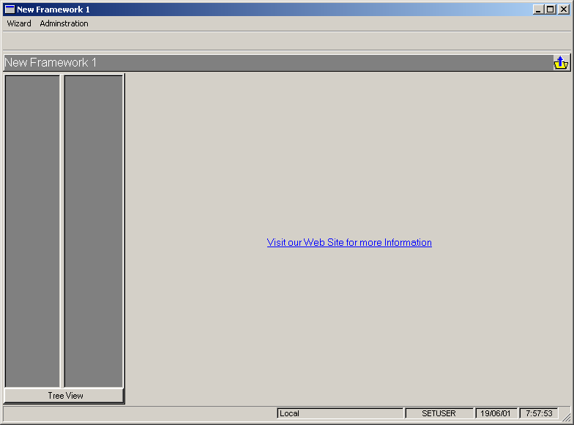
What does it look like ?
An empty Framework
Notes:
The Visual LANSA Framework is very literally and very visually an application framework.
Here it is shown as an empty framework.

