Slide 1
DSD Final Presentation (MIPS)
B05901013 張景皓
B05901014 吳靖平

Slide 2
Table of Contents
Baseline
J/JR/JAL/JALR
BEQ/BNE
Forwarding
Stall
Cache
Extensions
BrPred
L2 Cache
MultDiv
Collaboration

Slide 3
Baseline

Slide 4
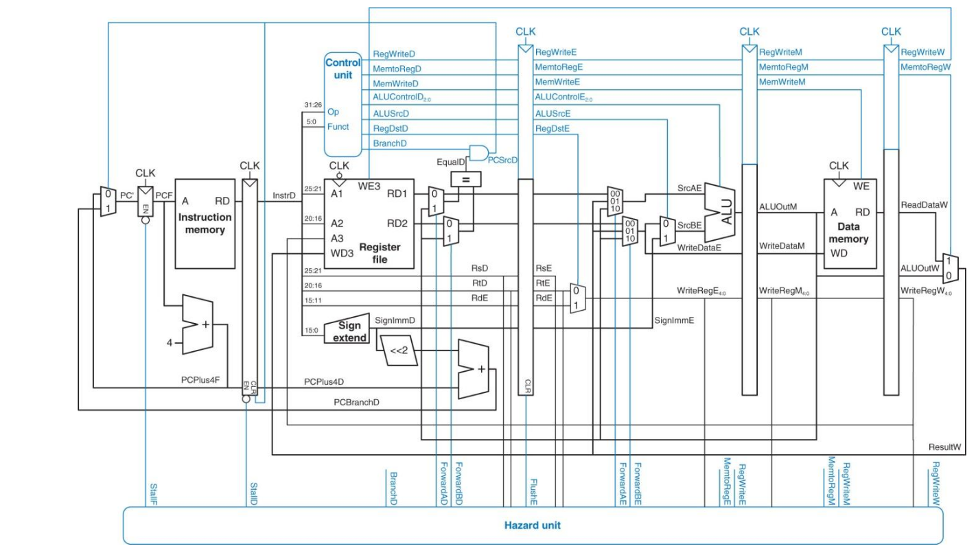
Overall Architecture

Slide 5
Jump-related Instructions

Slide 6
Implemented Instructions
MIPS Instruction | Op/funct | Operation
j destination | 2 | PC = address * 4
jal destination | 3 | $ra = PC; PC = address * 4
jr $rs | 0/8 | PC = $rs
jalr $rt $rs | 0/9 | $rt = PC; PC = $rs

Slide 7
Flush IF/ID
//IF_ID is stalled to refetch new instruction when nop_FD is HIGH
assign nop_FD = (Jump[1] ^ Jump[0]) ? 1'b1 : 1'b0;
// j/jal: Jump = 2’b01
//jr/jalr: Jump = 2’b10
Notes:
Jump-related instructions的解碼發生在ID stage，也表示同時間IF stage所讀取的指令為PC+4而非jump所指到的PC。所以凡是讀到j/jr/jal/jalr等指令，IF/ID的gate所存取的值必須要flush，重新讀取新指令(jump destination)，如此才不會執行到錯誤的指令

Slide 8
Forwarding

Slide 9
Forwarding Conditions
assign ForwardAD = (RegWrite_IE & (RegisterRd_IE != 5'b0) & (RegisterRd_IE == RegisterRs_FD)) ? 2'b11 : (RegWrite_EM & (RegisterRd_EM != 5'b0) & (RegisterRd_EM == RegisterRs_FD)) ? 2'b10 : (RegWrite_MW & (RegisterRd_MW != 5'b0) & (RegisterRd_MW == RegisterRs_FD)) ? 2'b01 : 2'b00;
assign ForwardBD = (RegWrite_IE & (RegisterRd_IE != 5'b0) & (RegisterRd_IE == RegisterRt_FD)) ? 2'b10 : (RegWrite_MW & (RegisterRd_MW != 5'b0) & (RegisterRd_MW == RegisterRt_FD)) ? 2'b01 : 2'b00;
assign ForwardAE = (RegWrite_EM & (RegisterRd_EM != 5'b0) & (RegisterRd_EM == RegisterRs_IE)) ? 2'b10 : (RegWrite_MW & (RegisterRd_MW != 5'b0) & (RegisterRd_MW == RegisterRs_IE)) ? 2'b01 : 2'b00;
assign ForwardBE = (RegWrite_EM & (RegisterRd_EM != 5'b0) & (RegisterRd_EM == RegisterRt_IE)) ? 2'b10 : (RegWrite_MW & (RegisterRd_MW != 5'b0) & (RegisterRd_MW == RegisterRt_IE)) ? 2'b01 : 2'b00;
Notes:
我們最初的寫法是參照講義的內容，但是後來發現判斷條件會不夠完整，應該在EX/MEM/WB每個階段之間都要加上forwarding datapath。以ForwardAD來說，ID/EX、EX/MEM、MEM/WB都有forwarding的判斷條件使data可以從各個stage直接送回ID stage。

Slide 10
00
01
11
10
00
01
11
10
Adjusted Forwarding Unit

Slide 11
Cache

Slide 12
Specification
Instruction Cache
Mode: read-only (ICACHE_ren = 1’b1; ICACHE_wen = 1’b0)
Size: 32 words (8 blocks * 4 words)
Approach: direct mapping
Write policy: write back
Data cache
Mode: read/write available
Size: 32 words (8 blocks * 4 words)
Approach: direct mapping
Write policy: write back

Slide 13
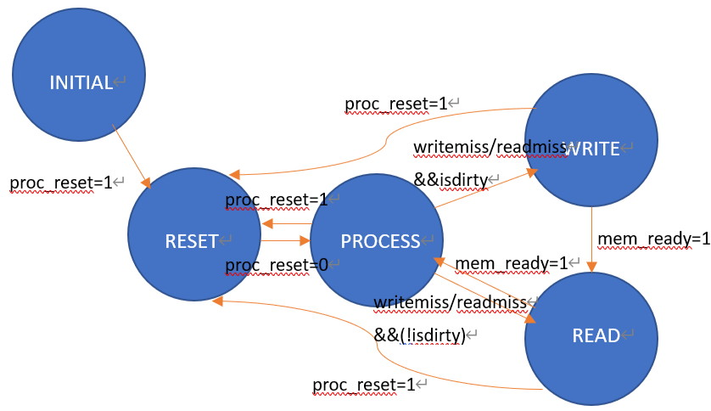
FSM

Slide 14
Why not 2-way associative cache?
 | area (um^2) | testbench clock (ns) | operation time (ns) | cycle | sdc (ns)
Direct mapping | 249159 | 4.47 | 8187.19 | ~1832 | 3
2-way associative | 258395 | 6.01 | 10905 | ~1818 | 3.5
Notes:
我們是直接使用HW4寫過的cache。Direct mapping與2-way associative兩個版本都有合成，但2-way合成出來結果不甚理想，連cycle = 6(ns)都過不了，因此最終決定使用direct mapping的版本作為Baseline MIPS的cache。

Slide 15
Extensions

Slide 16
Branch Prediction

Slide 17
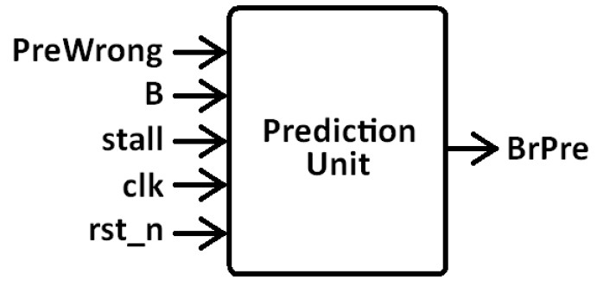
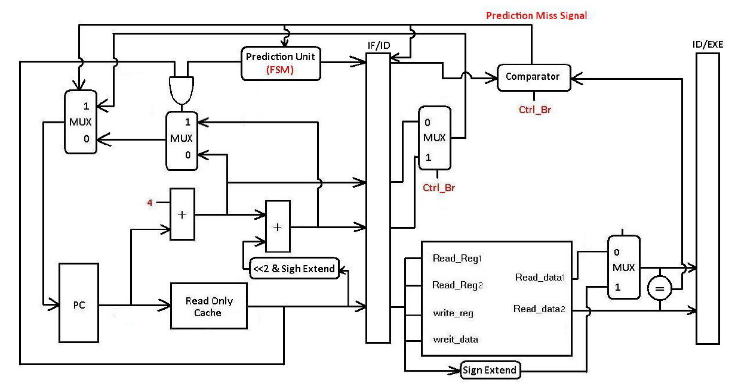
Architecture

Slide 18
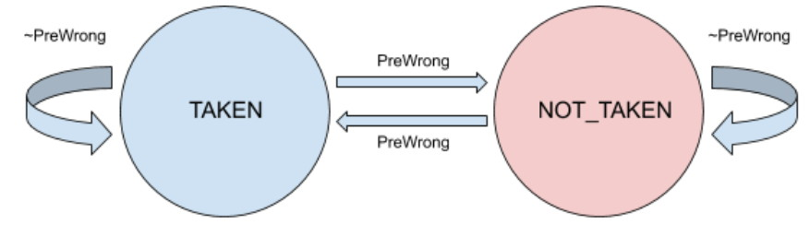
1-bit predict

Slide 19
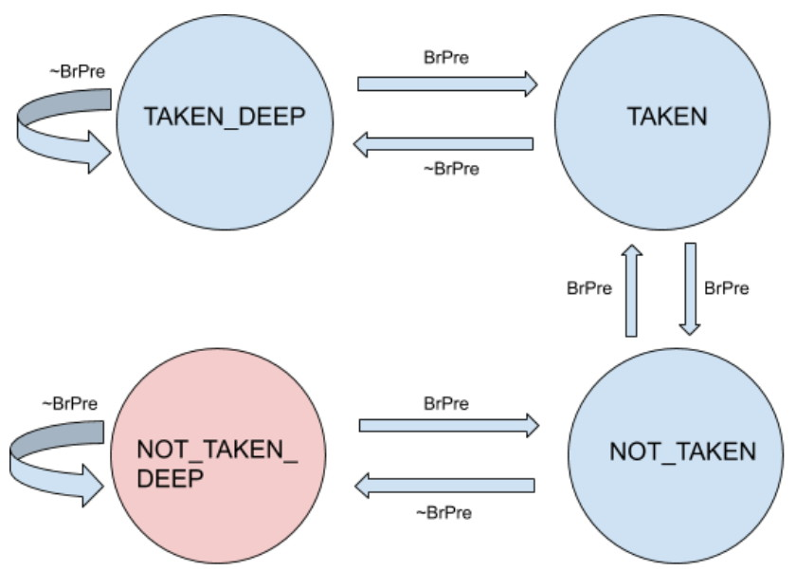
2-bit predict

Slide 20
RTL simulation results comparison
# of cycles
Model | a=10, b=20, c=30 | a=1, b=50, c=1 | a=1, b=1, c=50
Baseline | 320 | 377 | 230
1-bit predict | 305/306 | 419/418 | 178/177
2-bit predict | 313/313/314/315 | 426/372/371/371 | 184/178/176/176
a = # of always not taken
b = # of interleaved branch
c = # of always taken

Slide 21
Gate-level simulation results comparison
a = 10, b = 20, c = 30
Model | sdc cycle(ns) | area(um^2) | tb pass cycle(ns) | total execution time(ns)
Baseline | 3 | 249159 | 4.57 | 1541
1-bit predict | 3.1 | 259936 | 4.2 | 1341
2-bit predict | 3 | 267800 | 3.51 | 1149

Slide 22
Gate-level simulation results comparison
has Hazard
Model | sdc cycle(ns) | area(um^2) | tb pass cycle(ns) | total execution time(ns)
Baseline | 3 | 249159 | 4.43 | 8187
1-bit predict | 3.1 | 259936 | 4.91 | 9443
2-bit predict | 3 | 267800 | 5.05 | 9596

Slide 23
L2 Cache

Slide 24
A unified 2-way associative cache
Total 256 words, 4 words for 1 block, 64 blocks in total
Approach: 2-way associative
Write policy: write back
Replacement policy: LRU (Least Recently Used)

Slide 25
Details in replacement
L2 cache is an unified cache, which means simultaneous access to same block could happen. In this situation, conditions for updating LRU should be specified. In our design, we always make the block storing D memory data the LRU block. This is because that since the instruction is usually fetched in order, normally it will be accessed on the next cycle, hence we should prevent it from being flushed.
if(proc_addr_D[BLOCK_WIDTH-1:0]==proc_addr_I[BLOCK_WIDTH-1:0])begin
block_LRU[proc_addr_D[BLOCK_WIDTH-1:0]] <= (proc_addr_D[27:BLOCK_WIDTH]==block_tag[proc_addr_D[BLOCK_WIDTH-1:0]][TAG_WIDTH-1:0])?1'b0:1'b1;//treat D read hit as LRU
end

Slide 26
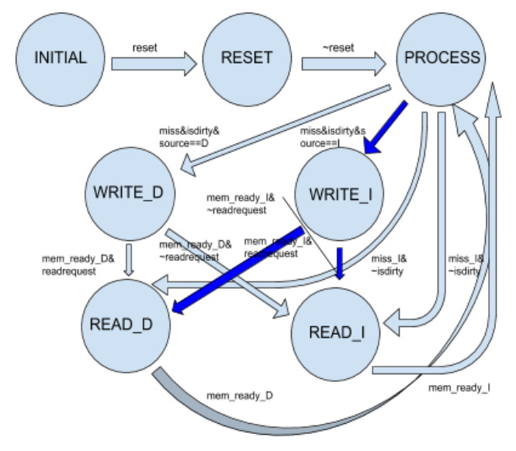
FSM

Slide 27
miss rate
n=20 / n=30
cache | # of access | # of miss | miss rate(%)
I cache | 30545/67435 | 20/20 | 0.07/0.03
D cache | 6587/14707 | 3144/9734 | 47.73/66.19
L2 cache | 1310/3405 | 37/47 | 2.82/1.38
n = 20: 40934 → 35914 (# of cycles)
n = 30: 93333 → 79993 (# of cycles)

Slide 28
gate-level simulation results comparison
n=20 / n=30
Model | sdc cycle(ns) | area(um^2) | tb pass cycle(ns) | total execution time(ns)
L2 cache | 10 | 849752 | N/A | N/A
L2 cache | 5 | 778617 | N/A | N/A
L2 cache | 4 | 809814 | 5.71 | 205636/457825
L2 cache | 3.5 | 856394 | 5.75 | 207074/461027
L2 cache | 3.3 | 856394 | 5.75 | 207074/461027
Baseline | 3 | 249159 | 4.57 | 199470/458648

Slide 29
Multiplication/Division

Slide 30
Implemented Instructions
MIPS Instruction | Op/funct | Operation
mult $rs $rt (signed) | 0/24 | {$HI, $LO} = $rs*$rt
div $rs $rt (signed) | 0/26 | {$HI, $LO} = {$rs%$rt, $rs/$rt}
mfhi $rd | 0/16 | $rd = $HI
mflo $rd | 0/18 | $rd = $LO

Slide 31
Multiplier/Divider Architecture (I)
Verilog Arithmetic Operators
MULT: begin
result_o = 32'b0;
{HI_o, LO_o} = $signed(data1_i) * $signed(data2_i);
end
DIV: begin
result_o = 32'b0;
HI_o = $signed(data1_i) % $signed(data2_i);
LO_o = $signed(data1_i) / $signed(data2_i);
end

Slide 32
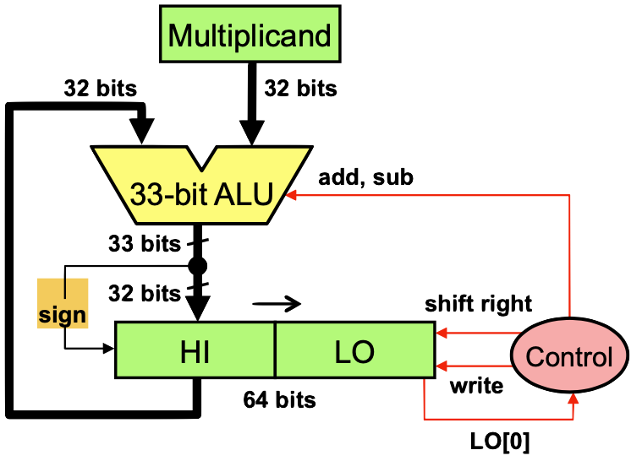
Multiplier/Divider Architecture (II)
Iterative Multiplication
if (product[0]) begin //1
if (count != 6'd31) next_product = $signed({product[63:32] + multiplicand, product[31:0]}) >>> 1'b1;
else next_product = $signed({product[63:32] + ~multiplicand + 1'b1, product[31:0]}) >>> 1'b1; //last shift-and-add
end else next_product = $signed(product) >>> 1'b1; //0

Slide 33
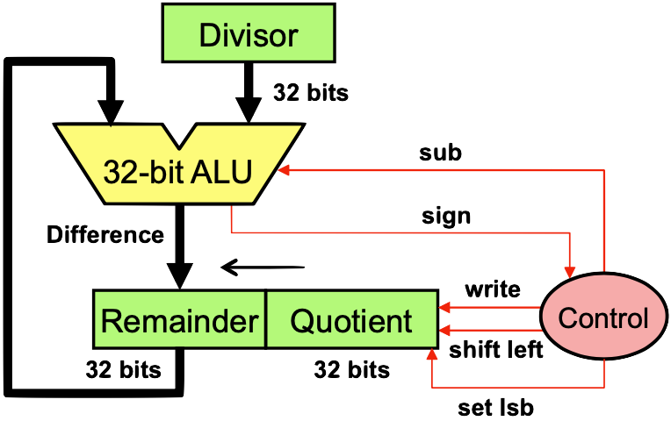
Multiplier/Divider Architecture (II)
Iterative Division
Convert dividend and divisor to positive
Perform unsigned division
Quotient sign = dividend sign XOR divisor sign
Remainder sign = dividend sign
Negate the sign of quotient and remainder if their signs are negative
if (count < 6'd32) begin
{next_remainder, next_quotient} = diff_positive ? {difference, quotient[30:0], 1'b1} : {shifted_remainder, quotient[30:0], 1'b0};
end else begin //negate the sign of quotient and remainder if negative
next_quotient = quotient_sign ? ~quotient + 1'b1 : quotient;
next_remainder = remainder_sign ? ~remainder + 1'b1 : remainder;
end

Slide 34
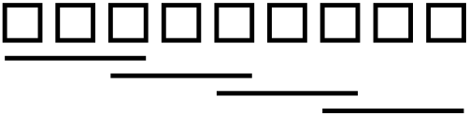
Multiplier Architecture (III)
Radix-4 Booth Encoding
Only 4 cycles needed for 8-bit multiplication
X_2i+1 | X_2i | X_2i-1 | Operation
0 | 0 | 0 | +0
0 | 0 | 1 | +y
0 | 1 | 0 | +y
0 | 1 | 1 | +2y (<<1)
1 | 0 | 0 | -2y (<<1)
1 | 0 | 1 | -y
1 | 1 | 0 | -y
1 | 1 | 1 | -0

Slide 35
Multiplier Architecture (III)
Radix-4 Booth Encoding Example
(-3) * (-7) = 1101 * 1001 (y * x) = 00010101 = 21 -> 2 cycles operation
{1001, 0} -> 100 (-2y), 010(+y)
1101
x) -2+1
---------
11111101
00011000
-----------
00010101

Slide 36
Non-algorithmic optimization
Multiplication
multiplicand/multiplier == 0
multiplicand/multiplier == 1
multiplicand/multiplier == 2, 4, 8, … (2^n) -> shift left logic
Division
dividend == 0
dividend == divisor
divisor == 1
divisor == 2, 4, 8, … (2^n) -> shift right logic

Slide 37
Overall Comparison
 | area (um^2) | testbench clock (ns) | operation time (ns) | cycle | sdc (ns)
Arithmetic Operator (*, /, %) | ~590000 | N/A | N/A | N/A | 10
Iterative Approach | 268584.69 | 4.71 | 3707.55 | ~787 | 3.5
Optimized Iterative Approach | 278926.95 | 4.17 | 2100.44 | ~504 | 3.2
Booth encoding multiplier + Iterative divider | 284726.97 | 4.21 | 1917.98 | ~456 | 3

Slide 38
42% cycle reduction
achieved by Booth-encoding (787 -> 456)
Operation time < 2 (us)
6% area increase (268000 -> 284000)

Slide 39
Collaboration

Slide 40
B05901014 吳靖平 | B05901013 張景皓
Baseline: cache | Baseline: other modules
Baseline: connect modules (i_MIPS) | Baseline: logic synthesis
Baseline: troubleshooting | Baseline: troubleshooting
Extension: BrPred | Extension: MultDiv
Extension: L2 Cache

