Slide 1
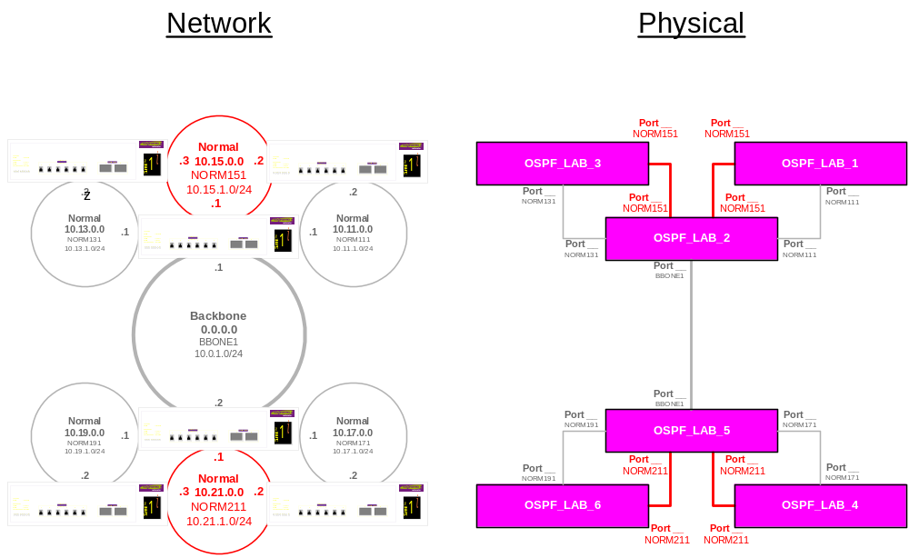
Lab18- OSPF Config II Topology (1)
Notes:
We create a new Area from the previous lab. Before, it was okay, and with a new area, the network collapses.
Switches 2 and 5 are not performing the functions as the four corner switches. The configurations for SW2 and SW5 are completely different that the rest.

Slide 2
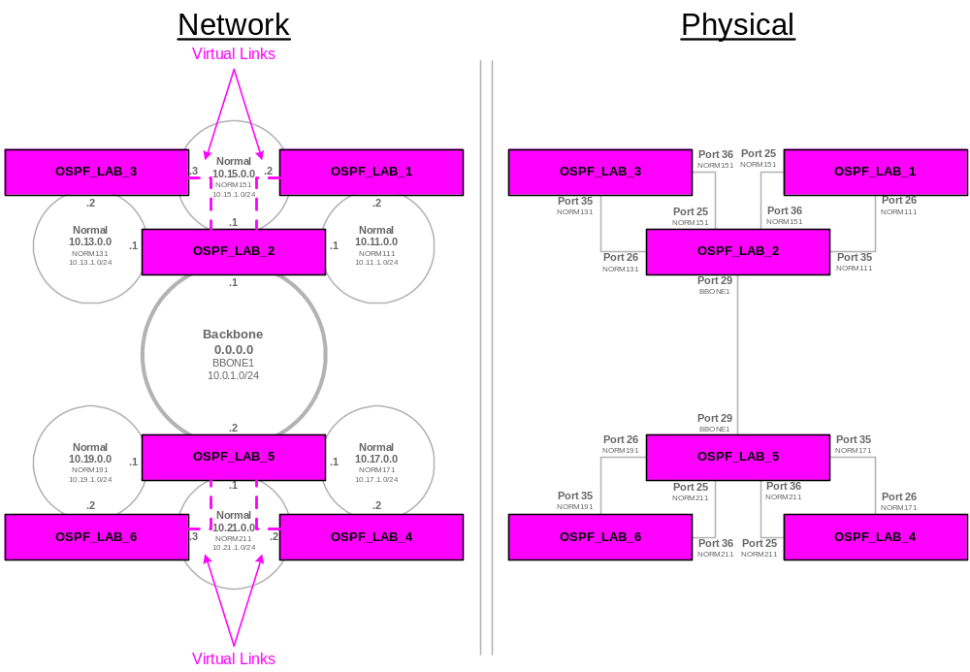
Lab18 - Network Topology 2 Configuring Virtual Links as shown

