Slide 1


2019
Silla Univ. Guide ChatBot
발표자：하양,방자욱

Slide 2

Main service objects : Freshmen and students who has lack knowledge of the school.
Example: I am a high school graduate and now want to study at Silla University. I want to go to some department of Silla University and I want to know something about major. Open the official website of Silla University, i could use the chatbot to help me find the address of each department of Silla Univ.
Example

Slide 3

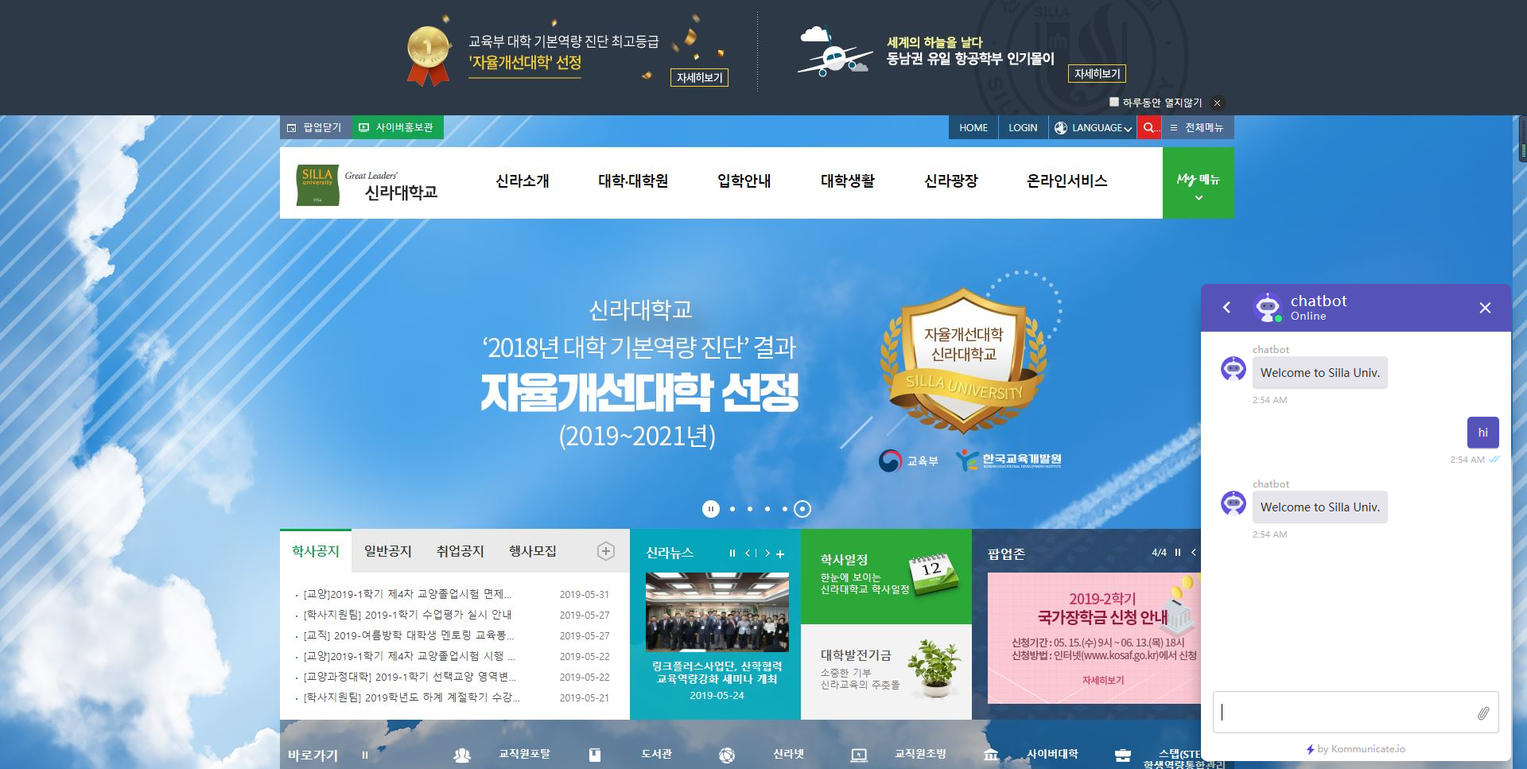
01
Silla Univ. Guide ChatBot

Slide 4
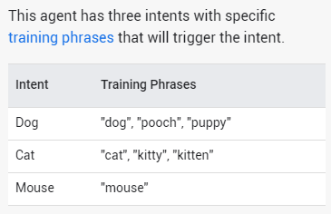
01
Dialogflow
Generally, an intent represents one dialog turn within the conversation. For example, you could create an agent that recognizes and responds to users' input about their favorite color. If a user said something like "My favorite color is purple", your agent would match that input to its corresponding intent and return the response you defined within that intent. Your agent's response usually prompts users for another utterance, which your agent will attempt to match to another intent, and the conversation continues.

Slide 5
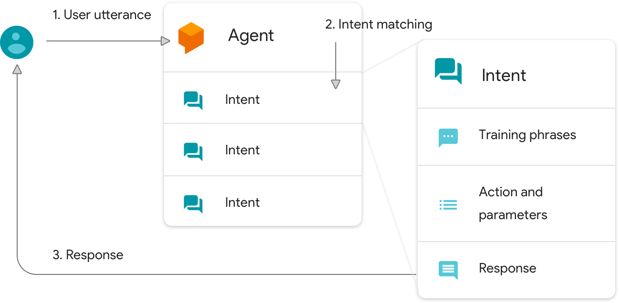
01
Dialogflow
The matched intent then delivers a response back to the user. This response can be a simple text or spoken acknowledgment or a webhook response that includes information obtained from another system. In Figure 1, Dialogflow sends a webhook request with the location and date parameters to a third-party weather service. This weather service returns a webhook response in JSON format. The agent's custom fulfillment parses the JSON data and delivers a response to the user with the relevant information.

Slide 6
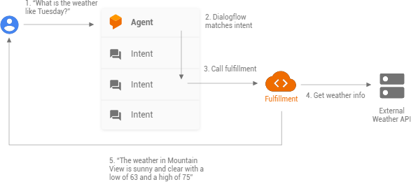
01
Dialogflow

Slide 7
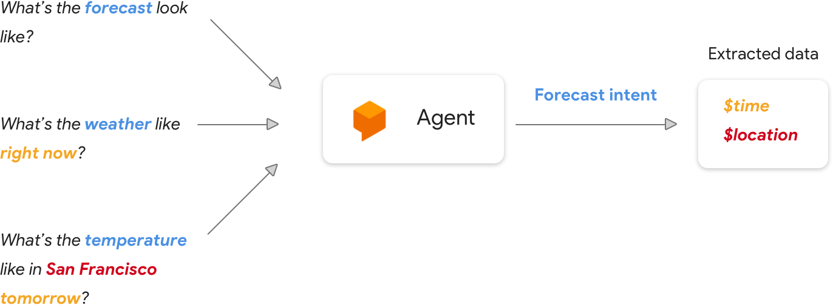
01
Dialogflow
To look up a weather forecast, you might need a few pieces of information, like the time users want the forecast for and their location. However, as we previously mentioned, different users might request a forecast in different ways. Dialogflow can understand these differences and translate them to a standard user intent to get the forecast. It can then parse the user's request for the pertinent data you need to fulfill the request. In this case, that's the user's desired time and location for the weather forecast. Finally, you can use this data to look up the weather with a public REST API and return the weather to the user in the form of a response.

Slide 8
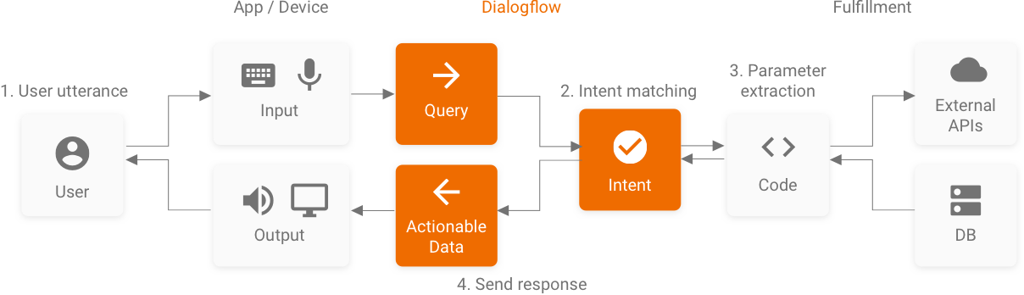
01
Dialogflow
1. Your agent matches a user utterance to an intent.
2. Your agent extracts parameters out of the user utterance and calls your fulfillment with a JSON payload that contains the parameters along with a host of other useful information about the intent.
3. Your fulfillment processes any necessary information it needs to from the JSON, such as calling another REST API with the extracted parameters.
4. Your fulfillment constructs a response and returns it back to Dialogflow to render to the user. This response can be simple text or a rich response, such as a card with an image.

Slide 9
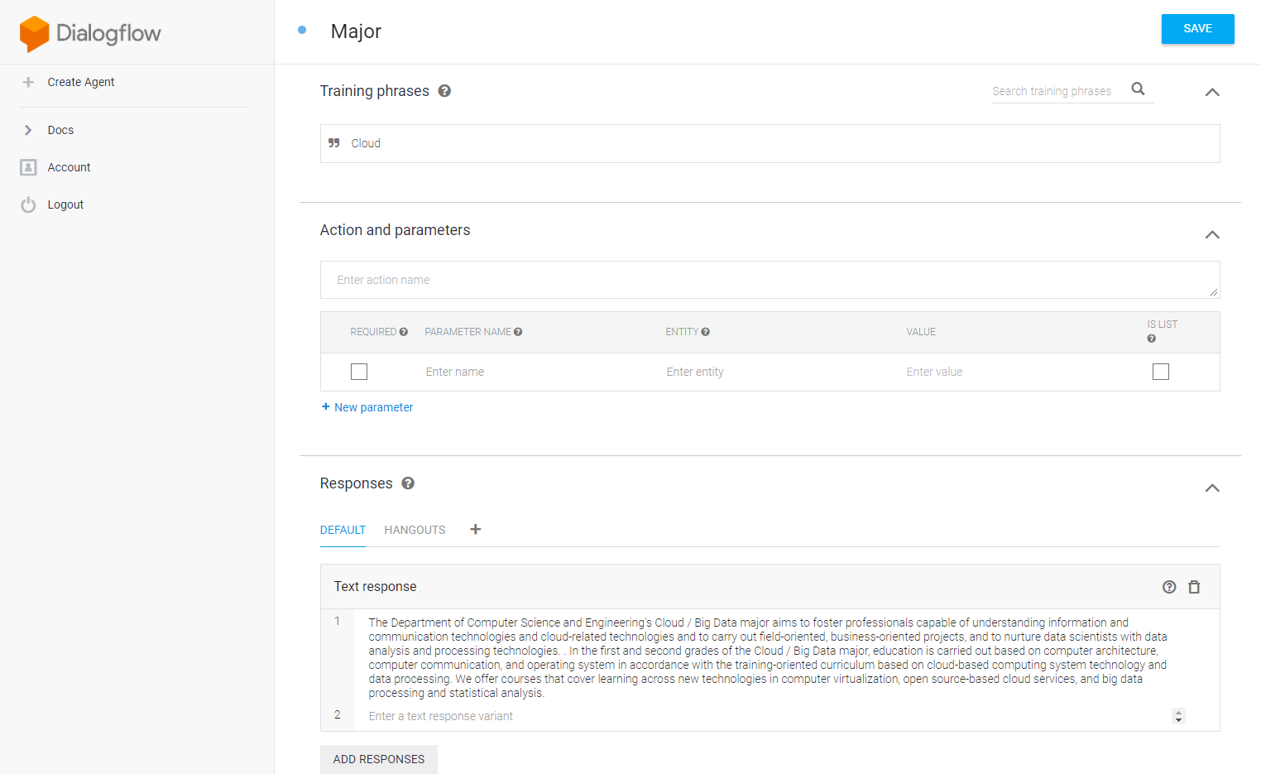
01
Dialogflow
1.Intent name
2.Question
3.Answer

Slide 10
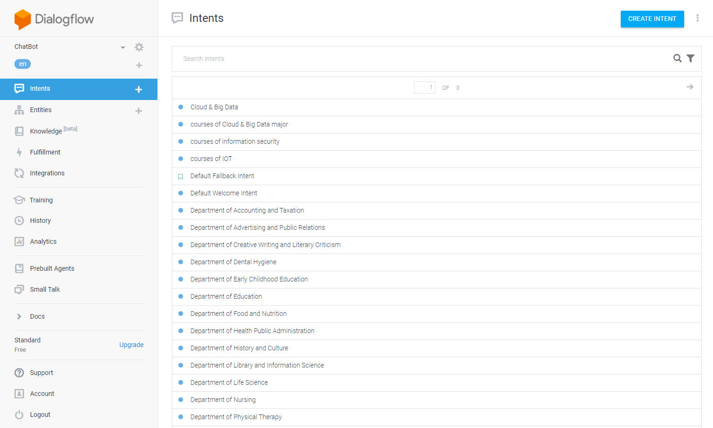
01
Dialogflow

Slide 11
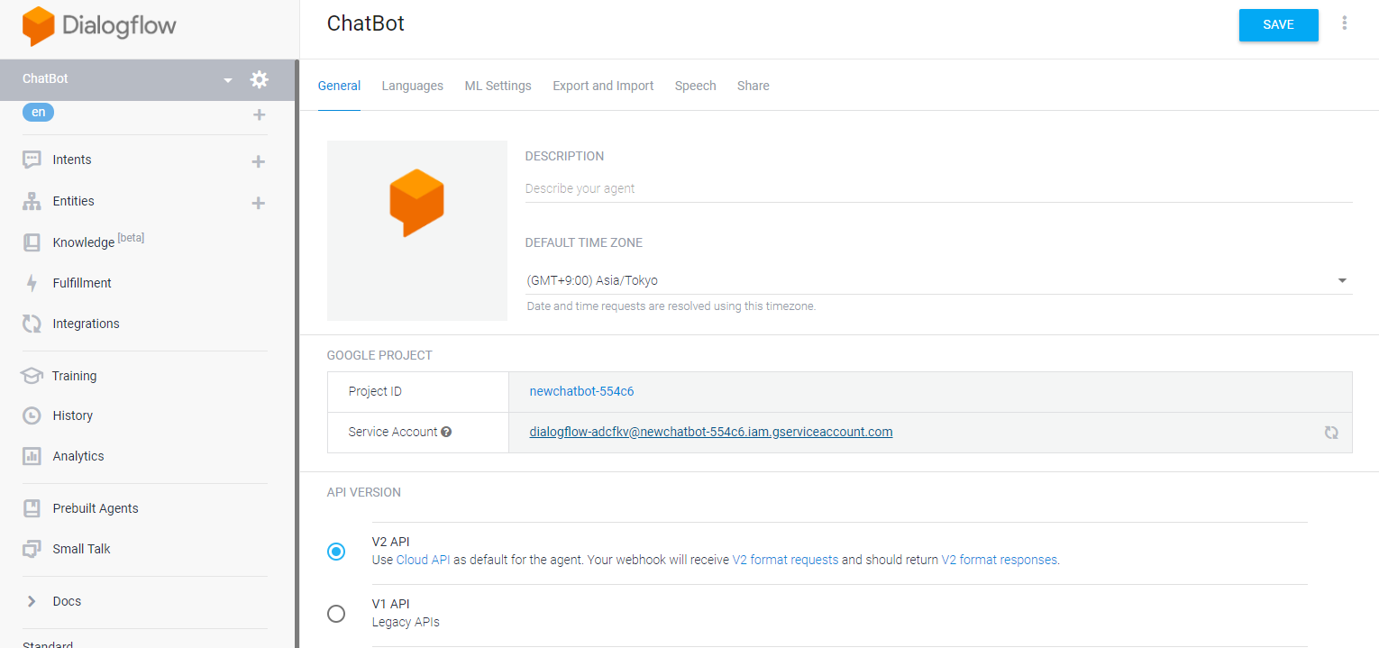
01
Dialogflow
Get the link to the key

Slide 12
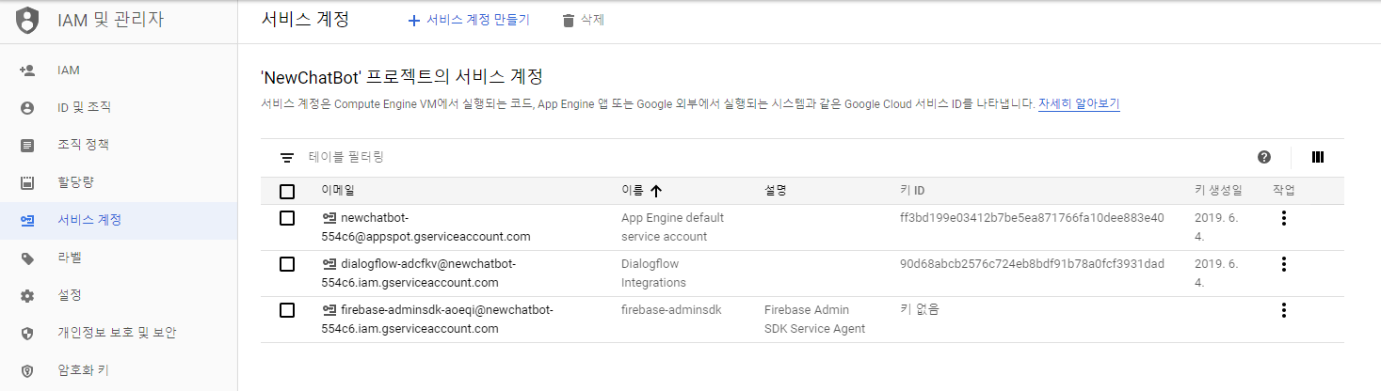
01
Google Cloud Platform
Get the key

Slide 13
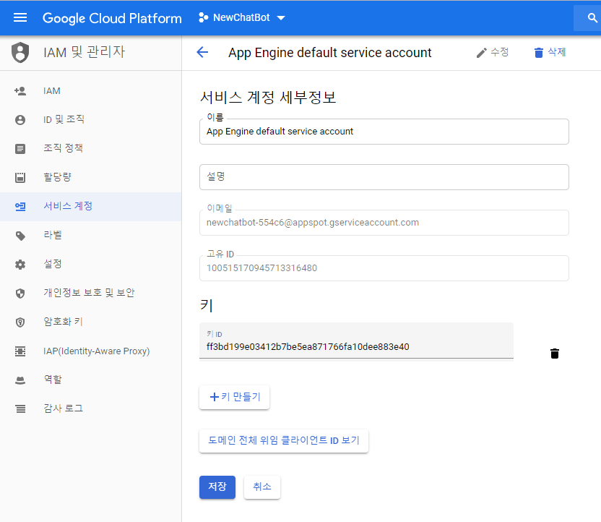
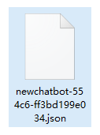
01
Google Cloud Platform

Slide 14
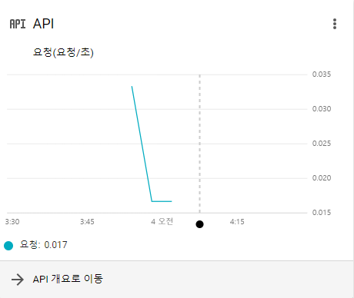
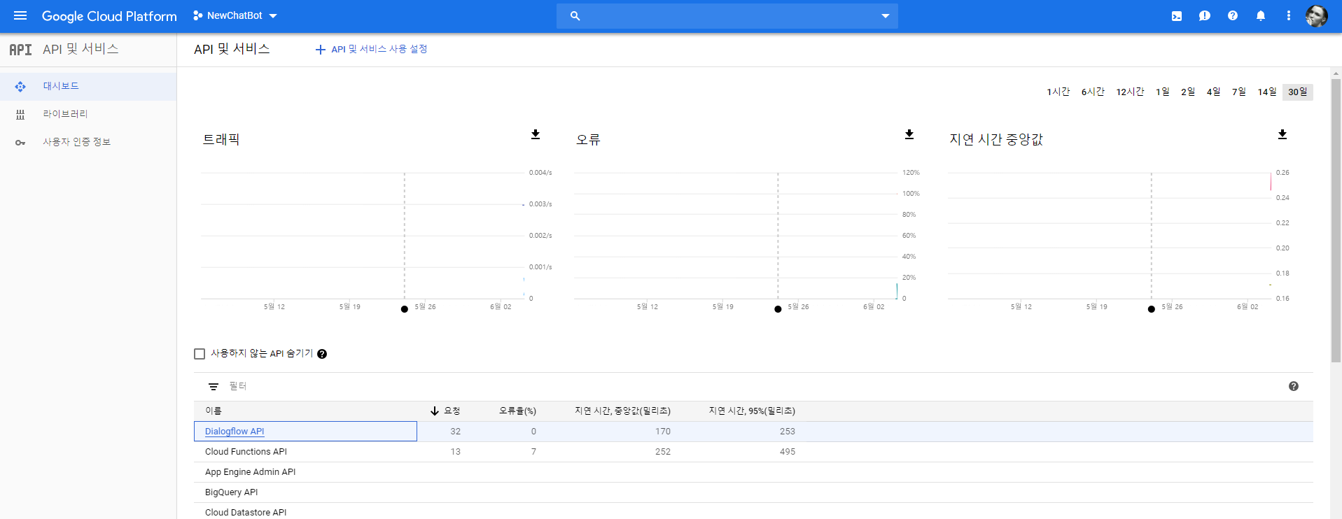
01
Google Cloud Platform

