Slide 1

Router & Switch
컴퓨터 소프트웨어공학부
노철우 교수
SILLA UNIVERSITY

Slide 2
Cisco CLI
Router>en
Router#config t
Router(config)#hostname R1
R1(config)# no ip domain-lookup
R1(config)# enable secret cisco
R1(config)# banner motd #Welcome cisco!!! #
R1(config)# line con 0
R1(config-line)# exec-timeout 0 0
R1(config-line)# password cisco
R1(config-line)# logging synchronous
R1(config-line)# login
R1(config-line)#exit
R1(config)# line vty 0 4
R1(config-line)# exec-timeout 0 0
R1(config-line)# password cisco
R1(config-line)# login
R1(config-line)#exit

Slide 3
Cisco CLI
R1(config)# int g0/0/0
R1(config-if)# ip add 172.16.3.1 255.255.255.0
R1(config-if)# no sh
R1(config-if)# exit
R1(config)# int s0/0/1
R1(config-if)# ip add 172.16.2.1 255.255.255.252
R1(config-if)# clock rate 64000
R1(config-if)# ^Z
R1#

Slide 4
Cisco CLI
R1# sh ip int br
R1# sh ip route

Slide 5
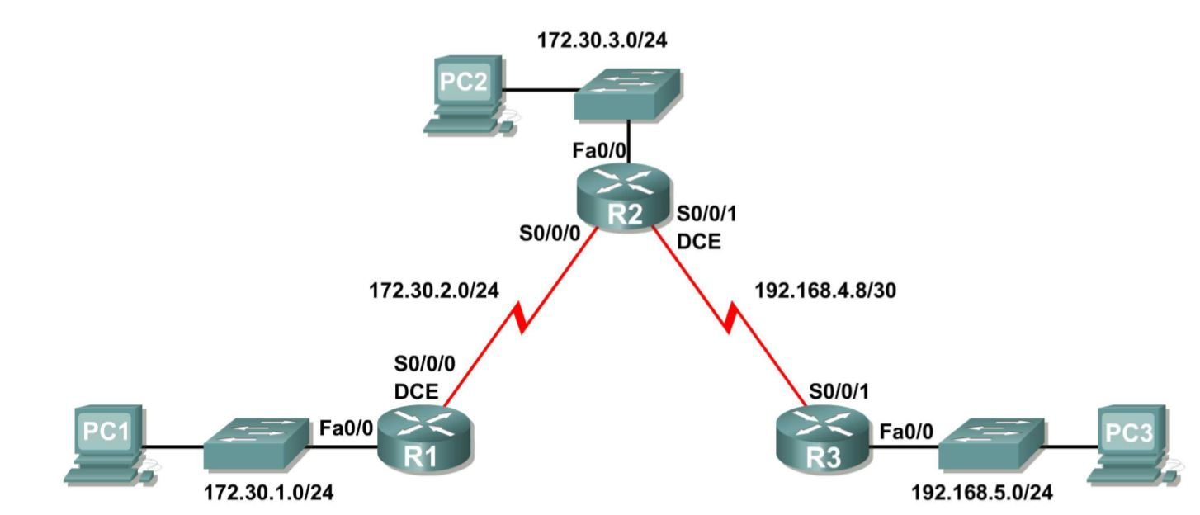

Slide 6
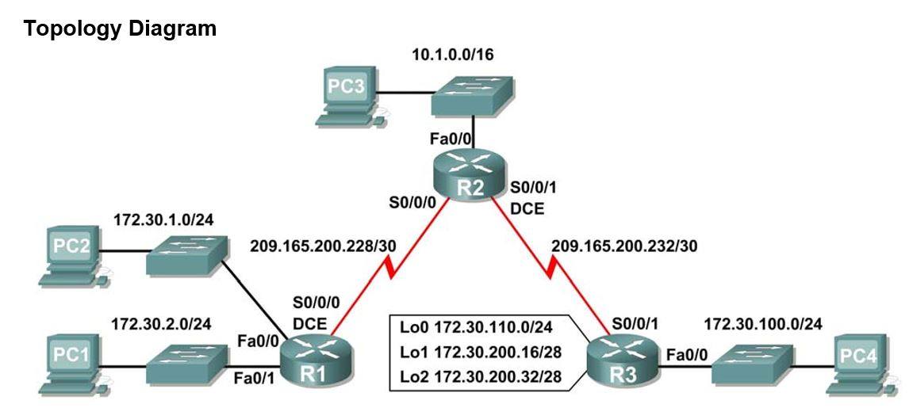

Slide 7
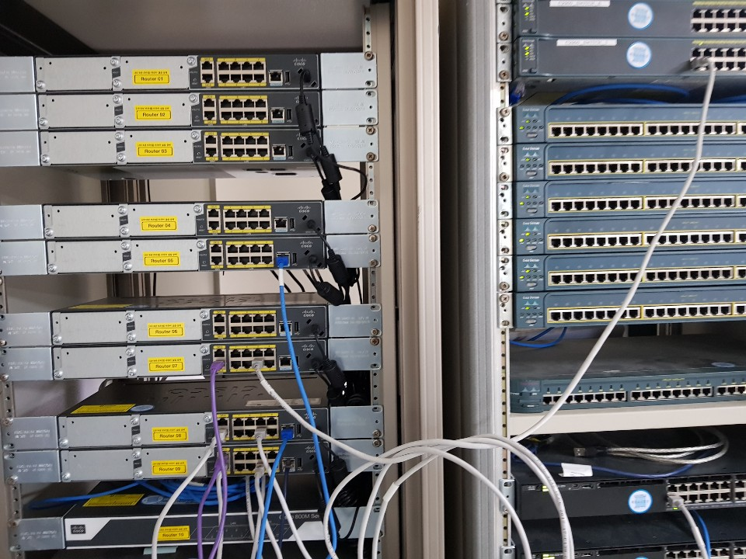
800M Router
WAN port: 8,9
LAN port: 0-7

Slide 8
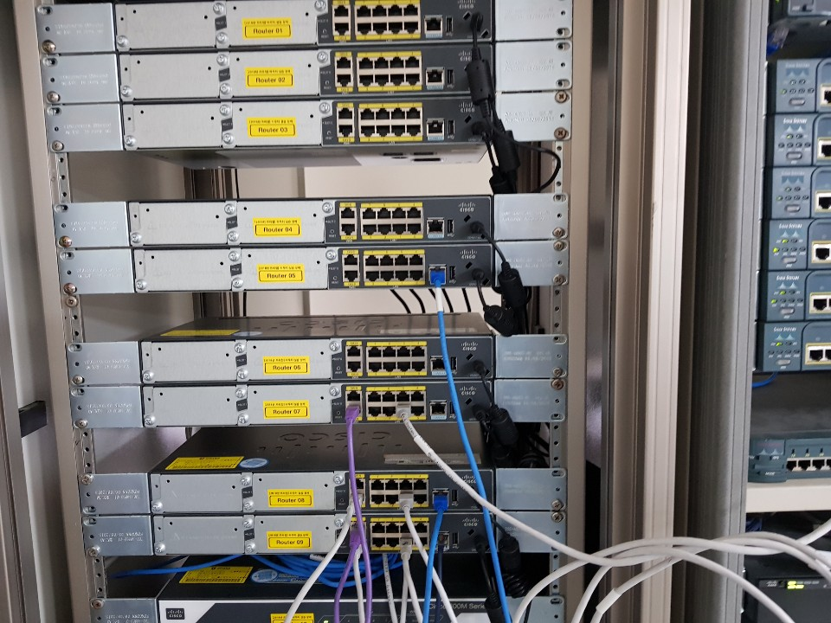

Slide 9
800M 라우터
telnet
conf t
hostname R1
line vty 0 4
pass cisco
transport input telnet
login
exit
enable secret cisco

Slide 10
800M 라우터
Router WAN port
conf t
int g0/8
ip add 209.168.200.230 255.255.255.252
no sh

Slide 11
800M 라우터
1. Router LAN port
conf t
int vlan 1
ip add 172.30.1.1 255.255.255.0
no sh
int g0/2 // PC 연결 port
switchport mode access
switchport access vlan 1
no sh
vlan 172
int vlan172
ip add 172.30.2.254 255.255.255.0
no sh
int range g0/4- g0/6
switchport mode access
switchport access vlan 172
2. Router WAN port
int g0/8 //WAN
ip add 172.30.2.1 255.255.255.0
no sh

Slide 12
800M 라우터
router rip
ver 2
network 172.30.0.0
network 209.165.200.0
no auto-summary

Slide 13
Router & Switch
L3 switch
conf t
ip routing
int range g0/2-0/6
no switchport
int g0/2
ip add 209.165.200.229 255.255.255.252
no sh
sh int g0/1 switchport
sh int trunk

Slide 14
이 슬라이드 부터
computer network 수업

Slide 15
Router
conf t
vlan 192
int vlan 192
ip add 192.168.1.1 255.255.255.0
no sh
ip default-gateway 10.10.10.1
int fa0/9
swithport mode access
switchport access vlan 192
no ip split-horizon

Slide 16
port 할당
# int range fa0/1-5
#sw mode trunk
#sw trunk native vlan 99
# int range fa0/6-10
#sw mode access vlan 30
VLAN 생성
#vlan 99
#name management
관리 인터페이스 주소 할당
#int vlan 99
#ip add 172.17.99.11 255.255.255.0
#no shutdown

Slide 17
Router
conf t
vlan 192
int vlan 192
ip add 192.168.1.1 255.255.255.0
no sh
ip rip send ver 2
ip rip recv ver 2

Slide 18
switch 2 -vlan
conf t
ip routing
int vlan 192
ip add 192.168.1.10
ip rip send ver 2
ip rip recv ver 2
no sh
int g 1/0/2
switchport mode access
switchport access vlan 192
no sh

Slide 19
switch 2 -vlan
conf t
ip routing
int vlan 192
ip add 192.168.1.10
ip rip send ver 2
ip rip recv ver 2
no sh
int g 1/0/2
switchport mode access
switchport access vlan 192
no sh

Slide 20
Inter-VLAN routing
(config)# vlan 1
(config)# vlan 2
(config)# int vlan 1
(config-if)# ip add 1.1.1.1 255.255.255.0
(config-if)# no sh
(config-if)# int vlan 2
(config-if)# ip add 2.2.2.2 255.255.255.0
(config-if)# no sh
(config-if)# int g0/1
(config-if)# switchport acc vlan 1
(config-if)# int g0/2
(config-if)# switchport acc vlan 2

Slide 21
inter-vlan
config)# int vlan 99
(config-if)# ip add 10.10.10.10 255.255.255.0
(config-if)# no sh
(config-if)# exit
(config)# ip default-gateway 10.10.10.1
(config)# int range g0/6, g0/2
(config-if)# sw m tr
(config-if)# sw tr native vlan 99
(config-if)# no sh
# sh int trunk
# sh int status
# sh int g0/2 switchport

Slide 22
switch
switch(config)#interface ethernet 12-16
switch(config-if)#switchport trunk allowed vlan 15,20-22,40,75
switch(config-if)# switchport trunk allowed vlan add 100-120
switch(config)#interface ethernet 10
switch(config-if)#switchport trunk native vlan 12
switch(config)# show interface switchport
switch>show interfaces trunk

Slide 23
switch encapsulation
===========
SWITCH(config)# int g0/3
(config-if)# sw tr encapsulation dot1q
(config-if)# sw m tr
(config)# int g0/4
(config-if)# sw tr allowed vlan all
(config-if)# sw tr allowed vlan remove 4
스위치의 default gateway를 라우터로 설정해준다.
SWITCH(config)# ip default-gateway 192.168.10.1
Routerconfig-if)# int g0/1.10
Routerconfig-subif)# encapsulation dot1q 10
Router(config-subif)#ip address 192.168.10.1 255.255.255.0
PC: gateway - 라우터 서브인터페이스 주소

Slide 24
SP
bridge priority
conf t
spanning-tree vlan 200 priority 32768

Slide 25
800M 라우터
username silla priviliege 15 password 0 cisco
username comeng priviliege 15 password 0 cisco
conf t
login local, no login local
transport input telent/ssh
exit
conf t
vlan 173
int vlan 173
ip add 172.16.3.1 255.255.255.0
int g0/9
-switchport mode access
-switchport access vlan 173

Slide 26
800M 라우터
=============
pass recovery
1.ctl break
rommon 1. config-reg 0x
copy

Slide 27
재분배
router rip
redistribute eigrp 1 metric 2
=다른 프로토콜을 RIP/EIGRP으로 재분배시 초기 메트릭 지정해야함
router eigrp 1
redistribute ospf 1 metric 1000 1 1 1 1500
router ospf 1
redistribute eigrp 1 subnets metric-type 1/2 (E1/E2)
redistribute connected subnets

