Slide 1
Routing
CCNA Exploration Semester 2
Chapter 1
S Ward Abingdon and Witney College
Notes:
Routing
S Ward Abingdon and Witney College

Slide 2
Topics
Identify a router as a computer with specialised hardware and operating system designed for routing
Give a router a basic configuration including IP addresses
Routing tables
Router activities – finding the best paths and switching packets
S Ward Abingdon and Witney College

Slide 3
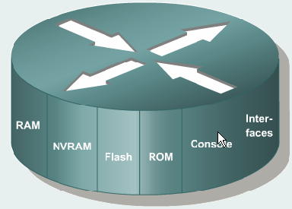
Router functions
Connect networks together
Find best routes
Switch packets from one network to another
Do this efficiently 24/7
Provide security by permitting or denying specified types of packet
Provide quality of service by prioritising packets
S Ward Abingdon and Witney College

Slide 4
Router as a computer
CPU: control unit handles instructions, ALU for calculations
RAM: volatile working storage
ROM: permanent storage for POST and start-up instructions
Operating System: software that runs the computer
System bus, Power supply
S Ward Abingdon and Witney College

Slide 5
Router differences
Long term storage is Flash and NVRAM,
not hard disk
Range of different interfaces all on different networks
No input/output peripherals. Connect via a console PC and use PC’s keyboard and screen
S Ward Abingdon and Witney College

Slide 6
RAM
Dynamic random access memory: as in a PC
Temporary memory while the router is on
Loses content when the router loses power or is restarted
Holds running configuration
Holds routing tables
Holds ARP cache
Holds fast-switching cache etc.
S Ward Abingdon and Witney College

Slide 7
NVRAM
Non-volatile RAM: keeps its contents when the router is off
Stores the startup configuration file
When you have configured a router, you must save your configuration to NVRAM if you want to keep it
S Ward Abingdon and Witney College

Slide 8
Flash
Electronically erasable, programmable ROM (EEPROM)
Keeps its contents when the router is off
Holds the operating system image (IOS)
Allows the IOS to be updated
Can store multiple versions of IOS software if it has enough capacity
Can be upgraded by adding SIMMs
S Ward Abingdon and Witney College

Slide 9
ROM
Permanent memory: cannot be upgraded without replacing the chip
Holds power-on self test (POST) instructions
Stores bootstrap program
Stores ROM monitor software (for emergency download of IOS, for password recovery)
May store basic IOS for emergency use (less common than it was)
S Ward Abingdon and Witney College

Slide 10
Router storage
ROM
Permanent
Holds POST, boot instructions, basic IOS
Flash
Keeps contents
Holds IOS image
RAM
Volatile
Holds runnning config, tables, queues etc
NVRAM
Keeps contents
Holds startup configuration file
S Ward Abingdon and Witney College

Slide 11
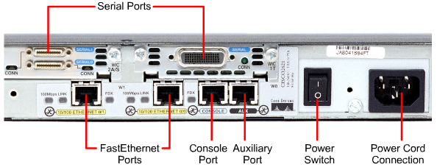
Interfaces
Can be attached directly to the motherboard (like our Fast Ethernet interfaces)
Can be on removable and interchangeable modules (like our serial interfaces)
Modules for
different
serial
connections
S Ward Abingdon and Witney College

Slide 12
Operating system
As specialised computers, routers and switches need operating systems.
Cisco devices use the Cisco Internetwork Operating System (IOS)
There are versions for different models of router and switch, and different feature sets
The IOS can be upgraded periodically
S Ward Abingdon and Witney College

Slide 13
Naming IOS image files
Platform-features-format-version
c2600-i-mz.122-8.T5
c2600 is the platform: Cisco 2600 series router
i is a code for the set of features in this IOS, another is ipbase
mz is a code to say that the IOS runs in RAM and the file is zip compressed
122-8.T5 is the upgrade version
S Ward Abingdon and Witney College

Slide 14
IOS storage
The IOS is stored in the router’s flash memory, often in compressed form
Most routers copy the IOS to RAM when they start up
You need enough space in flash and in RAM if you upgrade the IOS
Some of our routers have more features than others – it depends on the IOS.
S Ward Abingdon and Witney College

Slide 15
IOS modes
ROM monitor:
  Used to recover from system failure or loss of password
  Needs direct access from console port
Boot ROM (optional, may not have this):
  Used when upgrading IOS
Cisco IOS
  Normal operation, stored in Flash, runs in RAM
S Ward Abingdon and Witney College

Slide 16
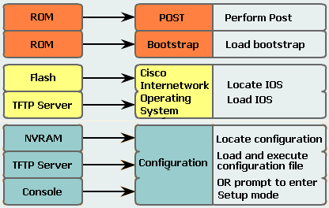
Router startup
S Ward Abingdon and Witney College

Slide 17
‘Normal’ start up
Run POST and bootup instructions from ROM
Load IOS file from flash
Load configuration from NVRAM
Fully operational
S Ward Abingdon and Witney College

Slide 18
Configuration register
Has 4 hex digits – that’s 16 binary digits
Configuration register is saved in NVRAM
show version to see its value
Value of last hex digit tells how to load IOS
Usual is 0x2102 (2 means load from flash)
Third hex digit controls whether configuration file is loaded. (0 means load, 4 means do not)
S Ward Abingdon and Witney College

Slide 19
Loading IOS
You see ############# as IOS loads from flash memory.
If you see a prompt instead:
rommon1>
Then the IOS was not loaded and you are in ROM monitor mode.
Try reload or boot
If this fails, the IOS file is probably missing…
S Ward Abingdon and Witney College

Slide 20
Configuration
If there is a startup configuration file in NVRAM then it will normally load into RAM as the running configuration.
If not, the router may look for a configuration on a TFTP server. Wait until it gives up.
It then prompts you to enter Setup mode: Would you like to enter the initial configuration dialog? [yes/no]: no
(If it asks if you want to exit Autoinstall: yes)
S Ward Abingdon and Witney College

Slide 21
Show version
IOS version
Bootstrap version
Router model and CPU
Amount of RAM
Number and type of interfaces
Amount of NVRAM
Amount of Flash
Configuration register
S Ward Abingdon and Witney College

Slide 22
Basic Configuration (revision)
Name
Passwords
Interfaces
Routing
Banner (Message of the day)
Save configuration
Check configuration
S Ward Abingdon and Witney College

Slide 23
Global configuration
Router>enable
Router#configure terminal (config t)
Router(config)#
Start in user exec mode
Go to privileged exec mode (no configuration so no password)
Go to global configuration mode
S Ward Abingdon and Witney College

Slide 24
Hostname
Give the router a name to show at its prompt
Do this in global configuration mode
Router(config)# hostname Abingdon
Abingdon(config)#
S Ward Abingdon and Witney College

Slide 25
Enable secret
Protect privileged exec mode with an encrypted password.
Abingdon(config)# enable secret class
You could set an enable password but this is not encrypted
There is no need to set both, but if you do then the enable secret will be used
S Ward Abingdon and Witney College

Slide 26
Passwords for login
Set login password on console port for security
Abingdon(config)# line con 0
Abingdon(config-line) password cisco
Abingdon(config-line) login
Abingdon(config-line) exit
You can also put a password on the AUX port in a similar way
S Ward Abingdon and Witney College

Slide 27
Passwords for Telnet login
Set login password on virtual lines to allow you to Telnet to the router
Abingdon(config)# line vty 0 4
Abingdon(config-line) password cisco
Abingdon(config-line) login
Abingdon(config-line) exit
S Ward Abingdon and Witney College

Slide 28
Interface configuration
Abingdon(config)# interface serial 0/0
Abingdon(config-if)# ip address 192.168.3.1 255.255.255.0
Abingdon(config-if)# no shutdown
Abingdon(config-if)# exit
This is for a DTE serial interface
Ethernet interfaces are configured the same way
S Ward Abingdon and Witney College

Slide 29
Interface DCE configuration
A DCE serial interface needs an extra line:
Abingdon(config)# interface serial 0/0
Abingdon(config-if)# ip address 192.168.3.1 255.255.255.0
Abingdon(config-if)# clock rate 64000
Abingdon(config-if)# no shutdown
Abingdon(config-if)# exit
S Ward Abingdon and Witney College

Slide 30
Interface description
You can give an interface a description
This does not affect the operation of the router but it is useful documentation
Do it in interface configuration mode for the required interface
Abingdon(config-if) description Serial line to Witney 01993 876543
S Ward Abingdon and Witney College

Slide 31
Message of the day
You can configure a message to be shown before the user logs on
Cisco recommend that you show a warning to unauthorised users (NOT “welcome”)
Abingdon(config)# banner motd # authorised users only #
# is a delimiter. Any character can be used.
S Ward Abingdon and Witney College

Slide 32
Routing
The router knows its directly attached networks because you have put IP addresses on its interfaces
It can put these networks in its routing table
It needs to find routes to networks that are not directly attached
You can give it static routes
You can enable a routing protocol
S Ward Abingdon and Witney College

Slide 33
Routing protocol: RIP
You choose the routing protocol
Then you tell the router which directly attached networks it should advertise
Abingdon(config) router rip
Abingdon(config-router) network 192.168.1.0
Abingdon(config-router) network 192.168.3.0 Abingdon(config-router) exit
S Ward Abingdon and Witney College

Slide 34
Save configuration
Your configuration is held in RAM as the running configuration
If you want to keep this configuration then you must save it to NVRAM into the startup configuration file
Abingdon# copy running-config startup-config
S Ward Abingdon and Witney College

Slide 35
Shortened commands
The Cisco IOS accepts shortened forms of commands
You need to type enough to distinguish the command from other commands
copy run start can be used instead of copy running-config startup-config
int s 0/0 can be used instead of interface serial 0/0
S Ward Abingdon and Witney College

Slide 36
Show commands
Show running-config
Show startup-config
Show ip route
Show ip interfaces
Show ip interface brief
S Ward Abingdon and Witney College

Slide 37
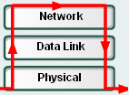

OSI layers 1, 2 and 3
Find destination network, check routing table for route, direct packet to correct outgoing interface
Check layer 2 address, decapsulate
Encapsulate with frame for next link
Receive signals from cable, convert to binary.
Encode binary, place signals on cable
S Ward Abingdon and Witney College

Slide 38

What the router does 1
Ethernet frame received from PC1 through port Fa0/0
Destination MAC address is router’s address
S Ward Abingdon and Witney College

Slide 39
What the router does 2
Strip off frame header and trailer (decapsulate)
Read destination IP address 192.168.4.9
S Ward Abingdon and Witney College

Slide 40
What the router does 3
Logical AND with IP address 192.168.4.9 and subnet mask 255.255.255.0 (/24) gives destination network address 192.168.4.0
S Ward Abingdon and Witney College

Slide 41
What the router does 4
Look in routing table for network address 192.168.4.0
Route found via 192.168.3.2 through S0/0
S Ward Abingdon and Witney College

Slide 42
What the router does 5
S0/0 connects to a WAN link using PPP
Encapsulate packet in PPP frame
Send frame out through S0/0
S Ward Abingdon and Witney College

Slide 43
No route found
If the destination network is not in the routing table:
Use a default route if one exists
Otherwise drop the packet and send an ICMP destination unreachable message to the source host.
S Ward Abingdon and Witney College

Slide 44
Routing tables
A router uses the routing table to select the best path to a network
Directly connected networks are taken from the interface configuration
Static routes can be added by administrator
Routes can be learned dynamically from other routers by using a routing protocol
S Ward Abingdon and Witney College

Slide 45
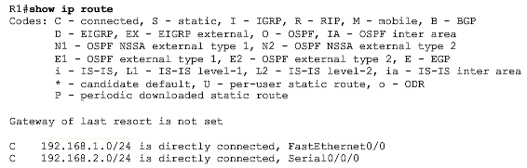
Show ip route
List of codes
List of routes
S Ward Abingdon and Witney College

Slide 46
Routing table
Directly connected
Exit port
Network and mask
C 192.168.1.0/24 is directly connected, FastEthernet0/0
C 192.168.2.0/24 is directly connected, Serial0/0
S 192.168.3.0/24 [1/0] via 192.168.2.2
R 192.168.4.0/24 [120/1] via 192.168.2.2, 00:00:20, Serial0/0
S Ward Abingdon and Witney College

Slide 47
Routing table
Static route
Network and mask
C 192.168.1.0/24 is directly connected, FastEthernet0/0
C 192.168.2.0/24 is directly connected, Serial0/0
S 192.168.3.0/24 [1/0] via 192.168.2.2
R 192.168.4.0/24 [120/1] via 192.168.2.2, 00:00:20, Serial0/0
Administrative distance and metric
Address of next hop router
S Ward Abingdon and Witney College

Slide 48
Routing table
Exit port
Dynamic route, RIP
Network and mask
C 192.168.1.0/24 is directly connected, FastEthernet0/0
C 192.168.2.0/24 is directly connected, Serial0/0
S 192.168.3.0/24 [1/0] via 192.168.2.2
R 192.168.4.0/24 [120/1] via 192.168.2.2, 00:00:20, Serial0/0
Administrative distance and metric
Address of next hop router
Time since last update
S Ward Abingdon and Witney College

Slide 49
Static routes Dynamic routes
Entered by administrator
Time consuming, different for each router
Must be updated if routes change
Little processing
No bandwidth used
Gives nothing away
Learned from other routers
Start the protocol then it runs by itself
Automatically updates when routes change
More processing
Uses bandwidth
Gives away information
S Ward Abingdon and Witney College

Slide 50
Routing protocols
Interior, used within an organisation’s networks
Exterior, used between different organisations’ networks
Distance vector
Link state
RIP
(IGRP)
EIGRP
OSPF
IS-IS
BGP
S Ward Abingdon and Witney College

Slide 51
Routing Table Principles
1. Every router makes its decision alone, based on the information it has in its own routing table.
2. The fact that one router has certain information in its routing table does not mean that other routers have the same information.
3. Routing information about a path from one network to another does not provide routing information about the reverse, or return, path.
S Ward Abingdon and Witney College

Slide 52
Metrics
A routing protocol may learn of several possible routes to a destination.
It uses metrics to pick the best route.
RIP uses hop count as its only metric.
OSPF uses “cost” based on bandwidth.
EIGRP uses bandwidth and delay and can use load and reliability as well.
S Ward Abingdon and Witney College

Slide 53
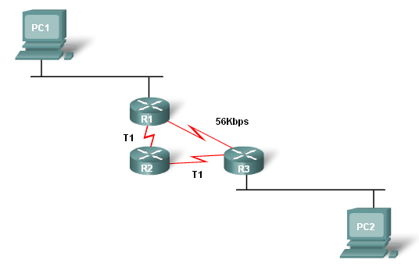
Metrics
RIP uses hop count. It picks this route as the best.
S Ward Abingdon and Witney College

Slide 54
Metrics
OSPF uses cost based on bandwidth. It picks this route as the best.
S Ward Abingdon and Witney College

Slide 55
Administrative distance
There may be more than one routing protocol running. There may also be static routes.
Static routes have administrative distance 1 or 0 by default.
RIP routes have administrative distance 120
OSPF routes have administrative distance 110
The route with the lowest administrative distance goes in the routing table
S Ward Abingdon and Witney College

Slide 56
The End
S Ward Abingdon and Witney College

